Slide 1

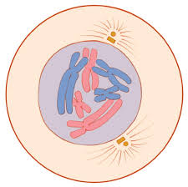
Introduction to Embryology
CELL DIVISION
DR. PRAVEEN KURREY
M.B.B.S., M.S. BCME, BCBR, CISP PROFESSOR ANATOMY
AIIMS RAIPUR

Slide 2
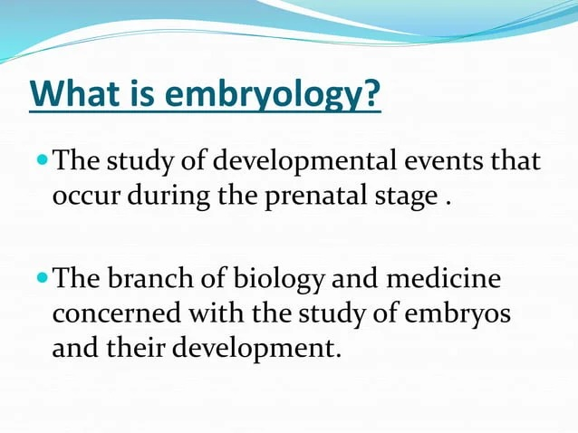

Slide 3
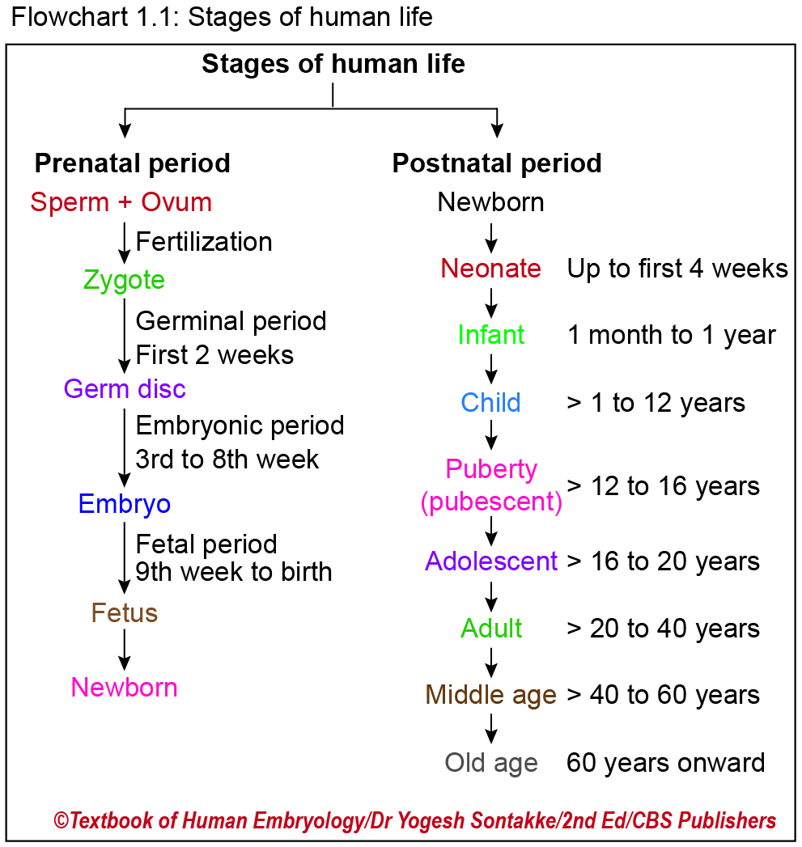

Slide 4
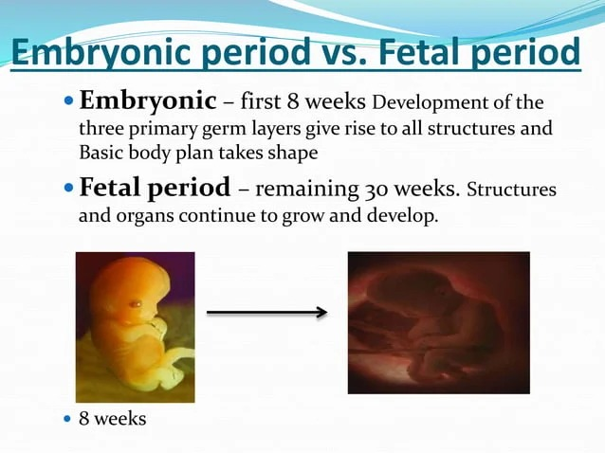

Slide 5
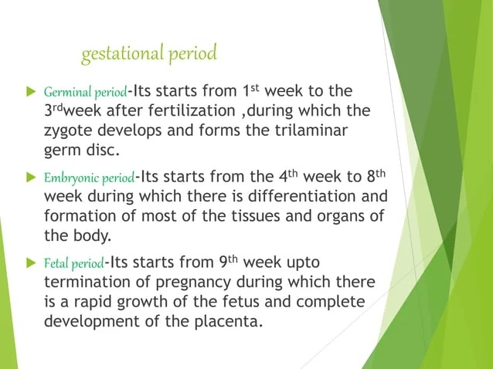

Slide 6
Basic terminology
Embryology: Study of the formation and the development of an organism.
Reproduction: Involves fusion of male and female gametes to produce offspring → maintain species.
Ontogeny: Study of the complete life cycle of an organism.
Phylogeny: Deals with evolutionary history and relationship among the organisms.

Slide 7
Ontogeny recapitulates phylogeny (Ernst Haeckel, 1866).
Developing the human kidney:
Pronephric kidney →
mesonephric kidney →
metanephric kidney.

Slide 8
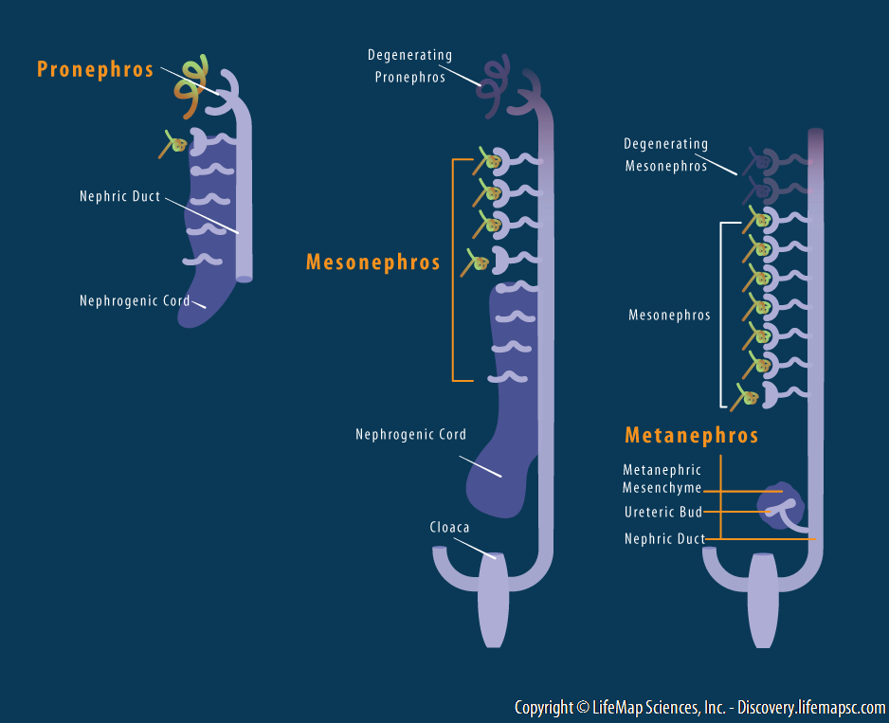
Ontogeny

Slide 9
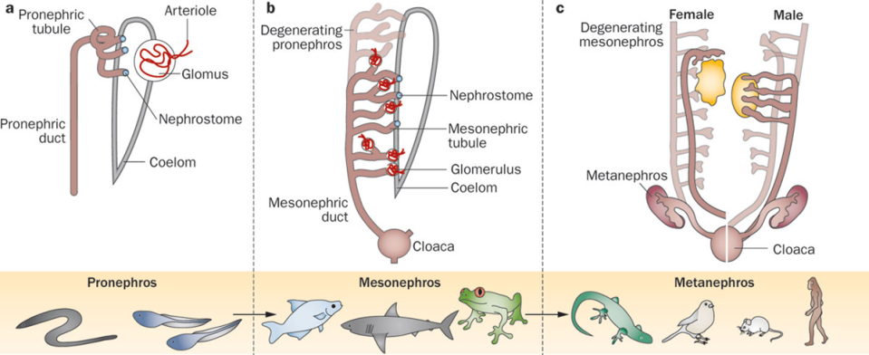
phylogeny
ROMAGNANI, P. ET AL. (2013) RENAL PROGENITORS: AN EVOLUTIONARY CONSERVED STRATEGY FOR KIDNEY REGENERATION
NAT. REV. NEPHROL. DOI:10.1038/NRNEPH.2012.290

Slide 10
Basic terminology
Development: Simple single cell → complex multicellular organism.
Growth is a mere increase in the number and size of cells.
Types of growth:
  Multiplicative growth: increase in cell number by cell division.
  Auxetic growth: increase in cell size.
  Accretionary growth: increase in intracellular substances.
Differentiation is the process of cell transformation to acquire specific character and function.
Totipotent cells: Form all differentiated cell types of an organism – e.g.: zygote, morula
Pluripotent: Form all differentiated cell types of an organism except placenta – e.g.: inner cell mass of blastocyst
Gametogenesis: Process of formation of gametes (ovum and sperms) from germ cells.

Slide 11
Need of embryology
3%–4% of live birth children - suffer from birth defects
To understand the gross anatomy of body and histological structures of the tissues.
Mutation of genes controlling the development → disease.
Reproductive medicine: For better practice for the well-being of mother and newborn.
For infertility cases (in vitro fertilisation, intra uterine insemination).
For prenatal diagnosis and fetal therapy (amniocentesis, chorionic villus sampling).
Notes:
Usually, 3%–4% of live birth children are suffering from birth defects. Understanding of this malformation is essential before treatment.
All structures in the human body are developing from a single cell. Studying embryology will help to understand the gross anatomy and histological structures of the body.
Deviated growth and development may lead to many diseases. Genes controlling development may have mutation results into a disease.
In the field of reproductive medicine, embryology helps for better practice for well-being of mother and newborn.
Knowledge of embryology can be applied in infertility cases (in vitro fertilisation, intra uterine insemination).
Knowledge of embryology is essential for prenatal diagnosis and fetal therapy (amniocentesis, chorionic villus sampling).

Slide 12
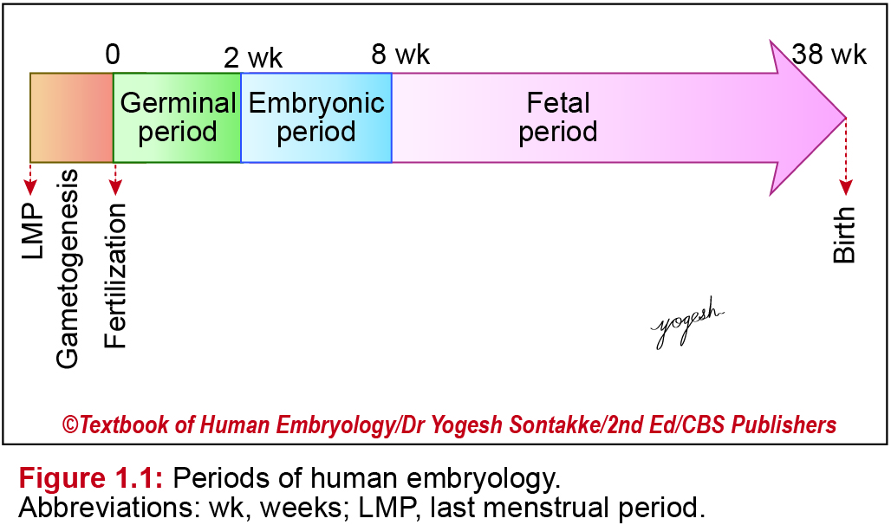
Periods of human embryology
Germinal period: first three weeks of development after fertilisation.
Embryonic period: from fourth to the eight week of development.
Foetal period: from the third month, up to termination of the pregnancy.
Notes:
Periods of human embryology
Most of the clinicians divide human prenatal development as first, second and third trimesters (each of three-month period).
Embryologically prenatal growth is divided as
Germinal period: first three weeks of development after fertilisation.
Embryonic period: from fourth to the eighth week of development.
Foetal period: from the third month, up to termination of the pregnancy.
Period of egg: It extends for one week from fertilisation till the implantation into the uterine wall.
The concepts (product of conception) is called preimplantation conceptus. In in vitro fertilisation pre-implantation conceptus needs to be transferred to the uterus for further growth.
Further, on implantation, conceptus is called post-implantation conceptus.

Slide 13
CELL DIVISION
Each human progresses from a single cell zygote to 100 trillion individual cells.
Body cells are broadly – two type
1.somatic cell
2. germ cell
Cell division required for growth & development , replacement.
Germ cell – production of gametes

Slide 14
Types of cell division
Mitosis – two identical diploid daughter cells formed from a single diploid cell
Meiosis- haploid gametes are formed from diploid precursor cells

Slide 15
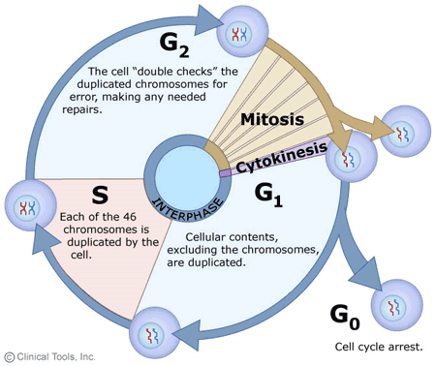
CELL CYCLE
Cell cycle = interphase + mitosis
Interphase = G1 + S + G2
Gap 1 – synthesis of RNA and proteins
S phase – DNA replication
Gap 2 – DNA repair

Slide 16
CELL CYCLE
Length of cell cycle varies in different cell types
Variation is in the length of the G1 phase
Very long G1 may lead to cell cycle arrest – G0
Cell cycle regulated by cyclin-dependent kinases (CDK s)
Faulty regulation of cell cycle may lead to carcinoma

Slide 17
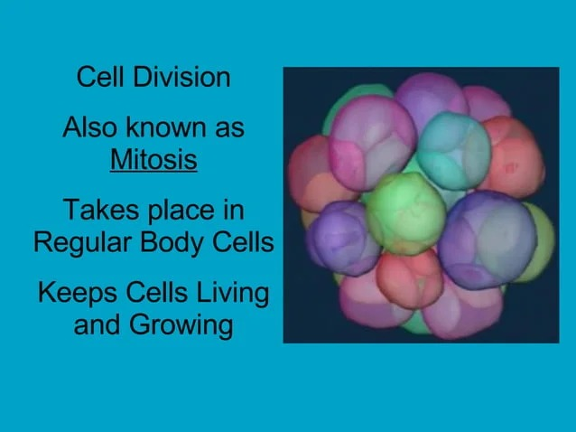

Slide 18
MITOSIS
Takes place in somatic cells
Complete in one sequence
Daughter cell have same no. of chromosomes as parent
Daughter cells are identical to each other and to the parent
Equational division
Stages
Prophase
Metaphase
Anaphase
Telophase

Slide 19
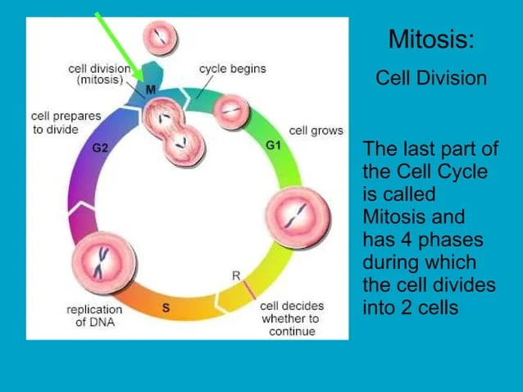

Slide 20
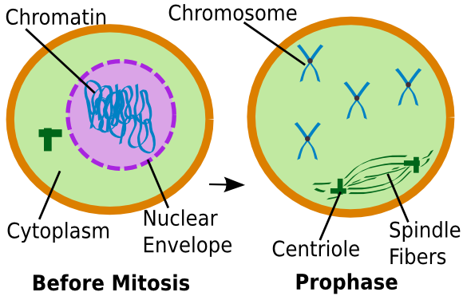
PROPHASE
Nucleolus disappears
Chromosome become coiled , condensed, shorten , thickens
Chromsome consist of two parallel subunit chromatid.
Sister chromatids of each chromosome attached at the centromere
Chromatid can not be recognised

Slide 21
Prometaphase
Chromatid become distigushable
Centrioles moves to opposite pole

Slide 22
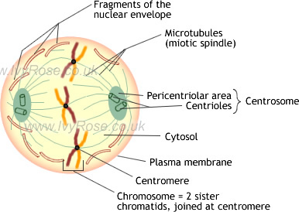

Slide 23
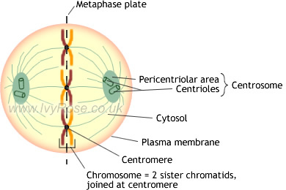
METAPHASE
Easiest to visualize microscopically
Nuclear membrane disappears
Chromosomes arranged along middle of spindle fibres
Clinical diagnosis of chromosomal disorders done in this phase
Spindle fibres pull the centromeres of the chromosomes

Slide 24
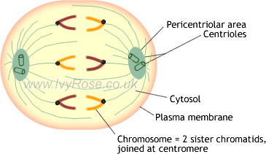
ANAPHASE
Centromere of each chromosome splits
Sister chromatids separate
Chromatids pulled towards opposite sides of cell
At the end cell contains 92 separate chromosomes

Slide 25
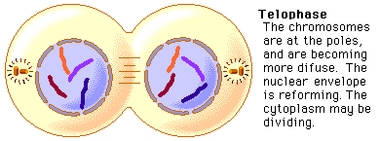
TELOPHASE
Spindle fibres disappear
Formation of nuclear membrane
Chromosomes begin to decondense
Cytokinesis follows
Formation of daughter cells with same no of chromosomes.

Slide 26
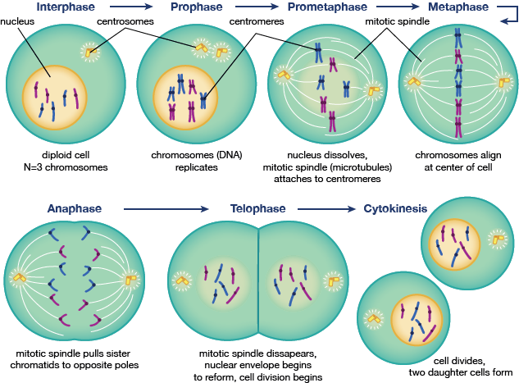

Slide 27
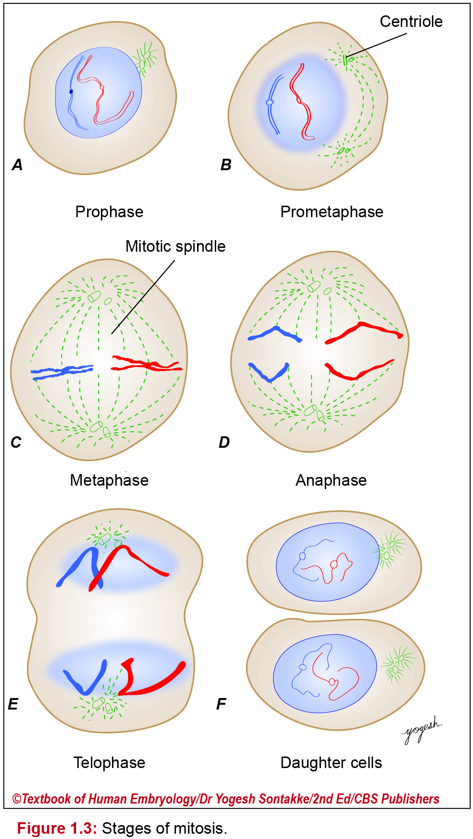

Slide 28
Clinical correlation
Significance of mitosis –
Genetic stability- it ensures continuous succession of identical cells through generations
Growth and development –help in growth& development
Regeneration growth & repair of dead and damaged cell.

Slide 29
MEIOSIS
Takes place in germ cell , Oogonia and spermatogonia are formed
Complete in two sequence , Meiosis –I & Meiosis –II
Reduction division –daughter cells have Half the no chromosome to parent
Daughter cells are not identical to each other and to the parent

Slide 30
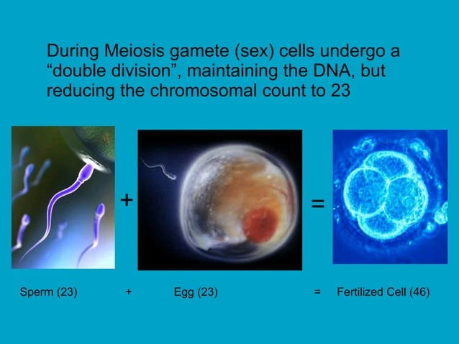

Slide 31
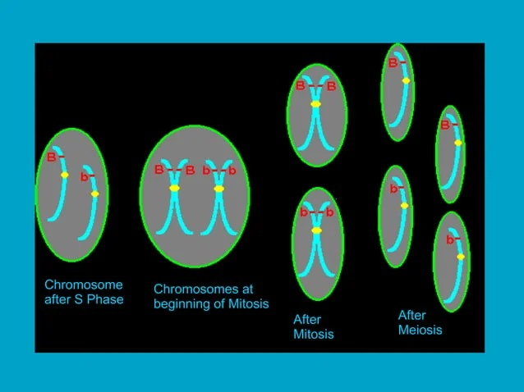

Slide 32
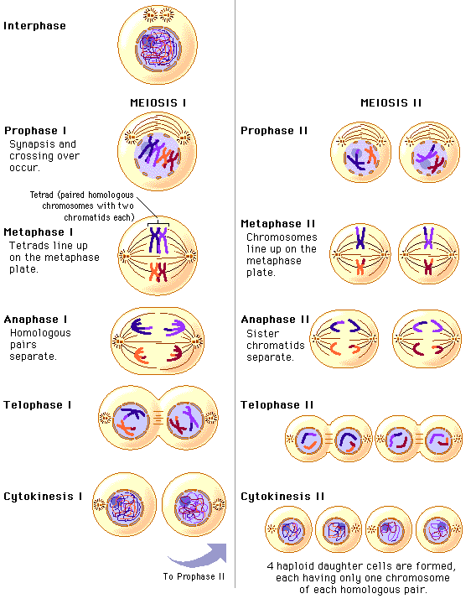
MEIOSIS I
Prophase -I
Metaphase- I
Anaphase - I
Telophase - I

Slide 33
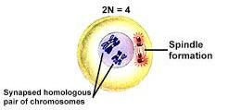
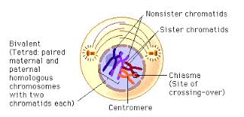
PROPHASE -I
Chromosomes become visible
Homologous chromosomes pair up side by side
Chromatids of homologous chromosomes interwine
Formation of chiasma
Crossing over takes place

Slide 34
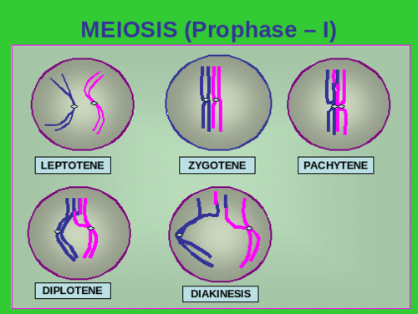
PROPHASE -I
Long and complicated
Five stage -
Leptotene
Zygotene
Pachytene
Diplotene
Diakinesis

Slide 35
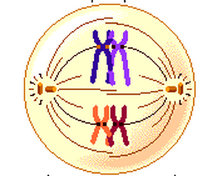
METAPHASE - I
Completion of spindle formation
Homologous chromosomes attached at the chiasma get aligned in equatorial plane
Two centromeres lie on opposite side of the plane

Slide 36
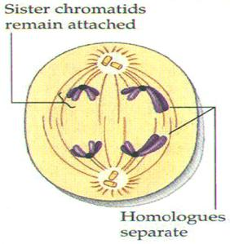
ANAPHASE -I
Chiasma disappears
Homologous chromosomes are pulled towards opposite poles of the cell
Half the number of chromosomes migrate towards each pole
Each pole consists of one member of each pair of autosomes and one sex chromosome

Slide 37
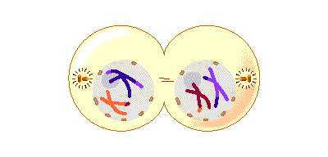
TELOPHASE - I
Homologous chromosomes have reached opposite sides of the cell
Nuclear membrane
begins to form
Cytokinesis follows
Each daughter cell contain haploid number of chromosomes

Slide 38
MEIOSIS - II
Equational division – essentially similar to mitosis
Differs from mitosis as DNA does not duplicate due to short interphase .
Prophase – II , Metaphase – II, Anaphase – II, Telophase – II
2 daughter cell of first meiotic division form 4 daughter cell with haploid no of chromosomes .
End result in males – four functional spermatogonia
End result in females – one oogonia and three polar bodies

Slide 39
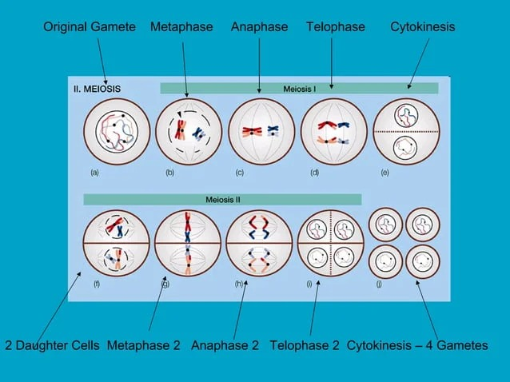

Slide 40
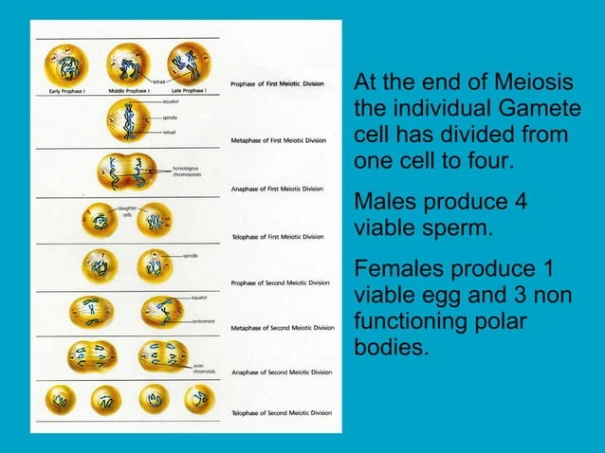

Slide 41
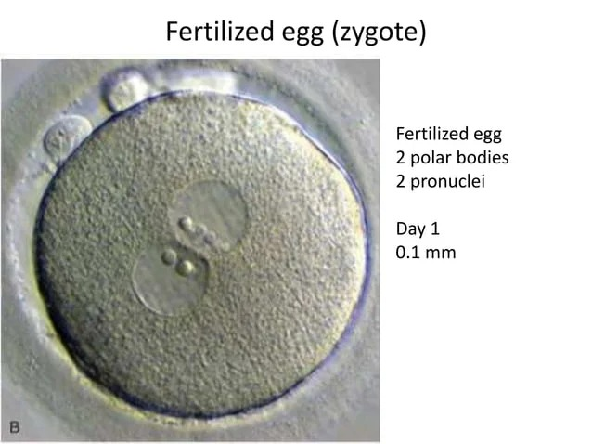

Slide 42
SIGNIFICANCE OF MEIOSIS
Sexual reproduction – Gametes haploid , zygotes diploid.
Genetic variation- random assortment and crossing over.
Hybrid vigor - increased function in any biological quality of hybrid offspring.

Slide 43
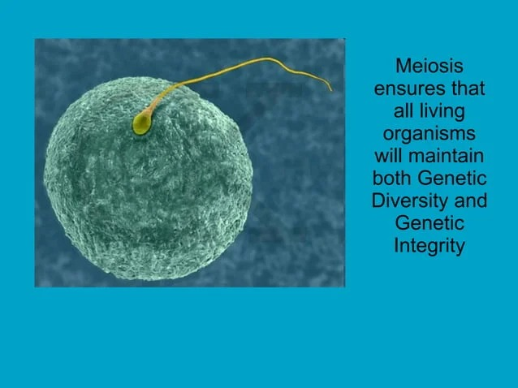

Slide 44
CHROMOSOMES
Dark-staining bodies within the nucleus of each animal cell
Formed by condensation of chromatin just before a cell undergoes division
Chromatin is observable in the nuclei of nondividing cells

Slide 45
Non-disjunction
Disjunction: usual separation of chromosomes in first meiotic division or sister chromatids in the second meiotic division
Non-disjunction: Abnormal segregation → resultant cells receive less number of chromosomes or extra chromosome → foetus with an abnormal number of chromosomes (trisomy or monosomy).
Examples:
  Down syndrome: trisomy of chromosome 21.
  Klinefelter syndrome: Extra X chromosome in males.
  Turner syndrome: lack of Y chromosome in phenotypic female (45,X).

Slide 46
Differences between mitosis and meiosis
Event | Mitosis | Meiosis
Occurrence | All cells of the body. | Only in germ cells.
Process | It is equational division. | It is a reductional division.
Prophase | No cross-over of genetic material. No synapsis. | Cross-over of genetic material takes place. Synapsis occurs in zygotene phase.
Metaphase | No chiasmata formation. Chromosomes arrange at the equator. | Chiasmata formation. Homologous chromosome arranges on either side of the equator.
Anaphase | Centromere divides. Chromatids move to opposite pole. | No division of centromere. Whole chromosome moves to opposite pole.
Telophase | Daughter cells with the same number of chromosomes (46). | Daughter cells with a haploid number of chromosomes (23).
Number of daughter cells | Two. | Four.

Slide 47
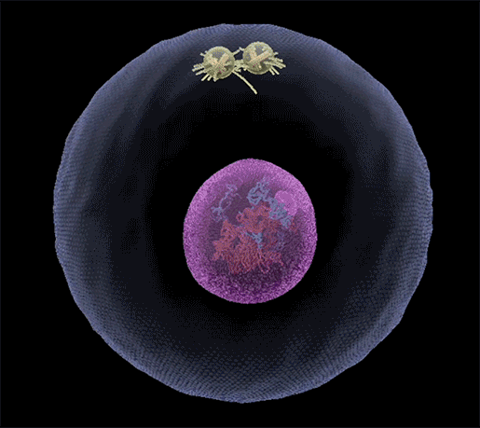
Chromatin condensing, centrosomes moving to opposite ends of the cell, and spindle fibers grabbing on to sister chromatids

Slide 48
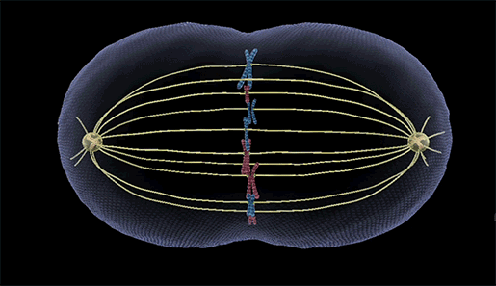
Sister chromatids pulling apart

Slide 49
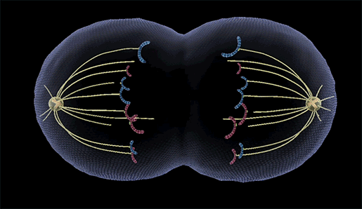
Telophase and cytokinesis

Slide 50
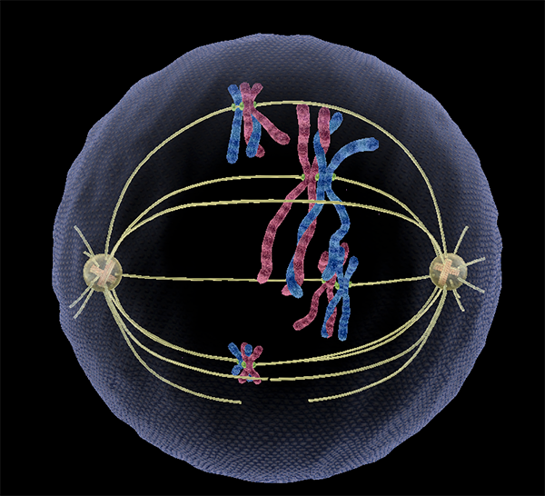
Crossing over in progress

Slide 51
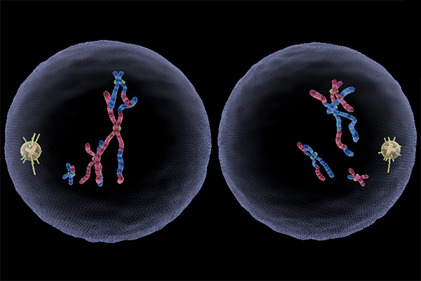
The end result of meiosis I

Slide 52
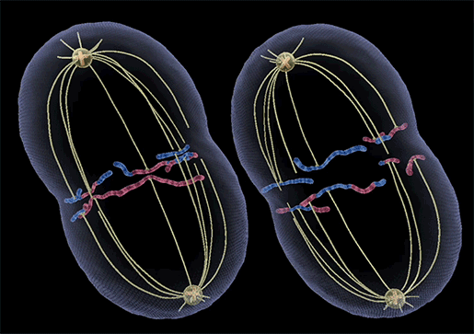

Slide 53

http://pkanatomyworld.com/

Slide 54
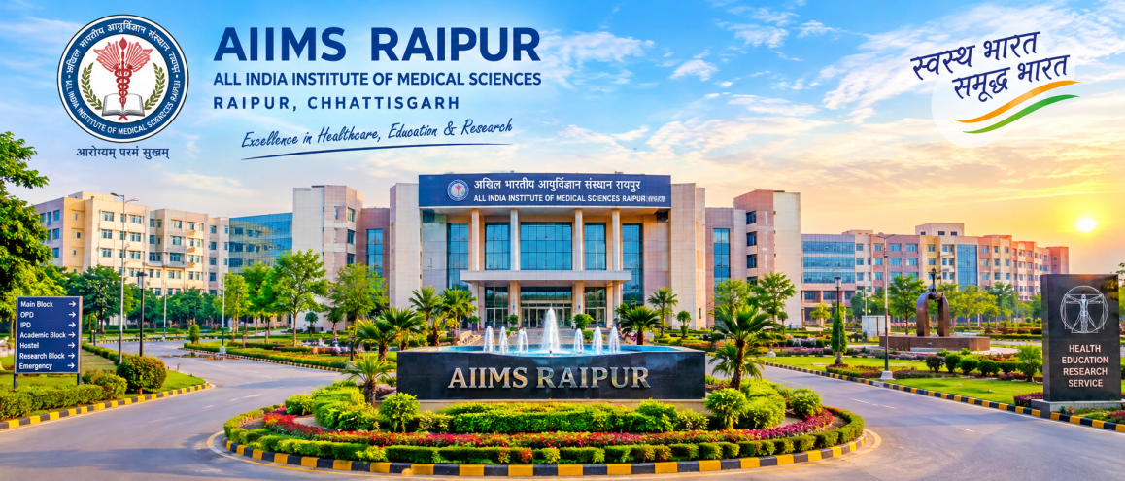

Slide 55
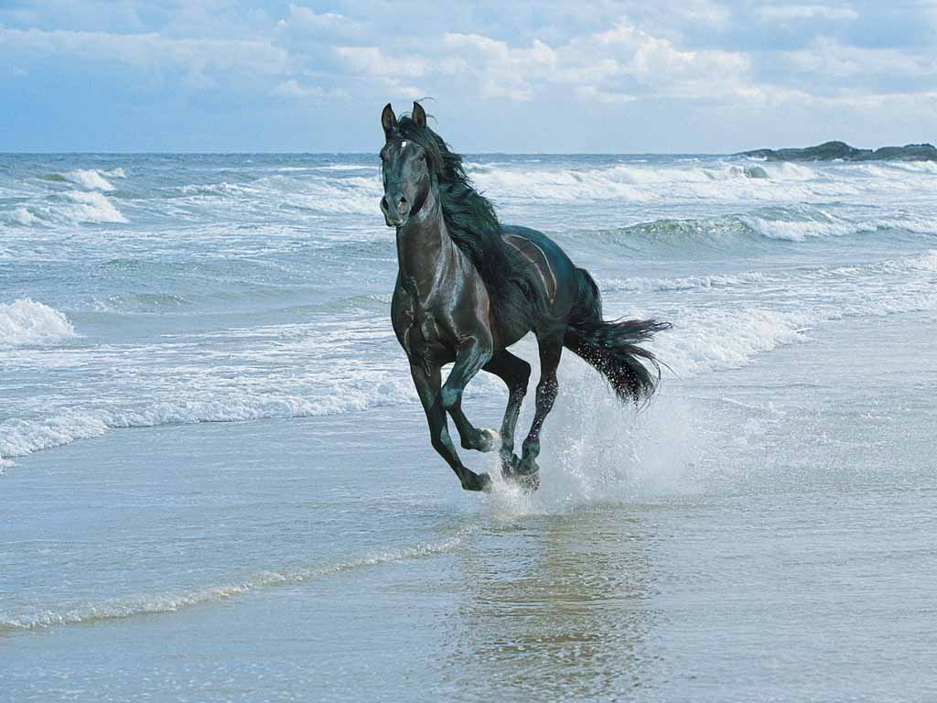
THANK YOU

