Slide 1
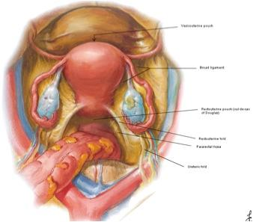
GROSS ANATOMY uterus
Dr. Praveen Kumar Kurrey
M.B.B.S., M.S.,BCME, BCBR,CISP
Professor Anatomy

Slide 2
UTERUS
Serves as part of the pathway for sperm to reach the uterine tubes.
Site of implantation of a fertilized ovum
Site for development of the fetus during pregnancy, and labor.
During reproductive cycles when implantation does not occur, the uterus is the source of menstrual flow.

Slide 3
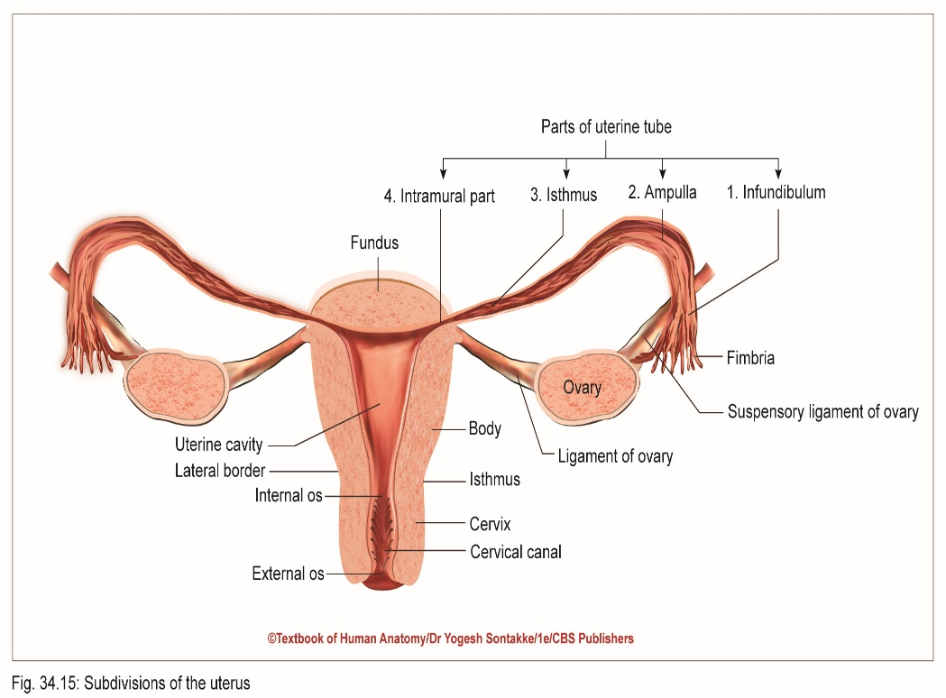
UTERUS
Synonym
Also called womb in layman language
Thick-walled, firm, muscular organ with narrow lumen
Location
Situated in true pelvis (lesser pelvis)
Between urinary bladder and rectum

Slide 4
UTERUS
Size, Shape, and Consistency
Pear-shaped and anteroposteriorly flat
Length: 3 inches (7.5 cm)
Breadth: 2 inches (5 cm)
Thickness: 1 inch (2.6 cm)
Weight: 30–40 g
Consistency: Firm

Slide 5
UTERUS
Parts of Uterus
Muscular body of uterus
Fibrous cervix
Isthmus – Junction of body and cervix – marked by circular constriction called isthmus

Slide 6
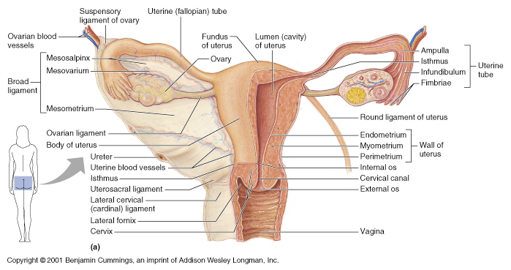

Slide 7
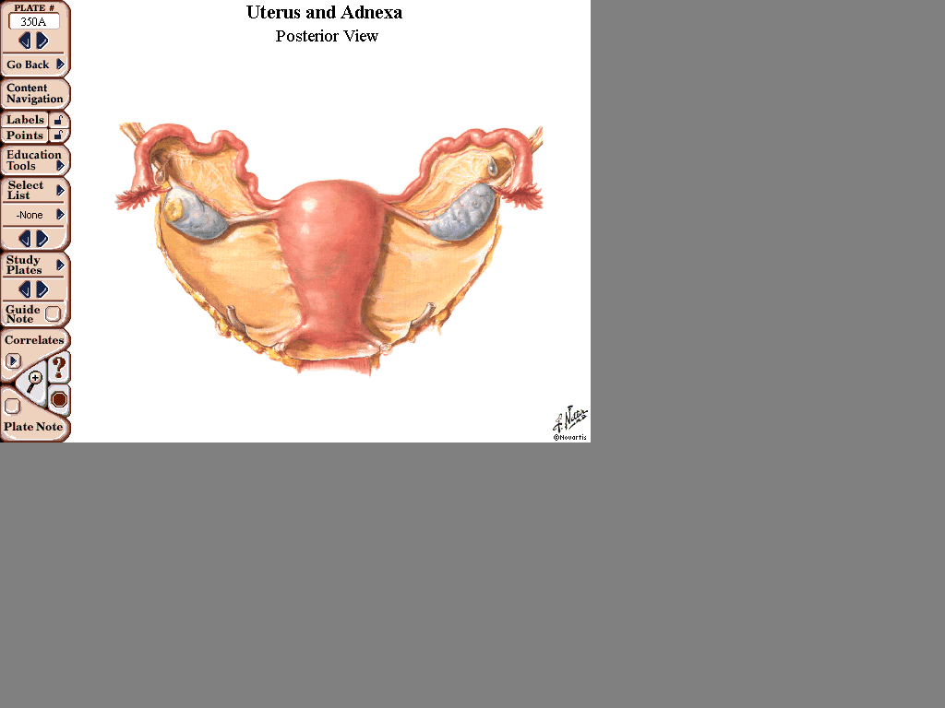
UTERUS
Suspensory ligament
Fallopian tube
Fundus
Mesosalpinx
Ovary
Mesovarium
Body
Broad
Ligament
Cervix

Slide 8

UTERUS: POST. VIEW

Slide 9
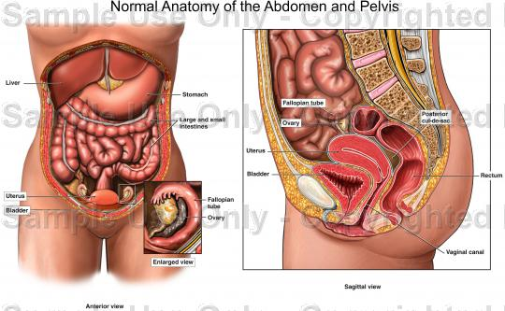
Location : Situated between the urinary bladder and the rectum
Shape : Inverted pear

Slide 10
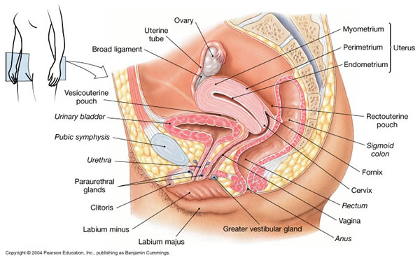

Slide 11
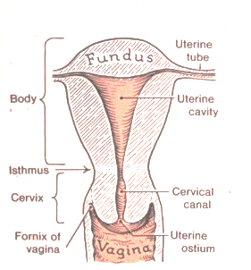
Anatomical subdivisions of the uterus include:
(1) Fundus: Dome shaped portion superior to the uterine tubes
(2) Body: Tapering central portion
(3) Cervix : Inferior narrow portion that opens into the vagina.

Slide 12
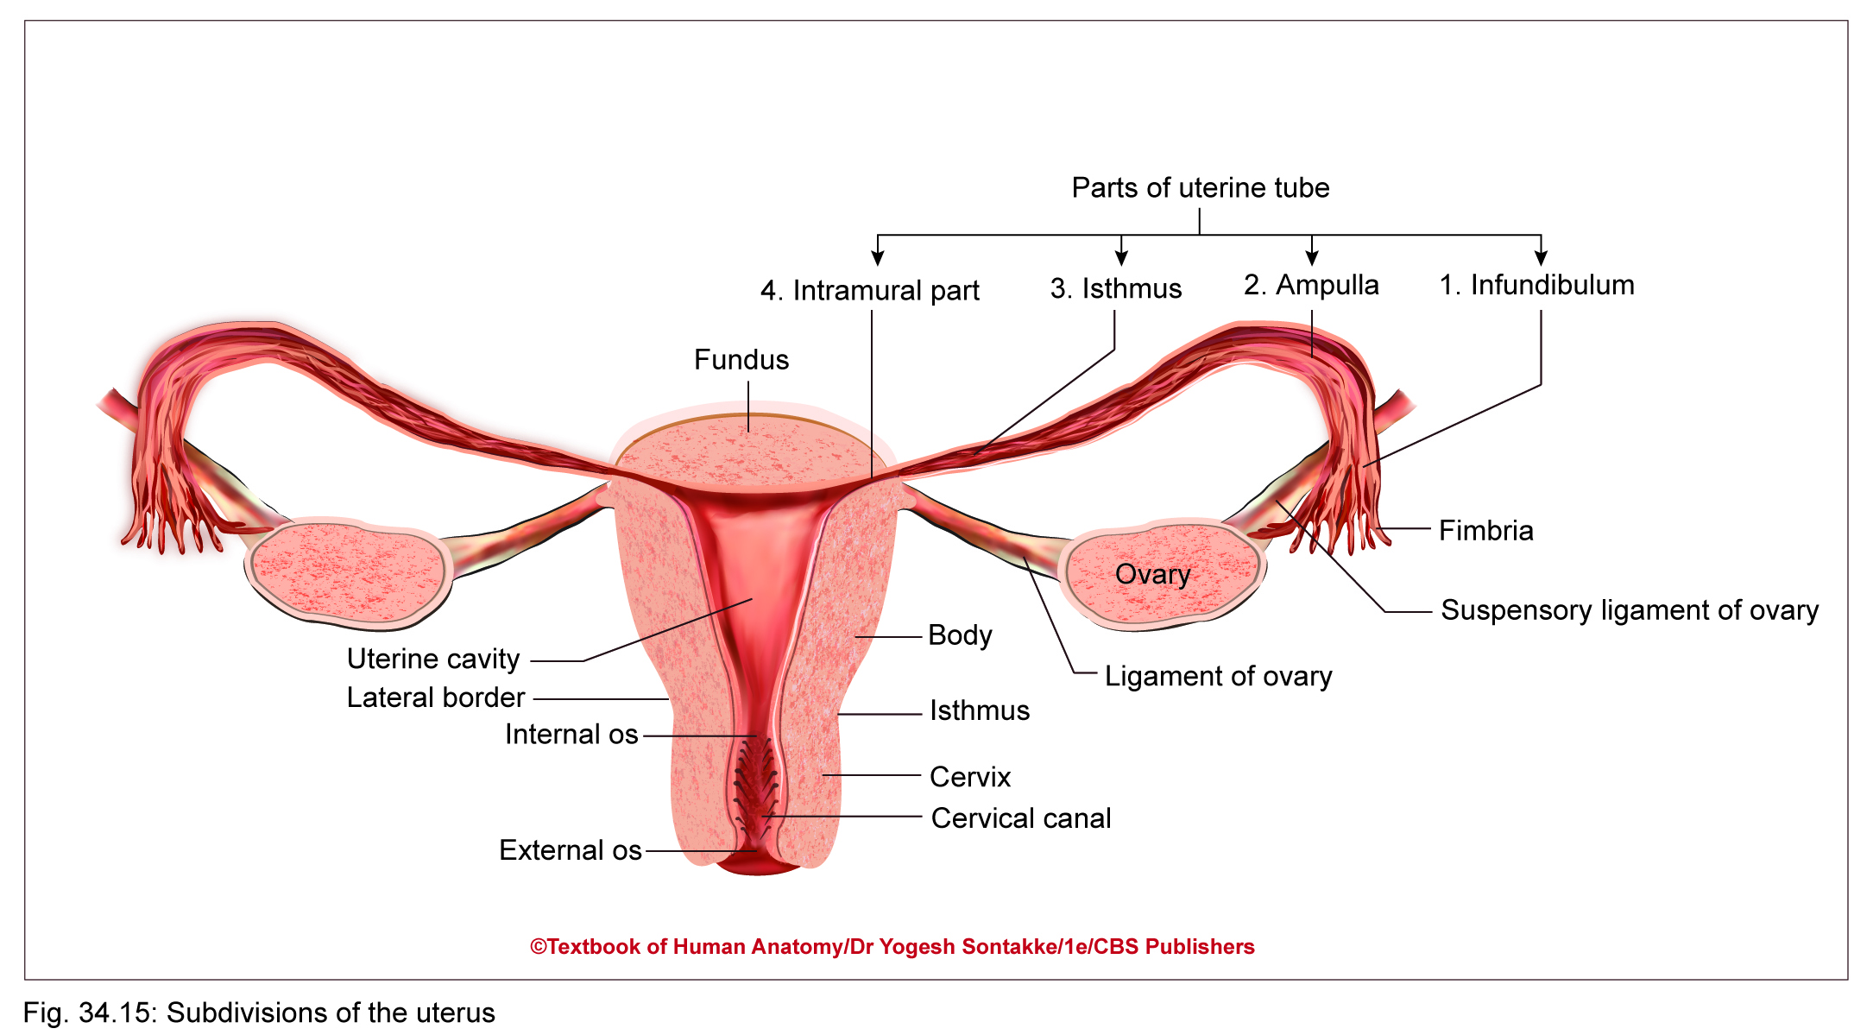

Slide 13
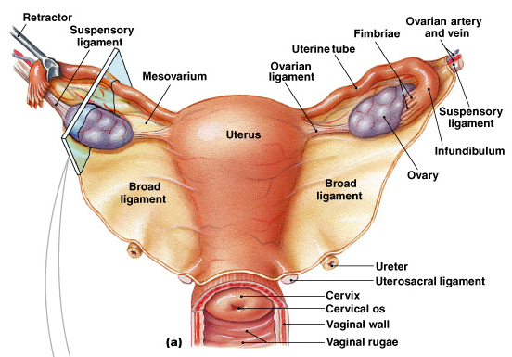

Slide 14
UTERUS
Body of uterus (corpus uteri)
Round and ovarian ligaments are attached to each cornu, inferior to attachment of fallopian tube
Body of uterus has:
  Fundus
  Uterine cornua
  Two surfaces: Anterior and posterior
  Two lateral borders (right and left)

Slide 15
UTERUS
Body of uterus (corpus uteri)
Two surfaces of body of uterus
Anterior surface –
  Flat and related to urinary bladder
  Covered with peritoneum
  Forms posterosuperior wall of uterovesical pouch

Slide 16
UTERUS
Body of uterus (corpus uteri)
Two surfaces of body of uterus
Posterior surface
  Convex and related to coils of intestine
  Covered with peritoneum
  Forms anterior wall of rectouterine pouch of Douglas

Slide 17
UTERUS
Lateral borders (right and left) of body of uterus
Each lateral border – convex and rounded
Nonperitoneal and provides attachment to broad ligament of uterus

Slide 18
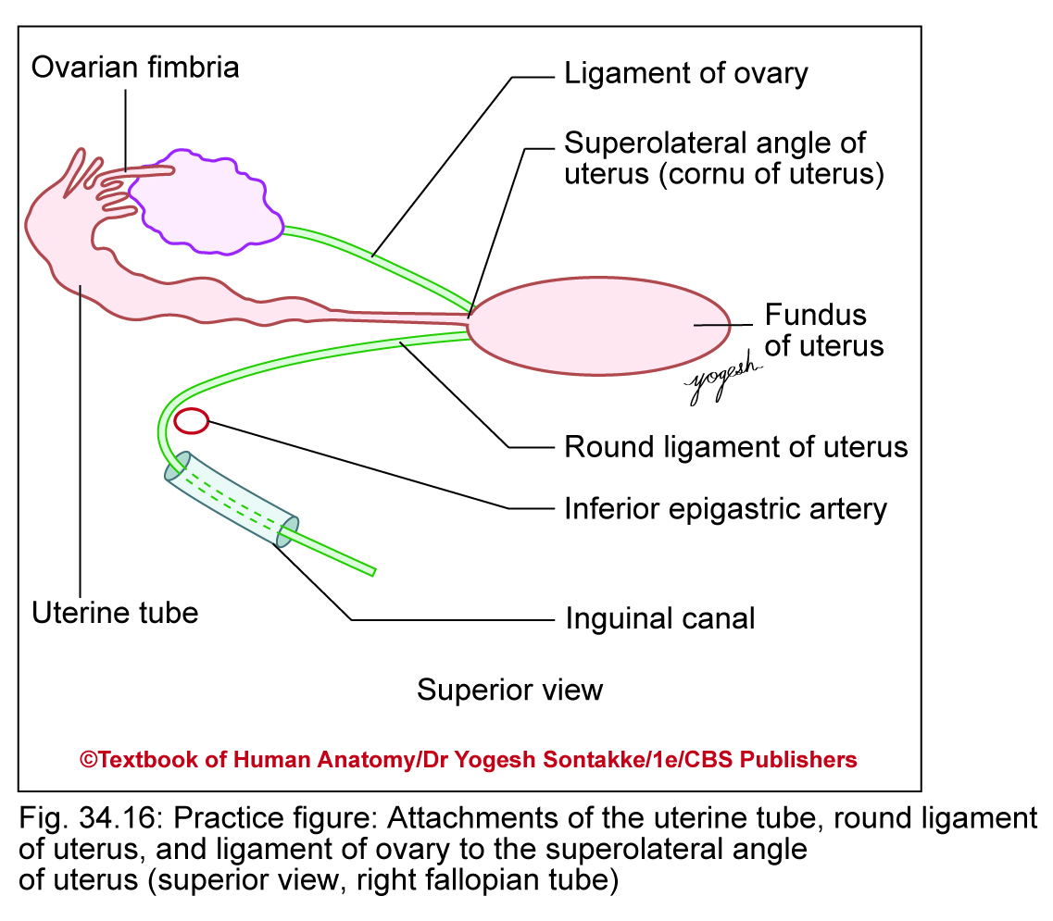
UTERUS
Broad ligament connects lateral border of uterus with lateral pelvic wall
Uterine tubes enter uterus at upper end of lateral border of uterus
Round ligament – attached to lateral border anteroinferior to tube, whereas ligament of ovary – attached posteroinferior to tube

Slide 19
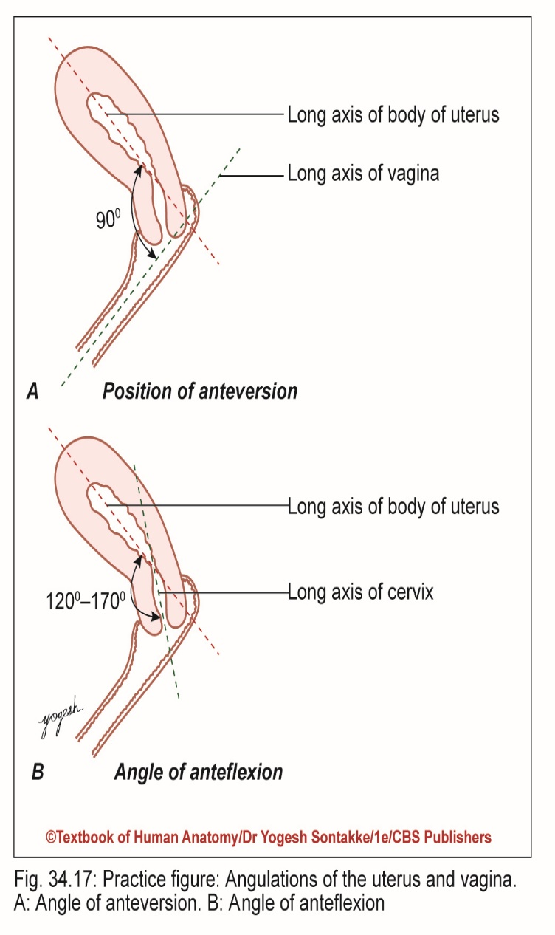
Position, Angular, and Axes of Uterus
Normal position of uterus: anteversion and anteflexion
Anteversion:
  Angle between long axis of cervix and long axis of vagina
  Forward tilting of uterus relative to vagina
  Usual anteversion – about 90°

Slide 20

Position and Axes of Uterus
Anteflexion
  Angle between long axis of body of uterus and long axis of cervix of uterus
  Forward flexion of uterus at level of isthmus or internal of cervix
  Usual anteflexion – about 120°

Slide 21
Position and Axes of Uterus
Retroversion
  In retroverted (tilted or tipped) uterus, uterus – tilted backward relative to vagina
  Long axis of uterus corresponds to axis of pelvic inlet and axis of the vagina to axis of pelvic cavity and pelvic outlet
Dextrorotation – right deviation of uterus

Slide 22
UTERUS
Cervix of uterus
Lower cylindrical part of uterus
2.5 cm long
Lower part of cervix projects into upper part of vagina; thus, cervix – divisible into two parts:
    Upper supravaginal
    Lower vaginal

Slide 23
UTERUS
Cervix of uterus
Clinically, isthmus – upper one-third of supravaginal part of cervix
Obstetrically this isthmus considered as lower uterine segment
Structurally, similar to body of uterus

Slide 24
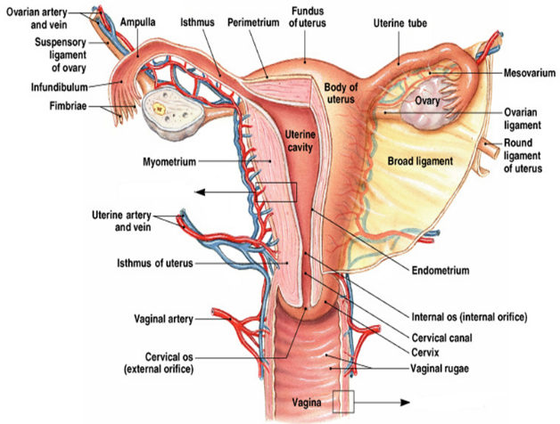
Uterine cavity: Interior of the body of the uterus
Cervical canal: Interior of the cervix
The cervical canal opens into the uterine cavity at the internal os and into the vagina at the external os.

Slide 25
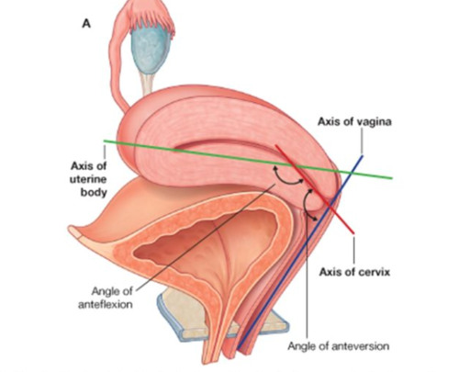
Normally, the body of the uterus projects anteriorly and superiorly over the urinary bladder in a position called anteflexion.
The cervix projects inferiorly and posteriorly and enters the anterior wall of the vagina at nearly a right angle in a position called anteversion

Slide 26
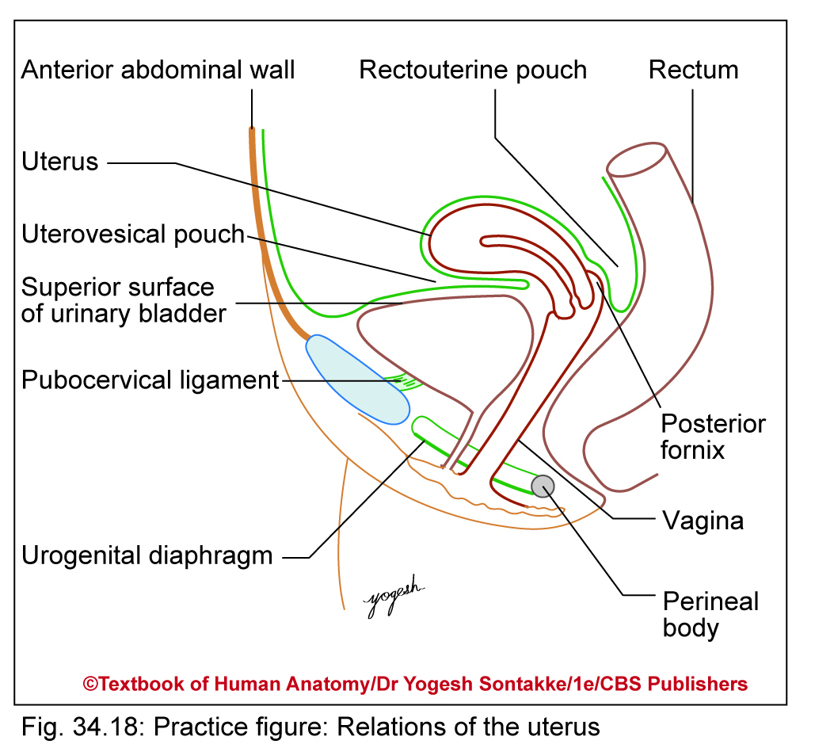
Relations of Uterus
Relations of body
Anterior
Uterovesical pouch
Surface of urinary bladder
Posterior
Rectouterine pouch
Coils of ileum, sigmoid colon
Lateral
Broad ligament
Ureter
Uterine vessels

Slide 27
Relations of Uterus
Relations of cervix
Anterior
Supravaginal part of cervix – related to posterior surface of urinary bladder
Vaginal part of cervix – Related to anterior fornix of vagina

Slide 28
Relations of Uterus
Relations of cervix
Posterior
Supravaginal part of cervix – related to rectouterine pouch with the ileum and sigmoid colon coils in it
Vaginal part of cervix – related to posterior fornix of vagina

Slide 29
Relations of Uterus
Relations of cervix
Laterally
Supravaginal part of cervix – related to ureter and uterine vessels
Vaginal part of cervix – related to fornixes of vagina

Slide 30
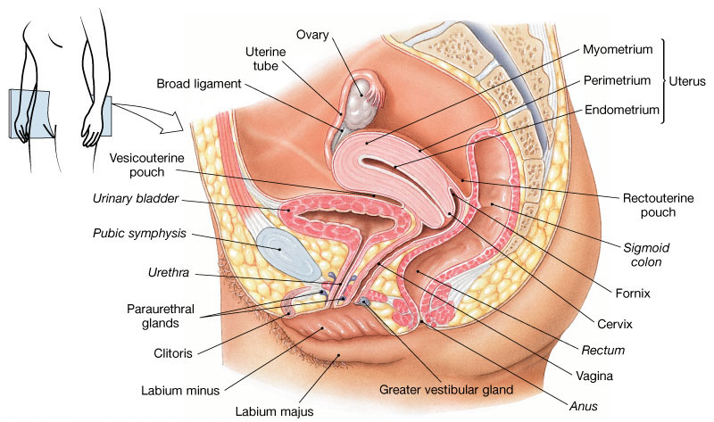
UTERUS:
PERITONEAL RELATIONS

Slide 31
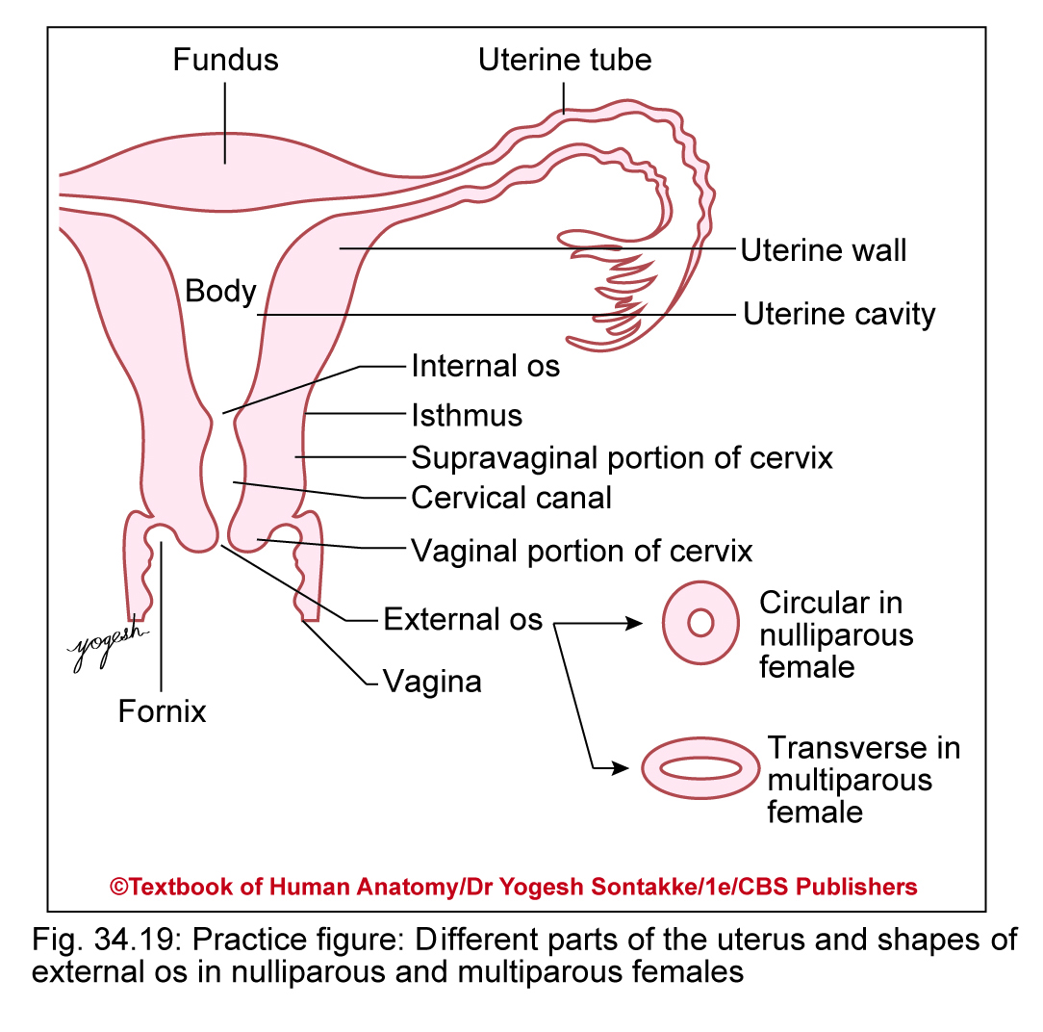
Cavity of Uterus
Divisible into cavity of body and cavity of cervix
Cavity of body
Triangular in coronal section
Apex – continuous inferiorly with cavity of cervix (cervical canal) through internal OS
In transverse section, cavity of body of uterus appears as slit, compressed anteroposteriorly

Slide 32
Cavity of Uterus
Cavity of cervix (cervical canal)
Spindle-shaped
Communicates superiorly with cavity of uterus through internal os and inferiorly with cavity of vagina through external os (ostium uteri)

Slide 33
Ligaments of Uterus
Peritoneal ligament (false ligaments)
  Anterior ligament (uterovesical fold)
  Posterior ligament (rectovaginal fold)
  Broad ligaments (right and left)
  Rectouterine folds (right and left)
Fibromuscular ligaments (true ligaments)
These all are paired
  Round ligament
  Transverse cervical ligament
  Uterosacral ligaments
  Pubocervical ligaments

Slide 34
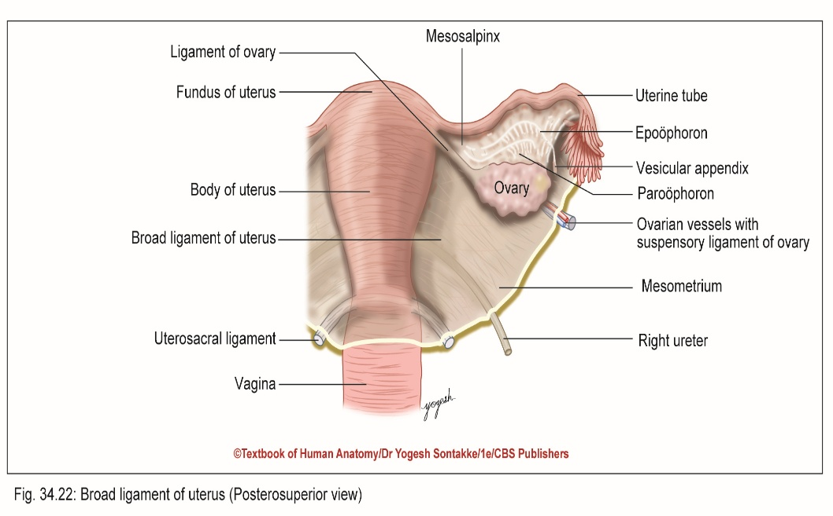
Broad ligaments of uterus
External features
Two surfaces:
  Superior and inferior (when bladder – empty)
  Anterior and posterior (when bladder – full)
Two borders:
  When bladder – empty: Anterior free border and posterior attached borders
  When bladder – full: Upper free border and inferior attached borders

Slide 35
Broad ligaments of uterus
Parts of broad ligament
Mesosalpinx – part of broad ligament between uterine tube and ligament of ovary
Mesometrium – part of broad ligament extending from pelvic floor to ovary, ligament of ovary, and body of uterus

Slide 36
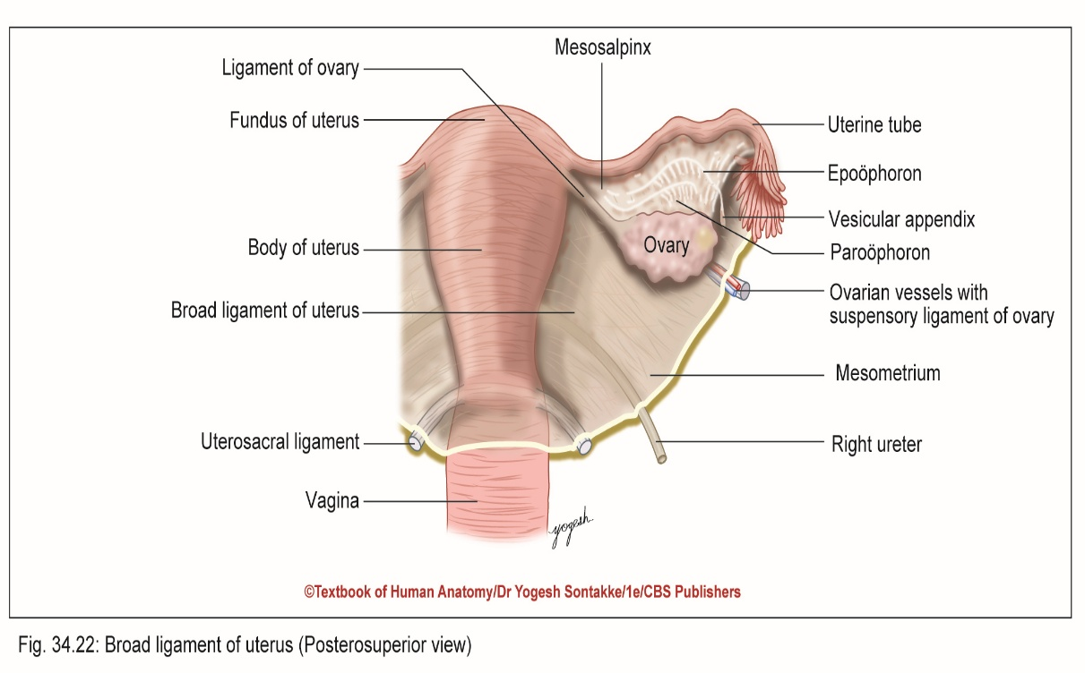
Broad ligament uterus

Slide 37
Broad ligaments of uterus
Parts of broad ligament
Mesoovarium – fold of peritoneum extends posteriorly from broad ligament to ovary
Infundibulopelvic ligament (suspensory ligament of ovary) – part of broad ligament extends from infundibulum of uterine tube to upper pole of lateral wall of pelvis

Slide 38
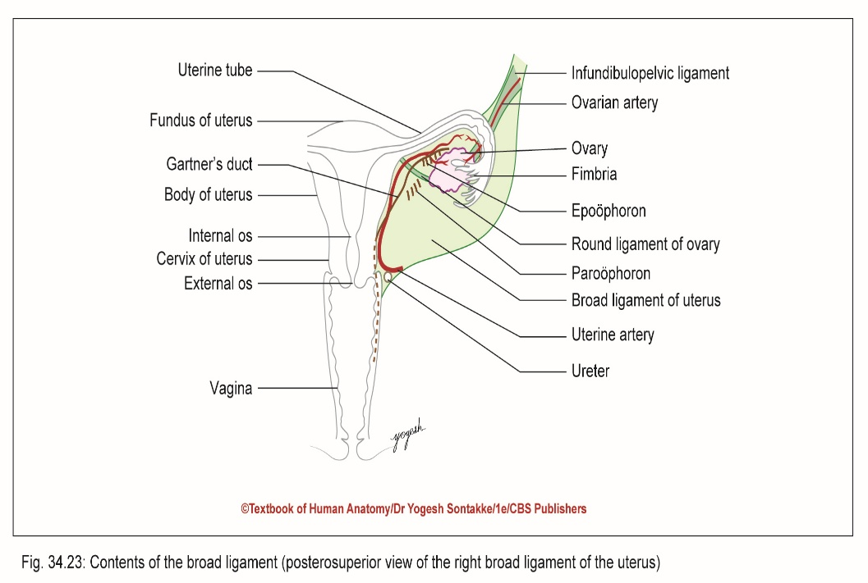
Broad ligaments of uterus
Contents of broad ligament
One tube: Uterine tube
Two ligaments: Round ligament of uterus, ligament of ovary
Arteries: Uterine and ovarian
Nerve plexuses: Uterovaginal and ovarian
Embryological remnants Epoöphoron and Gartner’s duct, paroöphoron, vesicular appendices
Lymph nodes and lymphatic vessels
Fibrofatty tissue or parametrium

Slide 40
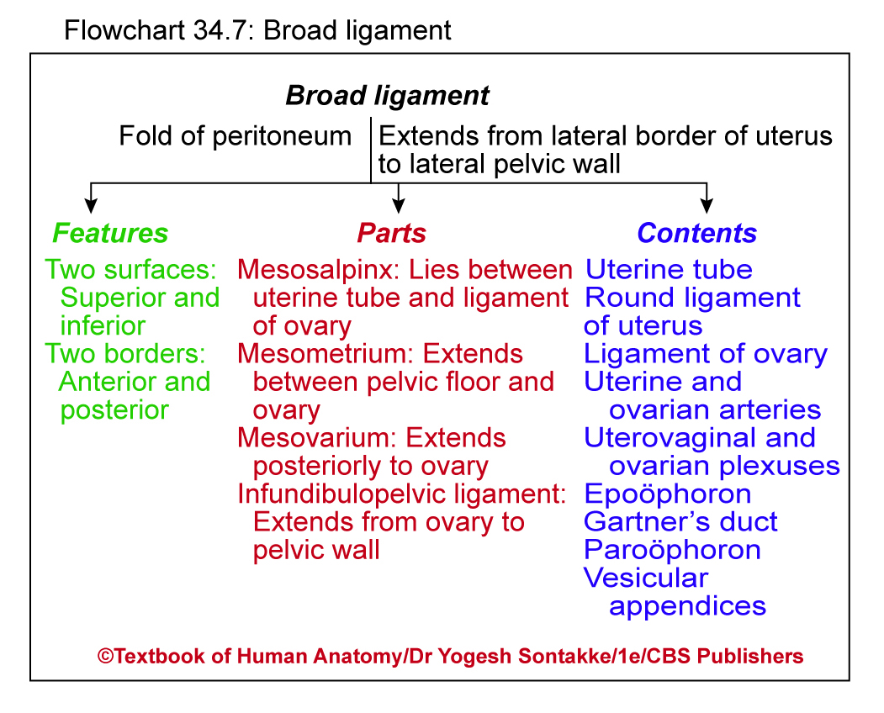

Slide 41
UTERINE VASCULAR SUPPLY
Uterine arteries – arise from internal iliac, ascend the sides of the uterus and send branches into the uterine wall
Arcuate arteries – branches of uterine arteries in the myometrium that give rise to radial branches
Radial branches – descend into endometrium and give rise to:
  Spiral arteries to stratum functionalis
  Straight arteries to stratum basalis

Slide 42
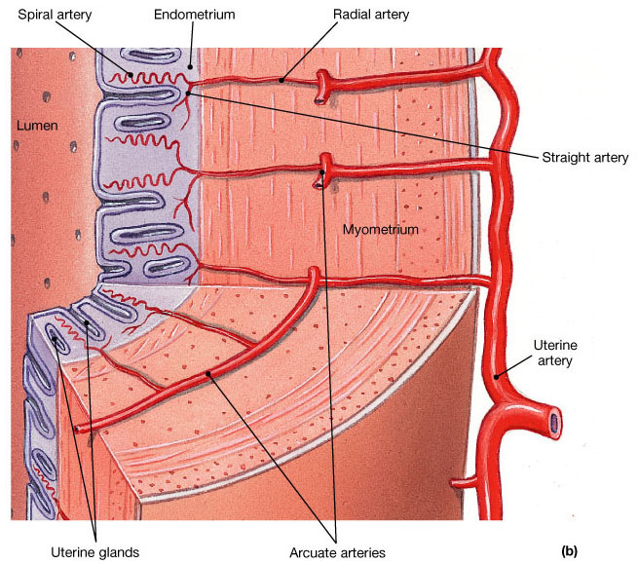
UTERUS: BLOOD SUPPLY

Slide 43
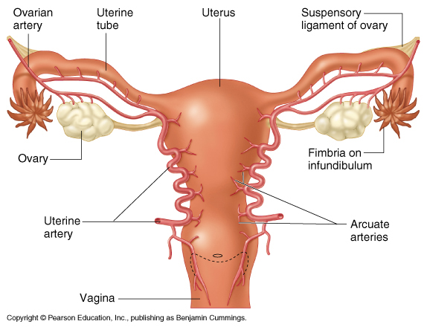
UTERUS: BLOOD SUPPLY

Slide 44
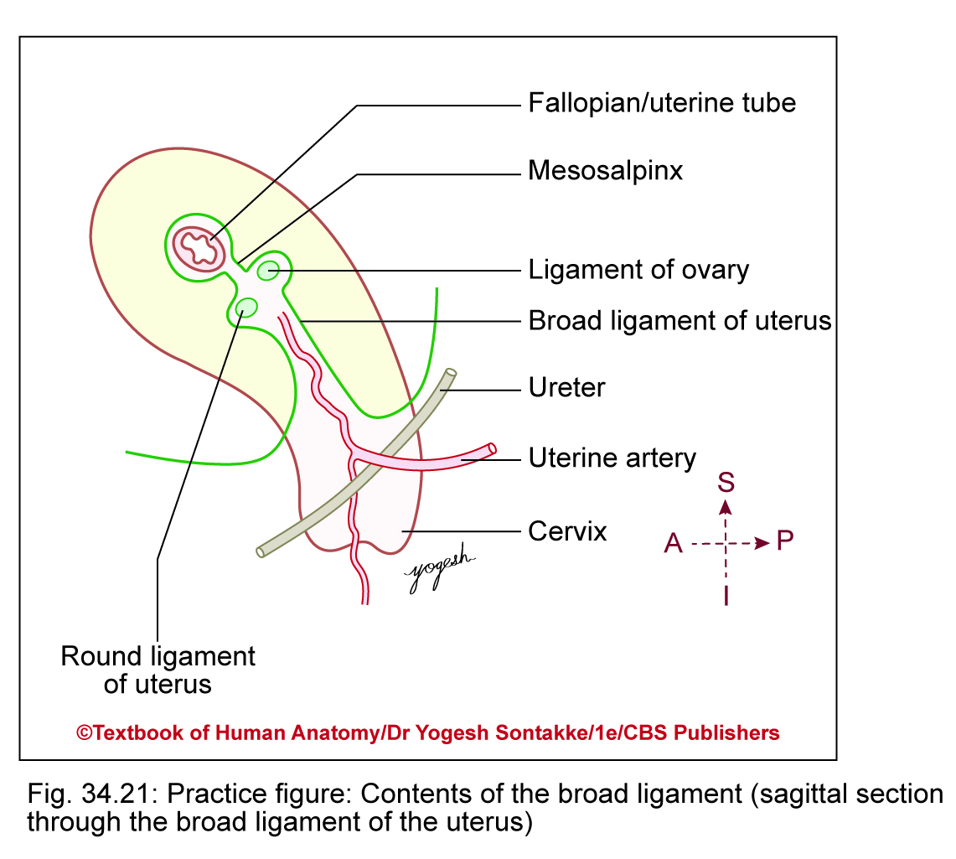
Arterial supply
Supplied by
  Two uterine arteries
  Two ovarian arteries
Venous drainage:
  Form plexus along lateral border of uterus
  Plexus drains into uterine, ovarian, and vaginal veins
  They finally drain into internal iliac veins

Slide 45
Lymphatic drainage
From fundus and upper part of body into pre and para-aortic nodes
From lateral angles of uterus drain into superficial inguinal nodes along round ligament
From lower part of body drain into external iliac nodes
From cervix drain into external iliac and obturator nodes, internal iliac nodes, sacral nodes

Slide 46
UTERUS: LYMPHATICS
PARAAORTIC NODES
Fundus
SUPERFICIAL INGUINAL
EXTERNAL ILIAC
Body
INTERNAL ILIAC
Cervix

Slide 47
SUPPORTS OF UTERUS

Slide 48
SUPPORTS OF UTERUS
A. Primary supports
  1. Muscular or active supports
    Pelvic diaphragm
    Perineal body
    Urogenital Diaphram
  2. Fibromuscular or mechanical supports
    Uterine axis
    Pubocervical ligaments
    Transverse cervical ligaments of Mackenrodt
    Uterosacral ligaments
    Round ligaments of uterus

Slide 49
SUPPORTS OF UTERUS
B. Secondary supports
  Broad ligaments
  Uterovescical fold of peritoneum
  Rectovaginal fold of peritoneum

Slide 50
SUPPORTS OF UTERUS
S
U
P
P
O
R
T
S

Slide 51
ANATOMICAL SUPPORTS
A
N
A
T
O
M
I
C
A
L

Slide 52
SUPPORTS : BONEY’S CLASSIFICATION
HOLDING APPARATUS
RETENTIVE APPARATUS
SUPPORTING APPARATUS

Slide 53
SUPPORTS : BONEY’S CLASSIFICATION
F
U
N
C
T
I
O
N
A
L

Slide 54
McGREGOR’S CLASSIFICATION
S
U
P
P
O
R
T
S

Slide 55
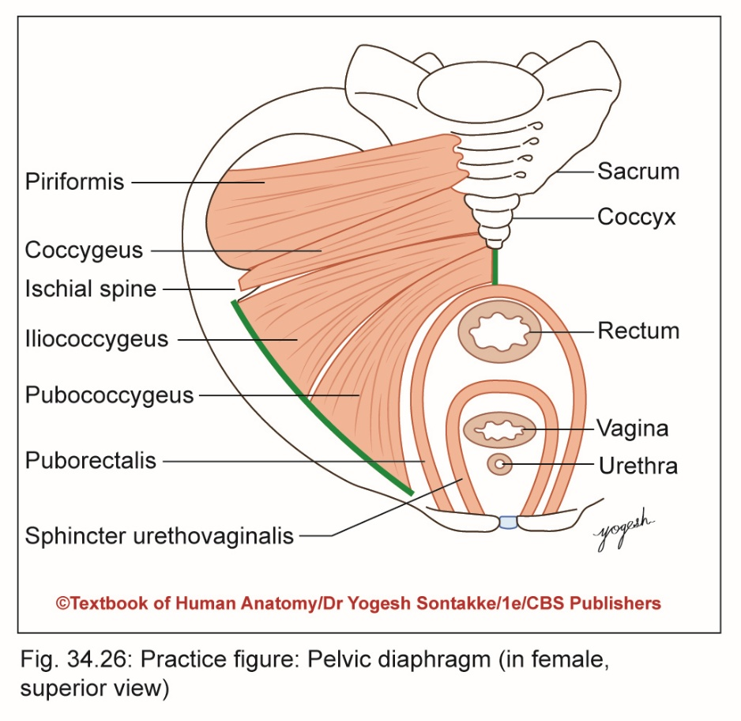
Primary Supports of Uterus
PELVIC DIAPHRAGM
Supports pelvic viscera and resists raised abdominal pressure
Pubococcygeus (part of levator ani) inserts on perineal body and supports vagina by forming sling
Rupture of these fibers during childbirth, support of vagina – lost, and may prolapse
Levator ani muscle:
Fixes perineal body
Supports pelvic viscera

Slide 56
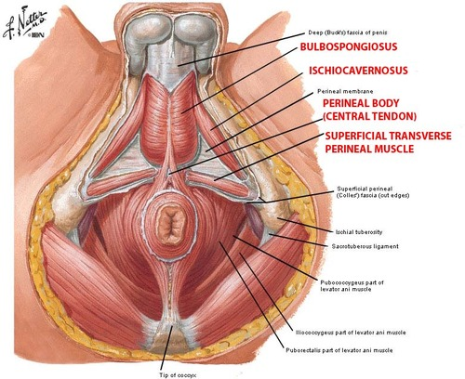
Primary Supports of Uterus
PERINEAL BODY
  Fibromuscular node located in center of perineum between vagina and rectum
  Gives attachments to perineal muscles and pelvic diaphragm and maintains integrity of pelvic floor

Slide 57
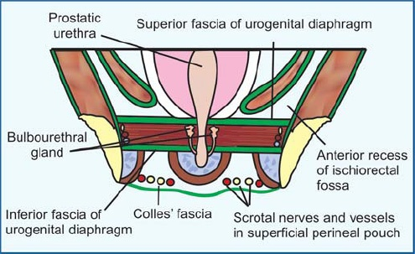
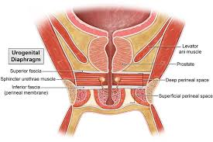
UROGENITAL DIAPHRAGM
2 Deep Transverse Perinei and Sphincter

Slide 58
  FIBROMUSCULAR OR MECHANICAL SUPPORTS
1. UTERINE AXIS
Anteverted and anteflexed position of uterus prevents organ from sagging down through vagina
Increased intra-abdominal pressure further accentuates anteversion of uterus and prevents prolapse of uterus

Slide 59
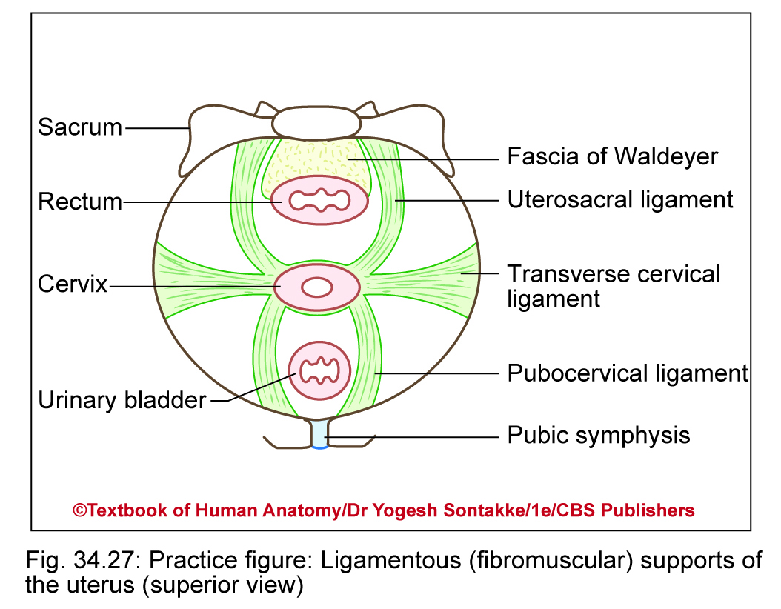
2. PUBOCERVICAL LIGAMENTS
Connect cervix to posterior surface of pubic bone
Pair of fibrous bands derived from endopelvic fascia
Correspond to puboprostatic ligaments in males

Slide 60
3. TRANSVERSE CERVICAL
ligaments of Mackenrodt:
Called cardinal ligaments, cervical ligaments, paracervical ligaments, or retinacula uterine sustentaculum of Bonny
Fibrous bands derived from endopelvic fascia

Slide 61
Fan-shaped bands
Connect lateral aspect cervix and upper vaginal wall to lateral pelvic wall
Form hammock which supports uterus and prevents prolapse

Slide 62
4. UTEROSACRAL LIGAMENTS
Pair of fibrous bands derived from condensation of endopelvic fascia
Connect cervix to second and third sacral vertebrae

Slide 63
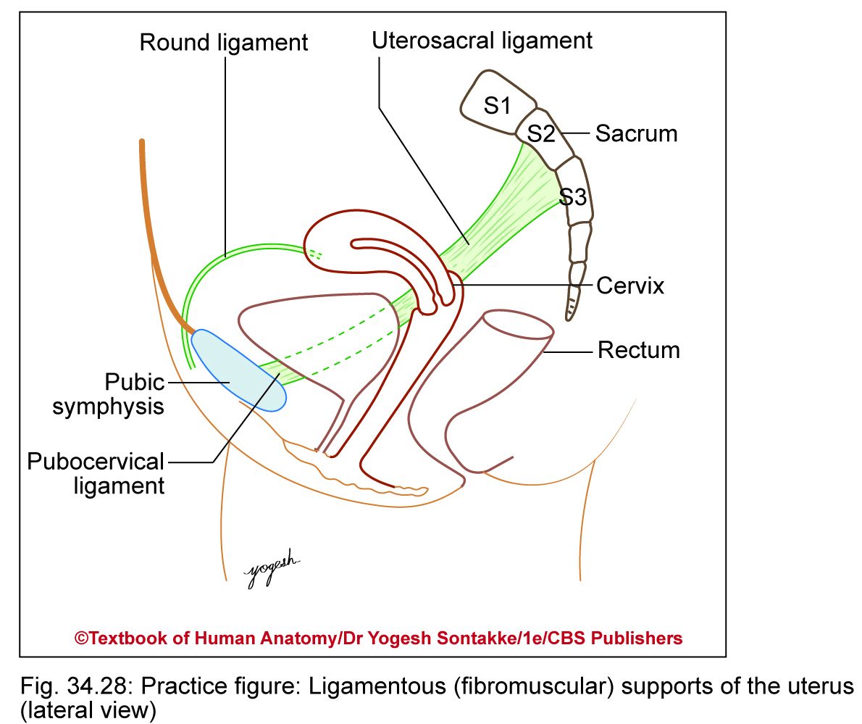
5. ROUND LIGAMENTS OF UTERUS
Pairs of fibromuscular bonds
Extend from lateral angle of uterus, run forward and laterally, then pass through deep inguinal ring, traverse inguinal canal, and merge with connective tissue of labia majora
Pulls fundus forward and helps to maintain anteversion and anteflexion of uterus

Slide 65
SECONDARY SUPPORT
1. Broad ligaments : Are double folds of peritoneum attaching the uterus to either side of the pelvic cavity.

Slide 66
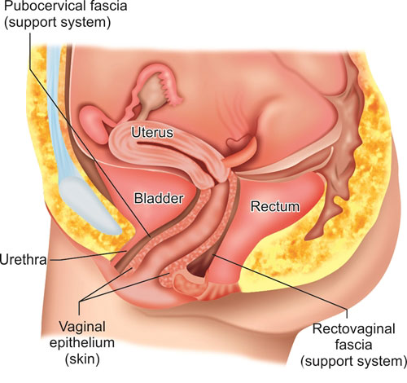
2. RECTOVAGINAL FOLD

Slide 67
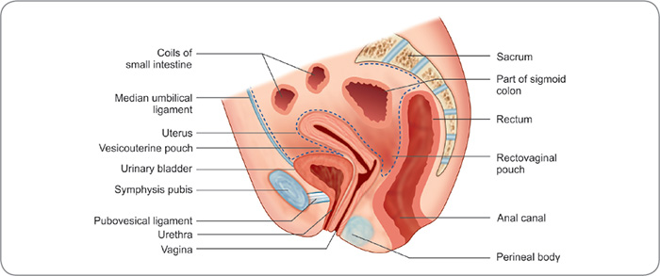
3. UTEROVESICAL FOLD

Slide 68
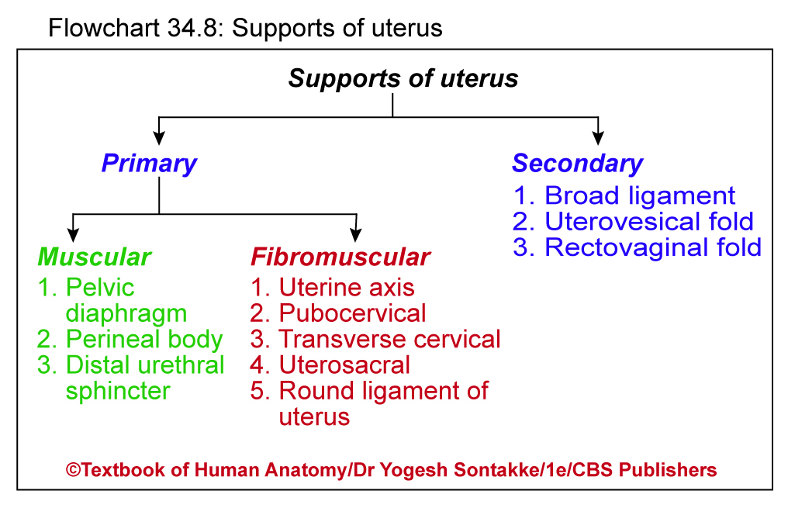

Slide 69

Histology
The uterus consists of three layers of tissue:
1. perimetrium, 2. myometrium, 3. endometrium
Perimetrium :The outer layer or serosa is part of the visceral peritoneum, composed of simple squamous epithelium and areolar connective tissue.
Laterally, it becomes the broad ligament
Anteriorly, it covers the urinary bladder and forms a shallow pouch, the vesicouterine pouch
Posteriorly, it covers the rectum and forms a deep pouch between the uterus and urinary bladder, the rectouterine or pouch of Douglas— the most inferior point in the pelvic cavity.

Slide 70
2. Myometrium : The middle layer of the uterus
3. Endometrium : The inner layer of the uterus is highly vascularized and has three components:
(1) An innermost layer composed of simple columnar epithelium lines the lumen.
(2) An underlying endometrial stroma is a very thick region of lamina propria
(3) Endometrial (uterine) glands develop as invaginations of the luminal epithelium and extend almost to the myometrium.
The endometrium is divided into two layers.
The stratum functionalis (functional layer) lines the uterine cavity and sloughs off during menstruation.
The stratum basalis (basal layer) is permanent and gives rise to a new stratum functionalis after each menstruation.

Slide 71
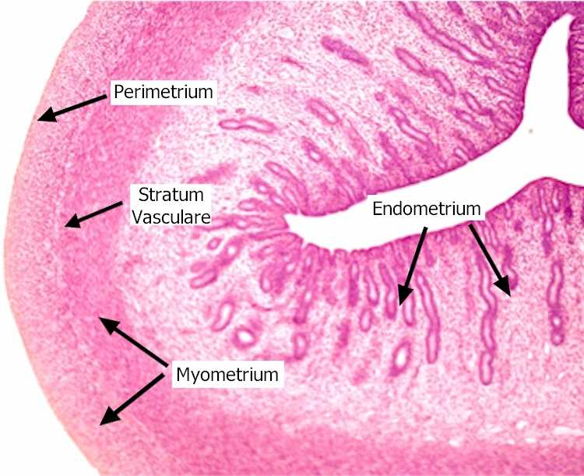

Slide 72
APPLIED ANATOMY
1. PROLAPSE OF UTERUS
Definition: herniation of uterus from normal anatomical position into vaginal canal
Causes
Due to weakening of supports of uterus
Usually occurs due to successive vaginal deliveries, obese female, advancing age, or connective tissue disorders
Signs and symptoms:
  Sensation of heaviness and pressure in vagina
  Bulging lump into vagina or protruding out of vagina
  Painful sexual intercourse

Slide 73
PROLAPSE OF UTERUS
UC
V
A
G
Introitus
NORMAL
1ST DEGREE
2ND DEGREE
3RD DEGREE
PROCIDENTIA

Slide 74
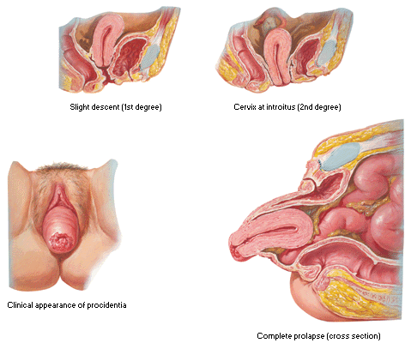
PROLAPSE OF UTERUS

Slide 75
Clinical Integration
2. Cesarean section (C-Section)
  Surgical procedure by which baby – delivered through horizontal incision in mother’s anterior abdominal wall and anterior wall of uterus
  Required in case of placenta previa, transverse lie of baby, multiple pregnancies, disproportionate baby’s head, and mother’s pelvis, and so on
3. Endometritis – inflammation of endometrium

Slide 76
APPLIED ANATOMY
4. Retoverted Uterus
5. Hysterectomy
6. Carcinoma Cervix – Most Common
7. IUCD- Intrauterine Contraceptive Device
(Copper T)

Slide 77
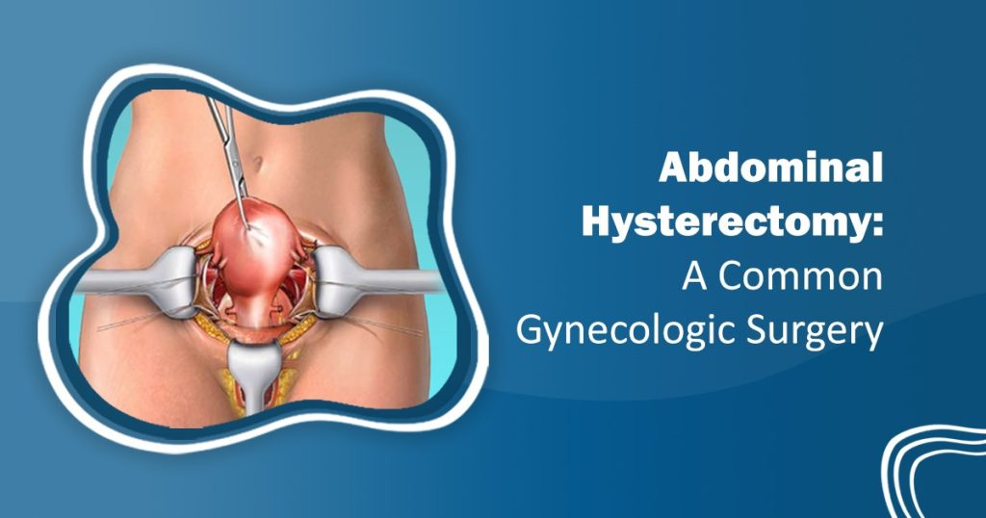
HYSTERECTOMY

Slide 78
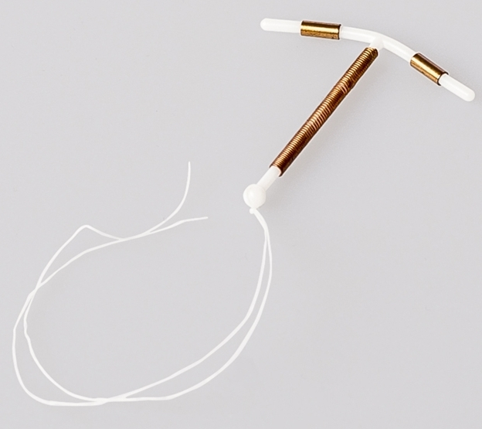
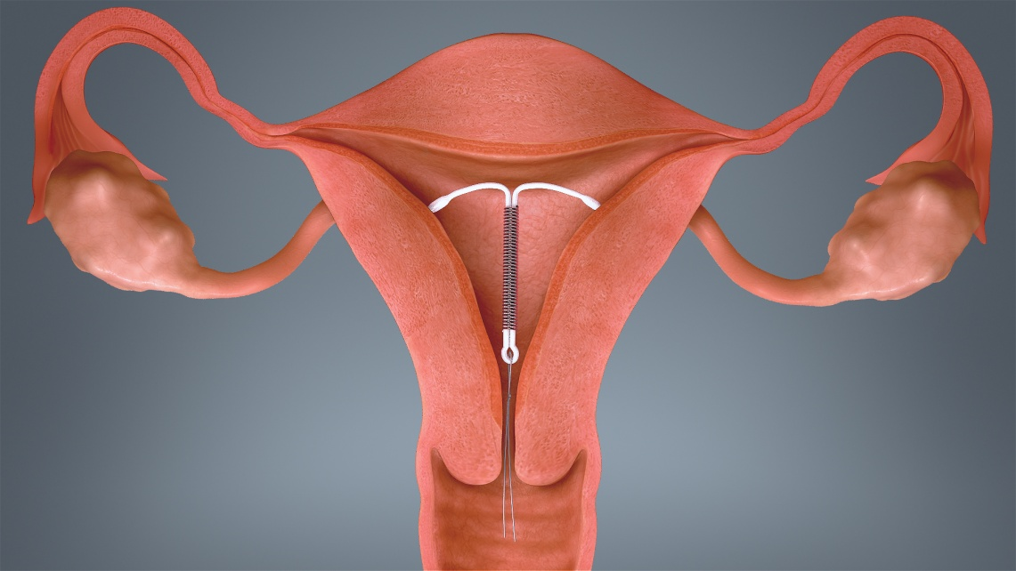
IUCD – COPPER -T

Slide 79
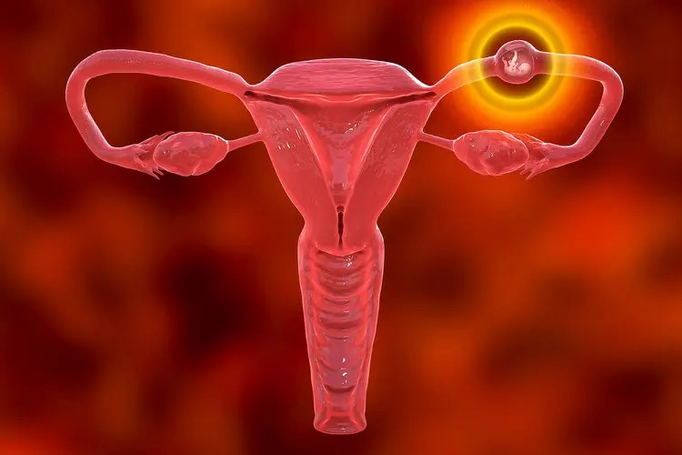
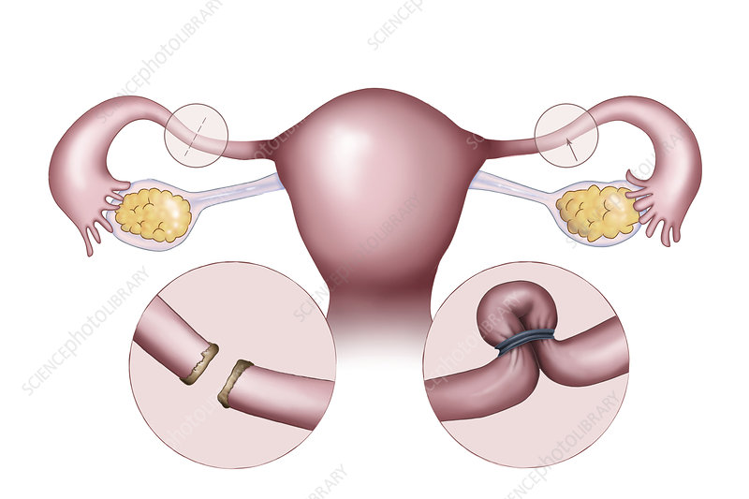
APPLIED ANATOMY
8. Sterlity – Tubal Blockage
9. Tubal Pregnancy
10. Tubectomy – TT Operation for Sterlization

Slide 80
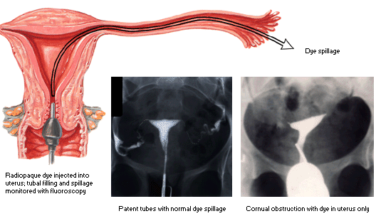
TESTING TUBE PATENCY:
11. HYSTEROSALPINGOGRAPHY

Slide 81
CLINICAL ANATOMY
HYSTERECTOMY : Surgical removal of the uterus.
Indications : fibroids , pelvic inflammatory disease, recurrent ovarian cysts, excessive uterine bleeding, and cancer of the cervix, uterus, or ovaries.
(A) Partial (subtotal) hysterectomy,: the body of the uterus is removed but the cervix is left in place.
(B) Complete hysterectomy : is the removal of both the body and cervix of the uterus.
(C) Radical hysterectomy : includes removal of the body and cervix of the uterus, uterine tubes, possibly the ovaries, the superior portion of the vagina, pelvic lymph nodes, and supporting structures, such as ligaments.

Slide 82

THANK YOU

