Slide 1
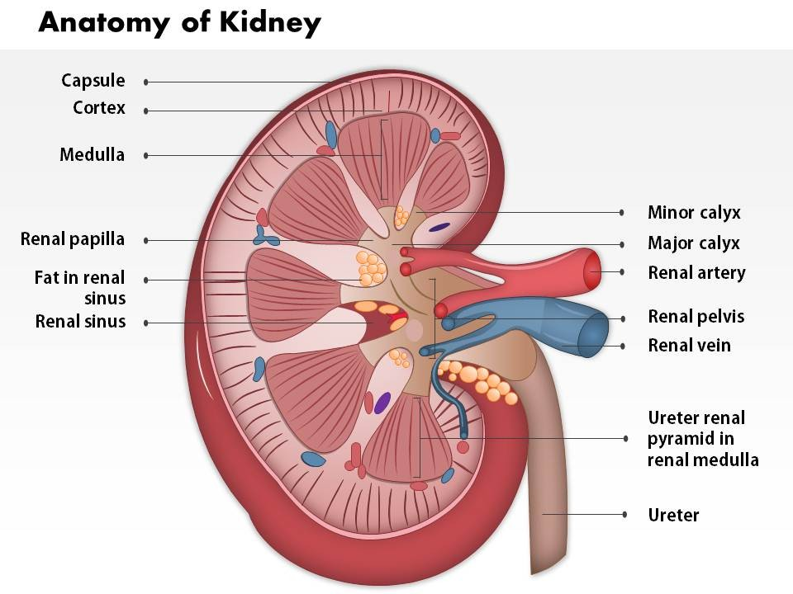
UROGENITAL SYSTEM -1
DEVELOPMENT
DR. PRAVEEN KURREY
M.B.B.S., M.S. BCME, BCBR ASSOCIATE PROFESSOR
DEPT.OF ANATOMY PT.JNMMC RAIPUR

Slide 2
Develops from 2 sources –
1 . Endodermal Cloaca
2. Mesodermal Intermediate cell mass

Slide 3
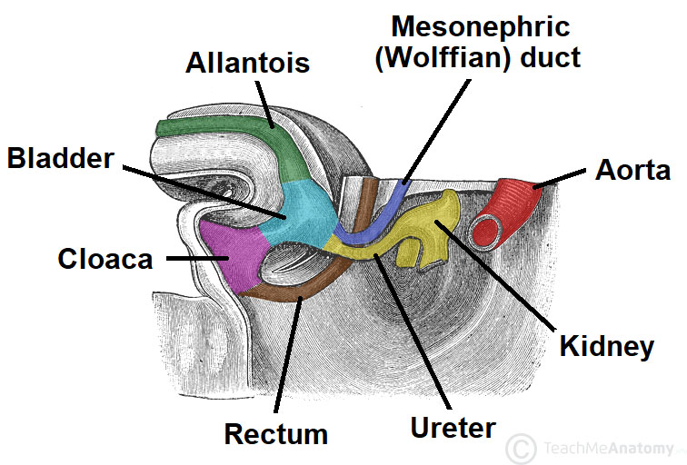

Slide 4
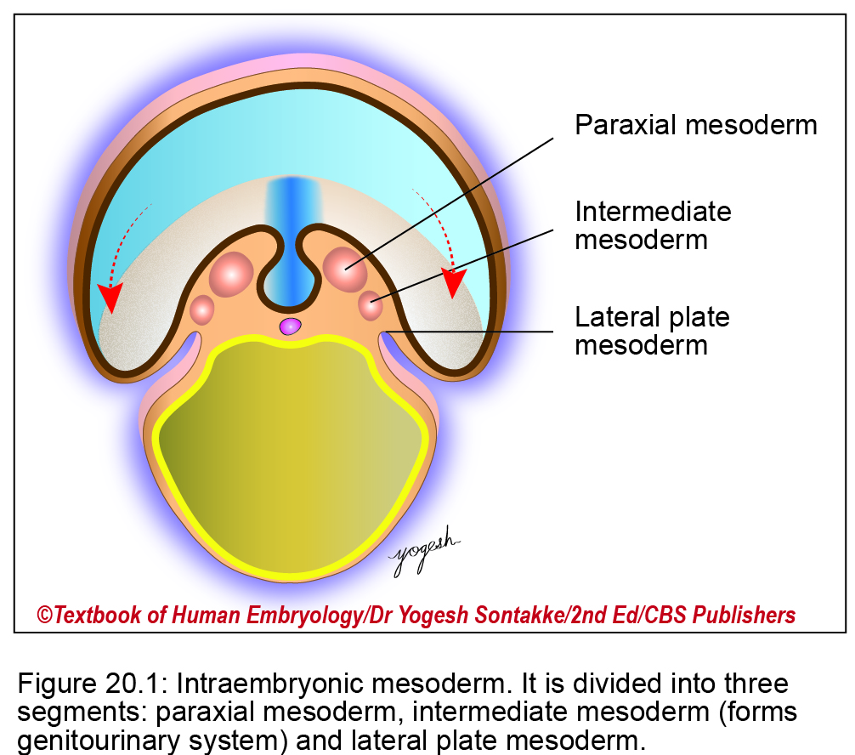

Slide 5
A. cLOACA
– Post allantoic dilated part of Hind gut
By Urorectal septum cloaca is divided intotwo parts
1. Primitive urogenital sinus
2. Primitive rectum
Initially these two are connected by Cloacal duct

Slide 6
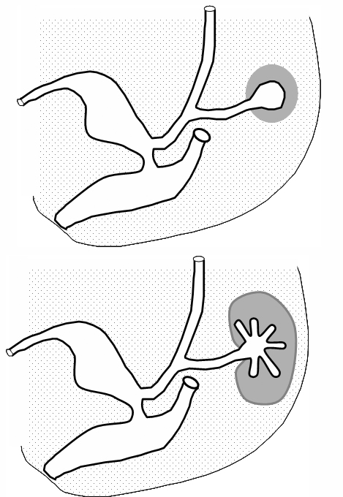
Metanephric blastema
VUC
Ureteric bud
DUGS
Primitive Rectum

Slide 7
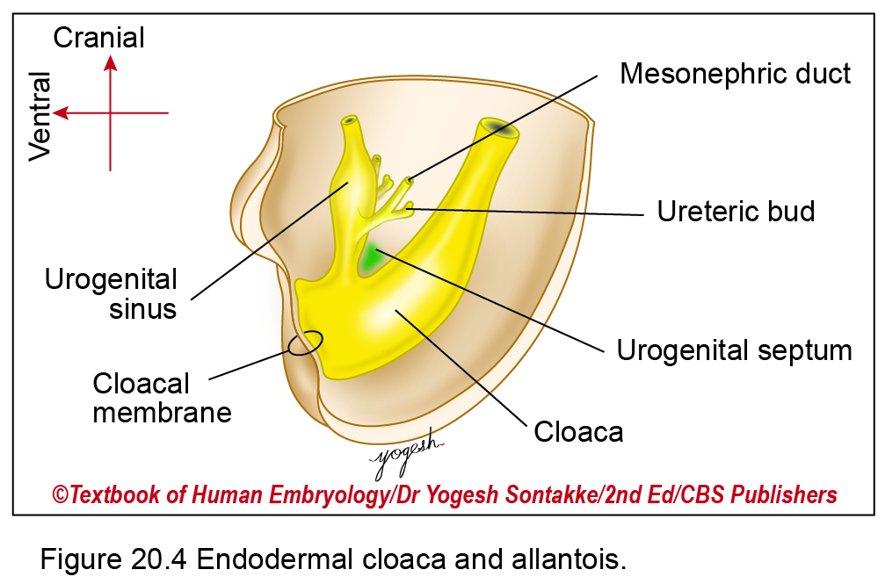

Slide 8
2. Primitive urogenital sinus – divided into two
Cranial – vesicourethral canal (VUC)
Caudal – Definitive urogenital sinus (DUGS)
3. In the junction of these two there is opening of Mesonephric duct which give rise to Ureteric bud.
4. Part of mesonephric duct caudal to opening of ureteric bud is called Common excretory duct.

Slide 9
5. Vesicourethral canal is divided into two –
a) Urinary bladder
b) Primitive urethra
6. Definitive urogenital sinus is divided into –
a) Pelvic pat
b) Phallic part

Slide 10
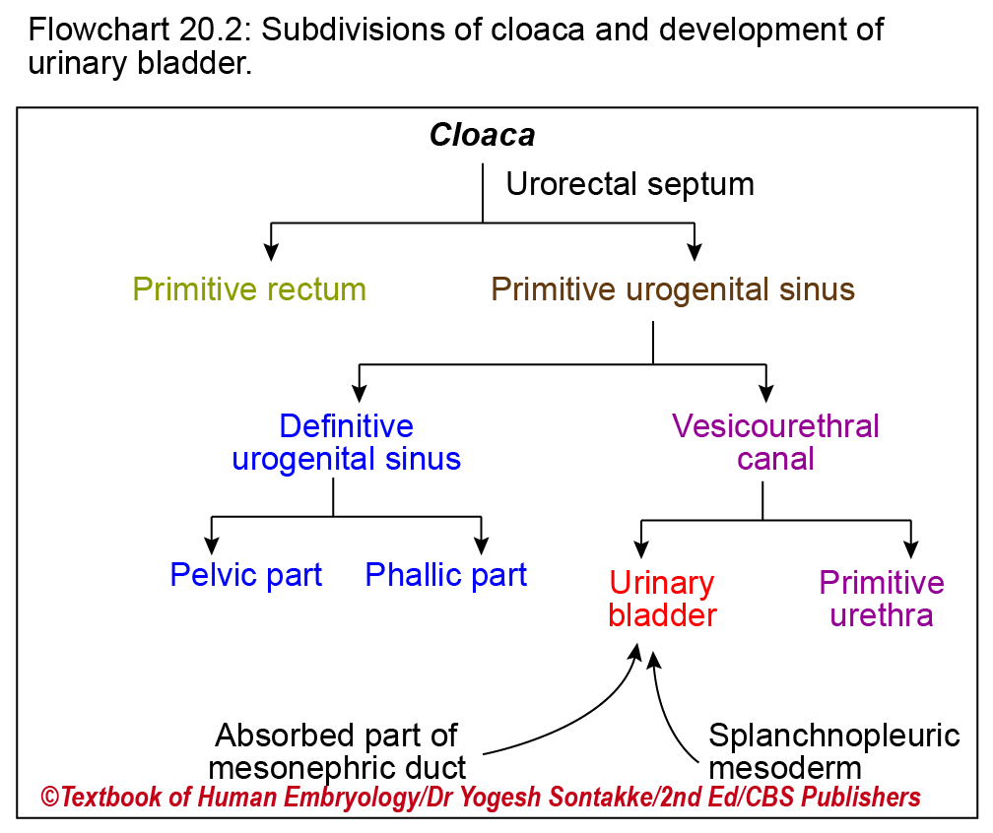

Slide 11
MESODERMAL INTERMEDIATE CELL MASS
Intermediate mesoderm forms bulging urogenital ridge on dorsal body wall just lateral to attachment of dorsal mesentery

Slide 12
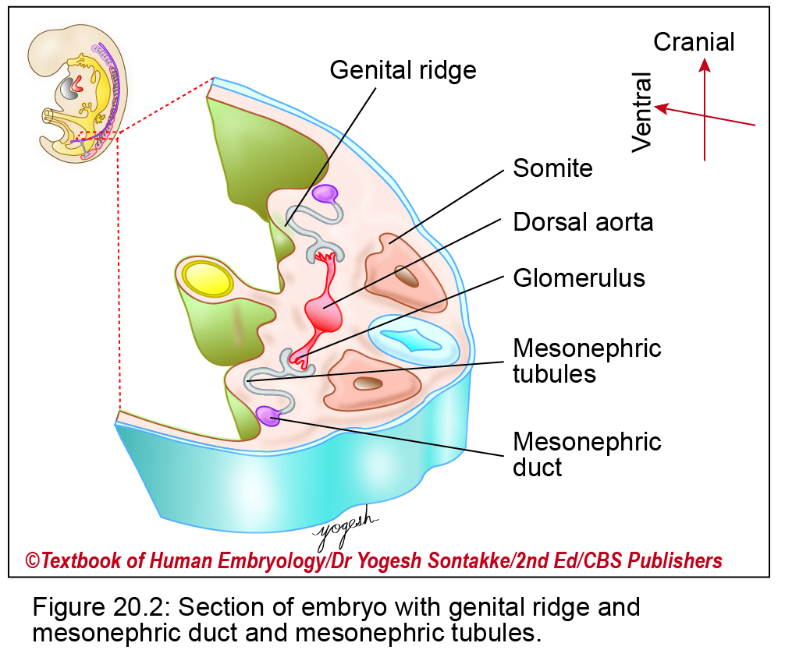
INTRODUCTION
• Urogenital ridge - two parts: Medial genital ridge and lateral nephrogenic cord.
Nephrogenic cord
  Extends from cervical to sacral segments of embryo.
  • Passes
  through pronephric, mesonephric and metanephric phases

Slide 13
B. MESODERMAL INTERMEDIATE CELL MASS
Develops into – a) Nephric system
b). Sex glands
1. In upper part it get segmented. Each segment is called Nephrotome.
2. Lower unsegmented part is called Nephrogenic cord.
3. In each Nephrotome there develops lumen , so Nephric tubule is formed.
4. In one end of nephric tubule there develops Glomerulus, in other end descend down , unite with succeeding tubule , forming Nephric duct ,which later becomes Mesonephric duct.
5. Lateral to MND ,in female there develops Paramesonephric duct (PMND)
6. Gonads are also formed.

Slide 14
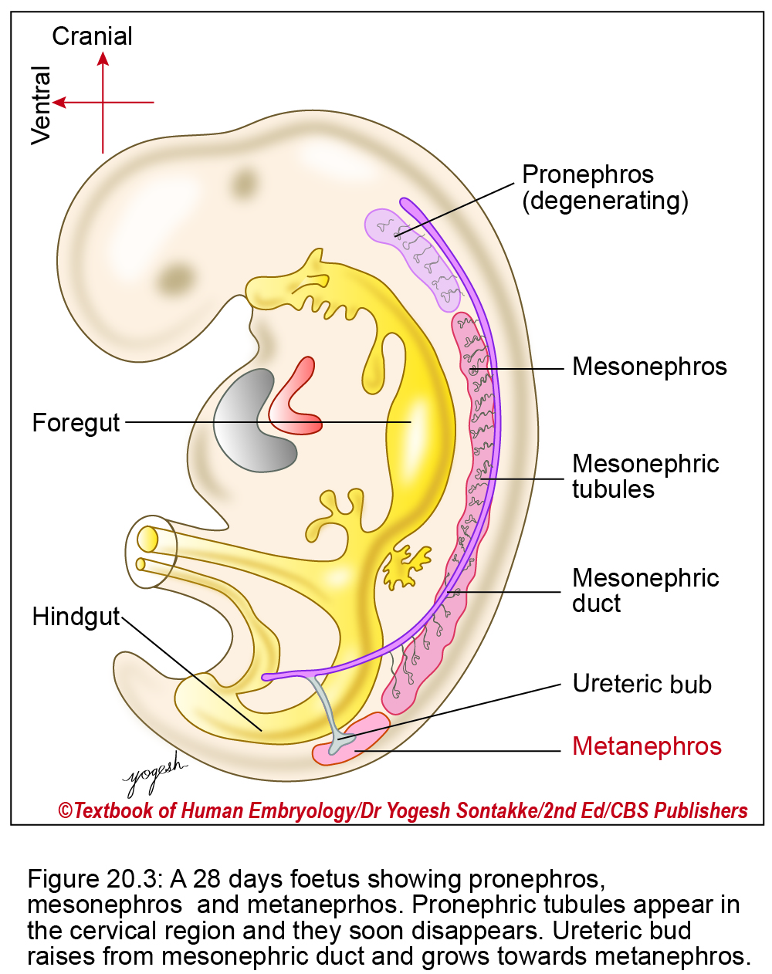

Slide 15
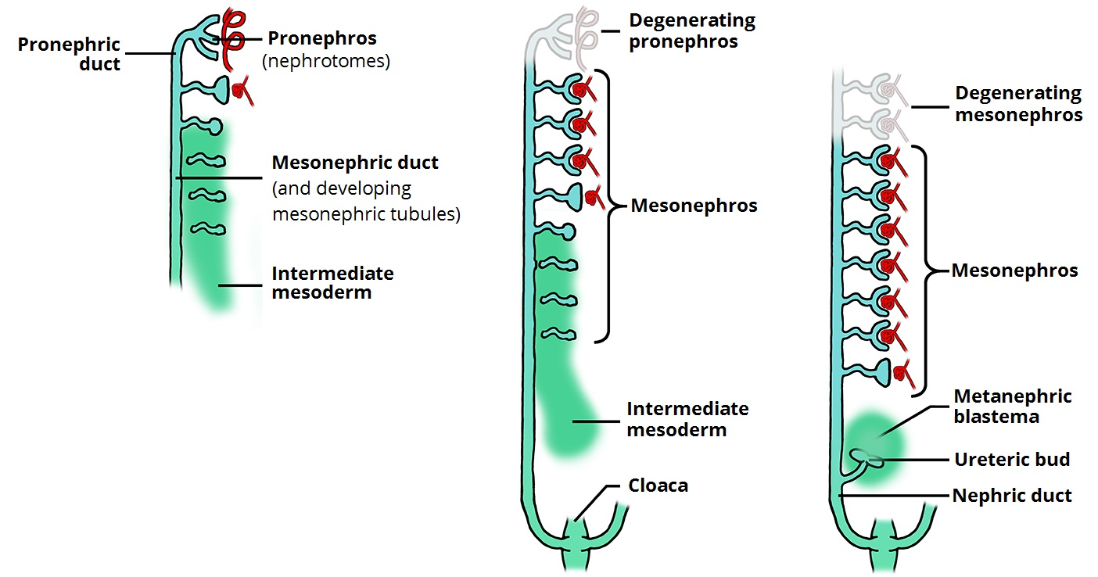

Slide 16
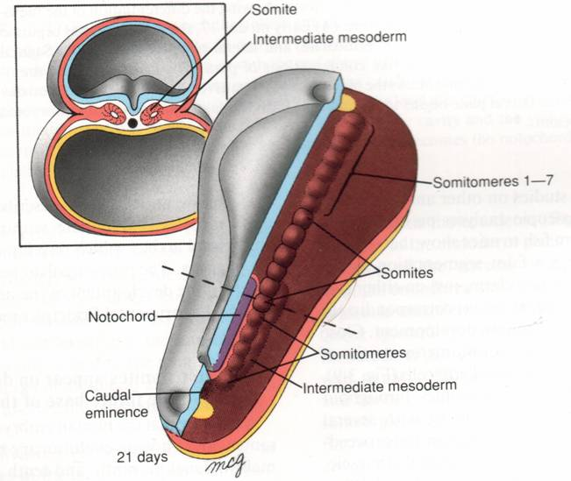
INTERMEDIATE MESODERM
Mesoderm appears in the 3 week embryo
  Paraxial = somites
  Intermediate
  Lateral plate
    Two layers separated by the Coelome
Intermediate mesoderm gives rise to “Paired Glands” (Kidneys, Adrenals and Gonads)

Slide 17
Overview of organogenesis of the urogenital organs
Cr.
    Urinary and reproductive systems are closely associated in topography,function and development.
    Two systems have common origin from the urogenital ridge(UGR) and have homologous structures.
    Internal genital duct system is derived from the foetal urinary system.
    Malformation of one system affects the other.
    The UGR is longitudinal swelling in dorsolateral side of the abdomen
    UGR--> formed mostly from
--non-segmented intermediate mesoderm
    Lateral UGR(nephrogenic plate) forms urinary organs and internal genital ducts.
    Ventromedial UGR is genital ridge, forms gonads.
V
D
Ca.
Gonad
Mesonephros
(nephrogenic
Plate)
(genital ridge)
Mesonephric
Duct
Paramesonephric
duct
The Urogenital ridge

Slide 18
From this partially segmented and partially unsegmented intermediate cell mass, 3 slightly overlapping Kidney is formed in intrauterine life in man in craniocaudal direction. They are –
1. Pronephros
2. Mesonephros (These two are transitory kidney in man)
3. Metanephros (Forms permanent kidney in man)
Each kidney has number of tubules and ducts.

Slide 19
PRONEPHRIC (Cervical kidney) – Develops in cervical region.It consist of nephric tubule which disappear , and nephric duct which persist. In man only nephric duct persist,while in Fish it is functioning kidney.
MESONEPHRIC (Thoracolumbar kidney) –
Develops in thoracolumbar region
Mesonephric tubule opens into nephric duct which is now known as mesonephric duct.
These two changes its liability from urinary system to genital system and forms duct system in testis. So misdirected attempt to form kidney. This is permanent kidney in Amphibians.
METANEPHRIC (Sacral kidney) –
Develops in sacral region.
It forms permanent kidney in amniotes including man.

Slide 20
The nephrogenic plate differentiates in a rostral to caudal direction and bilaterally. The three nephric systems appear in recapitulating sequence during development.
Progression
in time
Vestigial
Pronephros
(functional in lower fishes)
Developing
Gastrointestinal
tract
Mesonephric
Tubules(higher fishes and
Amphibians)
Segmented
intermediate
mesoderm
(mesonephros)
Mesonephric
duct
Unsegmented
intermediate
mesoderm
(mesonephros)
Ureteric
bud
Unsegmented
intermediate
mesoderm
(metanephros)
Reptiles,birds,mammals

Slide 21
Development Of Kidney
0
3 embryonic kidneys (from intermediate mesoderm)-
  Pronephros- transient (week 3-5), nonfunctional, 5-7 paired segments.
  Mesonephros- transient (week 4- month 4), excretory organ while metanephros begins development. Form renal corpuscles.
    Formation of nephric ducts/wolffian ducts (controlled by Pax2, Lim 1) precedes development of mesonephric tubules.
    Small number of elements from mesonephros persist to form reproductive tract.
      Males- efferent ductules of testes, epididymis and vas- wolfian origin.
      Females- nonfunctional mesosalpingeal structures.

Slide 22
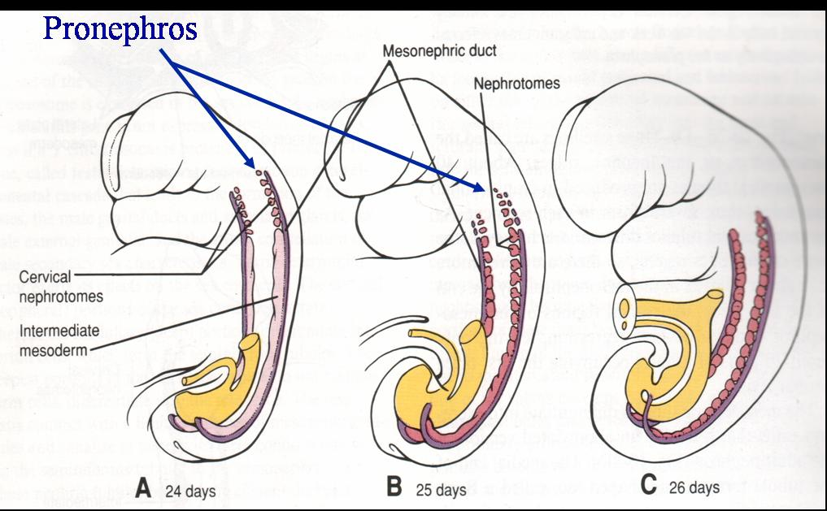
Pronephros – in humans
Appears at Day 21
In segmented intermediate mesoderm in the cervical region
It degenerates by day 24
It is never functional in humans

Slide 23
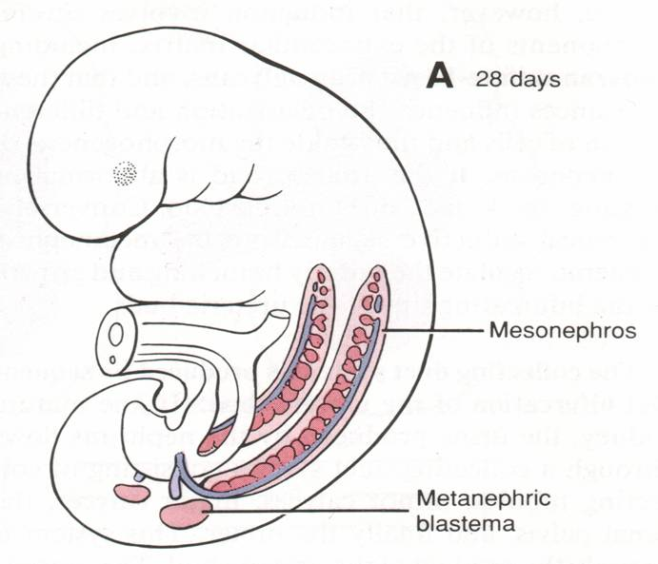
Mesonephros - in humans
The Mesonephros first appears early in week 4
In thoracic and lumbar segments of intermediate mesoderm.
Urine is produced and drains along the mesonephric (Wolfian) duct to the cloaca/bladder
In week 5 the thoracic segments regress but the mesonephric kidney continues functioning until week 10

Slide 24
Sequence of development of the metanephros(1)
Metanephrogenic
mass
Mesonephric duct
Metanephros develops at somites 26-28 from 2 precursors
--> Ureteric bud(UB)
Metanephric Blastema (MB)
Formation UB and MB is by reciprocal inductive interactions between the tissues.
The diverticulum forms caudal of the existing mesonephric duct and grows and into the MB at the nephrogenic plate
UB forms the duct system
MB forms nephrons
The ureteric bud branches as it grows towards the metanephrogenic mass(B)
A
Urachus
Bladder
Int.mesoderm
Ureteric bud
Collecting ducts
Metanephros
Ureter
B

Slide 25
Morphogenesis of the ureteric bud2)
Kidney of dog
The ureteric bud forms the duct system
The metanephric Blastema forms the nephrons by nephrogenesis.
Dichotomous branching pattern of the ureteric bud is species specific.
cortex
medulla
renal pelvis
collecting
duct
ureter
collecting duct
cortex
minor calyx
ureter
major calyx
medulla
Kidney of ox

Slide 26
DEVELOPMENT OF KIDNEY
Formation
Ascent
Rotation
Shaping of kidney

Slide 27
A. Formation : Metanephric kidney develops in lumbosacral region.
Kidney develops from –
1. Collecting Part – Ureteric bud (Arise fom caudal aspect of Mesonephric duct MND)
Pelvis of ureter
Major calyx
Minor Calyx
Collecting tubules

Slide 28
2. Excretory part – Metanephric blastema (Derived from lower part of Nephrogenic cord)
Bowman’s capsule
Proxymal convulated tubule
Loop of Henle
Distal convulated tubule

Slide 29
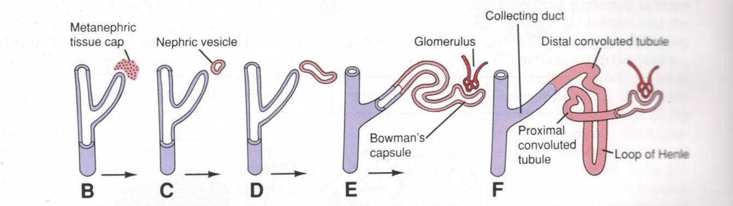

Slide 30
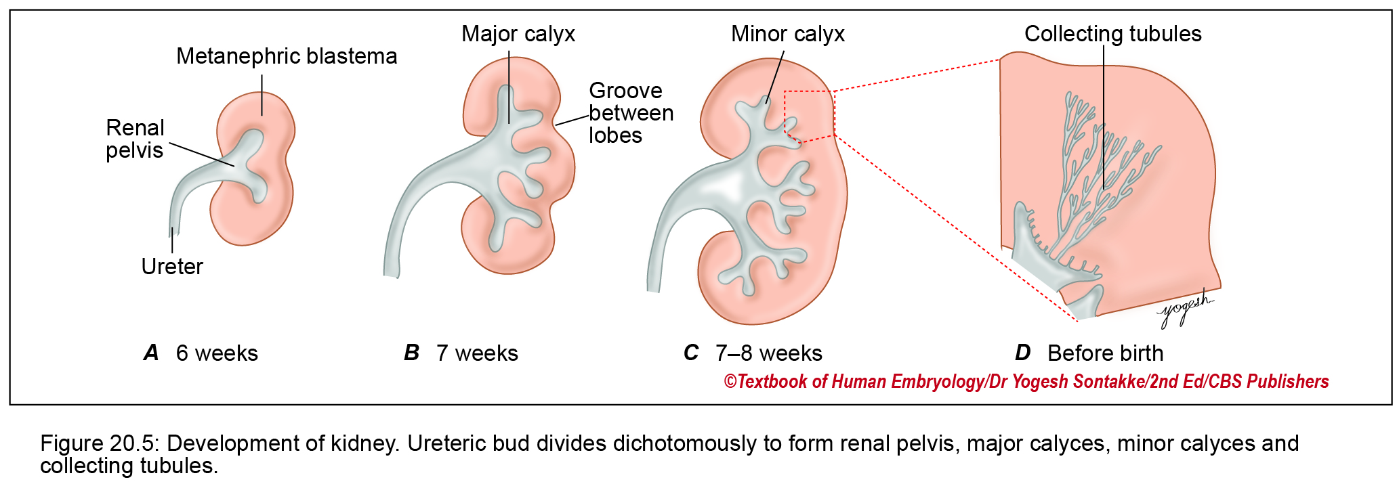

Slide 31
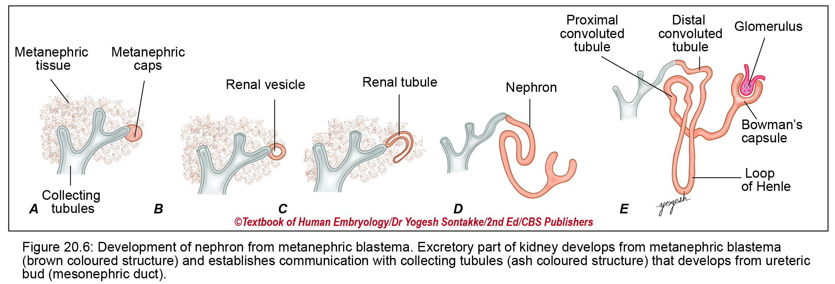

Slide 32
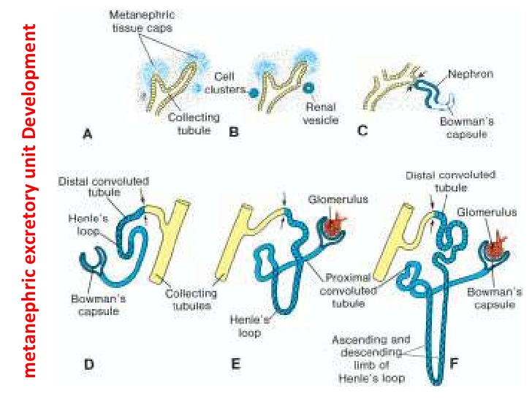

Slide 33
B. Ascent Of Kidney :
Initially kidney lie in front of sacrum. From here it ascends up to the adult position ie. Lumbar region in 9th week.
Factors responsible for ascent –
Continuous lengthening of ureteric bud
Diminution of fetal curvature
Pelvic cavity not suits for its growth so pelvic viscera displaces kidney upwards
It ascends in search of better nutrition

Slide 34
Ascent of the Kidneys
In the 6th week the kidneys begin to ascend from the sacral region to their position in the upper abdomen.
The metanephric ducts elongate and become the ureters.
As the kidney ascends it receives new segmental arteries from the aorta and loses those vessels below (“climbing a ladder”). Thus sometimes there is more than one renal artery.
Sometimes one kidney fails to ascend => pelvic kidney
Sometimes the left and right kidneys become attached in the pelvis then the horseshoe kidney can’t ascend above the inferior mesenteric artery

Slide 35
3. Rotation of Kidney : Initially hilum of kiney is directed ventrally. After rotation hilum is directed medially.
4. Shaping of kidney : Embryonic kidney is lobulated as parenchyma is not completely formed.At infancy parenchyma is completely formed gives smooth appearance of fetal kidney.

Slide 37
Anomalies related to development of kidney
1. Renal agenesis – Kidney may be absent at one side or both side. It give rise to Olighydramnios (SALL-1, PAX-2, EYA-1 Genes involved).
2. Renal hypoplasia – Underdeveloped kidney
3. Renal hyperplasia – Overdeveloped kidney
Anomalies in position –
Faulty ascent – Sacral, Lower lumbar, Thoracic kidney
Both kidney lie on one side
Both kidney displaces towards opposite side. It is indicated by Crossing of ureters.

Slide 38
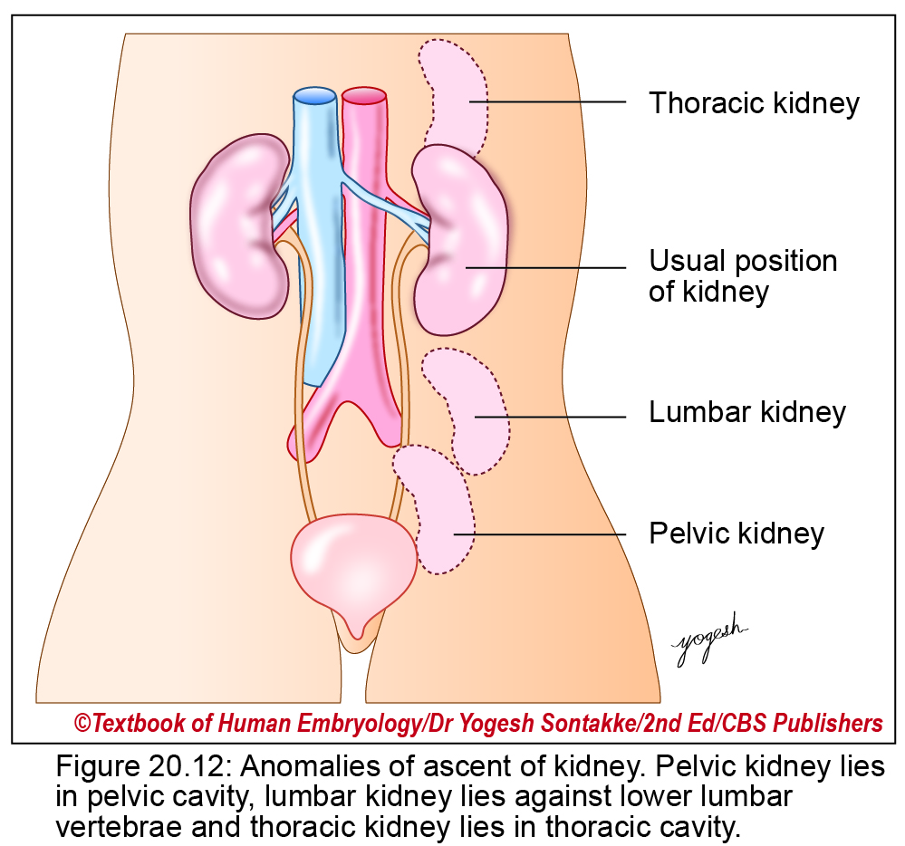
Anomalies of ascent of kidney
– Pelvic kidney: Kidney lies in pelvic cavity.
– Lower lumbar kidneys: Kidney lies against lower lumbar vertebrae.
– Thoracic kidneys: Abnormally high ascent of kidneys in thoracic cavity.

Slide 39
Malrotation of kidney – Hilum of kidney may be on ventral or lateral side
Anomalies in shape –
Lobulated kidney
Horseshoe shaped kidney – Two sides of kidney are fused at lower pole by isthmus.
Fusion at upper pole of kidney
Pancake kidney – Excessive fusion
Floating kidney – Suspended from posterior bodywall by folds of peritoneum.

Slide 40
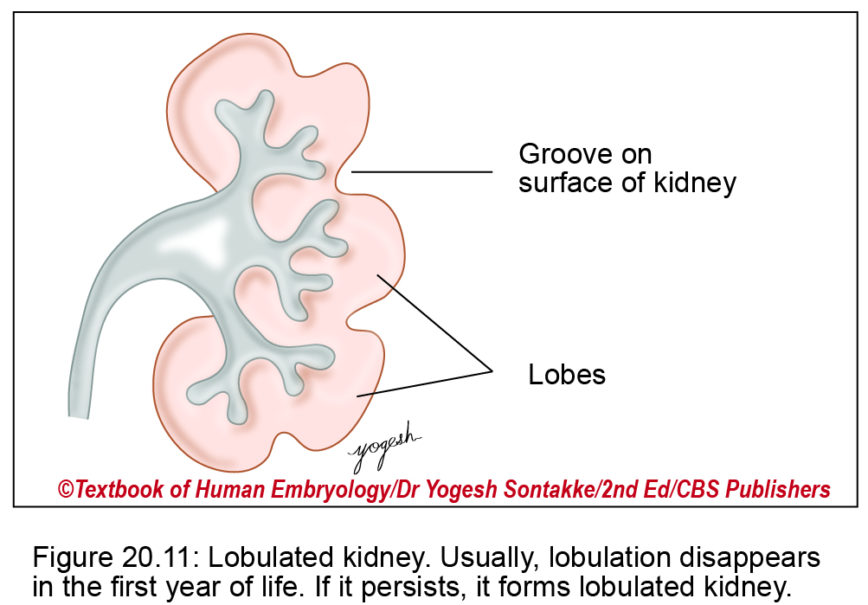
Congenital Anomalies of Kidney

Slide 41
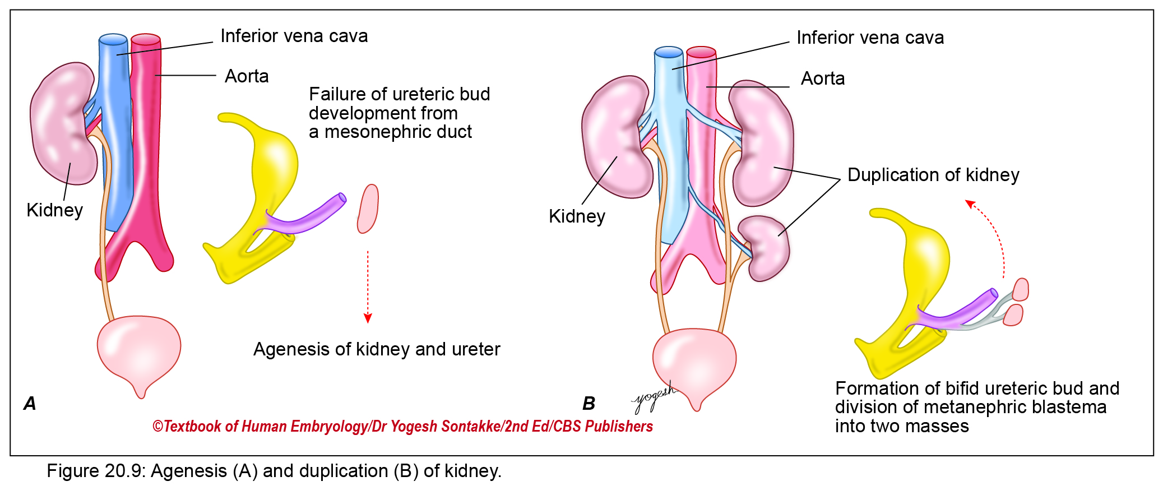
Congenital Anomalies of Kidney

Slide 42
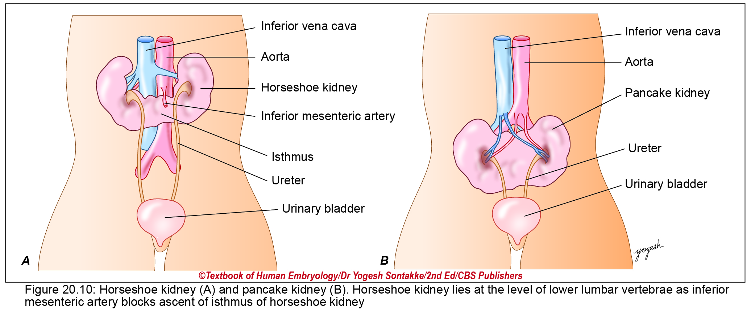
Congenital Anomalies of Kidney

Slide 43
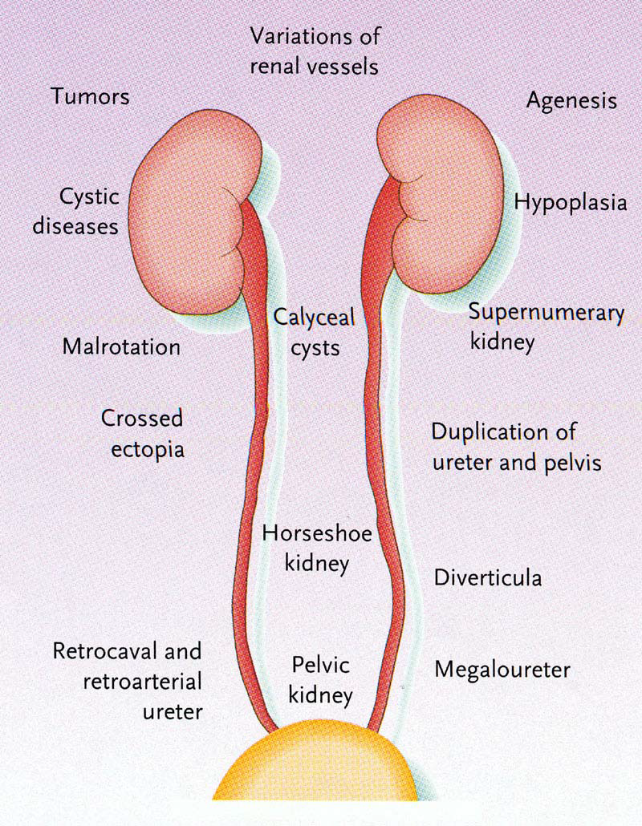

Slide 44
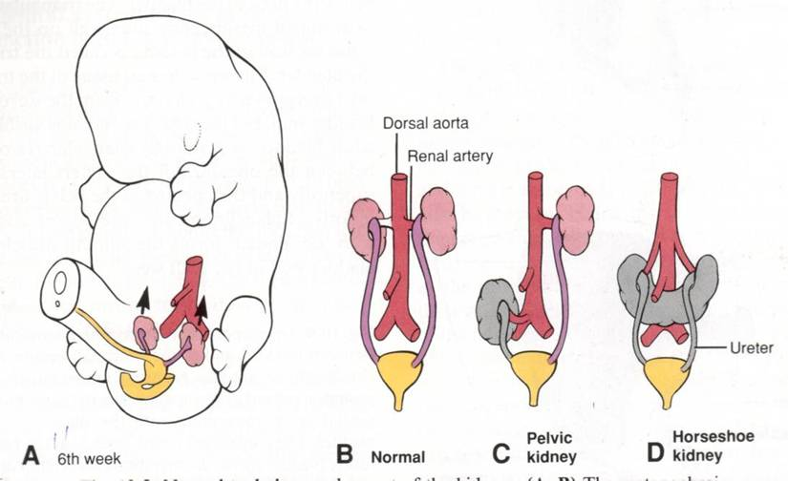
Anomales of Kidneys

Slide 45
POLYCYSTIC KIDNEY – Cyst like formation or wide dilation of Nephron, PCT, DCT or Collecting tubule.
2 types are-
Adult Congenital
1. More common 1:500 Less common 1:5000
2. Defect lies in nephron PCT , DCT Defect lies in Collecting tubule
3. Not causes renal failure Causes renal failure
4. Genes located on short Genes on 6 chromoome
Arm of 16p chromosome

Slide 46
Thank You

Slide 47
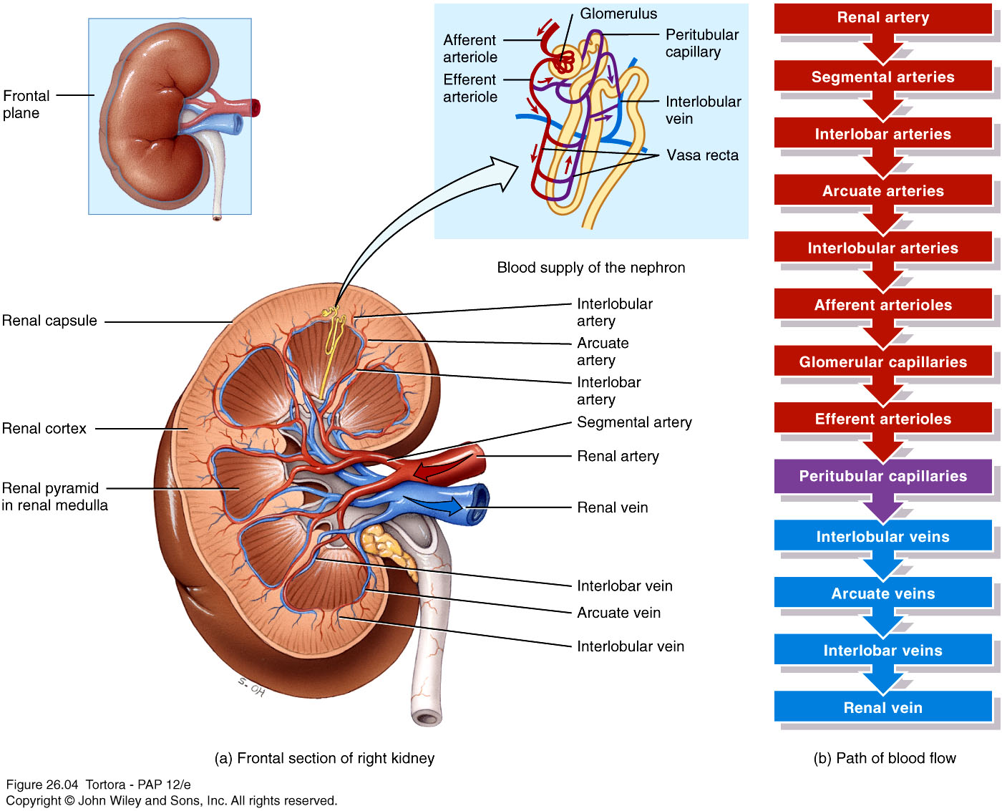
Blood supply of the kidneys

Slide 48
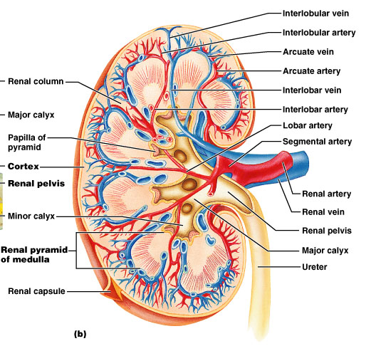
Internal Anatomy of the Kidneys
Interlobar artery
Figure 23.3b

Slide 49
Path of Blood Through Kidney
Renal artery
  → interlobar arteries (up renal columns, between lobes)
  → arcuate arteries (over pyramids)
  → interlobular arteries (up into cortex)
  → afferent arterioles
  → glomerulus (cluster of capillaries)
  → efferent arterioles (near medulla → vasa recta)
  → peritubular capillaries
  → interlobular veins → arcuate veins → interlobar veins
Renal vein

Slide 50
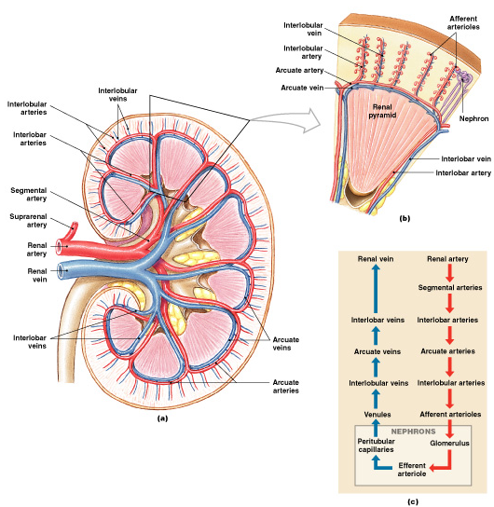

Slide 51
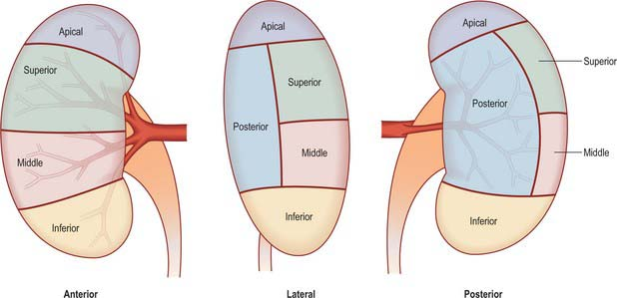
VASCULAR SEGMENTS

Slide 52
URINARY BLADDER
Epithelium
Most of UB except Trigone – Cranial part of Vesico urethral canal – Endodermal
Epithelium of Trigone —Absorbed part of Meso nephic duct MND (Common excretory duct) -- Mesodermal
Apex of UB – Allantois (Urachus - Medial umbilical ligament)
Musculature – Splanchnopleuric mesoderm surrounding Cloaca
Note: Allantois attaches apex of urinary bladder to umbilicus .
Proximal part contribute in formation of apex of bladder
Distal part obliterate to form urachus which after birth forms Median umbilical ligament.

Slide 53
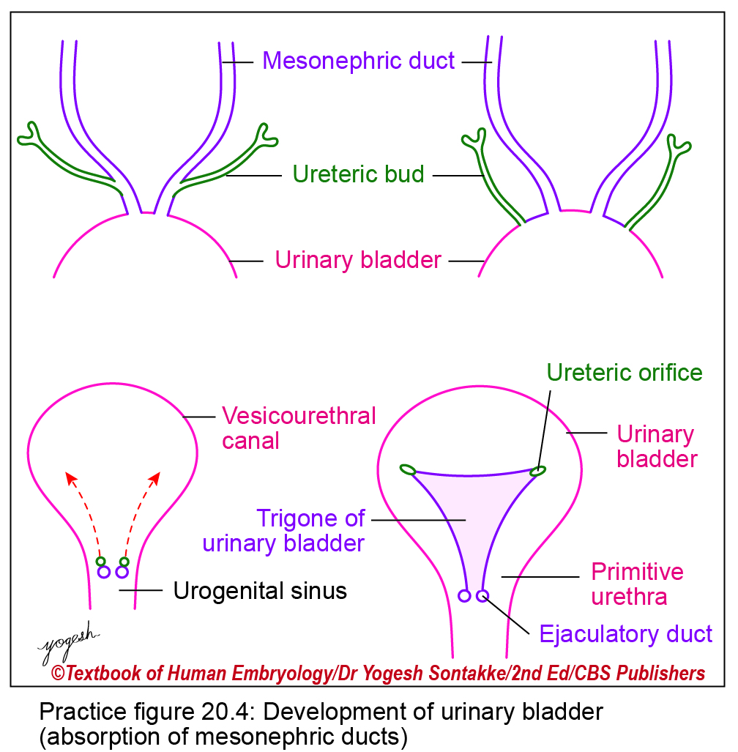

Slide 55
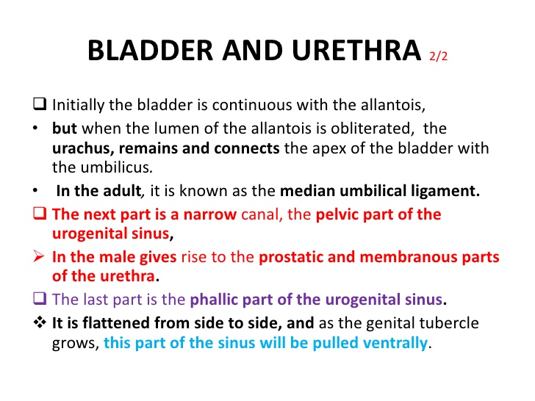

Slide 56
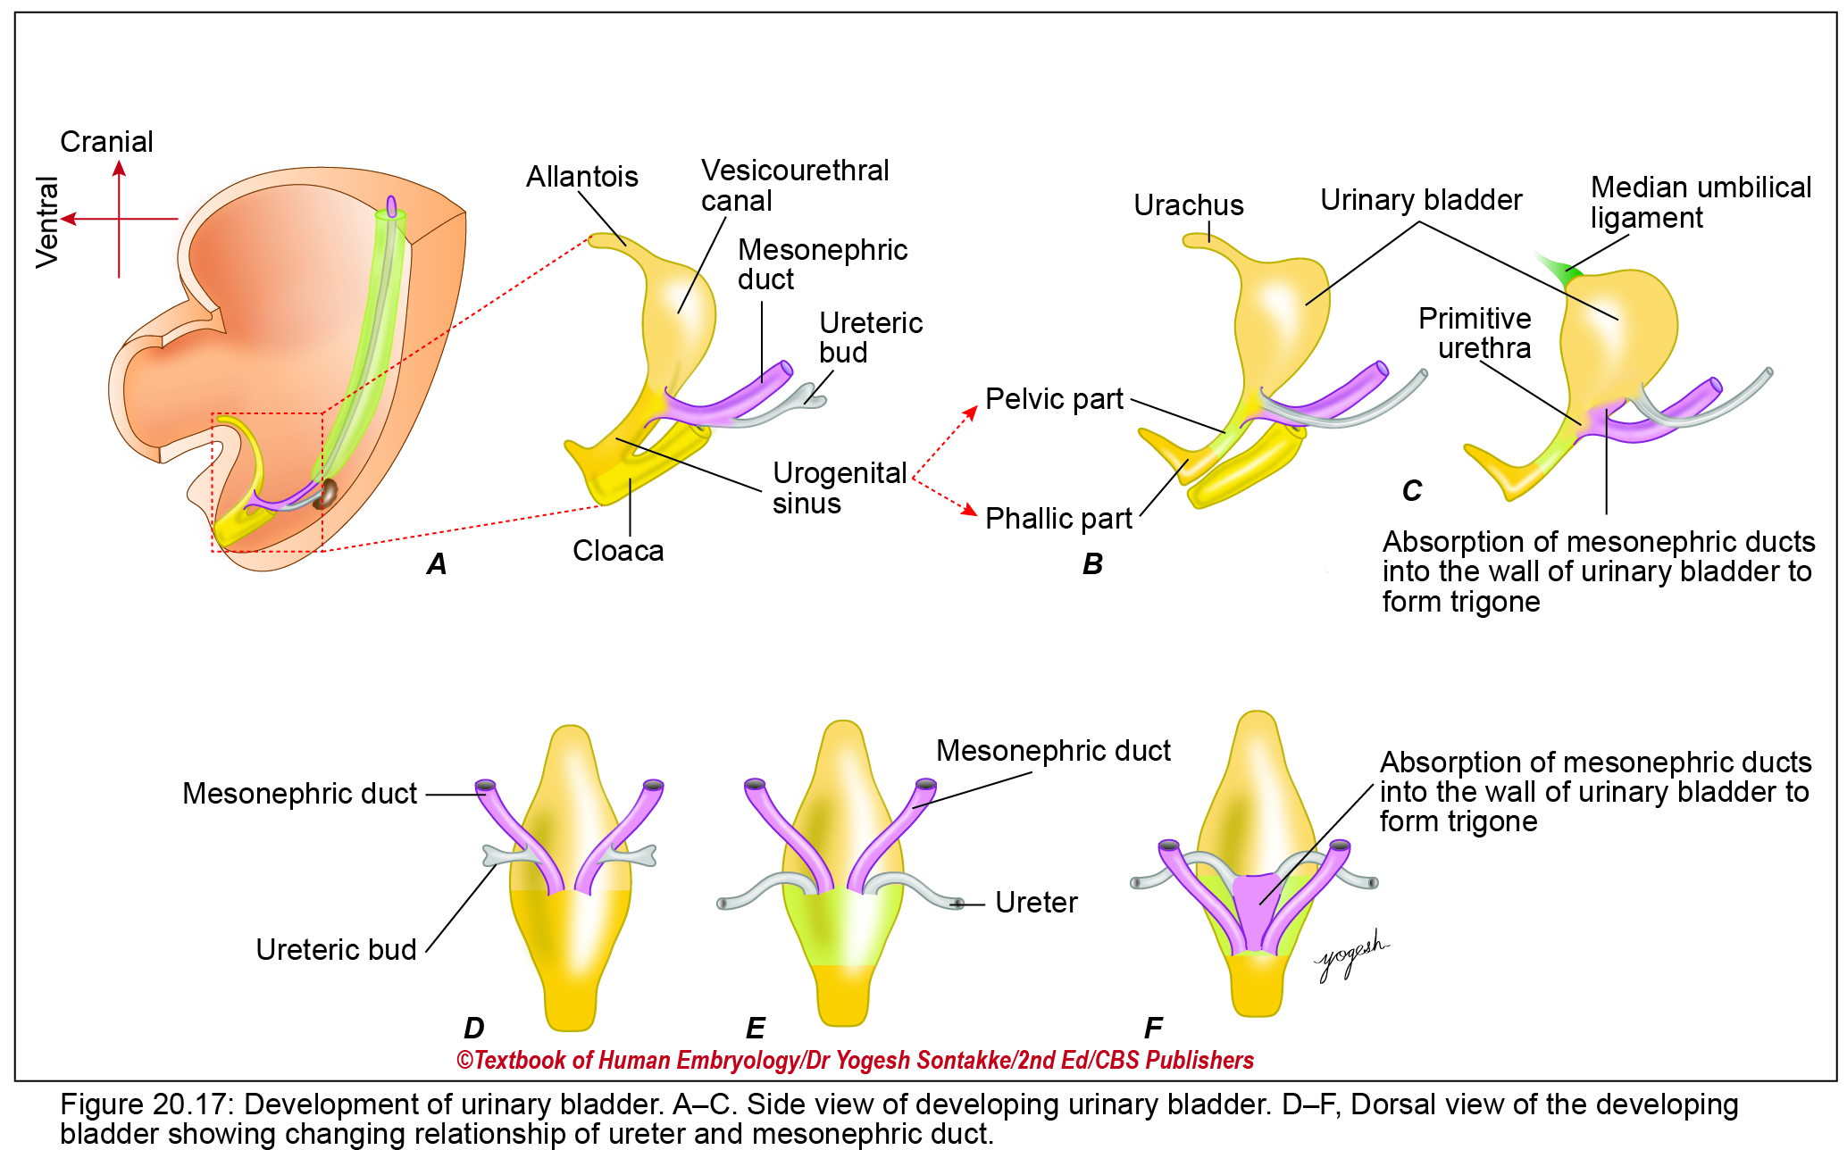

Slide 57
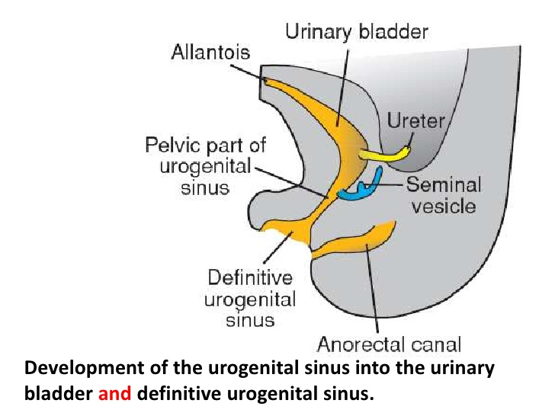

Slide 59
Anomalies
Remnants of urachus-
Urachal fistula – Total patency of lumen of urachus .Urine come out from umbilicus .
Urachal diverticulum –Proximal part of urachus is patent
Urachal cyst – Middle part of urachus is patent
Urachal sinus – Distal part of urachus is patent
Ectopia vesicae – Infraumbilical part of anterior abdominal wall and anterior wall of urinary bladder is not developed. So cavity of bladder is exposed to exterior.

Slide 60
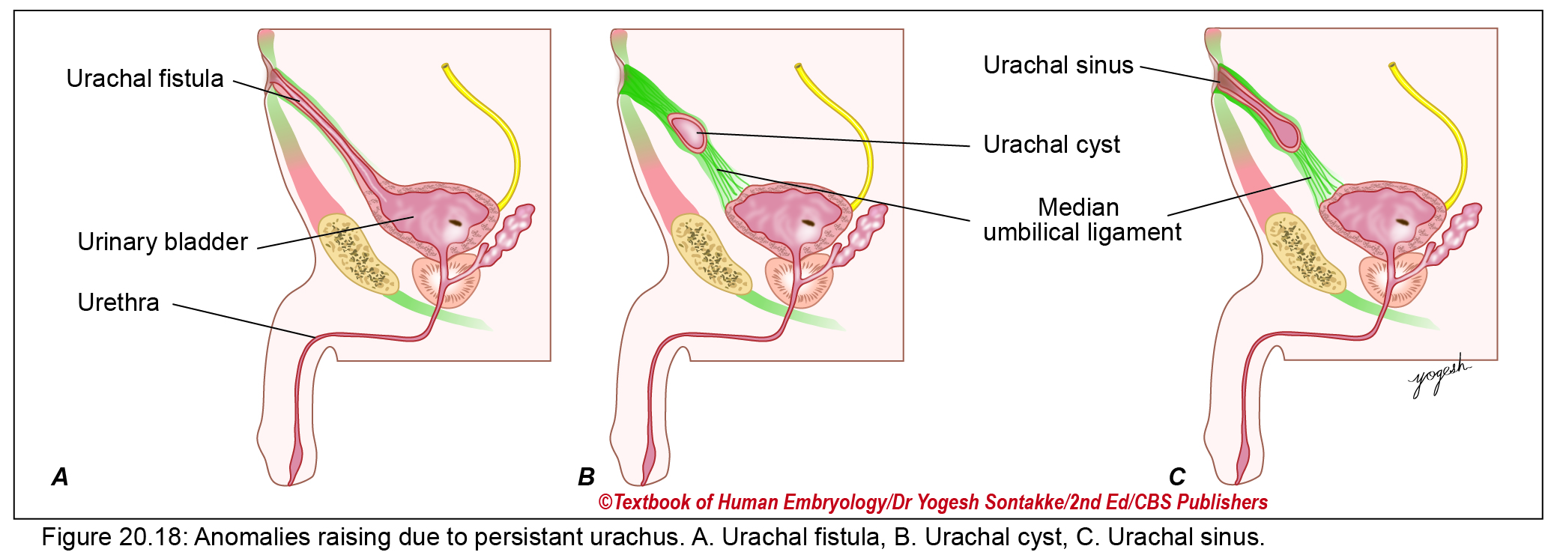

Slide 61
Ectopia vesicae
• It is also called extrophy of urinary bladder.
• Abnormality:
– Deficient midline infraumbilical part of anterior abdominal wall
– Deficient anterior wall of urinary bladder
– Interior of bladder exposed
– Urine dribbles from exposed bladder
• Embryological basis:
  – Failure of complete formation of lateral fold of embryo.
  – Failure of migration of mesoderm in lateral folds.
• Incidence: 1:10,000 births.
• Constant association: Ectopia vesicae is always associated with epispadias.

Slide 62
: Bladder exstrophy (ectopia vesicae) is a congenital anomaly that includes exstrophy and epispadias with protrusion of the urinary bladder through a defect in the anterior abdominal wall.
In this condition, posterior wall of the bladder is seen externally just below the umbilicus.
Incidence is 1:10,000–50,000 live births with male preponderance (3:1)

Slide 63
MALE URETHRA
Upper prostatic part –
. Caudal part of Vesico urethral canal except
. Posterior wall - Absorbed part of Mesonephic duct MND (CED)
Lower postatic part + Membranus urethra – Pelvic part of (UGS) Urogenital sinus
Penile urethra except terminal part – Phallic part of (UGS) Urogenital sinus through urethral plate
Terminal part – Ectodermal indipping of cells from glans

Slide 64
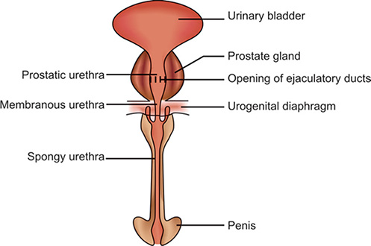

Slide 65
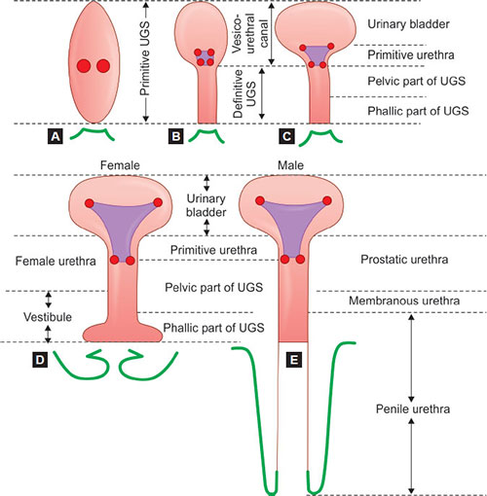

Slide 66
Anomalies:
Hypospadios – Urethra opens in ventral or undersurface of penis instead of tip of glans.It has 4 types –
Balanic
Penile
Penoscrotal
Perineal

Slide 67
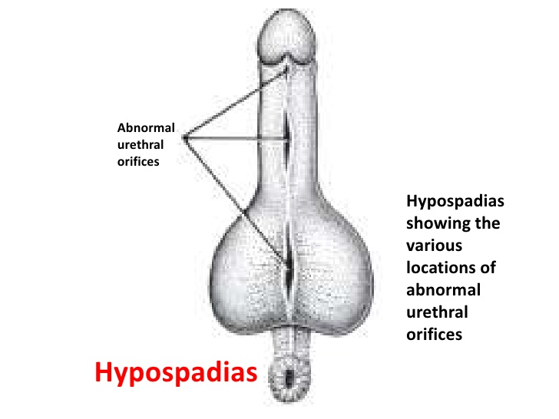

Slide 68
FEMALE URETHRA
Similar with –
Upper prostatic part of male urethra
SOURCES --
1. Caudal part of Vesicourethral vanal
2. Absorbed part of Mesonephric duct (CED)
3. Contribution from pelvic part of Urogenital sinus

Slide 69
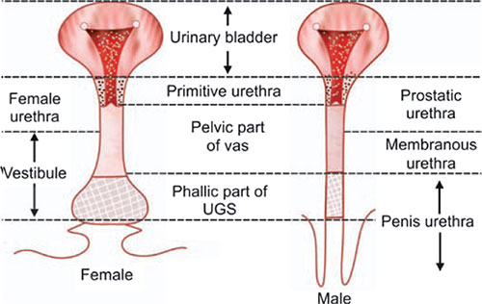

Slide 70
Development of Prostate
Parenchyma -- Develops from buds arising from developing prostate in 6th week of intrauterine life.
Caudal part of vesicourethral canal
Pelvic part of urogenital sinus
This two forms outer glandular zone of prostate which is common site of carcinoma.
From absorbed part of mesonephric duct form inner glandular zone where BPH is common

Slide 71
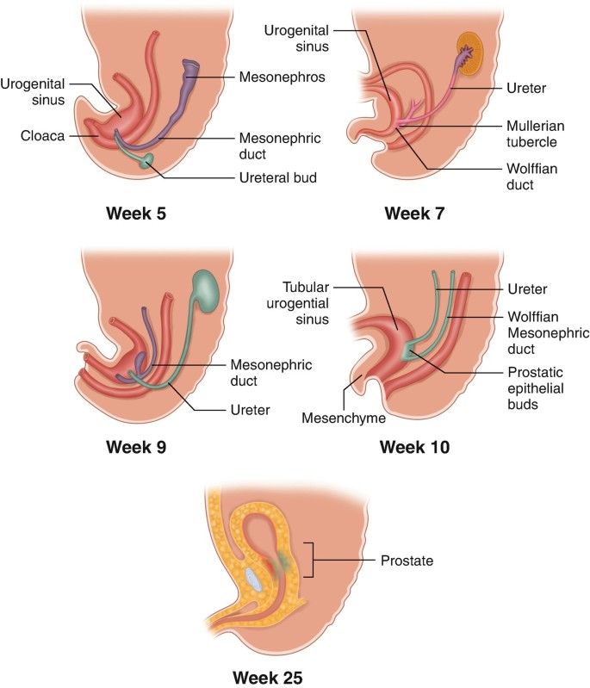

Slide 72
Stroma – Surrounding mesoderm form connective tissue.
Bud arising from developing prostatic urethra arranged in 5 groups –
Anterior b) Posterior c) Middle d) 2 lateral

Slide 74
Female homologous of Prostate
Bud arising from caudal part of vesicourethral canal form Urethral gland.
Bud arising from pelvic part of urogenital sinus form Paraurethral gland.
Paraurethral gland of Skene

Slide 75
Questions for University Exam
Q1. Describe Kidney -- Relations of anterior and posterior surface, Coverings, Histology and Development .
Q2. Sources of development of urinary bladder.
Q3. Parts of urethra its development and clinical anatomy.
Q4. Describe prostate – Relations, Zones, Histology ,Age changes, Development and clinical anatomy.
Dr. Praveeen Kurrey

Slide 76
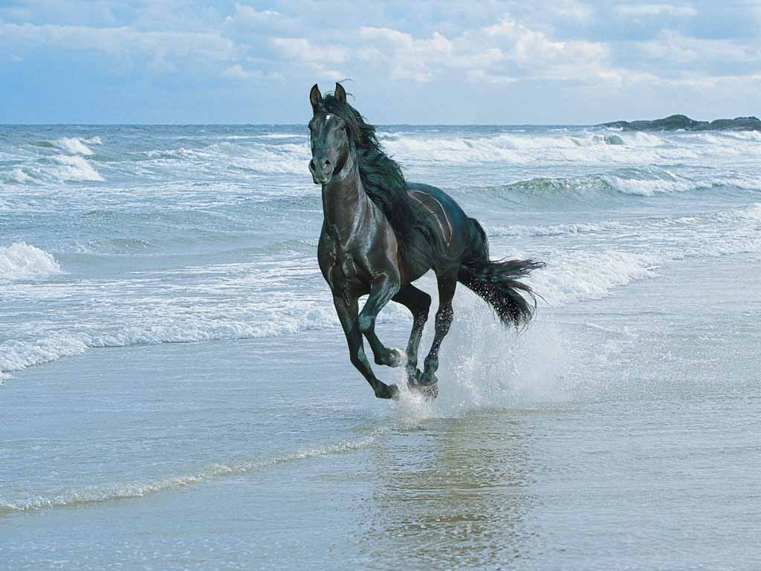
THANK YOU

