Slide 1
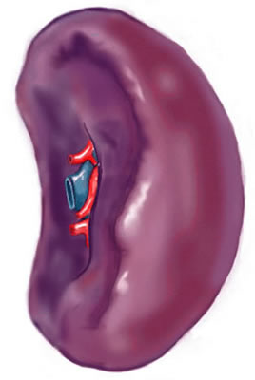
GROSS ANATOMY
SPLEEN
DR. PRAVEEN KUMAR KURREY MBBS, MS, BCME, BCBR, CISP
PROFESSOR ANATOMY

Slide 2
CONTENT
INTRODUCTION
LOCATION
DIMENSION
EXTERNAL FEATURES
RELATIONS
BLOOD SUPPLY
NERVE SUPPLY
LYMPHATIC DRAINAGE
DEVELOPMENT
APPLIED

Slide 3
INTRODUCTION
Spleen is a highly vascular, friable and elastic organ.
It is tetrahedral in shape.

Slide 4
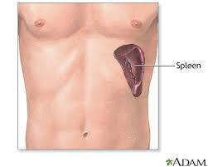
LOCATION
Lies mainly in left hypochondrium, and partly in the epigastrium region of the abdomen.

Slide 5
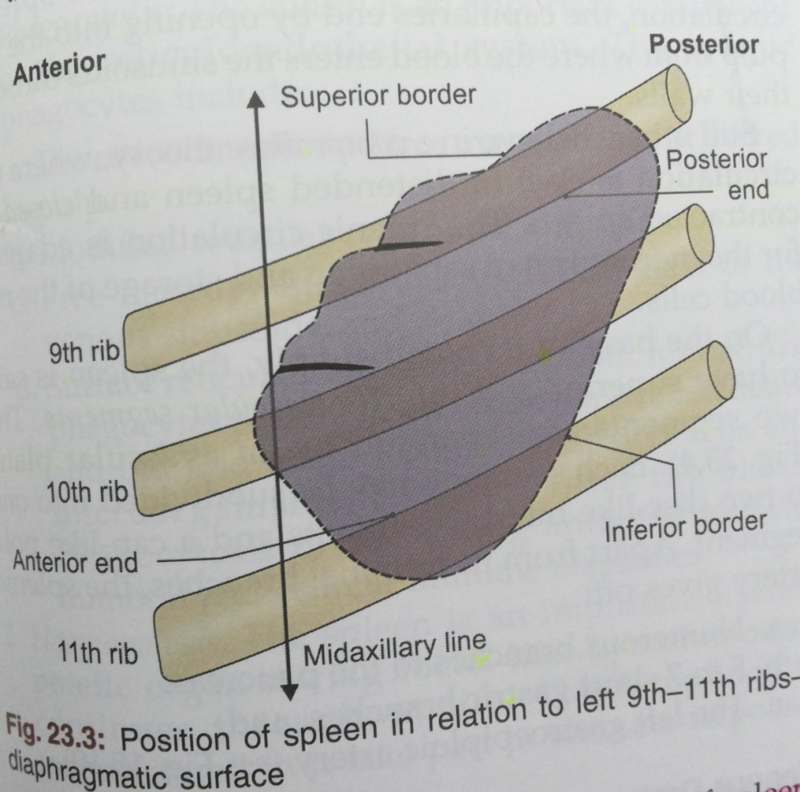
Position
The spleen lies obliquely along the long axis of 10th rib.

Slide 6
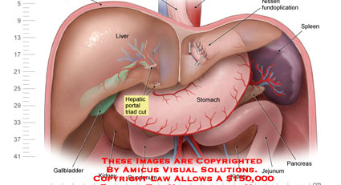
Spleen Is Wedged Between The Fundus Of Stomach And The Diaphragm.

Slide 7
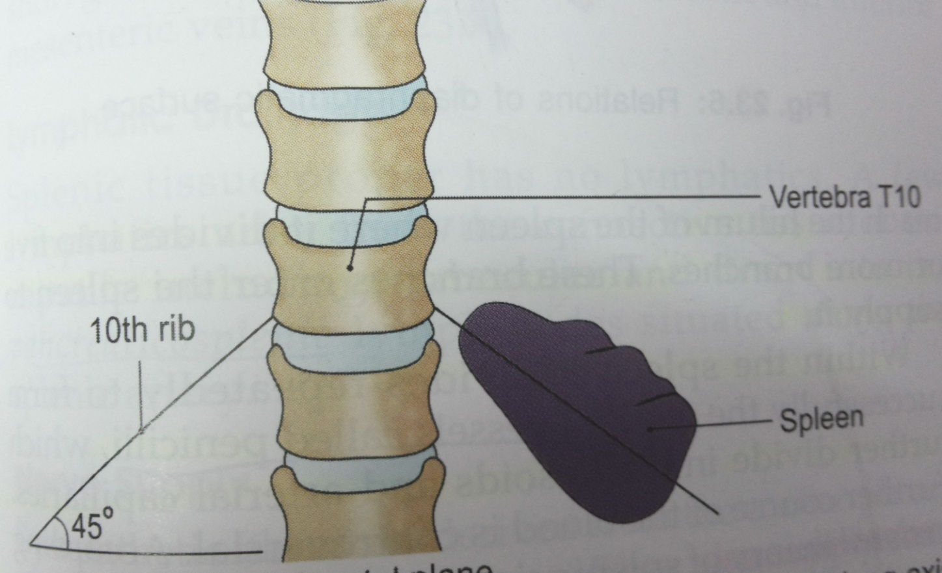
Direction- downwards, forwards and laterally making an angle of about 45 degree with the horizontal plane.

Slide 8
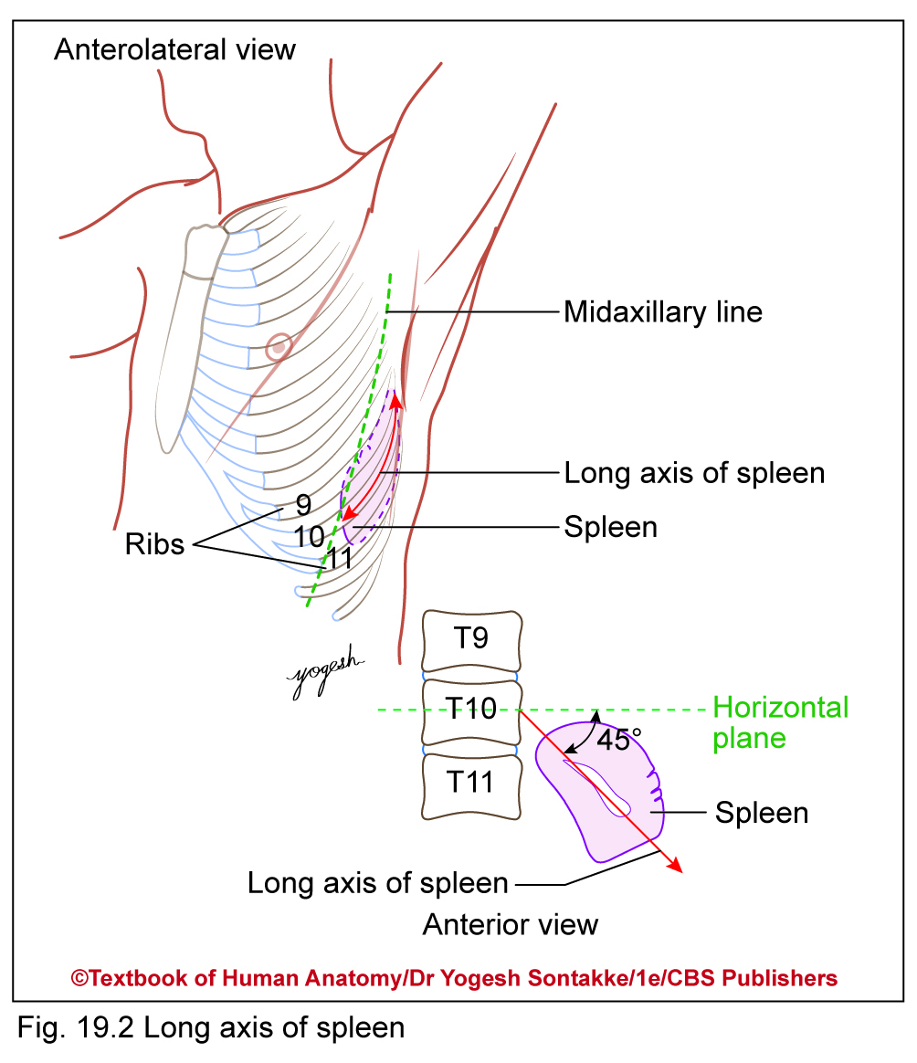

Slide 9
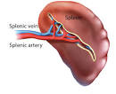
DIMENSIONS
Length 5 inches (12cm)
Breadth 3 inches (7cm)
Thickness 1 inch (3cm)
Weight 150 gm (7 ounces) weight
Related to 9,10,11th ribs

Slide 10
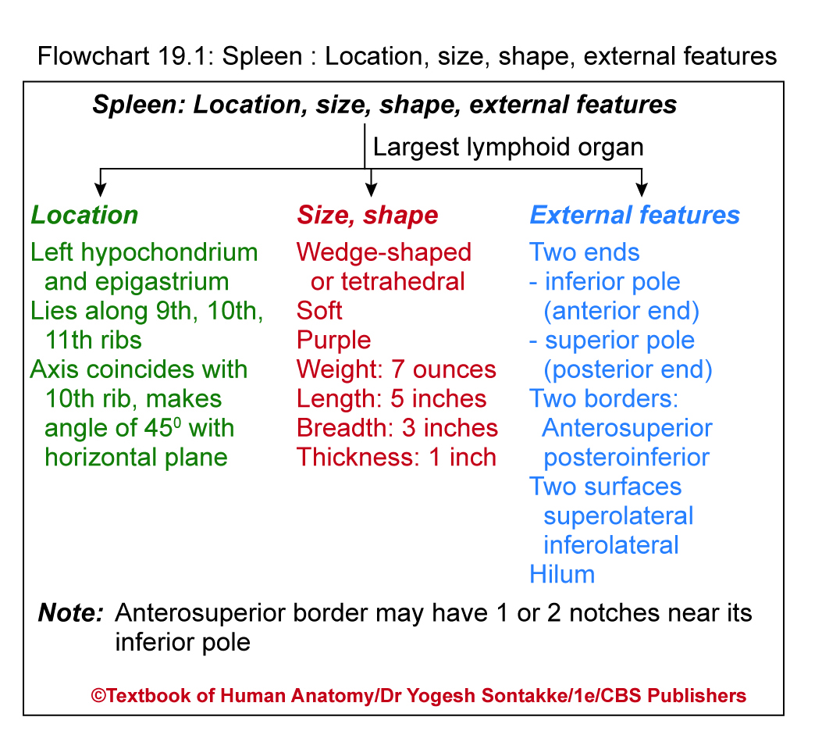

Slide 11
EXTERNAL FEATURES
Two ends
Anterior end expanded, directed downwards forwards and reaches the midaxillary line.
Anterior end

Slide 12
(2) Posterior end rounded, directed upwards, backwards and medially and rests on the upper pole of left kidney.
Posterior end

Slide 13
Three borders
Superior border
intermediate
border
Inferior border

Slide 14
Two surfaces
Diaphragmatic surface- convex and smooth.
Visceral surface is concave and irregular.
Diaphragmatic surface
visceral surface

Slide 15
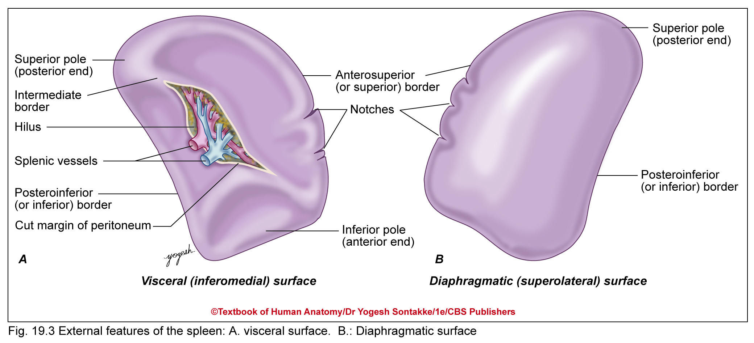

Slide 16
Two angles
Anterobasal angle
Posterobasal angle

Slide 17
Hilum
Lies between superior and intermediate borders.
Pierced by branches and tributaries of splenic vessels.
Hilum

Slide 18
PRESENTING PARTS OF SPLEEN
 | Recent terms | Previous terms
Ends of spleen | Anterior extremity Posterior extrimity | Posterior end Anterior end
Borders | Superior Inferior Ridge | Superior Inferior Intermediate
Surfaces | Superolateral (diaphragmatic) Inferomedial (visceral) | Lateral (diaphragmatic) Medial (visceral)

Slide 19
SPLEEN
ANATOMICAL POSITION
Hold spleen in left palm in such way
Convex smooth diaphragmatic surface faces posterolaterally and to left
Broad inferior pole – directed downward, forward, and to left, and rounded superior pole – directed upward, backward, and to right
Anterosuperior border has one or two notches near anterior end
Note: Tilt palm so long axis of spleen lies along middle finger, and should make angle of 45° with horizontal plane

Slide 20
RELATIONS
1.Peritoneal relations
Spleen is surrounded by peritoneum, and is suspended by following ligaments-
Gastrospenic ligament-
Extends from hilum of the spleen to the greater curvature of the stomach. It contains short gastric vessels lymphatics and sympathetic nerves.

Slide 21
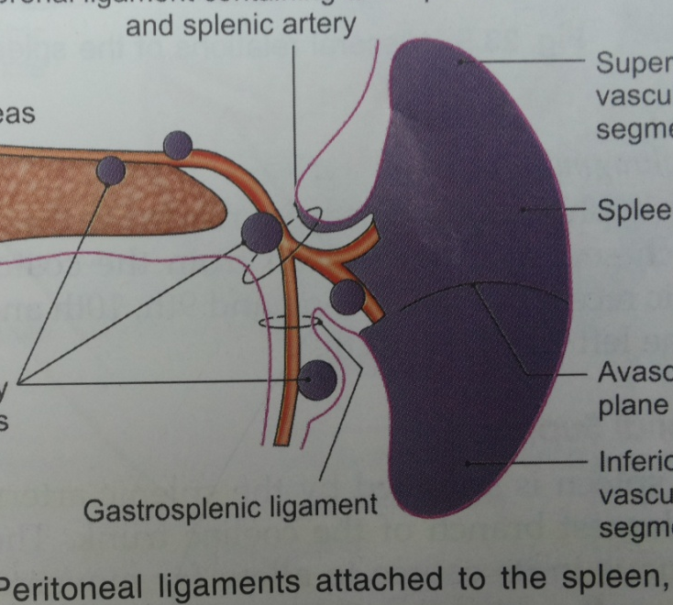
2. Lienorenal ligament-
extends from hilum of the spleen to the anterior surface of left kidney. It contains the tail of the pancreas, splenic vessels, lymph nodes , lymphatics and sympathetic nerves.

Slide 22
(3) Phrenicocolic ligament-
It is a horizontal fold of peritoneum extending from splenic flexure of colon to the diaphragm opposite the 11th rib in midaxillary line.

Slide 23
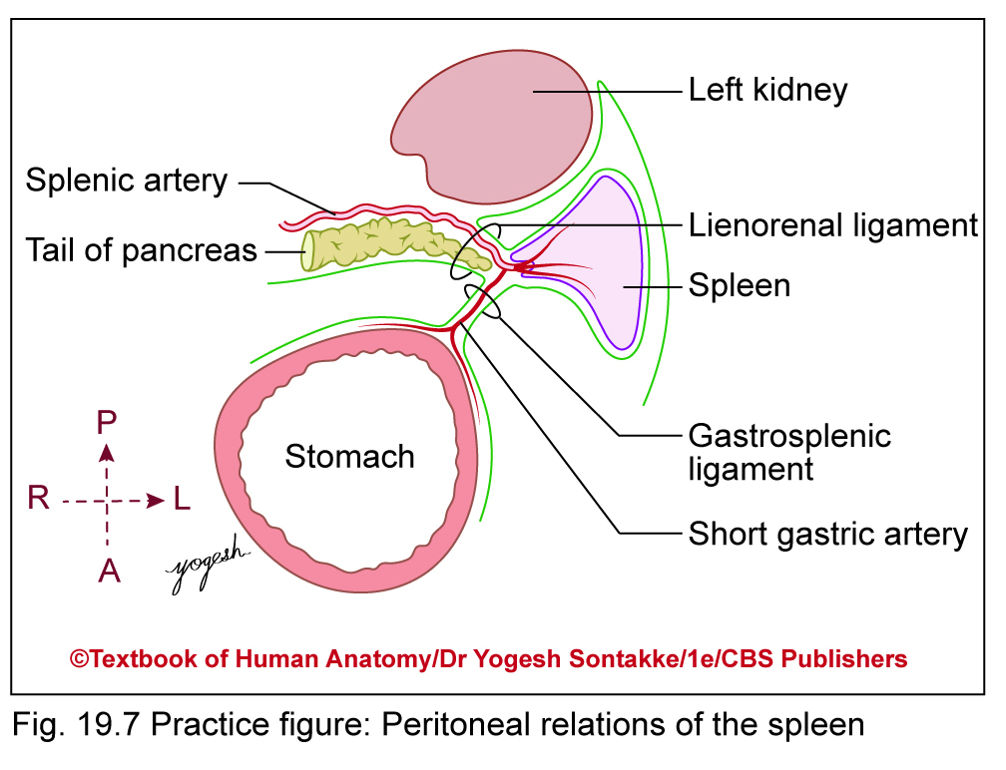

Slide 24
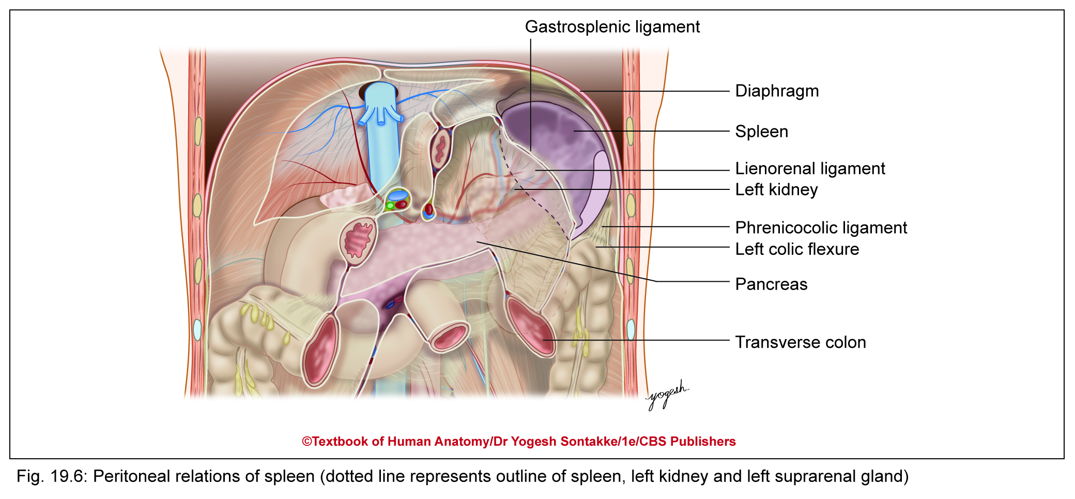

Slide 25
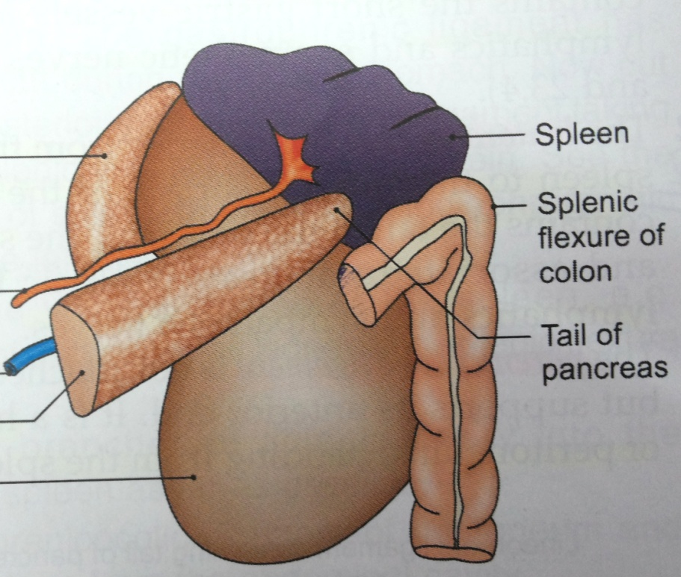
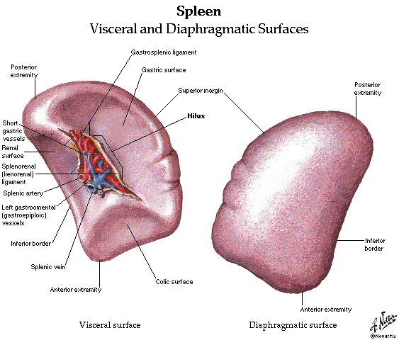
2.Visceral relations
(1) Visceral surface- Fundus of the stomach, left kidney, the splenic flexure of the colon and tail of pancreas.

Slide 26
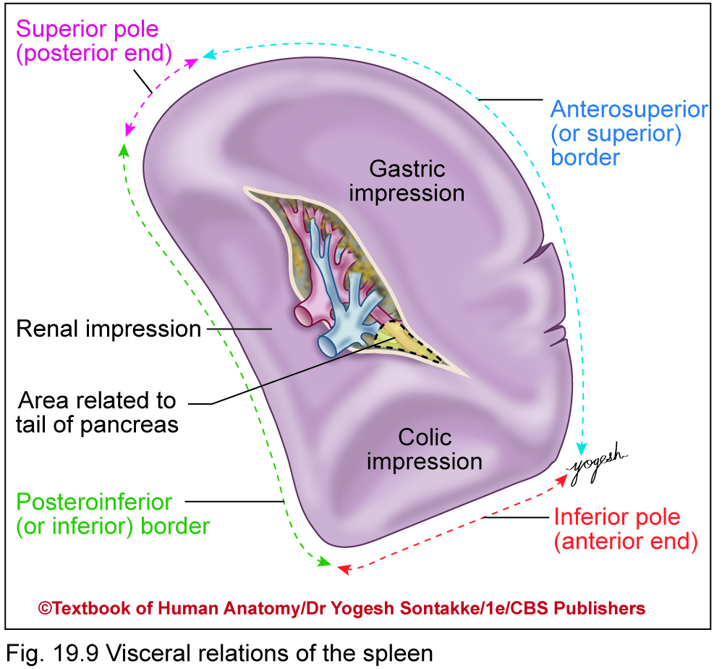
RELATIONS OF VISCERAL SURFACE
Related to
  Fundus of stomach
  Anterior surface of left kidney
  Left colic flexure
  Tail of pancreas
These viscera produce gastric, renal, colic, and pancreatic impressions respectively

Slide 27
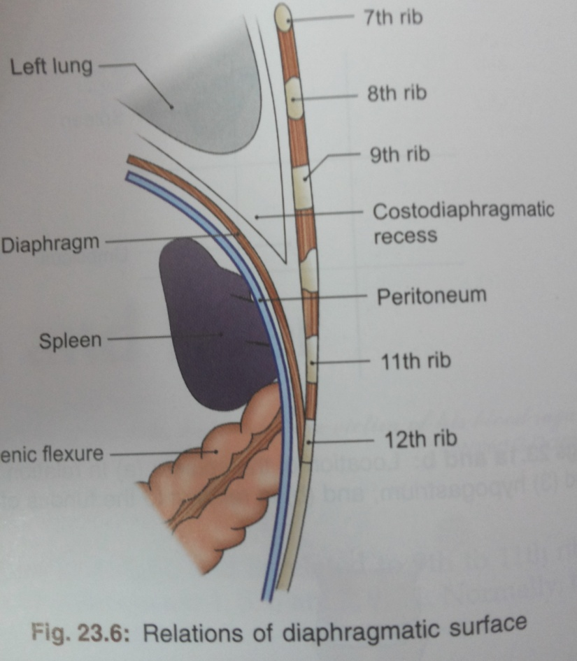
(2) Diphragmatc surface-
diaphragm separates the spleen from the costodiaphragmatic recess of pleura, lung and 9^{th,} 10th , 11th ribs of the left side.

Slide 28
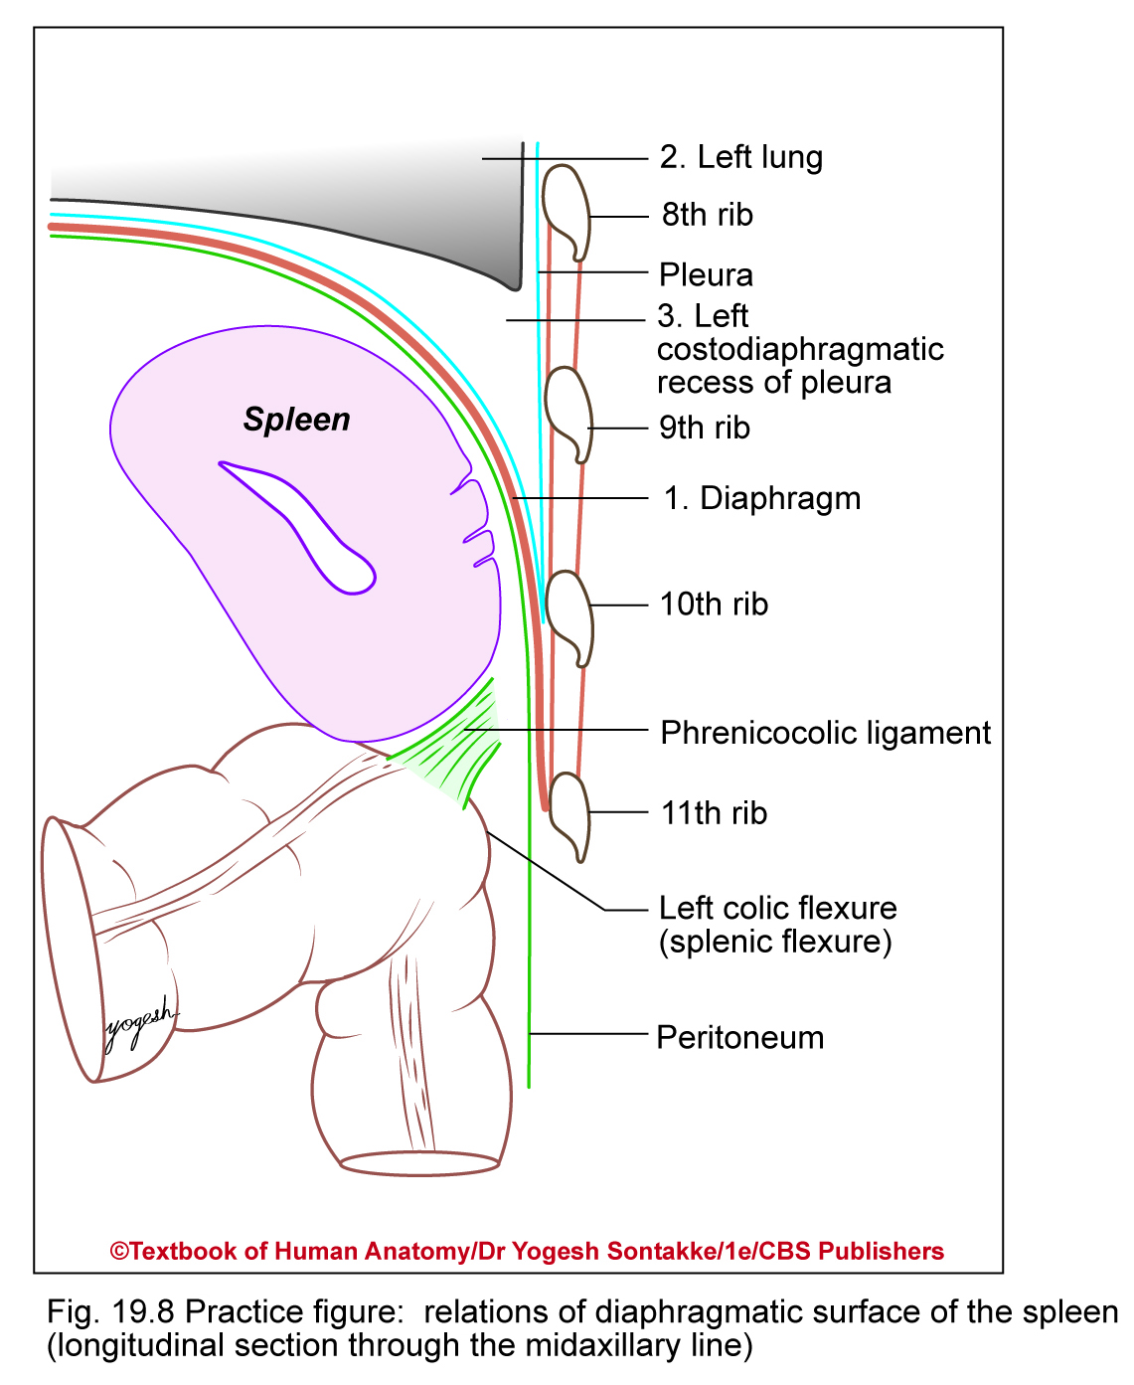
RELATIONS OF DIAPHRAGMATIC SURFACE
  Diaphragm
  Lower end of left lung and left pleural sac in upper part
  Left costodiaphragmatic recess in lower part
  Left 9th, 10th, and 11th ribs and their intercostal spaces

Slide 29
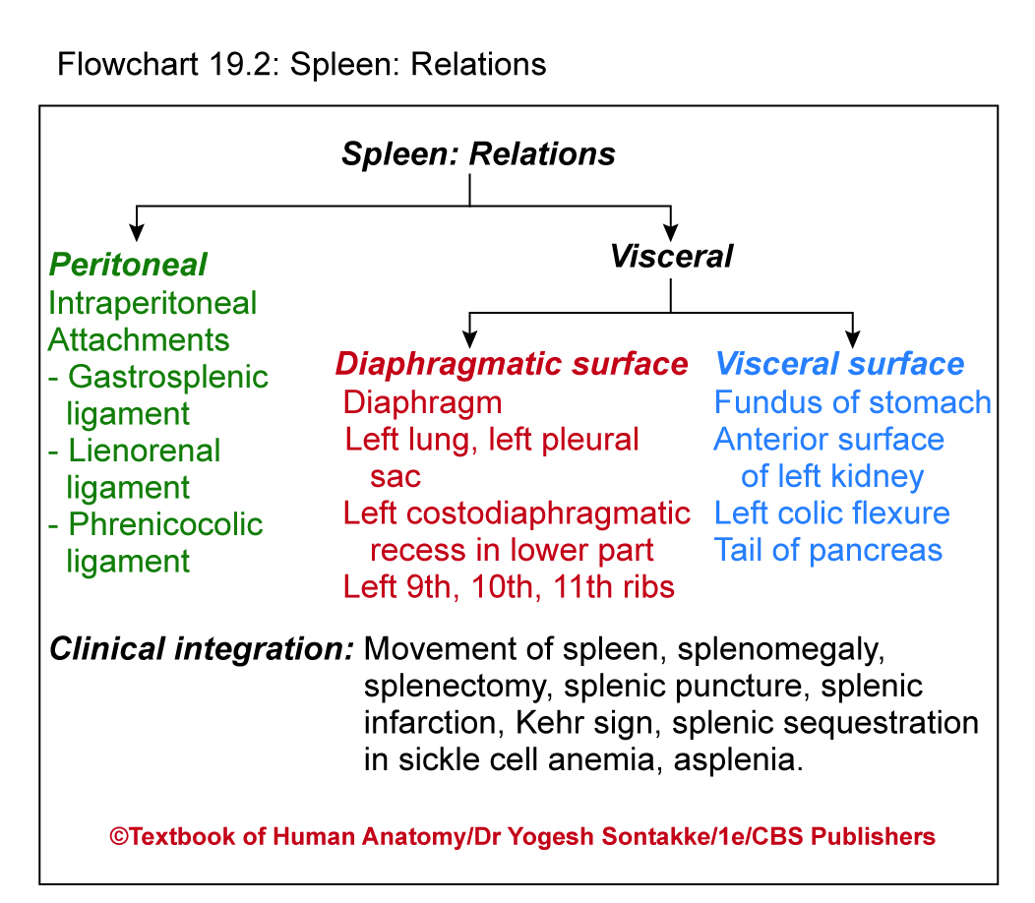

Slide 30
BLOOD SUPPLY
Arterial supply- Splenic artery
Venous drainage-Splenic vein

Slide 31
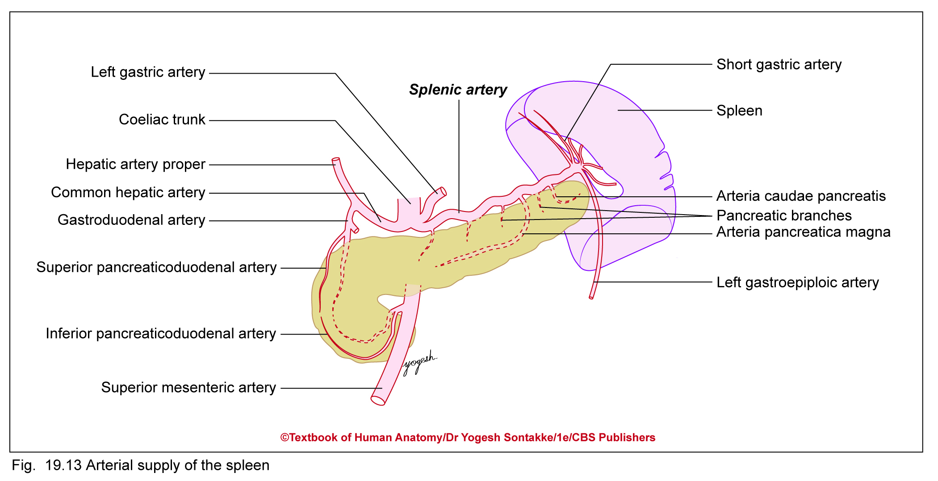
BLOOD SUPPLY,
Arterial supply
Supplied by splenic artery
Largest branch of coeliac trunk
One of most tortuous arteries in body and allows movements of spleen
Splenic artery passes behind stomach, along superior border of body and tail of pancreas
Passes through lienorenal ligament, and at hilum of spleen, gives 4–5 branches for spleen

Slide 33
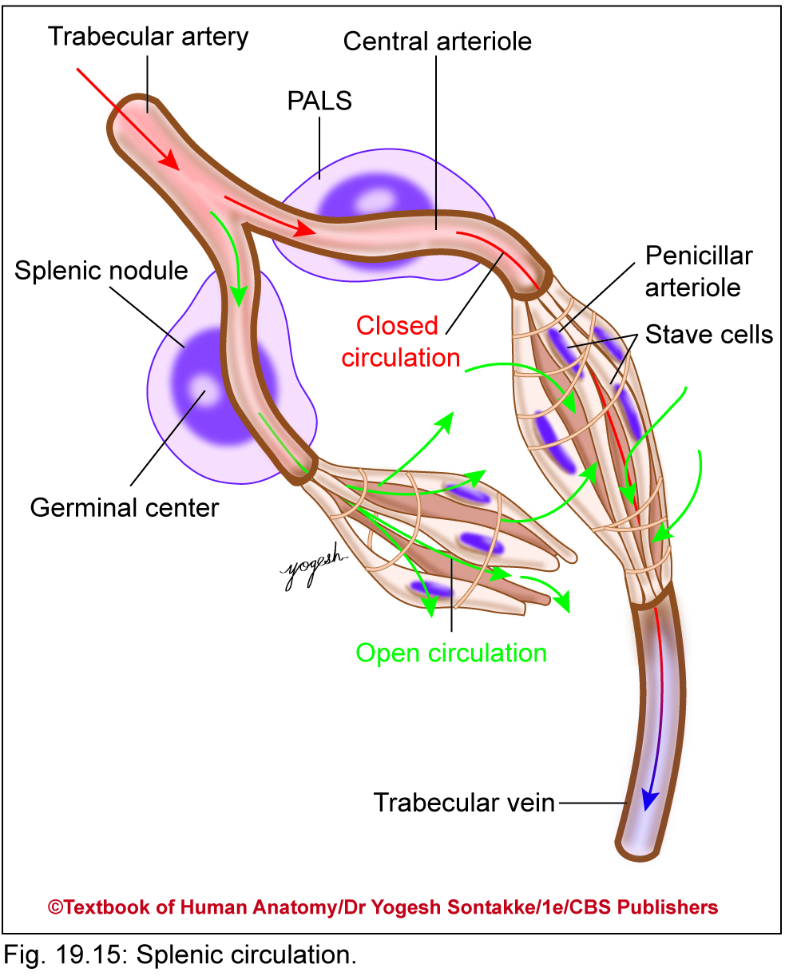
Splenic microcirculation

Slide 34
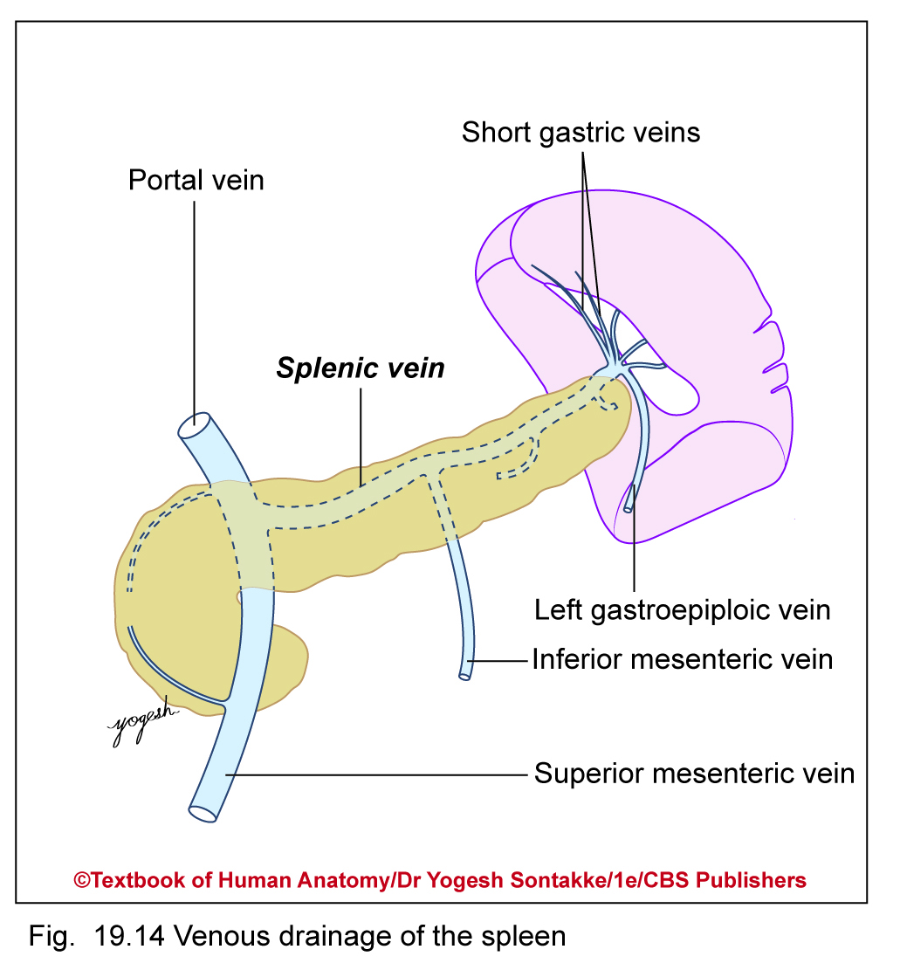
VENOUS DRAINAGE
Splenic venules run in trabeculae and join to form smaller veins converge at hilum as 4–5 veins
These smaller veins join to form splenic vein
Splenic vein runs horizontally behind body of pancreas
Joins with superior mesenteric vein to form portal vein behind neck of pancreas

Slide 35
NERVE SUPPLY
Sympathetic fibers from coeliac plexus supply blood vessels and small number of smooth muscles in the capsule of spleen
They regulate blood flow to spleen
Sympathetic fibers carry pain sensation
Parasympathetic fibers from vagus nerves through splenic vessels
Coeliac plexus
LYMPHATIC DRAINAGE
Pancreaticosplenic lymph nodes

Slide 36
FUNCTIONS OF THE SPLEEN
Phagocytosis
Haemopoiesis
Immune response
Storage of RBCs

Slide 37
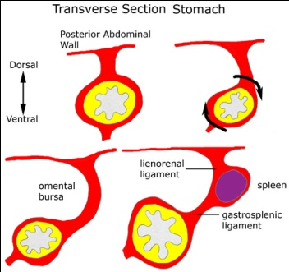
DEVELOPEMENT
From the left layer of dorsal mesogastrium during 6 week of intrauterine life.

Slide 38
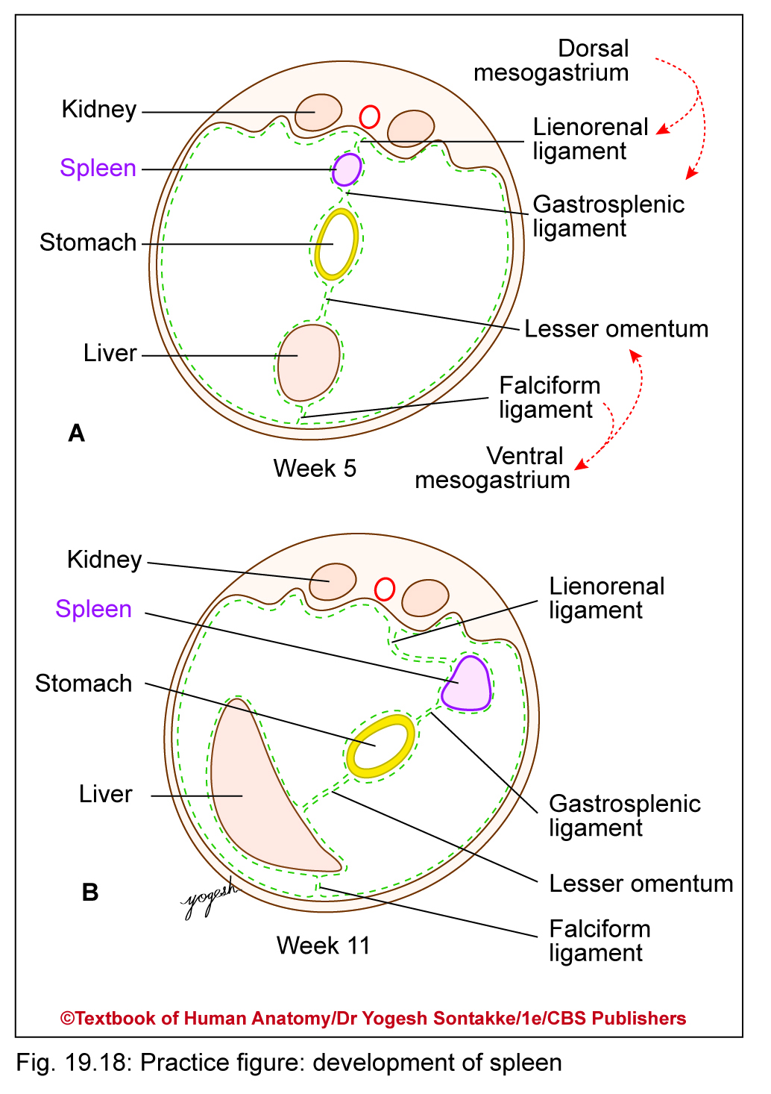
Development of spleen

Slide 39
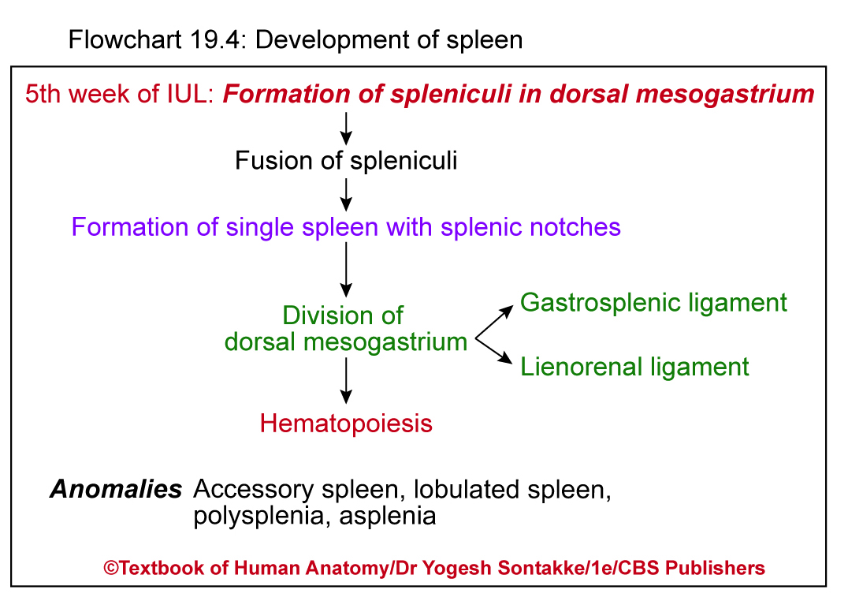

Slide 40
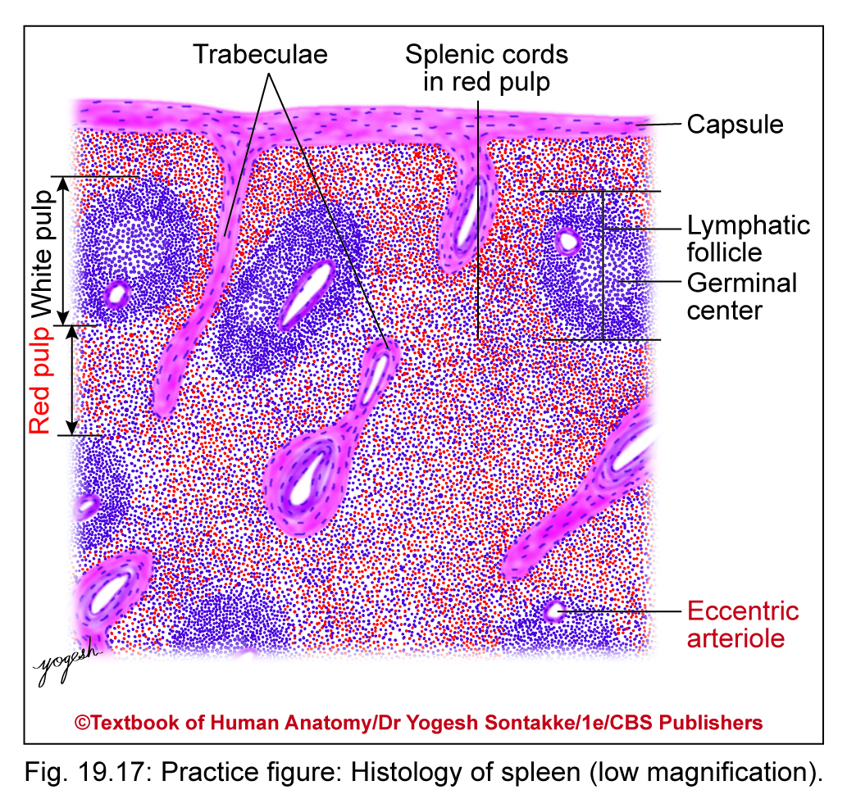
histology

Slide 41
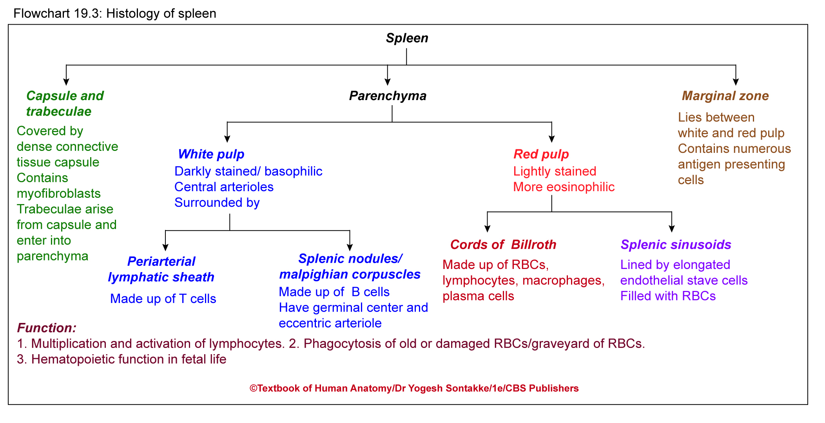

Slide 42
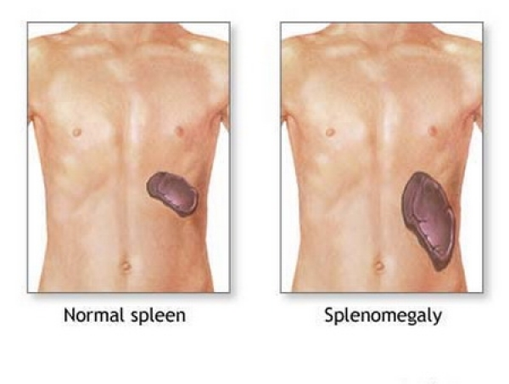
APPLIED ANATOMY
(1) Splenomegaly- Enlargement of the spleen it than projects towards the right iliac fossa in the direction of the axis of tenth rib.

Slide 43
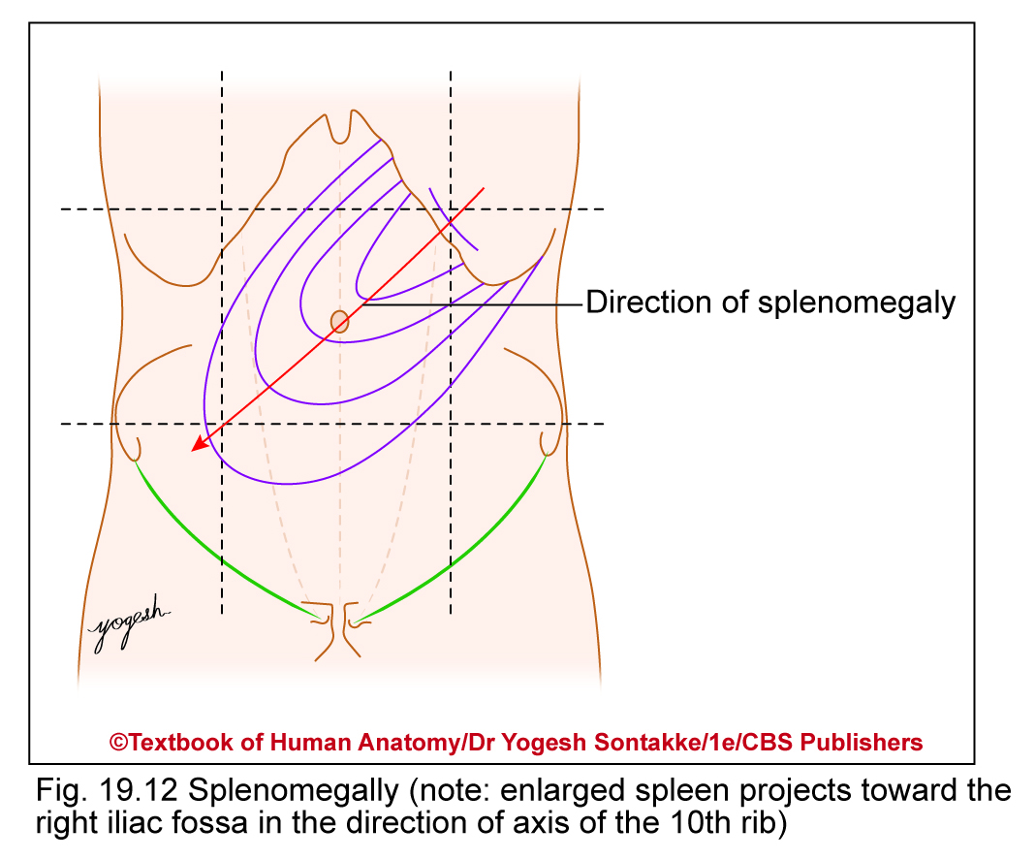
APPLIED ANATOMY
Splenomegaly
Enlargement of spleen
Enlarged spleen projects toward right iliac fossa in direction of axis of 11th rib
Causes: Occurs because of immunological or hematological causes such as
  Abnormal RBCs (thalassemia, sickle cell anemia)
  Immune disorders and infections (malarial infection, splenic abscess, typhoid fever, rheumatoid arthritis)
  Cancerous conditions (leukemia)
  Obstruction to venous blood (cirrhosis of liver, obstruction of portal vein)

Slide 44
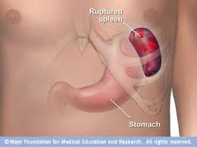
(2) Ruptured spleen - most common cause is blunt abdominal trauma , penetrating injuries, stab or gunshot wounds, infectious diseases, medical procedures such as colonoscopy, haematological diseases, medications, and pregnancy.

Slide 45
KEHR SIGN
Classical symptom of Ruptured spleen
Occurrence of acute pain in tip of shoulder due to presence of blood in peritoneal cavity
Root value C3 and C4 and nerves involved – phrenic nerve and supraclavicular nerve
Note: Kehr sign – seen in ruptured spleen, renal calculi, subdiaphragmatic abscess, and ruptured ectopic pregnancy

Slide 46
(3) Splenectomy- Surgical removal of spleen. It may be complete or partial (only one segment of spleen can be removed according to state of spleen).
(4) Referred pain- to the epigastrium, left hypogastrium.

Slide 47

(5) Accessory spleen
Small splenic nodule extra to the spleen usually formed in early embryogenesis.

Slide 48
APPLIED ANATOMY
Accessory spleen
Failure of fusion of spleniculi with main splenic tissue gives rise to accessory spleen at following sites
  Hilus of spleen, gastrosplenic ligament, lienorenal ligament, tail of pancreas, along splenic artery, and left spermatic cord
Lobulated spleen: Incomplete fusion of spleniculi (persistent fetal spleen) produces lobulated spleen
Right-sided bilaterality or isomerism – characterized by asplenia or hypoplastic spleen, whereas left-sided bilaterality is characterized by polysplenia

Slide 49
(6) Splenosis is a condition where displaced pieces of splenic tissue (often following trauma or splenectomy) autotransplant in the abdominal cavity as accessory spleens.

Slide 50

THANK YOU

