Slide 1
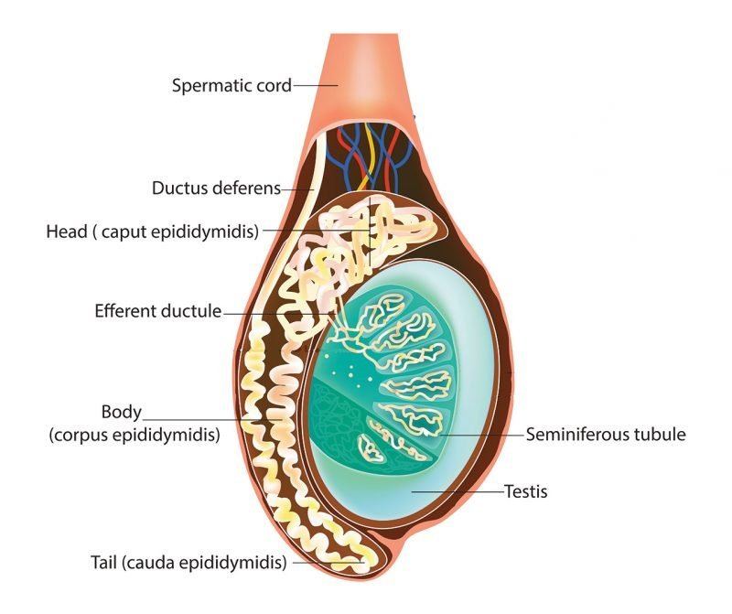
GROSS ANATOMY
SCROTUM AND TESTIS
DR. PRAVEEN KUMAR KURREY MBBS, MS, BCME, BCBR, CISP
PROFESSOR ANATOMY

Slide 2
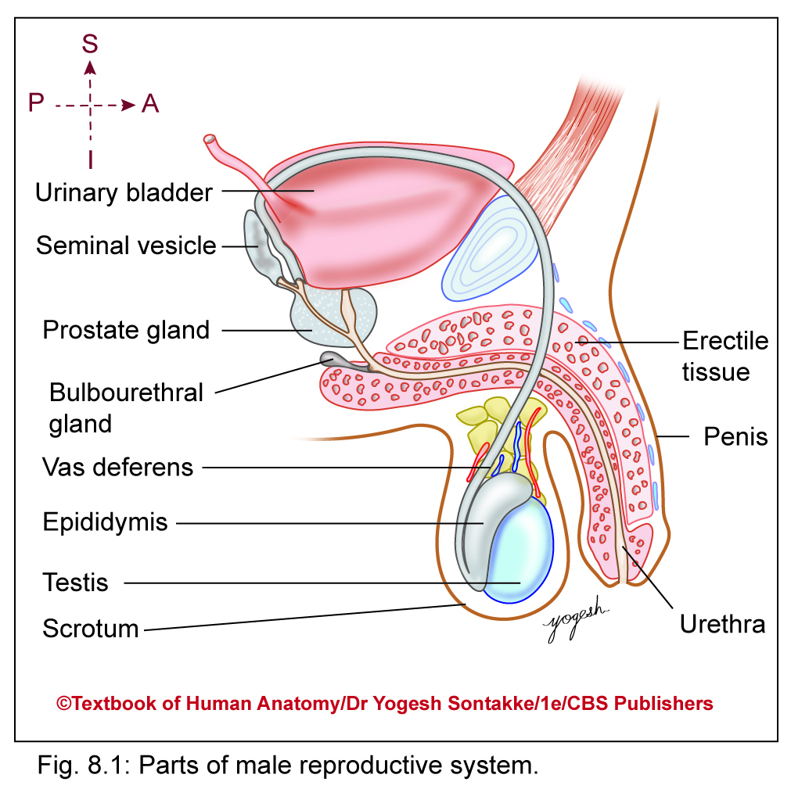
MALE GENITAL ORGANS
External organs
  Penis
  Scrotum
Internal organs
  Testis
  Epididymis
  Vas deferens
  Prostate
  Seminal vesicles
  Bulbourethral glands

Slide 3
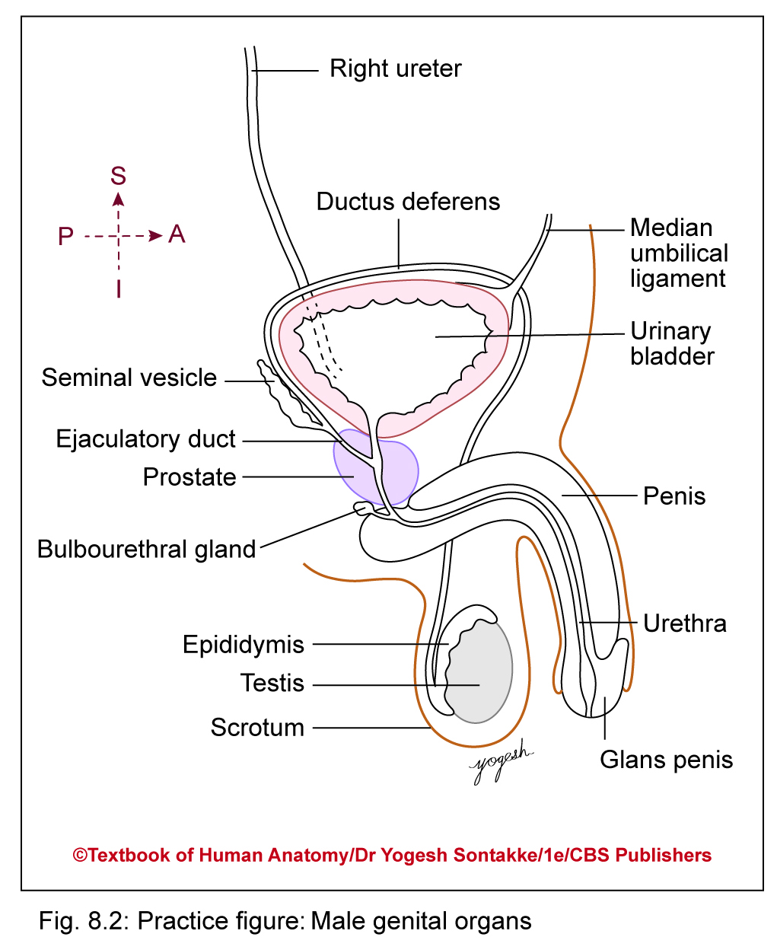
Male Genital Organs
In surgical aspects, male external genital organs include-
Penis
Scrotum
Testis
Epididymis
Spermatic cords

Slide 4
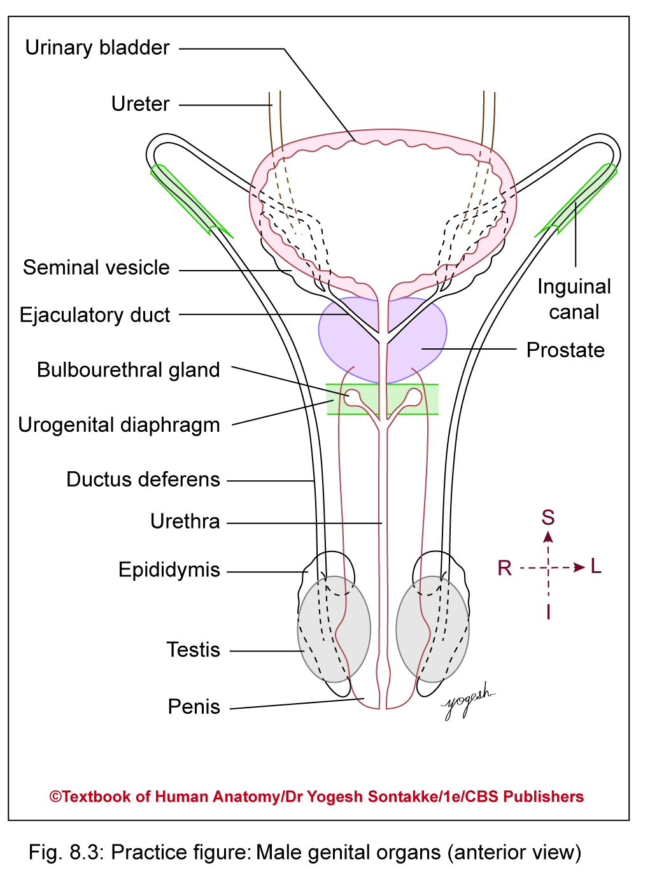

Slide 5
SCROTUM
Large pendulous pouch of skin located in lower part of anterior abdominal wall, below and behind penis (scrotum = bag in Latin)
Contents of scrotum
Two testes
Two epididymis
Lower part of spermatic cords

Slide 6
SCROTUM
Features
Bilateral in development
Formed by midline fusion of two genital swellings
Midline fusion – represented by median raphe or ridge Divides scrotum into right and left halves
Median raphe continues forward in midline of ventral surface of penis and backward in midline of peritoneum of anus
Left side of scrotum – slightly lower than right half because of longer left spermatic cord
Due to presence of dartos muscle lies subcutaneously, skin of scrotum – corrugated or rough, especially on exposure to cold
Brings testes near body to maintain temperature

Slide 7
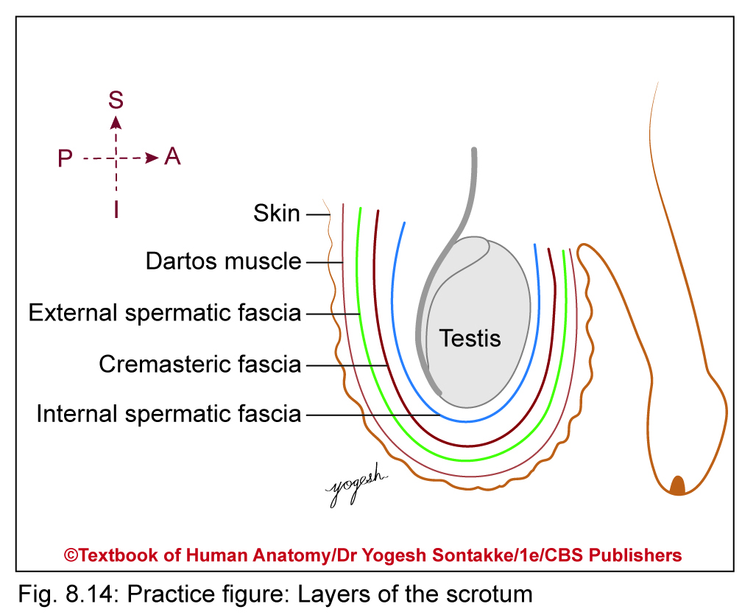
LAYERS OF SCROTUM
From outside inward
  Skin
  Dartos muscle
  External spermatic fascia
  Cremasteric muscle and fascia
  Internal spermatic fascia

Slide 8
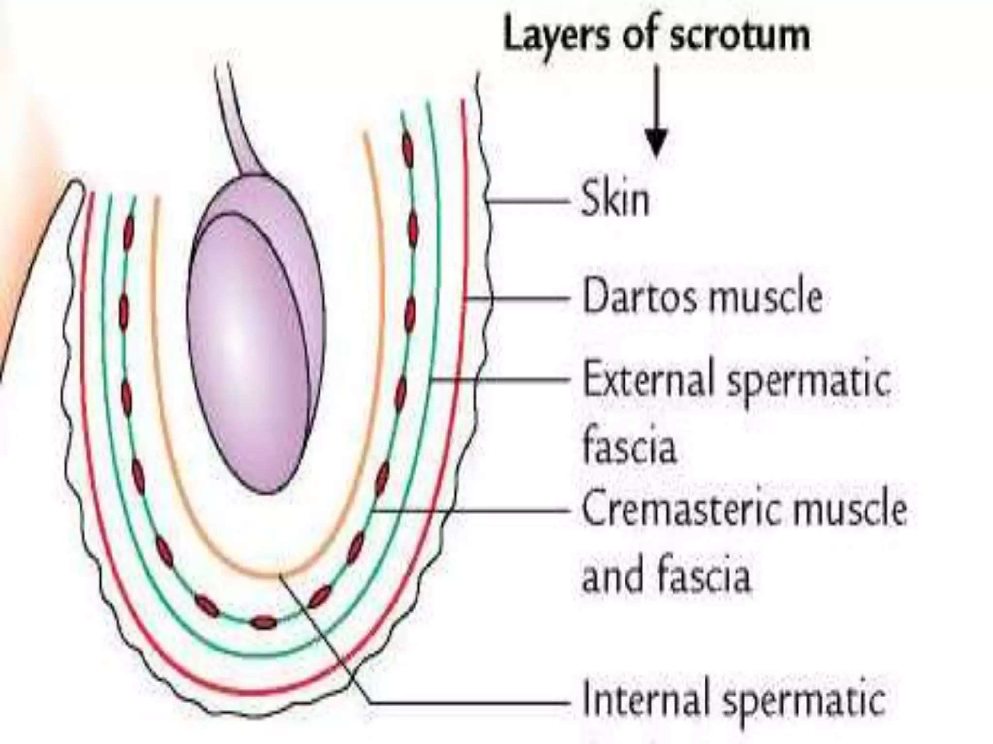

Slide 9
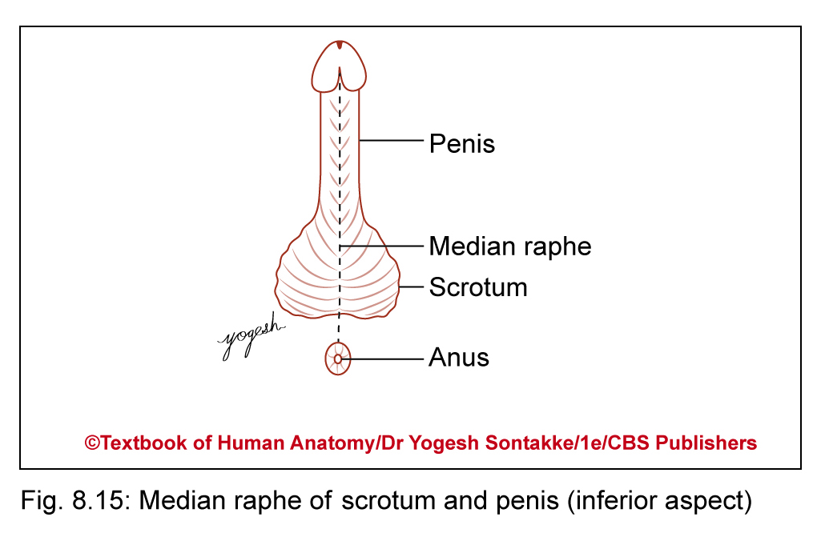
CLINICAL ANATOMY
Skin of scrotum – thin, pigmented, and corrugated due to dartos muscle
Shows median raphe continues on ventral surface of penis
Corrugation – more in young person and increases on exposure to cold
This skin has numerous sebaceous and sweat glands

Slide 10
CLINICAL ANATOMY
Dartos muscle – subcutaneous involuntary muscle
Replaces superficial fascia in scrotum
Supplied by sympathetic fibers from superior hypogastric plexus
External spermatic fascia – continuation of external oblique muscle

Slide 11
CLINICAL ANATOMY
Cremasteric muscle and fascia – derived from internal oblique and Transversus abdominis muscle
Supplied by genital branch of genitofemoral nerve
Internal spermatic fascia – derived from fascia transversalis

Slide 12
Layers of scrotum and corresponding layers of anterior abdominal wall
Layer of scrotum | Layer of anterior abdominal wall
Skin | Skin
Dartos muscle | Superficial fascia (fascia of Camper and fascia of Scarpa)
External spermatic fascia | External oblique muscle
Cremasteric muscle and fascia | Internal oblique muscle
Internal spermatic fascia | Fascia transversalis

Slide 13
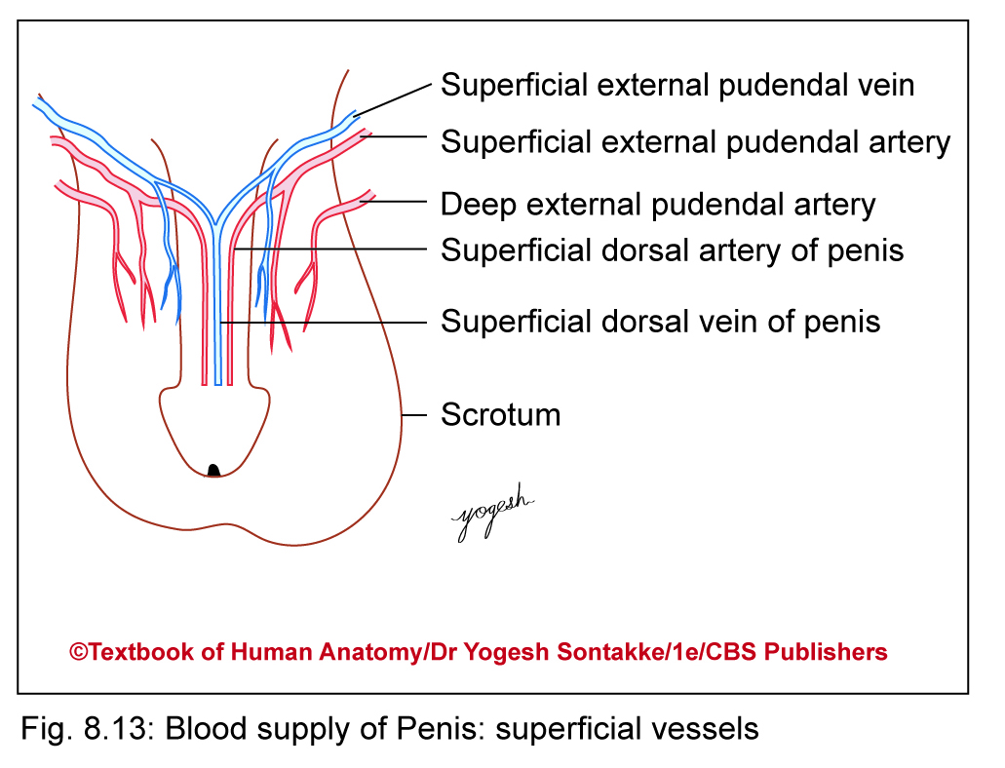
BLOOD SUPPLY
Supplied by
  Superficial external pudendal artery
  Deep external pudendal artery
  Scrotal branches of internal pudendal artery
  Cremasteric branch of inferior epigastric artery

Slide 14
BLOOD SUPPLY
Blood supply
Venous blood from scrotum partly goes to great saphenous vein and partly to internal iliac vein
Lymphatic drainage
Lymphatics from scrotum drain into superficial inguinal nodes

Slide 15
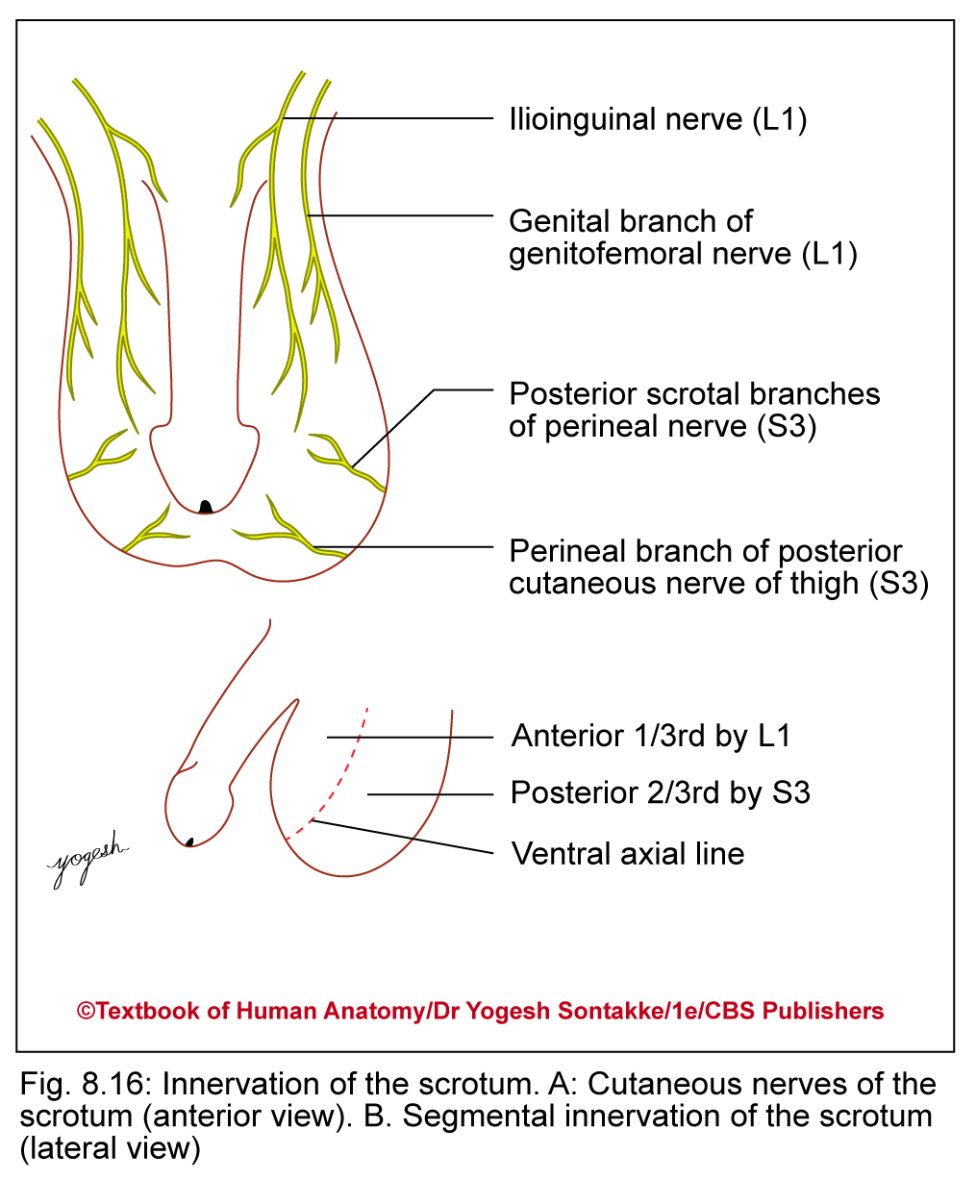
NERVE SUPPLY
Anterior 1/3rd of scrotum
  Ilioinguinal nerve
  Genital branch of genitofemoral nerve (L1)
Posterior 2/3rd of scrotum
  Posterior scrotal branches of pudendal nerve (S3)
  Perineal branch of posterior cutaneous nerve of thigh (S3)
  Dartos muscle (involuntary): Sympathetic fibers from superior hypogastric plexus through genital branch of genitofemoral nerve

Slide 16
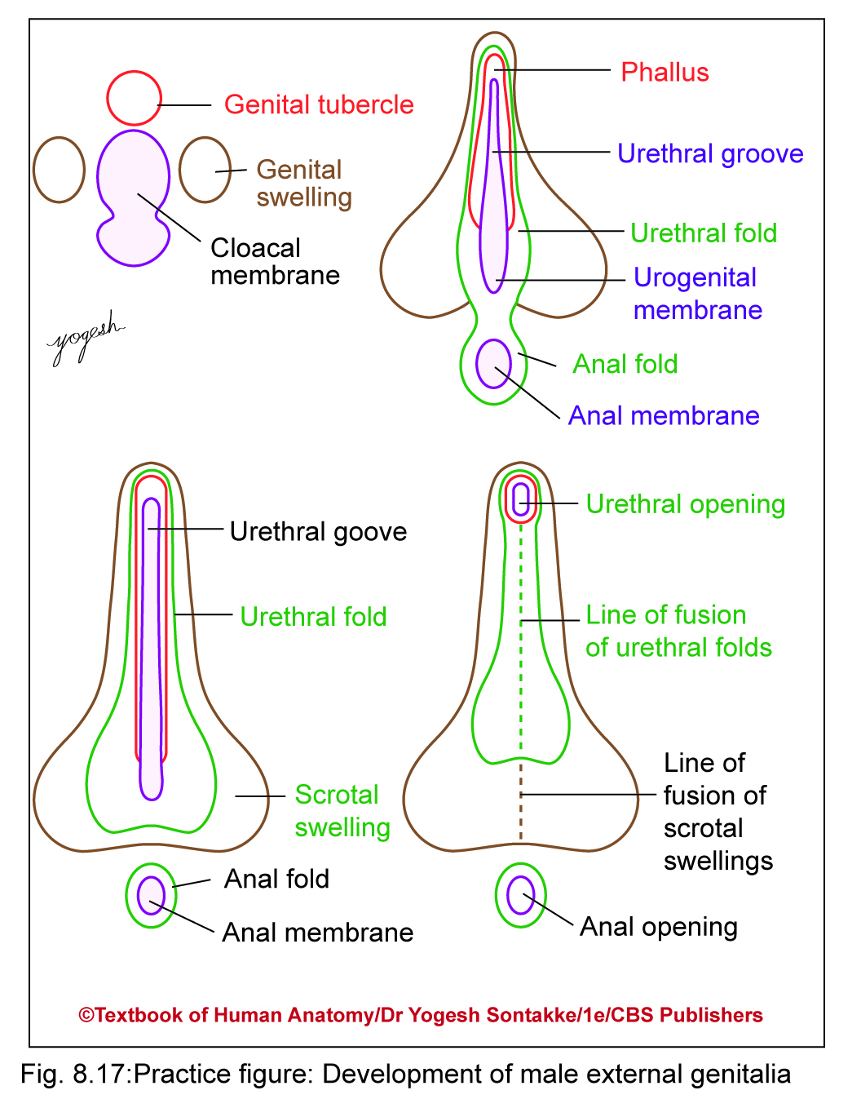
DEVELOPMENT
Male external genitalia, on fusion of urethral folds, both genital swellings enlarge to form scrotal swellings (labial swellings in female)
These scrotal swellings enlarge and fuse in the midline to form scrotum
Line of fusion of scrotal swellings forms midline fibrous raphe on scrotum

Slide 17
CLINICAL ANATOMY
Scrotal edema: Due to laxity of skin, scrotum – common site for edema
Sebaceous cyst- Skin of scrotum has large number of hair follicles and sebaceous glands
Common site for edema
Bifid scrotum in male – seen in pseudohermaphroditism
Scrotal elephantiasis
Infection of filarial parasite (Wuchereria bancrofti) causes blockage of lymphatic vessels
May affect scrotum and produce scrotal enlargement called scrotal elephantiasis

Slide 18
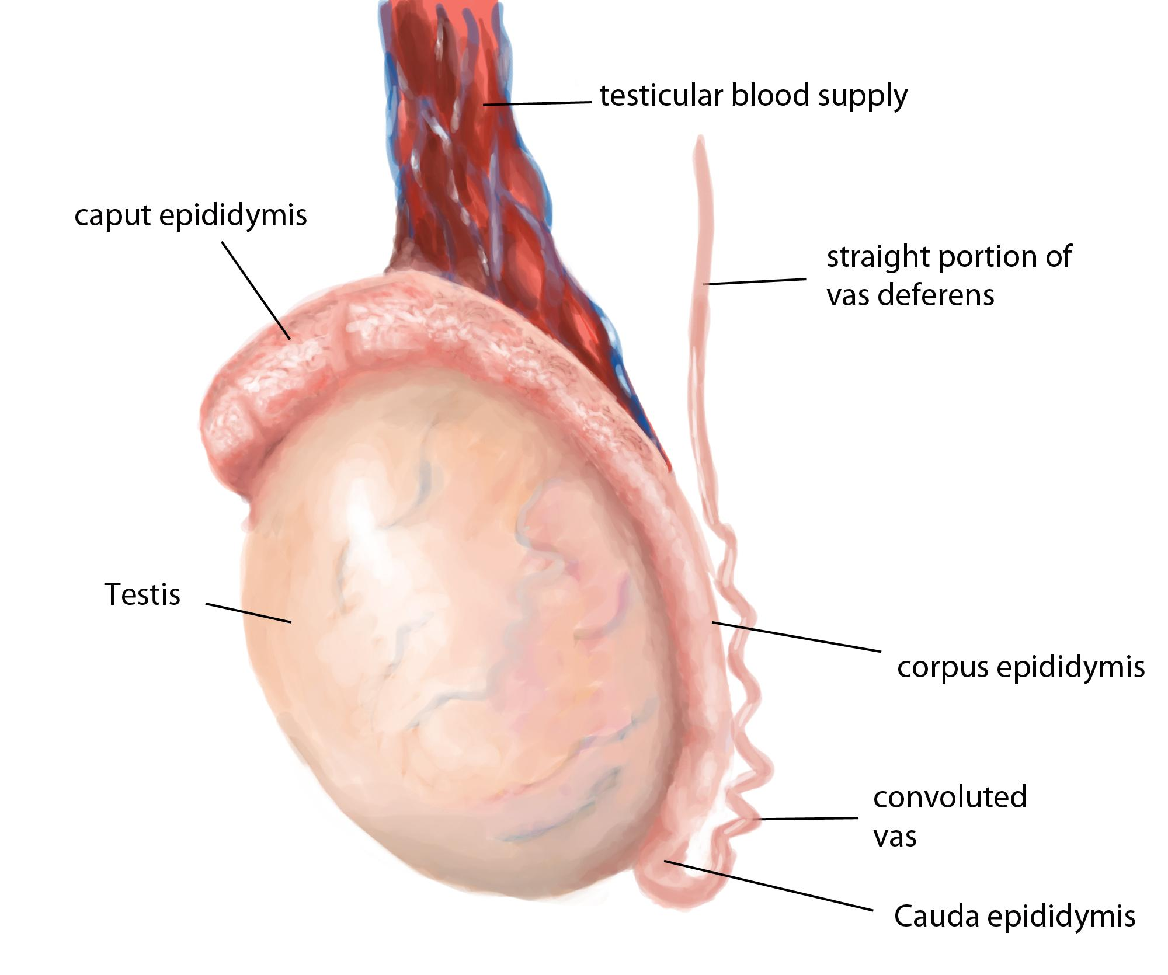
TESTIS

Slide 19
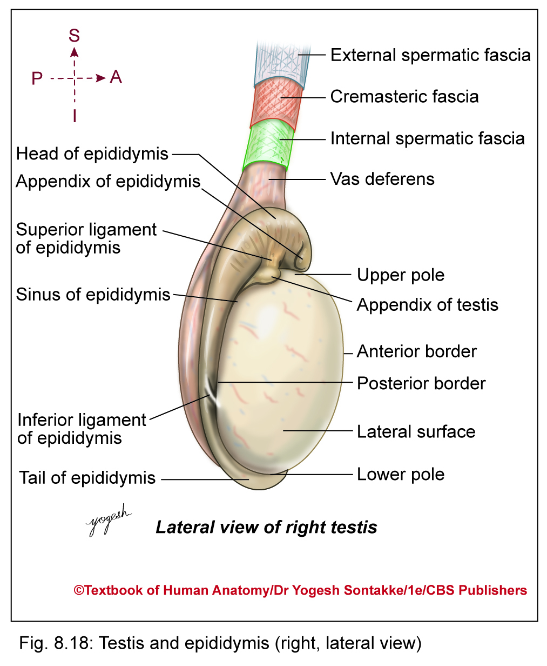
TESTIS
Testis (testes in plural) – male gonad
Suspended in scrotum by spermatic cord
Homologous with ovary of female
Shape and Dimension
Shape
  Oval or ellipsoid in shape
  Compressed from side to side

Slide 20
TESTIS
Dimensions-
  Length: 4 cm (4–5 cm)
  Breadth: 2.5 cm (2–3 cm)
  Anteroposterior diameter: 3 cm (3–4 cm)
  Weight: 12–20 gm

Slide 21

Position in scrotum
Suspended in scrotum by spermatic cord
Lies obliquely so upper pole – tilted forward and laterally and lower pole backward and medially
Left testis – slightly lower than right due to longer left spermatic cord and early descent of left testis in embryonic life

Slide 22
Parts of Testis
  Two poles – upper pole and lower pole
  Two borders – anterior and
  posterior
  Two surfaces – medial and lateral

Slide 23
Anatomical Position
Upper pole of testis gives attachment to spermatic cord
Anterior border – smooth, convex, and free
Posterior border provides attachment to epididymis
Lateral surface of testis – separated from epididymis by cavity called sinus of epididymis, and looks in direction to which testis belongs

Slide 24
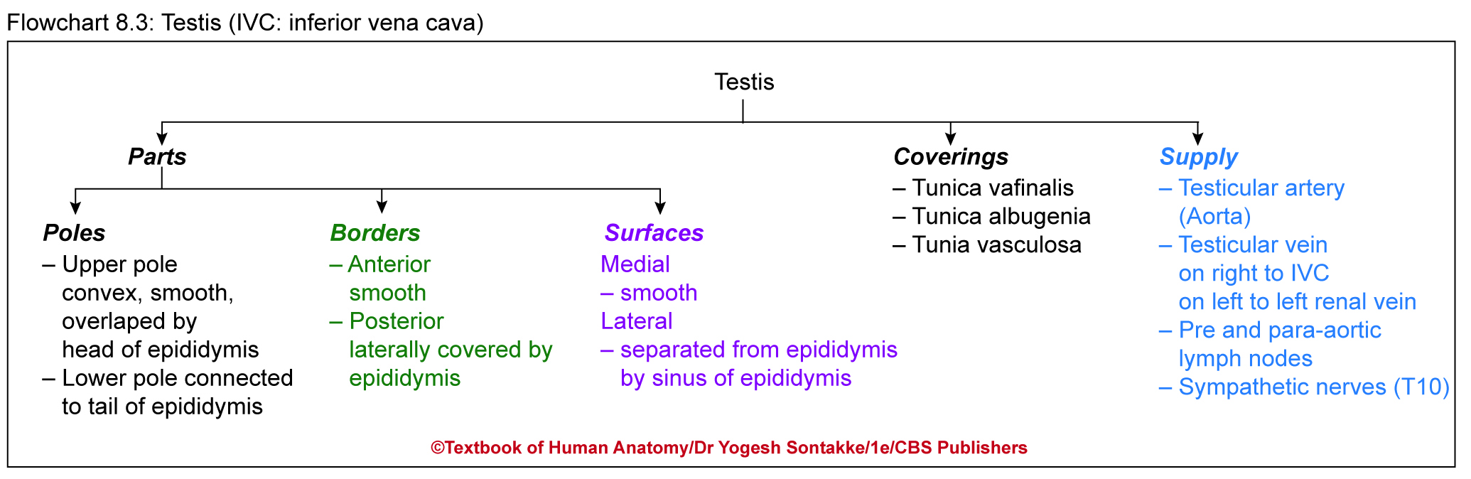

Slide 25
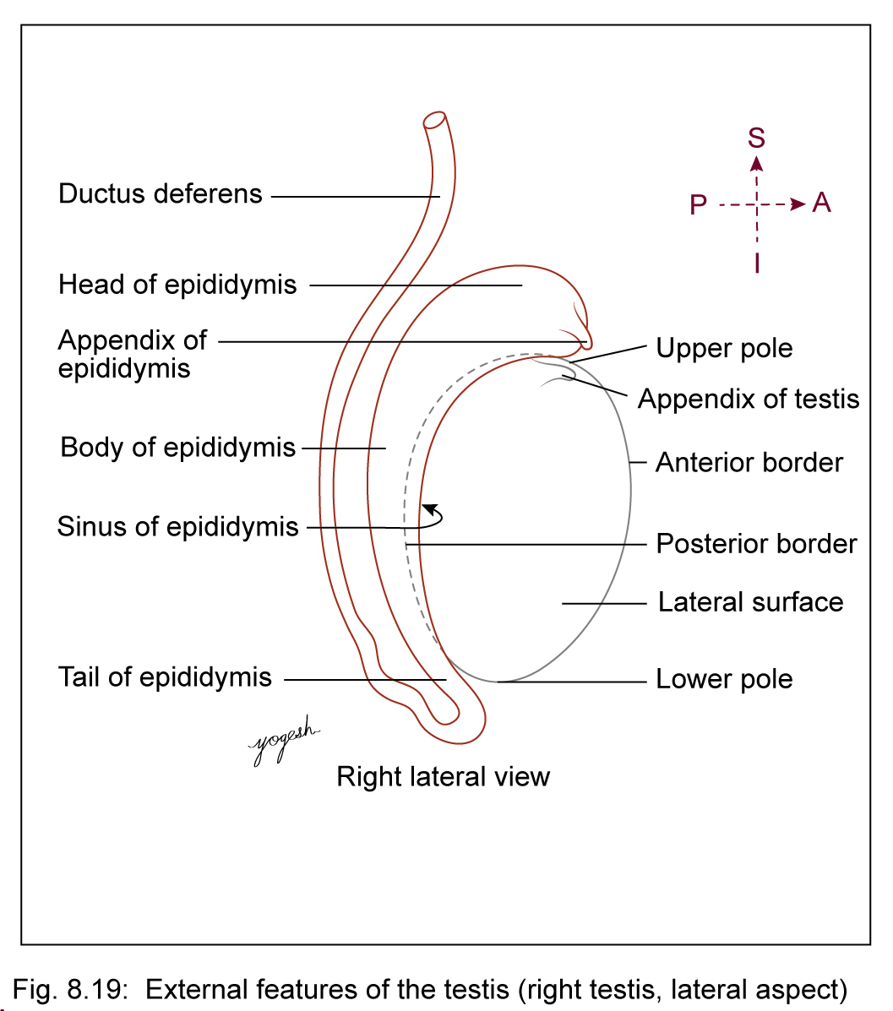
External Features
Two poles: Upper and lower
Two borders: Anterior and posterior
Two surfaces: Medial and lateral.
Upper pole (upper end)
  Convex and smooth
  Overlapped by head of epididymis
  Upper pole gives attachment to spermatic cord

Slide 26
Lower pole (lower end)
  Also convex and smooth
  Connected to tail of epididymis by loose areolar tissue and lamina vaginalis

Slide 27
External Features
Anterior border
Smooth and convex
Covered by tunica vaginalis
Posterior border
Broad, flat, and partially covered by tunica vaginalis
Lateral part of posterior border gives attachment to epididymis
Medial surface: Smooth and convex

Slide 28
External Features
Lateral surface
Also smooth and convex
Lateral surface – separated from epididymis by semilunar recess of vaginal sac
This extension of recess of tunica vaginalis – called sinus of epididymis

Slide 29
testis

Slide 30
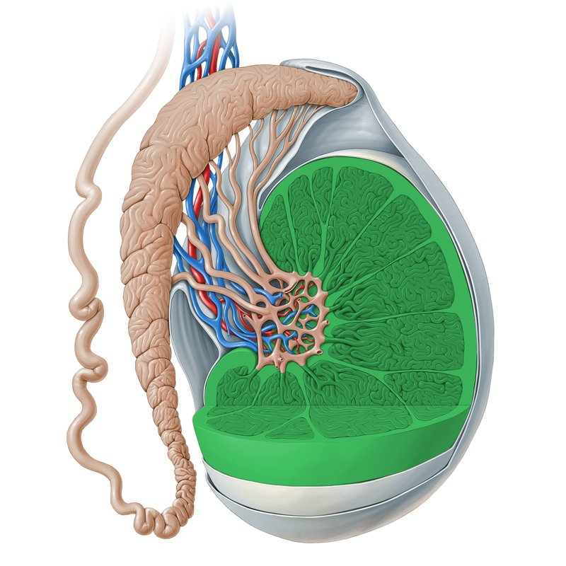
Testis and epididymis

Slide 31
CLINICAL ANATOMY
Identifications of spermatic cord, epididymis, and sinus of epididymis are essential in side determination of testis
Upper end of testis gives attachment to small, oval fibrofatty body called appendix of testis
Remnant of paramesonephric duct

Slide 32
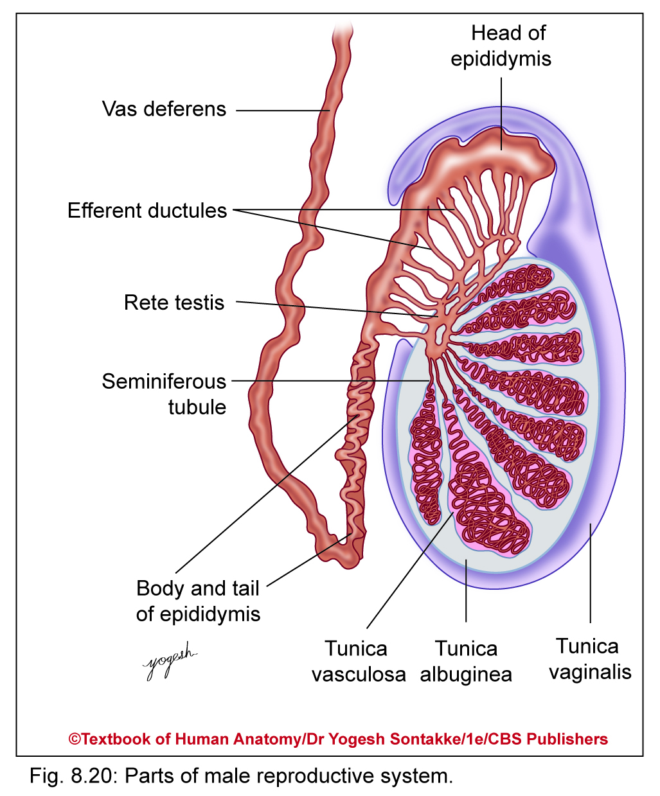
Coverings of Testis
Three coats of testis from superficial to deep -
Tunica vaginalis
Tunica albuginea
Tunica vasculosa

Slide 33
CLINICAL ANATOMY
Tunica vaginalis
Lower persistent portion of processes vaginalis
Serous sac (like peritoneal cavity– invaginated by testis from behind, thus surface of testis covered by visceral layer of tunica vaginalis
Parietal layer of tunica vaginalis lines inner side of scrotum
Vaginal sac – cavity between two layers of tunica vaginalis

Slide 34
CLINICAL ANATOMY
Tunica albuginea (white in Latin)
Thick fibrous connective tissue layer enclosing entire testis
Projects into substance of testis from posterior border as incomplete Thickened vertical partition known as mediastinum testis
Divide testis into number of cone-shaped lobules (200–300)
Tunica vasculosa – Innermost layer of testis, lining lobules of testis

Slide 35
STRUCTURE OF TESTIS

Slide 36
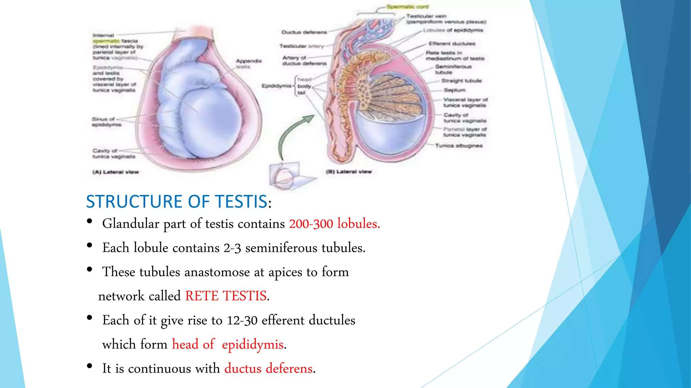

Slide 37
STRUCTURE OF TESTIS
Lobules- 200 to 300
Seminiferous tubules- 2 to 3 in each lobules (60cm)
Straight Tubules- 20 to 30 (SFT joines at apex of lobules)
Rete Testis- Network of tubules
Efferent Ductules – 12 to 30
Lobe of head of Epididymis- Tubules coiled
Body and tail of Epididymis- Single duct

Slide 38
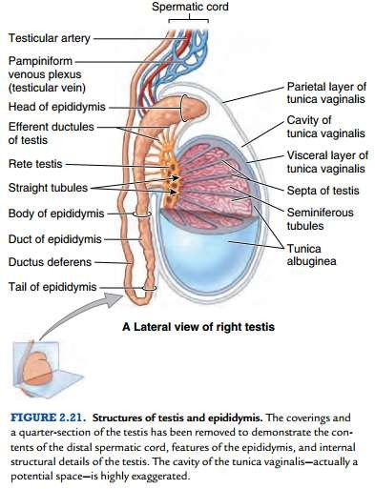
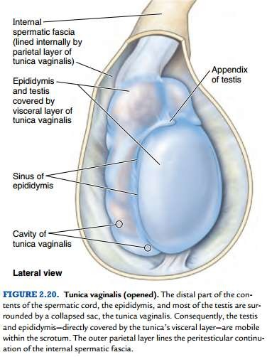

Slide 39
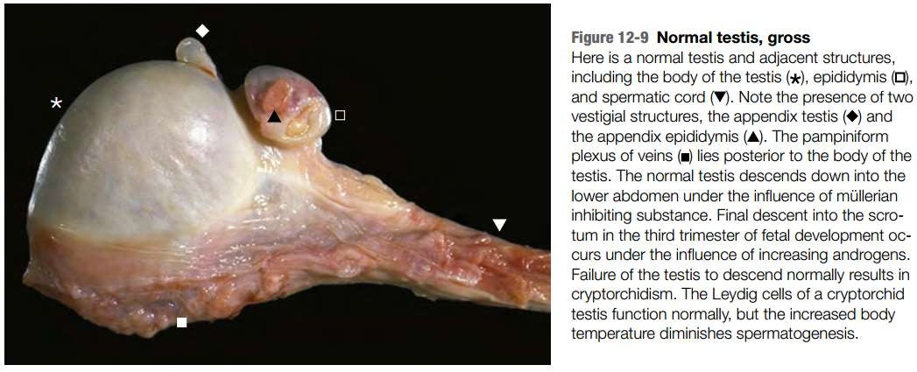
Robbins and Cotran, Atlas of Pathology, 3rd edition, Page 310

Slide 40
CLINICAL ANATOMY
Testis – externally covered by skin, dartos muscle, external spermatic fascia, internal spermatic fascia, cremasteric fascia, muscle, internal spermatic fascia, and parietal layer of tunica vaginalis
Hydrocele
Accumulation of fluid with vaginal sac which lies between parietal and visceral layers of processus vaginalis
May be vaginal, infantile, congenital, or encysted
Fluid from hydrocele can be removed by giving small incision and inserting canula through skin of scrotum

Slide 41
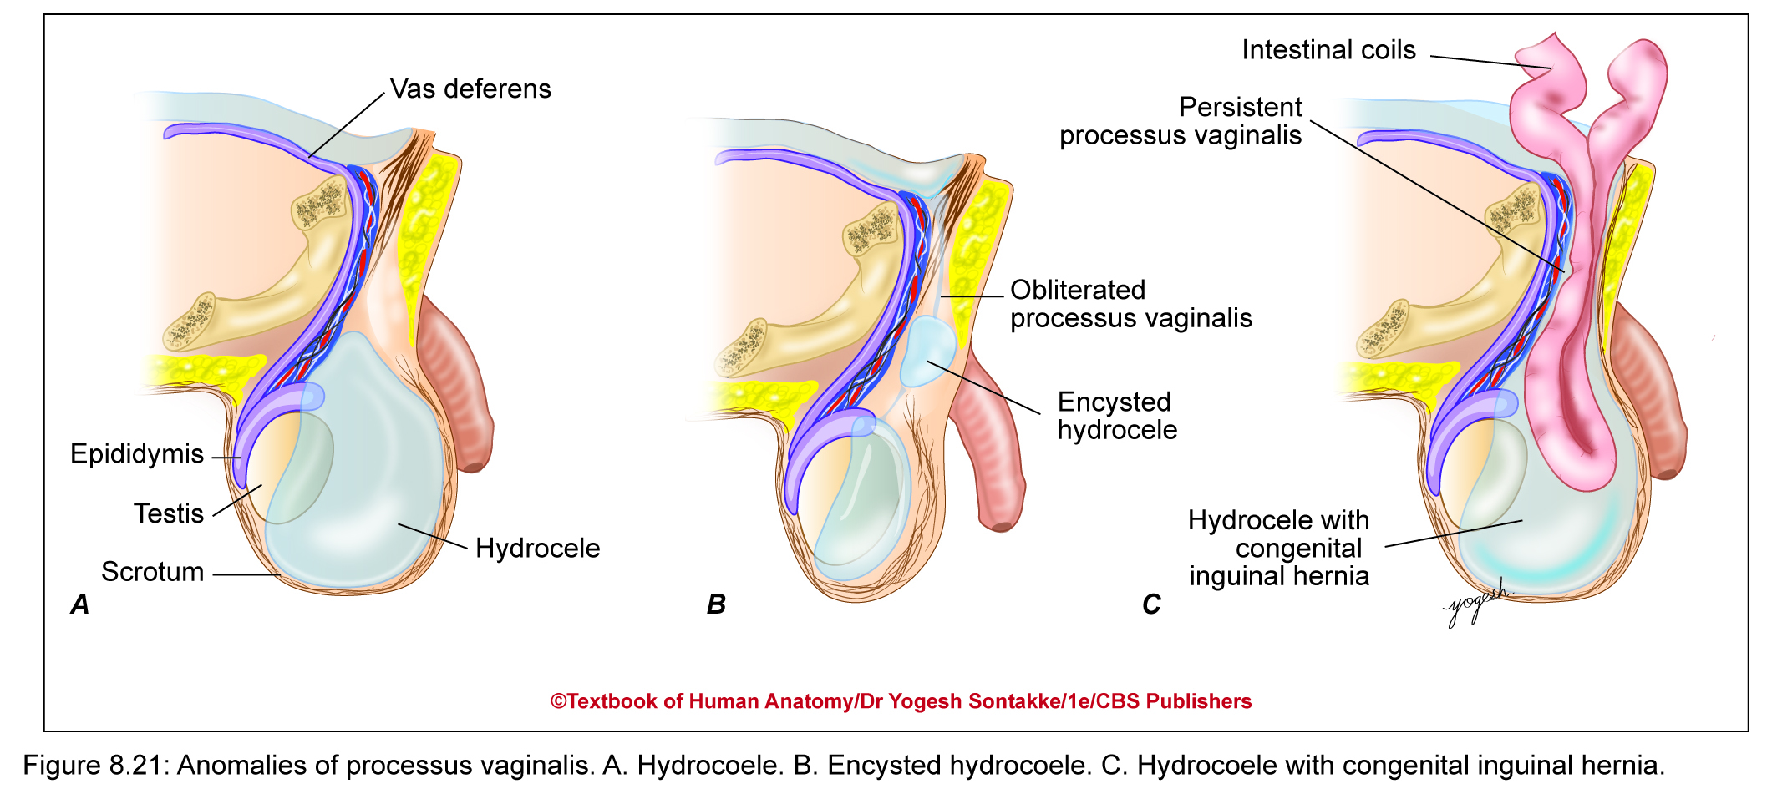

Slide 42
Histology of Testis
Testis – covered by fibrous tunica albuginea and vascular tunica vasculosa
Septae divide testis into approximately 250 incomplete lobules
Each lobule contains 1–3 highly coiled seminiferous tubules – surrounded by lamina propria, blood vessels, lymphatics, and Leydig cells
Seminiferous tubules – lined by seminiferous epithelium with two types of cells: Spermatogenic cells (spermatogonia, spermatids, and sperms) and Sertoli cells
Sertoli cells – tall columnar cells support development of spermatogenic cells

Slide 43
Histology of Testis
Leydig (interstitial) cells
Polyhedral eosinophilic cells lie in clusters and produce testosterone
These cells – epithelioid cells
These cells contain Reinke’s crystals and lipofuscin pigment
Seminiferous tubules drain into straight tubules (lined by Sertoli cells) and then into rete testis (lined by simple cuboidal to columnar epithelium)

Slide 44
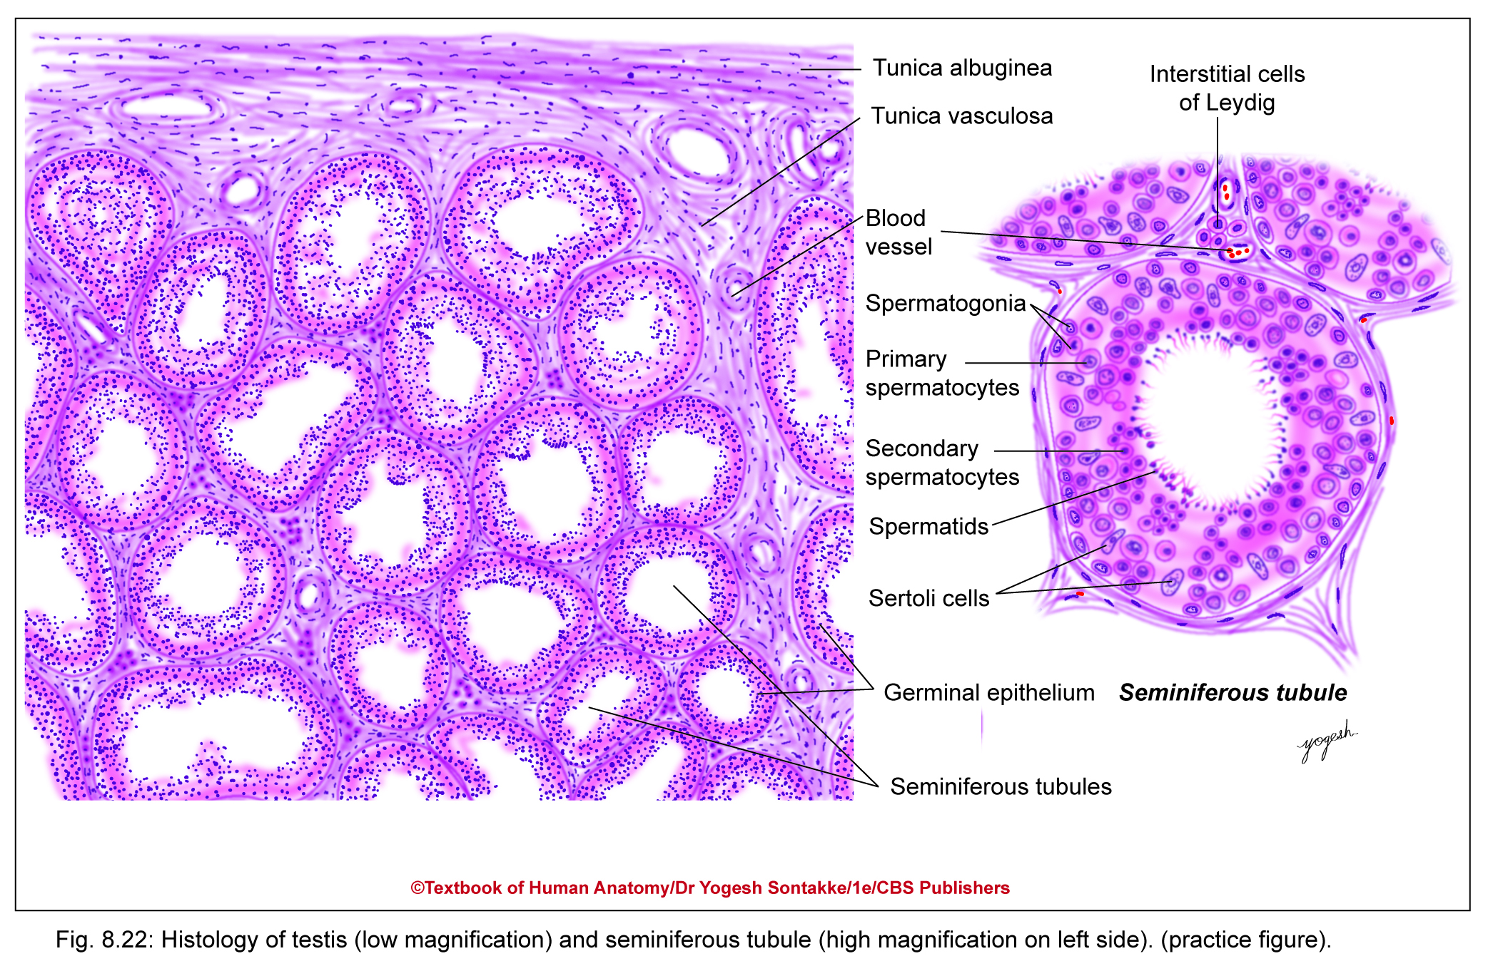

Slide 45
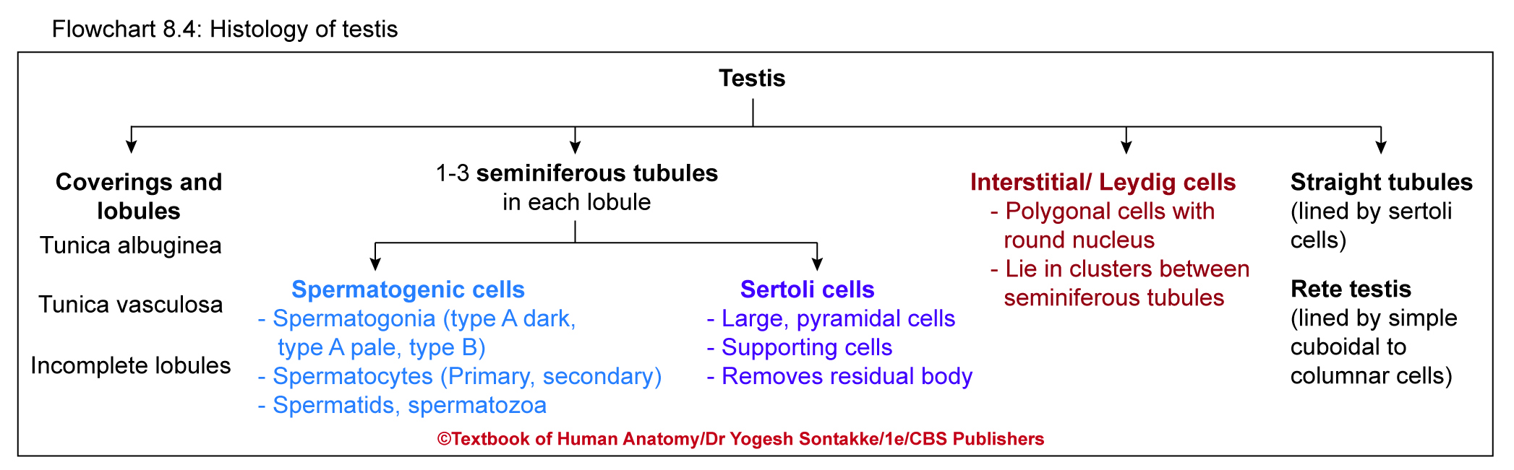

Slide 46
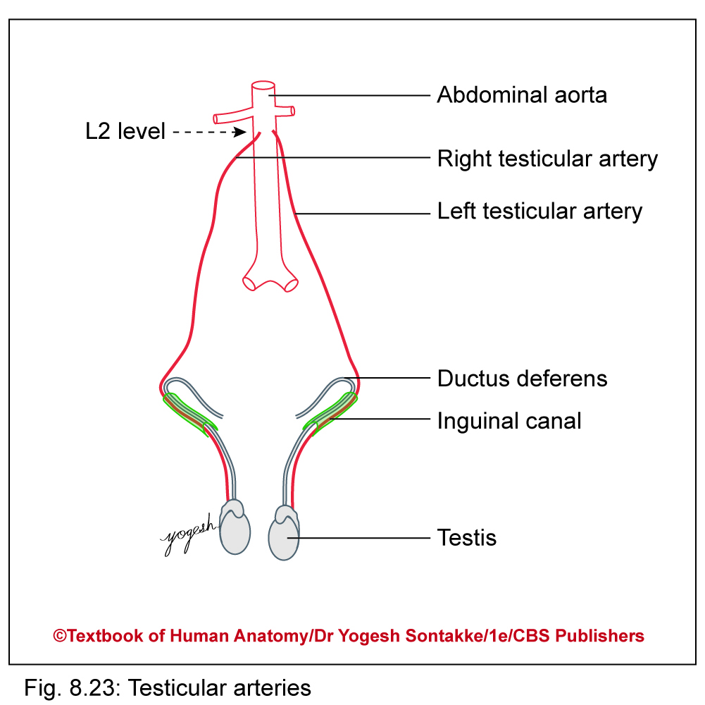
Blood Supply
Arterial supply
  Testicular artery – branch of abdominal aorta and supplies most of testis
  Artery to vas deferens – branch of superior or inferior vesical artery
  Cremasteric artery – branch of inferior epigastric artery

Slide 47
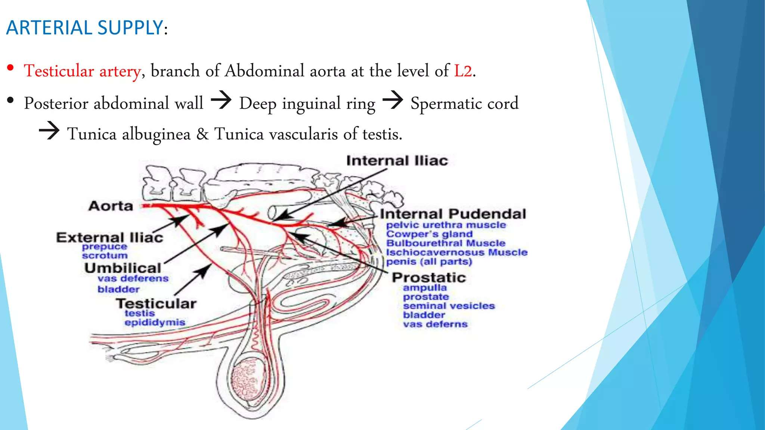

Slide 48
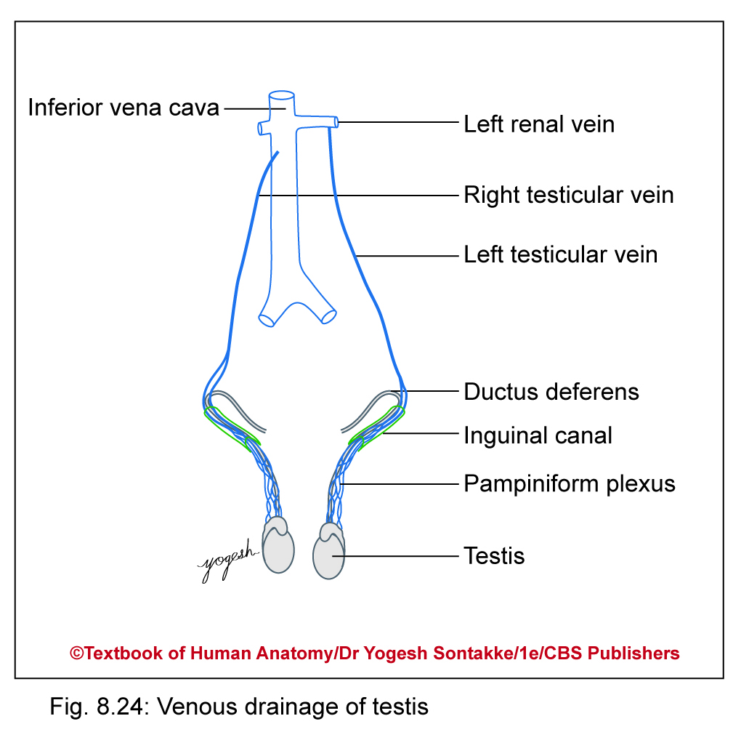
Venous drainage
Plexus of veins derived from veins emerging from testis
Condense to form finally testicular vein
On right, testicular vein drains into inferior vena cava and on left, into left renal vein

Slide 49
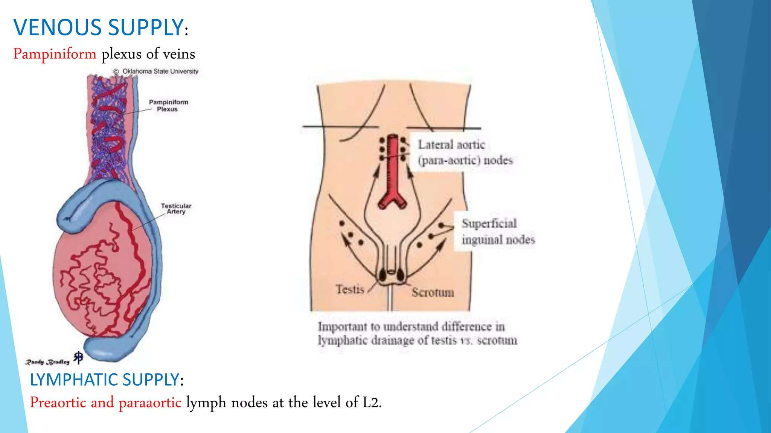

Slide 50
Venous drainage
About 15–20 veins emerge from posterior border of testis and epididymis and join to form pampiniform plexus in spermatic cord
Veins of this plexus unite to form four veins at superficial inguinal ring
Condense to form two veins at deep inguinal ring
At posterior abdominal wall, these two veins fuse to form single testicular vein

Slide 51
Lymphatic Drainage, and Innervation
Lymphatic drainage
Ascend upward along with
  Testicular vessels and drain into preaortic and paraaortic group of lymph nodes at level of L2 vertebra
Innervation (T10)
Supplied by sympathetic nerves from renal and aortic plexuses
These fibers are vasomotor as well as they carry sensation

Slide 52
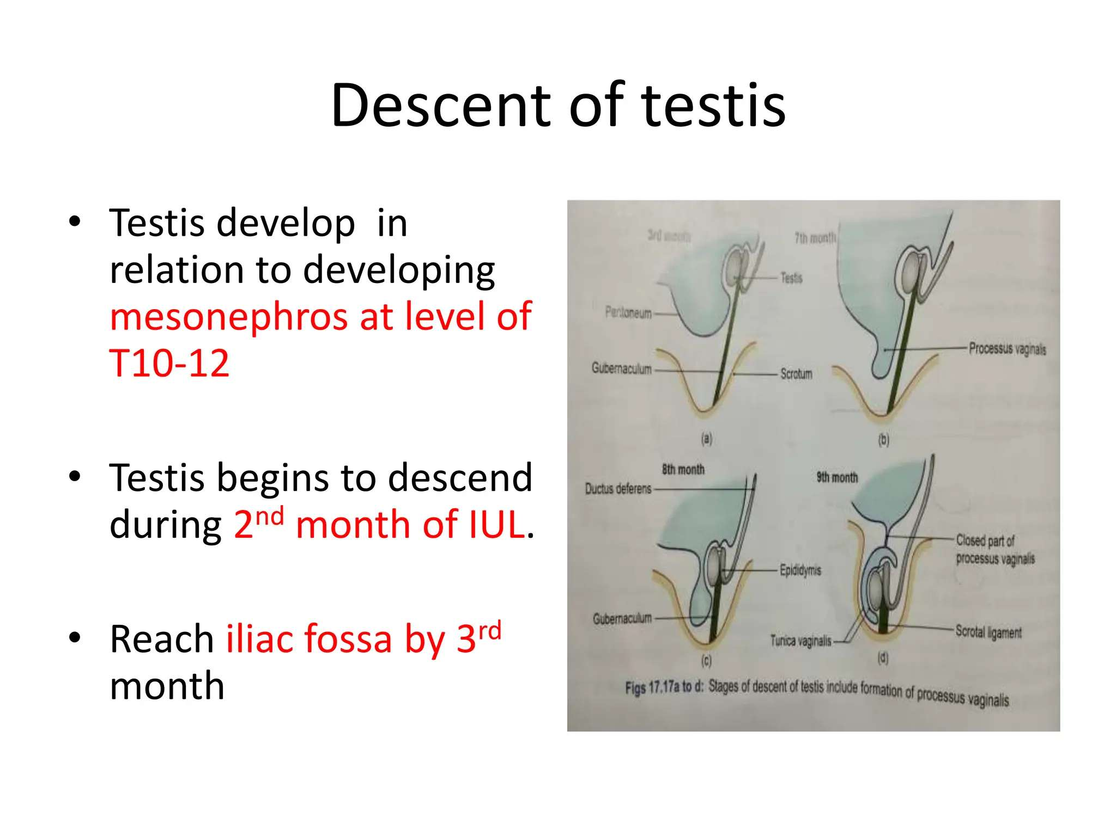

Slide 53
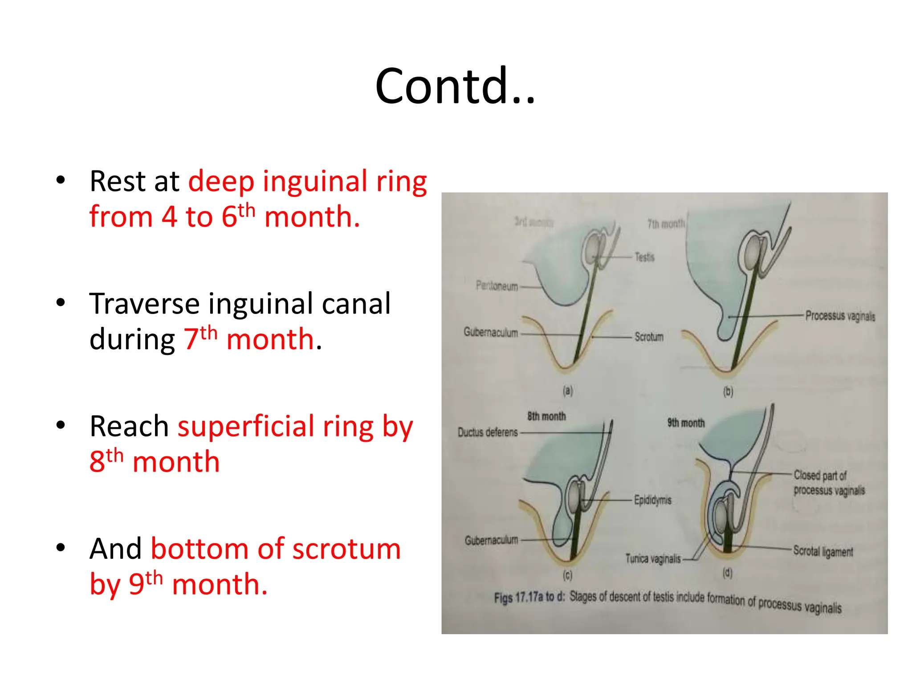

Slide 54
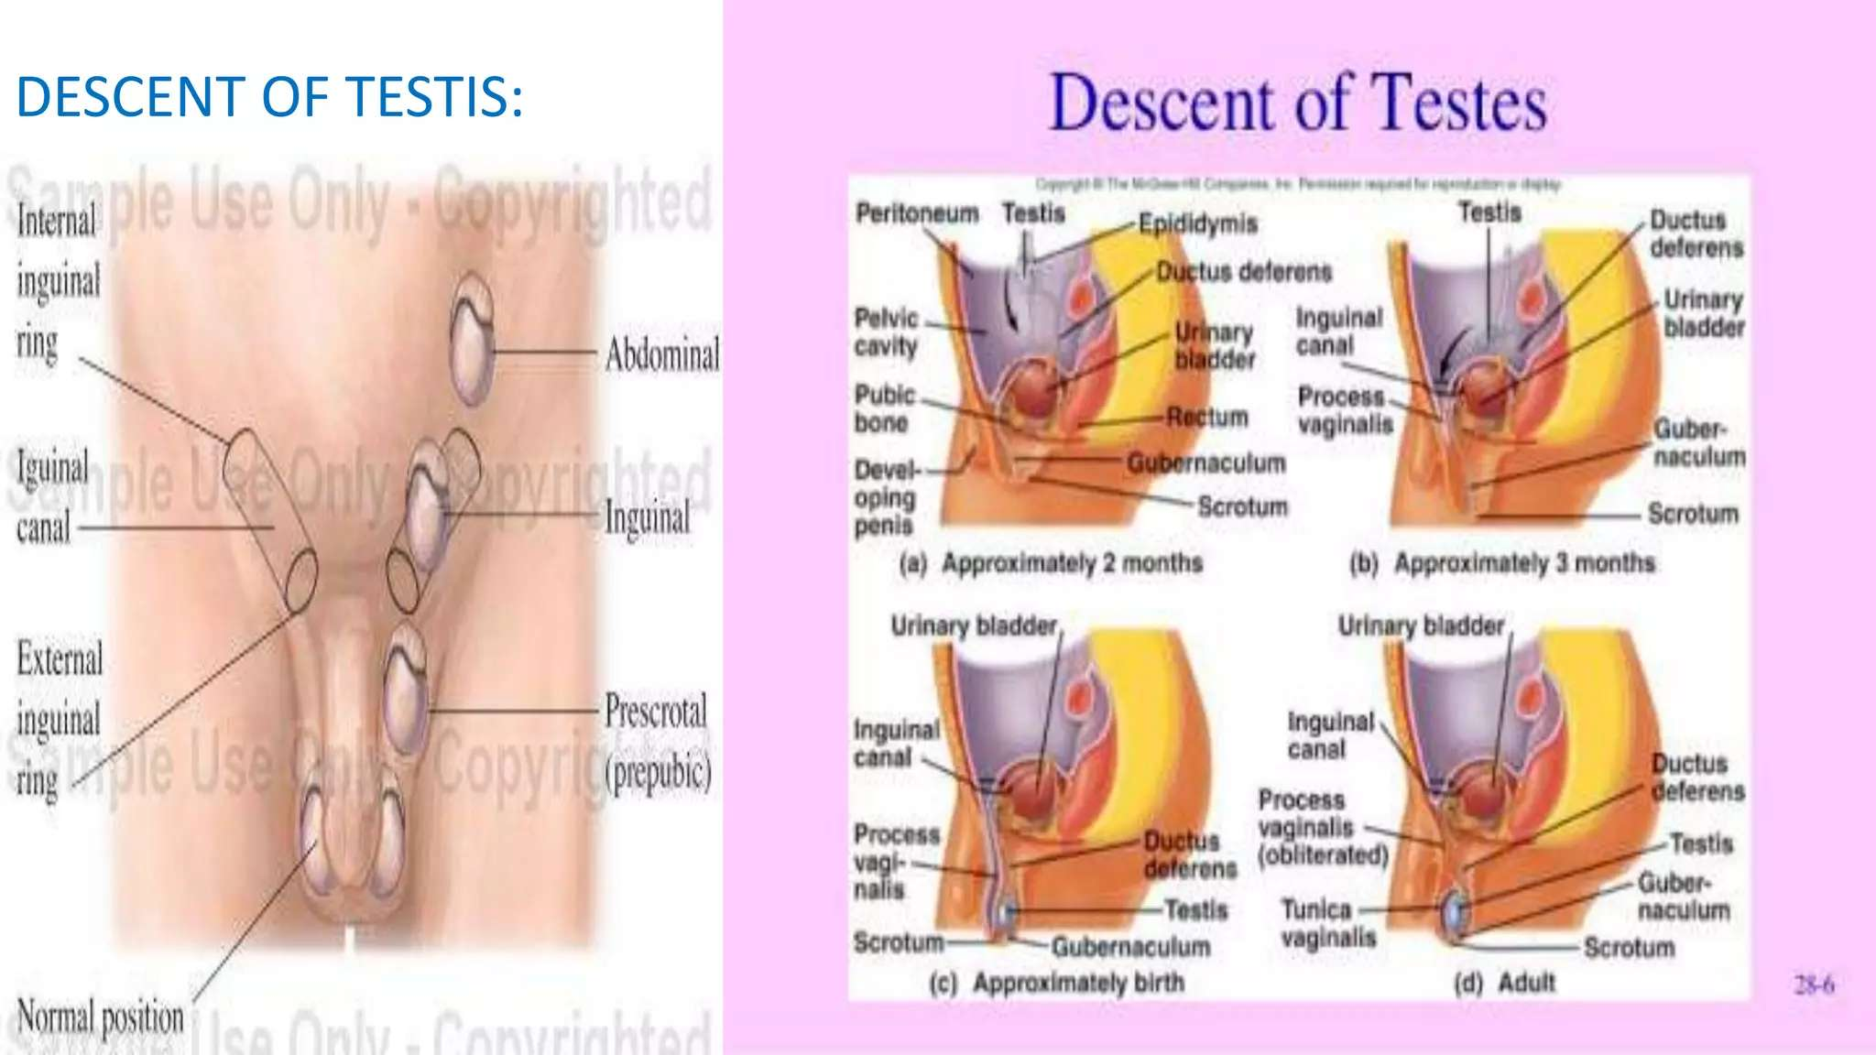

Slide 55
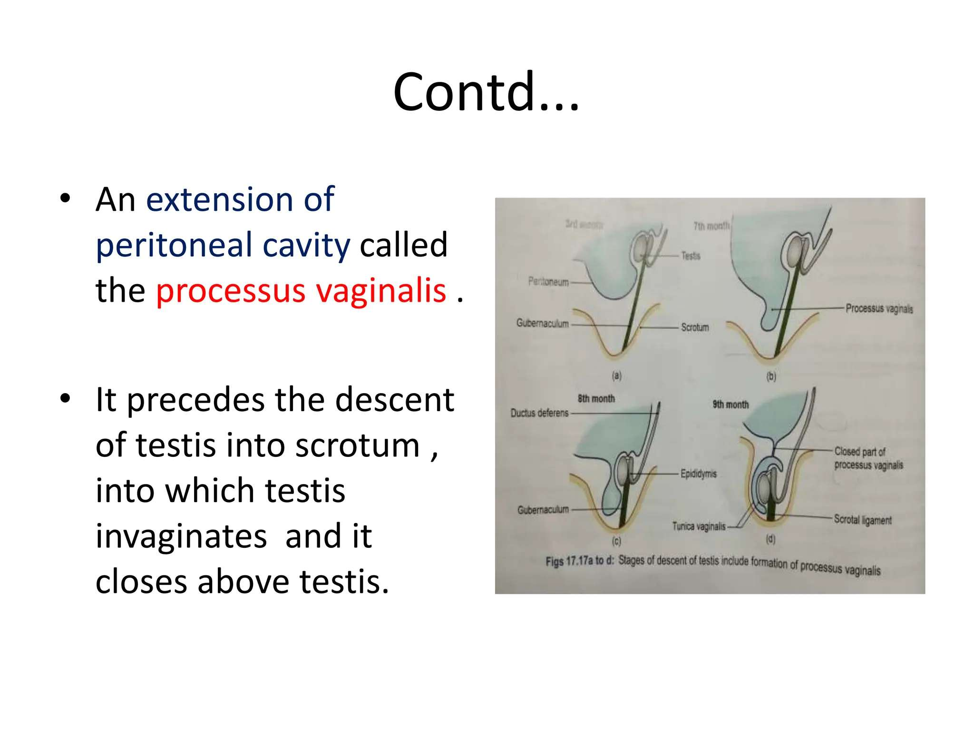

Slide 56
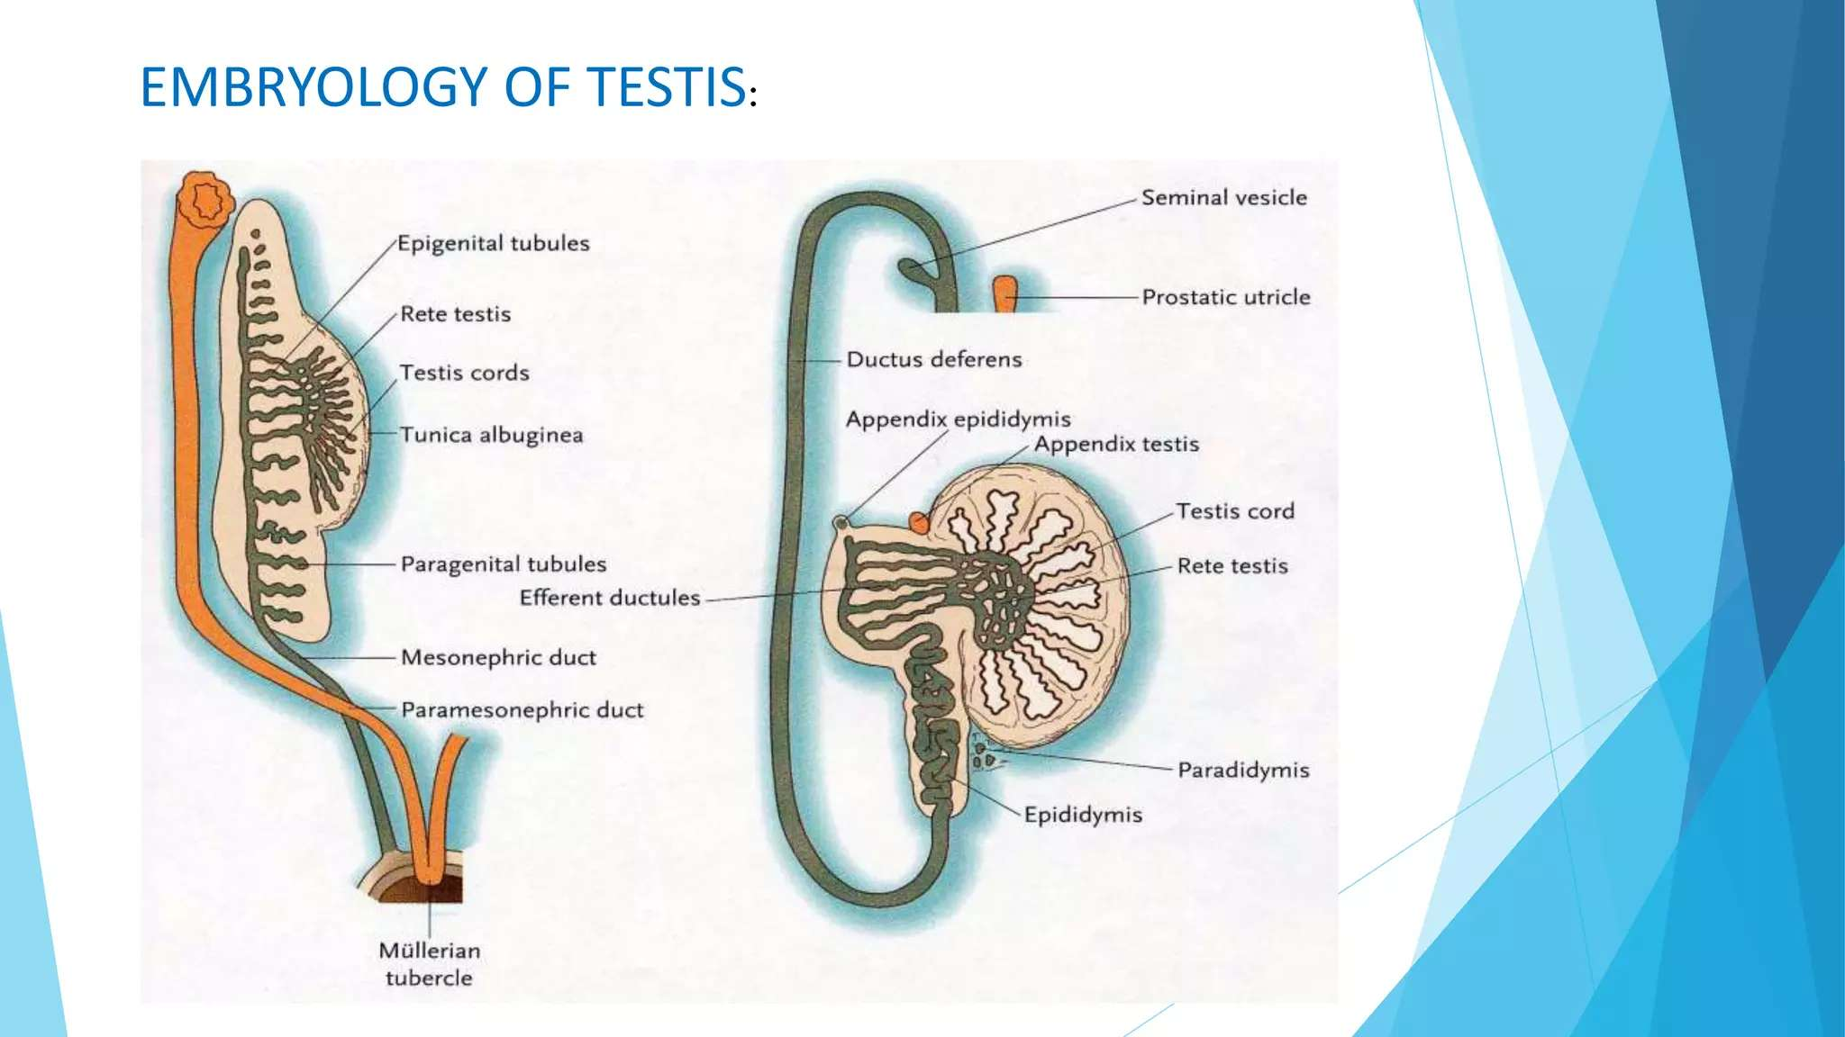

Slide 57
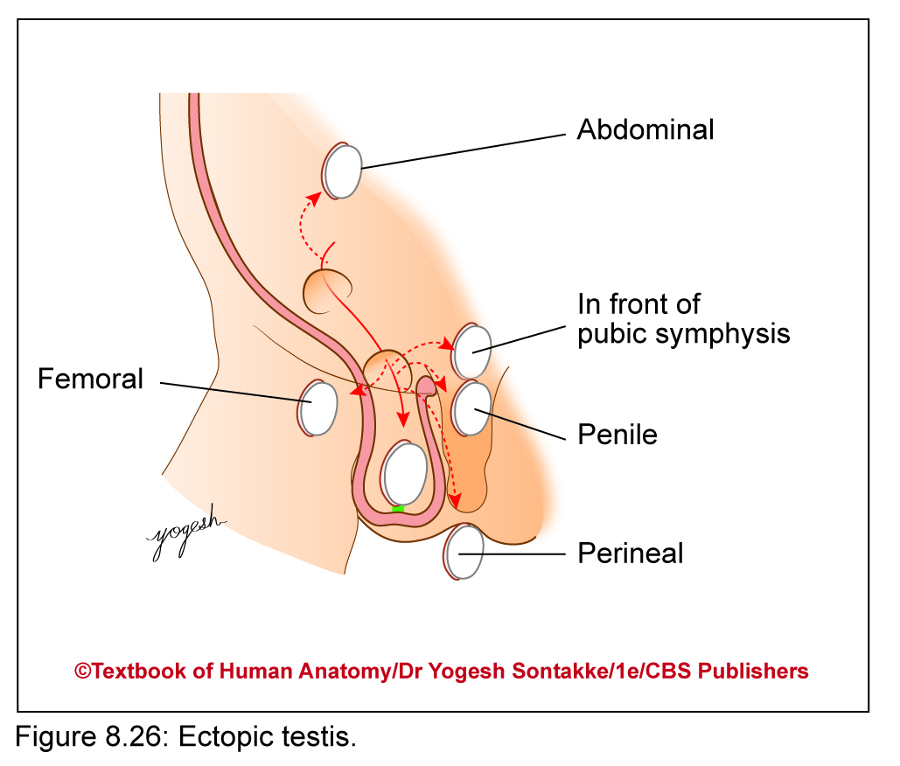
CLINICAL ANATOMY
Anomalies of testis
1. Undescended testis / Cryptorchidism
failure of descent of testis results in absence of one or both testes from scrotum
Incidence: 3% of full-term and about 30% of premature infant boys show undescended testis

Slide 58
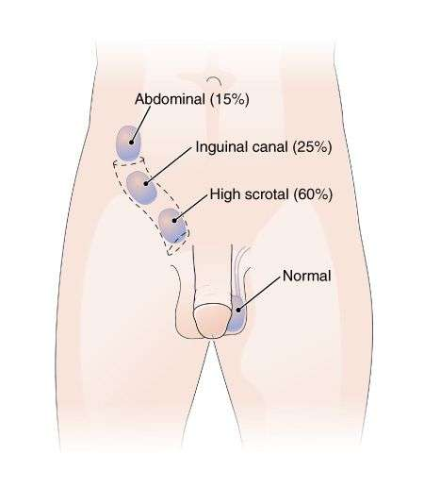
CLINICAL ANATOMY
It may be --
Lumbar
Iliac
Inguinal
Upper Scrotal
(NORMAL PATH OF DESCENT)

Slide 59
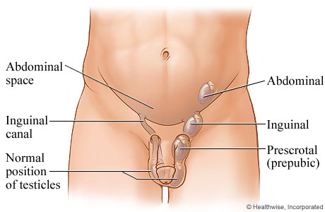
CLINICAL ANATOMY
Out of these in about 80% cases, testis descents during first year of life
May result in infertility, malignancy, or atrophy. Treatment - involves watchful waiting for first year of life
Orchidopexy - testis can be surgically moved to scrotum

Slide 60
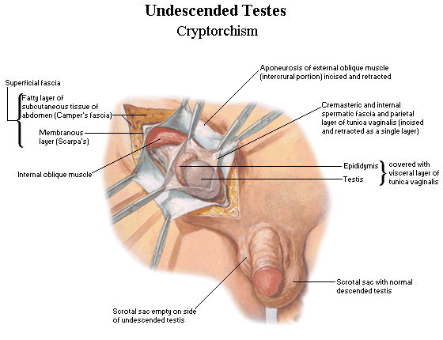

Slide 61
CLINICAL ANATOMY
2. Anorchism:
Both testes – absent or present as rudimentary gonads in abdomen
3. Monorchism: Only one testis descended, whereas another one remains intra-abdominal

Slide 62
CLINICAL ANATOMY
4. Ectopic testis
Testis deviated from usual course of descent
Superficial perineal pouch (perineal)
In front of pubic symphysis
In femoral canal (femoral)
In skin of penis (penile)
Under skin in front of thigh

Slide 63
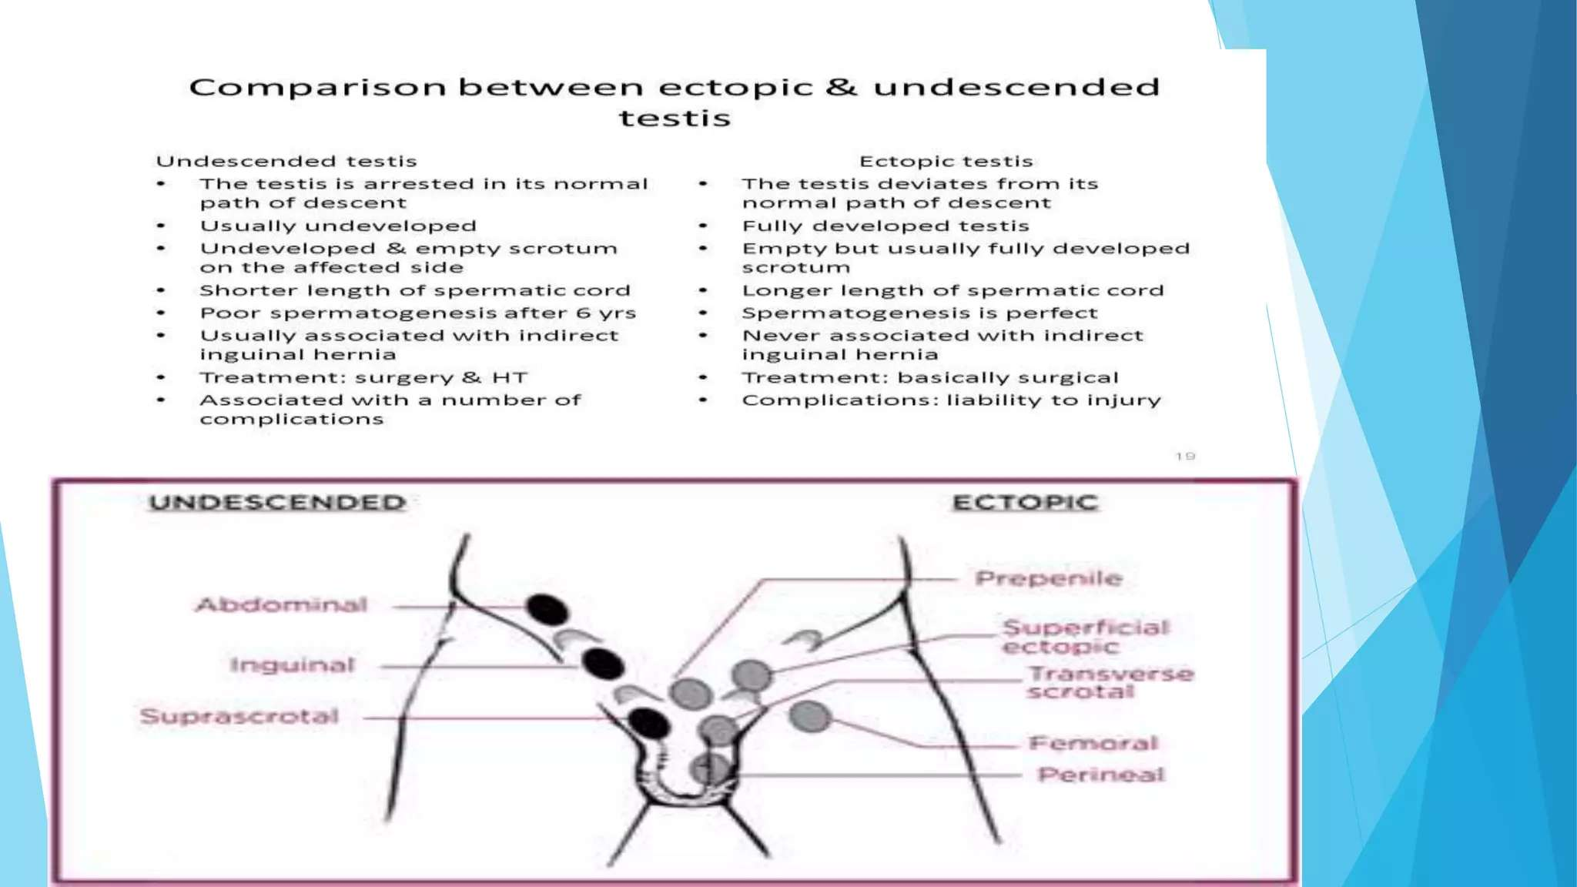

Slide 64
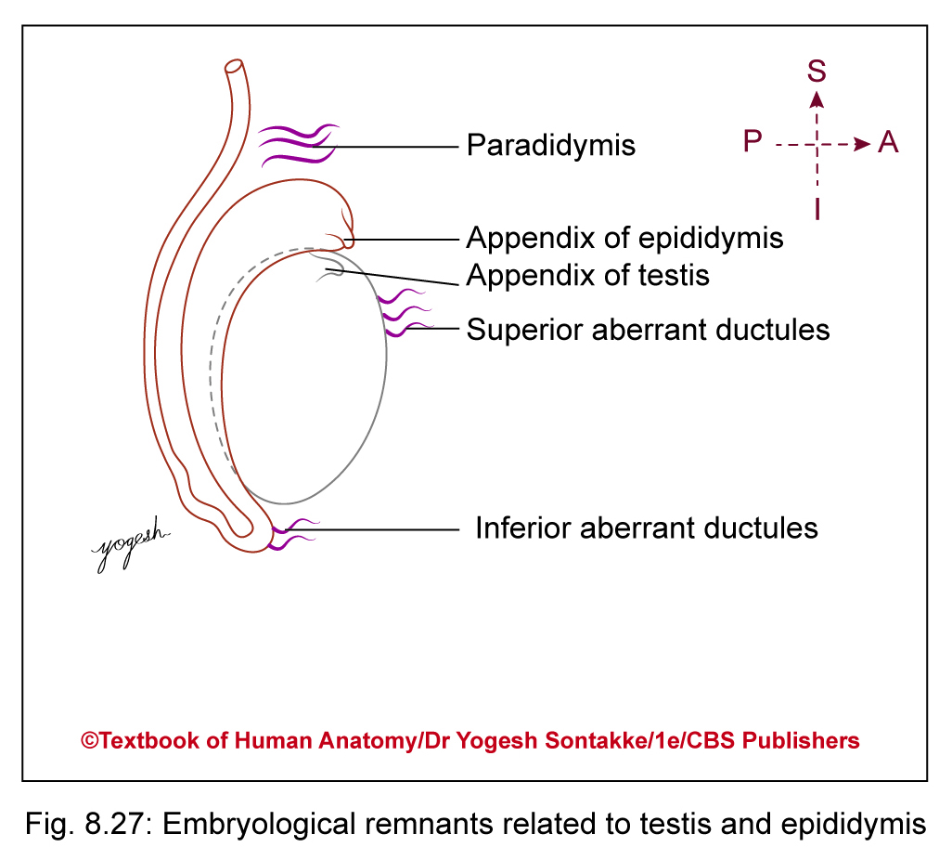
CLINICAL ANATOMY
5. Embryological remnants in relation to testis
  Appendix of testis or Hydatids of Morgagni – remnant of paramesonephric duct
  Appendix of epididymis – remnant of mesonephros
  Small rounded pedunculated body attached to head of epididymis

Slide 65
CLINICAL ANATOMY
  Superior aberrant ductules – remnants of few cranial mesonephric tubules
  These – attached to upper pole of testis

Slide 66
CLINICAL ANATOMY
Inferior aberrant ductules – remnants of intermediate mesonephric tubules
These are 1 or 2 in number and attached to tail of epididymis
Paradidymis or organ of Giraldés – remnants of caudal mesonephric tubules
Lying in spermatic cord above head of epididymis and not connected to testis or epididymis

Slide 67
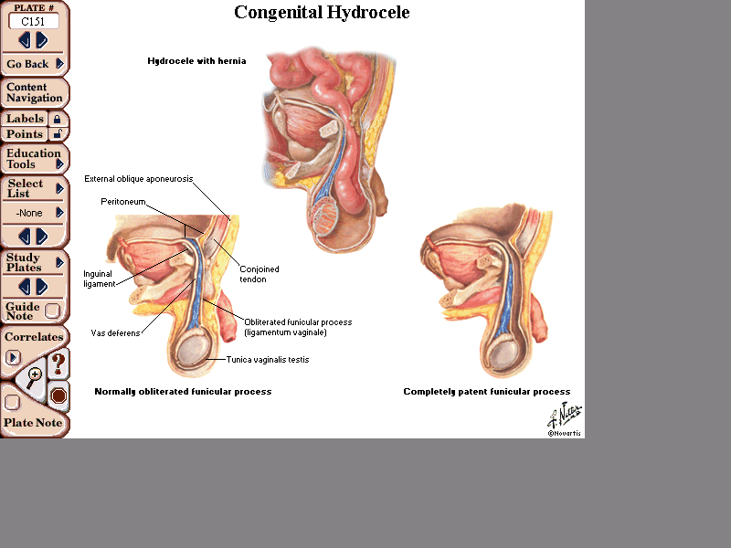
processus vaginalis
(processus vaginalis)

Slide 68
processus vaginalis

Slide 69
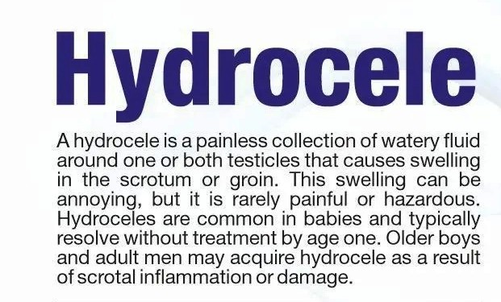

Slide 70
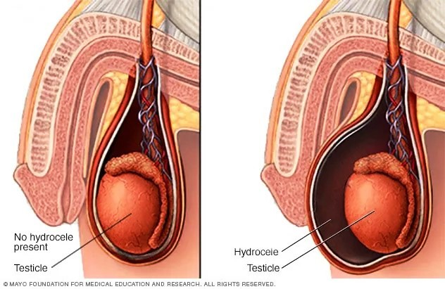
HYDROCELE

Slide 71
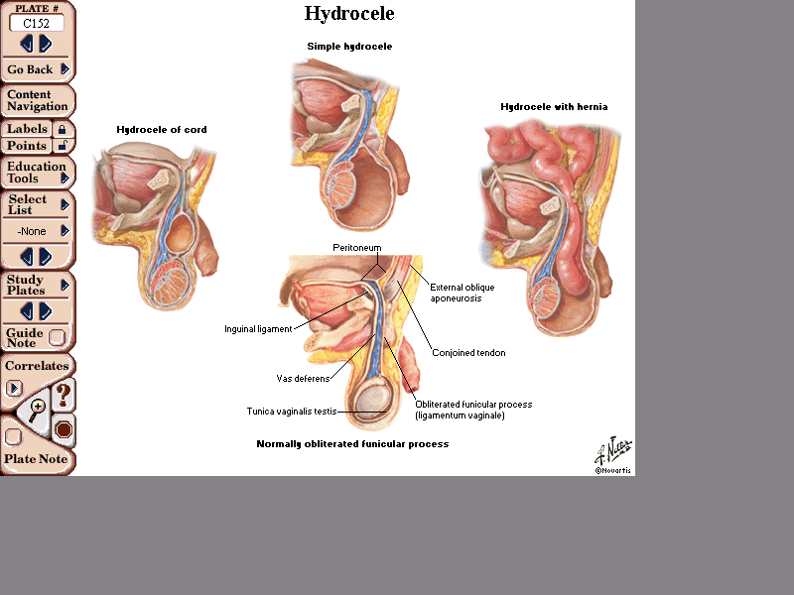

Slide 75
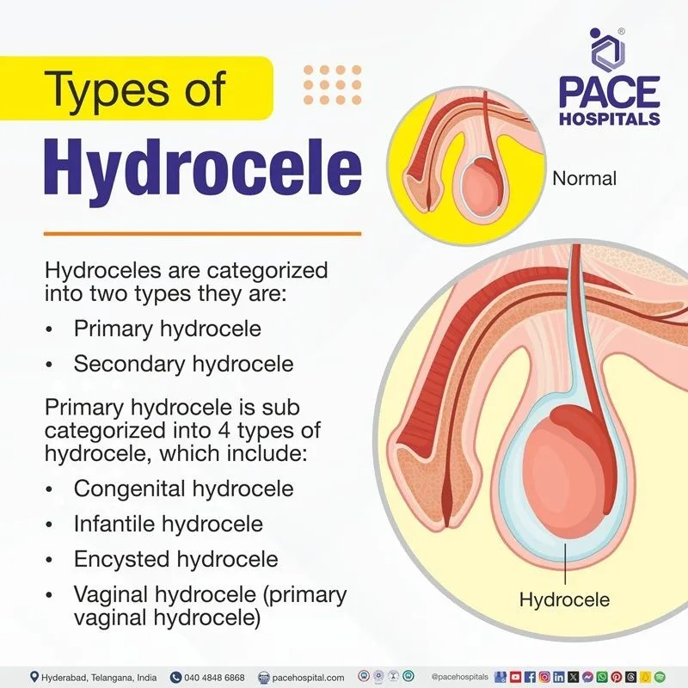

Slide 76
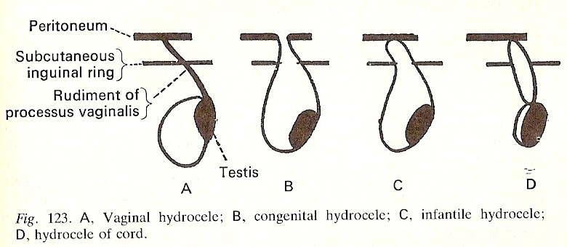
Types of Hydrocoele

Slide 77
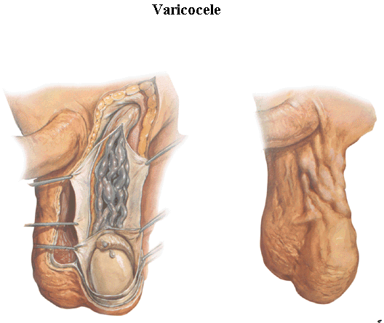

Slide 78

THANK YOU

