Slide 1
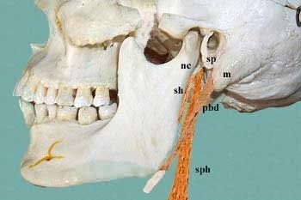
STYLOID APPARATUS
Dr. Praveen Kumar Kurrey
Dept. Of Anatomy
Pt.J.N.M. Medical college

Slide 2
Styloid Apparatus
1. Styloid Process
Muscles
2. Styloglossus
3. Stylohyoid
4. Stylopharyngeus
Ligaments
5. Stylohyoid
6. Stylomandibular

Slide 3
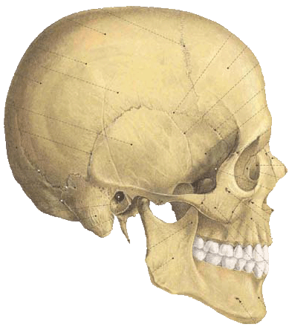
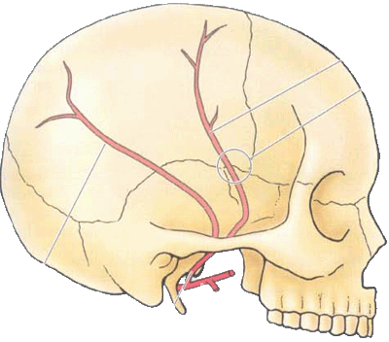
Styloid Process

Slide 4
STYLOID PROCESS
Long, slender, needle-like thin projection from inferior aspect of temporal bone
Location: Located on norma basalis, anteromedial to mastoid process
Length: 2.5 cm
Direction: Directed downward, forward, and slightly medially
Parts
Has base, body and apex (tip)
Base – partially ensheathed by tympanic plate

Slide 5
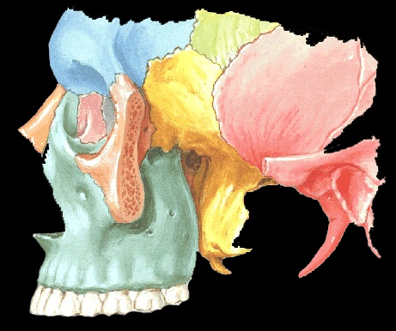
Styloid Process

Slide 6
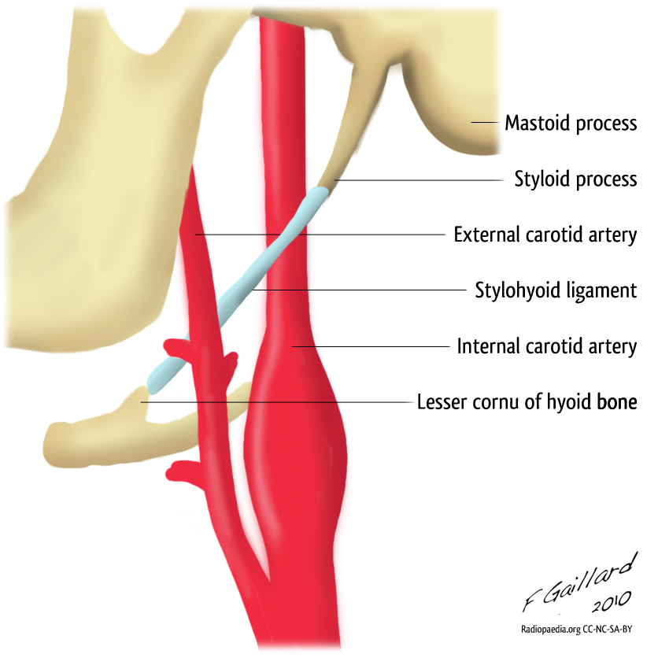
Styloid process between ECA & ICA

Slide 7
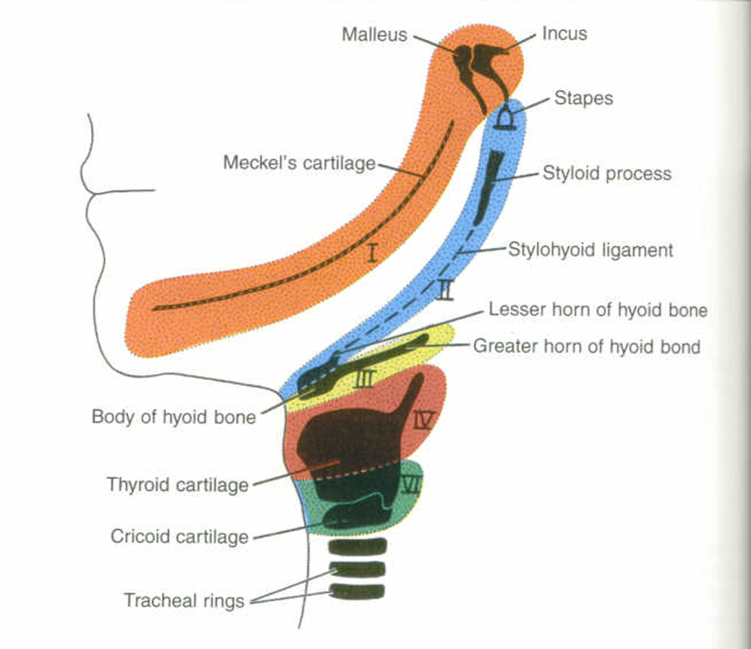
DEVELOPMENT OF STYLOID PROCESS

Slide 8
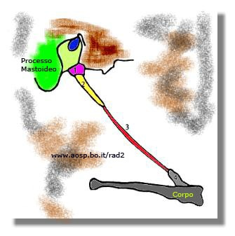
Styloid Process with Stylohyoid muscle

Slide 9
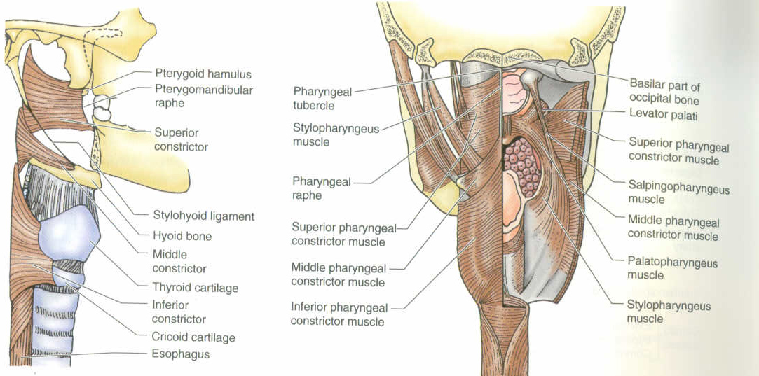
MUSCLES

Slide 10
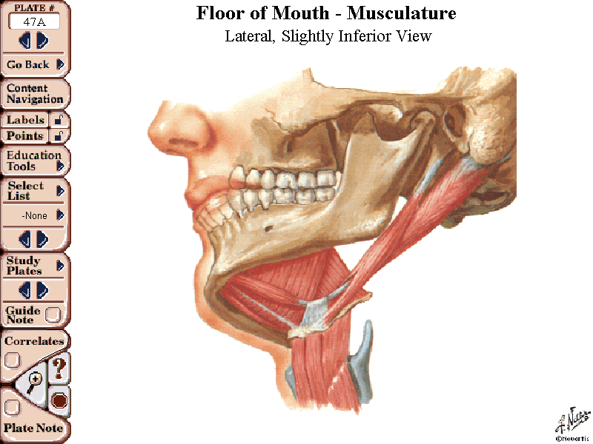
Stylohyoid muscle pierced by Post. belly of Digastric muscle

Slide 11
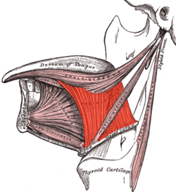
Muscles of Styloid Apparatus
Styloglossus
Stylohyoid
Stylopharyngeus

Slide 12
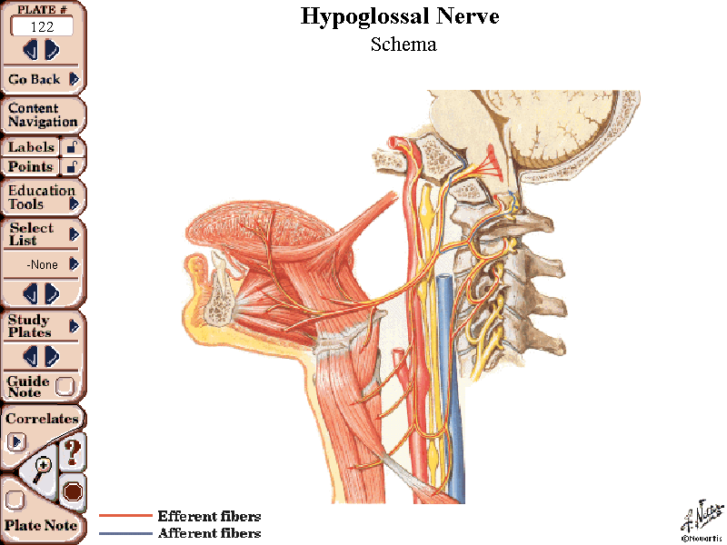
Insersion of Styloglossus muscle

Slide 13
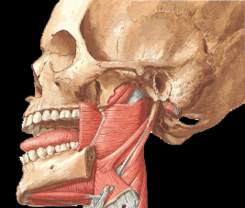
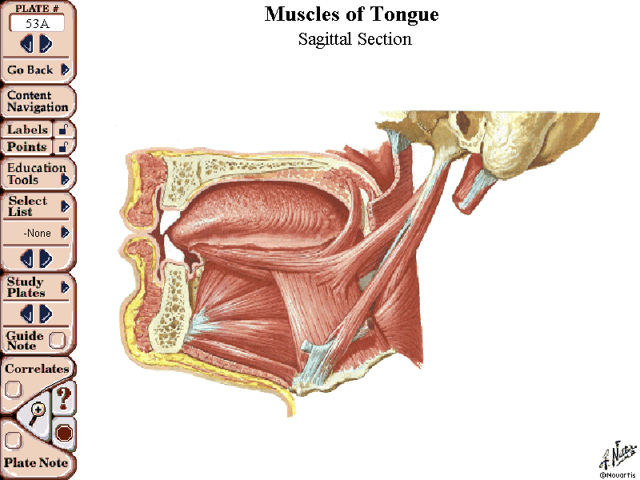
Muscles - Styloglossus & Stylohyoid

Slide 14
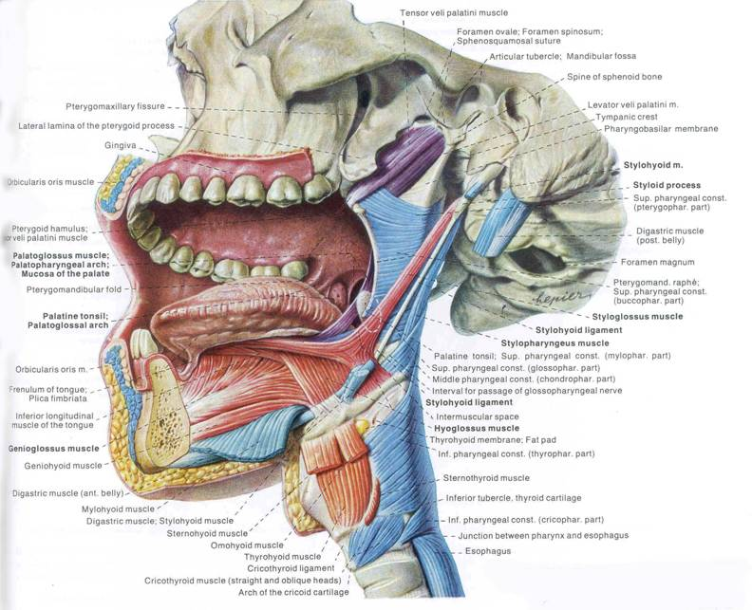
Styloglossus m/s
Stylopharyngeus m/s
Stylohyoid ligament

Slide 15
DEVELOPEMENTAL CORRELATION OF STYLOID APPARATUS
SN | S. APPARATUS | DEVELOPES FROM | NERVE SUPPLY
1. | Styloid Process | Reichard’s cartilage (2nd Branchial arch)
2. | Stylohyoid m/s | 2nd Branchial arch | Facial nerve
3. | Stylopharyngeus m/s | 3rd Branchial arch | Glossopharyngeal n.
4. | Styloglossus m/s | Occipital myotomes | Hypoglossal n.
5. | Stylohyoid ligament | Reichard’s cartilage (2nd Branchial arch)
6. | Stylomandibular ligament | Investing layer of Deep cervical fascia

Slide 16
Features and attachments of styloid apparatus
Structure | Attachments | Features
Stylohyoid muscle | Extends from posterior surface of styloid process to junction of body and greater cornua of hyoid bone | Develops from 2nd arch Supplied by facial nerve
Styloglossus muscle | Extends from tip of styloid process and stylohyoid ligament to side of tongue | Pulls tongue upward Develops from occipital myotomes Supplied by hypoglossal nerve
Stylopharyngeus muscle | Extends from medial surface and base of styloid process to the posterior border of lamina of thyroid cartilage | Elevate larynx during swallowing Develops from 3rd arch Supplied by glossopharyngeal nerve
Stylohyoid ligament | Extends from tip of styloid process to lesser cornua of hyoid bone | Develops from perichondrium of disappearing 2nd arch (Reichert’s) cartilage
Stylomandibular ligament | Extends from tip of styloid process to angle of ramus of mandible | Derived from investing layer of deep cervical fascia

Slide 17
APPLIED ANATOMY
Enlargement of styloid process – Mainly due to
Ossification of stylohyoid ligament
Clinical manifestation
1.Glossopharyngeal neuralgia
2.Eagle’s syndrome – Otalgia ,pharyngeal pain referred to ears
3.Carotidynia
4.Pulsatile tinitus
5.Dysphonia
6.Globus pharyngeus- Palpable neck mass
Treatment : Surgical excision of styloid process
a)Intraoral
b)External
c)Transtonsilar fracture of styloid process
d)Excision of cornu of hyoid bone

Slide 18
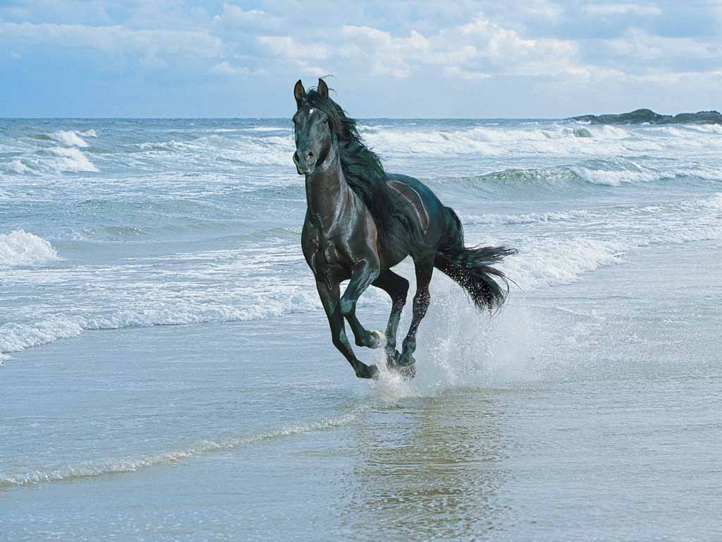
THANK YOU

