Slide 1
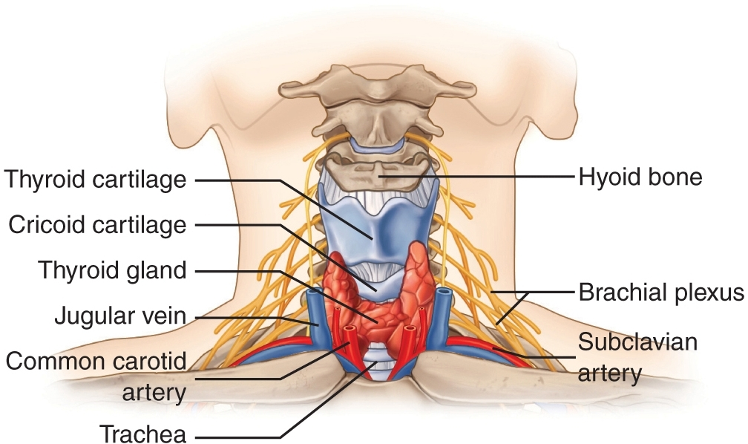
GROSS ANATOMY - head and neck anterior midline structures of neck
Dr. Praveen Kumar Kurrey
M.B.B.S., M.S.,BCME, BCBR, CISP
Professor Anatomy

Slide 2
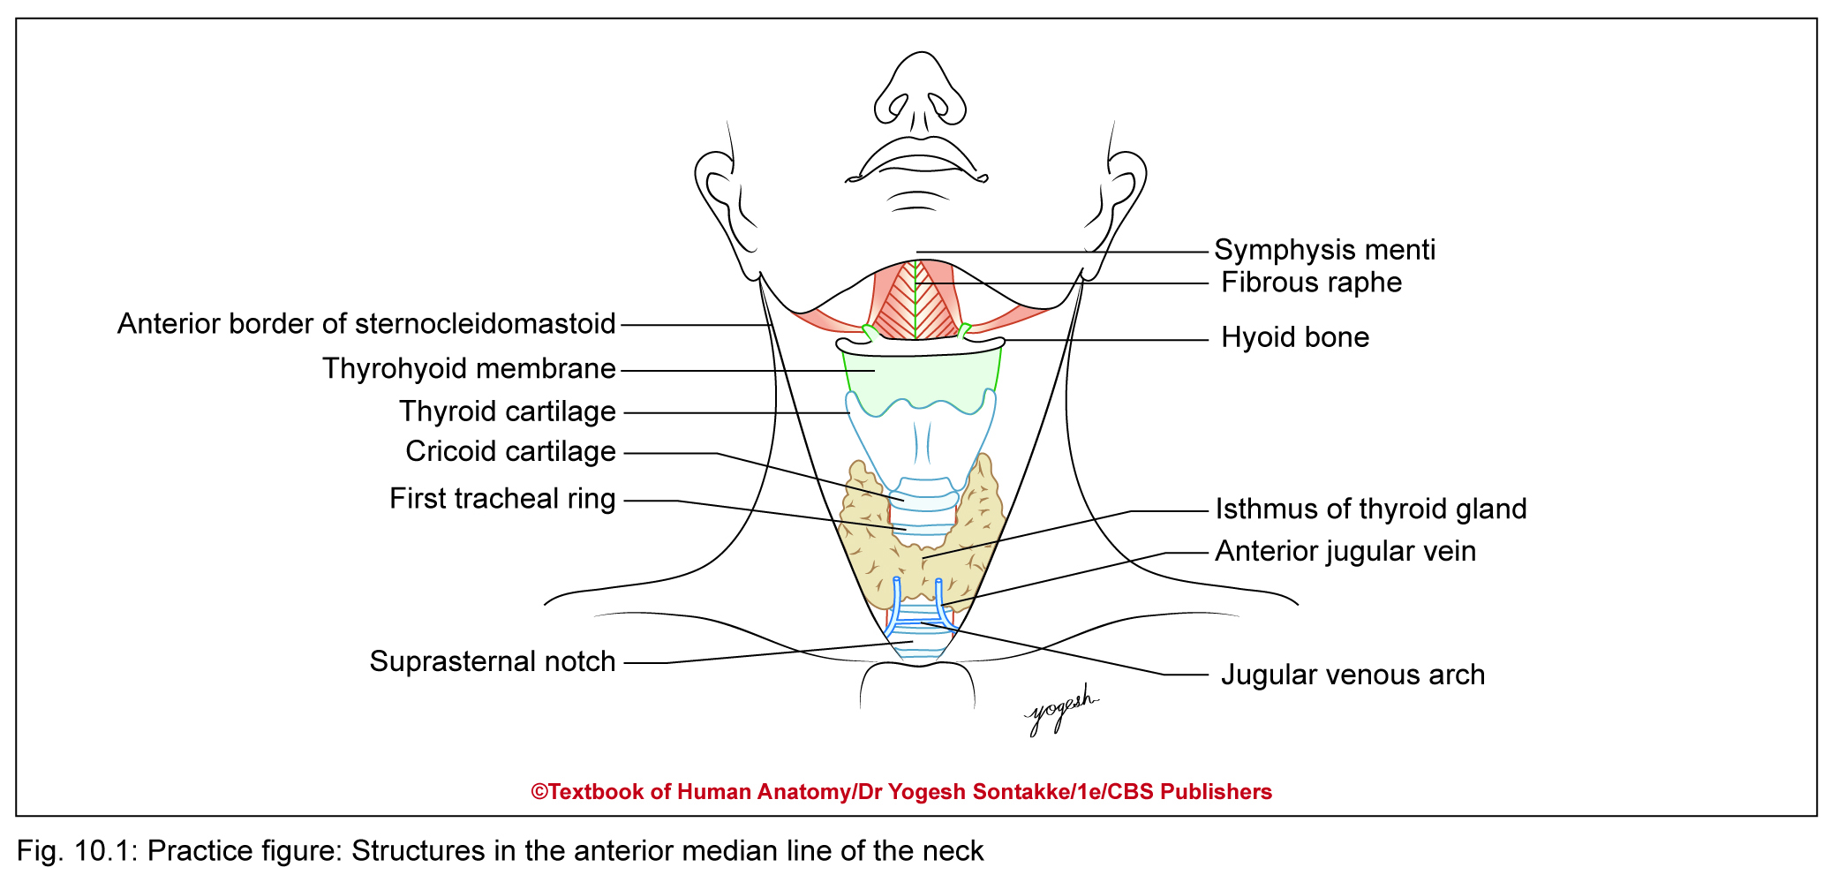
ANTERIOR MEDIAN REGION OF NECK
About 2– 3 cm wide vertical area extending from symphysis menti to the suprasternal notch

Slide 3
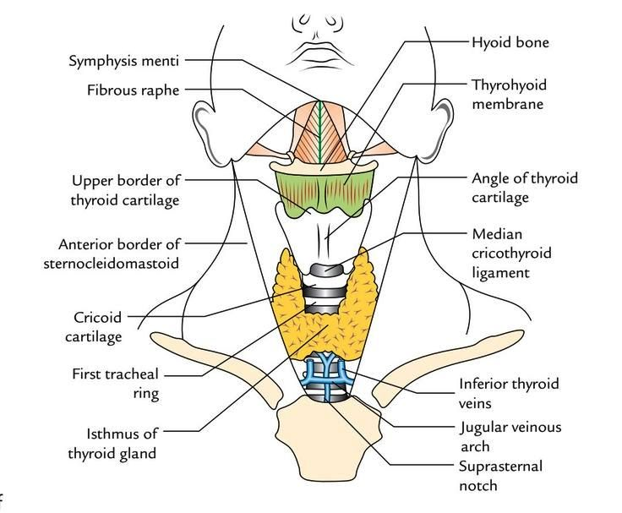
MIDLINE NECK STRUCTURES

Slide 4
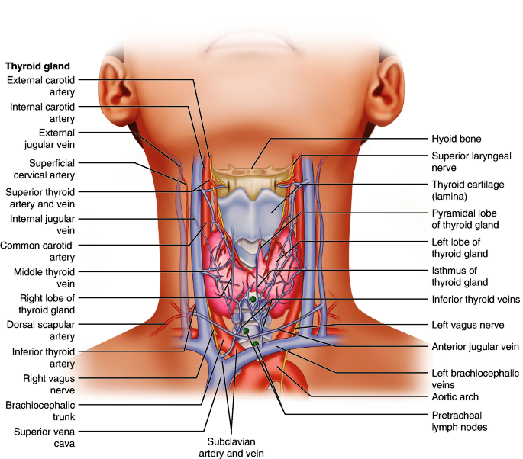

Slide 5
ANTERIOR MEDIAN REGION OF NECK
  Skin
  Superficial fascia: Contains
  Fibers of platysma:
  Anterior Jugular vein
  Submental LN
  Transverse/Anterior cutaneus nerve of neck

Slide 6
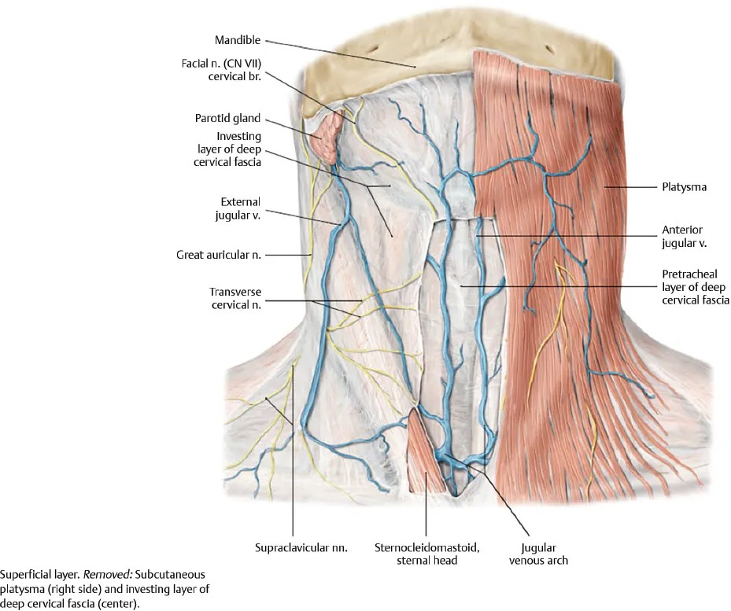
PLATYSMA AND DCF

Slide 7
Anterior median region of neck
Anterior jugular vein
Begins in submental region
Descends about 1 cm lateral to median line
About 2–3 above sternum, pierces investing layer of deep cervical fascia and passes laterally deep to sternocleidomastoid muscle

Slide 8
SUPRAHYOID – ABOVE HYOID BONE
INFRAHYOID - BELOW HYOID BONE

Slide 9
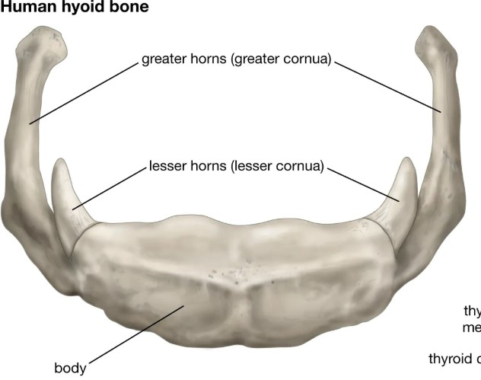
Hyoid bone

Slide 10
SUPRAHYOID STRUCTURES
Submental lymph nodes: They lie just below symphysis menti
Fibrous Raphe- Mylohyoid Muscle – Diaphragma Oris (Submental Triangle)
Transverse cutaneous nerve of neck traverses across middle of neck
Deep fascia or investing layer: In upper part, splits and encloses submandibular glands
In lower part, splits to enclose suprasternal space

Slide 11
SUPRAHYOID STRUCTURES
Deep structures
Mylohyoid muscle and median raphe
Anterior belly of digastric
Superficial part of submandibular gland
Mylohyoid nerve and vessels
Submental branch of facial artery

Slide 13
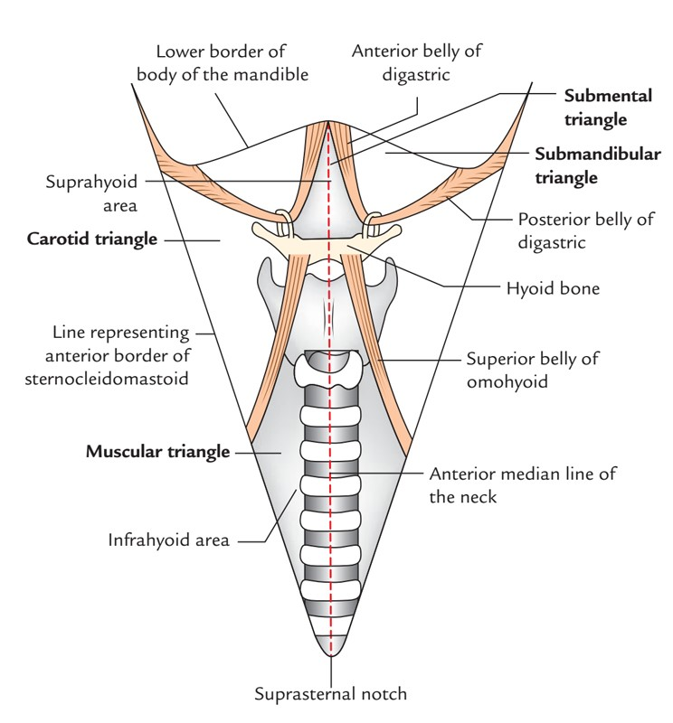
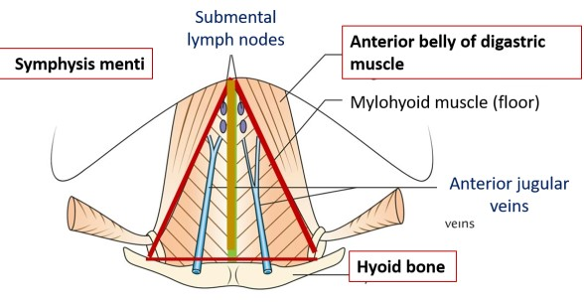
SUBMENTAL TRIANGLE

Slide 14
INFRARAHYOID STRUCTURES
Infrahyoid muscle:
Thyrohyoid membrane:
Thyroid cartilage
Cricothyroid membrane
Cricoid cartilage
Cricothyroid muscle
First Tracheal Ring
Thyroid gland (Isthmus)
Trachea
Inferior Thyroid Veins
Thyroidea Ima Artery
Jugular Venous Arch
Suprasternal Notch

Slide 15
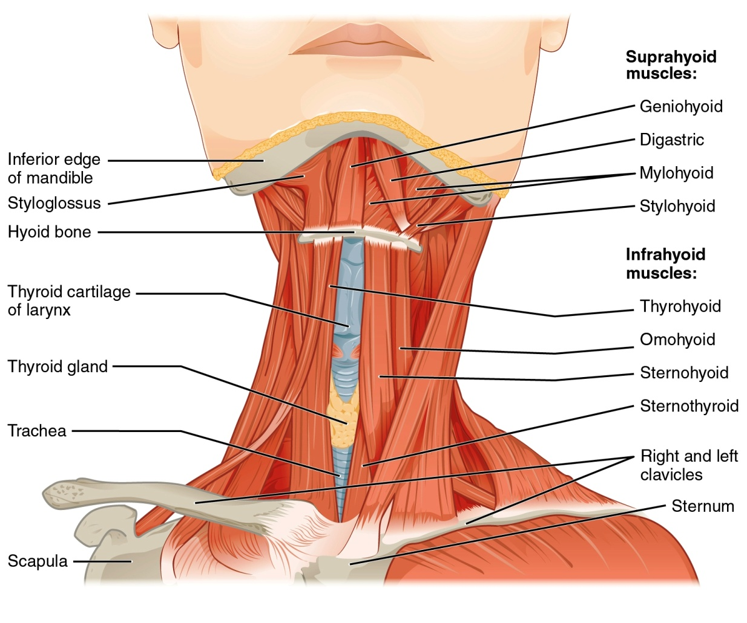
INFRAHYOID MUSCLES

Slide 16
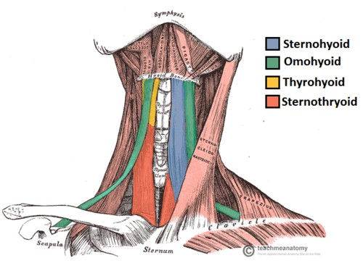
INFRAHYOID MUSCLES

Slide 17
MIDLINE NECK STRUCTURES
THYROHYOID MEMBRANE

Slide 18
Thyrohyoid membrane
Pierced by
Internal laryngeal nerve and
Superior laryngeal vessels
Median Thyrohyoid Ligament-
Midline Thickening of Thyrohyoid membrane
It connects upper border of Thyroid cartilage to upper border of body of hyoid bone
Subhyoid Bursa- membrane is separated by hyoid bone by this

Slide 19
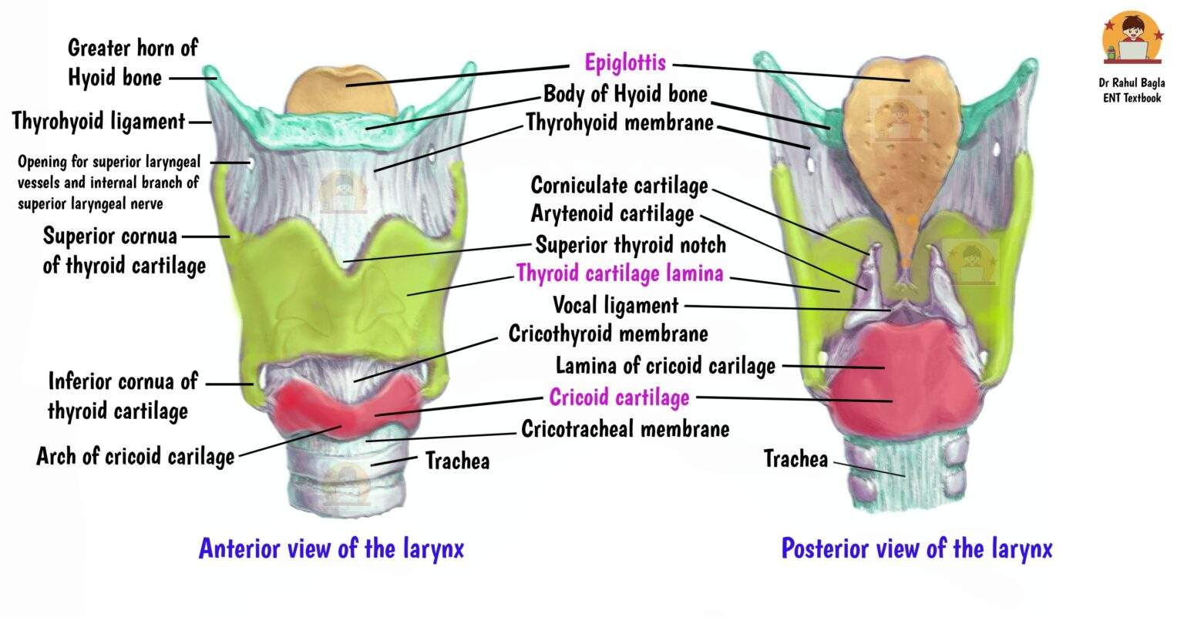
THYROID CARTILAGE

Slide 20
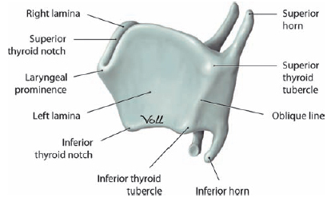
THYROID CARTILAGE
Angle of Thyroid cartilage – Forms Laryngeal Prominence which is prominent in adult males called Adam’s Apple.
Upper Border is Notched- Lies opposite C4 vertebra.

Slide 21
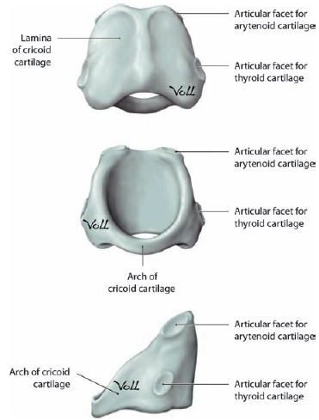
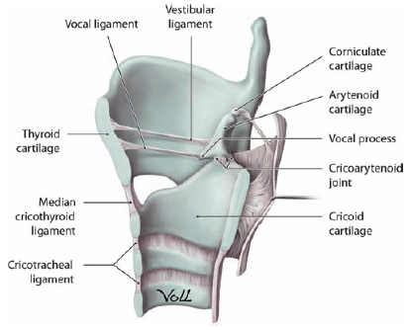
CRICOID CARTILAGE

Slide 22
CRICOID CARTILAGE
Most Important landmark in front of neck as-
Junction of Larynx and Trachea
Junction of Pharynx and Oesophagus
Carotid Tubercle- Anterior tubercle of Transvere processof C6 vertbra against which common carotid artery can be compressed.

Slide 24
Cricothyroid membrane
Median Cricothyroid Ligament - Midline Thickening

Slide 25
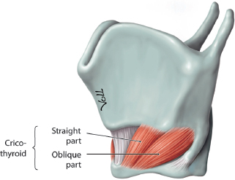
CRICOTHYROID MUSCLE

Slide 26
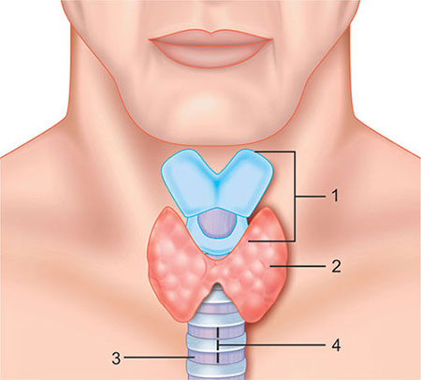
THYROID GLAND

Slide 27
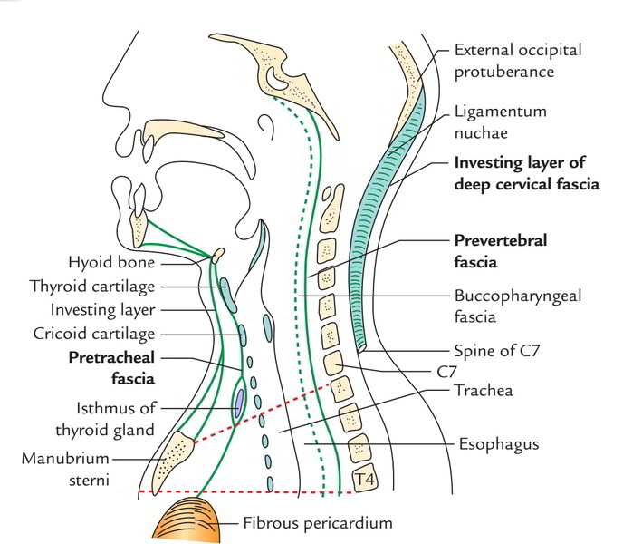
Deep cervical fascia

Slide 28
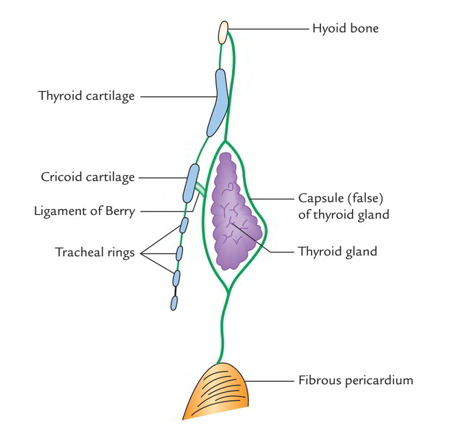
Pretracheal fascia

Slide 29
Pretracheal fascia
Forms False capsule of Thyroid Gland
Forms Suspensory Ligament of Berry – Attach Thyroid gland to Cricoid cartilage

Slide 30
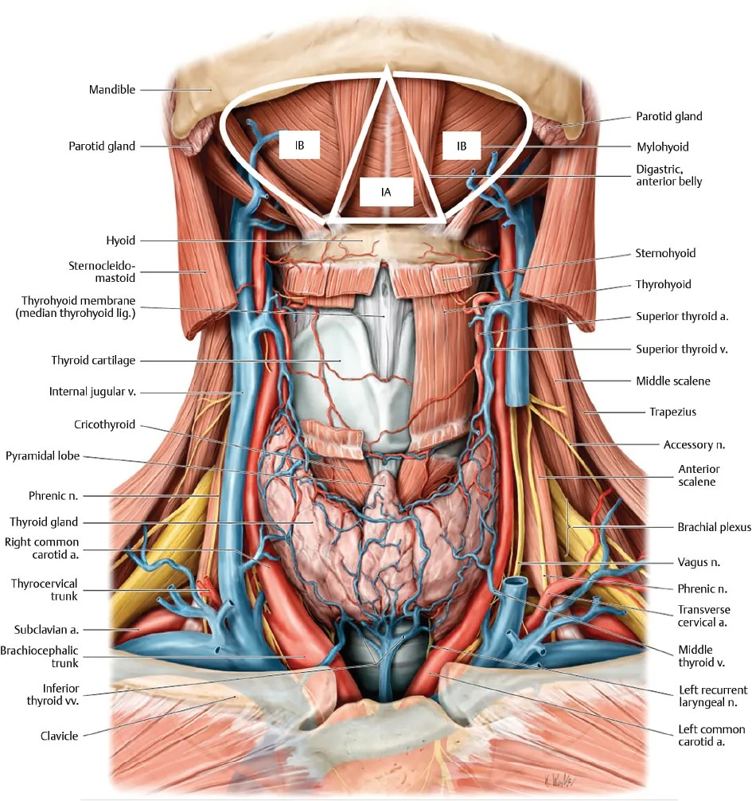
THYROID GLAND,
JUGULAR VENOUS ARCH

Slide 31
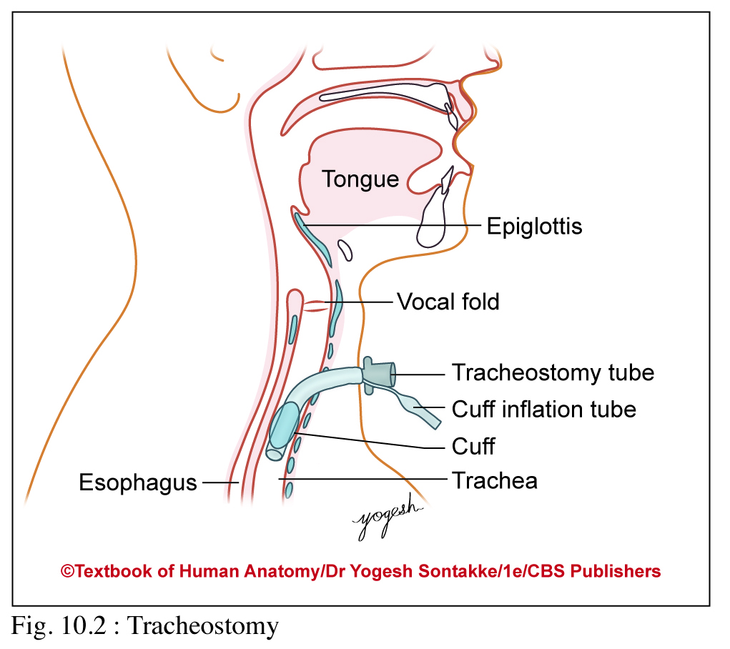
CLINICAL ANATOMY
Common anterior midline swelling includes
  Enlarged submental lymph nodes
  Thyroglossal cyst
  Goitre

Slide 32
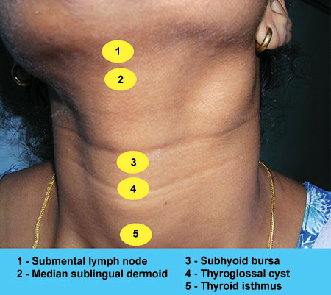
COMMON MIDLINE SWELLINGS

Slide 33
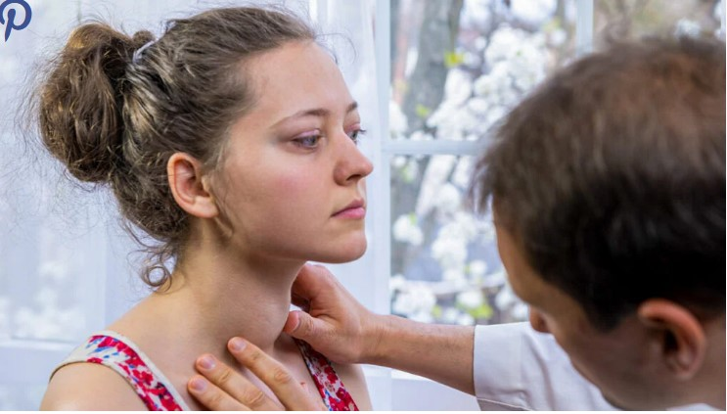
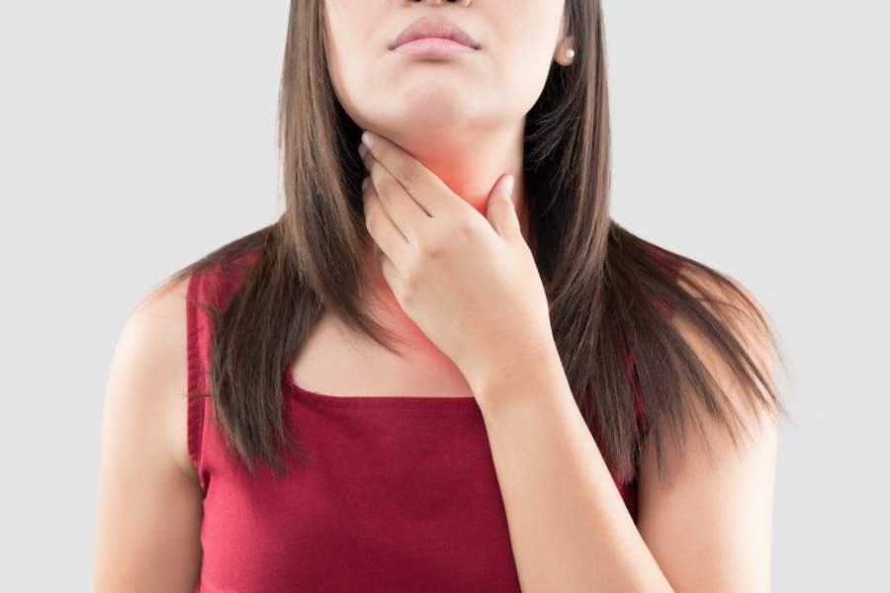
GOITRE

Slide 34
Tracheostomy:
A Tracheostomy is a surgical procedure that creates an opening (stoma) in the neck and directly into the trachea (windpipe) to facilitate breathing.
A tube is inserted to bypass upper airway obstructions, allow for long-term mechanical ventilation, or manage secretions.
It is used for both temporary emergencies and permanent, long-term conditions

Slide 35
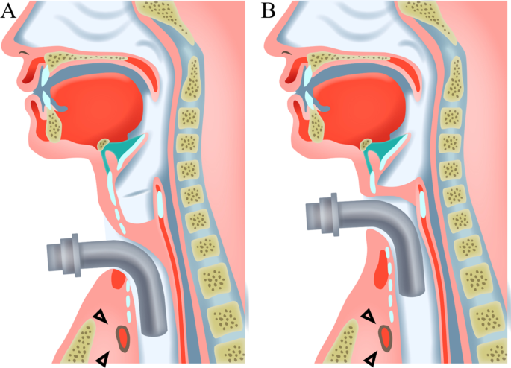
TRACHEOSTOMY

Slide 36
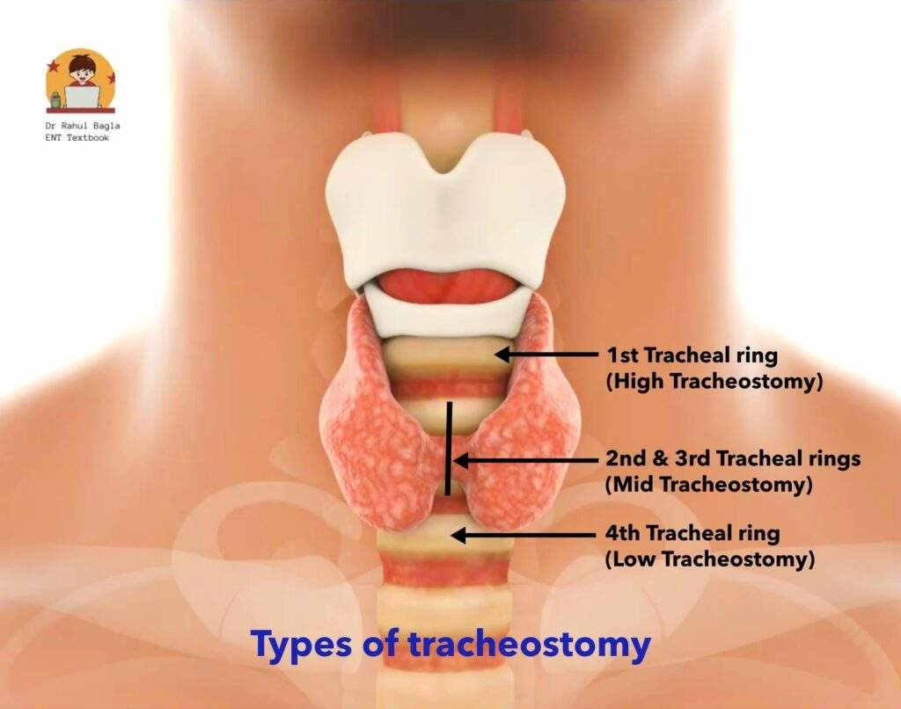
TYPES OF TRACHEOSTOMY

Slide 37
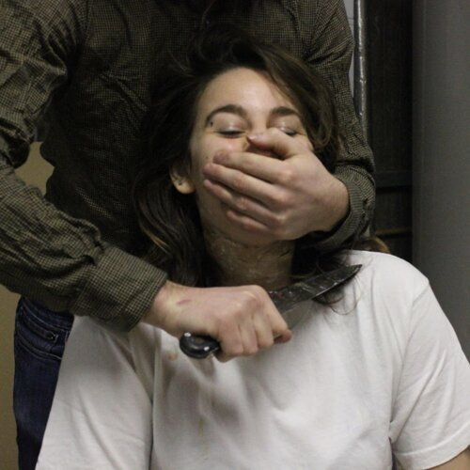
Cut throat wounds

Slide 38


Slide 39

THANK YOU

