Slide 1
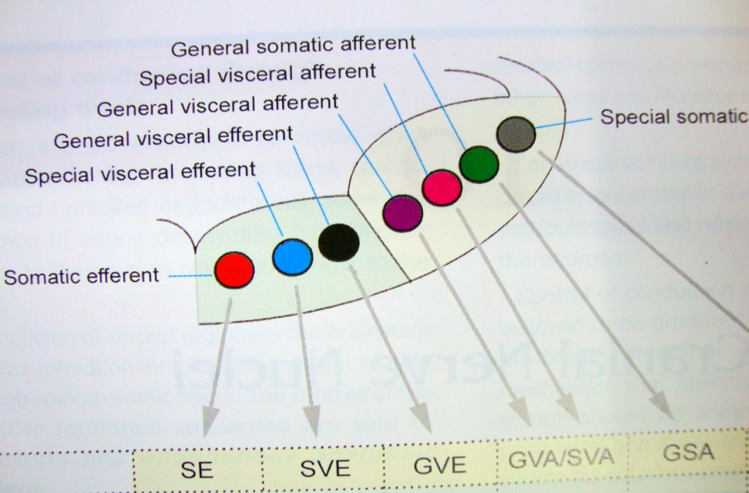
BRAIN
FUNCTIONAL COMPONENTS &
DISTRIBUTION OF CRANIAL NERVES
Dr. Praveen Kumar Kurrey
M.B.B.S., M.S.,BCME , BCBR,CISP
Professor Anatomy

Slide 2
The Cranial nerves
I. Olfactory
II. Optic
III. Oculomotor
IV. Trochlear
V. Trigeminal
VI. Abducens
VII Facial
VIII. Vestibulocochlear
IX. Glossopharyngeal
X. Vagus
XI. Accessory
XII. Hypoglossal

Slide 3
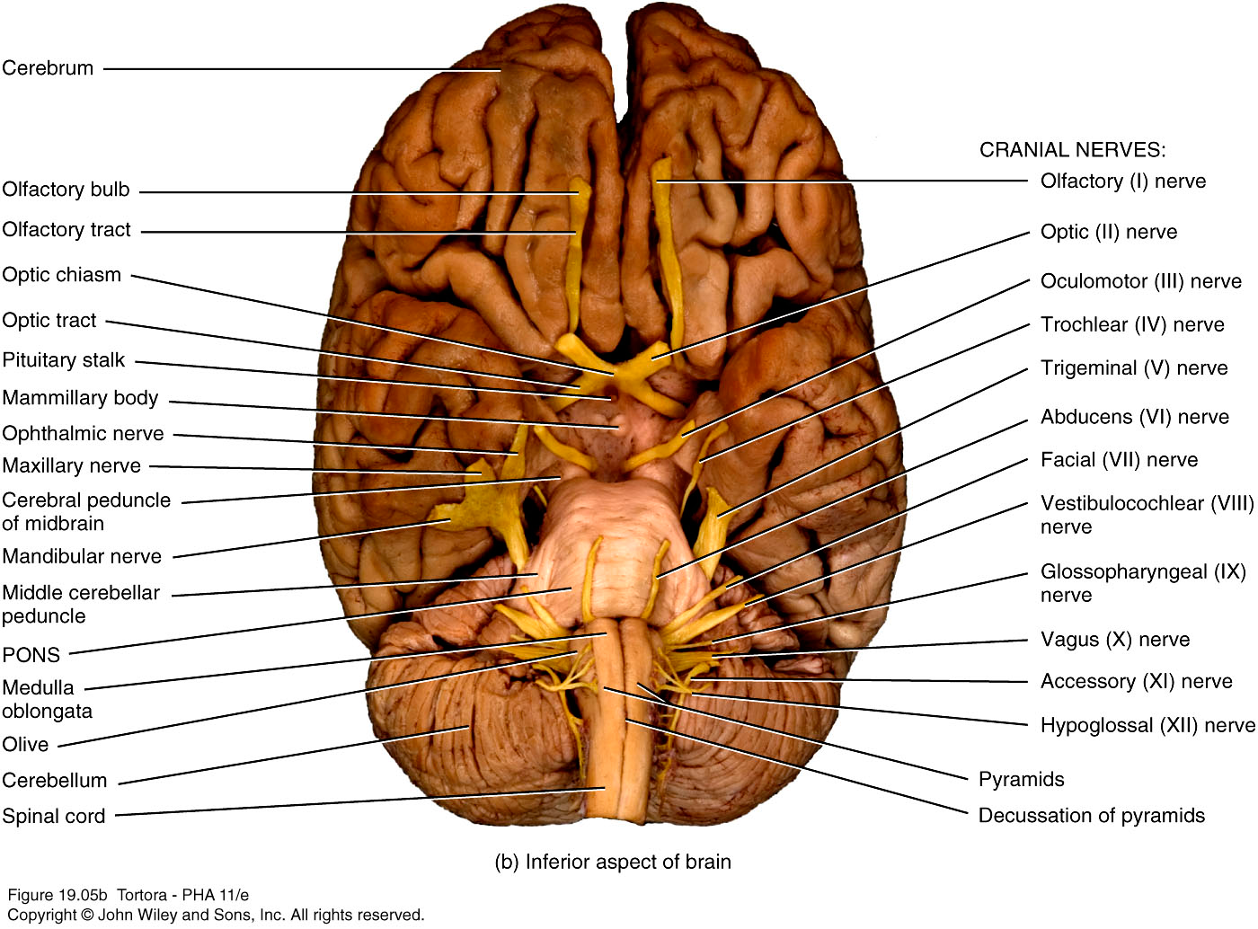

Slide 4
DEVELOPMENT OF FUNCTIONAL COLUMN
In early stage of development –The walls of neural tube consist of 3 layers –
1.Inner eppendymal layer
2.Middle mantle layer
3.Outer marginal layer
Mantle layer differentiate into
a)Dorsal alar lamina—Sensory(A)
b)Ventral basal lamina—Motor(E)
Alar lamina is divided into 2 functional column-
1 )GSA
2)GVA
Basal lamina divided into--
1)GSE
2)GVE

Slide 5
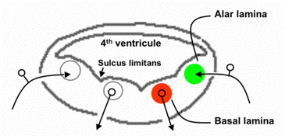
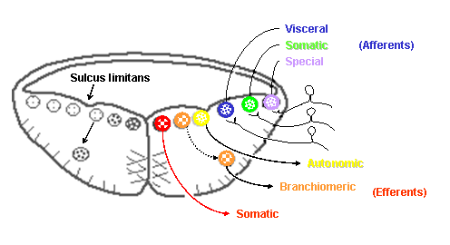
DEVELOPEMENT

Slide 6
Development continues…
During development of hind brain 2 events occur
1) Neural tube widens to form 4th ventricle—As a result alar lamina splayed apart like a open book.Consequently functional components undergo directional change from ventrodorsal to mediolateral.
Dorsal alar –lateral
Ventral basal –medial
2)Three more columns developes
a) 2 branchial /special column appear (b/n somatic &visceral column)
b)Special somatic column appear (most laterally)
Thus total 7 functional column develop --

Slide 7
FUNCTINAL COLUMN IN BRAIN STEM
MOTOR COLUMNS
  General Somatic Efferent (GSE)
  Special Visceral Efferent (SVE)
  General Visceral Efferent (GVE)
  SENSORY COLUMNS
  General Visceral Afferent (GVA)
  Special Visceral Afferent (SVA)
  General Somatic Afferent (GSA)
  Special Somatic Afferent (SSA)

Slide 8
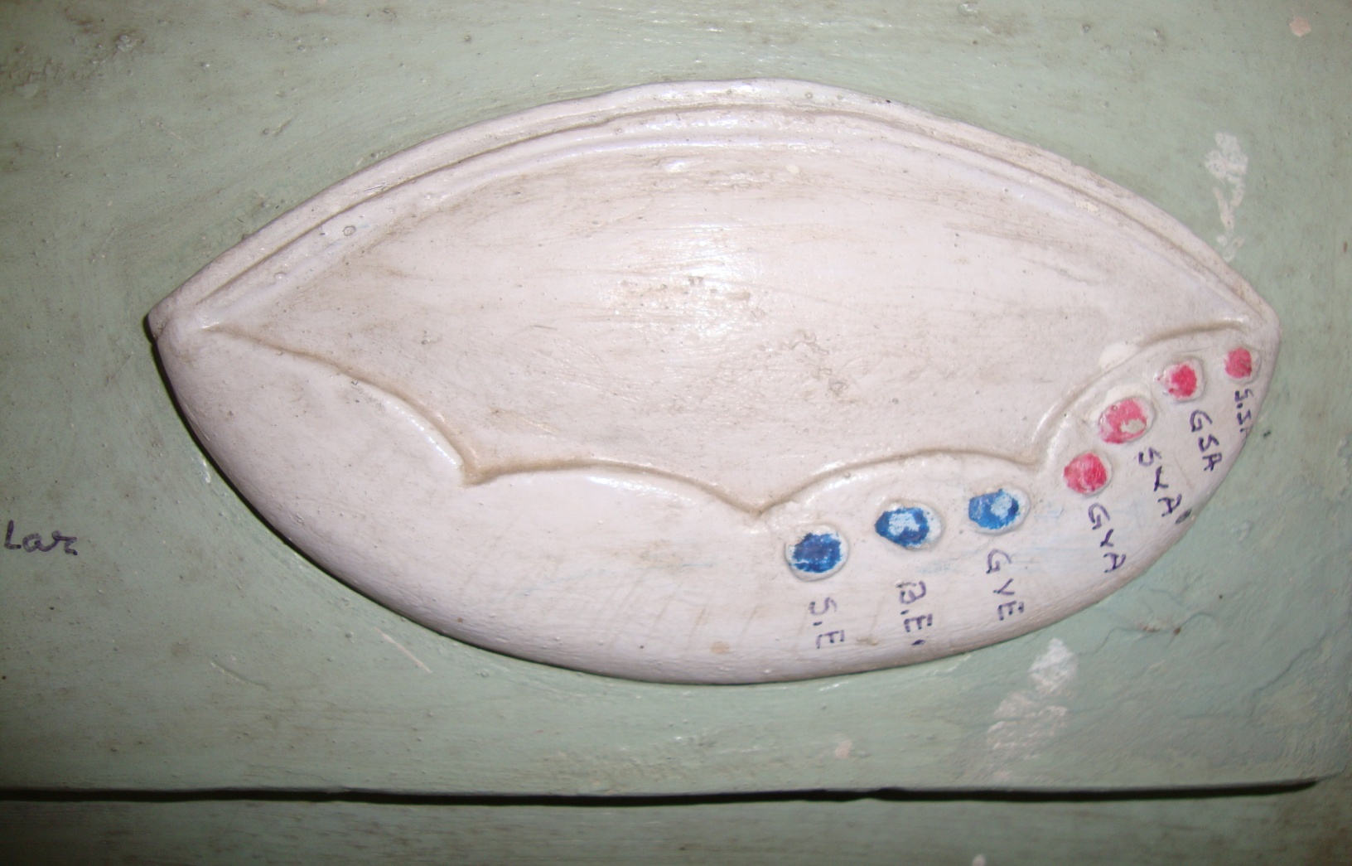
7 Functional columns

Slide 9

FUNCTIONAL COLUMNS

Slide 10
GSE Column | SVE Column | GVE Column | GVA/SVA Column | GSA Column | SSA Column
Oculomotor nucleus | Motor nu. Of Trigeminal | Edinger westphal nu. | Nu.Tractus solitarius (Gustatory nu.) | Sensory nu. Of Trigeminal | Vestibular nu.(Sup, Inf,Med,Lat.)
Trochlear nucleus | Motor nu. Of Facial n. | Lacrimatory nu. |  | 1. Chief sensory nu. | Cochlear nu. Ventral &Dorsal)
Abducent nucleus |  | Sup.salivatory nu. |  | 2.Mesencephalic nu.
Hypoglossal nucleus | Nucleus ambiguus | Inf.salivatory nu. |  | 3. Spinal nu.
 |  | Dorsal nu.of vagus n.

Slide 11
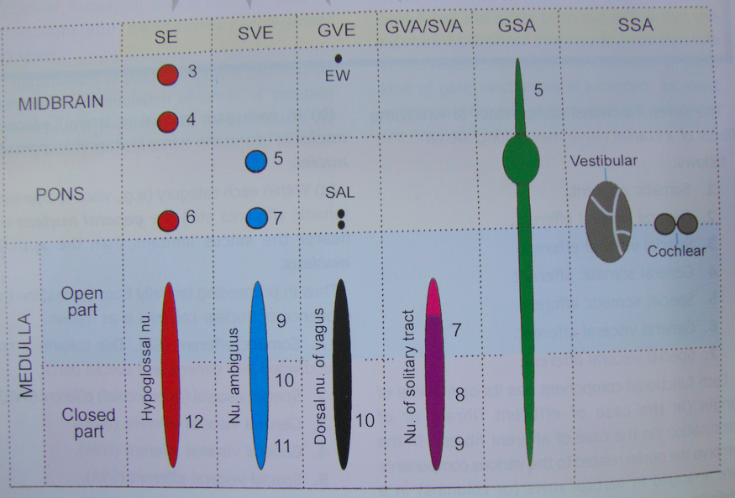
Distribution of nuclei

Slide 12
3 Types of cranial nerves
Somatic efferent nerves --Those that contain GSE fibres .(e.g., CN III , IV, VI and XII) .
Special sensory -- Those that contain fibres (SSA or SVA) and nothing else (e.g., CN I, II and VIII)
Branchiomeric nerves-- And the remaining nerves that are more complex, contain several components including the innervation of the branchial arch musculature (e.g., CN V, VII, IX, X and XI).

Slide 13
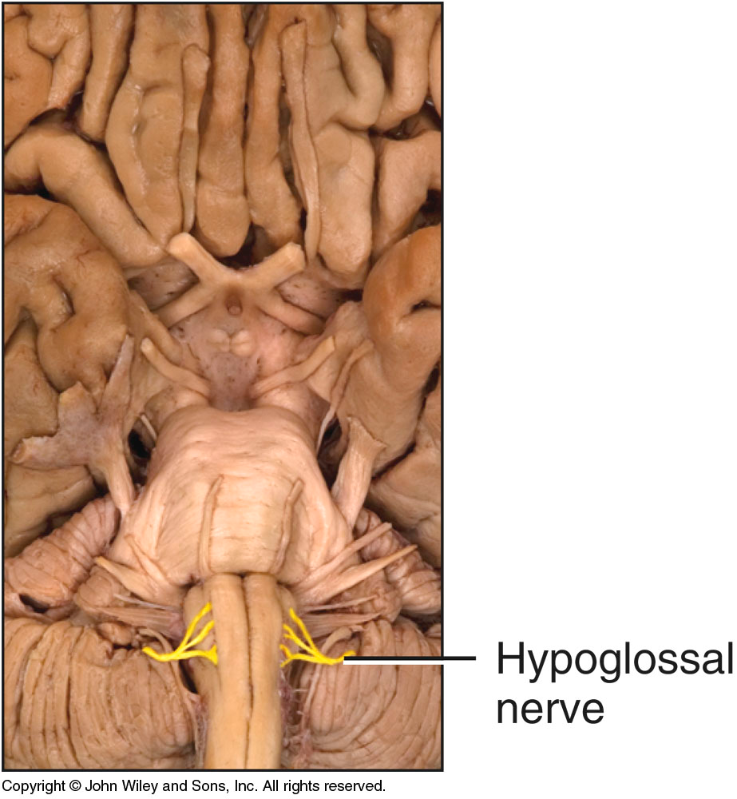
FUNCTIONAL COMPONENTS OF INDIVIDUAL CRANIAL NERVES

Slide 14
Nerve | Functional Component | Nucleus | Location | Function
I (olfactory) | SSA | Olfactory bulb | Cerebral cortex | Originates in olfactory epithelium. Olfaction sense
II (optic) | SSA | Lateral geniculate nucleus and superior colliculus | Cerebral cortex | Originates in ganglion cells of retina.Vision sense
III (occulomotor) | GSE | Oculomotor nucleus | Upper part of midbrain | SR, IR, MR, IO, levator palpebrae superioris
 | GVE | Edinger-Westphal nucleus | Upper part of midbrain | Sphincter pupillae, ciliary muscle
 | GSA | Mesencephalic nu. Of trigeminal ? | Upper part of midbrain | Proprioception from eye muscles
IV (trochlear) | GSE | Trochlear nucleus | Lower part midbrain | Superior oblique

Slide 15
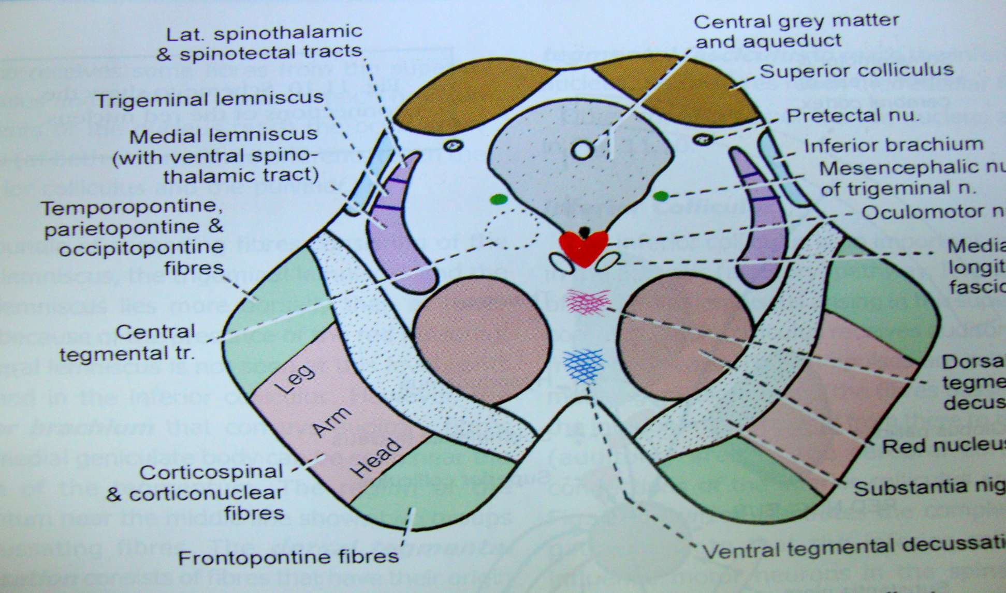
T.S. THROUGH UPPER PART OF MIDBRAIN SHOWING OCCULOMOTOR NUCLEUS

Slide 16
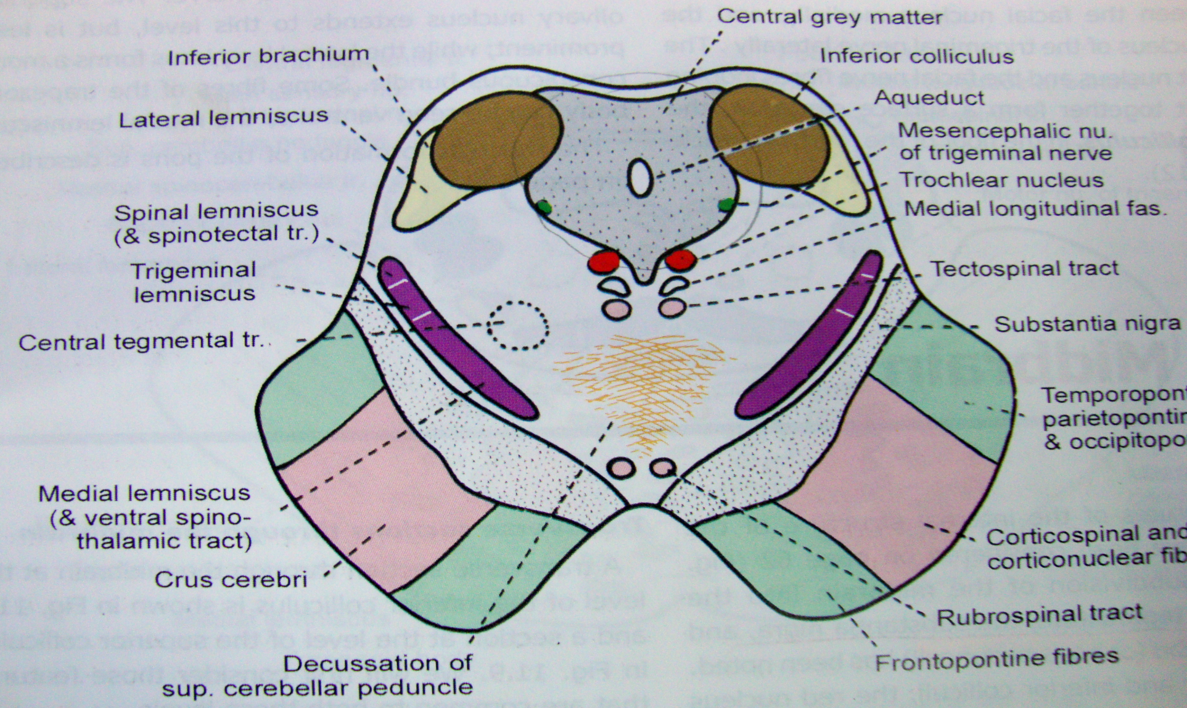
T.S. THROUGH LOWER PART OF MIDBRAIN SHOWING TROCHLEAR NUCLEUS

Slide 17
Nerve | Fn.Cmp. | Nucleus | Location | Function
V(trigeminal) Nerve | SVE | Trigeminal motor nucleus | Upper pons | Muscles of mastication, tensor tympani,Tensor palati,myelohyoid &Ant.belly of digastric.
 | GSA | 1.Spinal nucleus | Lower pons | Pain & temp: Skin & deep tissues of head, dura mater
 |  | 2.Mesencephalic nucleus | Midbrain | Proprioception : face, tongue,eyes.m/s of mastication
 |  | 3.Chief sensory nu. | Upper pons | Touch--face mouth & nose
VI (abducens) | GSE | Abducens nucleus | Lower pons | Lateral rectus

Slide 18
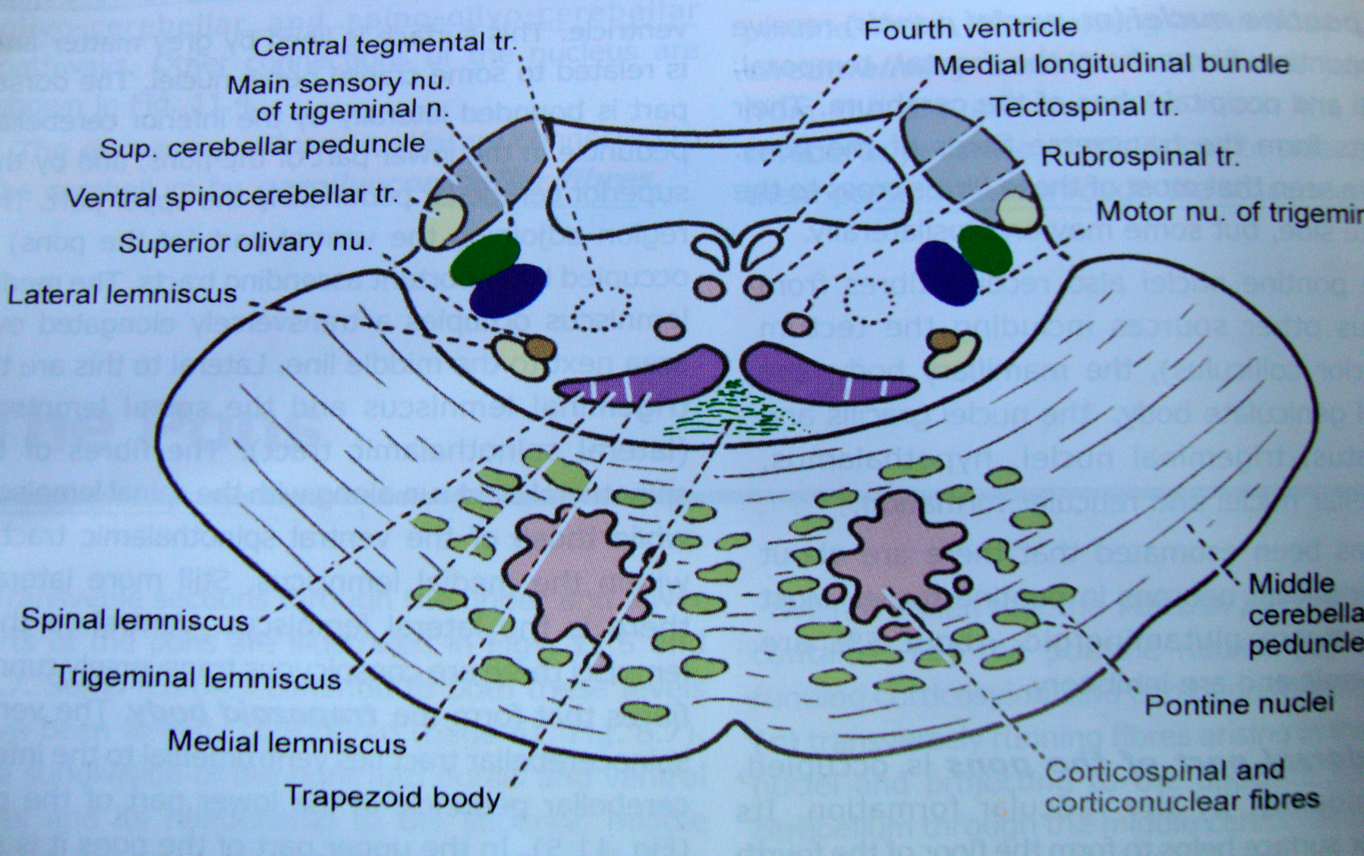
T.S. THROUGH UPPER PART OF PONS SHOWING TRIGEMINAL NUCLEUS

Slide 19
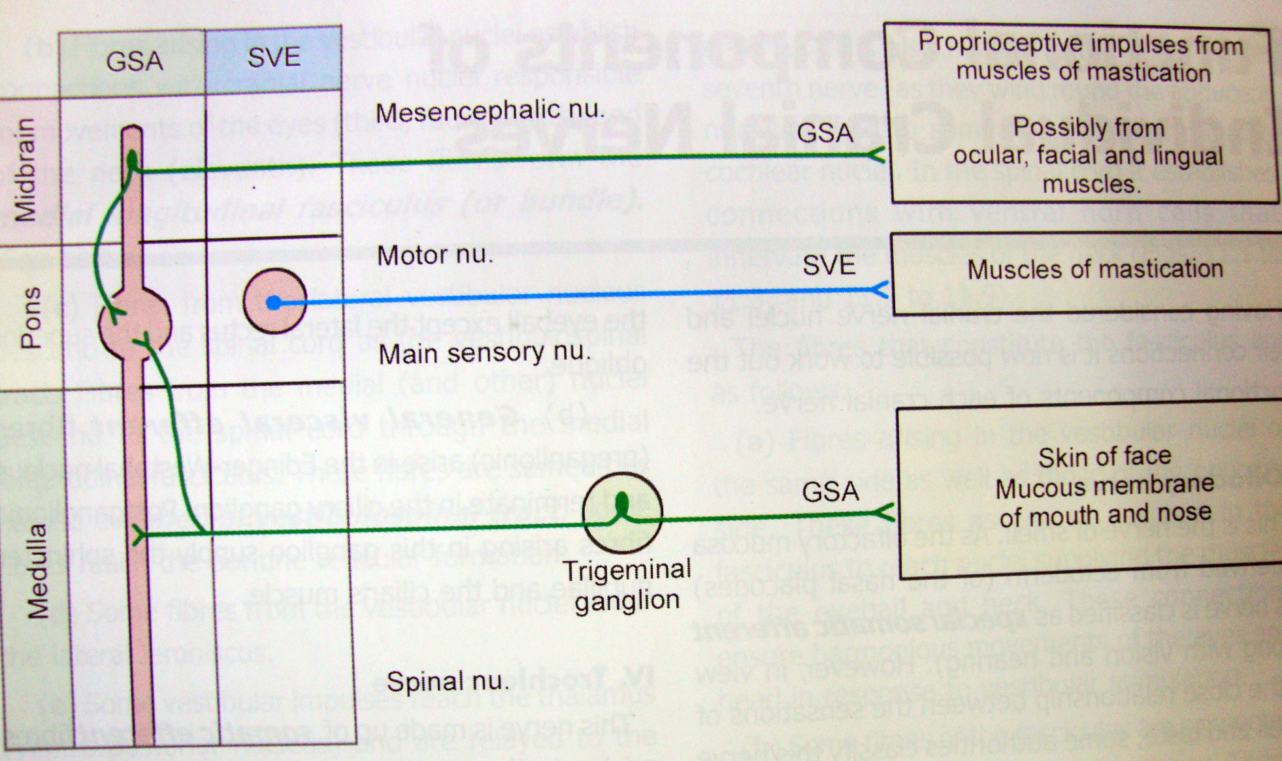
DISTRIBUTION OF TRIGEMINAL NERVE

Slide 20
Nerve | Fn.Cmp | Nucleus | Location | Function
VII (facial) | SVE | Facial motor nucleus | Lower pons | Ms of facial expression, stapedius,stylohyoid,buccinator,post.belly of digastric
 | GSA | Mesencephalic nu of trigeminal | Pons | Proprioception fm above m/s
 | SVA | Solitary nucleus | Lower pons | Taste buds on anterior 2/3 of tongue and palate
 | GVA | Solitary nucleus | Lower pons | Mucous membranes of nasopharynx
 | GVE | a) Superior salivatory nucleus | Lower pons | Subman. & subling. salivary glands
 |  | b) Lacrymatory nucleus | Jn.of pons & medulla | Lacrymal gland
VIII(vestibulocochlear) | SSA | Cochlear nu. a) Ventral b) Dorsal | Pontomedullary junction | Organ of Corti, cristae of semicircular canals, Hearing
 |  | Vestibular nu. Sup/Inf/Med/Lat. Nu. | Pontomedullary junction | maculae of utricle and saccule Equilibrium, balance

Slide 21
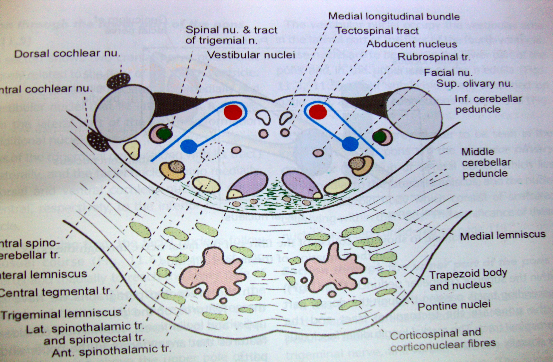
T.S. THROUGH LOWER PART OF PONS SHOWING 6TH 7TH & 8TH NERVE NUCLEUS

Slide 22
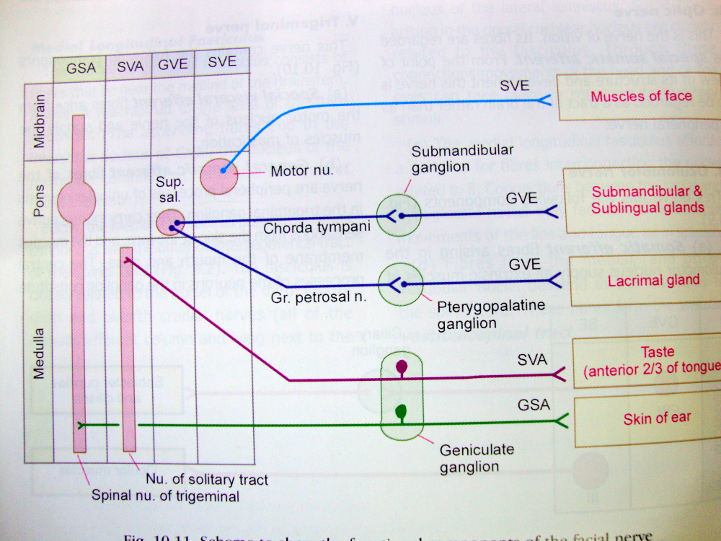
DISTRIBUTION OF FACIAL NERVE

Slide 23
Nerve | F.C. Nucleus Location Function
IX(glossopharyngeal) | SVE | Nucleus ambiguus | Medulla | Pharynx (stylopharyngeus)
 | GVE | Inferior salivatory nucleus | Medulla | Parotid gland
 | GSA | Spinal nucleus of trigeminal nerve ? | Pons | Outer ear
 | SVA | Nucleus tractus solitarius(Upper part) | Medulla | Taste buds of post. 1/3 of tongue
 | GVA | Nu.Tractus solitarius (Lower part) | Medulla | Carotid sinus & body, mucous membranes of nasal and oral pharynx & middle ear (touch pain temp.)

Slide 24
Nerve | Fn.Cmp . Nucleus Location Function
X (vagus) | SVE | Nucleus ambiguus | Medulla | All m/s of pharynx except stylopharyngeus, All m/s of larynx except cricothyroid,& All m/s of palate except tensor palati.
 | GVE | Dorsal motor nucleus of vagus | Medulla | Motor & secretomotor to bronchial tree ,Thoracic and abdominal viscera.Inhibitory to heart
 | GSA | Spinal trigeminal nucleus | Lower pons | Outer ear
 | SVA | nucleus tractus solitarius | Medulla | Taste buds of most post.part of tongue ,epiglottis & palate
 | GVA | Solitary and spinal trigeminal nuclei | Medulla | Thoracic and abdominal viscera, pharynx,trachea,oesophagus,mucous membranes of larynx and laryngopharynx

Slide 25
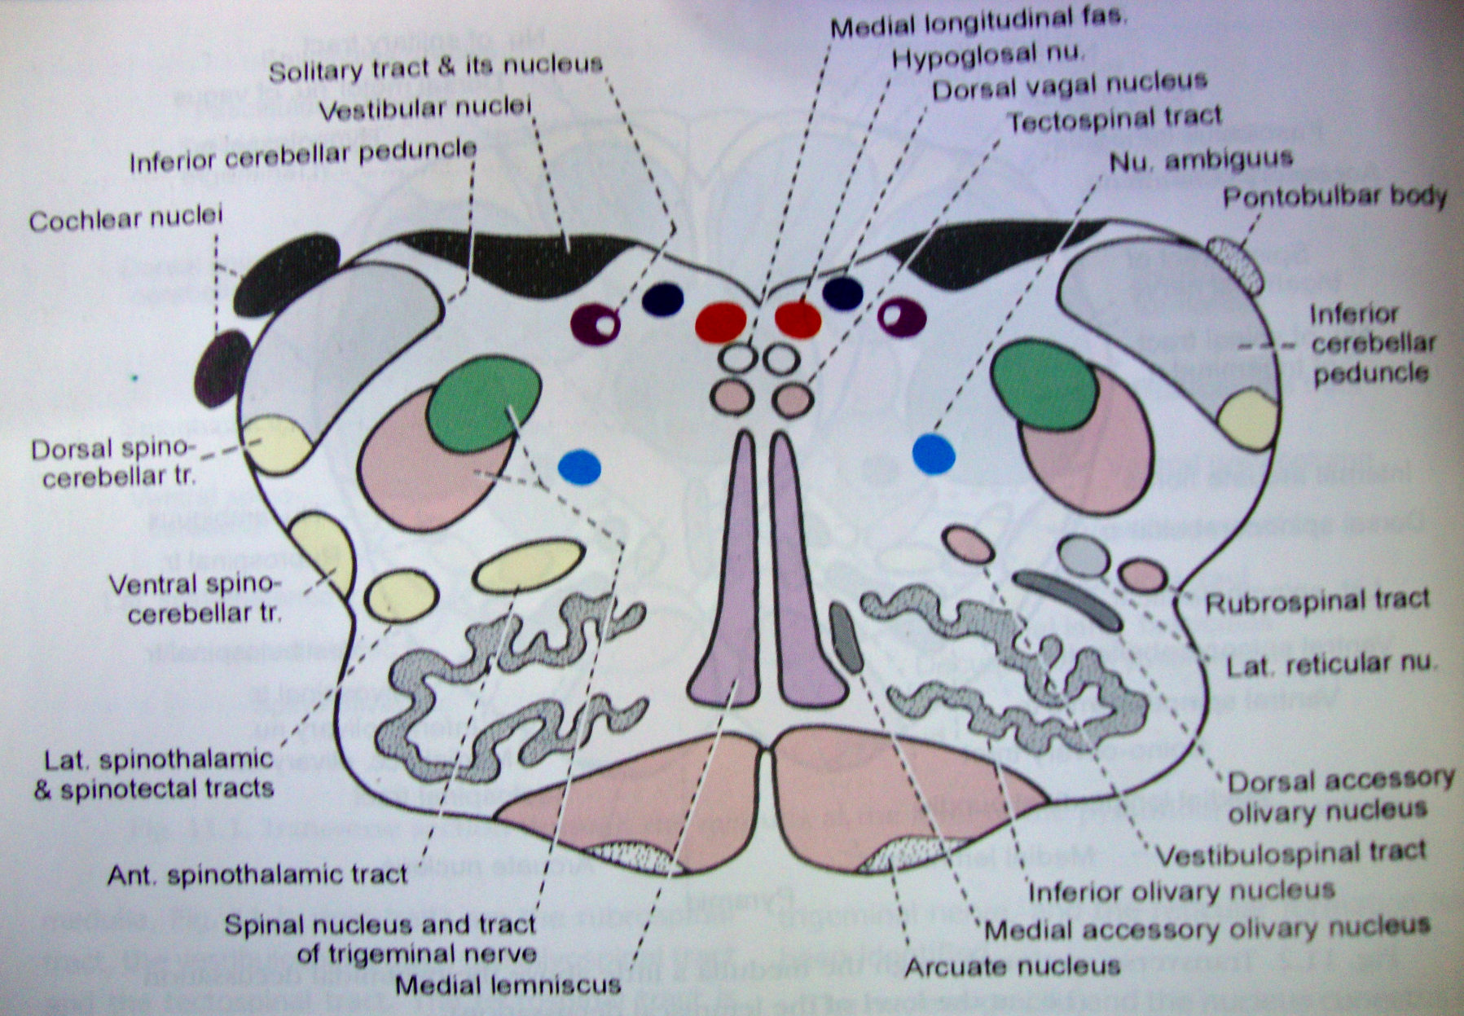
T.S.THROUGH OPEN PART OF MEDULLA SHOWING 8TH ,10TH ,& 12TH NERVE NUCLEUS

Slide 26
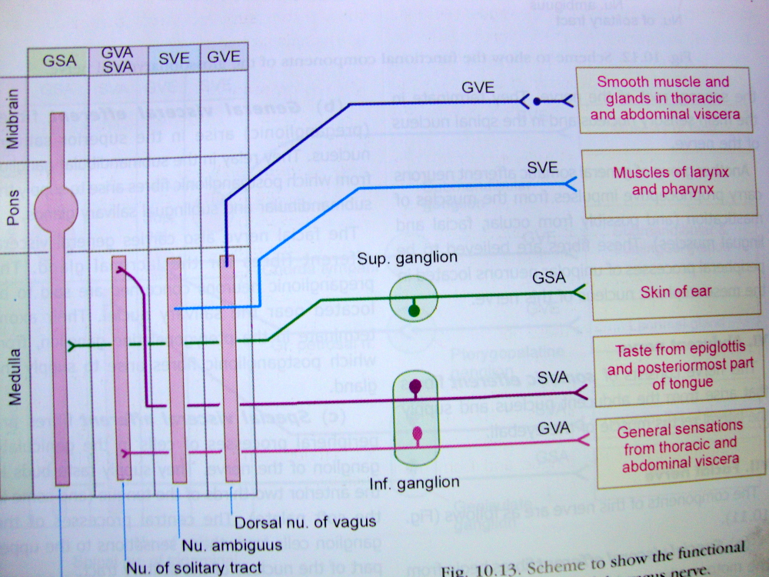
DISTRIBUTION OF VAGUS NERVE

Slide 27
XI Spinal accessory | SVE | Nu.Ambiguus | Medulla | M/s of palate,pharynx,& larynx
 | GSE | Spinal Accessory nucleus | Medulla | Sternocleidomastoid,trapezius
 | GSA | Mesencephalic nu.of trigeminal | Pons | Proprioception fm SCM &Trapezius
XII (hypoglossal) | GSE | Hypoglossal nucleus | Upper medulla | Muscles of the tongue
 | GSA | Mesencephalic nu of trigeminal | pons | Proprioception fm tongue

Slide 28
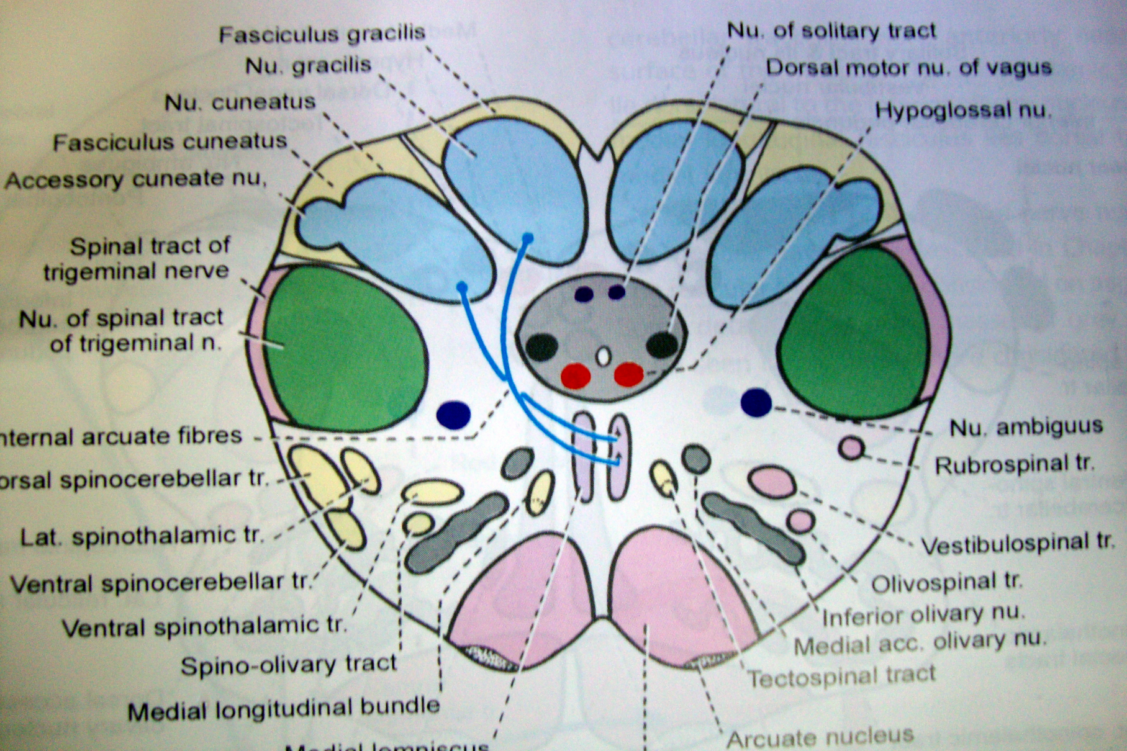
T.S.Of Medulla at level of Sensory Decussation showing 9th ,10th & 12th Nerve Nucleus

Slide 29
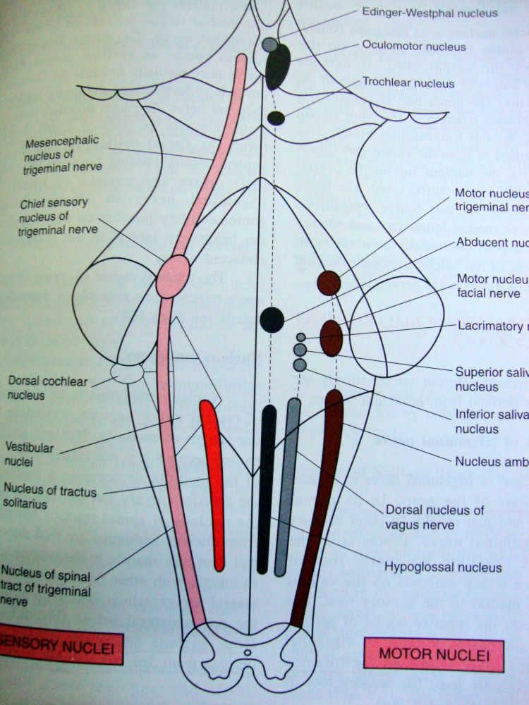
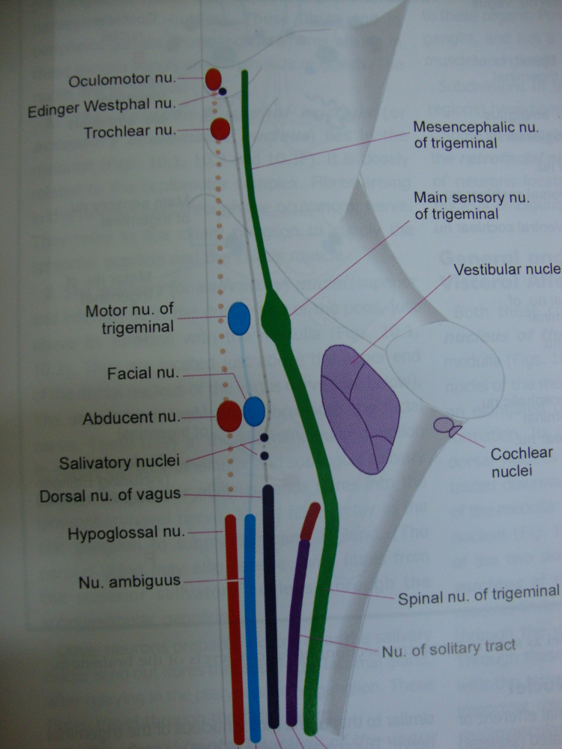
Location of Nuclei in Brainstem

Slide 30
Oculomotor Nucleus
This consists of a series of longitudinal cell columns or subnuclei.
The column supplying:
The levator palpebrae superioris is located in the midline and innervates this muscle on both sides;
The superior rectus projects to the contralateral eye;
The medial rectus, inferior rectus, and inferior oblique all project to the ipsilateral eye;
Edinger-Westphal Nucleus
This column includes preganglionic parasympathetic neurons (GVE).
It straddles the midline and projects to the ipsilateral ciliary ganglion.
The ciliary ganglion then innervates the sphincter pupillae and the ciliary muscle.

Slide 31
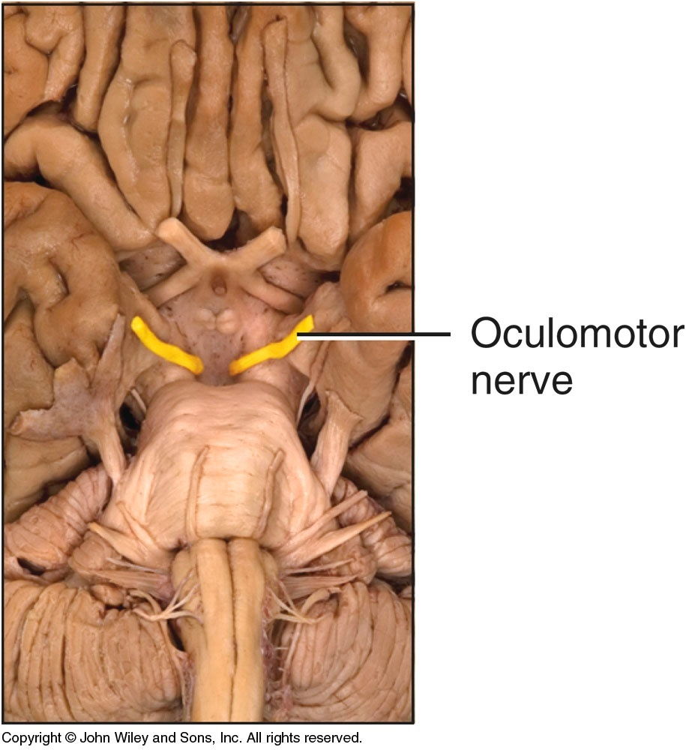

Slide 32
Trochlear Nerve
This supplies the superior oblique muscle.
Its cell bodies are located in the contralateral trochlear nucleus.
This is a small nucleus located at the level of the inferior colliculus.
Here, it indents the medial longitudinal fasciculus (MLF).
Fibres leaving the nucleus turn caudally in the periaqueductal grey.
They then arch dorsally to decussate and leave the brainstem at the pons-midbrain junction.
The trochlear nerve is unique in that:
It is the only cranial nerve attached to the dorsal aspect of the brainstem;
It is the only one to originate completely from the contralateral nucleus.

Slide 33
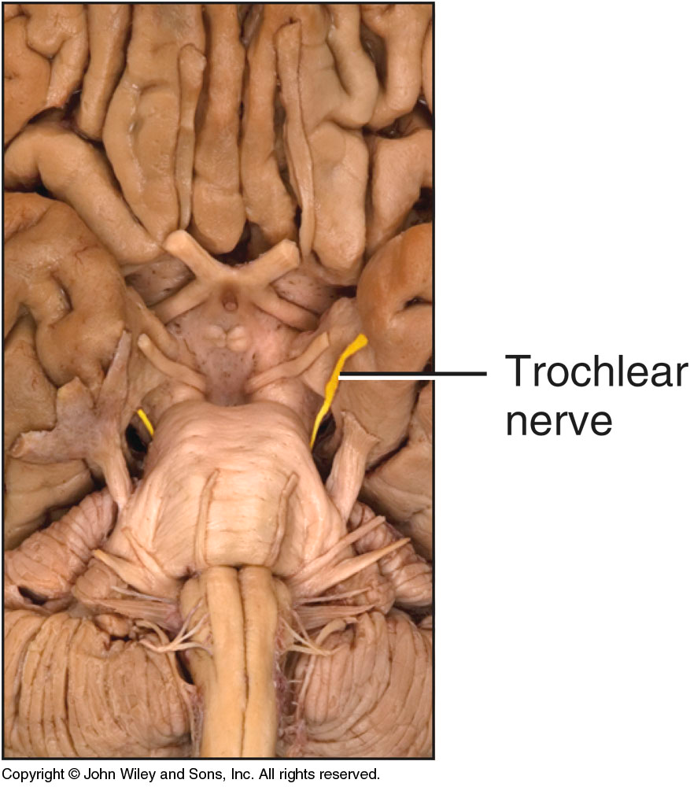

Slide 34
Abducens Nerve
This supplies the lateral rectus muscle.
The fibres originate from the ipsilateral abducens nuclei.
This is located in the caudal pons, beneath the floor of the 4th ventricle.
Medial to the nucleus is two bundles of fibres.
The more medial of the two is the MLF.
Between the MLF and the abducens nuclei are the motor fibres of the facial nerve.
The facial fibres project dorsomedially and wrap around the abducens nucleus.
They then turn back ventrally to exit from the brainstem.
Here, the fibres are known as the internal genu of the facial nerve.
The abducens nuclei along with the internal genu are responsible for the facial colliculus in the floor of the 4th ventricle.

Slide 35
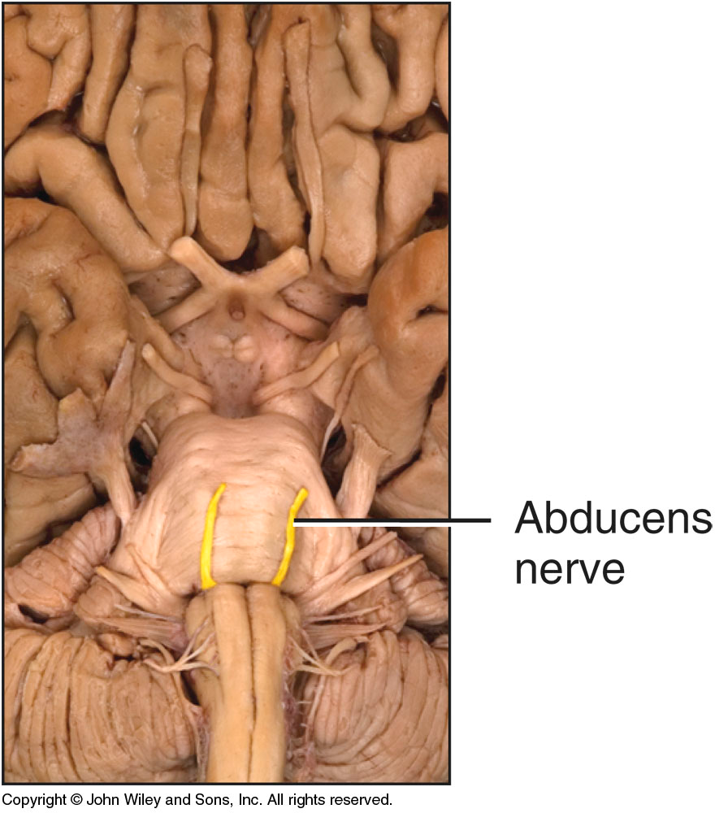

Slide 36
Hypoglossal Nerve
This nerve supplies the muscles of the tongue.
The fibres originate in the ipsilateral hypoglossal nucleus.
This extends from the caudal medulla to the rostral part of the rostral medulla.
This nucleus is situated in the midline just beneath the floor of the 4th ventricle.
Here it forms the hypoglossal trigone, a triangular elevation.
Hypoglossal axons proceed ventrally and emerge as a series of rootlets in the groove between the pyramid and the olive.

Slide 38
Olfactory Nerve I
Special somatic afferent
Sensory
Transmits impulses related to smell
Arises in nasal cavity, throughcribiform plate, to
olfactory bulb and tracts

Slide 39
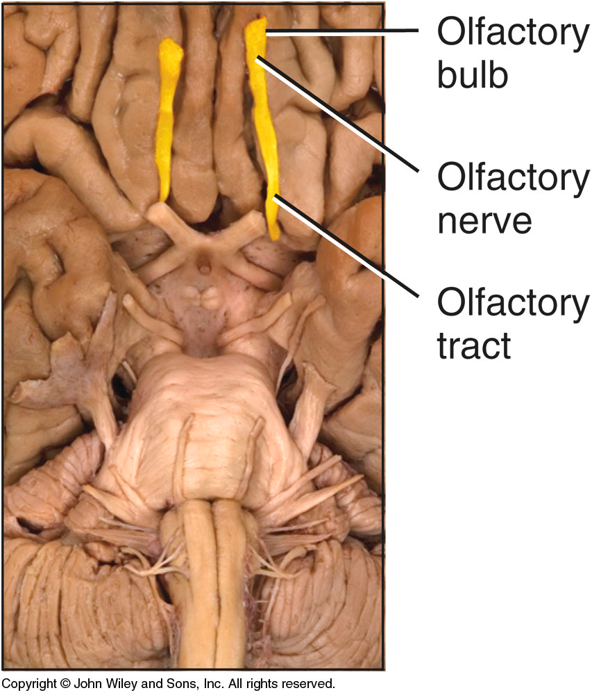

Slide 40
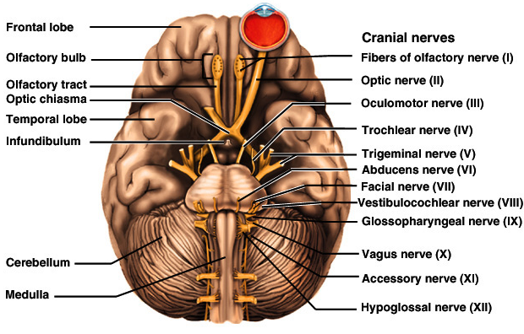
THANK YOU

