Slide 1
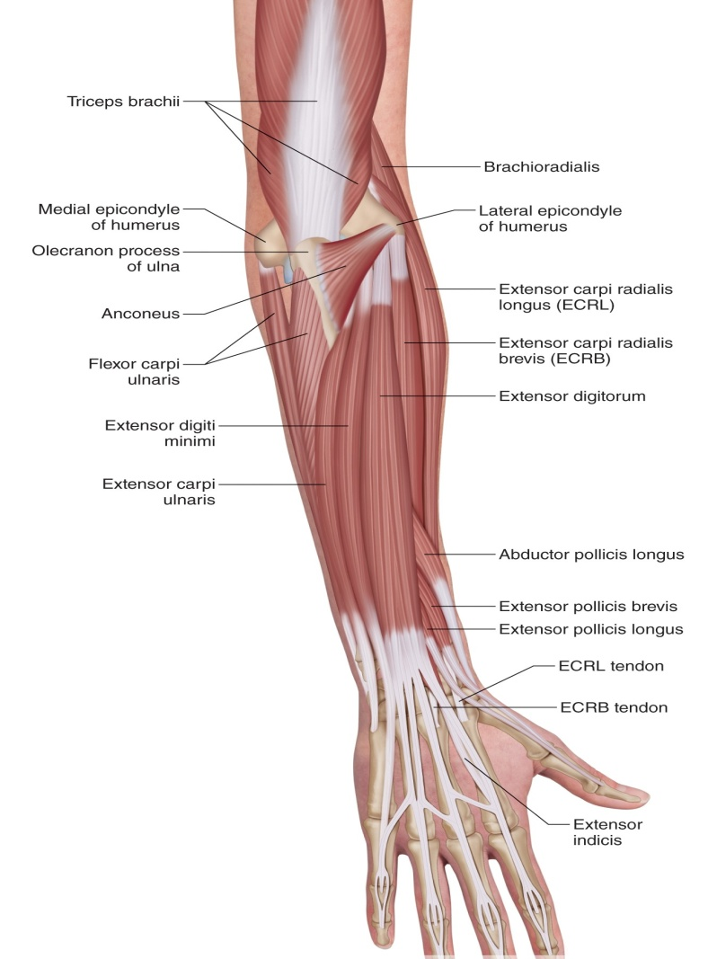
GROSS ANATOMY back of forearm
Dr. Praveen Kumar Kurrey
MBBS, MS, BCME, BCBR
Professor, Anatomy

Slide 2
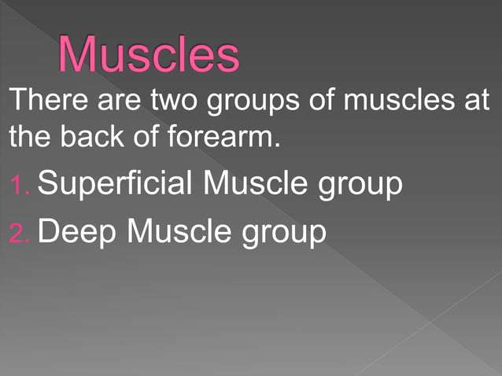

Slide 3
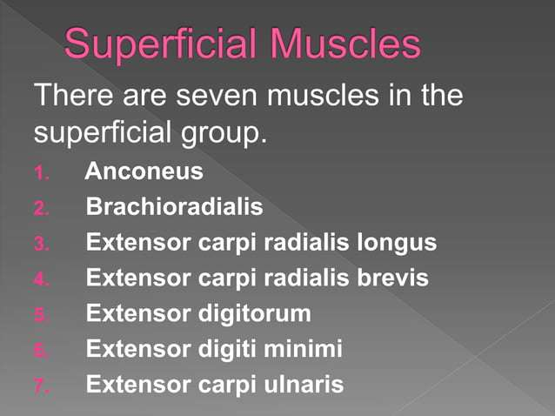

Slide 4
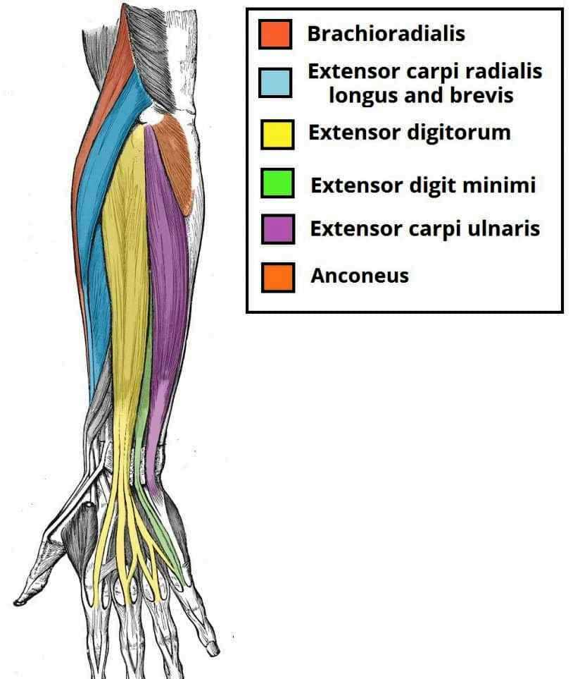

Slide 5
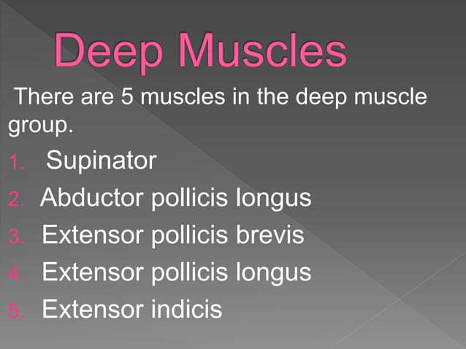

Slide 6
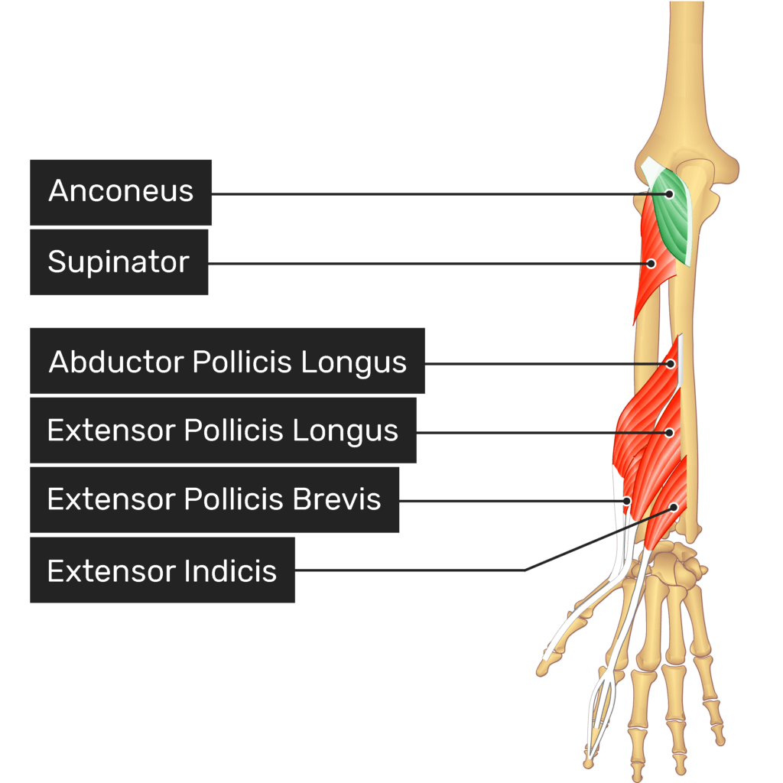

Slide 7
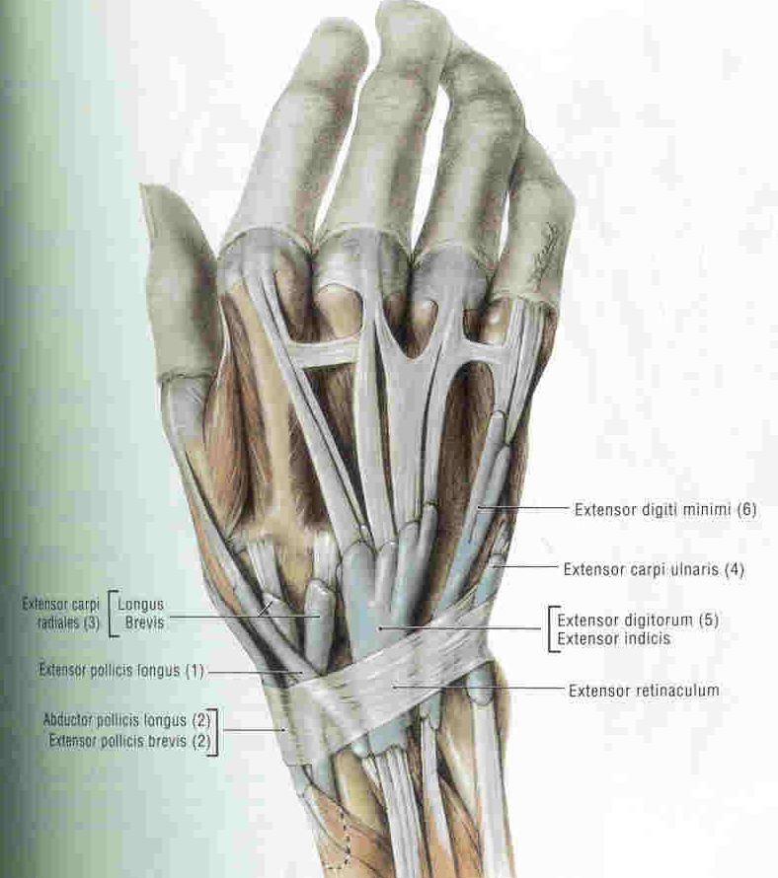
EXTENSOR COMPARTMENT : BACK OF FOREARM
1. Aconeus
2. Brachioaradialis-(BR)
3. Extensor carpi radialis longus (ECRL)
4. Extensor carpi radialis brevis (ECRB)
5. Extensor digitorum-(ED)
6. Extensor digiti minimi--(EDM)
7. Rxtensor carpi ulnaris--(ECU)
8. Supinator
9. Abductor pollicis longus--(APL)
10. Extensor pollicis brevis-(EPB)
11. Extensor pollicis longus --(EPL)
12 Extensor indicis --(EI)

Slide 8
Lateral Muscles
Brachioradialis
Extensor carpi radialis longus
Extensor carpi radialis brevis

Slide 9
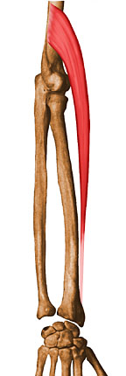
1. Brachioradialis
  Origin: lateral supracondylar ridge of humerus
  Insertion: lateral aspect of radial styloid process
  Innervation: radial nerve
  Action: elbow flexion, especially w/ forearm in neutral position

Slide 10
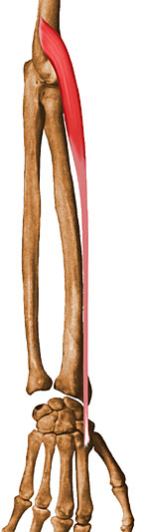
2. Extensor Carpi Radialis Longus
Origin: lateral supracondylar ridge of humerus
Insertion: dorsal base of 2nd metacarpal
Innervation: radial nerve
Action: extend and abduct/radial deviate the wrist

Slide 11
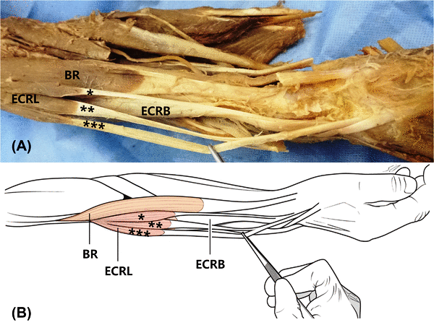

Slide 12
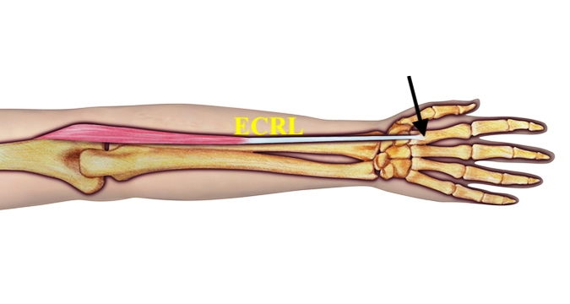
3. Extensor Carpi Radialis Longus

Slide 13
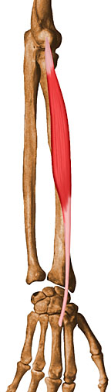
4. Extensor Carpi Radialis Brevis
Origin: common extensor tendon at lateral epicondyle
Insertion: dorsal base of 3rd metacarpal
Innervation: radial nerve
Action: extend and abduct/radial deviate the wrist

Slide 14
Medial Muscles
Extensor digitorum
Extensor carpi ulnaris
Extensor digiti minimi

Slide 15
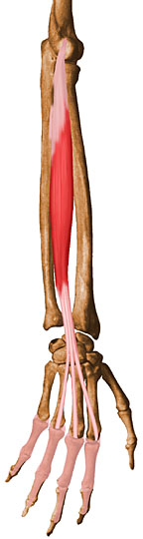
5. Extensor Digitorum
Origin: common tendon from lateral epicondyle
Insertion: bases of middle and distal phalanges via bands of 4 tendons
Innervation: radial nerve
Action: MCP/IP joint extension

Slide 16
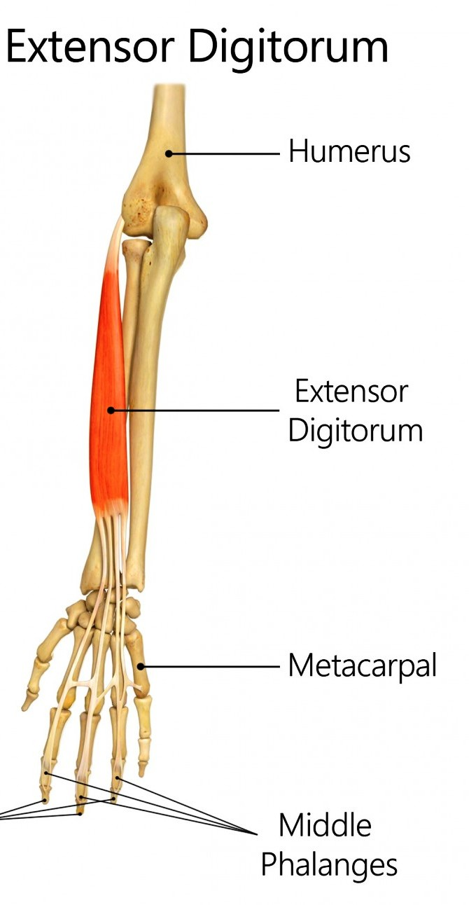
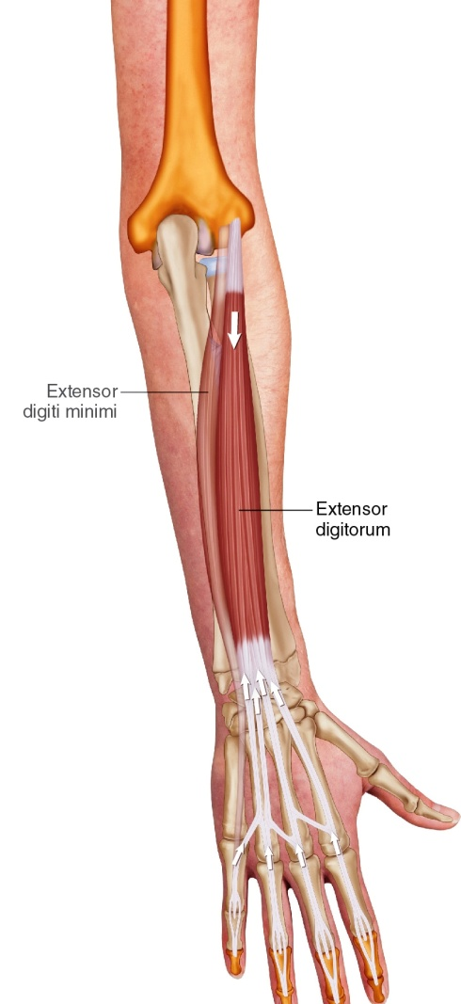
Extensor Digitorum

Slide 17
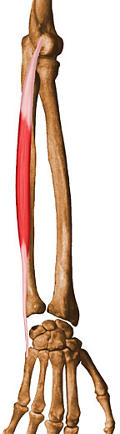
6. Extensor Carpi Ulnaris
Origin: common extensor tendon at lateral epicondyle
Insertion: ulnar side of base of 5th metacarpal
Innervation: radial nerve
Action: extend and adduct/ulnar deviate the wrist

Slide 18
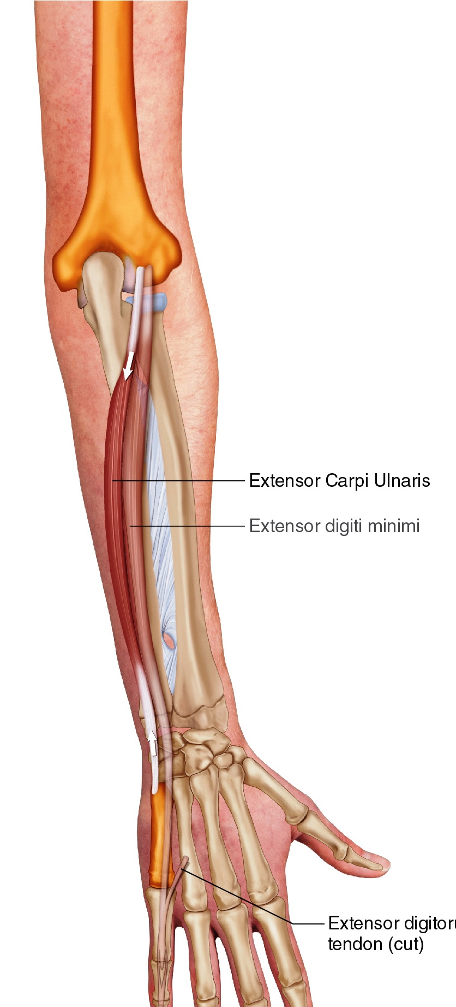
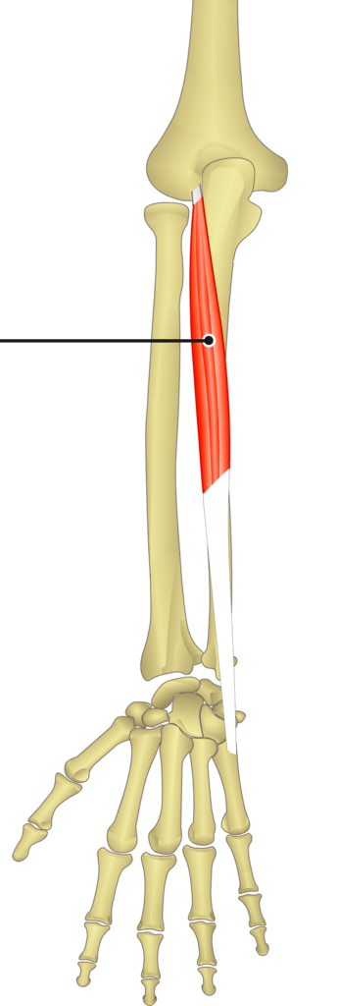
Extensor Carpi Ulnaris

Slide 19

7. Extensor Digiti Minimi
Origin: Lateral epicondyle of the humerus
Insertion: Extensor expansion of the little finger (5th digit)
Actions:Extends the little finger at the metacarpophalangeal and interphalangeal joints
Assists in extending the wrist
Innervation: Posterior interosseous nerve (C7, C8)

Slide 20
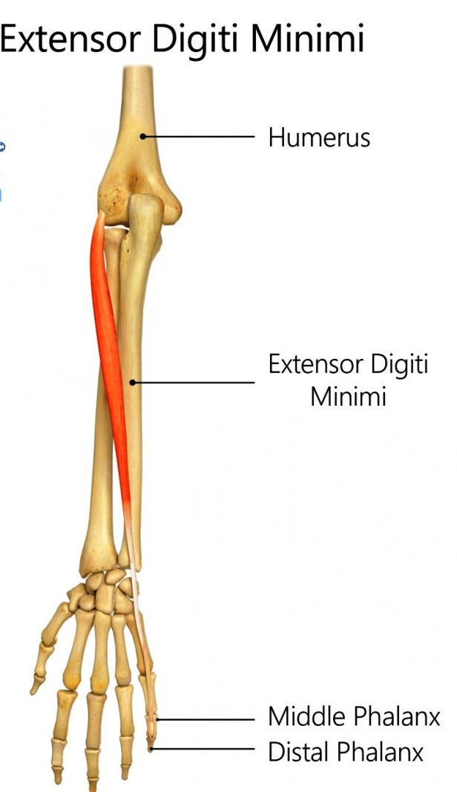
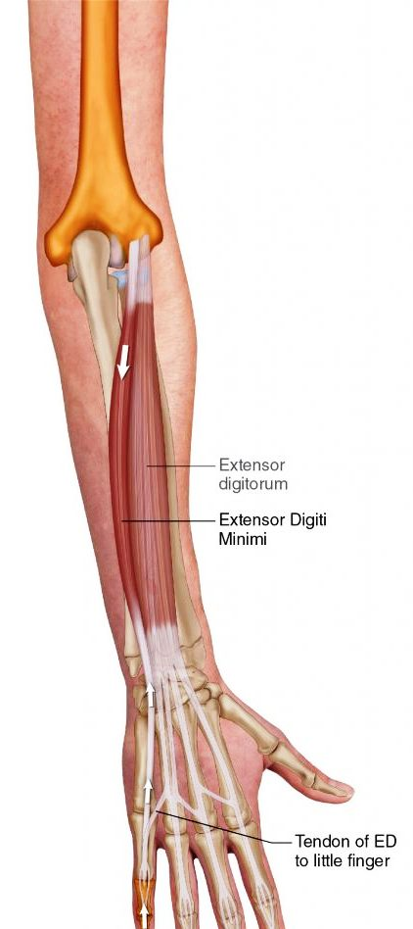
Extensor Digiti Minimi

Slide 21
“Outcropping” Muscles
Abductor pollicis longus
Extensor pollicis longus
Extensor pollicis brevis

Slide 22

8. Abductor Pollicis Longus
Origin: posterior, distal radius and ulna
Insertion: base of 1st metacarpal
Innervation: median nerve
Action: extension, abduction of 1st carpometacarpal joint

Slide 23
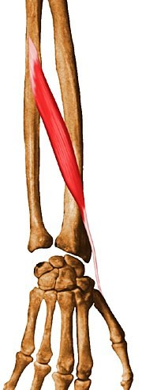
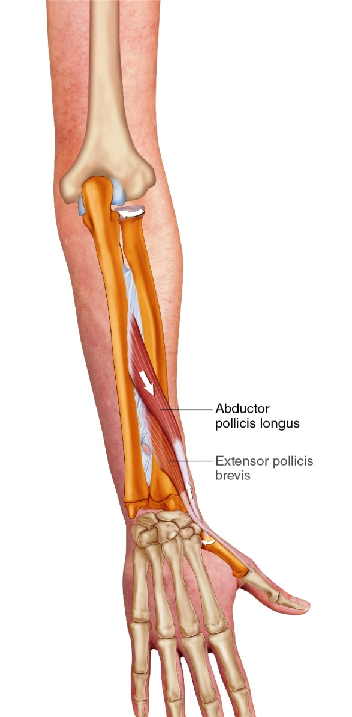
Abductor Pollicis Longus

Slide 24

9. Extensor Pollicis Longus/Brevis
Origin: longus – posterior, middle ulna, brevis – posterior, distal radius
Insertion: dorsal aspect of base of distal phalanx of thumb
Innervation: deep radial nerve
Action: extension of 1st carpometacarpal and metacarpophalangeal joints

Slide 25
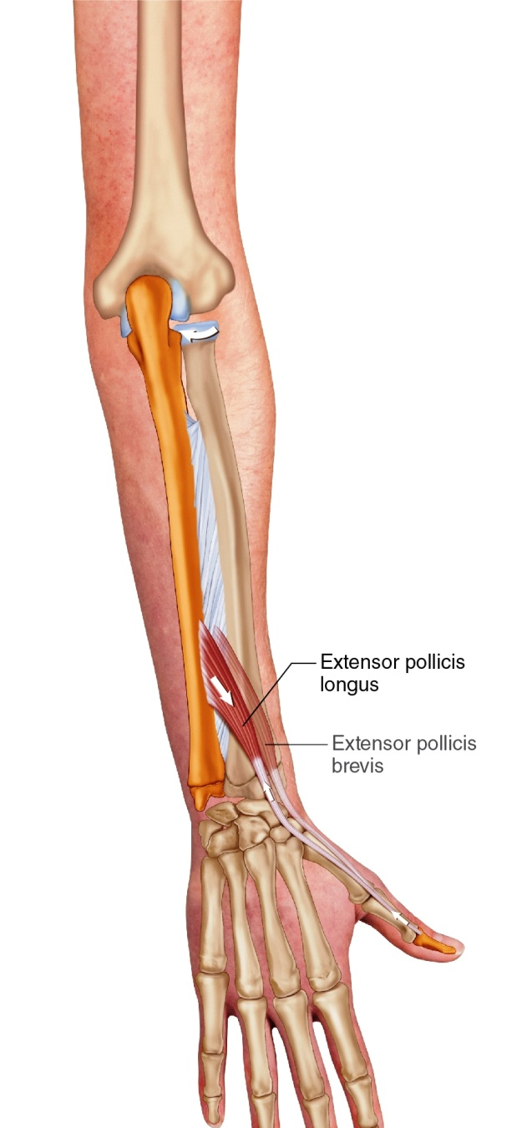
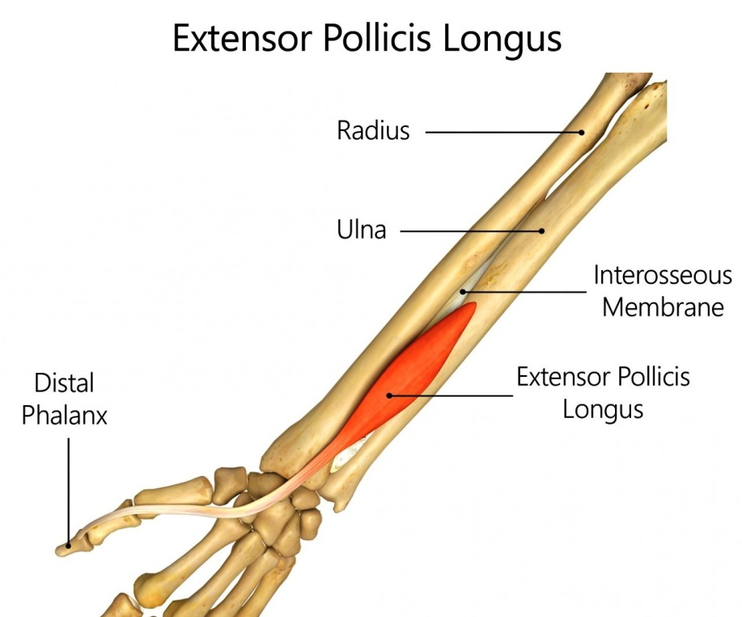
Extensor Pollicis Longus

Slide 26
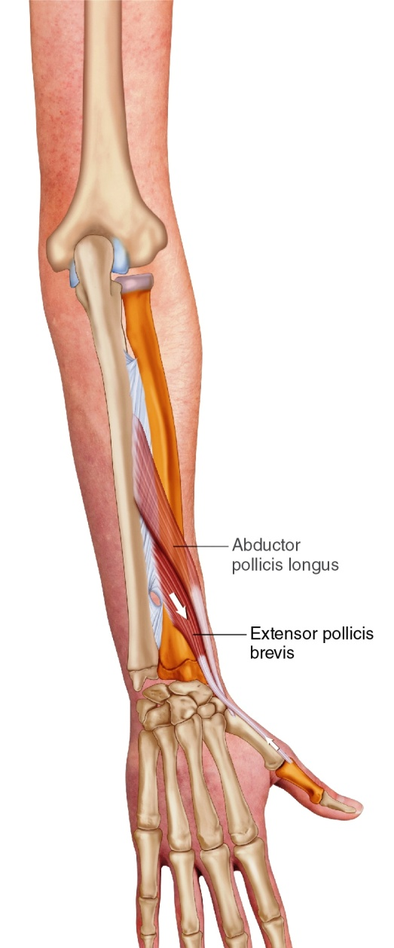
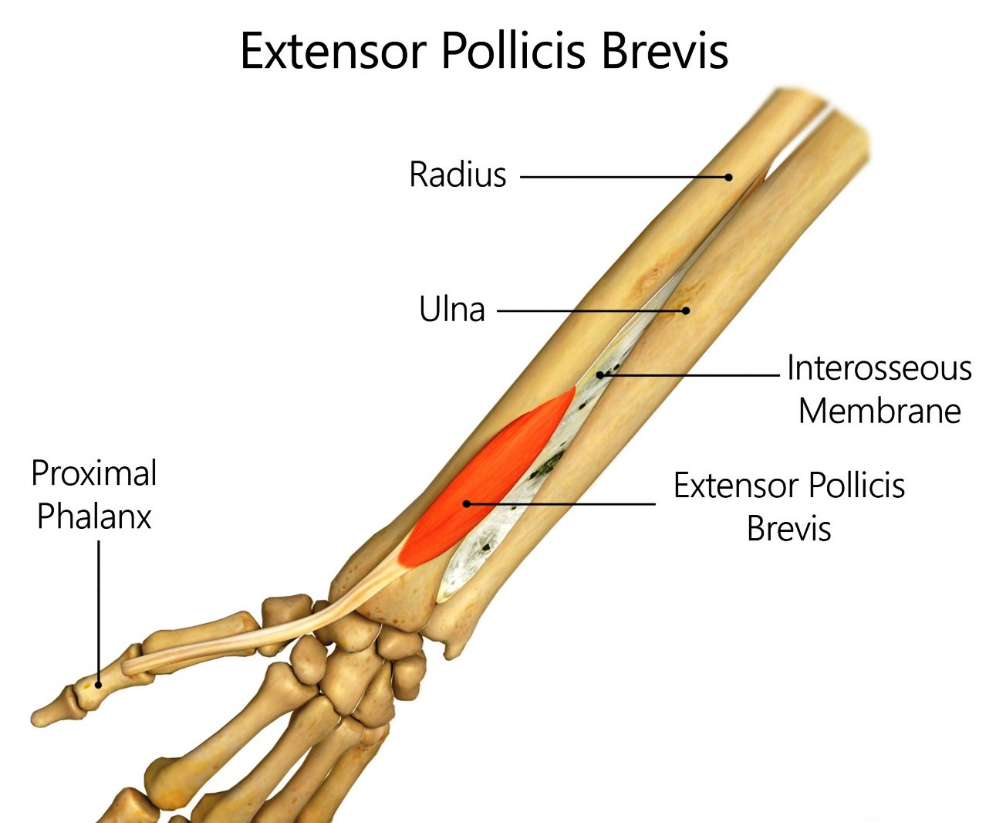
10. Extensor Pollicis Brevis

Slide 27
“Accessory” Muscles
Supinator
Anconeus
Extensor indicis

Slide 28
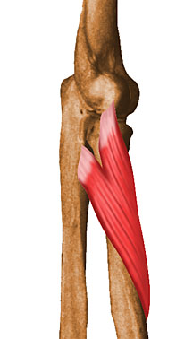
11. Supinator
Origin: lateral epicondyle, annular ligament/RCL and supinator crest of ulna
Insertion: lateral proximal 1/3 of radius
Innervation: posterior interosseous nerve (deep branch of radial nerve)
Action: forearm supination

Slide 29
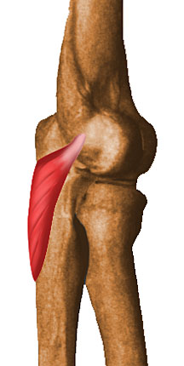
12. Anconeus
Anconeus
  Origin: lateral epicondyle of humerus
  Insertion: lateral aspect of olecranon and posterior ulna
  Innervation: radial nerve
  Action: assists elbow extension

Slide 30

13. Extensor Indicis
Origin: Posterior surface of the ulna and the interosseous membrane.
Insertion: The extensor expansion of the index finger.
Innervation: Supplied by the posterior interosseous nerve, a branch of the radial nerve.
Action- Primary Action: Extends the index finger at the metacarpophalangeal, proximal interphalangeal, and distal interphalangeal joints.
Secondary Action: Assists in wrist extension.

Slide 31
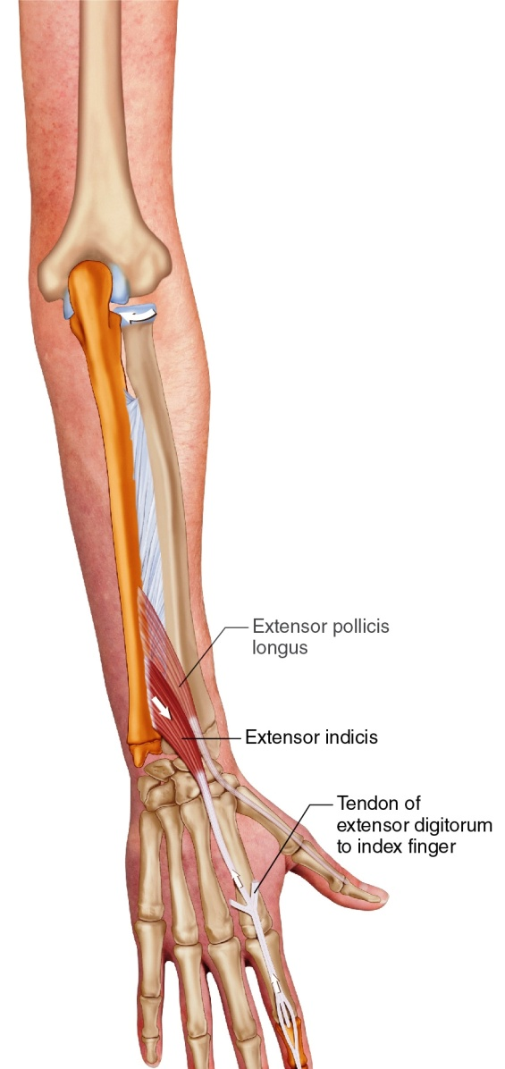
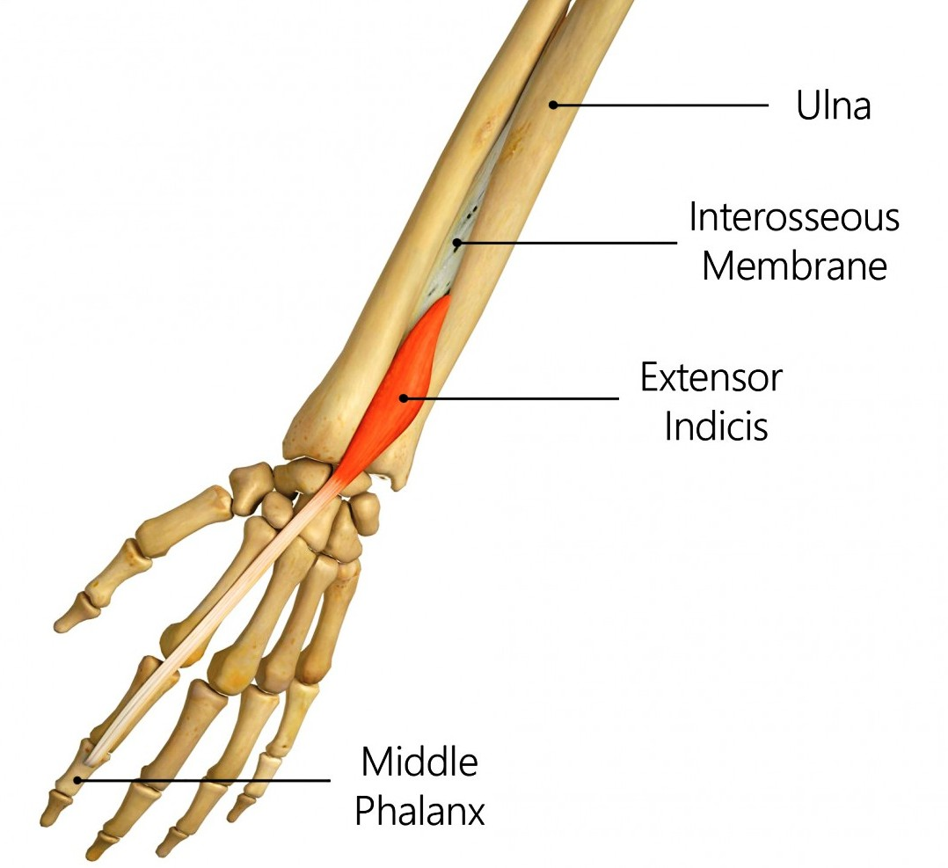
Extensor Indicis

Slide 32
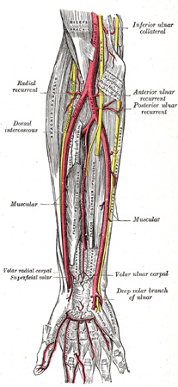
Blood Vessels
Radial artery
  Originates at radial head, emerges from antecubital fossa between brachioradialis and pronator teres muscles
  Continues laterally along forearm deep to brachioradialis muscle

Slide 33
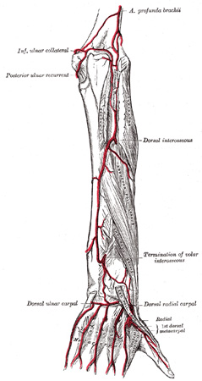
Blood Vessels
Ulnar artery
  Originates at radial head, continues medially down forearm

Slide 34
EXTENSOR COMPARTMENT : NERVE SUPPLY
ECRB
ED
EDM
ECU
S
APL
EPB
EPL
EI
Aconeus
Brachioradialis
ECRL
Radial nerve
Posterior interosseous nerve

Slide 35
APPLIED ANATOMY
Carrying angle
  Cubitus valgus (carrying angle)
  Cubitus varus (gunstock deformity)

Slide 36
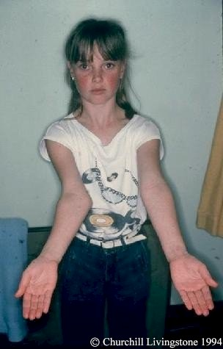
Carrying Angle/Cubitus Valgus
Formed by long axis of humerus and midline of forearm
Male norms – 11-14 degrees
Female norms – 13-16 degrees
Larger angles are considered abnormal

Slide 37
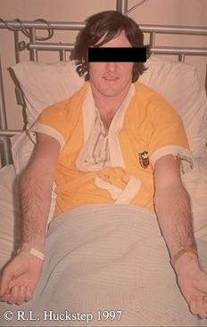
Gunstock Deformity/Cubitus Varus
Usually develops secondary to condylar humerus fracture

Slide 38
WRIST DROP
Radial nerve palsy - A condition where the wrist and fingers cannot be actively extended, causing the hand to hang flaccidly.
Symptoms
Difficulty or inability to extend the wrist upward
Weakness or paralysis of the hand, wrist, and finger extensors
The hand appears to drop or hang in a flexed position
Weakness of the extensors in the fingers and thumb
Potential for numbness on the back of the hand, along the radial side

Slide 39
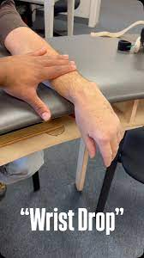
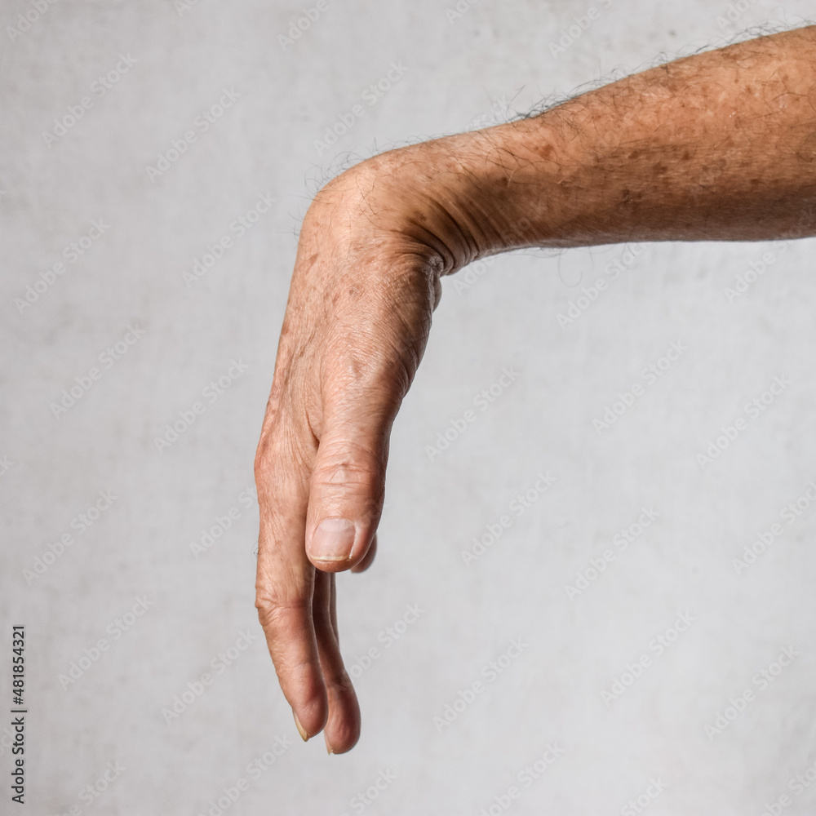
WRIST DROP

Slide 40
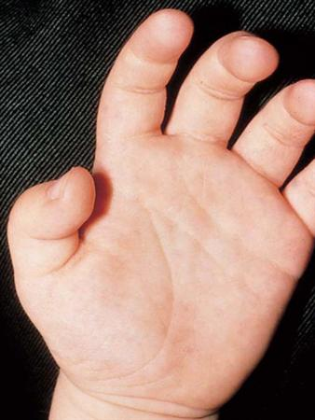
HAMMER THUMB DEFORMITY
Mallet Thumb Deformity-
is a condition where the end of the thumb droops because the extensor tendon that straightens it has been torn.
EPL- Extensor Pollicis Longus tendon

Slide 41


