Slide 1
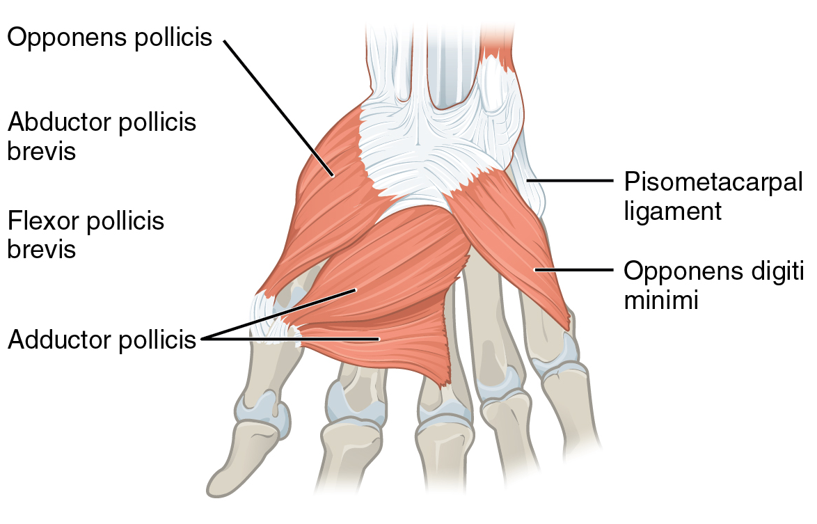
Intrinsic MUSCLES OF hand
(GROSS ANATOMY)
Dr. Praveen Kumar Kurrey
MBBS, MS, BCME, BCBR
Professor Anatomy

Slide 2
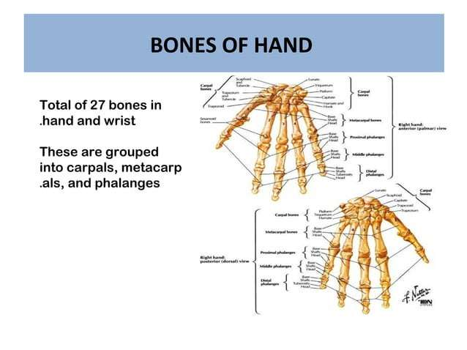

Slide 3
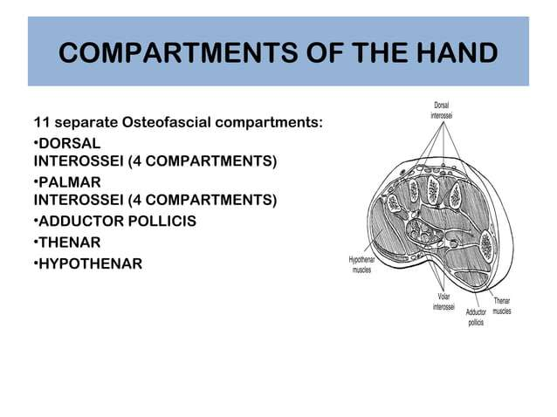

Slide 4
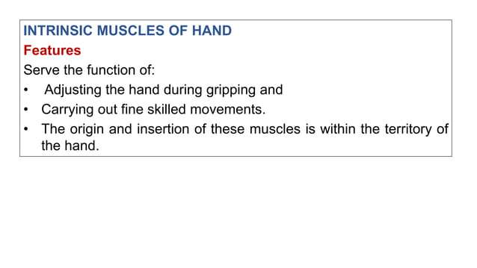

Slide 5
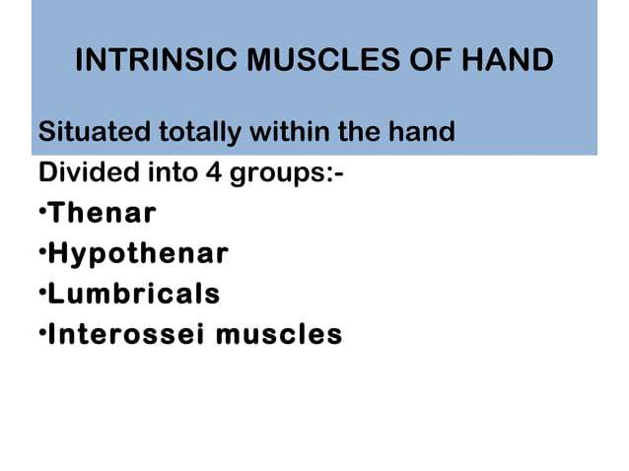

Slide 6
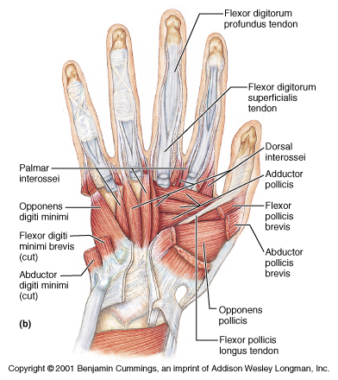
THE PALM
THENAR
Adductor Pollicis
Flex. Pollicis Brevis
Opponens P Brevis
Adductor Pollicis
INTEROSSEI
4 Palmar
4 Dorsal
LUMBRICALS
Four in FDP tendons
HYOPTHENAR
Palmaris Brevis
Ab. Digiti Minimi
Flex. Digiti Minimi
Opp. Digiti Minimi

Slide 7
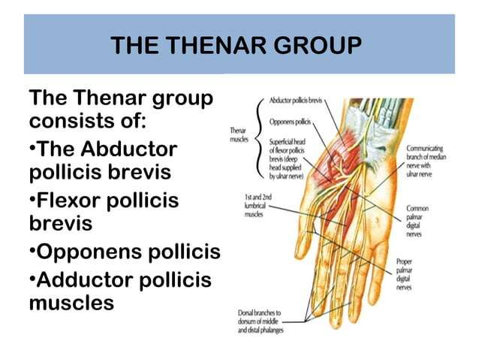

Slide 8
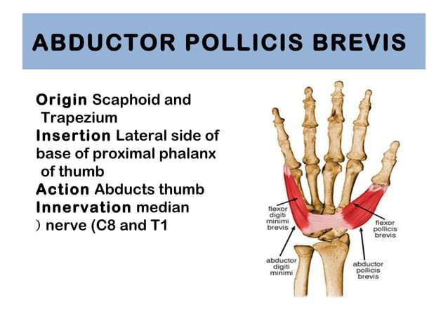

Slide 9
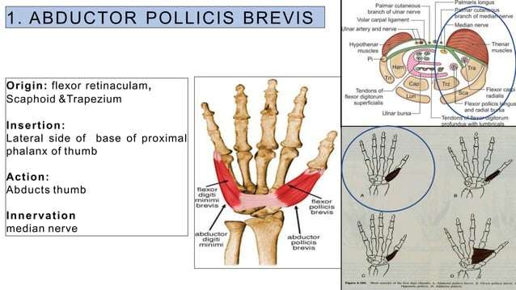

Slide 10
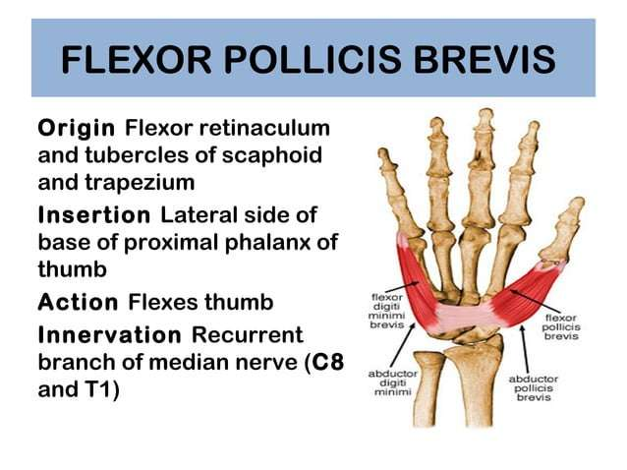

Slide 11
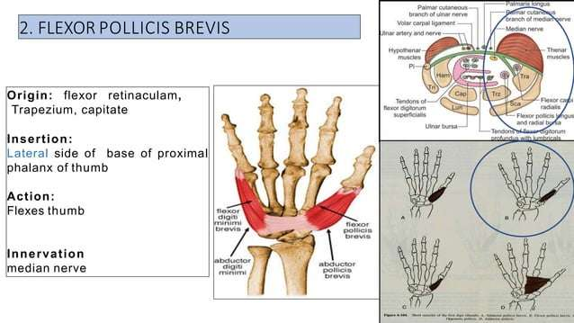

Slide 12
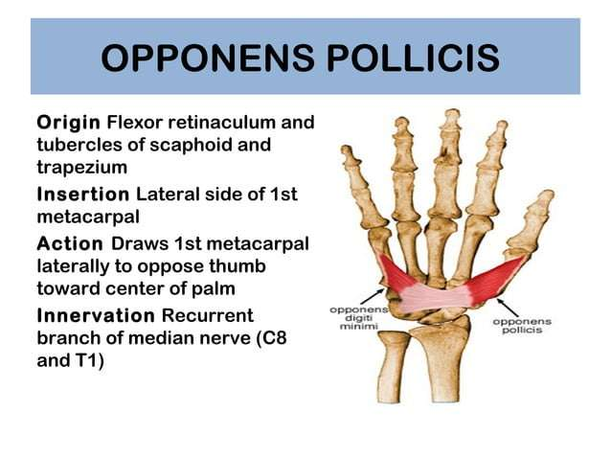

Slide 13
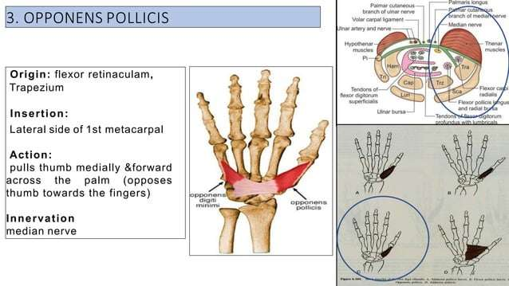

Slide 14
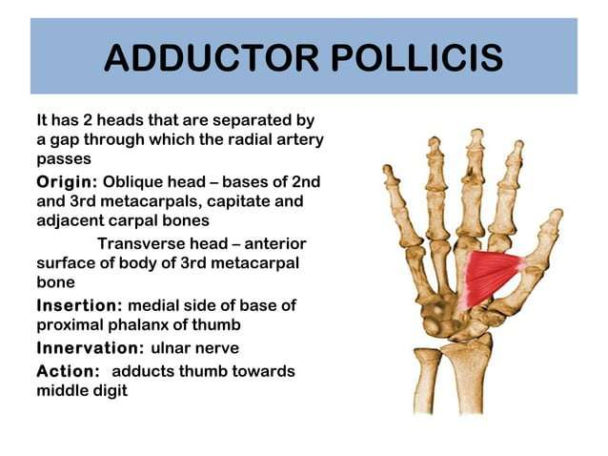

Slide 15
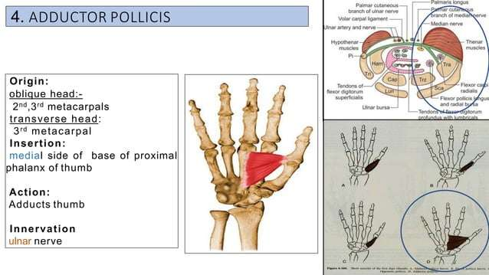

Slide 16
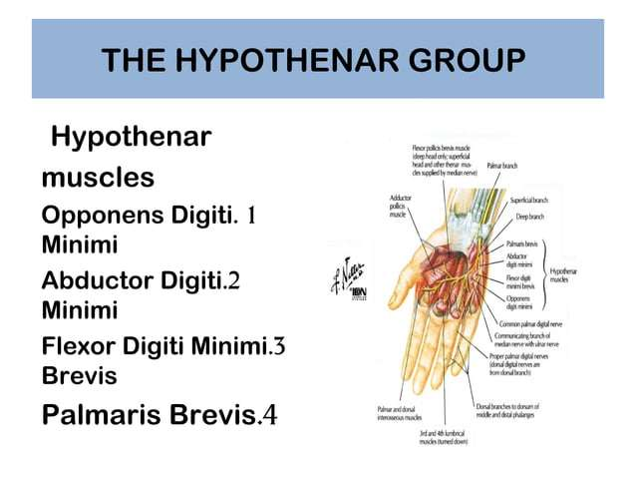

Slide 17
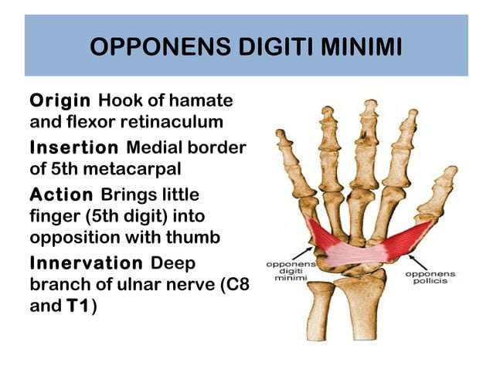

Slide 18
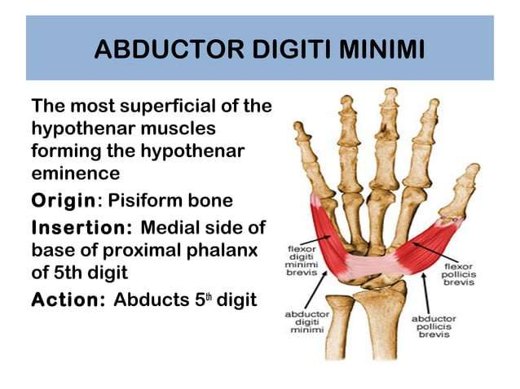

Slide 19
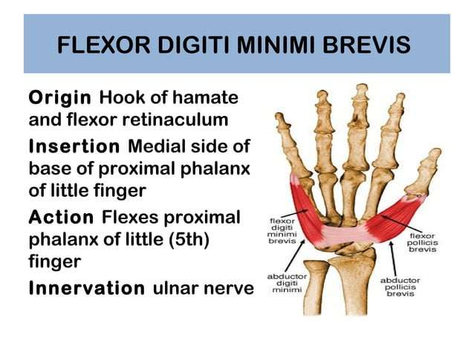

Slide 20
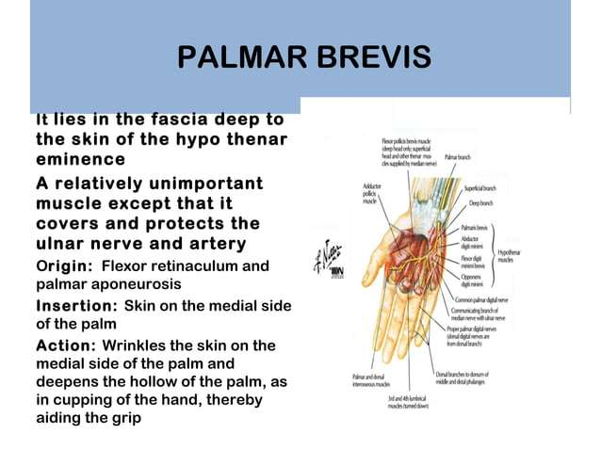

Slide 21
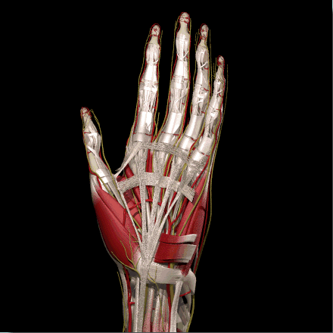
PB
PALMARIS BREVIS MUSCLE

Slide 22
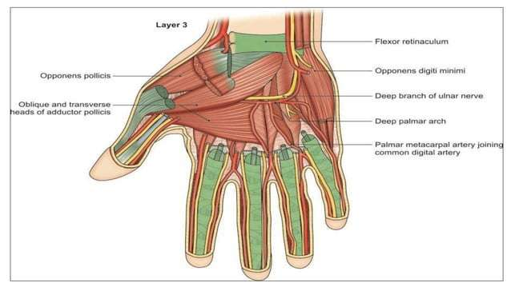

Slide 23
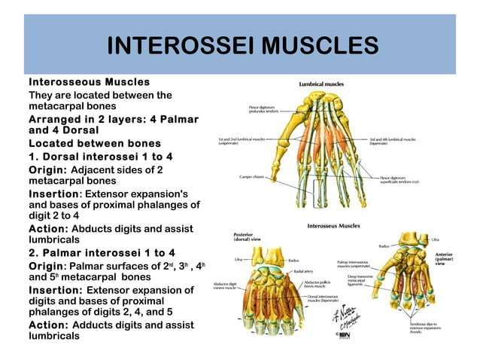

Slide 24
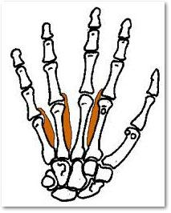
PALMAR INTEROSSEI
ORIGIN
  First: base of first metacarpal bone, ulnar side
  Second: length of second metacarpal bone, ulnar side
  Third: length of fourth metacarpal bone, radial side
  Fourth: length of fifth metacarpal bone, radial side
INSERTION
Chiefly, into the extensor expansion of the respective digit, with possible attachement to base of proximal phalanx as follows
  First: ulnar side of thumb
  Second: ulnar side of index finger
  Third: radial side of ring finger
  Fourth: radial side of little finger
ACTION
Adduction of thumb, index , ring, and little finger toward the axial line through the third digit. Assist in flexion of metacarpophalangeal joints, and extension of interphalangeal joints of the three fingers
NERVE
ulnar nerve C8, T1

Slide 25
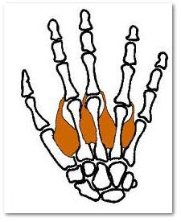
DORSAL INTEROSSEI
ORIGIN
  First, lateral head: Proximal one half of ulnar border of first metacarpal bone
  First, medial head: radial border of second metacarpal bone
  second, third, and fourth: adjacent sides of metacarpal bones in each interspace
INSERTION
into extensor expansions and to base of proximal phalanges as follows:
  First: radial side of index finger, chiefly to base of proxiaml phalanx
  Second: radial side of middle finger
  Third: ulnar side of middle finger, chiefly into extensor expansion
  Fourth: ulnar side of ring finger
ACTION
Abducts the index, middle, and ring fingers from the axial line through the third digit. Assists in flexion of metacarpophalangeal joints and extension of interphalangeal joints of the same fingers. The first assists in addition of the thumb
NERVE
ulnar nerve - C8, T1

Slide 26
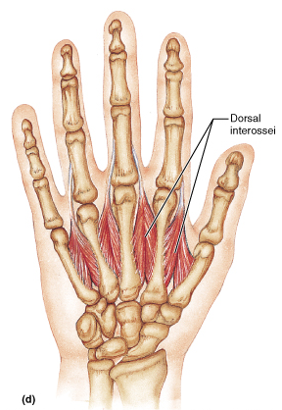
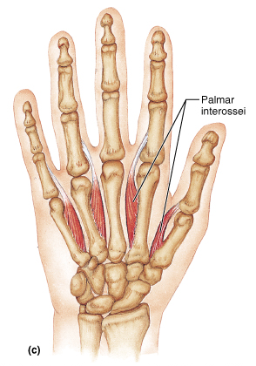
THE INTEROSSEI
ABDUCTION
ADDUCTION

Slide 27
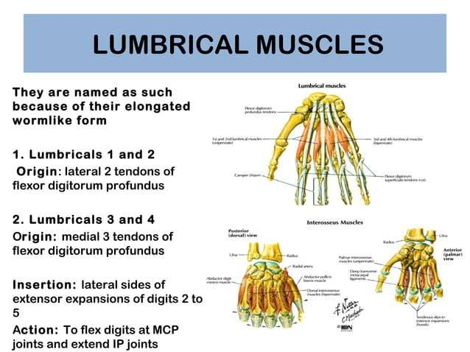

Slide 28
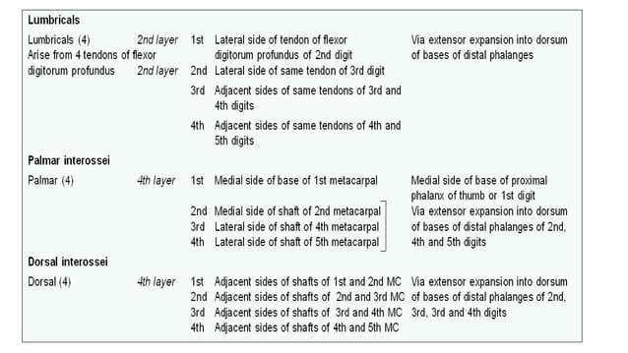

Slide 29
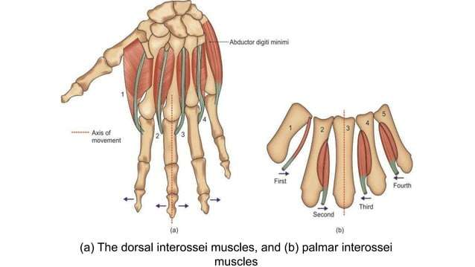

Slide 30
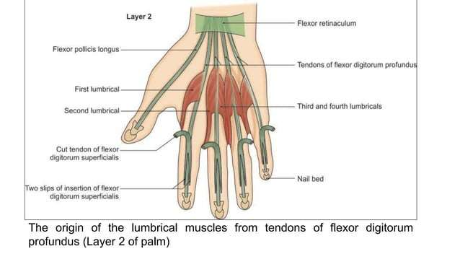

Slide 31
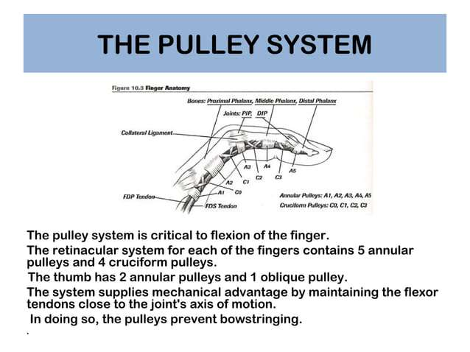

Slide 32
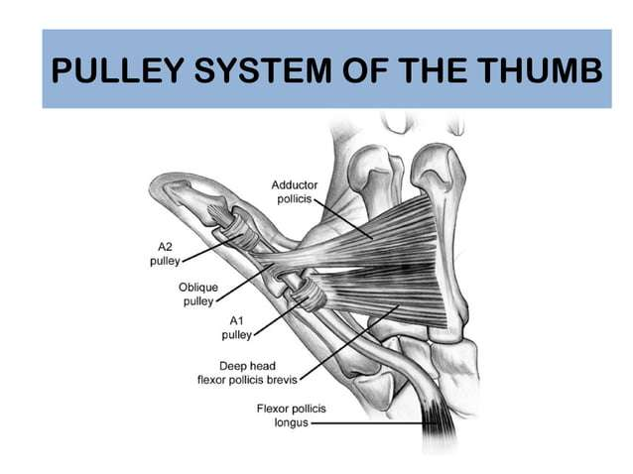

Slide 33
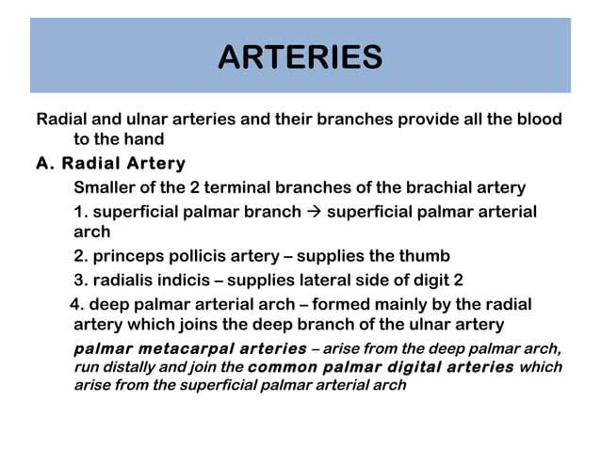

Slide 34
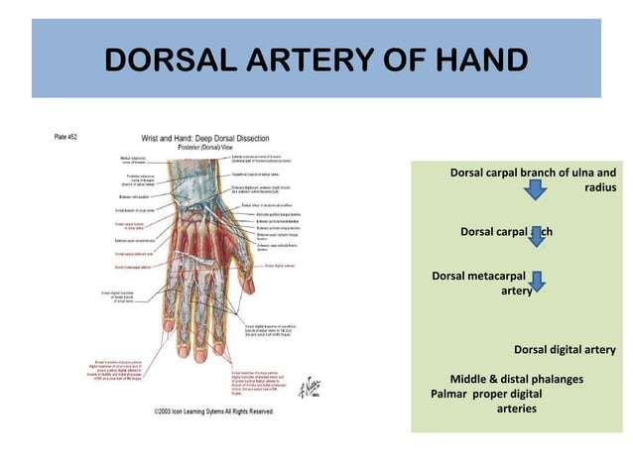

Slide 35
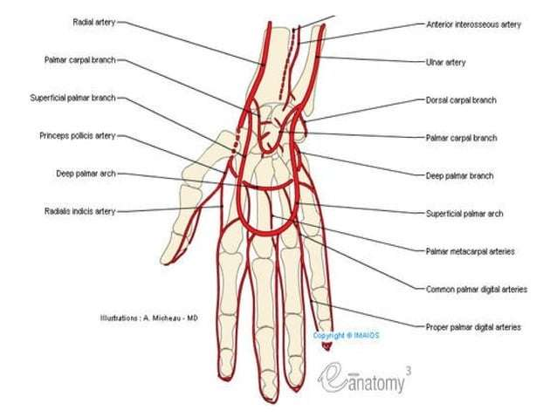

Slide 36
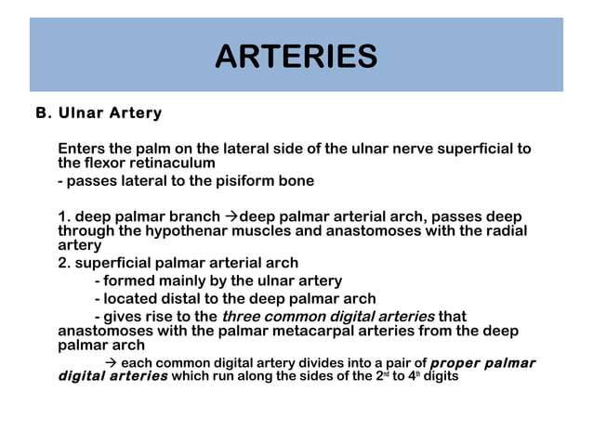

Slide 37
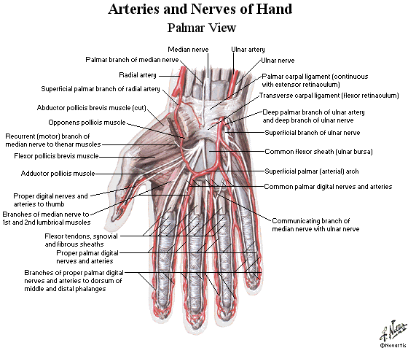

Slide 38
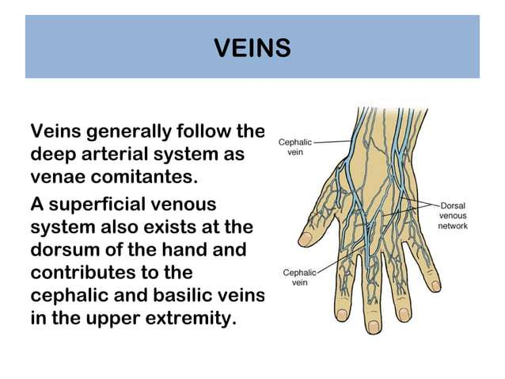

Slide 39
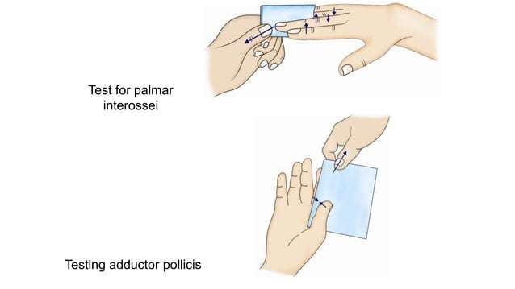

Slide 40
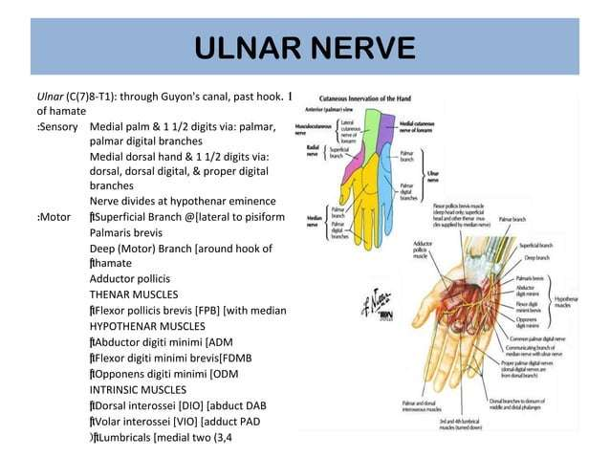

Slide 41
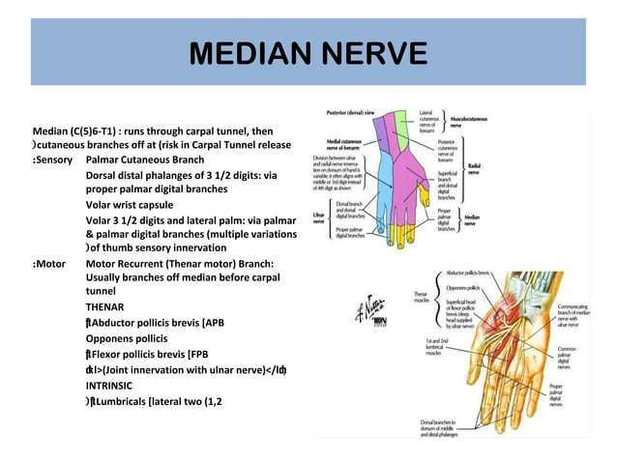

Slide 42
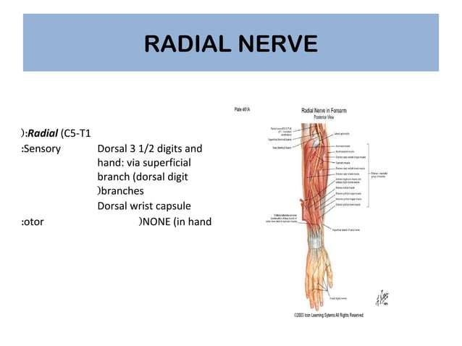

Slide 43
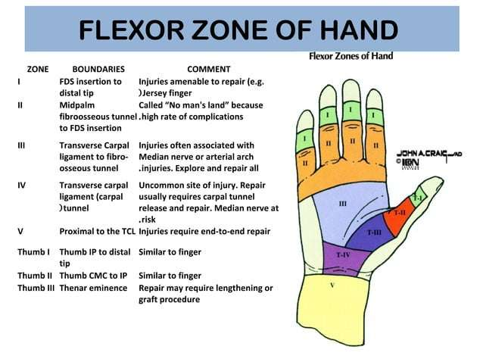

Slide 44


