Slide 1
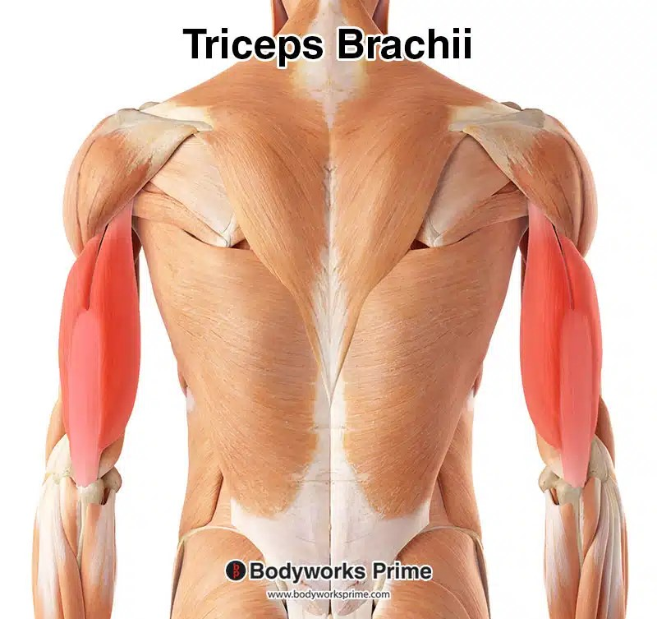
GROSS ANATOMY back of arm
Dr. Praveen Kumar Kurrey
M.B.B.S., M.S., BCME, BCBR
Professor Anatomy

Slide 2
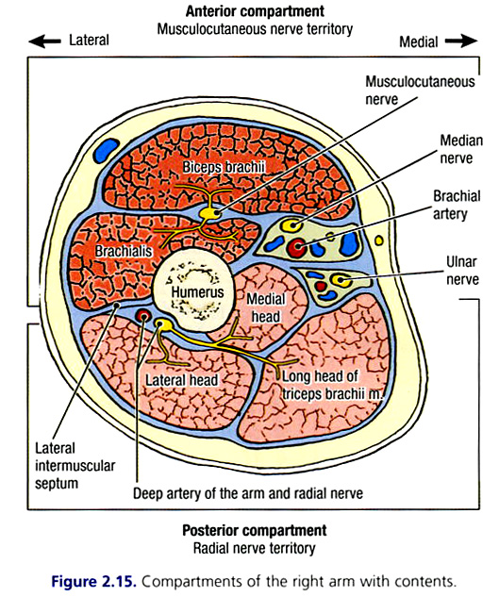
POSTERIOR COMPARTMENT OF ARM
• Contents:
  Triceps brachii muscle
  Radial nerve
  Profunda brachii artery
  Ulnar nerve and ulnar collateral arteries pass through the posterior compartment.

Slide 3
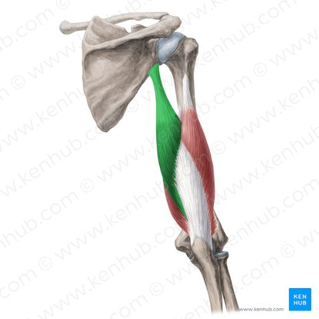
Triceps Brachii Muscle
• Large bulky muscle that fills the posterior compartment of arm.
• Has three heads (long, lateral, and medial), hence, called triceps

Slide 5
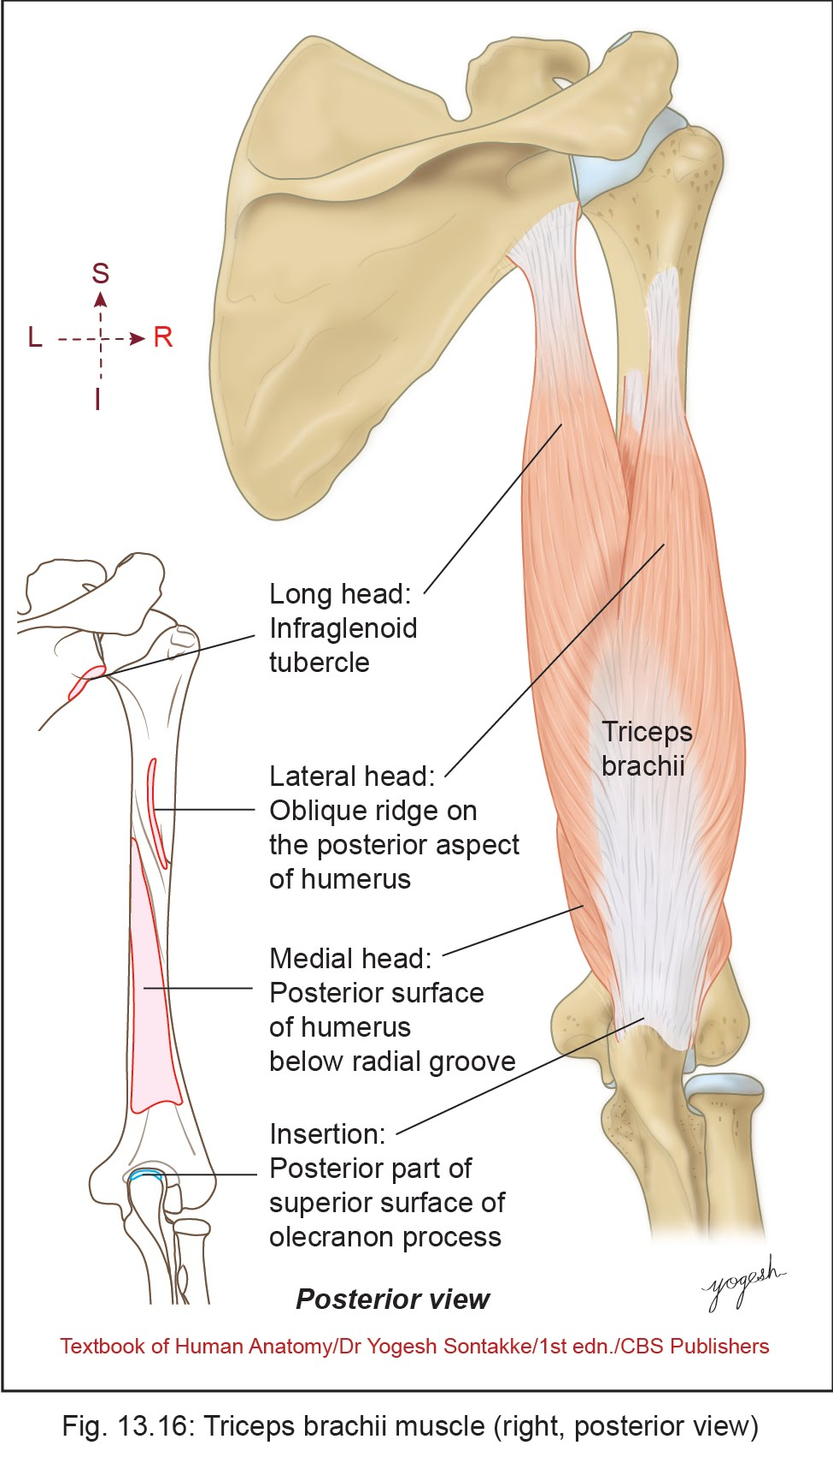
Triceps Brachii Muscle
Origin
Long head – infraglenoid tubercle of scapula
Lateral head – from an oblique ridge on the posterior surface of the humerus that lies lateral to the radial groove.
Medial head –posterior surface of humerus inferomedial to the radial groove and from medial and lateral intermuscular septa

Slide 6
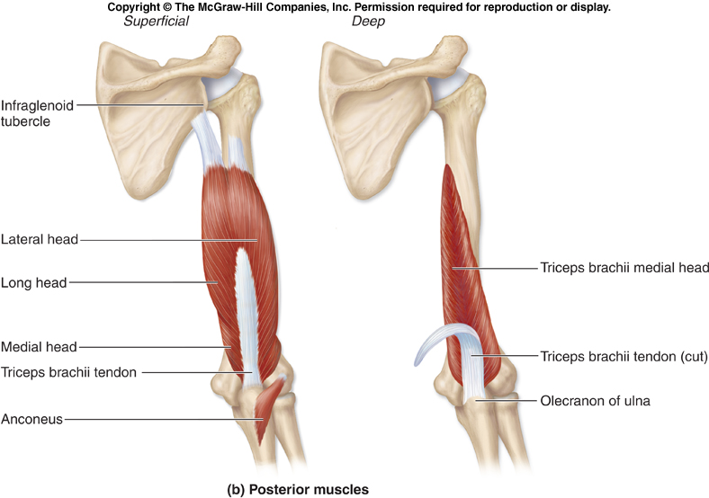
Triceps brachii

Slide 7
Triceps Brachii Muscle
Insertion
Posterior part of superior surface of olecranon process.
Nerve Supply
• Radial nerve

Slide 8
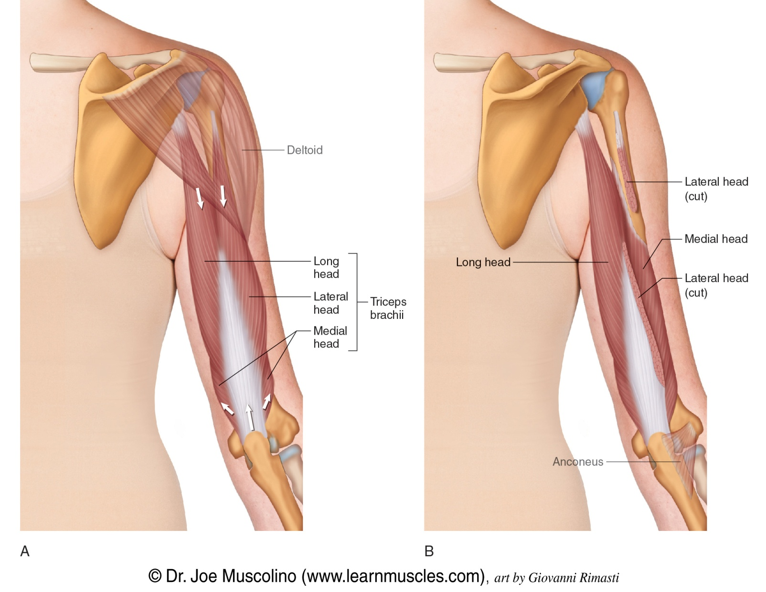
Triceps Brachii Muscle
Actions
Powerful extensor of the elbow
Long head – extension and adduction of arm at the shoulder joint

Slide 9
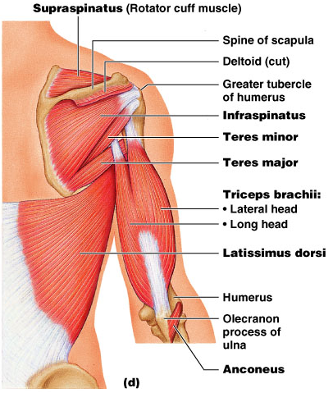

Slide 10
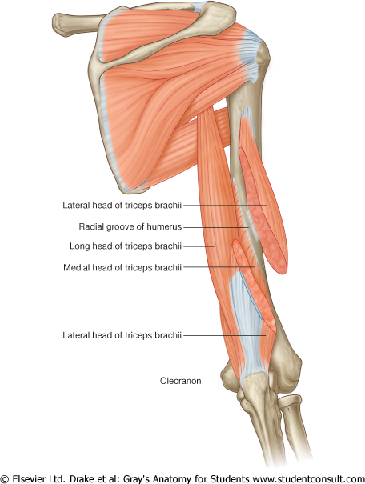
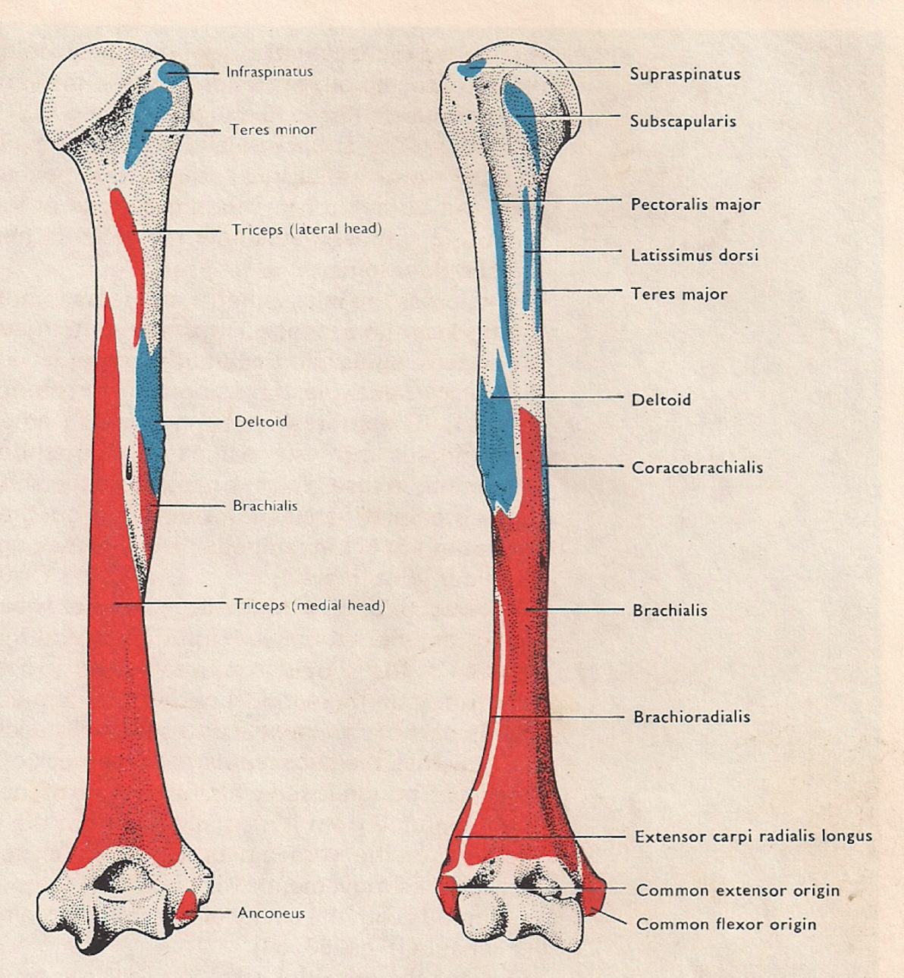
Triceps with three heads

Slide 11
Clinical ANATOMY
• Escape of triceps in radial nerve injuries: In the radial nerve injuries in the spiral groove, triceps escapes from complete paralysis as the long and medial heads of triceps receives the branches of radial nerve arising in the axilla.
Articularis cubiti: These are the fibers of medial head that inserts on the capsule of elbow joint and prevents the Nipping of capsule during extension of elbow.

Slide 12
CLINICAL ANATOMY
• Radial nerve supplies long and medial head before entering in radial groove, and in the groove, it gives branches to medial and lateral head.
• Through radial nerve
  – C6 fibers supply lateral head
  – C7 fibers supply long head
  – C8 fibers supply medial head
• Long head supports the head of humerus in abducted position of arm.

Slide 13
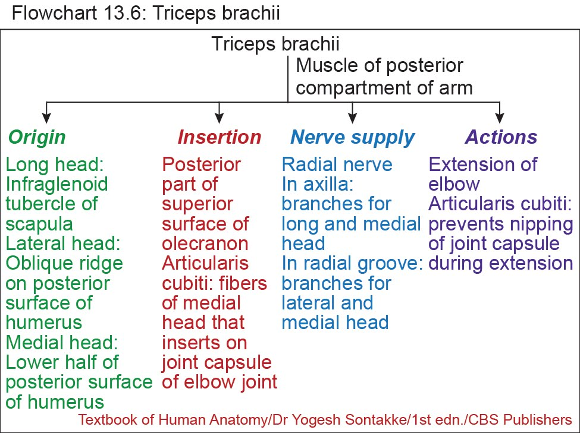

Slide 14
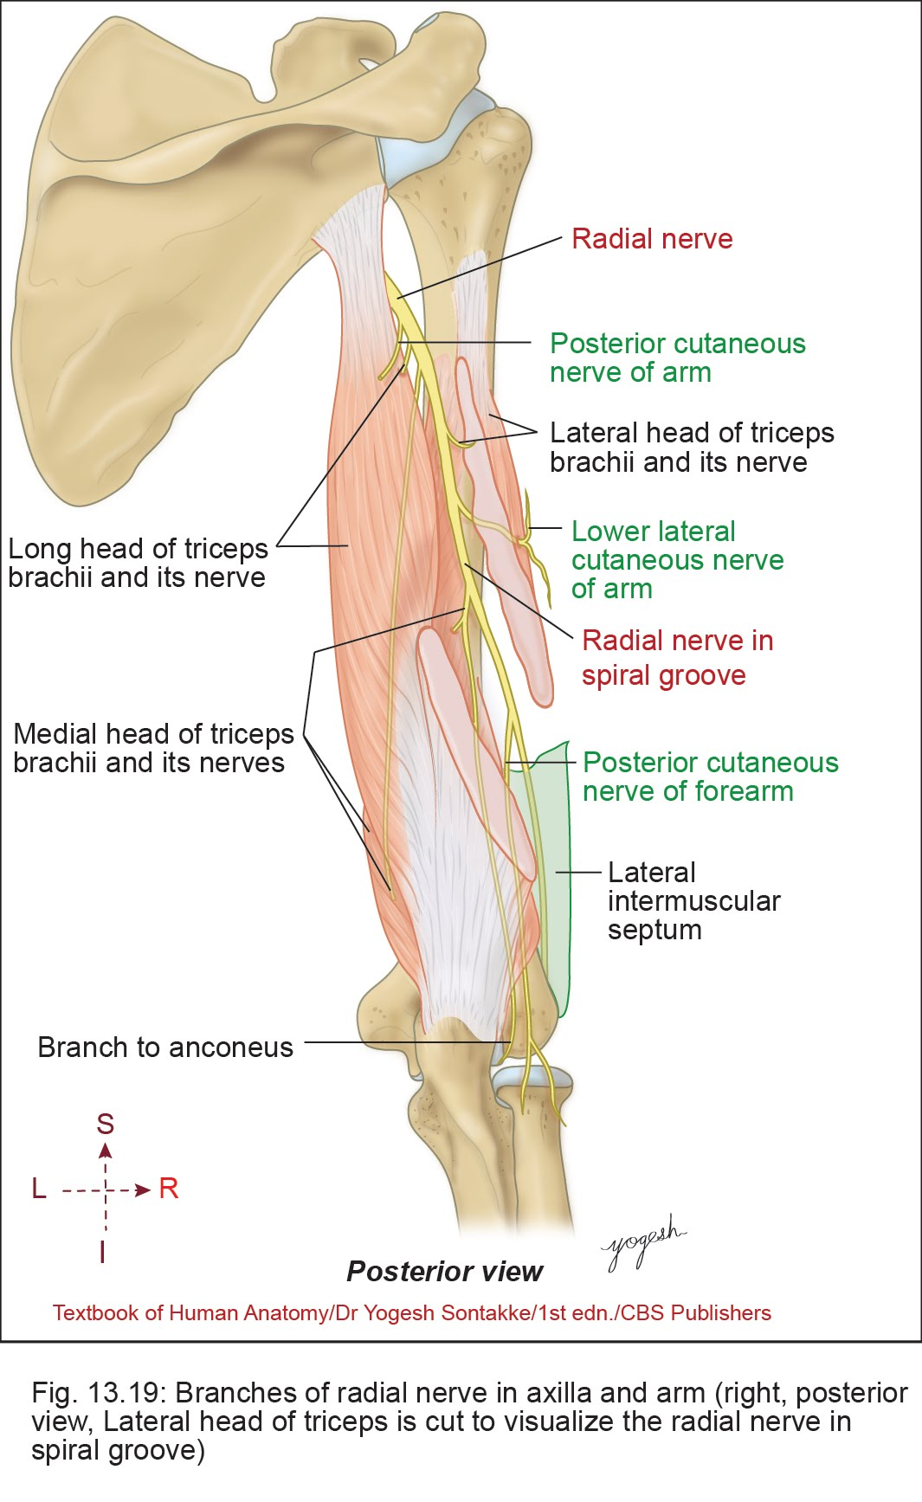
Radial Nerve
• Radial (Musculospiral) nerve – main nerve of posterior compartment of arm, forearm, and dorsum of hand
• Radial nerve is the continuation of the posterior cord
Root value: C5–C8,T1

Slide 15
Radial Nerve
Beginning
• Arises as continuation of posterior cord of brachial plexus behind the third part of axillary artery, in the lower part of axilla.
Largest and Thickest branch of Brachial plexus

Slide 16
Radial Nerve
Course and relations
• Begins in lower part of axilla.
• Runs behind the axillary artery and for a short distance behind the upper part brachial artery.
• Radial nerve enters in the posterior compartment of arm through Lower Triangular intermuscular space along with profunda brachii artery.

Slide 17
Radial Nerve
Course and relations
• Runs downward and laterally in the radial groove
• Pierces lateral intermuscular septum to reenter the anterior compartment of arm. Here, it lies under the cover of brachioradialis and extensor carpi radialis longus.
• Radial nerve divides into superficial branch and posterior interosseous nerve or deep branch at just below the lateral epicondyle.

Slide 18
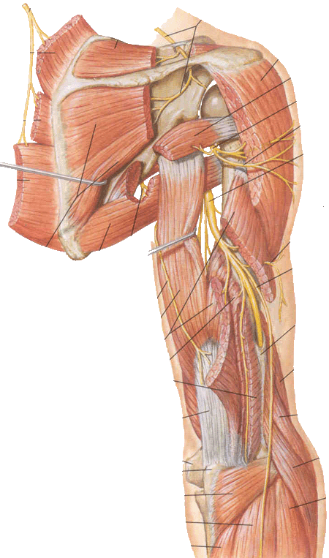

Slide 19
Radial Nerve
Branches
1. In the axilla
1. Branches to the long and medial heads of triceps brachii
2. Posterior cutaneous nerve of arm for the skin on the back of the arm.

Slide 20
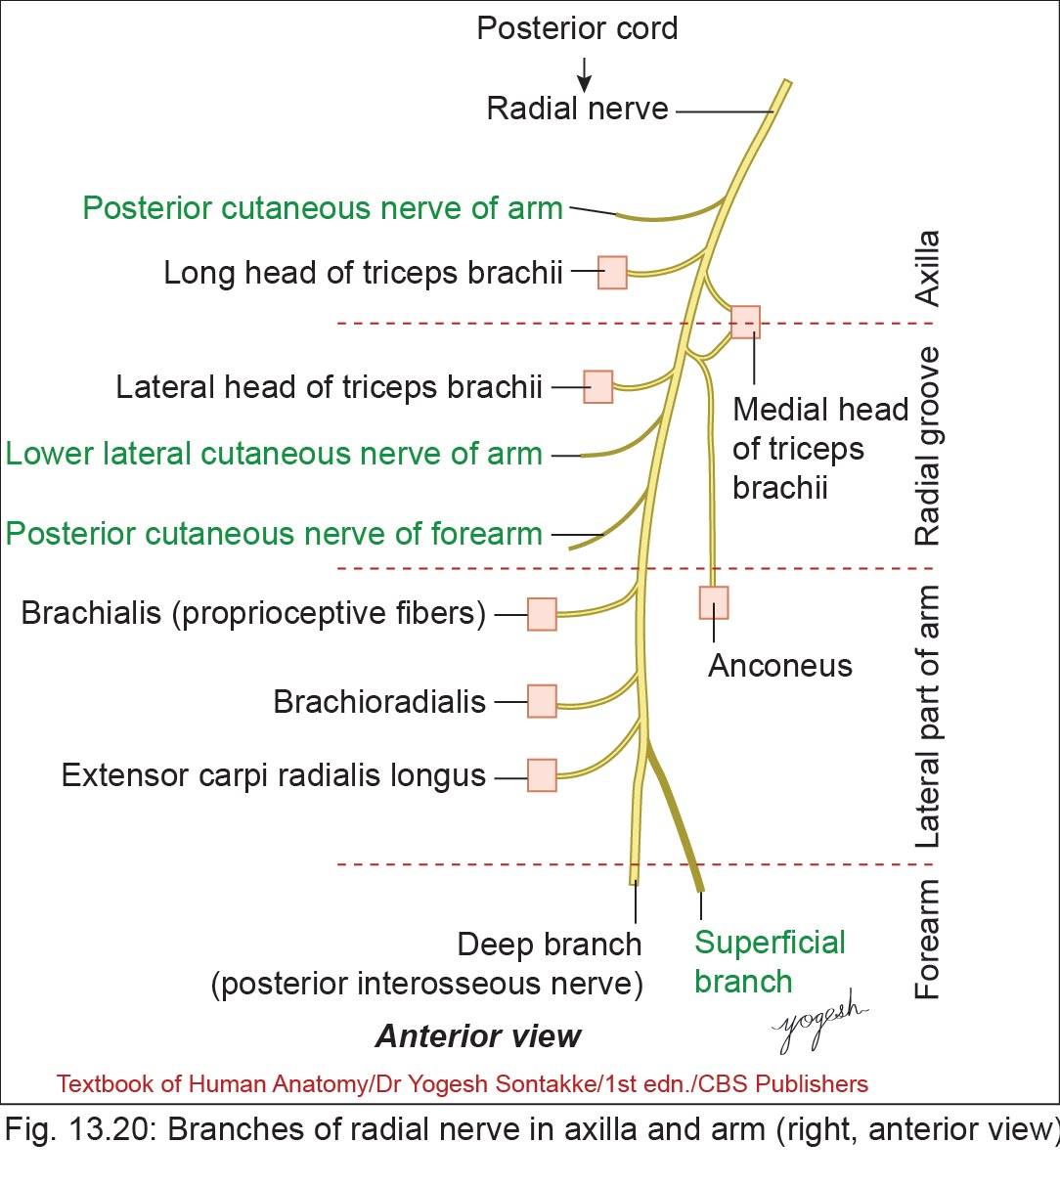

Slide 21
Radial Nerve
Branches
2. In the Radial groove
1. Branch to the lateral head of triceps brachii
2. Branch to the medial head of triceps brachii (also called ulnar collateral nerve as it lie lose to ulnar nerve)
3. Branch to Anconeus (through branch to medial head of triceps)
4. Lower lateral cutaneous nerve of arm
5. Posterior cutaneous nerve of forearm

Slide 22
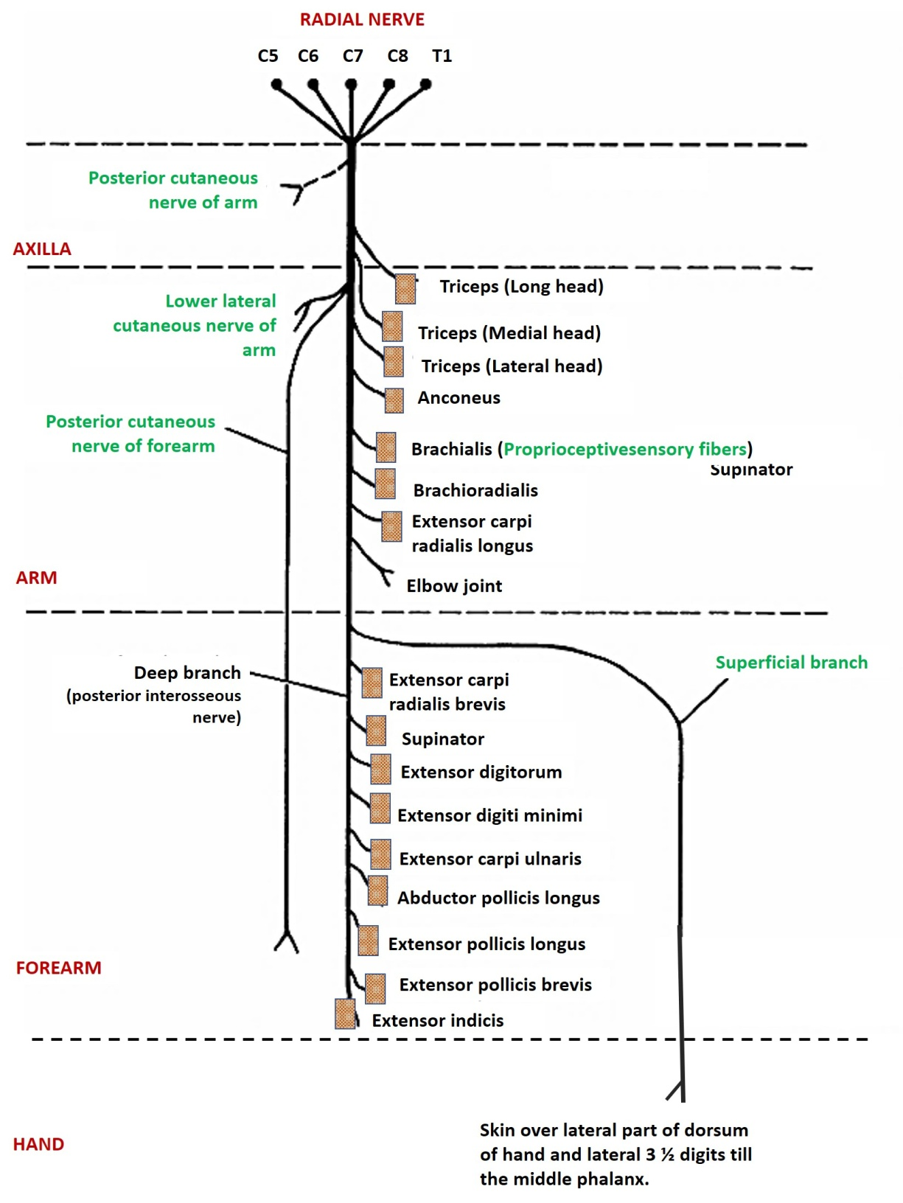
Radial Nerve
Branches
3. In the lower part of arm
(in anterior compartment of arm)
• Branches to
  1. Brachialis
  2. Brachioradialis
  3. Extensor carpi radialis longus
• Articular branch to elbow

Slide 23
Radial Nerve
4. Terminal branches
1. Superficial branch – sensory for dorsum of hand, posterior aspects lateral 3 and 1/2 fingers
2. Deep branch or posterior interosseous nerve: It pierces the supinator muscle. It supplies all remaining muscle of posterior compartment of forearm.

Slide 24
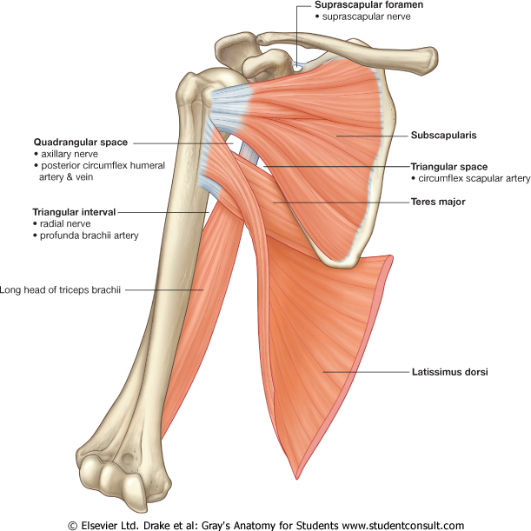

Slide 25
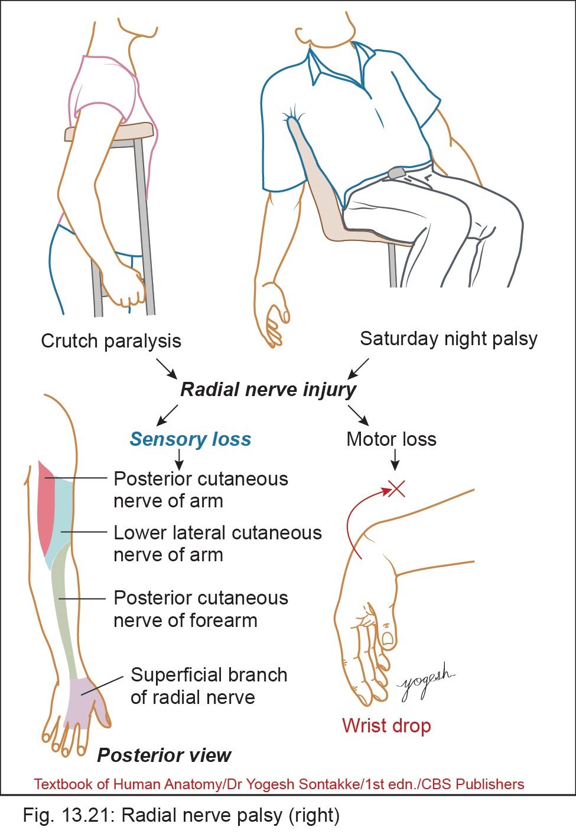
Clinical ANATOMY
Injuries to Radial nerve
• Injuries to radial nerve produces signs and symptoms based on the site of injury.

Slide 26
Clinical anatomy
1. Injury in the axilla (Saturday night palsy) (Crutch Palsy)
• It occurs due to sleeping on armchair with limb hanging by the side of the chair or by pressure of the crutch
• Results
  – Loss of extension of forearm, weakness of supination.
  – Loss of extension of wrist and fingers (wrist drop)
  – Loss of sensation in lower and lateral posterior aspect of arm posterior aspects, forearm, hand, and lateral 3 ½ fingers

Slide 27
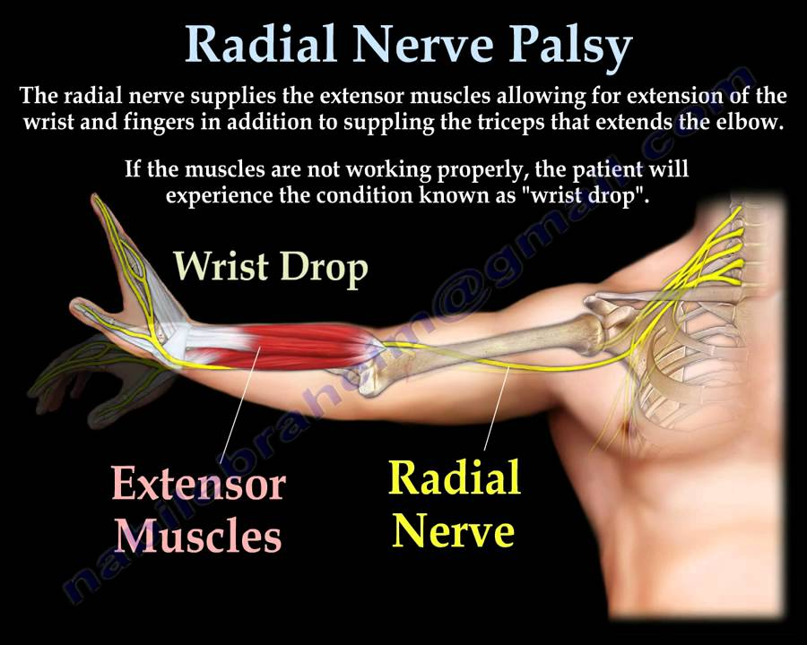

Slide 28
:
Radial nerve
palsy

Slide 30
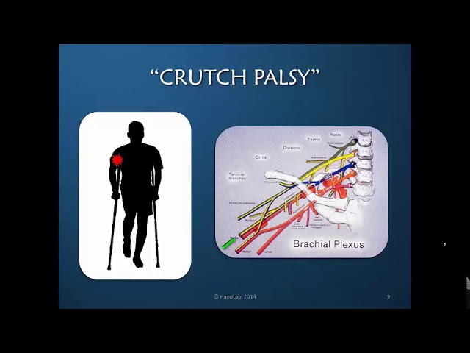

Slide 31
Clinical ANATOMY
2. Injury in the radial groove
• All above signs and symptoms except medial and long head of triceps are preserved (weakness of extension of elbow).

Slide 32
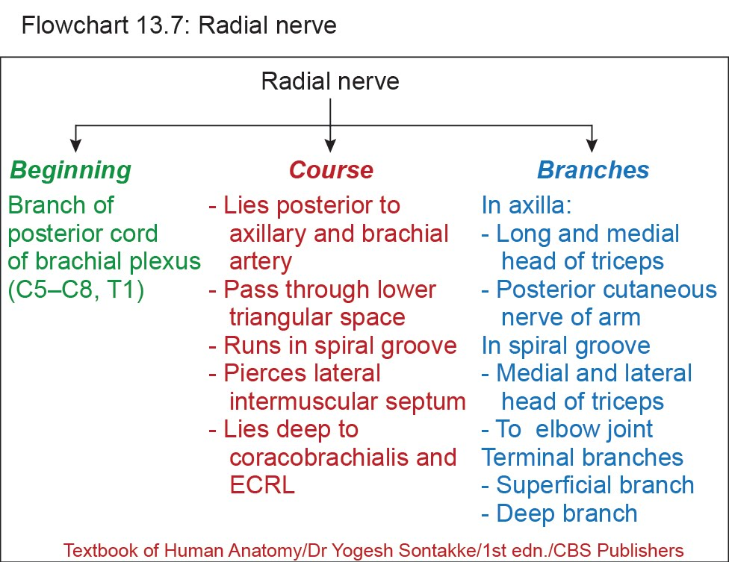

Slide 33
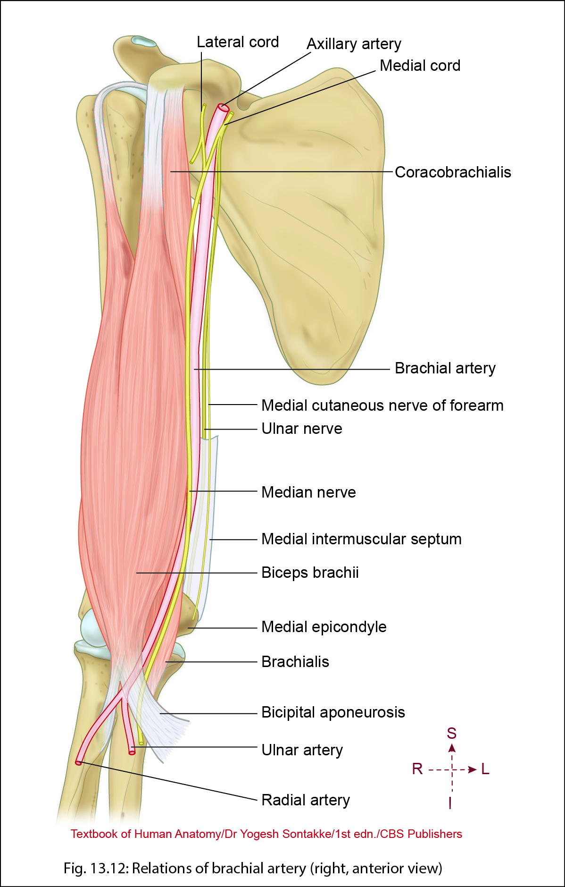
Brachial Artery
• Main artery of the arm and forearm
Beginning
• Continuation of the axillary artery at the level of lower border of teres major muscle
Termination
• Two terminal branches: radial and ulnar arise at the level of neck of the radius.

Slide 34
Brachial Artery
Relations
In the arm
• Anterior
– Crossed by median nerve from lateral to medial.
• Posterior
– Triceps brachii (in upper part)
– Brachialis (in lower part)
• Medial
– Ulnar nerve and basilic vein (in upper part)
– Median nerve in lower part
• Lateral
– Median nerve
– Coracobrachialis (in upper part)
– Biceps brachii (in lower part)

Slide 35
Relations
In cubital fossa
• Anterior
– Bicipital aponeurosis
– Median cubital vein
• Posterior
– Brachialis
• Medial
– Median nerve
• Lateral
– Tendon of biceps

Slide 36
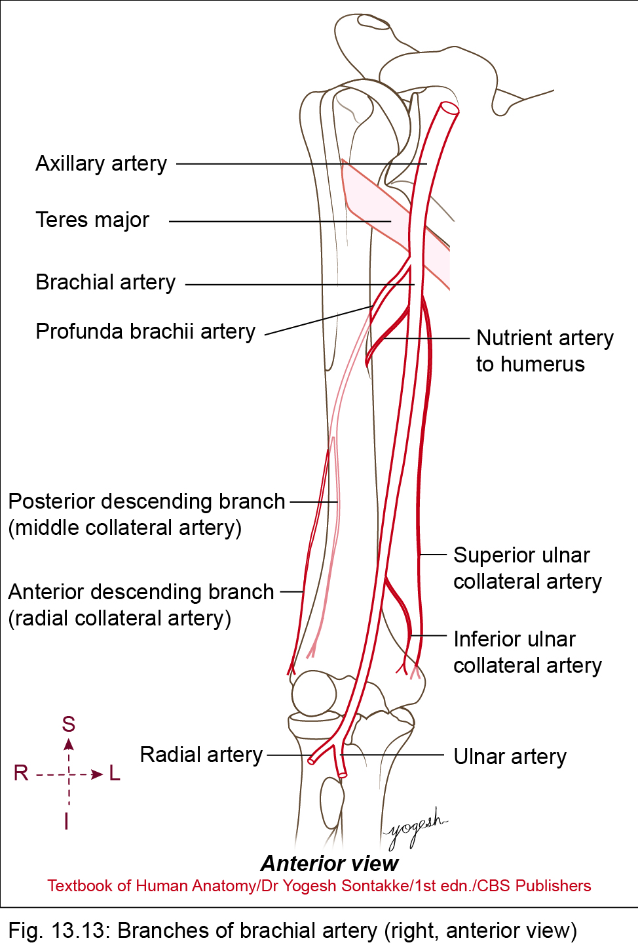
Brachial Artery
Branches
1. Profunda brachii artery
2. Superior ulnar collateral artery
3. Inferior ulnar collateral artery
4. Nutrient artery to humerus
5. Unnamed muscular arteries
Terminal branches
6. Ulnar artery
7. Radial artery

Slide 38
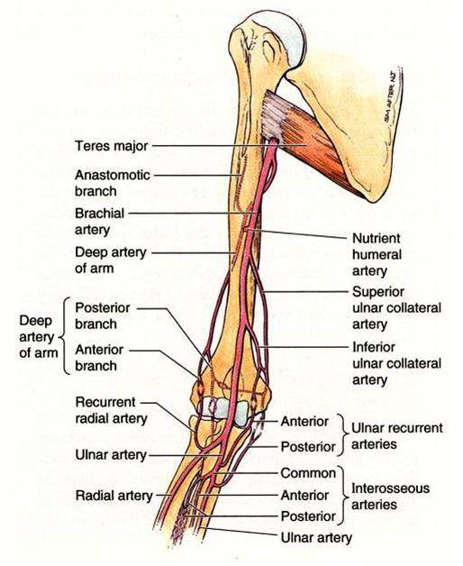

Slide 39
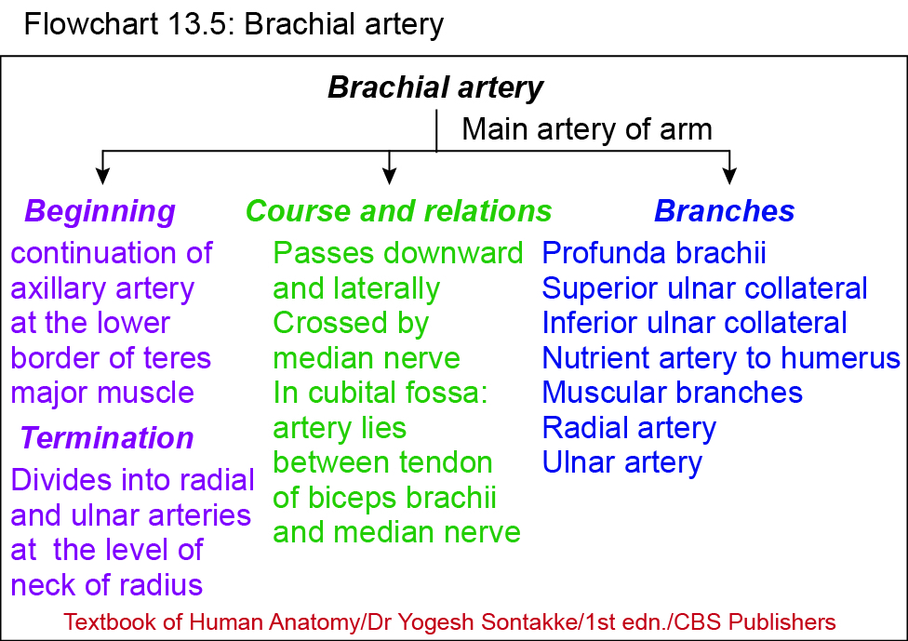

Slide 40
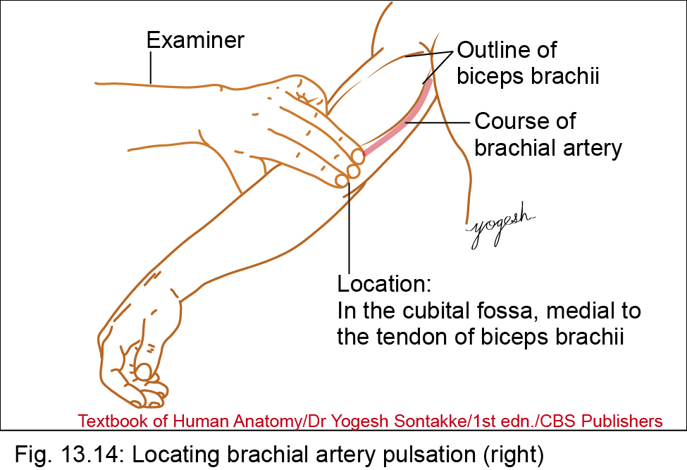
Clinical anatomy
Pulsation of brachial artery
• Can be felt in the cubital fossa, medial to the tendon of biceps brachii.
Compression of brachial artery
• To stop the bleeding from the injury of forearm and hand, brachial artery can be compressed against the shaft of humerus (by using tourniquet or BP apparatus cuff).

Slide 41
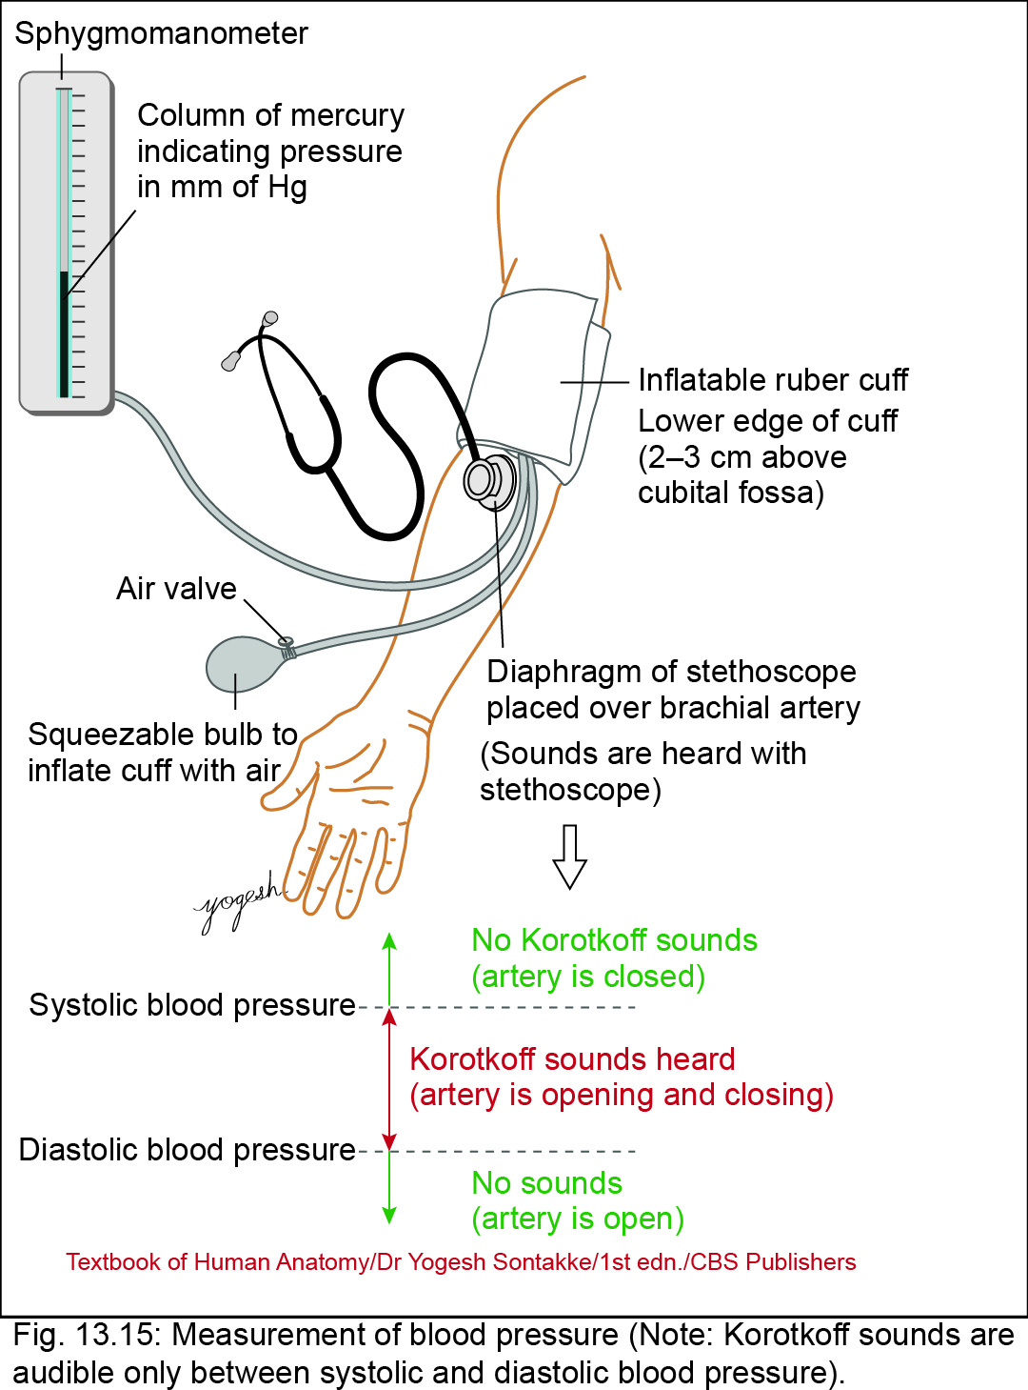
Clinical anatomy
Recording of blood pressure
• Pulsations of brachial artery stop as the pressure of the cuff tighten around the arm raises above the systolic blood pressure and the pulsations restart as the pressure decreases than the systolic pressure.

Slide 42
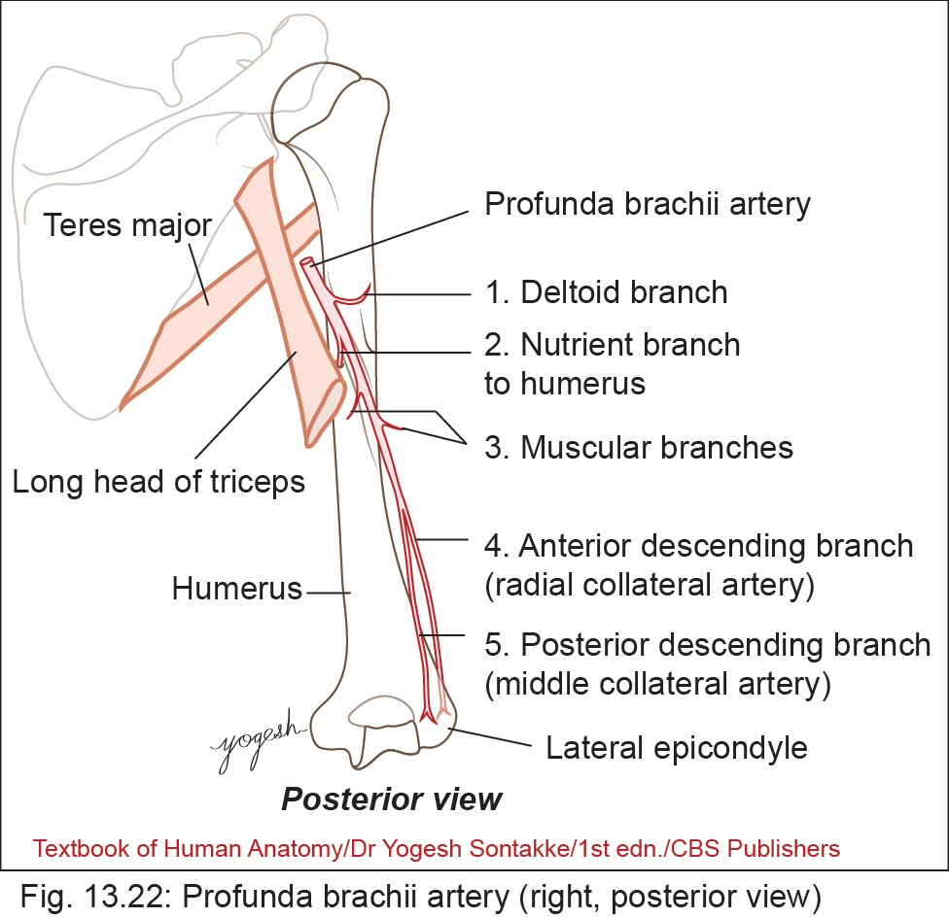
Profunda Brachii Artery
• Main artery of the posterior compartment of arm (profundus = deep)
• Largest branch of brachial artery
Beginning
• Brachial artery just below the teres major muscle

Slide 44
Profunda Brachii Artery
Course and relations
• Passes from posteromedial aspects of brachial artery into lower triangular intermuscular space
• Runs in spiral groove along with the radial nerve
Termination
• Divides into anterior descending and posterior descending branches

Slide 45
Profunda Brachii Artery
Branches
1. Deltoid (ascending) branch
2. Nutrient artery to humerus
3. Numerous muscular branches
4. Anterior descending (radial collateral) artery
5. Posterior descending (middle collateral) artery

Slide 46



Slide 47


