Slide 1
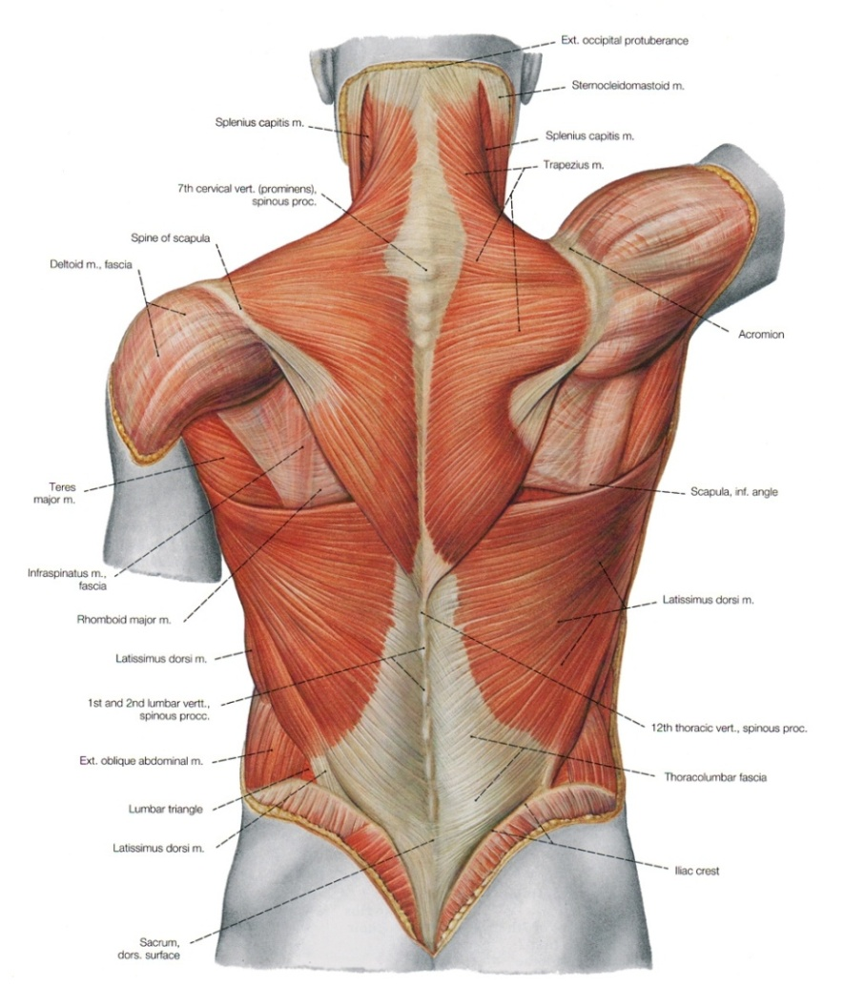
MUSCLES OF BACK
(GROSS ANATOMY)
Dr. Praveen Kumar Kurrey
MBBS, MS, BCME, BCBR
Professor Anatomy

Slide 2
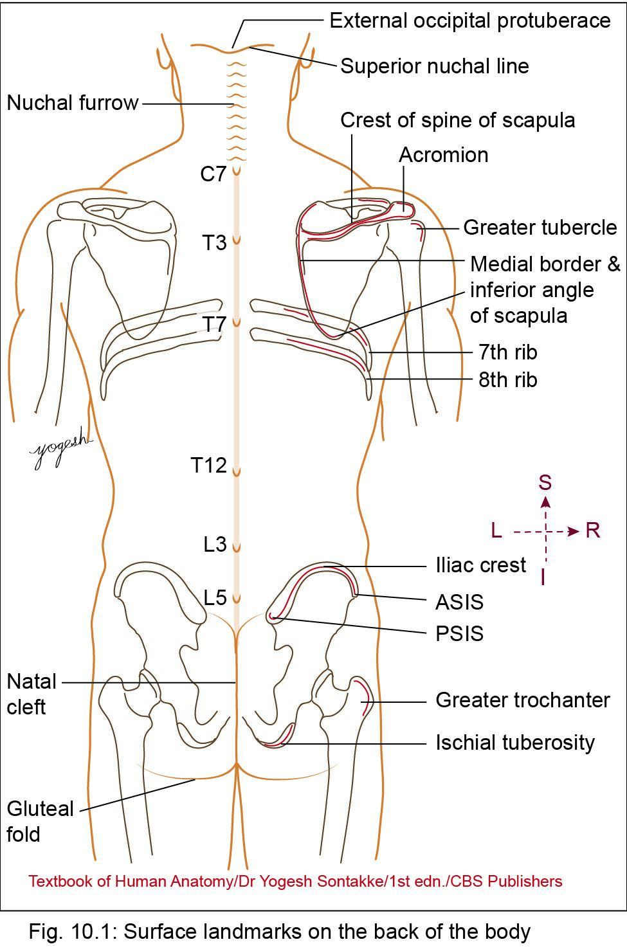
SURFACE LANDMARKS
Eighth rib
  Lies just below inferior angle of scapula
Iliac crest
  Curved bony crest of hipbone that lies below waist
Anterior superior iliac spine
  Anterior end of iliac crest
Posterior superior iliac spine
  Posterior end of iliac crest
  Can be felt in shallow dimple above buttock, about 5 cm from median plane

Slide 3
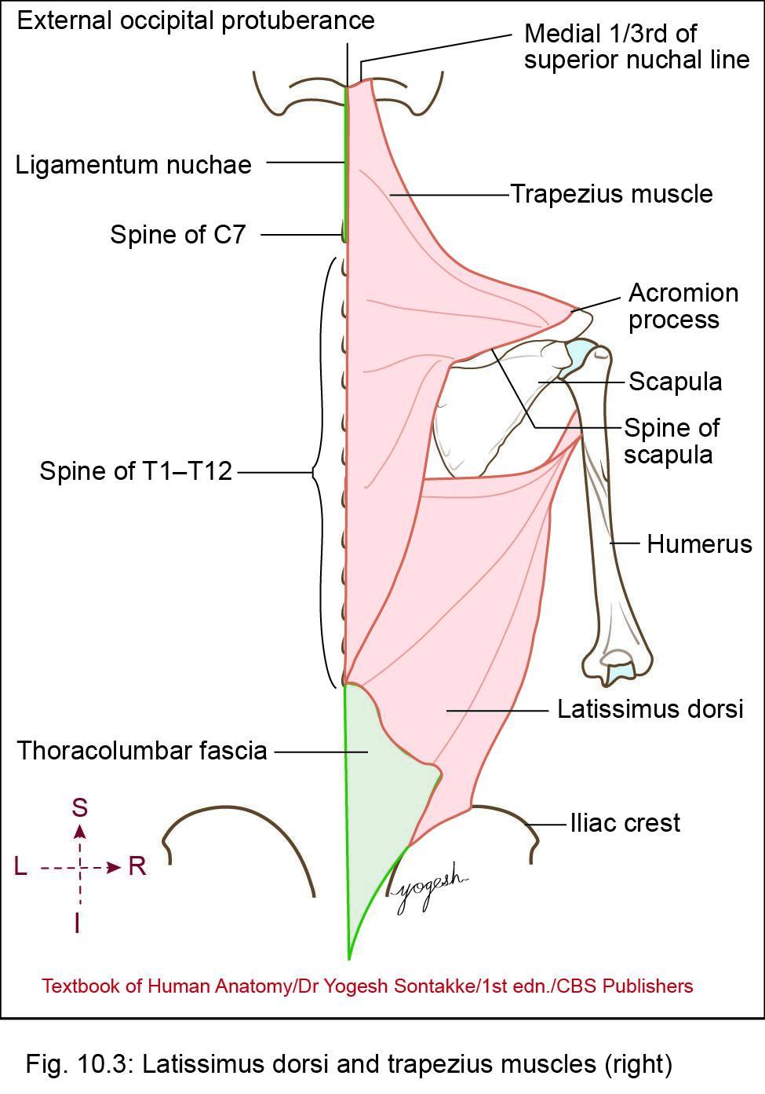
MUSCLES OF THE BACK
Posterior Axio-Appendicular muscles
Connect appendicular skeleton of upper limb –axial skeleton
Grouped as-
  Superficial layer
    -Trapezius
    -Latissimus dorsi
Deep layer
  Levator scapulae
  Rhomboid major
  Rhomboid minor

Slide 4
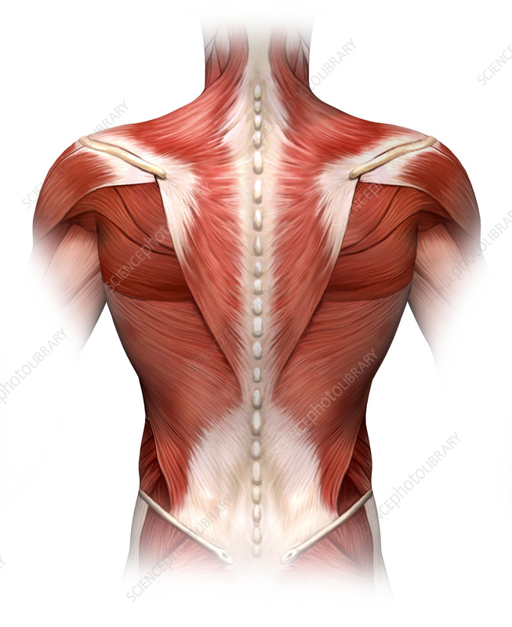

Slide 5
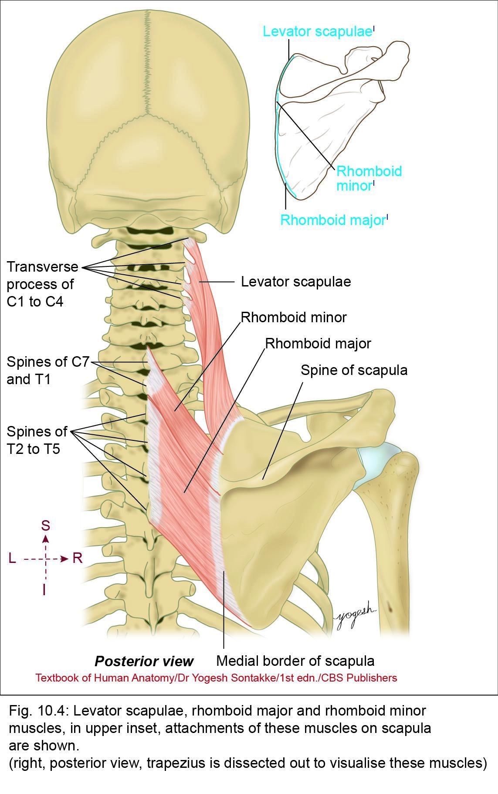

Slide 6
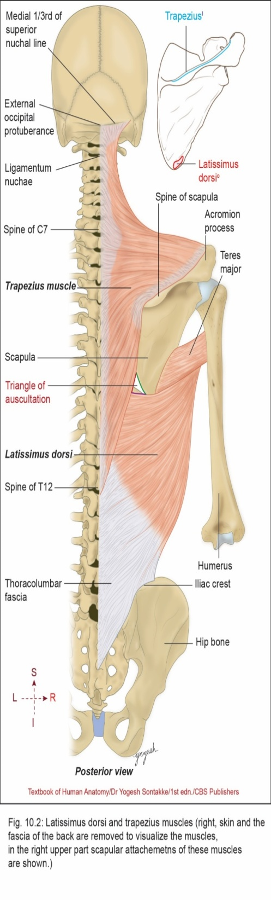
1. Trapezius Muscle
Origin
  Superior nuchal line (medial one-third)
  External occipital protuberance
  Ligamentum nuchae
  Spine of C7 vertebra
  Spines of T1 to T12 vertebrae

Slide 7
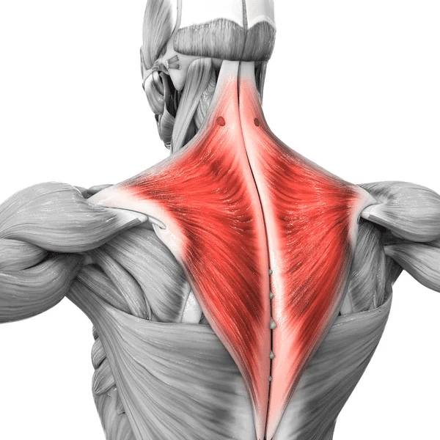
TRAPEZIUS

Slide 8
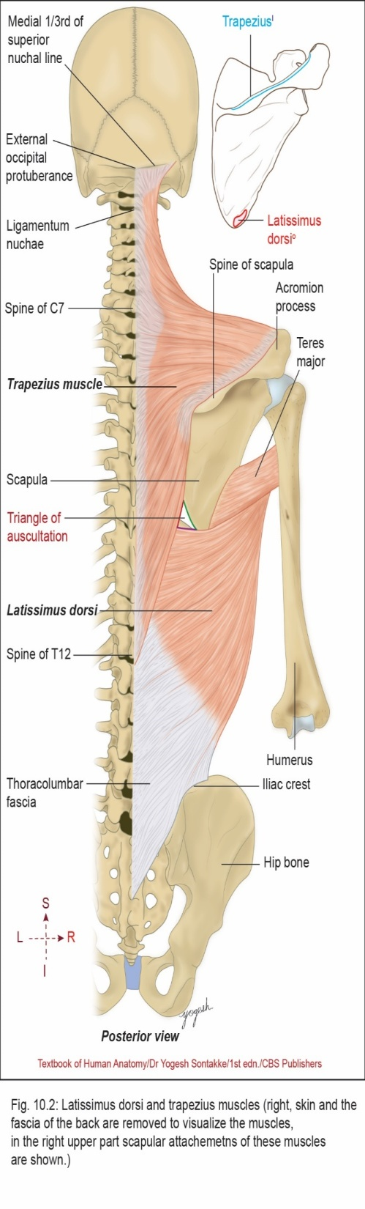

Slide 9
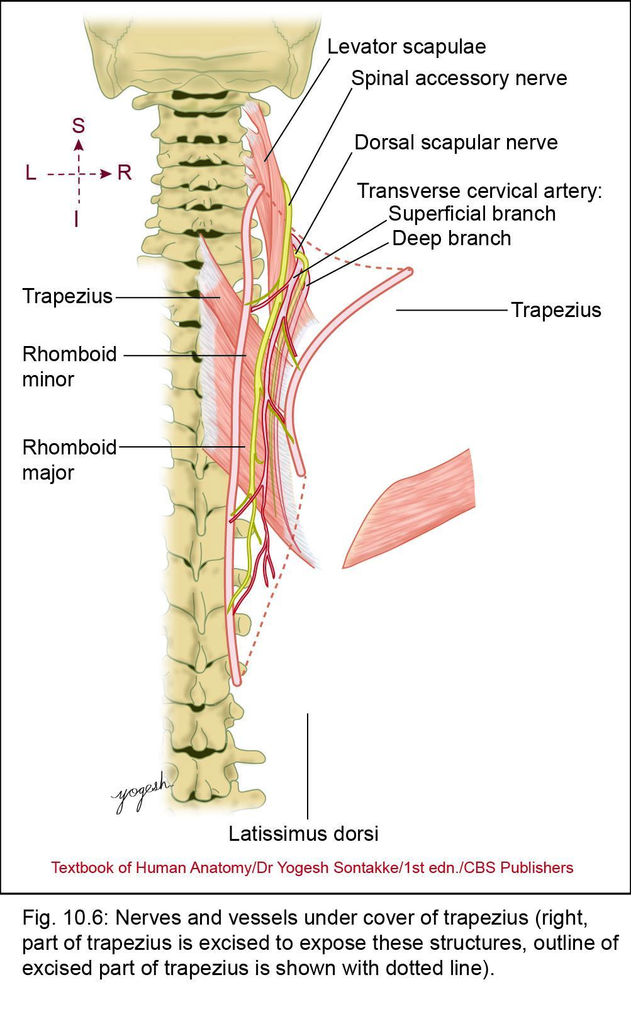
Trapezius Muscle
Insertion
  Upper fibers – posterior border of lateral one-third of clavicle
  Middle fibers – medial border of acromion process and upper lip of crest of spine of scapula
  Lower fibers – apex of triangular area at medial end of spine of scapula
Innervations (nerve supply)
Supplied by
  Spinal part of spinal accessory nerve
  Proprioception by ventral primary rami of C3 and C4

Slide 10
Trapezius Muscle
Actions
Steadies scapula and performs following action
  Upper fibers
    -Along with levator scapulae – elevation of scapula (shrugging of shoulder)
  Middle fibers
    -Along with rhomboid major and minor – retraction of scapula
  Lower fibers:
    -Along with serratus anterior – rotates scapula in overhead abduction of arm

Slide 11
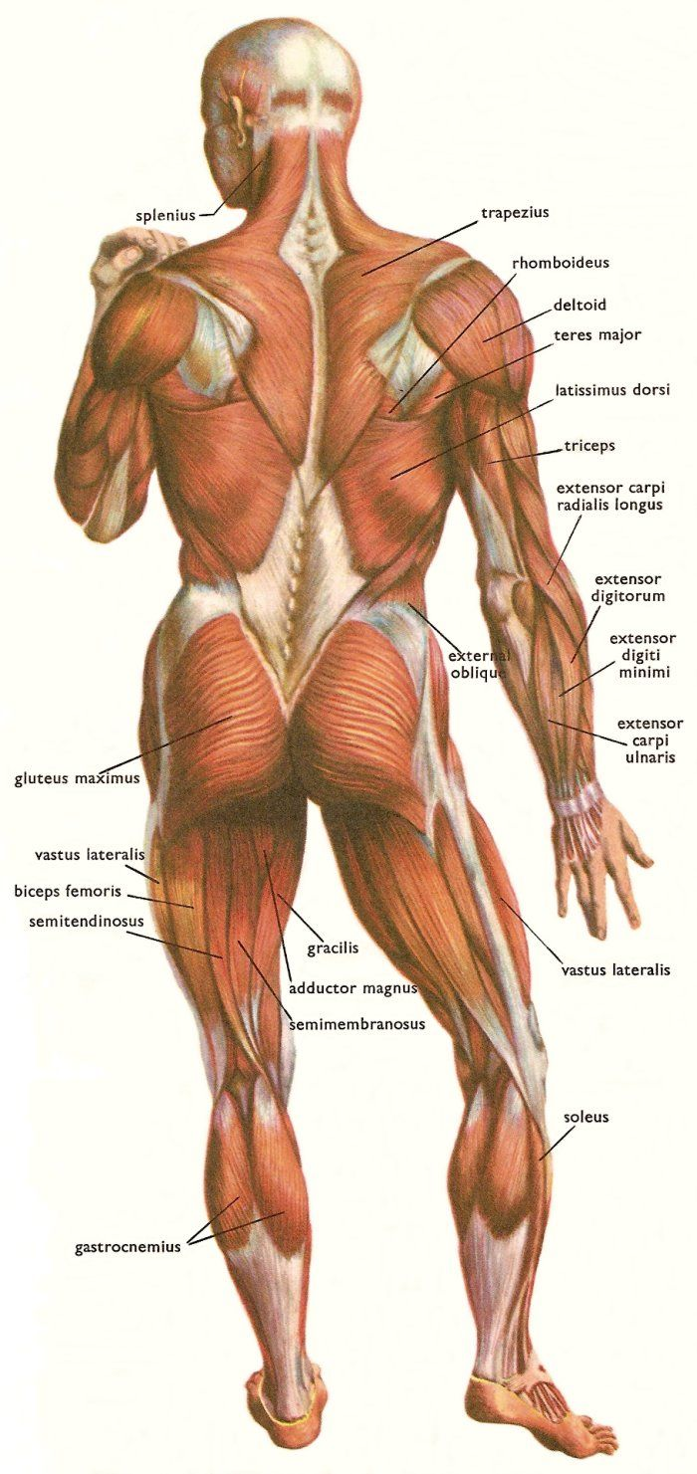

Slide 14
2. Latissimus Dorsi
Widest Muscle of Body
Wide, thin sheet-like muscle covers wide area of back (latissimi = wide, dorsi = back, in Latin)
Large fan-shaped muscle connects humerus with trunk
Origin
Originates from
  Spines of lower six thoracic vertebrae (deep to origin of trapezius)
  Thoracolumbar fascia
  Outer lip of iliac crest
  Lower four ribs
  Inferior angle of scapula

Slide 15
Latissimus Dorsi
Direction of fibers
Fibers ascend upward and laterally (lowest fibers almost vertical and uppermost fibers are nearly horizontal)
Fibers turn around inferolateral border of teres major muscle – form posterior axillary fold

Slide 16
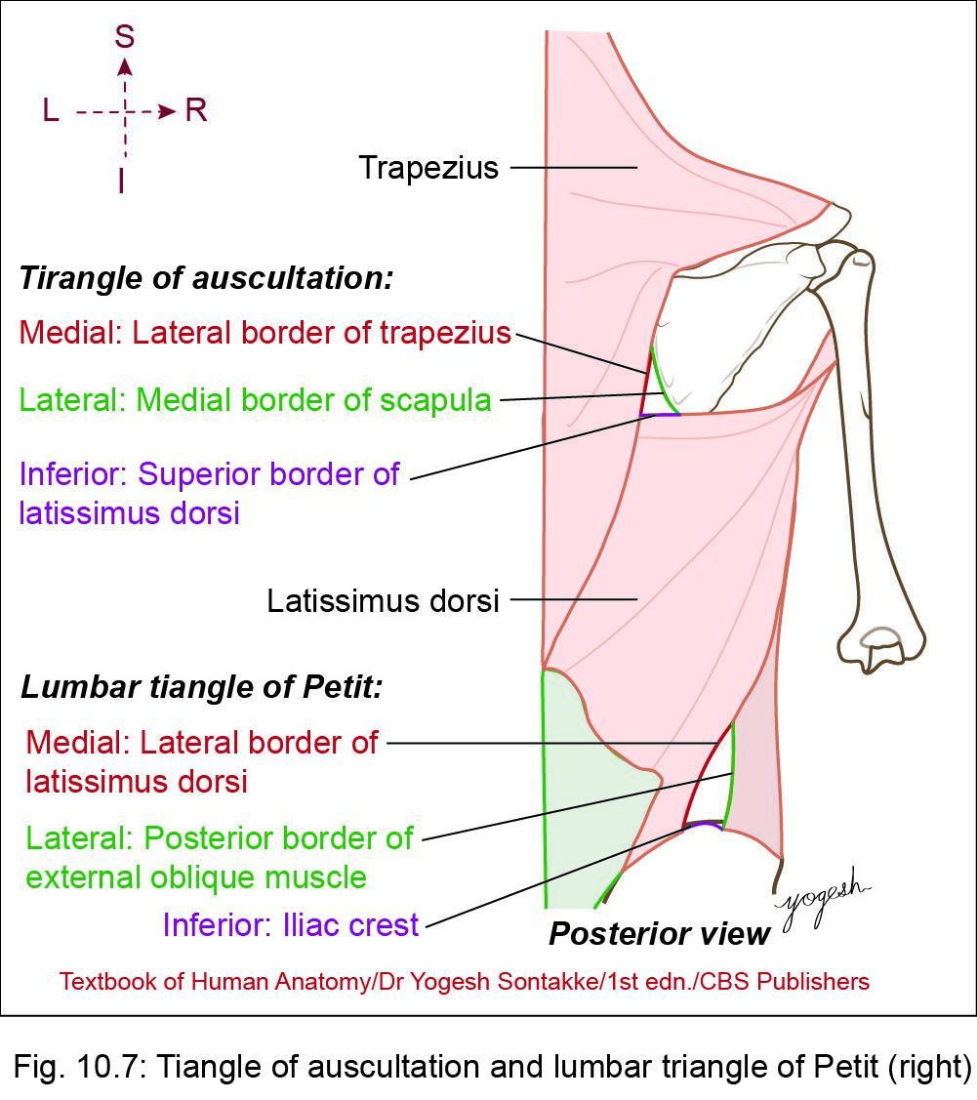
Latissimus Dorsi
Insertion
  Muscle inserts in floor of bicipital groove (intertubercular sulcus)
  Lowest fibers insert – higher levels and higher fibers insert in lower levels
Innervation
  Thoracodorsal nerve (nerve – latissimus dorsi) (C6–C8)
  (Middle Subscapular Nerve)
  Branch of posterior cord of brachial plexus

Slide 17
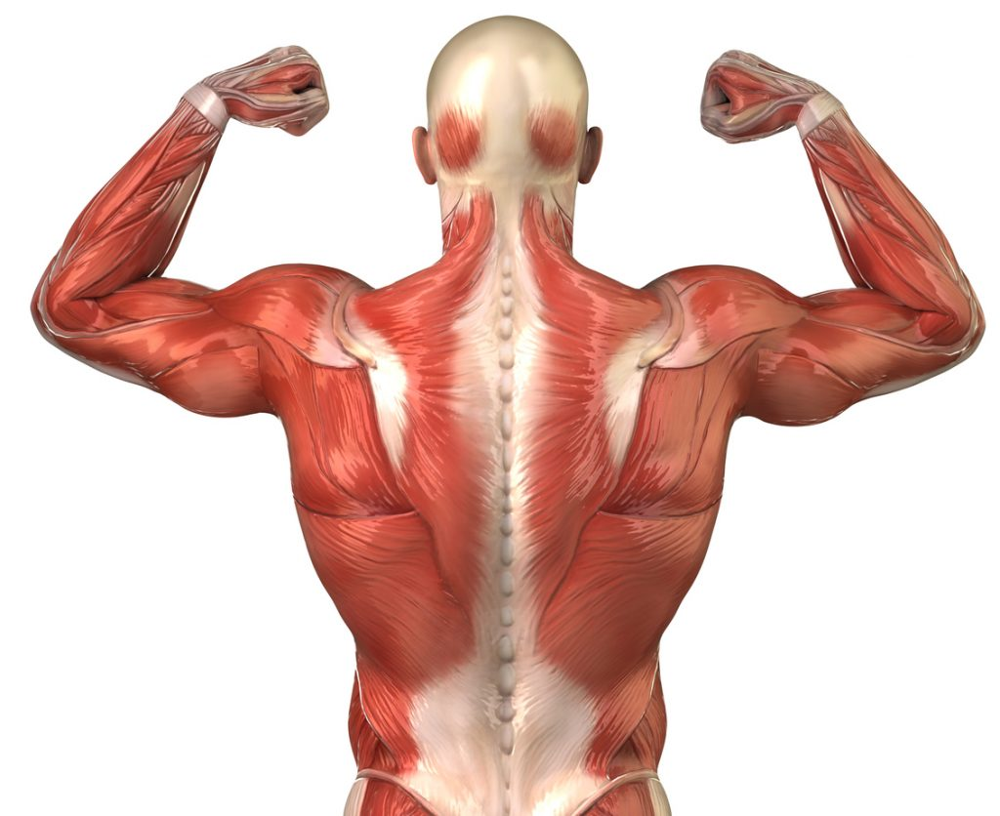
LATTISSIMUS DORSI

Slide 18
Latissimus Dorsi
Actions
  Helps – swimming, rowing, climbing, and pulling
  Movements require adduction, extension, and medial rotation of shoulder
  Violent expiration: coughing and sneezing
  Climbing on rope: this action, humeral attachment (proximal attachment of the muscle) – fixed and trunk moves upward
  Pectoralis major muscle also helps – climbing

Slide 19
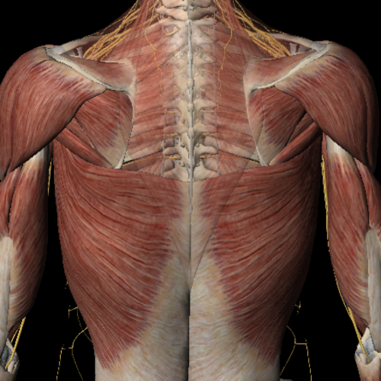

Slide 20
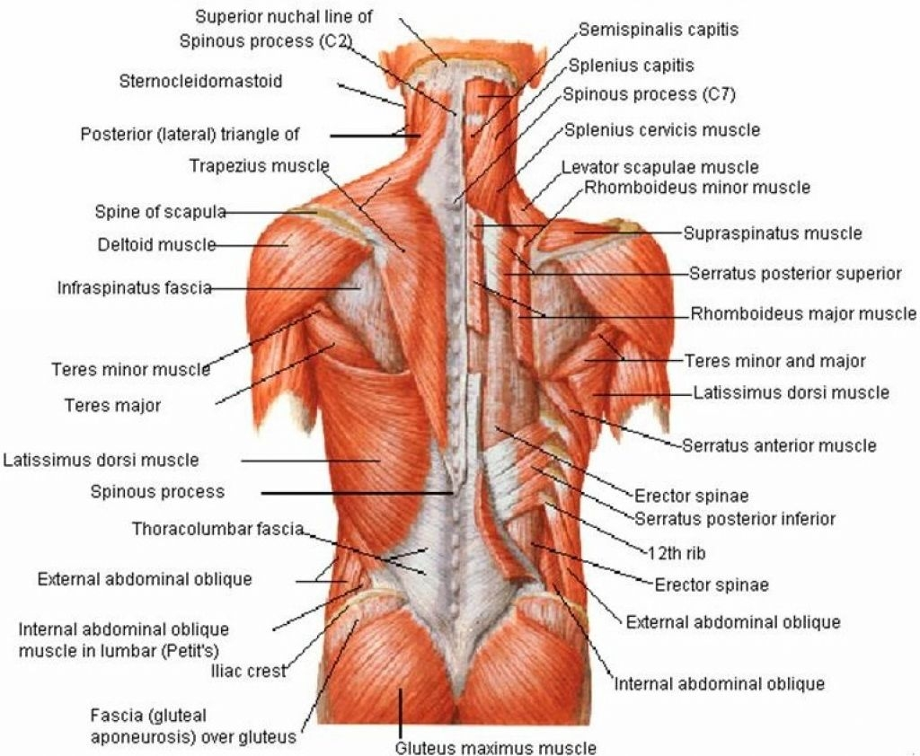

Slide 22
Clinical anatomy
1. Cardiomyoplasty
Patients with low cardiac output but not suitable for heart transplant, latissimus dorsi is wrapped around the heart and this muscle is stimulated electrically using pacemaker along with heart

Slide 23
Clinical anatomy
2. Musculocutaneous flap for breast reconstruction
  Case of carcinoma of breast, breast reconstruction surgery – required after mastectomy (removal of breast)
  Musculocutaneous flap of latissimus dorsi with thoracodorsal nerve and thoracodorsal artery (branch of subscapular artery) and venae comitantes may be used for breast reconstruction
3. Injury to Thoracodorsal nerve
  May occur during mastectomy as axillary tail reaches up to nerve
  Results in paralysis of latissimus dorsi muscle and inability – raise trunk during climbing
  Latissimus dorsi – useful in breast reconstruction surgeries and for filling back defects

Slide 24
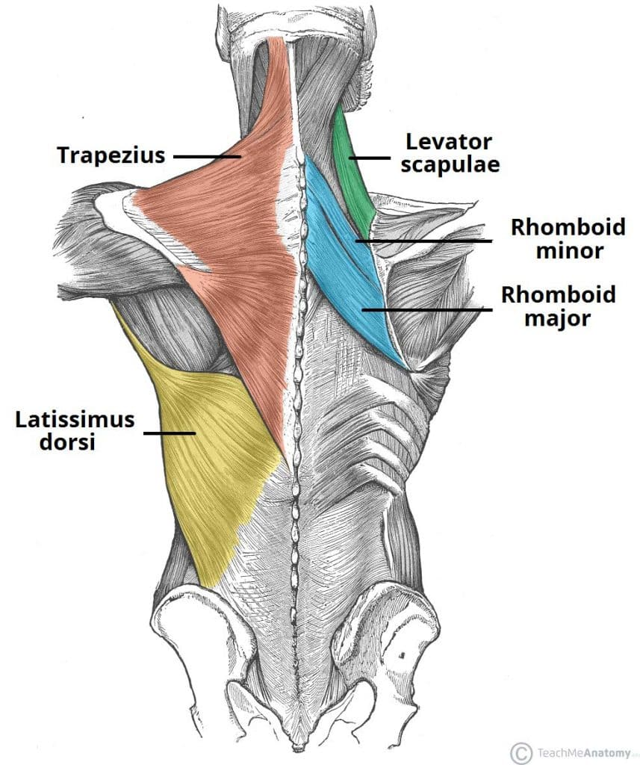
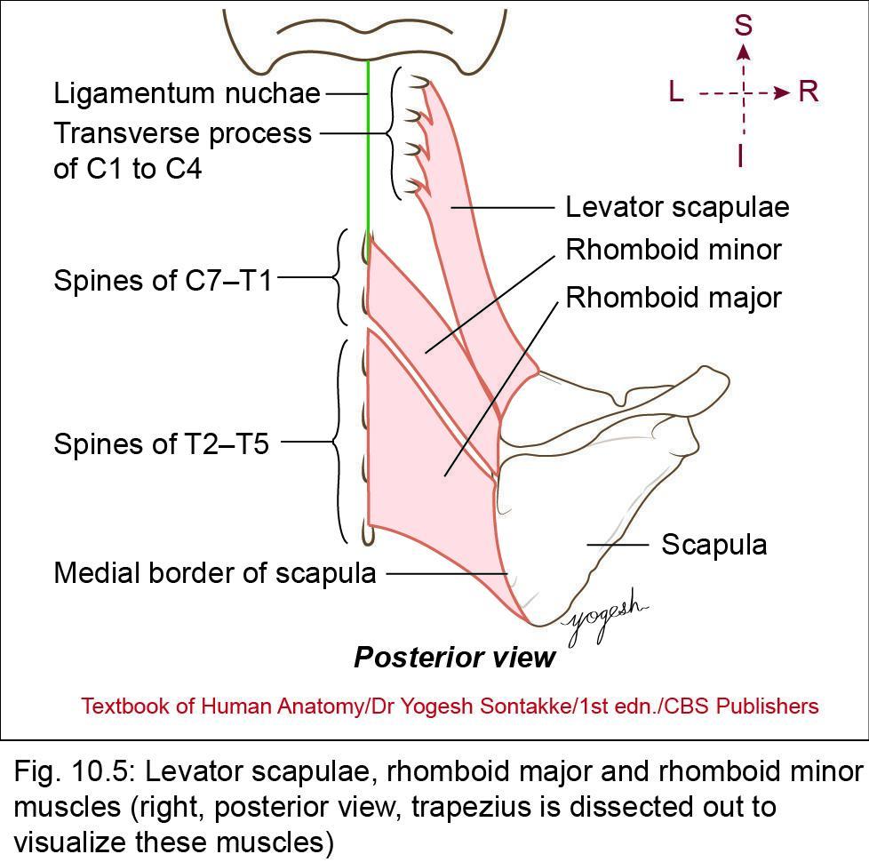
Deep Muscles
Deep posterior axio-appendicular muscles are
  Levator scapulae
  Rhomboid major
  Rhomboid minor

Slide 25
Deep Muscles
1. Levator Scapulae
  Strap-like muscle situated – back of neck
  Elevates the scapula, called levator scapulae
Origin
  Transverse processes of C1–C2 vertebrae
  Posterior tubercles of transverse processes of C3–C4 vertebrae
Direction of fibers
  Runs obliquely downward and laterally

Slide 26
LEVATOR SCAPULAE
Insertion
Inserts on
  Superior angle of scapula
  Posterior surface of medial border of scapula (between superior angle and root of the spine)
Innervations (nerve supply)
Innervated by
  Dorsal scapular nerve (C5)
  Branches from C3 and C4 nerves
Action
Elevates and steadies scapula

Slide 27
2. Rhomboideus Minor
Small rhomboid-shape lies under cover of trapezius
Origin
Originates from
  Lowest part of ligamentum nuchae
  Spine of C7 and T1 vertebrae
  Supraspinous ligament intervening between C7 and T1 vertebrae
Direction
Muscle fibers run downward and laterally

Slide 28
Rhomboideus Minor
Insertion
Inserts on medial border of scapula on triangular area – root of spine
Innervation
Dorsal scapular nerve (C5)
Action
Retracts scapula

Slide 29
3. Rhomboideus Major
Quadrilateral sheet of muscle lies deep – trapezius and inferior – rhomboid minor
Origin
Originates from spines of T1 – T5 vertebra and intervening supraspinous ligaments
Insertion
Inserts on posterior aspects of medial border of scapula below root of spine

Slide 31
Rhomboideus Major
Innervation
Dorsal scapular nerve (C5)
Actions
Rhomboid minor and major, and middle fibers of trapezius retract scapula
Rhomboids steady scapula with help of serratus anterior muscle

Slide 32
DORSAL SCAPULAR NERVE
(NERVE TO RHOMBOIDS)
Branch From Root of Brachial Plexus
Dorsal scapular nerve arises from ventral primary ramus of C5 spinal nerve in neck
Enters in posterior triangle of neck between scalenus anterior and scalenus medius muscles (in neck)
Nerve passes laterally for short distance and pierces scalenus medius muscle
Then, passes downward on the anterior surface of the levator scapular muscle

Slide 33
DORSAL SCAPULAR NERVE
(NERVE TO RHOMBOIDS)
Dorsal scapular nerve and deep branch of transverse cervical artery lie deep – levator scapulae muscle
  Dorsal scapular nerve supplies-
    -Levator scapulae
    -Rhomboid minor
    -Rhomboid major

Slide 34
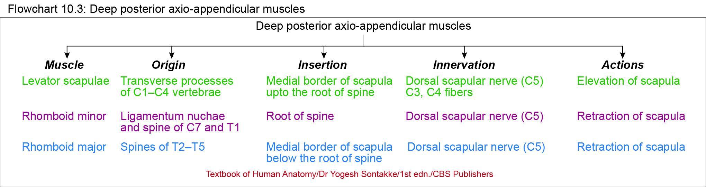

Slide 35
APPLIED ANATOMY
1.Rhomboid pain/syndrome: Pain or tightness between the shoulder blades can be caused by dysfunction or trigger points in the rhomboid muscles. The rhomboids can become stretched and overactive to compensate for tight pectoralis muscles, leading to pain and discomfort.
2. Muscle transfer procedures: In some cases, like the Eden–Lange procedure, the DSN's preservation is crucial when transferring the rhomboid and levator scapulae muscles.

Slide 36
APPLIED ANATOMY
3. Hypertrophied middle scalene muscle. DSN compression/entrapment neuropathy can present with a spectrum of clinical conditions:
Pain
Muscle spasms/tightness (involving the levator and/or rhomboids)
Midscapular dysesthesia
In the chronic setting, scapular winging secondary to atrophic changes and muscle denervation

Slide 37

THANK YOU

