Slide 1
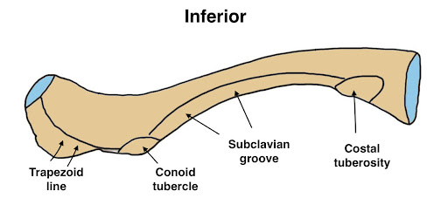
UPPER LIMB
CLAVICLE
Dr. Praveen Kumar Kurrey
M.B.B.S., M.S. , B.C.M.E, B.C.B.R.
Professor Anatomy

Slide 2
INTRODUCTION
Each upper limb consists of 32 bones:
  1. Pectoral girdle
  Scapula 1
  Clavicle 1
  2. Bone of arm
  Humerus 1
  3. Bones of forearm
  Radius 1
  Ulna 1
  4. Carpals 8
  5. Metacarpals 5
  6. Phalanges 14

Slide 3
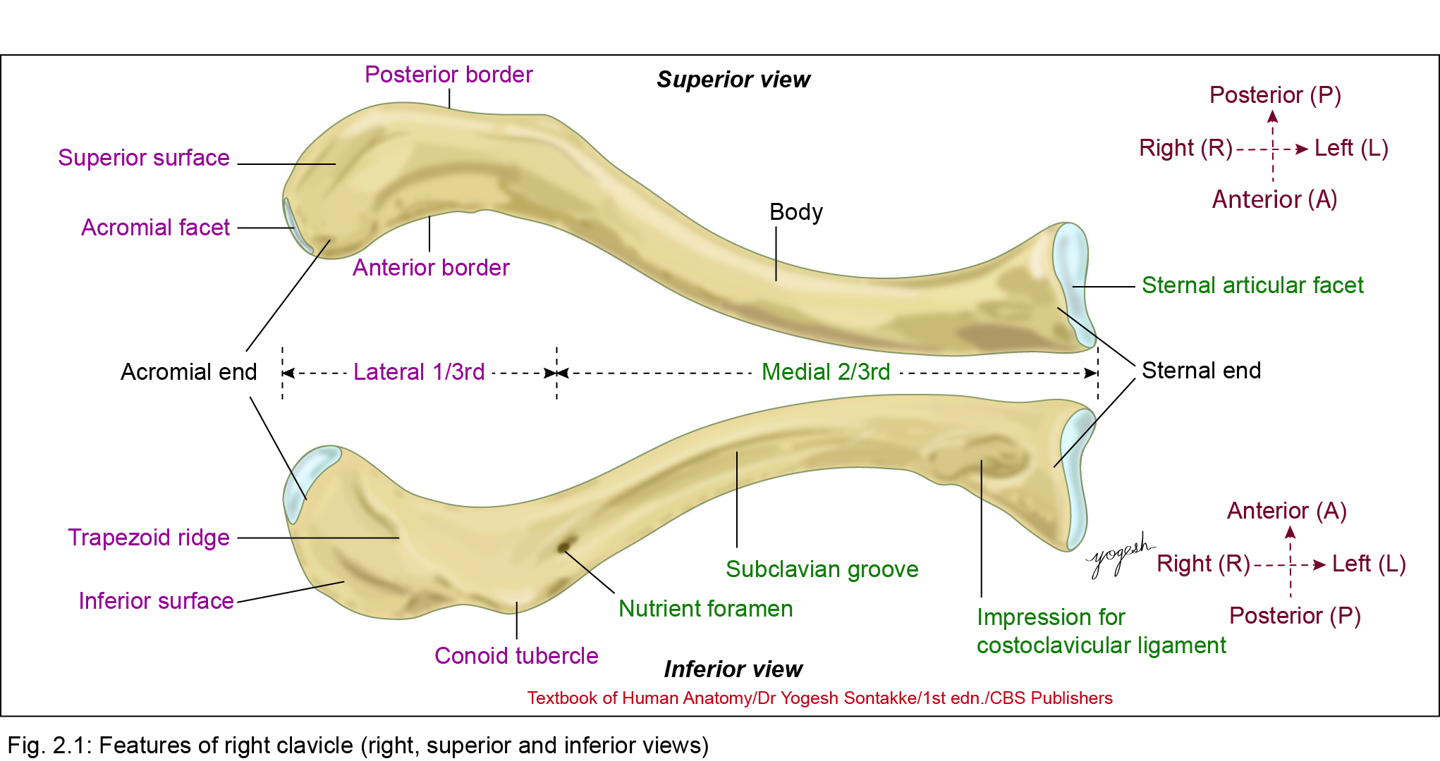
CLAVICLE
Clavicle or collarbone is a modified long bone
Situated in front of root of the neck
Connects upper limb with trunk
Resembles the letter ‘f’ due to its curvature; anteriorly convex medial two-thirds and anteriorly concave lateral one-third

Slide 4
PECULARITIES
Only Long Bone That Lies Horizontally
Subcutaneous Throughout
First Bone To Start Ossifying
Only Long Bone Which Ossifies In Membrane
No Haversian System
Only Long Bone Which Has Two Primary Centres Of Ossification
Occasionally Pierced by The Middle Supraclavicular Nerve

Slide 5
CLAVICLE
Two ends
  Flat lateral end
  Thick medial end.
Inferior surface of clavicle – grooved (subclavian groove)

Slide 6
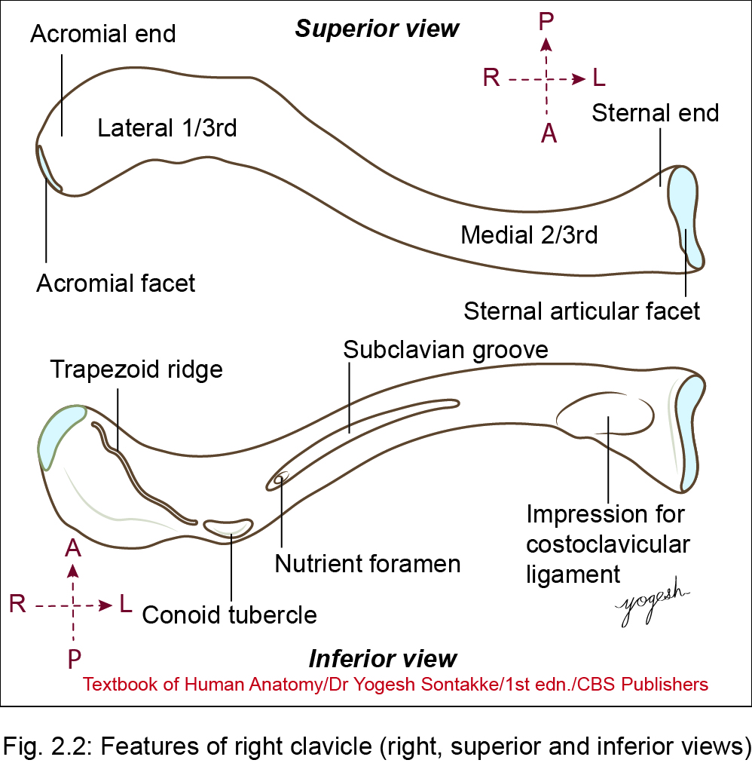

Slide 7
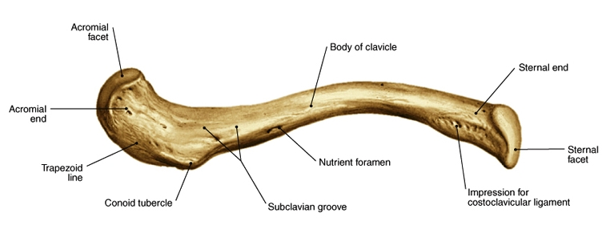
Clavicle parts

Slide 8
Anatomical Position and Side Determination
Hold the clavicle horizontally in such a way that
  The shaft
    -medial two-thirds convex anteriorly
    -lateral one-third concave anteriorly
  Inferior surface of shaft – grooved (subclavian groove)

Slide 9
Anatomical Position and Side Determination
  3. Thick end directs medially
    Flat end directs laterally (to side of bone and helps to decide side of the bone: For example, flat end of right clavicle should be on the right)

Slide 10
Anatomical Position and Side Determination
For side determination of any bone
One point for each of three dimensions
  Anteroposterior
  Superior – inferior
  Medial – lateral

Slide 11
Functions of Clavicle
Weight transmission
  Transmits weight of upper limb to axial skeleton through coracoclavicular ligament
Strut function:
  Acts as strut that keeps upper limb away from the trunk (body) to make upper limb move freely

Slide 12
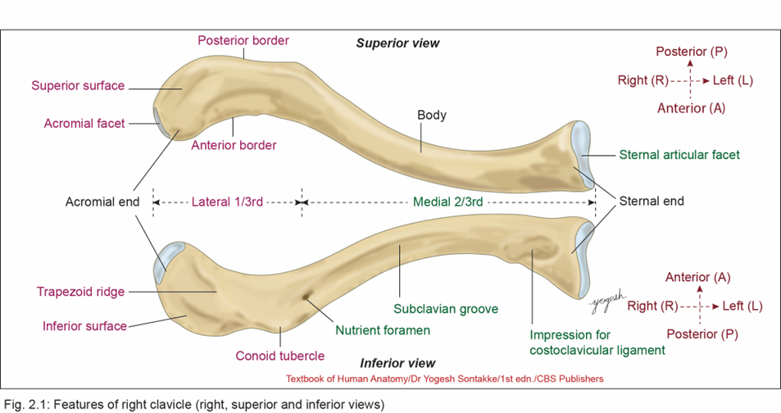
Features of Clavicle
Has middle shaft (body) and two ends
  Medial or sternal end
  Lateral or acromial end

Slide 13
Features of Clavicle
Shaft
    Middle part – long and forms a shaft.
    Shaft – curved in shape of alphabet ‘f’.
    Based on pattern of curvature–Divided into two parts
      Medial two-thirds
        Rounded and convex forward
      Lateral one-third
        Flat from above downward and concave forward

Slide 14
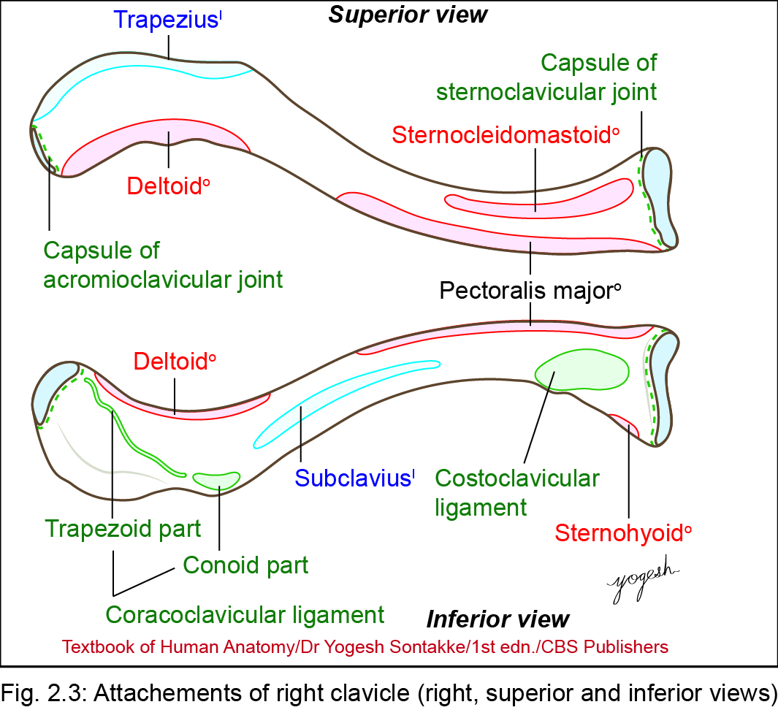
Medial two-thirds of clavicle
Cylindrical.
Has four surfaces
  Anterior
  Posterior
  Superior
  Inferior

Slide 15
Medial two-thirds of clavicle
Anterior surface
  Convex
  Attachments: –origin – clavicular head of pectoralis major muscle
Posterior surface
  Smooth, concave backward.
  Attachments: Near medial end, posterior surface gives origin to sternohyoid muscle

Slide 16
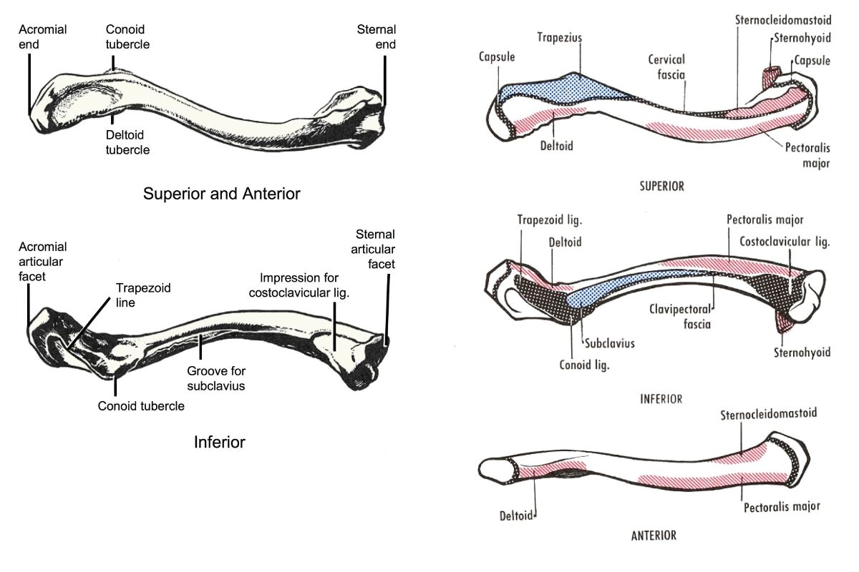

Slide 17
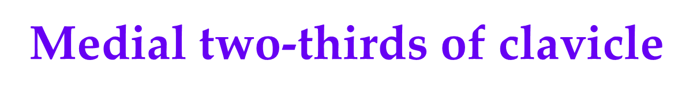
Relations
  Formation of brachiocephalic vein: Behind medial end and posterior surface of medial two-third of clavicle, the internal jugular vein joins the subclavian vein to form brachiocephalic vein
  Brachial plexus and subclavian artery: Posterior surface of medial two-thirds is related to trunks of brachial plexus and third part of subclavian artery

Slide 18
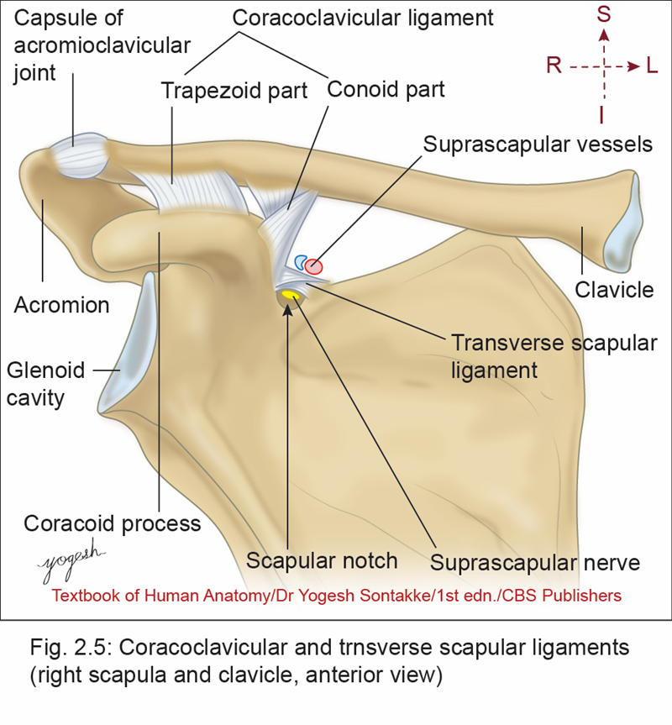
Superior surface
  Rough – medial part
  Smooth – lateral part
  Attachment
  Gives origin to clavicular head of sternocleidomastoid muscle (Note: Sternal head arises from anterior surface of manubrium)

Slide 19

Medial two-thirds of clavicle
Inferior surface
  Rough oval impression at medial end of surface
  Longitudinal subclavian groove on lateral part of surface
  Nutrient foramen at lateral end of subclavian groove, transmits a branch of suprascapular artery and directed away from sternal end

Slide 20
Medial two-thirds of clavicle
Inferior surface
Attachments
  Costoclavicular ligament: extends from rough oval impression at medial end of interior surface – first costal cartilage and first rib
  Subclavius muscle –inserted to subclavian groove.
  Clavipectoral fascia –attached – margins of subclavian groove

Slide 21
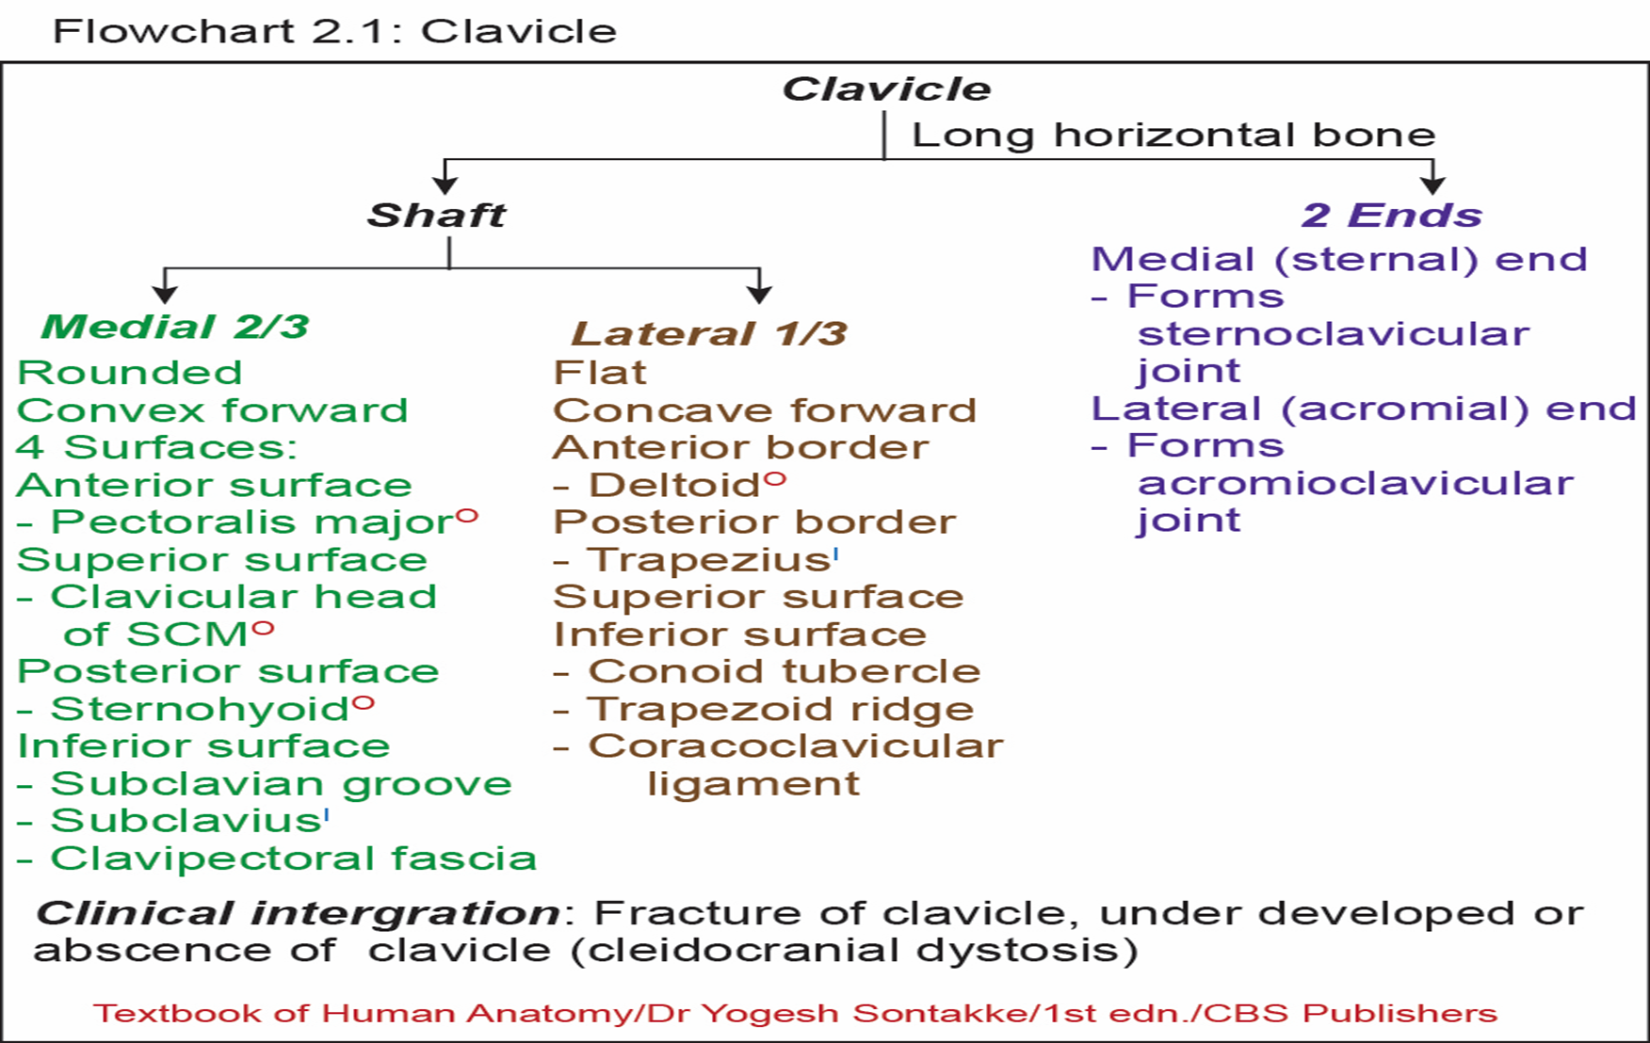

Slide 22
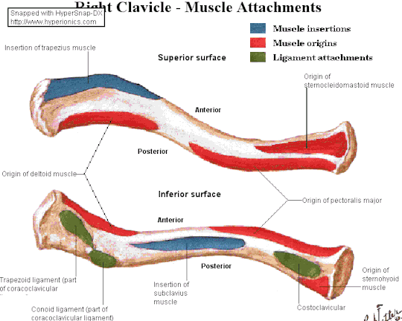

Slide 23
Lateral one-third of clavicle
  Flat
  Has superior and inferior surfaces, anterior and posterior borders
Anterior border
  Rough and concave forward.
  It may show a small deltoid tubercle
  Attachment: gives origin – deltoid muscle

Slide 24
Lateral one-third of clavicle
Posterior border
  Convex backward and thick
  Attachment: gives insertion – trapezius muscle
Superior surface
  Rough anteriorly and posteriorly and its middle smooth part is subcutaneous
Inferior surface
  Shows conoid tubercle and trapezoid ridge

Slide 25
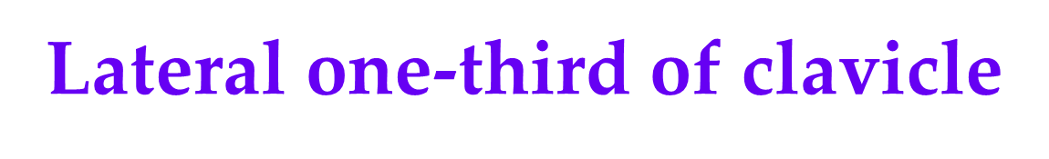
Attachment
Coracoclavicular ligaments: has two parts
  Conoid part – attached to conoid tubercle
  Trapezoid part – attached to trapezoid ridge

Slide 26
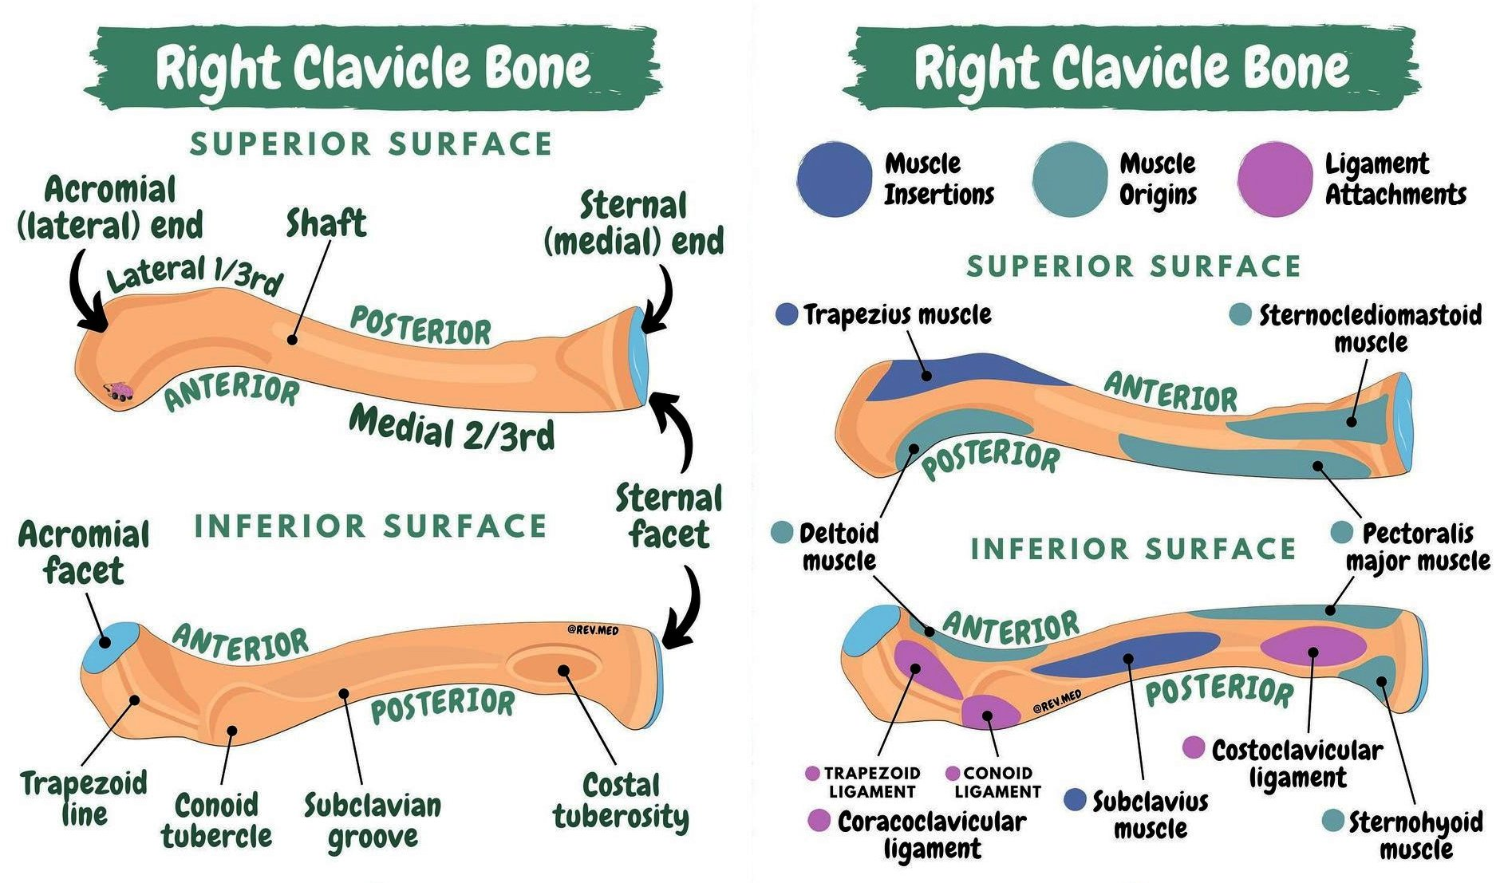

Slide 27
Ends of Clavicle
  Has two ends
    Medial
    Lateral

Slide 28
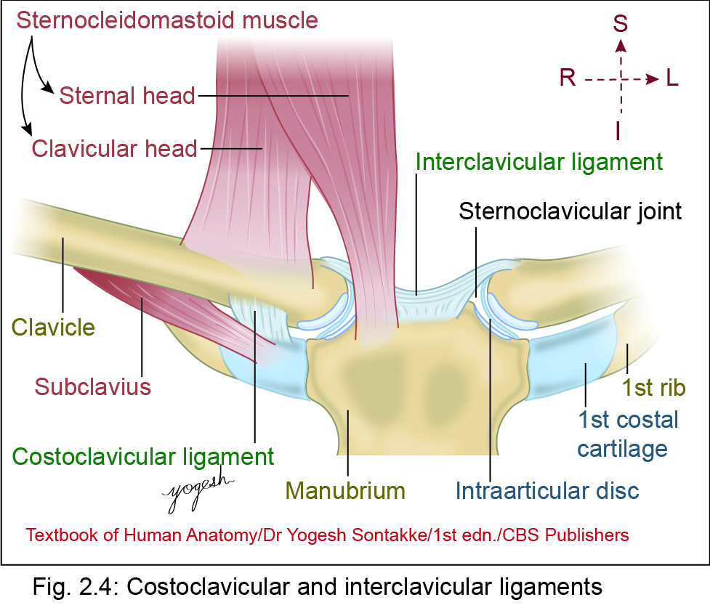
Medial (sternal) end
  Quadrangular.
  Has a saddle-shaped articular surface.
  Articulation
    Articulates with clavicular notch of manubrium sterni – form sternoclavicular joint
  2. Attachments
    Fibrous capsule of sternoclavicular joint
    Intraarticular disc
    Interclavicular ligament

Slide 29
Lateral (acromial) end
    Flat above downward and has a small oval articular facet
  • Articulation
    Medial margin of acromion to form acromioclavicular joint
  • Attachments
    Margin of articular facet gives attachment – capsule of acromioclavicular joint

Slide 30
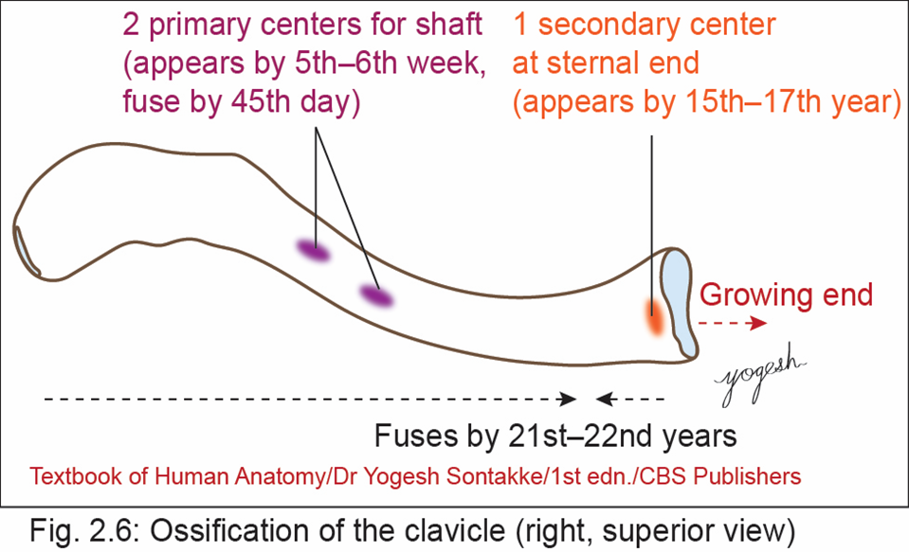
Ossification
  Clavicle–first bone in the body to ossify
  Has membranocartilaginous ossification
  Most of the bone ossifies in membrane
  Except– medial end that ossifies in cartilage

Slide 31

Ossification
Ossification centers
  Two primary centers for shaft
  One secondary center for medial end

Slide 32
CLINICAL ANATOMY
    The sternal end of clavicle – growing end of clavicle
    Because secondary center (epiphysis) at this end
    Appears in late teens and fuses by 21st–22nd years
    Hence, nutrient foramen – directed away from sternal end

Slide 33
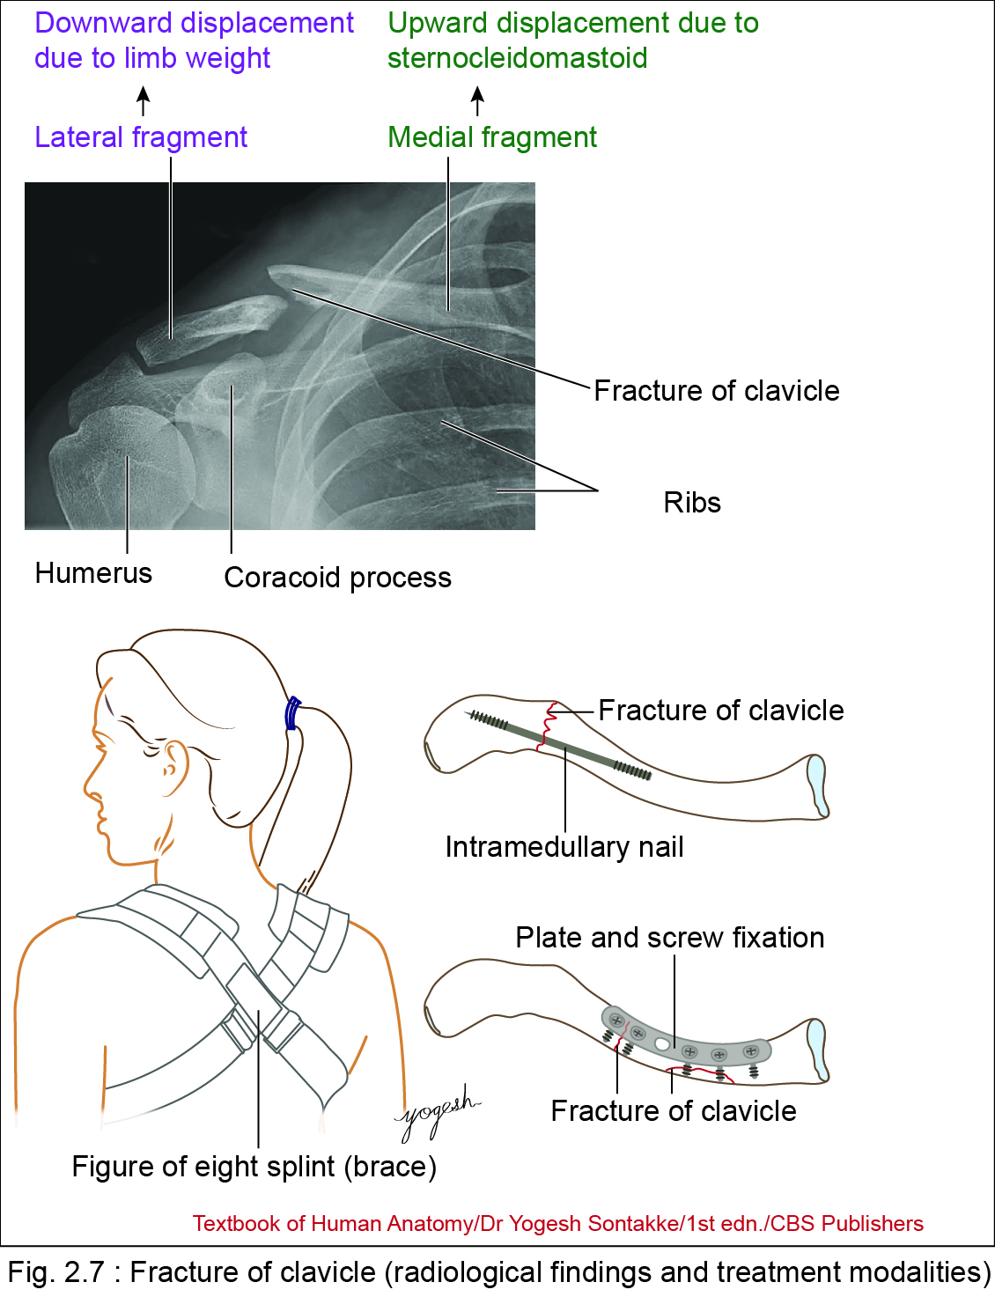
Clinical Integration
  Weakest point of clavicle
  Most commonly fractured at junction of lateral two-fifths and medial three-fifths
  Previous concept
  Junction of medial two-thirds and lateral one-third is weakest point of clavicle

Slide 34
Clinical anatomy
Fracture of clavicle
    Occurs mostly as a result of violent impact or fall on the outstretched hand
    Commonest site: Junction of medial three-fifths and lateral two-fifths
    Displacements of fractured fragments
    -Medial and Lateral

Slide 35
Clinical anatomy
Fracture of clavicle
    Medial fragment – elevated due to sternocleidomastoid muscle
    Lateral fragment – displaced downward due to weight of limb
    Diagnosis: Radiological (X-ray) examination

Slide 36
Clinical anatomy
  Treatment
  – Nonsurgical
  Most of cases are treated with figure of eight splint (brace) with immobilization of upper limb
  – Surgical
  Surgical treatment – based on severity of fracture or complications (skin perforation, nerve compression, nonunion)
  Involves plate and screw fixation or fixation of intramedullary nail

Slide 37
Clinical anatomy
Cleidocranial dysostosis
  A birth defect that has improperly developed or absence of clavicles and associated with anomalies of skull and teeth.
  Shoulders can be approximated anteriorly – front of chest
  Weight transmission
  The weight of upper limb – transmitted to axial skeleton through coracoclavicular, costoclavicular and interclavicular ligaments

Slide 38

THANK YOU

