Slide 1
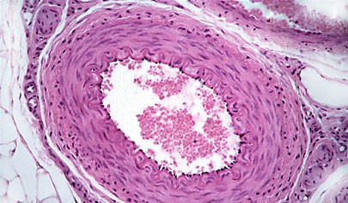
HISTOLOGY
BLOOD VASCULAR SYSTEM
.Elastic Artery
.Muscular Artery
.Arteriole
.Vein
.Capillary
.Sinusoids
Dr. Praveen Kumar Kurrey
M.B.B.S., M.S.,BCME, BCBR
Professor Anatomy

Slide 2
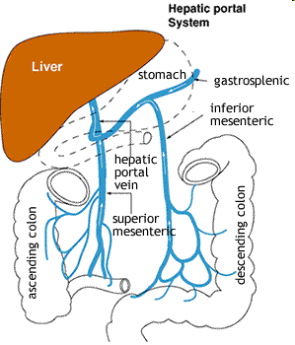
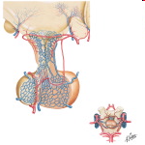
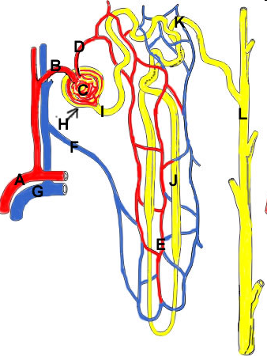
Introduction
Circulatory Units
    Blood, Lymph, Aq Humour, Synovial Fluid, CSF.
2 Pathways
    Systemic
    Pulmonary
Portal System
  Venous
    Portal Vein
    Hypothalamo – Hypophyseal
  Arteial
    Kidney

Slide 3
Blood Vessels

Slide 4
Basic Structure
Tunica Intima
  Endothelium
  Subendothelial Tissue
  Internal Elastic Lamina (Fenestrated Membrane Of Henle)
Tunica Media
  B/W IEL & EEL
Tunica Adventitia

Slide 5
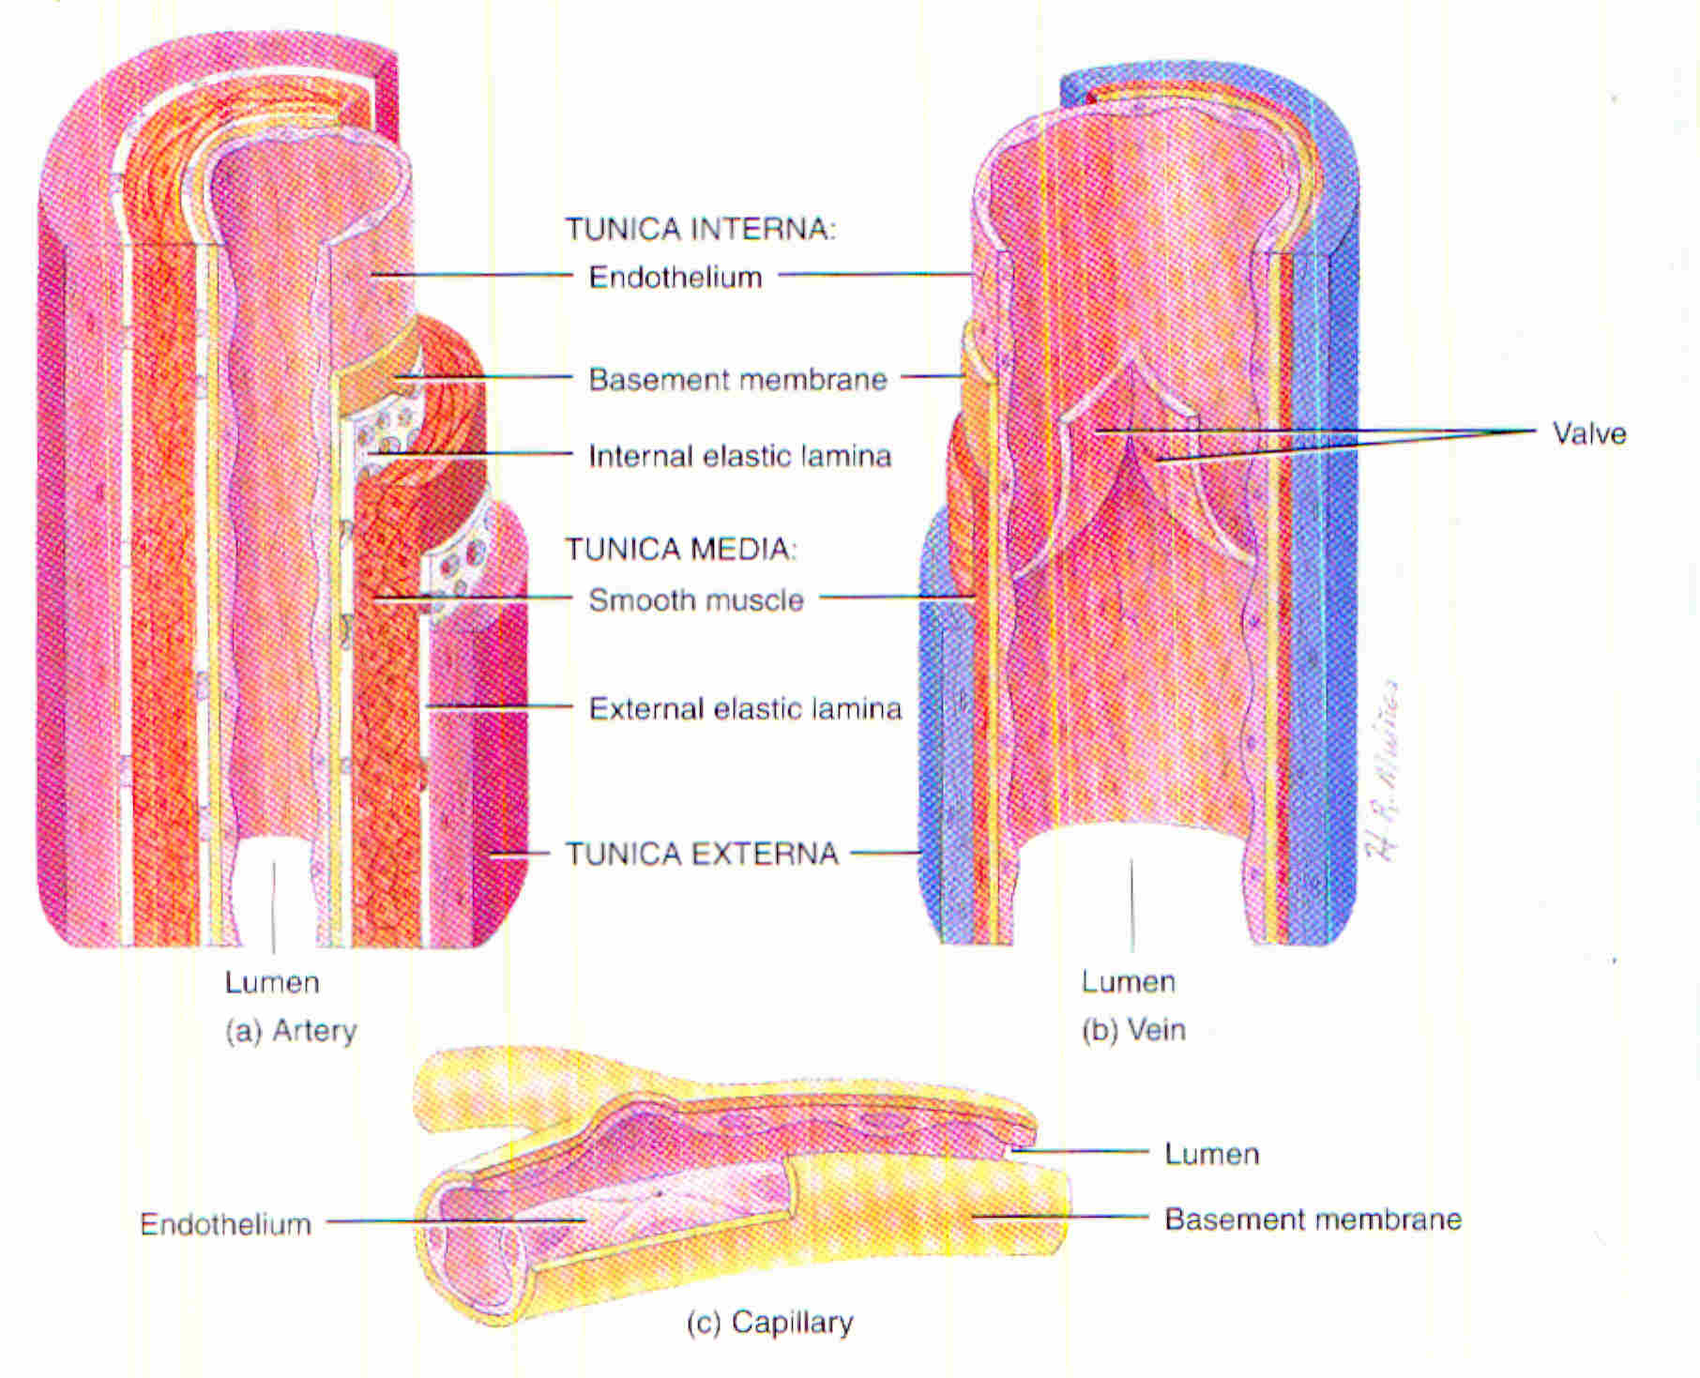
Basic Structure

Slide 6
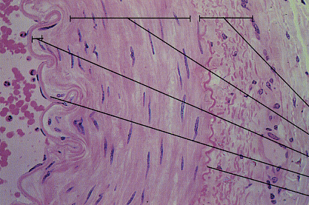
ARTERY WALL
Adventitia
Tunica media
Lamina propria
Endothelium
Ext. elastic mem

Slide 7
Elastic Arteries
Largest Diameter
Thickness 1/10 Of Dia
Lumen Large & Round
TI
  20% Thickness
  AVG AORTA - 100µ
  Stains Lighter Than Tm
  Main Cell Is Sm – Contractile + Secretes Gs + Fibres
TM
  Thickest, 70% Of Wall
  Composition – Elastin Laminae/Lamellae + Sm Layers In B/W + Gs + Collagen
TA
  Longitudinally Running Fibres + Sm
TM:TA :: 3:1
V V – Outer 1/3 Of TM + TA

Slide 8
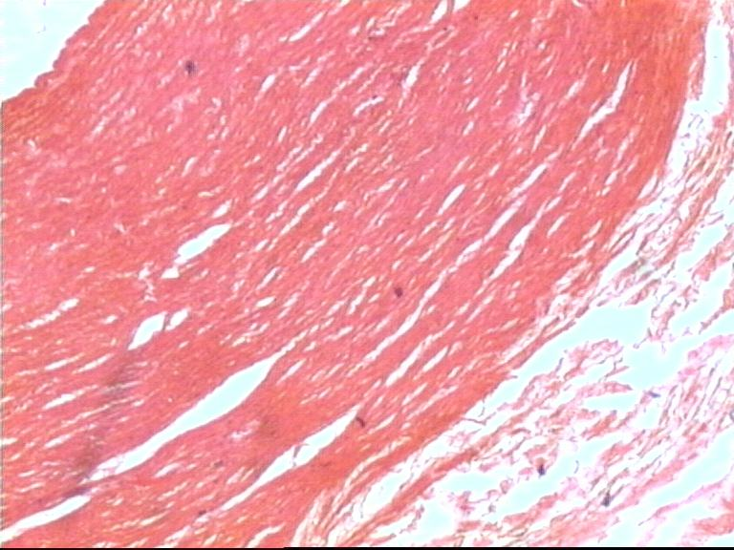
Elastic Artery L.P.
E
TI
TM
TA

Slide 9
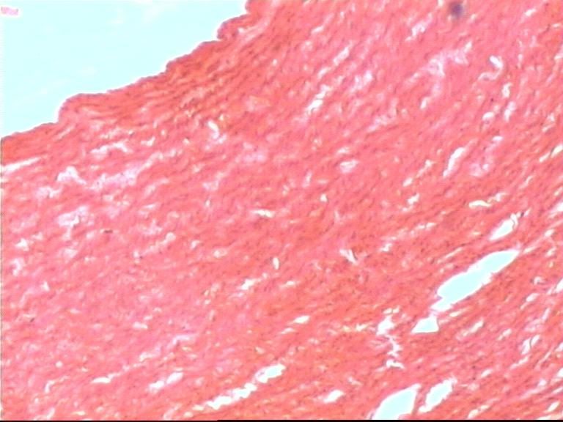
Elastic Artery

Slide 10
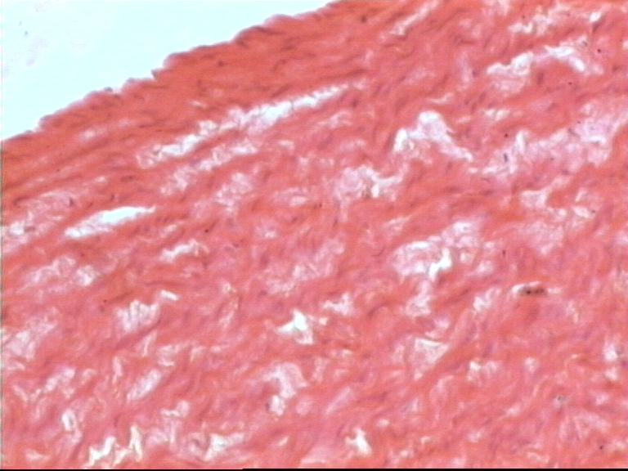
Elastic Artery H.P.

Slide 11
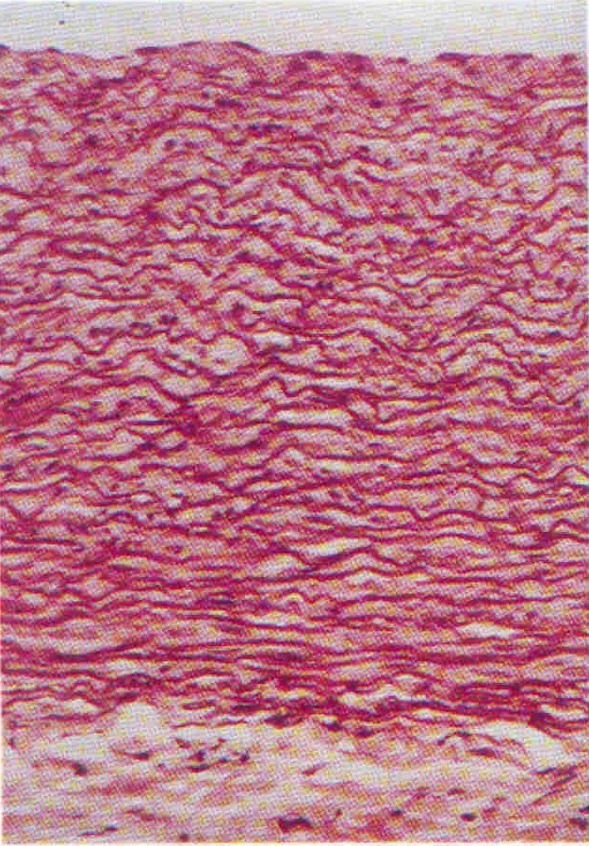
Elastic Artery
Verhoeff’s Stain

Slide 12
Muscular Arteries
Thickness ¼ Dia Of Lumen
Lumen Round & Open
TI
  Endo Thrown Into Folds
  Subendothelial Layer thin
  Prominent IEL – Wavy (Sm Contraction & < Elastin In TM)
TM
  Forms 1/3 – 2/3 Thickness
  30 – 40 Laminae Of Sm + Collagen + Elastic + Gs, No Fibroblasts
  EEL +
TA
  Longitudinally Running Collagen + Elastic
TM :TA ::1:1

Slide 13
Muscular Artery

Slide 14
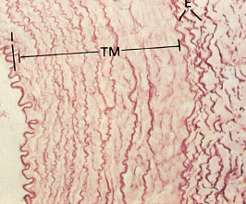
Muscular Artery

Slide 15
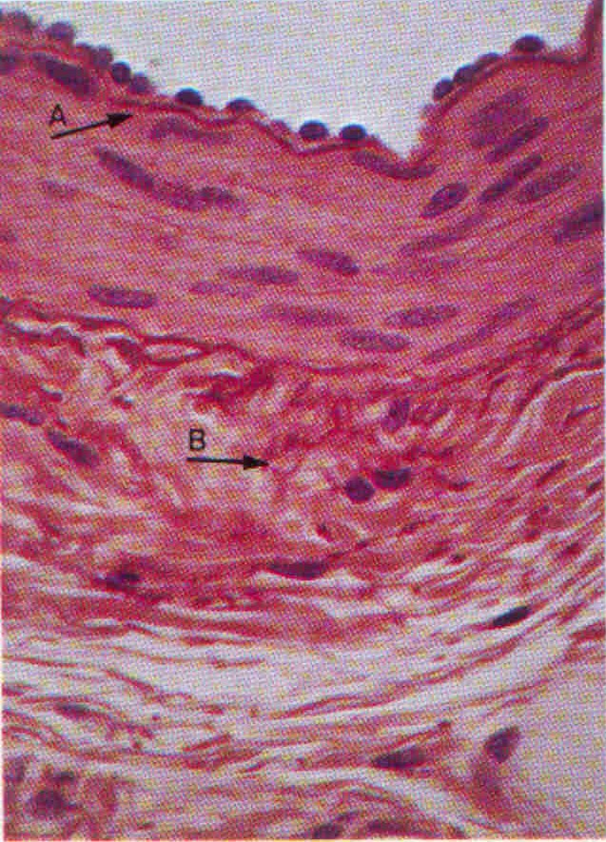
Muscular Artery H.P.

Slide 16
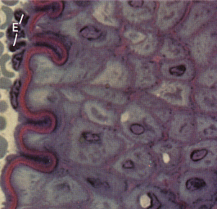
Muscular Artery: internal elastic lamina

Slide 17
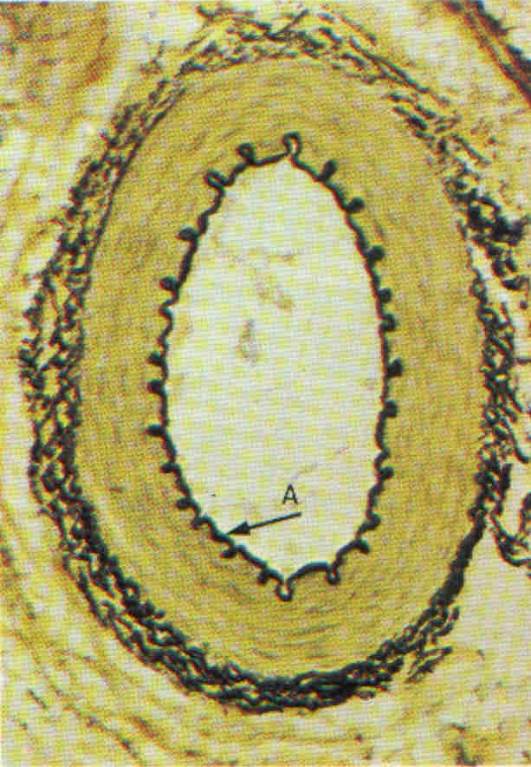
Muscular Artery

Slide 18
Veins
Thin Walls <1/10 Of Dia Of Lumen
Irregular Lumen – Collapsed
TI –Endo + Bm, < Sub Endo Tissue
TM – 3-4 Layers Of Sm + Collagen
TA – Thickest, Sm + Collagen+ Elastic, Plenty VV
TM:TA:: 1:3
MUSCULAR ART – V V – TA + ½ TM
VEIN – VV – TA + TM

Slide 19
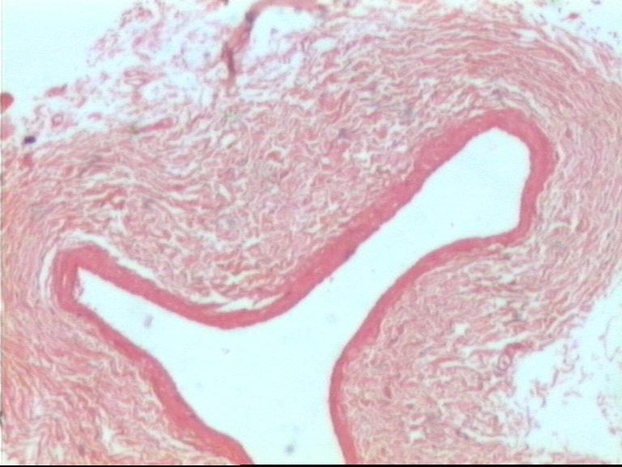
Vein L.P.

Slide 20
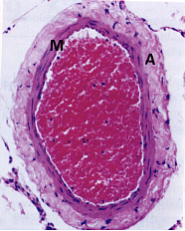
VEIN

Slide 21
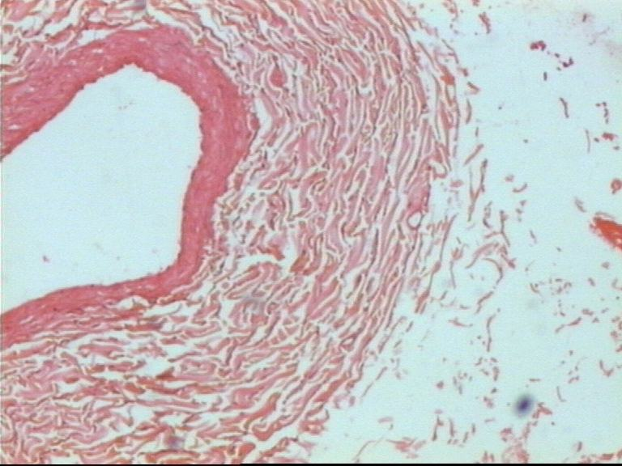
Vein H.P.

Slide 22
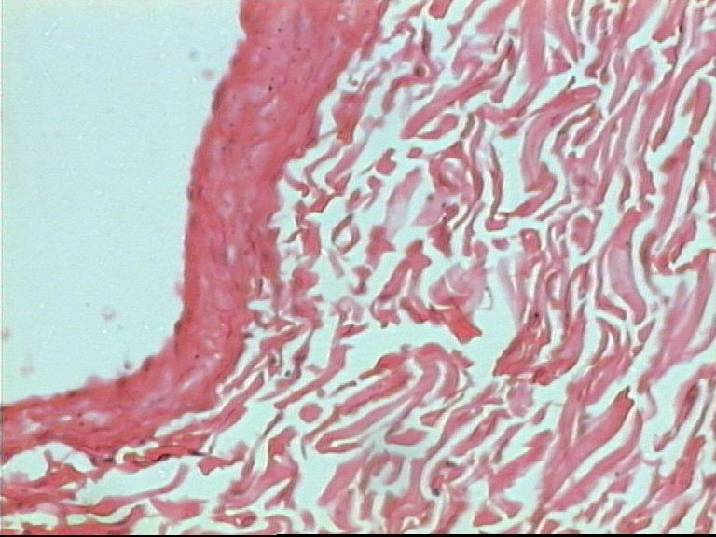
Vein H.P.

Slide 23
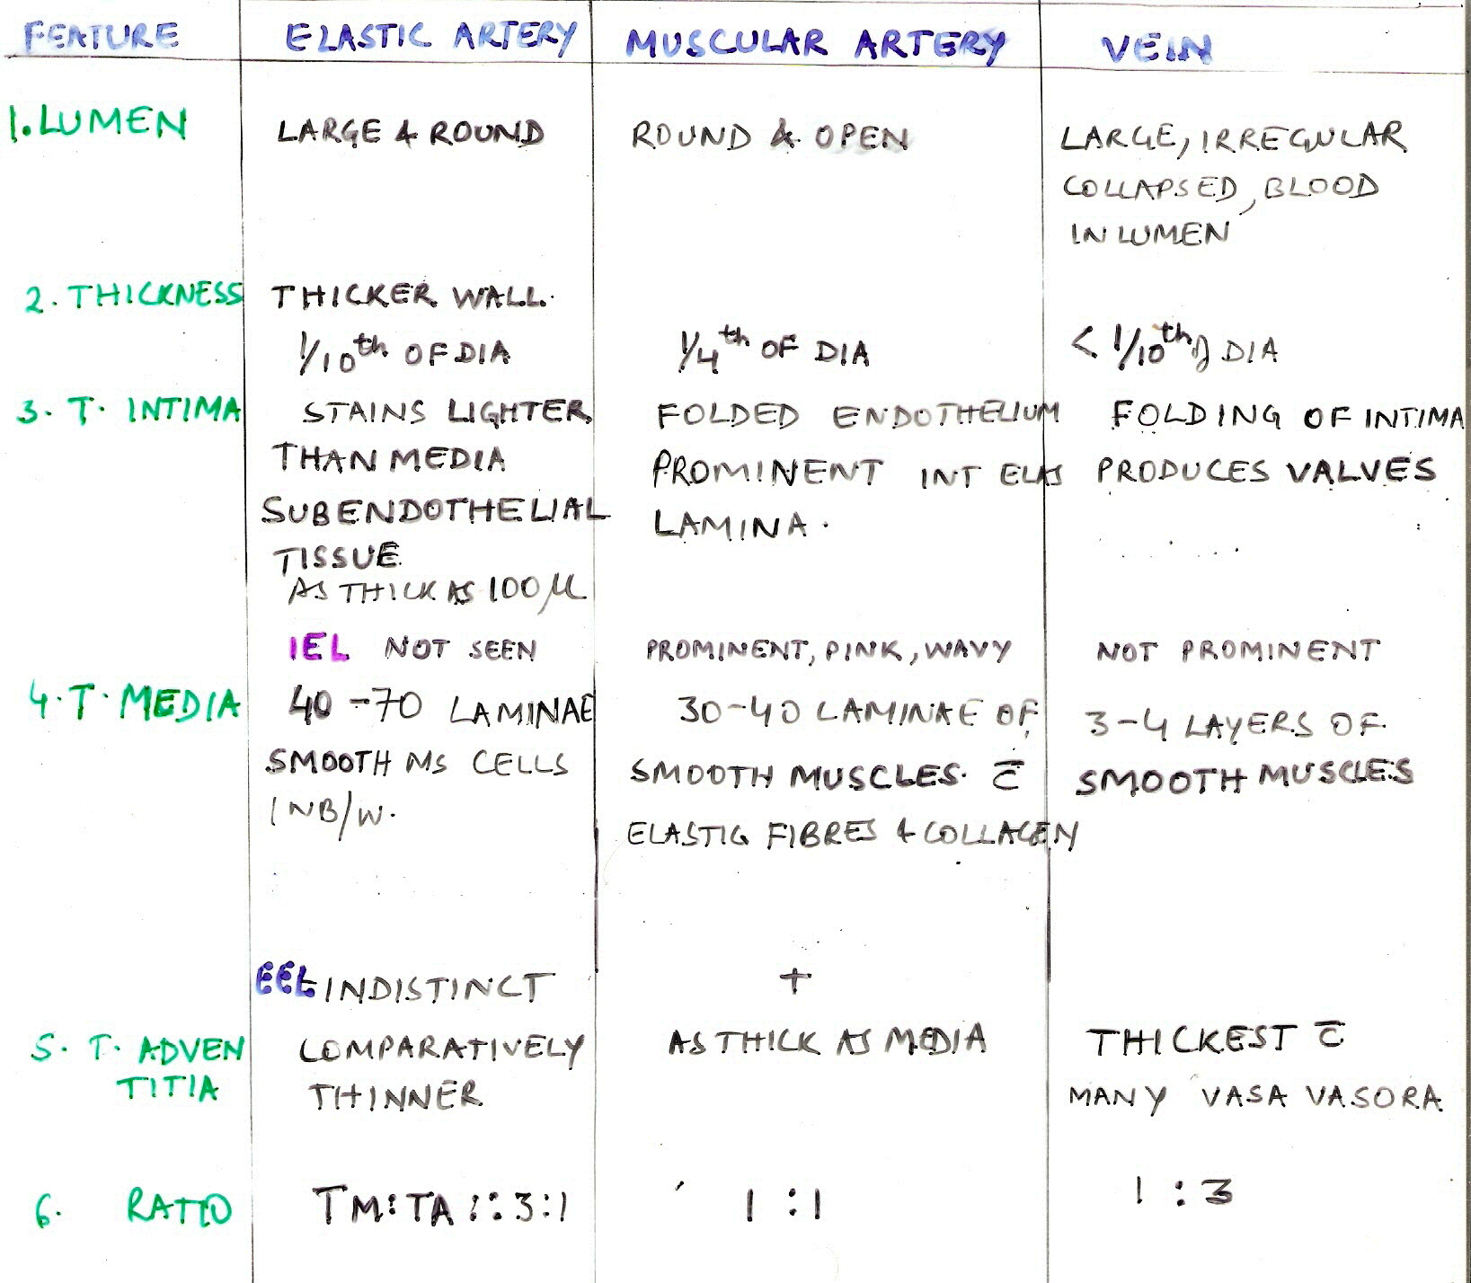

Slide 24
Arterioles
Lumen Round & Open
< 100µ DIA
Thick Wall & Narrow Lumen
TI
  Endo + Bm
TM
  1-2 Layers Of Invol Ms & Collagen F
TA
  Thin Layer Collagen & Elastic F
LUMEN
  < 50µ - TERMINAL ARTERIOLE
  >50µ - MUSCULAR

Slide 25
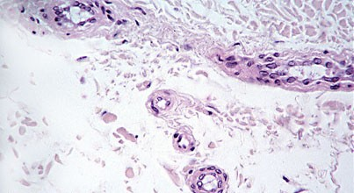
Arteioles

Slide 26
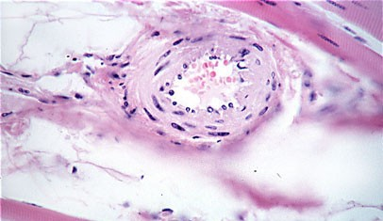
Arteriole

Slide 27
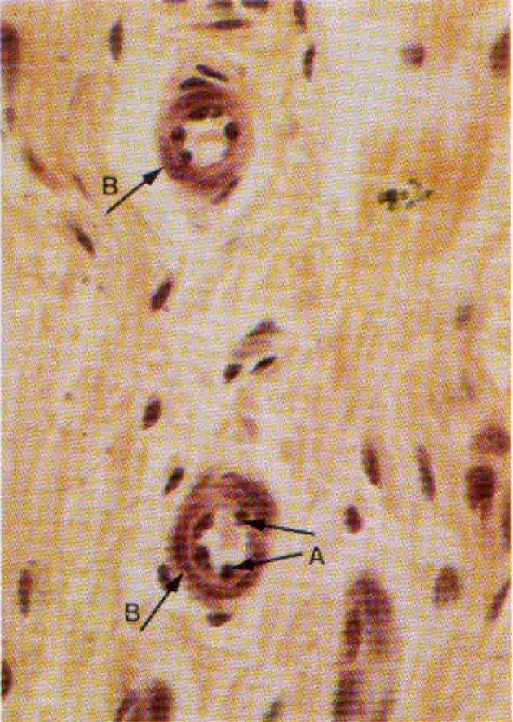
Arteriole T.S.

Slide 28
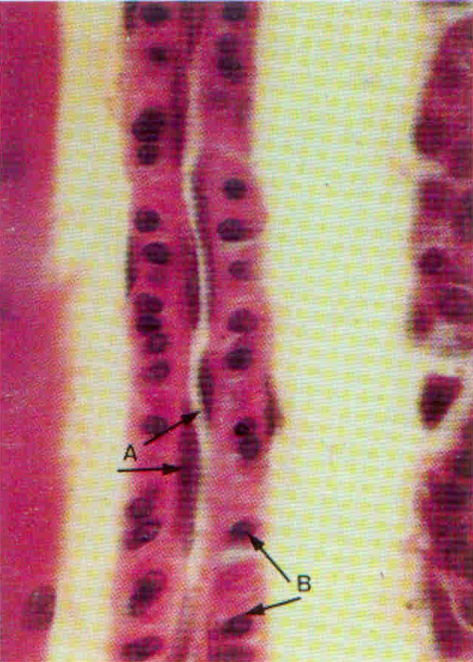
Arteriole L.S.

Slide 29
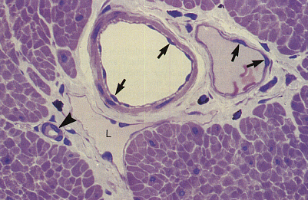
Arteriole, Venule

Slide 30
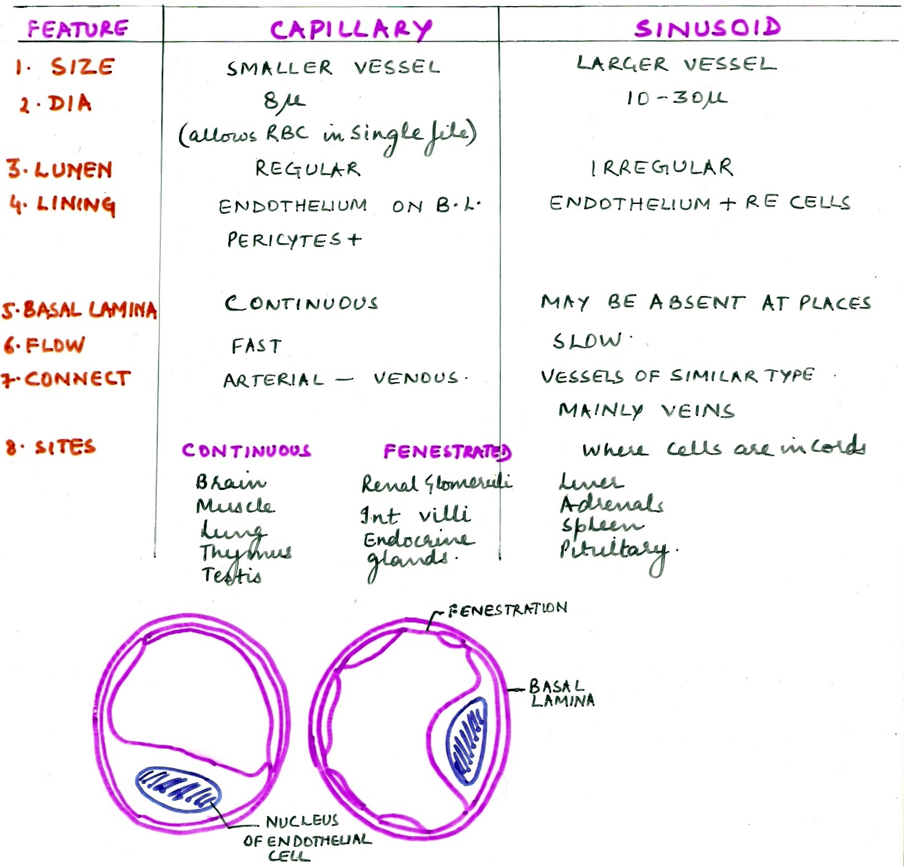

Slide 31
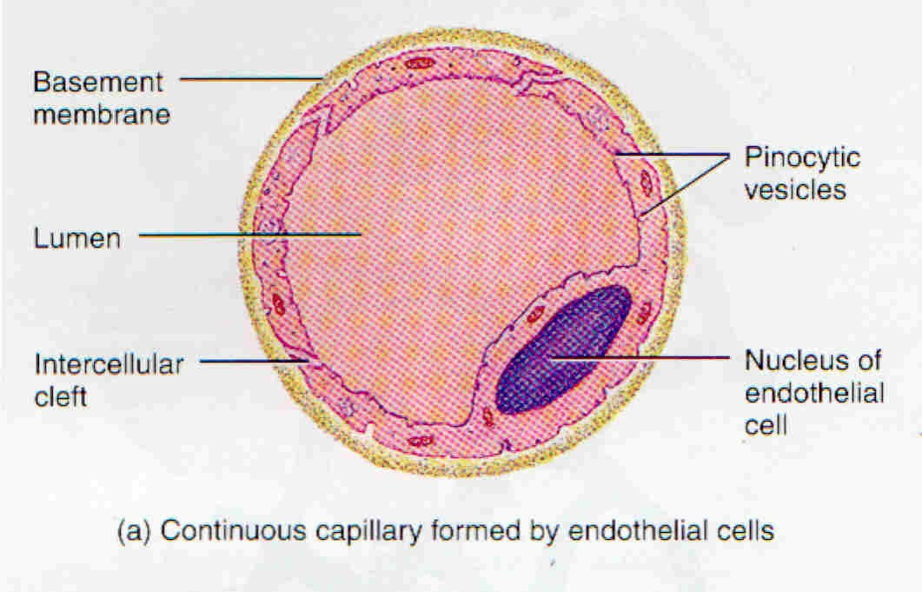
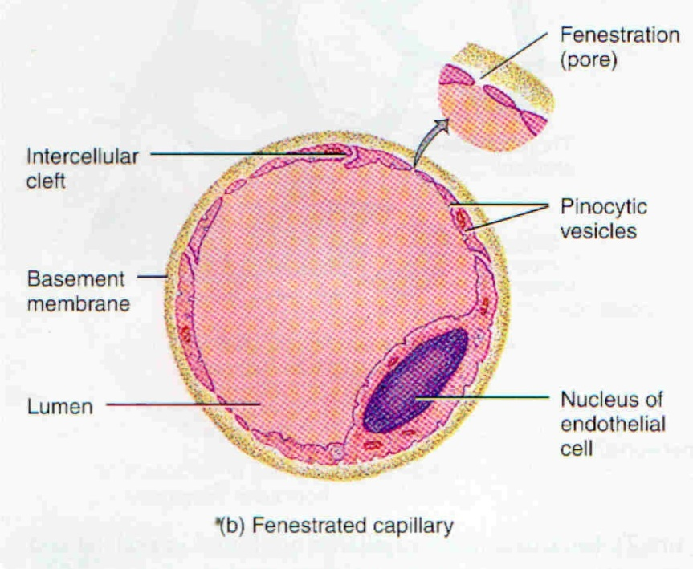
Capillaries

Slide 32
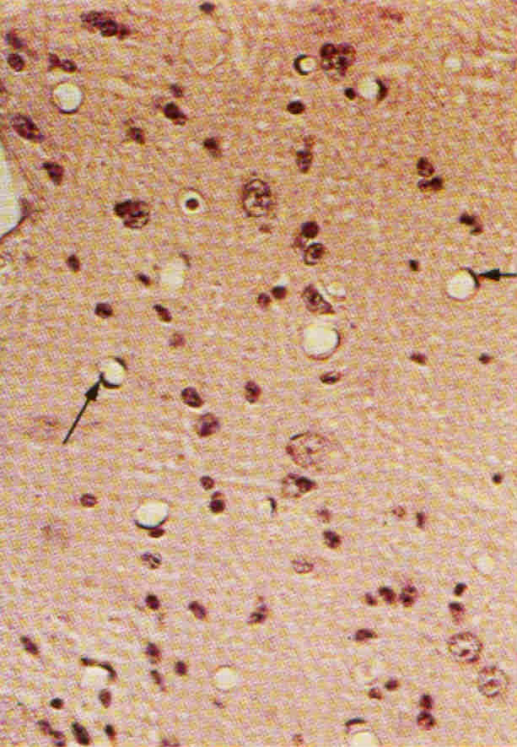
Capillary

Slide 33
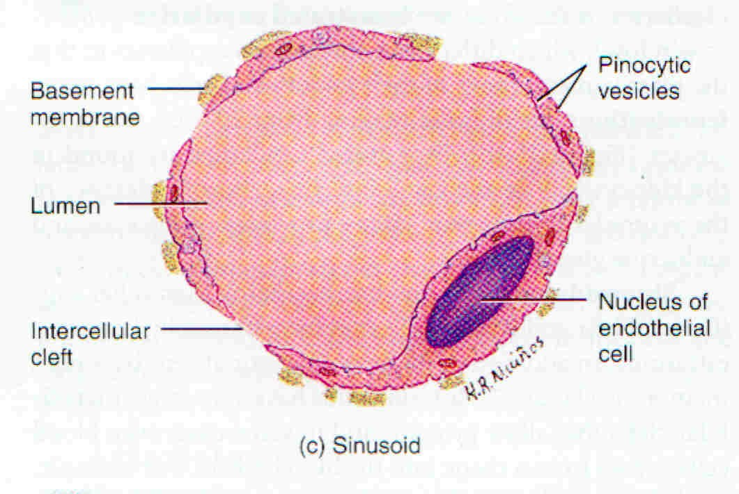
Sinusoid

Slide 34
Venule
2 – 3 Capillaries +
8 - 30µ
Endo + Bl
No IEL
Very Thin TA
No Muscle Till 30µ

Slide 35
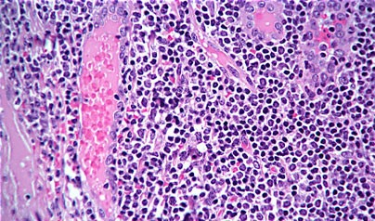
Post - Capillary Venule

Slide 36
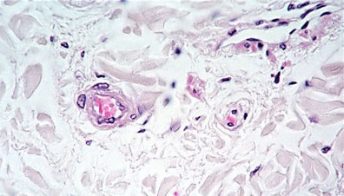
Arteriole + Venule

Slide 37


THANK YOU

