Slide 1
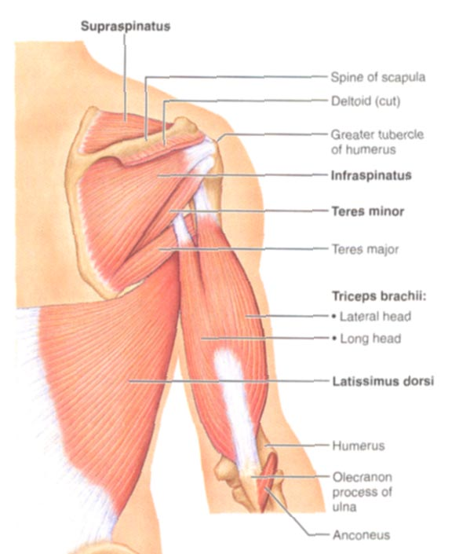
THE UPPER LIMB
Joints
Arm Muscles,
Axilla
Brachial Plexus
Nerves
Dr. Praveen Kumar Kurrey
M.B.B.S., M.S., BCME, BCBR
Professor Anatomy

Slide 2
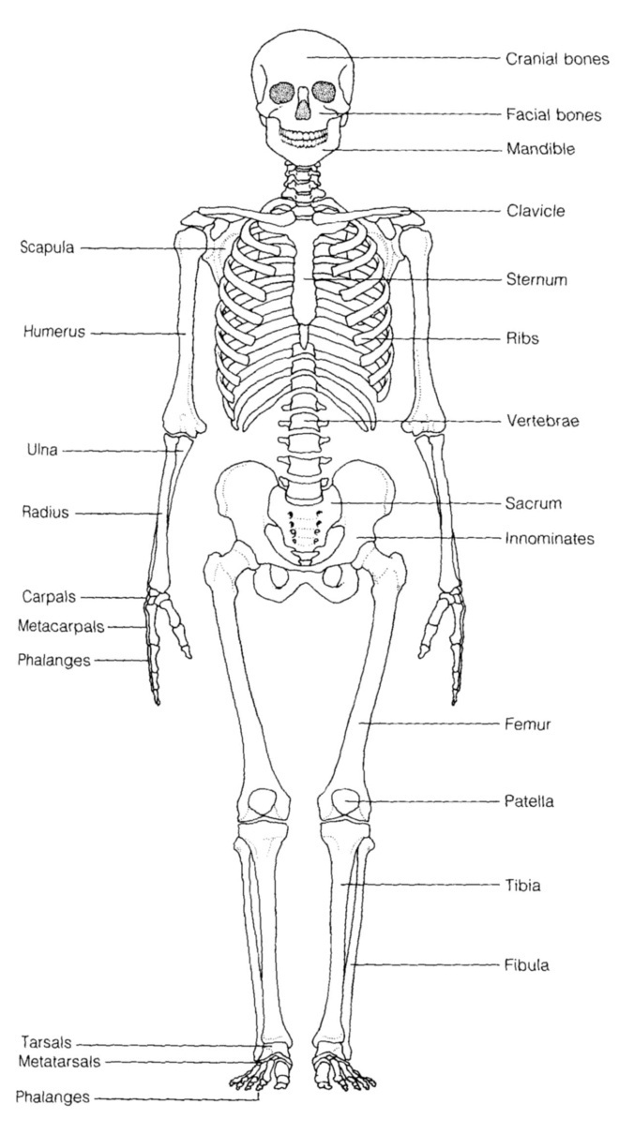
Bones of Upper Extremity
Appendicular Skeleton
Pectoral Girdle = scapula,clavicle
Upperlimb
  Arm: humerus
  Forearm: radius, ulna
    Interosseus membrane
  Hand: carpals, metacarpals, phalanges

Slide 3
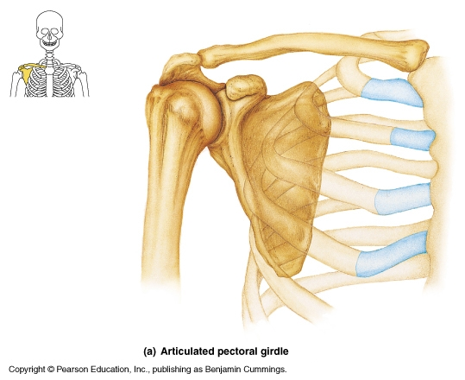
Joints of Upper Extremity
Sternoclavicular
  Synovial-saddle
  Diarthrosis
Acromioclavicular
  Synovial-plane
  Diarthrosis
Glenohumeral joint
  Synovial-ball&socket
  Diarthrosis
  Many ligaments
  Muscle reinforcement
  Great Mobility

Slide 4
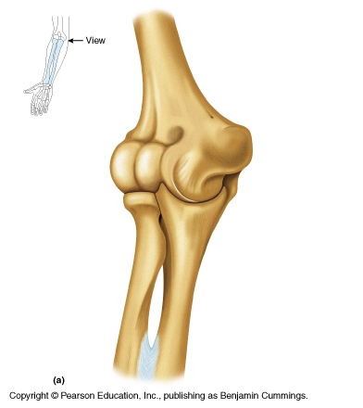
Joints of the Upper Extremity
Elbow Joint
  Synovial – hinge
  Diarthrosis
Articulations
  Humerus & Ulna
  Humerus & Radius
Many Ligaments

Slide 5
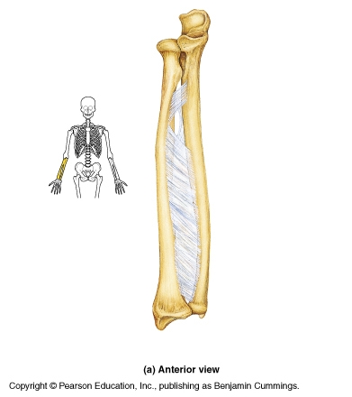
Joints of Upper Extremity
Proximal Radioulnar joint
  Synovial - pivot
  Diarthrosis
Distal Radioulnar joint
  Synovial – pivot
  Diarthrosis
Allows pronation and supination of forearm

Slide 6
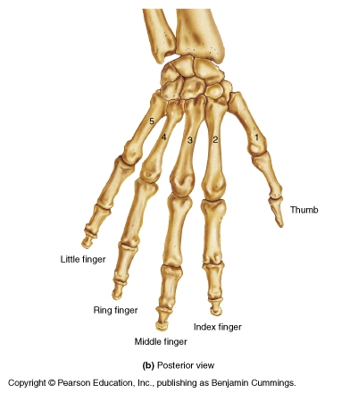
Joints of the
Upper Extremity
Radiocarpal joint
  Synovial-condyloid
  Distal radius with proximal row of carpals
Intercarpal joints
  Synovial-plane
Carpal-metacarpal (2-5)
  Synovial-plane
Trapezium-metacarpal 1
  Synovial-saddle
Metacarpal-phalangeal
  Synovial-condyloid
Interphalangeal
  Synovial-hinge
ALL DIARTHROSES

Slide 7
Muscles
Naming
  Flexor carpi ulnaris
  Flexor digitorum superficialis
  Flexor pollicis longus
  Pronator quadratus
  Extensor carpi radialis brevis

Slide 8
Muscles of Scapula
If ORIGIN on scapula = Move Arm
  Subscapularis
  Supraspinatus
  Infraspinatus
  Teres Minor
  Teres Major
  Latissimus Dorsi (partial O on scap)
  Coracobrachialis
If INSERTION on scapula = Move scapula
  Rhomboids
  Trapezius
  Pectoralis Minor
  Serratus Ventralis
  Levator Scapulae
Rotator Cuff

Slide 9
Nerve Supply of Scapular Muscles
Origin on Scapula:
  Latissimus dorsi = Thoracodorsal nerve
  Subscapularis, Teres Major = Subscapular nerves
  Supraspinatus, Infraspinatus = Suprascapular nerves
  Teres Minor = Axillary nerve
Insertion on Scapula
  Levator Scapular, Rhomboids = Dorsal Scapular nerve
  Pectoralis Minor = Pectoral n.
  Serratus Ventralis = Long Thoracic n.
  Trapezius = Accessory n.

Slide 10
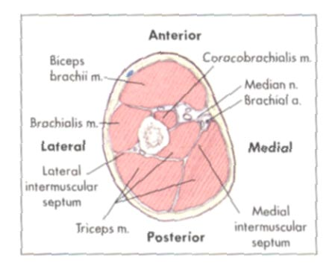
Muscles of Arm: Cross elbow, Move forearm
2 Compartments
  Anterior: Flexors of forearm
  Posterior: Extensors of forearm
Anterior Compartment
  Biceps brachii = MC nerve
  Brachialis = MC nerve
  Brachioradialis = Radial nerve
Coracobrachialis = Musculocutaneus nerve
  O = coracoid process of scapula
  I = medial side humeral shaft
  A = flex, adduct arm
Posterior Compartment
  Triceps brachii = Radial nerve
  Anconeus = Radial nerve

Slide 11
Muscles of forearm: Cross wrist + finger joints, moves hand
Cross Wrist = flex, extend, abduct, adduct hand
Cross Fingers = flex, extend fingers
Most muscles fleshy proximally, long tendons distally
Flexor + Extensor Retinacula
  wristbands keep tendons from bowing
  thick, deep fascia
Anterior Flexor Compartment (Superficial + Deep layers)
  Most flexors have common tendon on medial epicondyle
  Contains 2 pronators
  Innervated by *Median, Ulna nerves
Posterior Extensor Compartment (Superficial + Deep layers)
  Innervated by Radial nerve (or branches of)

Slide 12
Innervation of Anterior Compartment-Forearm Muscles
Muscle
Nerve
Superficial Muscles
  Flexor digitorum superficialis Median
  Flexor carpi radialis Median
  Pronator teres Median
  Palmaris longus Median
  Flexor carpi ulnaris Ulnar
Deep Muscles
  Pronator quadratus Median
  Flexor pollicis longus Median
  Flexor digitorum profundus Ulnar (med 1/2) Median (lat 1/2)

Slide 13
Anterior Compartment Forearm
Medial Epicondyle
Brachioradialis
Pronator Teres
Flexor Carpi Radialis
Flexor Carpi Ulnaris
Flexor Retinaculum
Flexor Digitorum Superficialis is deep to other flexors
Anterior View

Slide 14
Innervation of Posterior Compartment-Forearm Muscles
Muscle
Nerve
Superficial
  Extensor carpi radialis longus Radial
  Extensor digitorum Radial
  Extensor carpi ulnaris Radial
Deep
  Supinator Radial
  Abductor pollicis longus Radial
  Extensor pollicis longus + brevis Radial
  Extensor indicus Radial

Slide 15
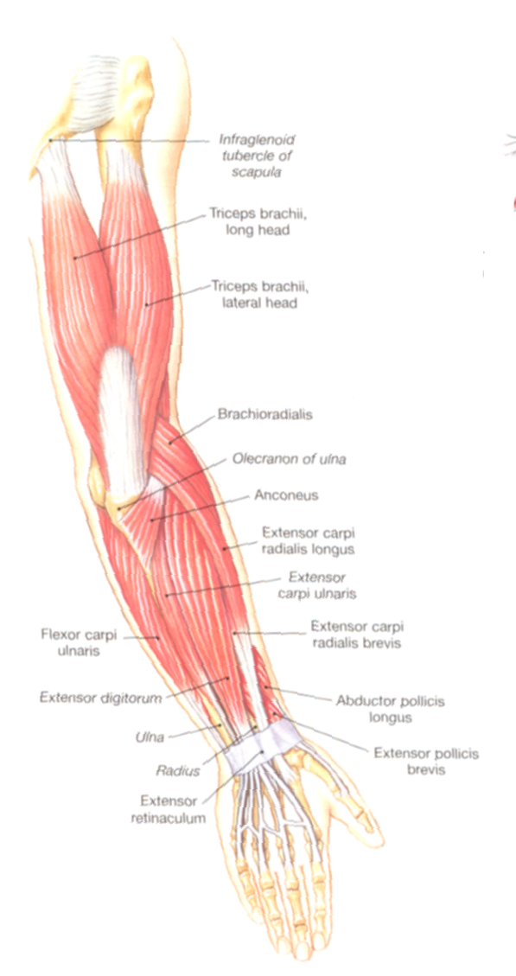
Posterior Compartment of Forearm
Lateral Epicondyle
Brachioradialis
Extensor digitorum
Ext Carpi Radialis Longus
Extensor carpi ulnaris
Posterior View

Slide 16
Intrinsic Muscles of Hand
Muscle
Nerve
Pinky (little finger)
  All digiti minimi Ulnar (Flexor, Abductor, Opponens)
Thumb
  Abductor pollicis brevis Median
  Flexor pollicis brevis Median
  Opponens pollicis Median
  Adductor pollicis Ulnar
Other Intrinsic Muscles
  Palmar + Dorsal Interossei Ulnar
  Lumbricals Median, Ulnar

Slide 17
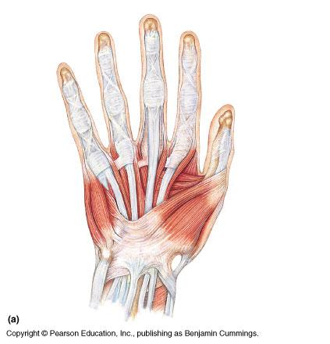
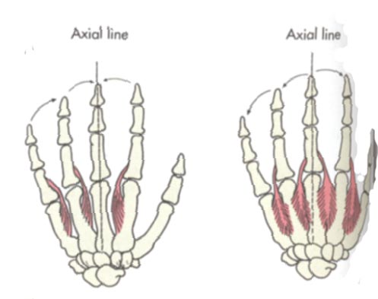
Intrinsic Muscles of Hand
pg 297
Palmar Interossei
Dorsal Interossei
Lumbricals
3rd
ADDuction
ABduction
2nd
4th
1st
Interossei help the lumbricals to extend IP joints and flex MC-P joints

Slide 18
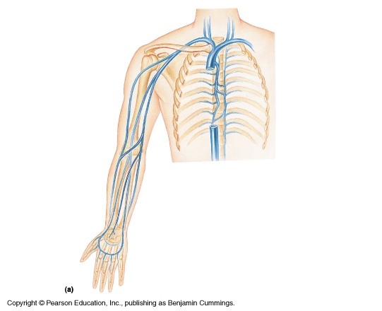
Blood Supply: Veins
SUPERFICIAL
Cephalic (arm-forearm)
Basilic (arm-forearm)
Median Cubital (elbow)
Median Vein
SF. Palmar Venous Arch
Digital
DEEP
Subclavian (neck)
Axillary (axilla)
Brachial (arm-elbow)
Radial (forearm)
Ulnar (forearm)
Deep Palmous Venous arch

Slide 19
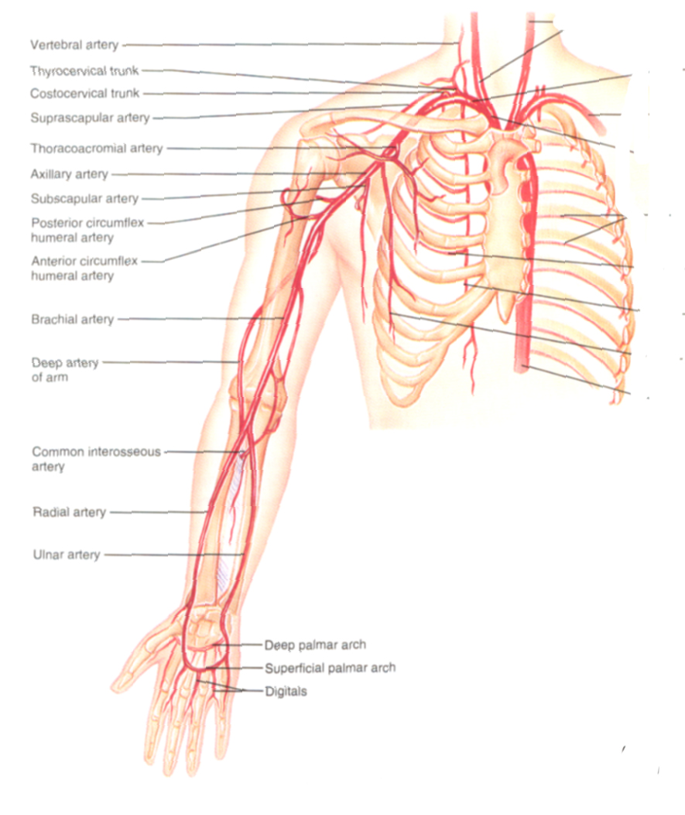
Blood Supply: Arteries
Subclavian (neck)
Axillary (armpit)
  Subscapular
Brachial (arm)
  Deep brachial
Radial (forearm)
Ulnar (forearm)
  Common Interosseous
Superficial & Deep Palmar arches
  Digital

Slide 20
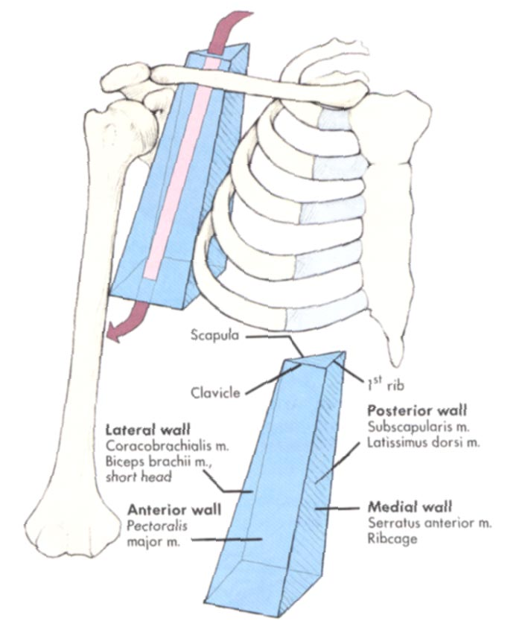
Axilla = Armpit
Region between arm and chest
Boundaries
  Ventral - pectoral muscles
  Dorsal = latissimus dorsi, teres major subscapularis
  Medial = serratus ventralis
  Lateral = bicipital groove of humerus
Contents
  Axillary lymph nodes, Axillary vessels Brachial Plexus

Slide 21
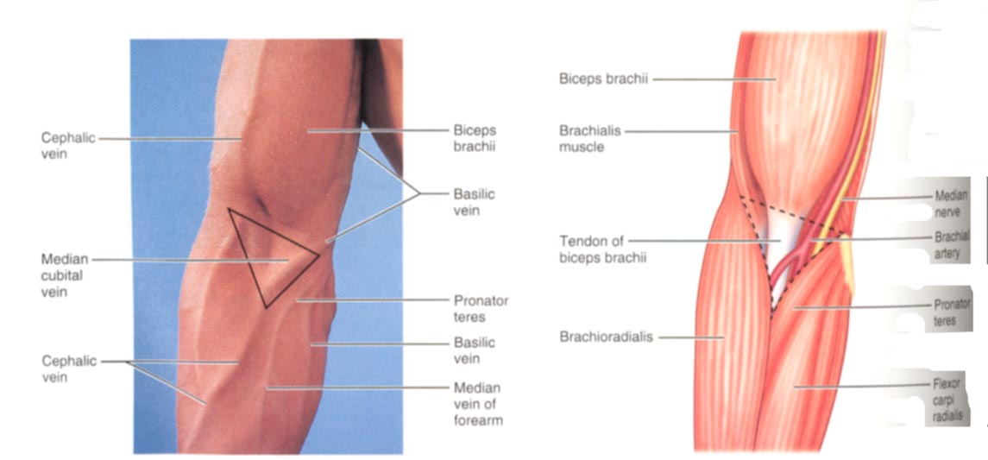
Surface Anatomy of Upper Limb
Biceps + Triceps brachii
Olecrenon Process
Medial Epicondyle
Cubital Fossa
  Anterior surface elbow
  Contents
    Median Cubital Vein
    Brachial Artery
    Median Nerve
  Boundaries
    Medial= Pronator teres
    Lateral= Brachioradialis
    Superior= Line between epicondyles

Slide 22
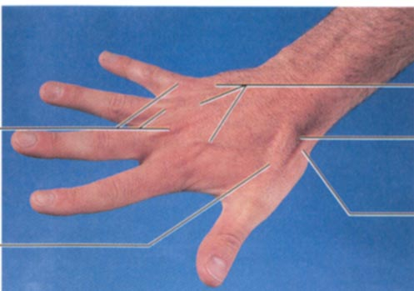
Surface Anatomy of Upper Limb
Carpal Tunnel
  Carpals concave anteriorly
  Carpal ligament covers it
  Contains: long tendons, Median nerve
  Inflammation of tendons = compression of Median nerve
Anatomical Snuffbox
  Lateral = E. pollicis brevis
  Medial = E. pollicis longus
  Floor = scaphoid, styloid of radius
  Contains Radial Artery (pulse)

Slide 23
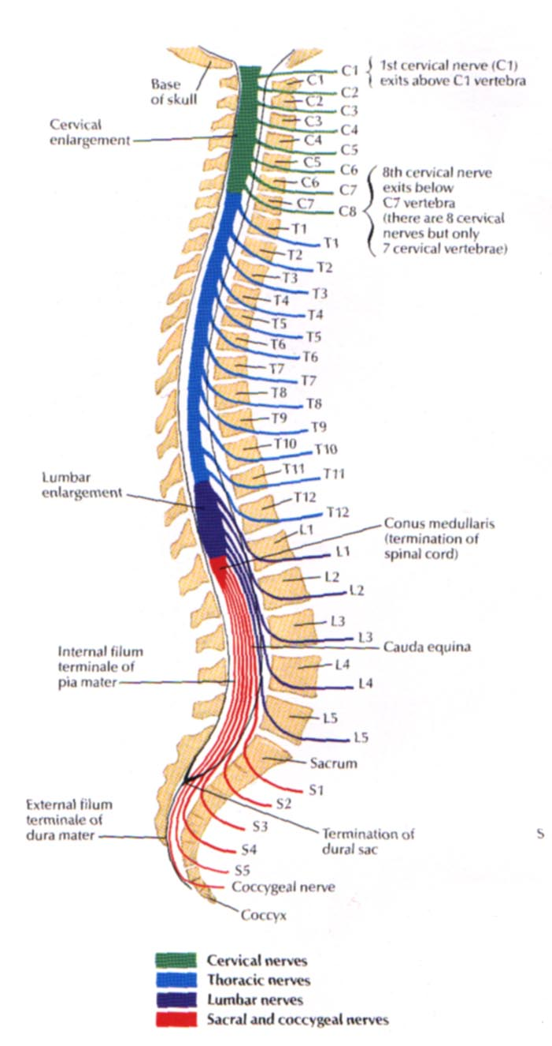
Brachial Plexus
Network of nerves; part in neck, part in axilla
Muscles of upper limb receive innervation from nerves of the brachial plexus
Formed from Ventral Rami of Inferior 4 Cervical Nerves (C₅₋₈) and T₁

Slide 24
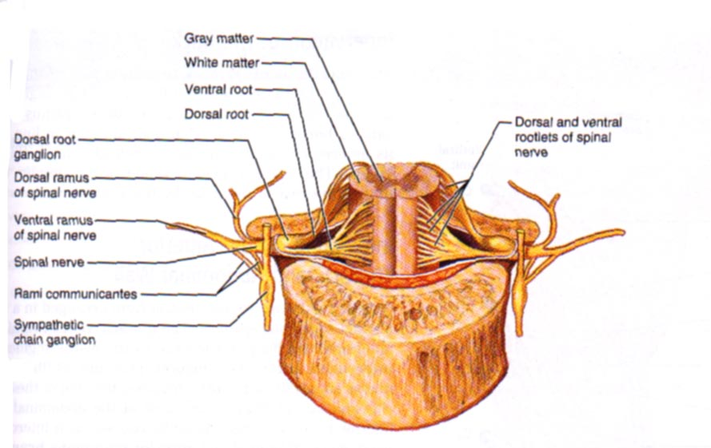
Where Ventral Rami Come From
Dorsal Root
Dorsal Ramus of spinal nerve
Ventral Ramus of spinal nerve
spinal nerve
Ventral Root

Slide 25
Parts of Brachial Plexus
Really Tired? Drink Coffee Buddy!
R = ROOTS (ventral rami)
T = TRUNKS
D = DIVISIONS
C = CORDS
B = BRANCHES

Slide 26
Roots join to form Trunks! (in neck)
Ventral Rami Trunks
C5 Upper Trunk
C6
C7 Middle Trunk
C8
T1 Lower Trunk

Slide 27
Trunks Split to form Divisions! (in neck)
Trunks Divisions
Upper Anterior Posterior
Middle Anterior Posterior
Lower Anterior Posterior

Slide 28
Divisions Join to form Cords! (in axilla)
Trunks
Divisions
Cords
U A P
M A P
L A P POSTERIOR CORD
LATERAL CORD
MEDIAL CORD

Slide 29
Cords Give off Branches!! (in axilla)
Lateral Musculocutaneous
Median
Medial Ulnar
Posterior Radial Axillary (thoracodorsal) (subscapular)

Slide 30
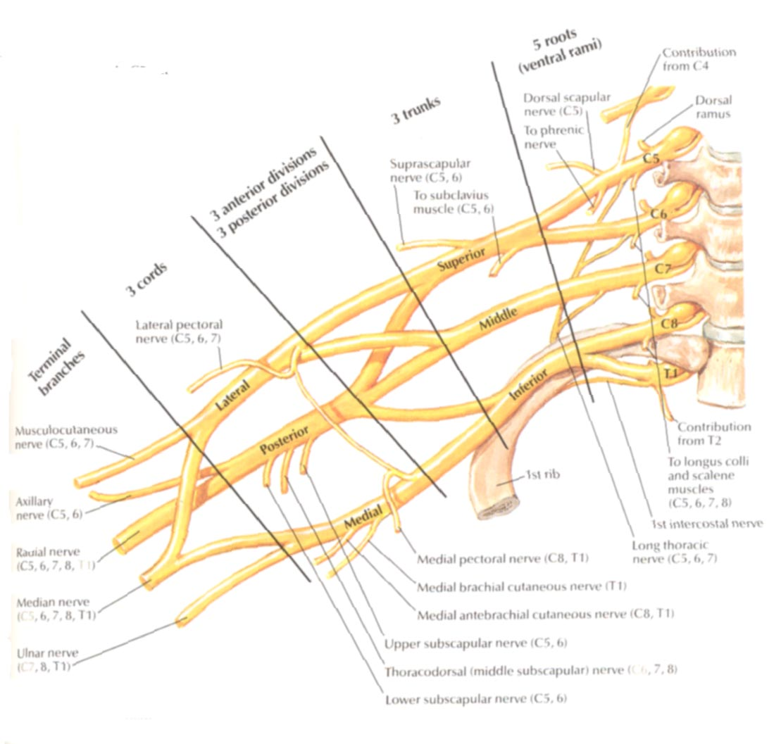
BRACHIAL PLEXUS...

Slide 31
Innervation by Posterior Cord
Radial Nerve (largest branch)
  Course: Through arm, around humerus, around lateral epicondyle, then divides
  Innervates: all posterior muscles of arm and forearm
    Triceps brachii, anconeus, supinator, brachioradialis
  Divides in forearm:
    Superficial = skin of arm and dorsolateral surface of hand
    Deep = extensor muscles of forearm (eg E. carpi radialis L + B)
  Damage to Radial Nerve = wristdrop
    Inability to extend the hand, st inability to fully extend forearm

Slide 32
Innervation by Posterior Cord (continued)
Axillary Nerve (runs w/ caudal humeral circumflex a.)
  Innervates:
    Deltoid and Teres minor (motor inn)
    Capsule of shoulder, skin of shoulder (sensory inn)
Subscapular Nerve {branches of C5 + C6 rami}
  Innervates: Subscapularis, Teres major
Thoracodorsal Nerve (runs w/thoracodorsal a+v)
  Innervates: Latissimus dorsi

Slide 33
Innervation by Lateral Cord
Musculocutaneous
  Course: branches to arm, distal to elbow becomes cutaneous for lateral forearm skin
  Innervates
    Biceps brachii, brachialis, coracobrachialis (motor inn)
    Skin distal to elbow (sensory)
Suprascapular (runs w/suprascapular a+v) {C5, C6}
  Innervates: Supraspinatus, Infraspinatus

Slide 34
Innervation by both Lateral and Medial Cords
Median
  Course: middle of brachial plexus, does not branch in arm, distal to elbow provides many branches to most forearm flexors, passes through carpal tunnel to hand to lateral palmar intrinsics
  Innervates: most muscles of anterior forearm (motor inn)
    (eg) most flexors, some intrinsics (thumb)
  Innervates: skin of lateral 2/3 hand on palm side, dorsum of fingers 2+3 (sensory inn)
  Nerve Damage = “Ape” Hand
    Inability to Oppose Thumb

Slide 35
Innervation by Medial Cord
Ulnar
  Course: runs along medial side of arm, behind medial epicondyle, superficial to carpal tunnel into hand, branches to supply intrinsics and skin
  Innervates:
    FCU and part of FDP, most intrinsics (motor inn)
    Skin of medial 2/3 of hand A+P (sensory inn)
  Nerve Damage: Clawhand
    Inability to extend fingers at interphalangeal joints, results in permanent flexion = claw

Slide 36
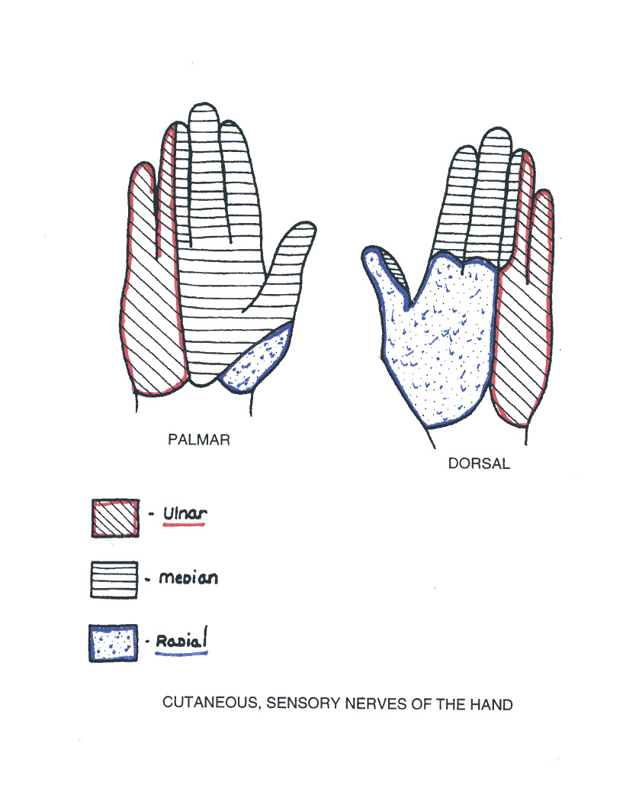
Cutaneous Innervation to the Hand

Slide 37
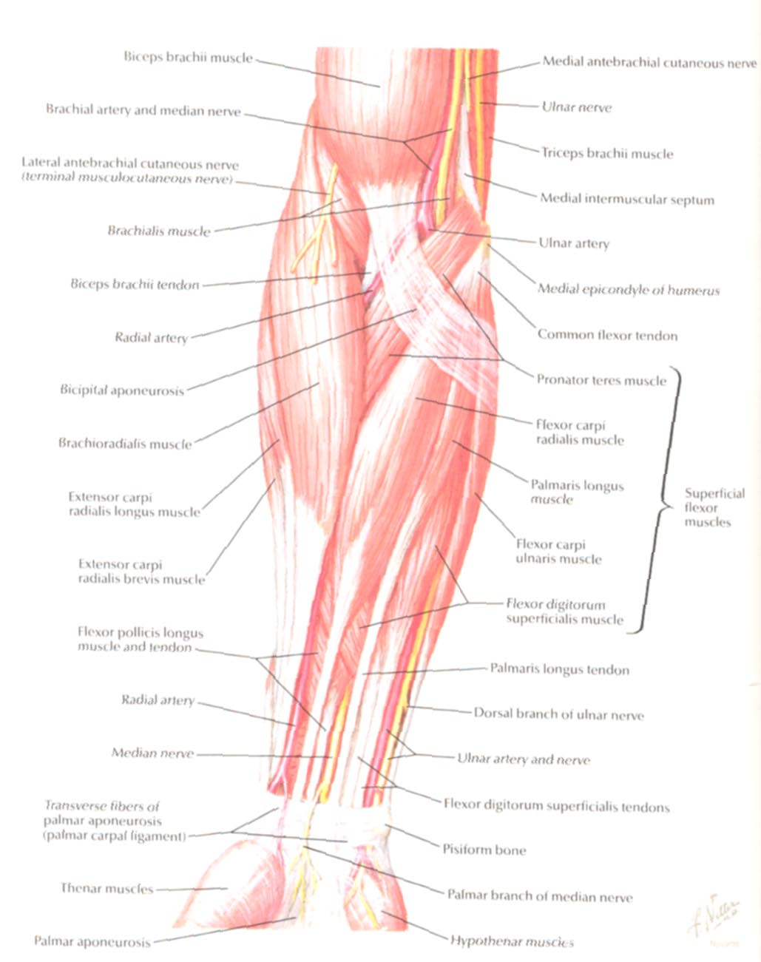
Ulnar Nerve
Median Nerve
Brachial Artery
Musculocutaneous Nerve
UlnarArtery
Where’s Radial Nerve?
Radial Artery
Median Nerve
Ulnar Nerve

Slide 38
THANK
YOU

