Slide 1
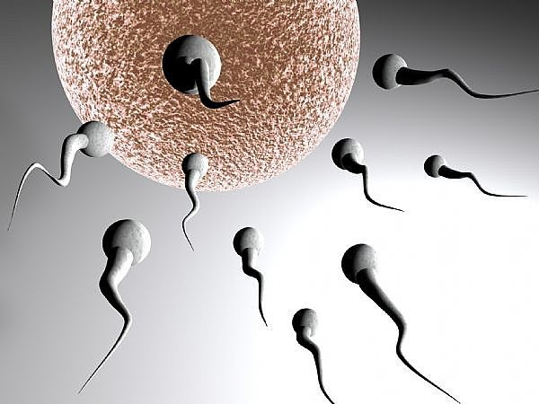
SPERM BANKING
PRESENTED BY:
DR. PRAVEEN KURREY
ASST. POFESSOR
DEPT. OF ANATOMY
CMCH BHOPAL

Slide 2
INTRODUCTION
A sperm bank or cryobank is a facility that collects and stores human sperm mainly from sperm donors, primarily for the purpose of achieving pregnancies through third party reproduction, notably by artificial insemination. Sperm donated in this way is known as donor sperm. The first two sperm banks were opened in Iowa City, Iowa, USA and Tokyo, Japan in 1965.

Slide 3
Sperm Banking is the collection, freezing (cryopreservation) and storage (cryobanking) of healthy sperm, usually during or after vasectomy reversal surgery or prior to vasectomy.
This is mainly for the purpose of preservation of their progeny.

Slide 4
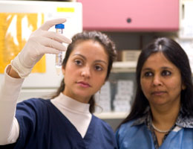
Beneficiaries
Single women
Women with infertile male partner
Women in same sex couple

Slide 5

Dr. L H Hiranandani Hospital – Centre for Human Reproduction, is one of India's largest human sperm banks

Slide 6

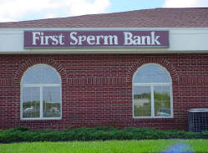




SPERM BANKS

Slide 7
Services Available
Semen Banking with Programs for both Long-term and Short-term storage.
Standard & Pre-processed Cryopreservation.
Semen Analysis - Cryosurvival - Concentration for Oligozoospermia.
Sperm Processing Procedures Including Retrograde Ejaculates for IUI.
Evaluation and Treatment of Infertile Males and Females.
Standard and Pre-Processed Anonymous Donor Semen.
Artificial Insemination.

Slide 8
Sperm banks
Enables more and more people to have choices over the whole issue of reproduction.
Women may choose to use an anonymous donor who will not be a part of family life, or they may choose known donors who may be contacted later in life by the donor children.
Women may choose to use a surrogate to bear their children, using eggs provided by the woman and sperm from a donor.
Sperm banks often provide services which enable a woman to have subsequent pregnancies by the same donor, but equally, women may choose to have children by a number of different donors.
Sperm banks increasingly adopt a less formal approach to the provision of their services thereby enabling people to take a relaxed approach to their own individual requirements.

Slide 9
Sperm Donation
Sperm donation is the name of the provision (or 'donation') by a man, known as a sperm donor, of his semen with the intention that it be used to achieve a pregnancy and produce a baby in a woman who is not the man's sexual partner .
Attempts are made to impregnate a woman with the donor's sperm using third party reproduction techniques notably artificial insemination.
A sperm donor may donate his sperm directly to recipient women, at a clinic known as a sperm bank or through a third party which brokers arrangements between sperm donors and recipient women, known as a 'sperm agency'.
Sperm provided in this way is known as donor sperm.

Slide 10
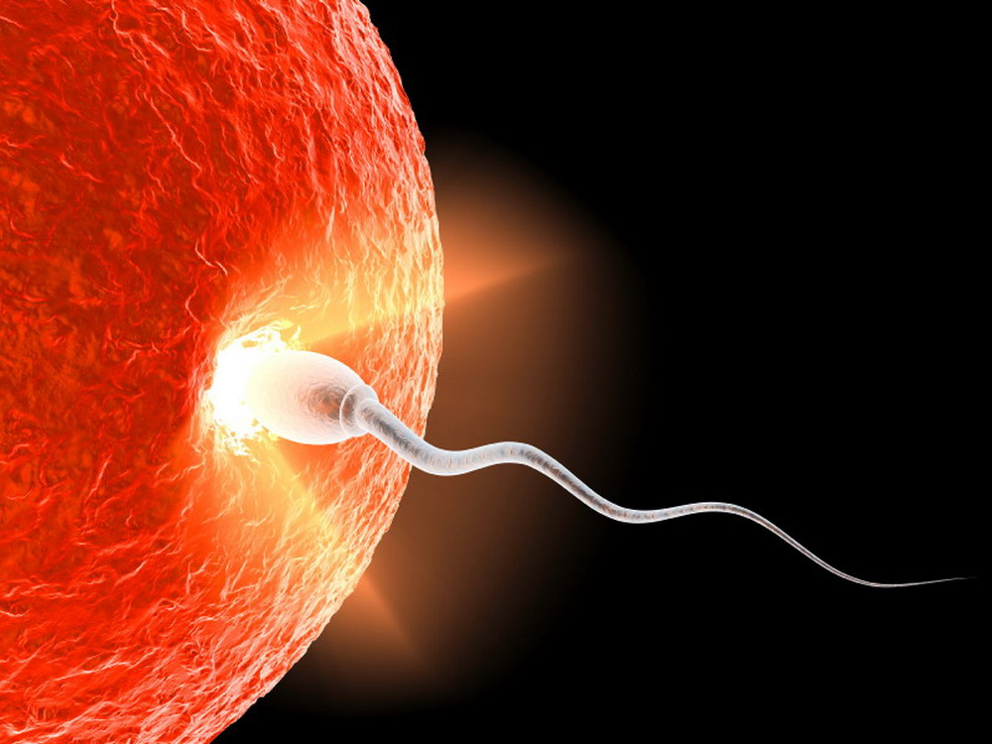
DONORS
a) Known
b) Anonymous.
Men between the ages of 18 and 35
Healthy with no known hereditary, genetic disease or any serious disability

Slide 11

The Human Fertilisation and Embryology Authority (HFEA)
It is governing body in UK that regulates all the activities of sperm banks and fertility centres. Once a donor registers with a sperm bank, it is essential that the HFEA be given his details.
Sperm banks check a donor’s background
medical history.
complete fitness
danger of getting any infections from the sperms.
A semen sample given by the donor is analysed by the bank as well, to check for the sperm health and sperm count before a donor can be registered.

Slide 12

DONOR PAYMENT
$20 to $ 50 (Rs.1000 to 2500) per unit of semen
Set fee for each donation plus an additional amount for each vial stored
Reasonable monthly income.

Slide 13
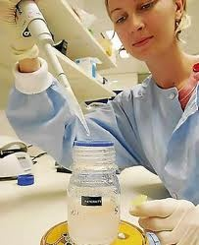
QUARANTINE PHASE
Usually there is a quarantine phase till which the donor sperm cannot be used, as during this time it is screened and various tests are carried out to check its quality.
The length of quarantine is usually about six months.

Slide 14

Who can Benefit from Sperm Donation?
Azoospermia- male with low sperm count
Father having genetic defects like haemophilia
Rhesus incompatibility.
single women who wish to have their own child.
Women in same sex couple

Slide 15

DONOR ‘s PROFILE
Donor Characteristics
Blood Group of Donor –
Build –
Height –
Complexion -
Occupation –
Date of Collection of Sample –
Donor Screened for - HIV/VDRL/HbsA,HCV(Negative) & Thalessemia.
Pre-Freeze Parameters:
Type of Sample - Native Ejaculate/Percoll Processed Volume -
Count -
Motility -
Grade -
Post-Thaw Parameters:
Volume -
Count -
Motility -
Grade -

Slide 16
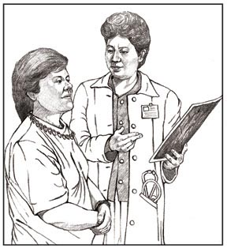
Medical screening
Sperm banks screen every potential donor for genetically inheritable diseases and infectious diseases that may be transmitted through sperm.
In the US, the screening procedures are regulated by the FDA, the ASRM, the American Association of Tissue Banks, and the CDC. The screening regulations are more stringent today than they have been in the past.

Slide 17
SCREENING
Taking a medical history of the donor, his children, siblings, parents, and grandparents etc for three to four generations back.
HIV risk assessment interview, asking about sexual activity and any past drug use.
Blood tests and urine tests for infectious diseases, such as:
HIV HTLV
  Hepatitis B Hepatitis C
  Syphilis Gonorrhoea
  Chlamydia Cytomegalovirus
Blood and urine tests for blood typing and general health indicators:
-ABO/Rh typing, CBC, liver panel and urinalysis.
-Complete physical examination.
Genetic testing for carrier traits of:
  - Cystic Fibrosis
  -Sickle-cell disease
  -Thalassemia

Slide 18
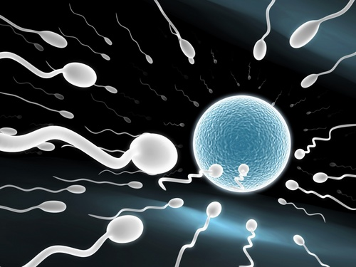
WHO Definition of
NORMAL SPERM COUNT
Concentration of spermatozoa >20 million per ml.
Volume of semen >2ml.
Number of spermatozoa >40 million/ejaculate
75 % of the spermatozoa should be alive
30 % of the spermatozoa should be of normal shape and form.
25 % of the spermatozoa should be swimming with rapid forward movement.
50 % of the spermatozoa should be swimming forward, even if only sluggishly.

Slide 19
Specimen Processing For Cryopreservation
A semen analysis is performed on each ejaculate. This includes --
Complete seminal fluid analysis
Quantitating sperm motility,
Forward progression
Sperm density,
Morphology.
All specimens are stored in liquid nitrogen storage tanks (-196degreeC).
There does not appear to be any increased risk of birth defects using frozen semen.
There is no guarantee that any given specimen will necessarily produce a pregnancy; however, recent studies indicate that the overall success rate following the use of cryopreserved semen is from 40%-50%.

Slide 20
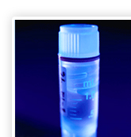
STORAGE
Small vials or straws of holding between 0.4 and 1.0 ml .
Cryogenically preserved in liquid nitrogen tanks.
Before freezing, sperm may be prepared so that it can be used for intra-cervical insemination (ICI), intrauterine insemination (IUI) or for IVF or assisted reproduction) (ART).

Slide 21
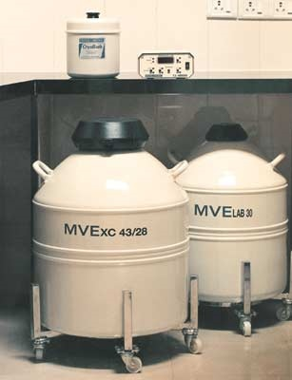
Semen Cryopreservation
Cryoprotectant is added to the semen to control sperm damage caused by
freezing. The specimen is then divided into individual cryo-vials, placed into
liquid nitrogen vapour for 30 minutes, and then plunged into liquid nitrogen.
At a temperature of -196°C all metabolic activity is halted. Semen can thus
be preserved for many years.

Slide 22
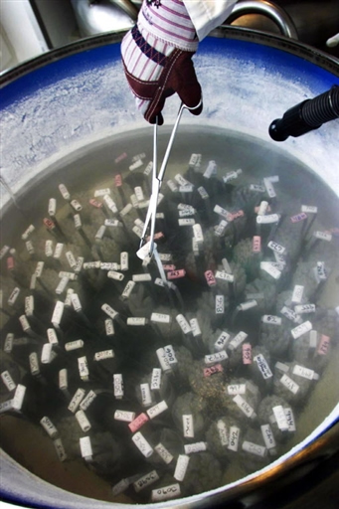
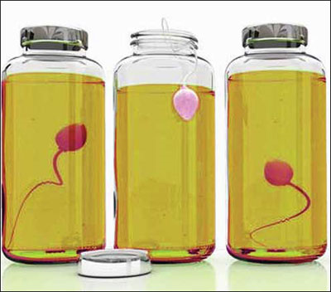
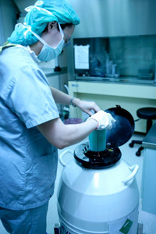
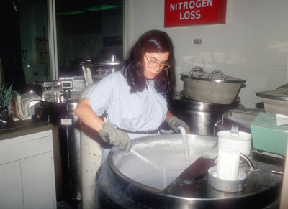
Semen Cryopreservation

Slide 23
IN VITRO FERTILIZATION (IVF)
In vitro fertilisation (IVF) is a process by which egg cells are fertilised by sperm outside the womb, in vitro. IVF is a major treatment in infertility when other methods of assisted reproductive technology have failed. The process involves hormonally controlling the ovulatory process, removing ova (eggs) from the woman's ovaries and letting sperm fertilise them in a fluid medium. The fertilised egg (zygote) is then transferred to the patient's uterus the intent to establish a successful pregnancy. The first "test tube baby", Louise Brown was born in 1978.

Slide 24
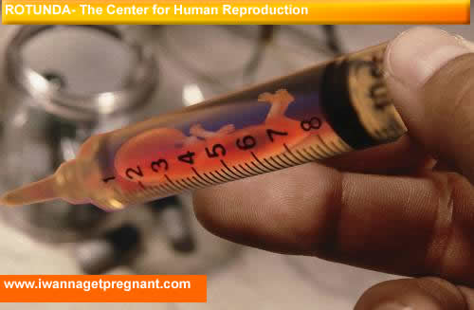

IN VITRO FERTILISATION

Slide 25

Cost
In the U.S., the cost of anonymous donor sperms ranges from $200 to $3000 (Rs.10,000 to 150,000) per unit of semen. Added to the sperm cost is the cost of the treatment, either IUI or IVF, which may range from ₤500 to ₤1000 (Rs.20,000 to 50,000).
If opting for donor sperms, you should also include additional costs of the drugs, treatments, and number of visits to the clinic to better judge the total expenditure of the whole process .

Slide 26

Success Rate
The use of donor sperm has been found to be very successful in cases where the female has normal functioning of the reproductive system. In the UK, almost a thousand couples are using donor sperms annually for artificial insemination.
Couples using donor sperm in IUI have a success rate of about 35%. IVF performed with donor sperm is associated with a success rate of 40% to 50%.

Slide 27
Counselling
Counselling of the recipients is done for two reasons:
Firstly, opportunity to ask questions about the process and using donor sperm.
Secondly, what kind of donor will best match your requirement.
The psychological and genetic impact on the recipient and the offspring
Worries regarding the legalities
Questions that the child may have about his birth. A counsellor may also raise some issues that you and your partner may not have considered yet.

Slide 28
Information made available by a sperm bank will usually include the race, height, weight, blood group, health and eye colour of the donor. Sometimes information about his age, family history and educational achievements will also be given.
Some sperm banks make a 'personal profile' of a donor available and occasionally more information may be purchased about a donor, either in the form of a DVD or in written form. Catalogs usually state whether samples supplied in respect of a particular donor have already given rise to pregnancies, but this is not necessarily a guide to the fecundity of the sperm since a donor may not have been in the program long enough for any pregnancies to have been recorded.

Slide 29
The psychological and psychosocial issues surrounding sperm banking
The existence of sperm banks remains controversial and in many parts of the world they are not allowed to be established or to operate.
Sperm banks do not provide a cure for infertility in that it is the sperm donor who reproduces himself, not a partner of the recipient woman.
Most societies are built upon the family model and sperm banks may be seen as a threat to this, particularly where a sperm bank makes its services available to unmarried women.

Slide 30
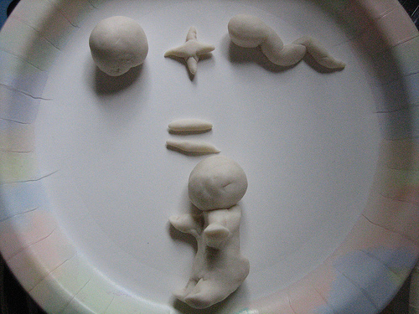
Sperm donation does not maintain the reproductive integrity of a relationship --biological father
Ethical issues for un-married women and single or coupled lesbians--conventional parenting and has wider issues for society as a whole, including the issues of the role of men as parents, the issue of family support for children, and the issue of financial support for women with children.

Slide 31
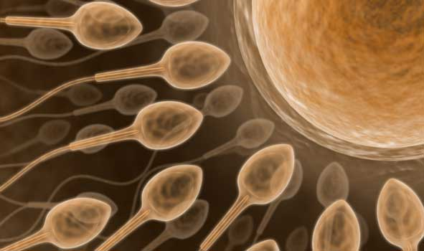
DON’T WASTE
DONATE

Slide 32
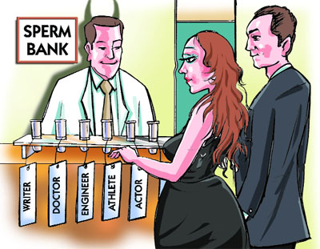
THANK YOU

Slide 34
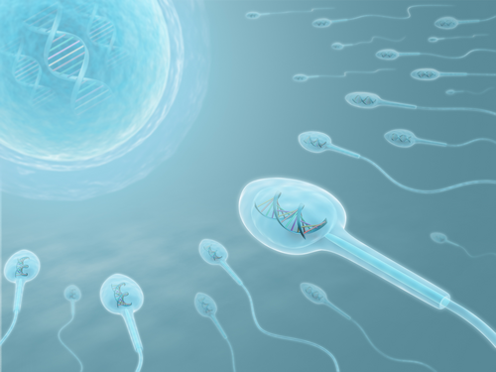

Slide 35
Infertility in the Man
A man may be infertile because he does not have enough sperm; because the sperm are not active enough; because the passage, or vas deferens, is blocked; or because of problems with ejaculation.
A number of factors can cause or contribute to male infertility:
Sexually transmitted diseases, such as gonorrhea or chlamydia
Fevers and infections, such as mumps occurring after puberty
Surgery of the reproductive tract, such as that for undescended testes, hernia repair, disorders of the prostate gland, or cancer
Damage to the vas deferens, most often by vasectomy
Varicose veins in the scrotum (varicocele)
Use of certain drugs, such as those for depression or high blood pressure
Exposure of the testes to high temperatures, such as those that result from the wearing of tight, unventilated clothing; excessive use of hot tubs; or conditions in the workplace
Use of tobacco, marijuana, or alcohol
Medical conditions, such as diabetes
Genetic or hormonal problems
Injury to the testes, such as that resulting from physical trauma or exposure to radiation, can also cause infertility in the man.

