Slide 1
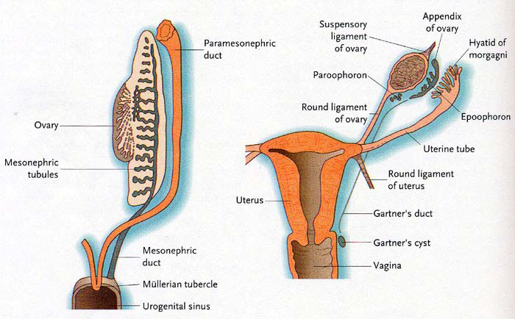
UROGENITAL SYSTEM -2
DEVELOPMENT
DR. PRAVEEN KURREY
M.B.B.S., M.S. ASSISTANT PROFESSOR
DEPT.OF ANATOMY PT.JNMMC RAIPUR

Slide 2
Develops from 2 sources –
1 . Endodermal Cloaca
2. Mesodermal Intermediate cell mass

Slide 3
MESONEPHRIC DUCT / WOLFFIAN / LEYDIGS/ ARCHINEPHRIC /NEPHRIC DUCT
Opens at the junction of vesicourethral canal and definitive urogenital sinus.
Later it give rise to Ureteric bud.
Part of mesonephric duct caudal to opening of ureteric bud is called Common excretory duct.
Later CED is absorbed in to dorsal wall of vesicourethral canal ,and MND and Ureteric bud opens separately.

Slide 4
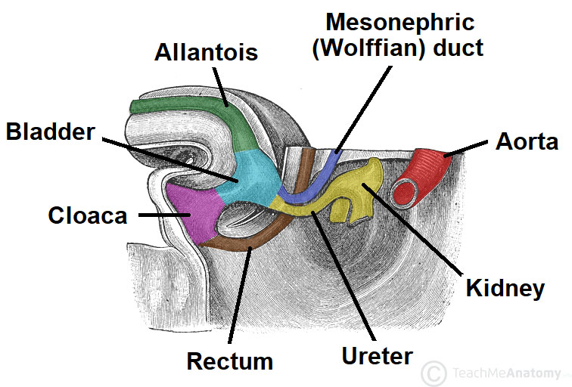

Slide 5
DERIVATIVES OF MND
A. Mesonephric duct proper
Appendix of epididymis
Canal of epididymis
Vas differens
Seminal vesicle
Ejaculatory duct

Slide 6
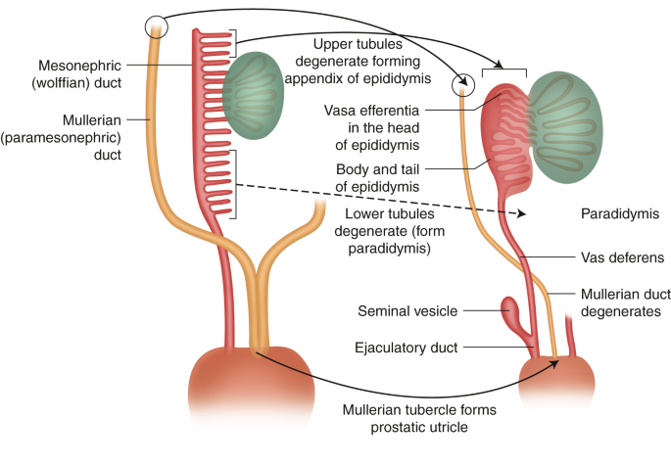

Slide 7
B. CED derivatives
Trigone of urinary bladder
Posterior wall of upper part of prostatic urethra in male and posterior wall of whole urethra in female
Inner glandular zone of prostate
C. Ureteric bud derivatives
Pelvis of ureter
Major calyx
Minor calyx
Collecting duct

Slide 8
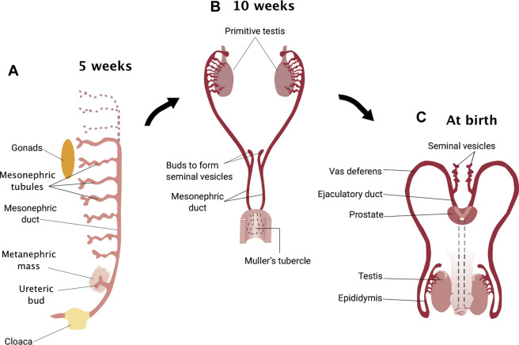

Slide 9
Derivatives of MND in Female –
From cranial part – Duct of Epoophoron
Caudal part – Gartners duct

Slide 10
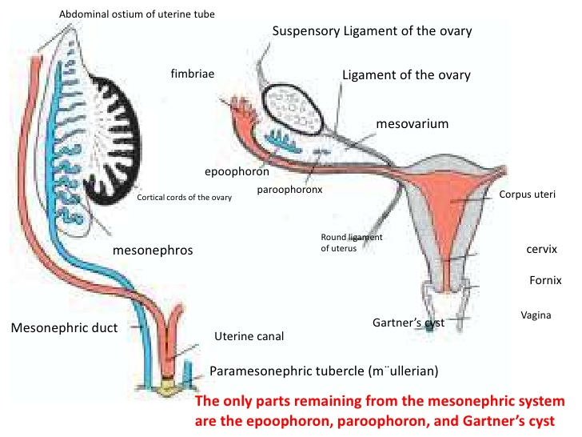

Slide 11
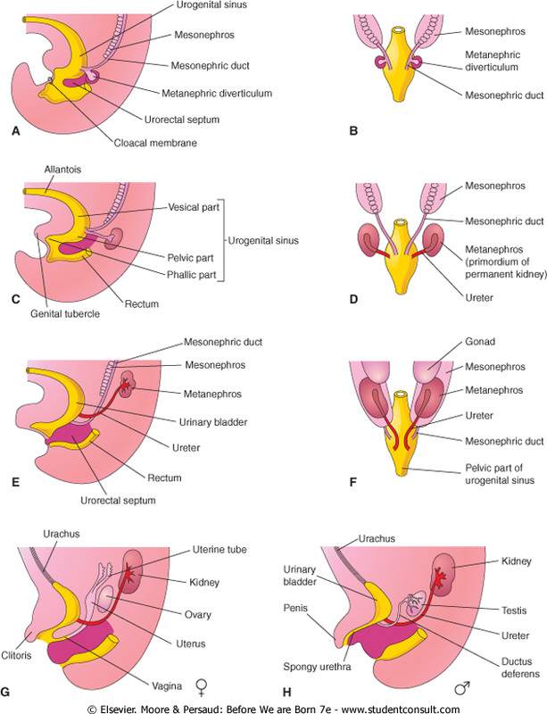

Slide 12
Mesonephric Tubule
15 -20 tubules chiefly forms Efferent duct of Testis
Divided into 3 groups-
Cranial – Form superior aberrant ductile which is only attached to testis
Middle – Form efferent duct of testis
Lower – Form a) Inferior aberrant ductules attached only to tail of epididymis
b). Paradidymis lying between testis and epididymis.
In Female – They form Tubules of Epoophoron and Paroophoron.

Slide 13
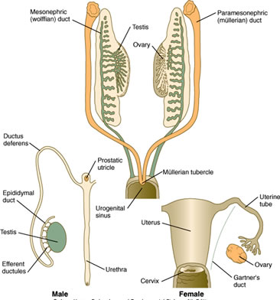

Slide 14
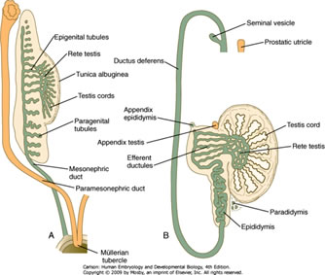

Slide 15
FEMALE GENITAL SYSTEM
PARAMESONEPHRIC / MULLERIAN DUCT
It develops lateral to cranial part of mesonephric duct as invagination in coelomic epithelium. It grows further to form cord . It canalise to form PMND.
It has 3 parts –
Cranial vertical part – Lateral to MND
Intermediate horizontal part – Crosses MND
Caudal vertical part – Lies in close contact with opposite duct

Slide 16
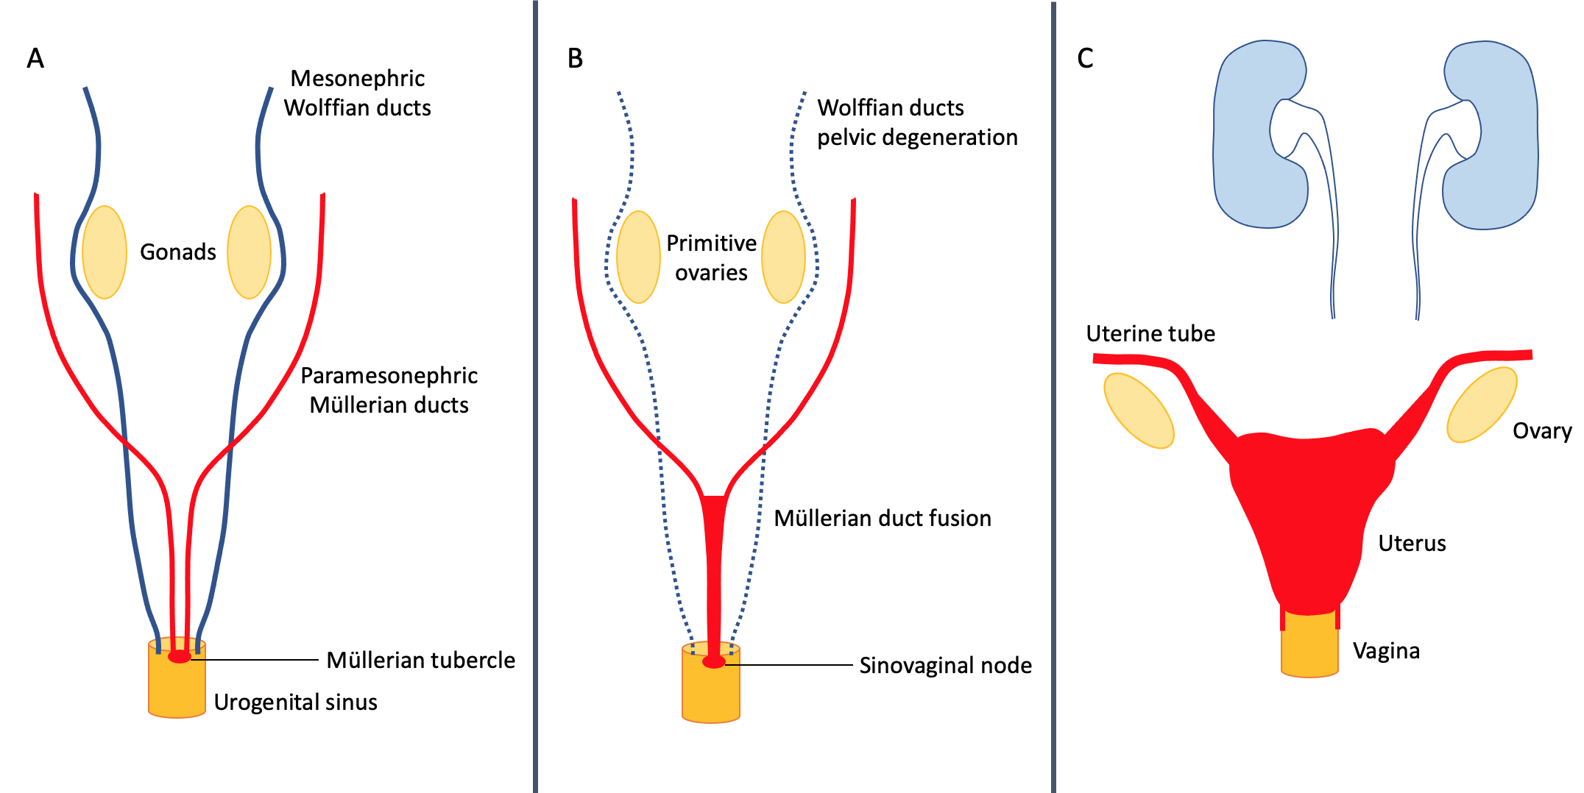

Slide 17
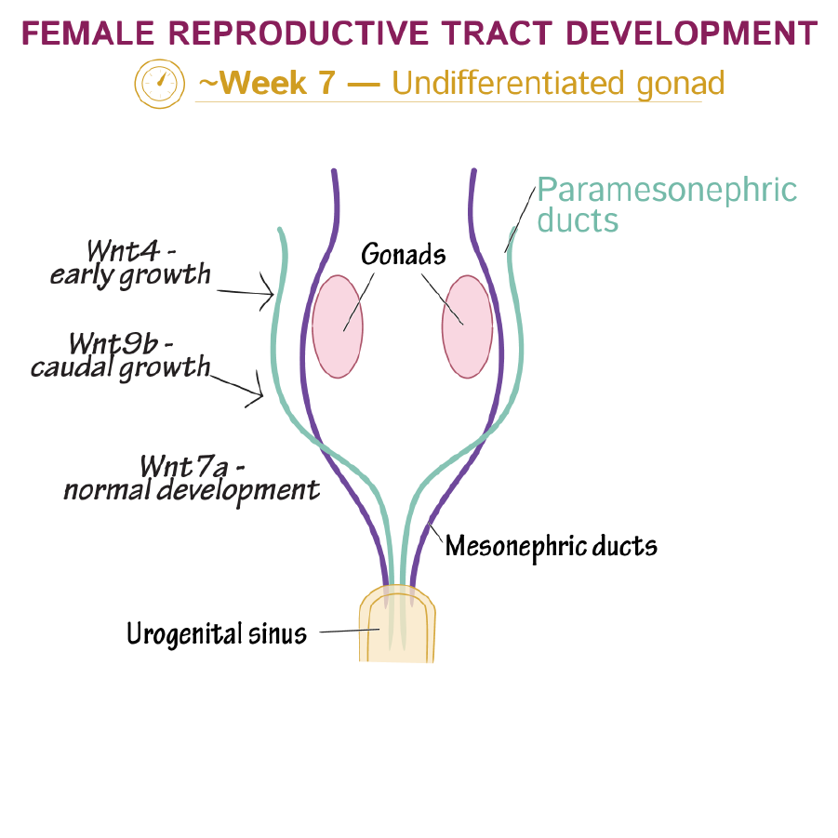

Slide 18
It opens in DUGS producing a tubercle called Mullerian tubercle.
Partition between two caudal vertical part disappears. 2 tubes unite to form Uterovaginal canal.
Now the parts are –
Cranial vertical part
Intermediate horizontal part
Uterovaginal canal

Slide 19
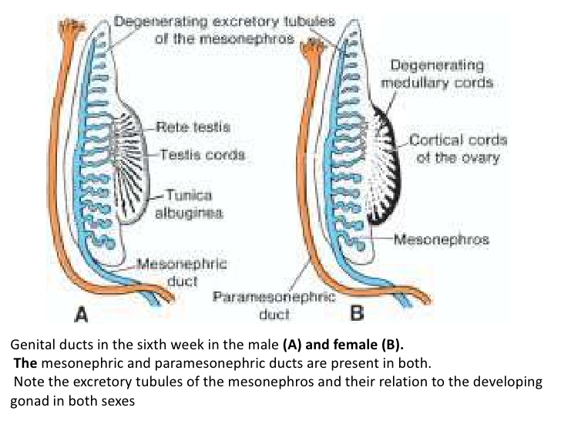

Slide 20
Derivatives of PMND in Females –
Fallopian tube
Uterus
Upper 4/5th of vagina

Slide 22
Derivatives of PMND in Males –
Appendix of testis
Prostatic utricle (Male Uterus)

Slide 23
Mullerian Tubercle – In Female forms
Central part – Degenerate to form opening of vagina
Peripheral part – Form Hymen membrane
Mullerian Tubercle in Male forms – Colliculus seminalis

Slide 24
Development of Fallopian tube –
Cranial vertical part of PMND
Intermediate horizontal part of PMND

Slide 25


Slide 26
Development of Uterus –
1. Epithelium of Fundus – Intermediate horizontal part of PMND
2. Epithelium of body and cervix—Cranial part of Uterovaginal canal
3. Myoepithelium – Surrounding splanchnopleuric mesoderm

Slide 27
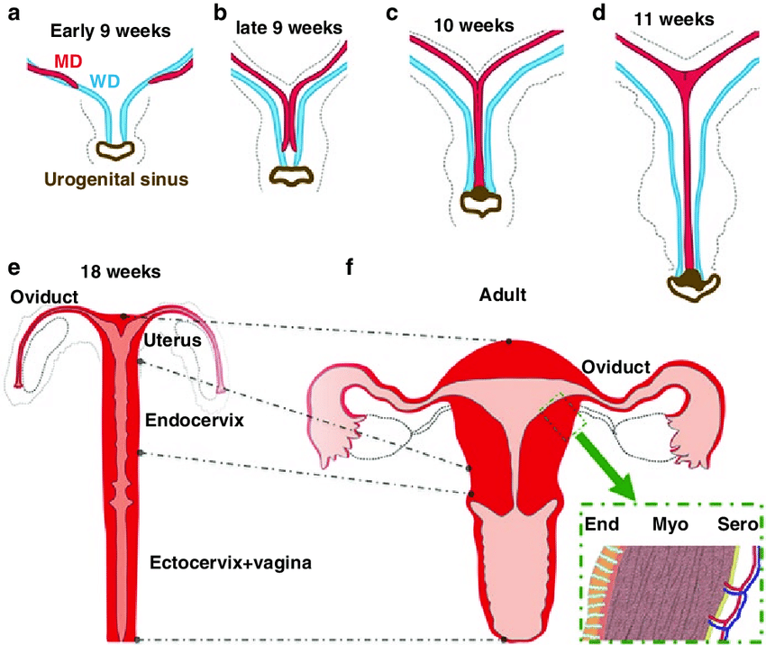

Slide 28
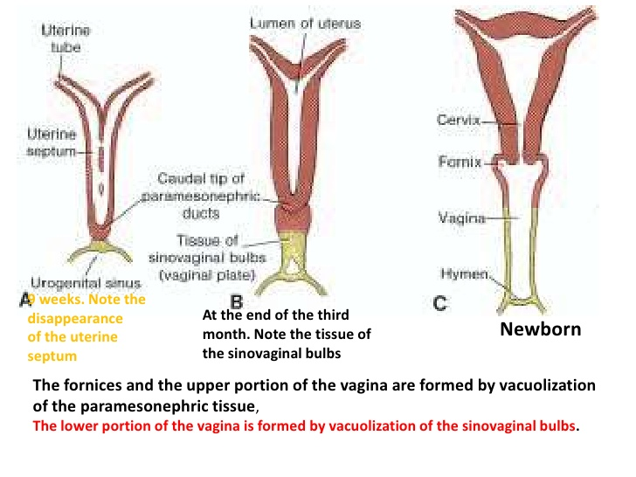

Slide 29
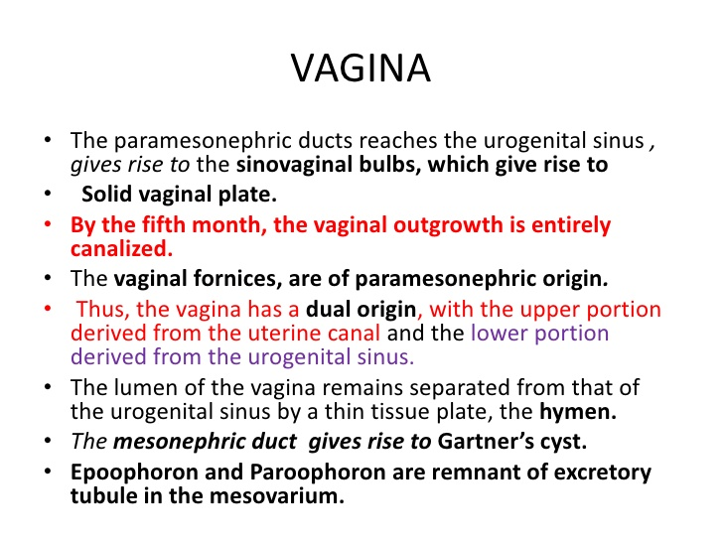

Slide 30
Development of Vagina –
By canalisation of vaginal plate
Upper 1/5th of vaginalplate – Formed by mesodermal proliferation of Uterovaginal canal
Lowr 4/5th of vaginal plate – Endodermal evagination from DUGS known as Sinovaginal bulb, later form single bulb.

Slide 31
Sources of Development of Vagina
Upper 1/5th – Caudal part of Uterovaginal canal (Mesodermal)
Lower 4/5th – Sinovaginal bulb (Endodermal evagination from DUGS)

Slide 32
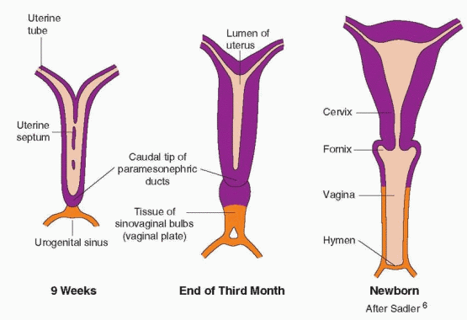

Slide 33
ANOMALIES –
Complete or partial failure of fusion of 2 PMND causes – Uterus didelphus – Caudal end of PMND fail to fuse. So there is 2 uterus, 2 cervix, 2 vagina
Double uterus – 2 uterus, 2 cervix, 1 vagina
Bicornuate uterus – Duplication of upper part
Unicornuate uterus
Septate uterus
Imperforated hymen – Failure of fusion of mullerian tubercle.

Slide 34
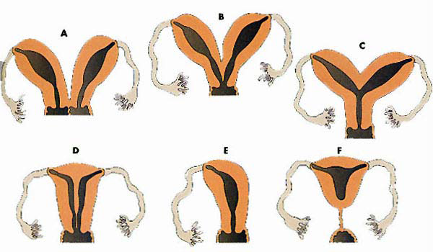

Slide 35
A. Double Uterus, Double Vagina
B. Double Uterus, Single Vagina
C. Bicornuate Uterus
D. Septate Uterus
E. Unicornuate Uterus
F. Cervical Atresia

Slide 36
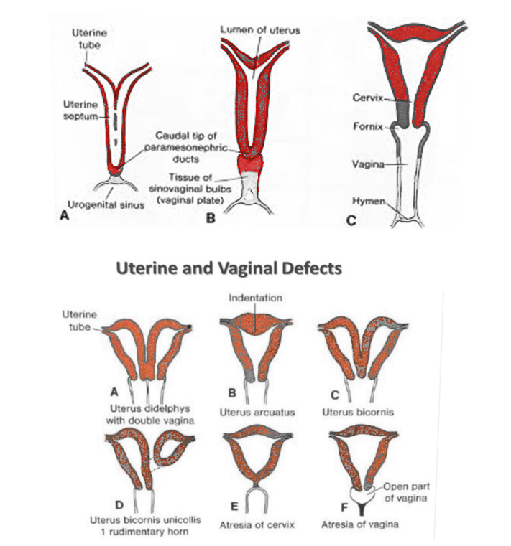

Slide 37
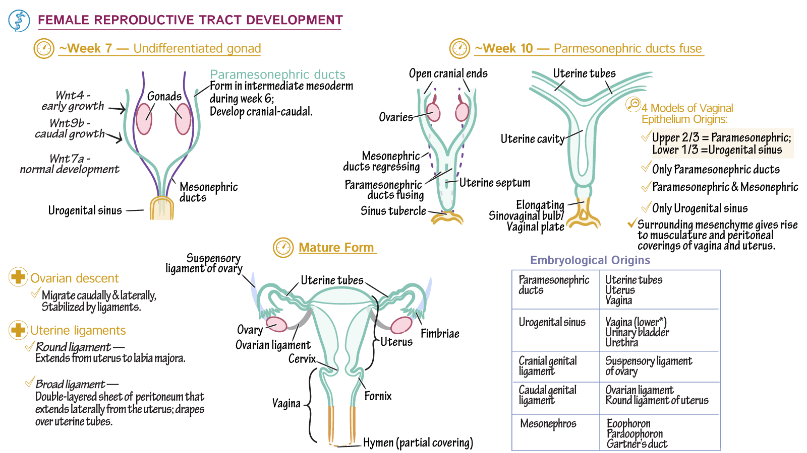

Slide 38

THANK YOU

