Slide 1
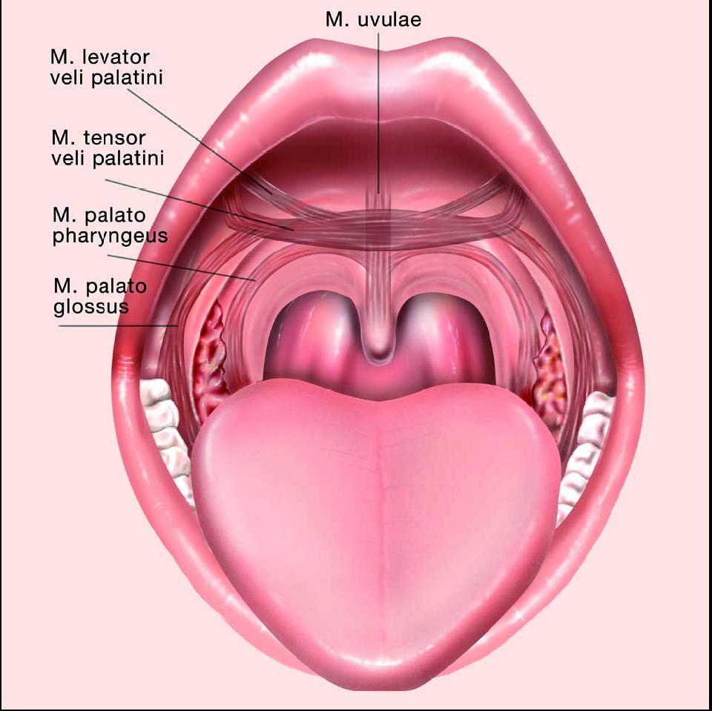
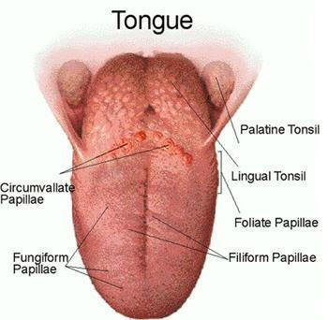
GROSS ANATOMY palate & the tonsil
DR. PRAVEEN KURREY
MBBS, MS, BCME, BCBR PROFESSOR ANATOMY

Slide 2
INTRODUCTION
Palate forms roof of mouth (palate = roof of mouth in Latin)
Separates nasal cavity from oral cavity
Consists of two parts:
  Hard palate: Forms anterior four-fifths of palate
  Soft palate: Forms posterior one-fifth of palate

Slide 3
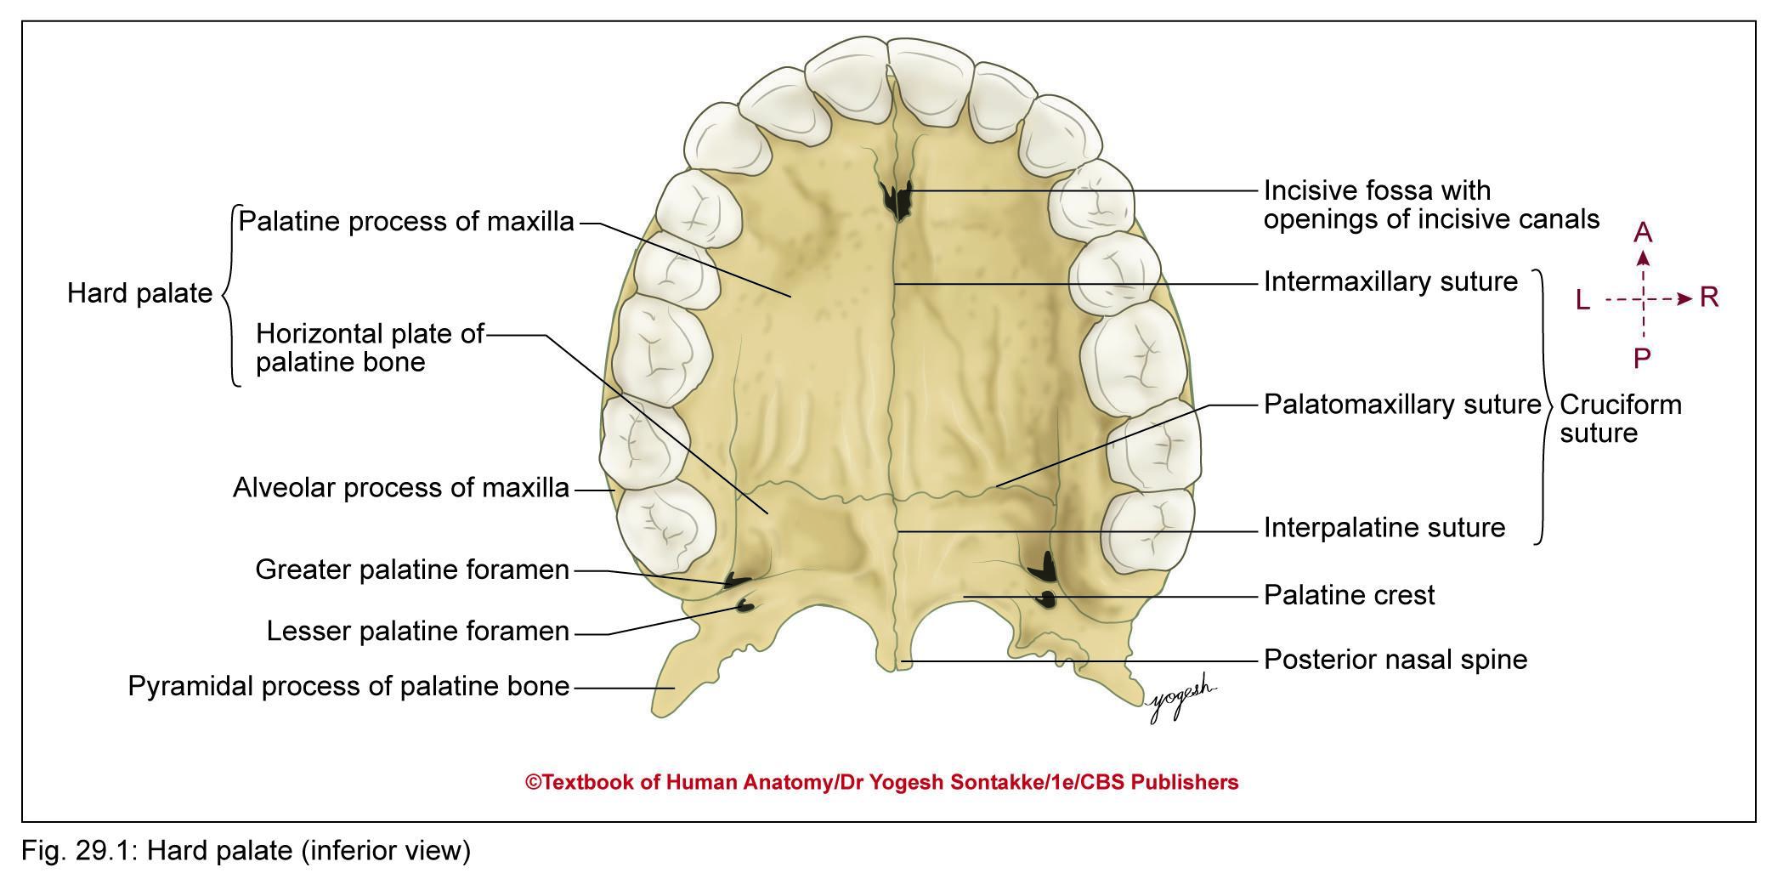
HARD PALATE
Forms portion between nasal and oral cavities
Bony Formation
Anterior two-thirds by palatine processes of maxillae
Posterior one-third by horizontal plate of palatine bone
Sutures: Shows cruciform suture consists of intermaxillary, interpalatine, and palatomaxillary sutures

Slide 5
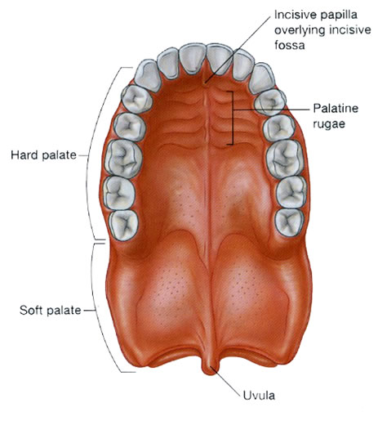

Slide 6
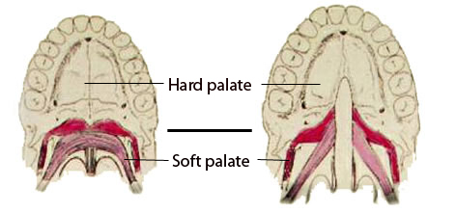

Slide 7
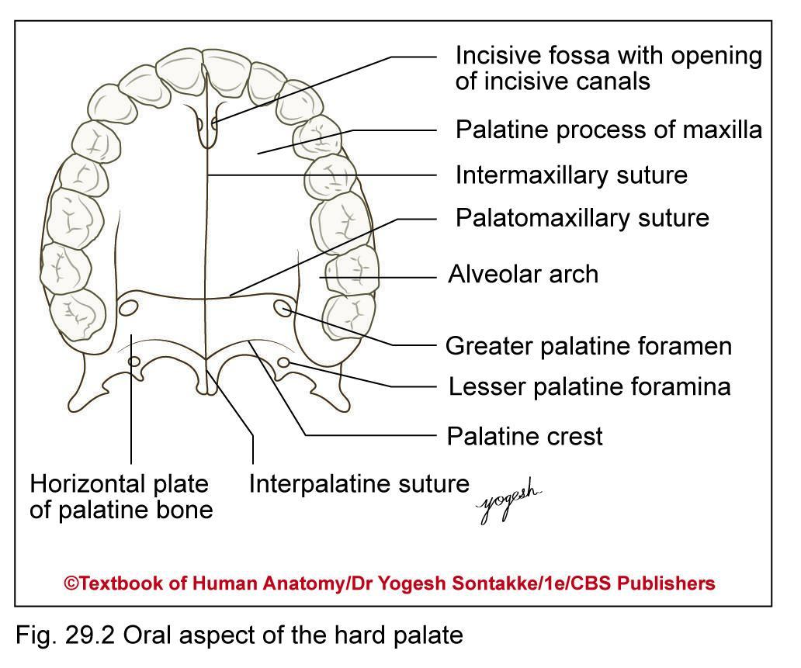
Foramina of Hard Plate
1. Incisive foramen (fossa):
Incisive canal: At bottom of t incisive fossa, opening of incisive canal, one on each side
2. Greater Palatine Foramen
3. Lesser Palatine Foramen

Slide 8
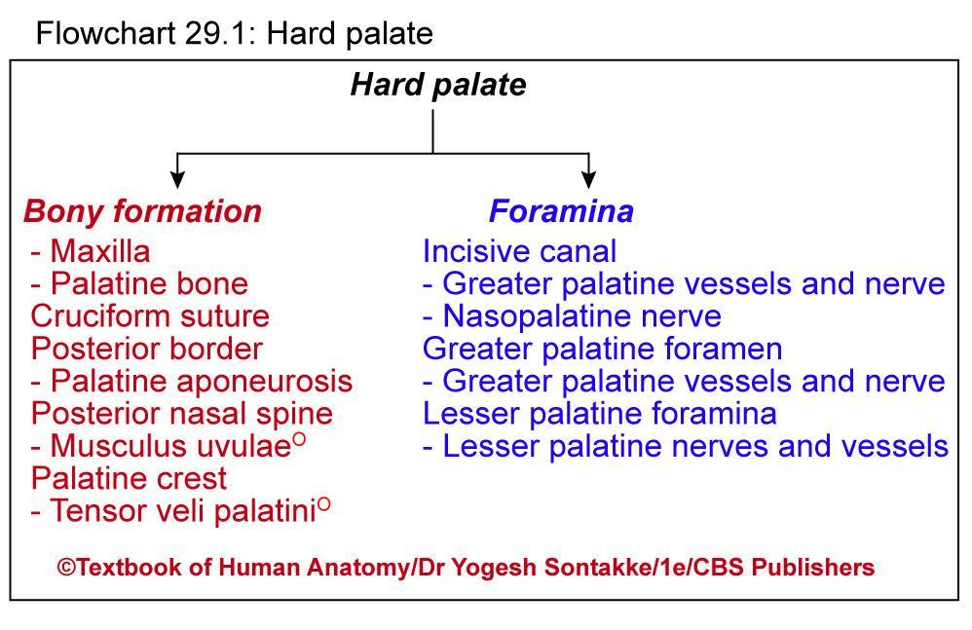

Slide 9
Blood Supply
  Arterial supply
  Greater palatine branches of third part of maxillary artery
  Lesser palatine branches of greater palatine artery
  Venous drainage
  Veins of hard palate accompany arteries and drain into pterygoid venous plexus

Slide 10
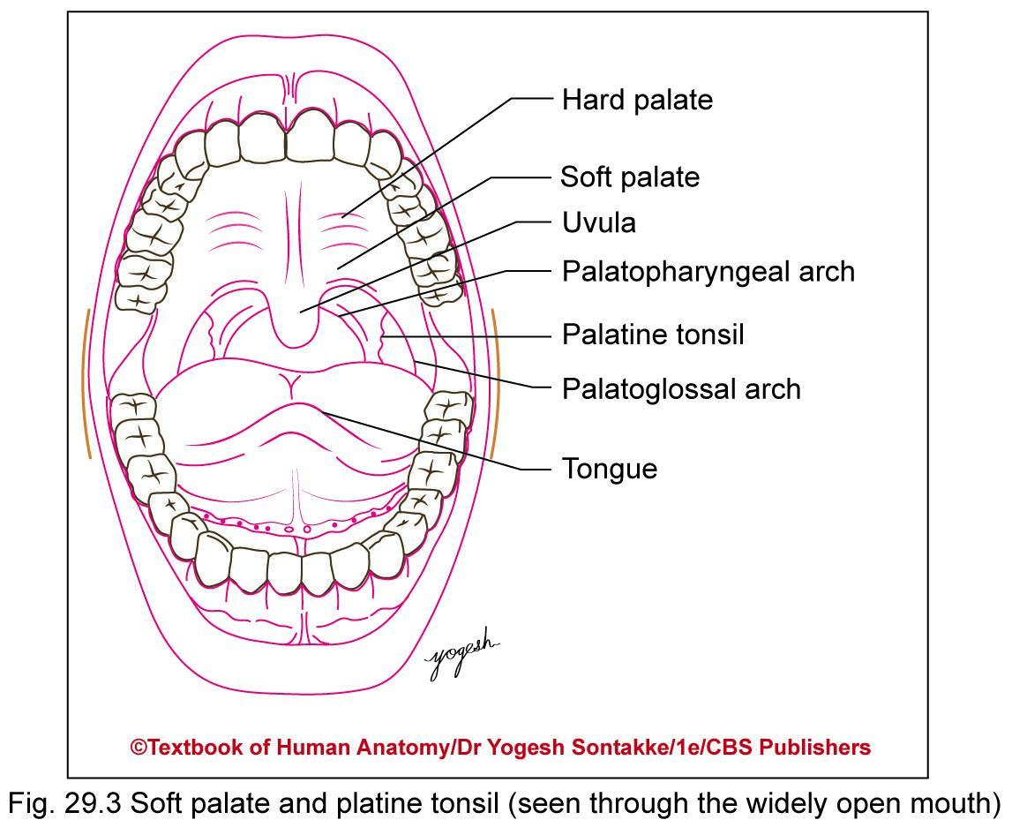
SOFT PALATE
Movable mucomuscular flap, suspended from posterior border of hard palate
Separates nasopharynx from oropharynx

Slide 11
SOFT PALATE
External Features
Has following parts
Two surfaces
Anterior or oral surface: Concave and marked by a median raphe
Posterior surface: Convex and superiorly continuous with floor of nasal cavity

Slide 12
SOFT PALATE
Two borders
Superior border: Attached to posterior border of hard palate
Inferior border: Free, forms anterior boundary of pharyngeal isthmus
Uvula: Midline conical projection hanging down from inferior border

Slide 13
SOFT PALATE
Two mucosal arches: From base of uvula, two mucous folds extend downward on each side
Palatoglossal arch or fold: Anterior fold extends downward and forward from uvula to side of tongue

Slide 14
SOFT PALATE
Contains palatoglossus muscle and forms
Anterior boundary of oropharyngeal isthmus
Anterior boundary of tonsillar fossa
2. Palatopharyngeal arch or fold: It is a posterior fold that extends downward and backward from the uvula to the lateral pharyngeal wall. It contains palatopharyngeus muscle. It forms the posterior boundary of the tonsillar fossa.

Slide 15
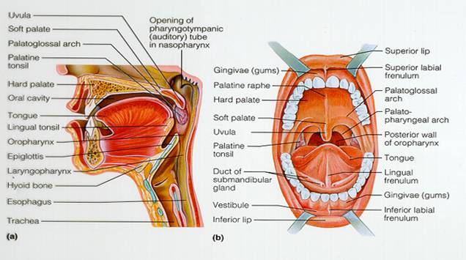

Slide 16
Structure of Soft Palate
Muscles
1. Levator veli palatini
2. and palatopharyngeus lie on superior surface of aponeurosis
3.Palatoglossus lies on anterior surface
4. Musculus uvalae lies within aponeurosis

Slide 17
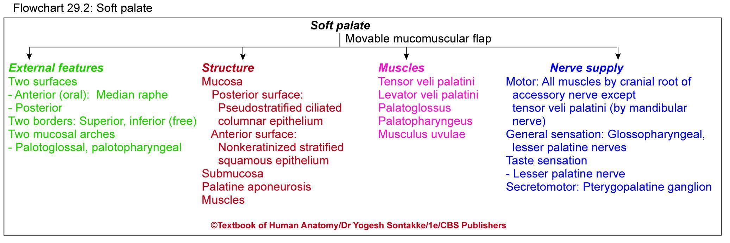

Slide 18
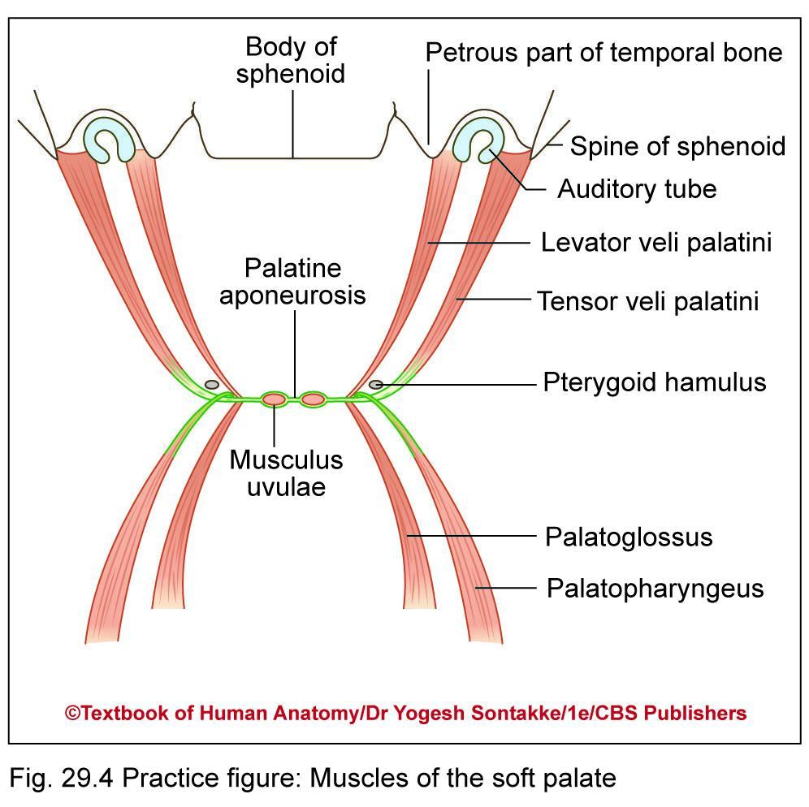
Muscle of Soft Palate
Consists of five pairs of muscles as follows
Tensor veli palatini
Levator veli palatini
Palatoglossus
Palatopharyngeus
Musculus uvulae

Slide 19
Oral Cavity

Slide 20
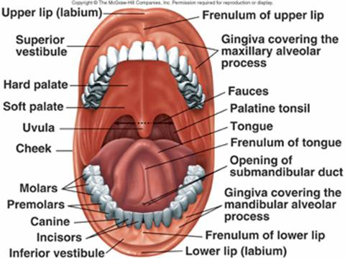

Slide 21
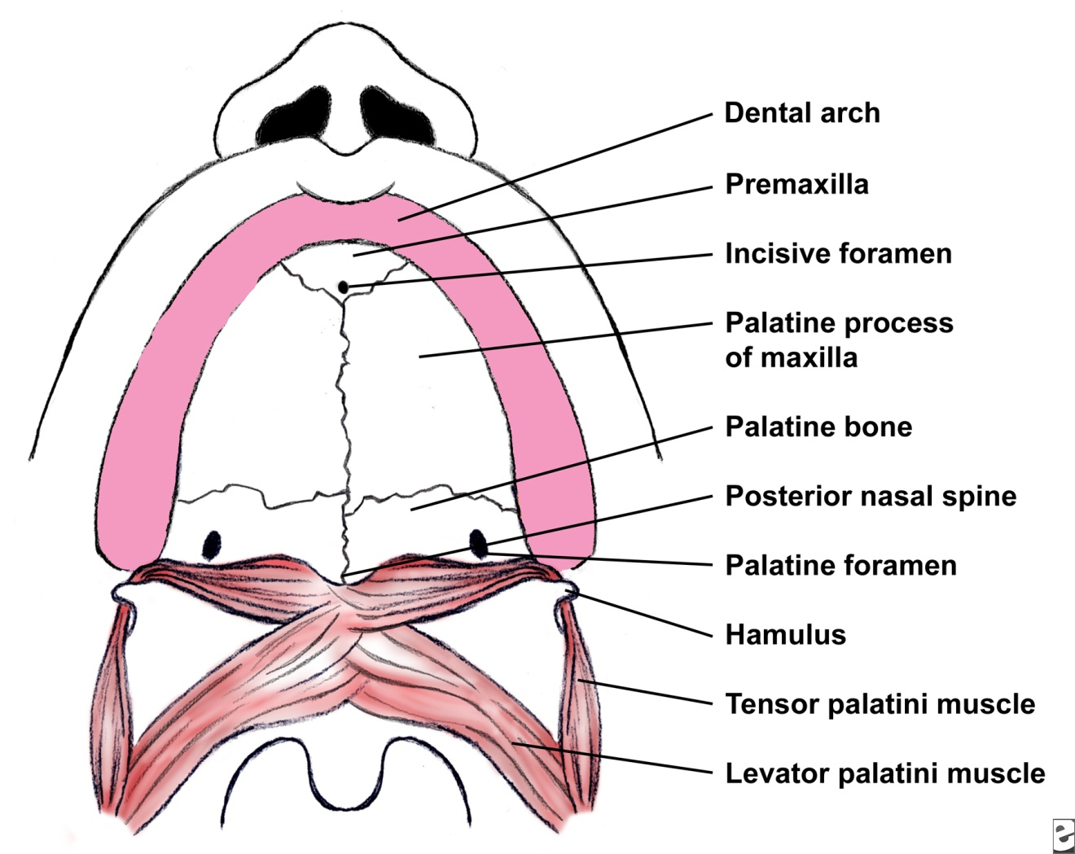

Slide 22
Muscles of soft palate
Muscle | Origin | Insertion | Actions
Tensor veli palatini triangular, thin muscle with round tendon forms palatine aponeurosis | Scaphoid fossa of medial pterygoid plate Lateral aspect of auditory tube Spine of sphenoid | Fibers converge to form round tendon which turns around pterygoid hamulus This tendon flattens to form palatine aponeurosis which is attached to posterior border and inferior surface of hard palate behind palatine crest | Tightens soft palate, mainly in anterior part Depresses palate by tightening ,Opens auditory tube during deglutition and yawning Equalizes air pressure between middle ear and nasopharynx
Levator veli palatini Cylindrical muscle | Inferior surface of petrous part of temporal bone near carotid canal Medial aspect of auditory tube | Fibers pass downward and medially through sinus of Morgagni Fibers spread out and get inserted into posterior (upper) surface soft palate and interdigitate with contralateral muscle in Midline | Elevation of posterior part of soft palate to close pharyngeal isthmus Slight opening of auditory tube
Palatoglossus | Oral surface of palatine aponeurosis | Muscle passes downward and forward into the palatoglossal arch ,inserted on side of tongue in front of sulcus terminalis | Elevates base of tongue Closes oropharyngeal isthmus

Slide 23
Muscles of soft palate
Muscle | Origin | Insertion | Actions
Palatopharyngeus Consists of two fasciculi separated by levator veli palatini | Anterior fasciculus: From posterior border of hard palate Posterior fasciculus: From palatine aponeurosis | Both fasciculi join posteriorly to form single muscle, passes backward to form palatopharyngeal arch Most of fibers insert on posterior border of lamina of thyroid cartilage Some fibers inserted into median pharyngeal raphe | Elevates larynx and pharynx Closes pharyngeal isthmus by opposing palate pharyngeal arches
Musculus uvulae Longitudinal muscle Help to close nasopharynx | Posterior nasal spine Palatine aponeurosis | Mucous membrane of uvula | Retract uvula

Slide 24
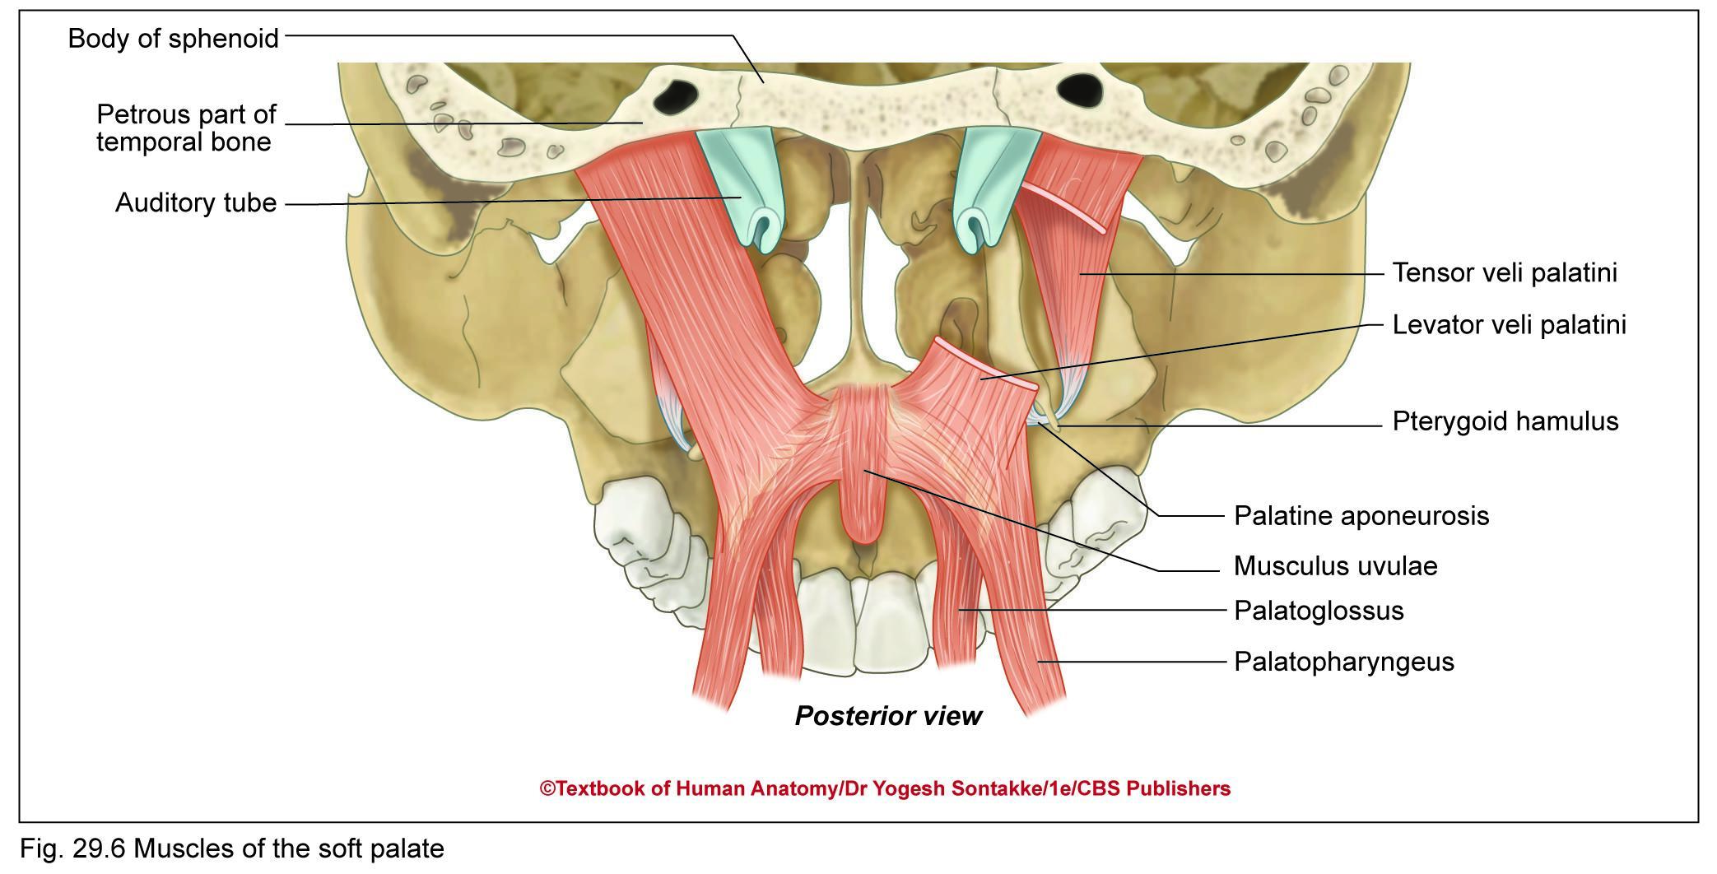

Slide 25
Nerve Supply
Motor supply: All muscles of soft palate are supplied by cranial root of accessory nerve (through pharyngeal plexus) except tensor veli palatini, which – supplied by mandibular nerve (through nerve to medial pterygoid muscle)
Sensory supply
General sensation – carried by
  Lesser palatine nerves (to the maxillary nerve)

Slide 26
Nerve Supply
  Glossopharyngeal nerve
Taste sensation – carried by lesser palatine nerves  pterygopalatine ganglion (without relay)  nerve to pterygoid canal  greater petrosal nerve  pseudounipolar neurons of geniculate ganglion  nervus intermedius of facial nerve  nucleus tractus solitarius
Secretomotor fibers: Parasympathetic fibers of pterygopalatine ganglion

Slide 27
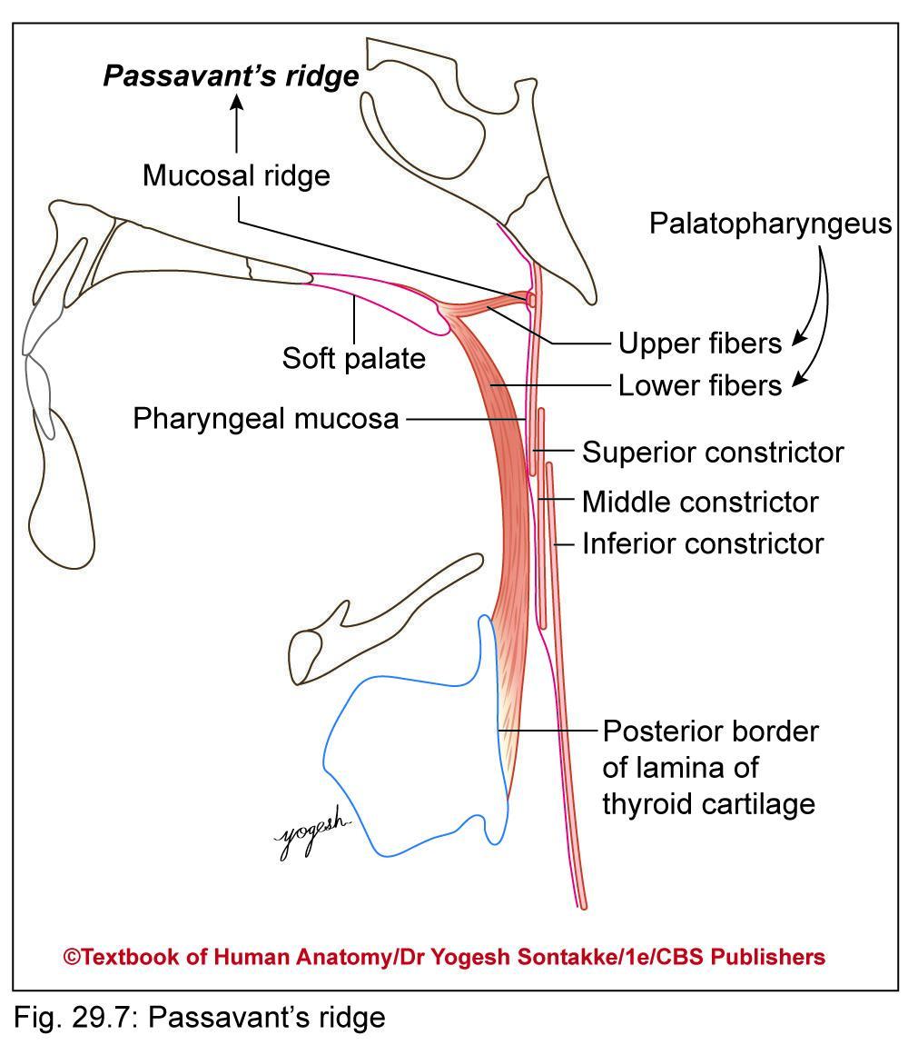
Passavant’s ridge
Formation: Some of upper fibers of palatopharyngeus (form Passavant’s muscle), pass circularly deep to mucous of pharynx to form sphincter on inner surface of superior constrictor
These fibers produce C-shaped mucosal ridge called Passavant’s ridge

Slide 28
Passavant’s ridge
Function
Contraction of Passavant’s muscle raises Passavant’s ridge and elevated soft palate comes in contact with this ridge to close pharyngeal isthmus

Slide 29
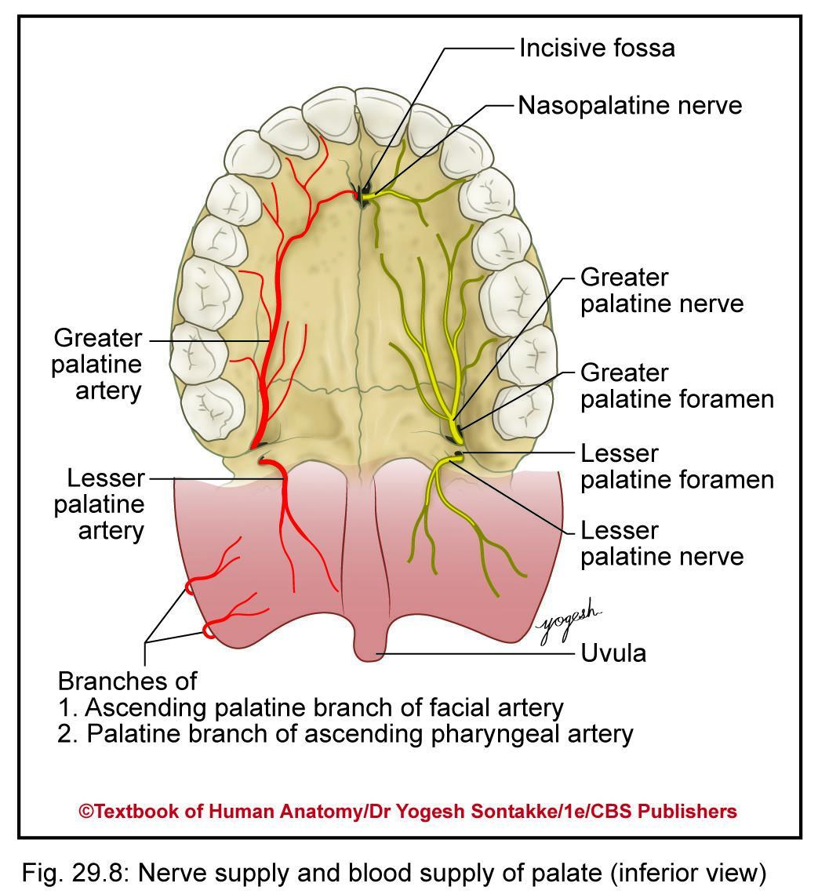
Blood Supply
Arterial supply
Greater and lesser palatine branches of maxillary artery
Ascending palatine branch of facial artery
Palatine branches of ascending pharyngeal artery

Slide 30
Blood Supply and Lymphatic Drainage
Veinous drainage
From soft palate drain into
  Pharyngeal venous plexus
  Pterygoid venous plexus
Lymphatic drainage
From soft palate drain into
  Retropharyngeal nodes
  Upper deep cervical nodes

Slide 31
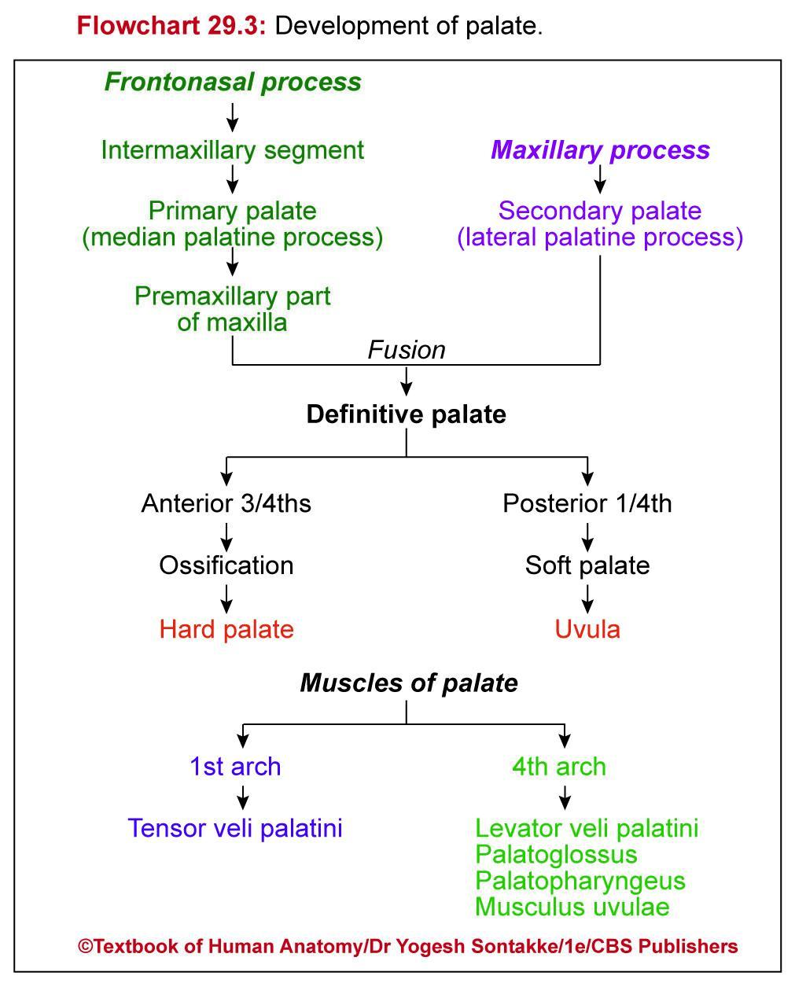

Slide 32
Cleft palate
Embryological basis
Nonfusion of median and lateral palatine processes, and nasal septum results in cleft palate
Unilateral complete cleft palate: Results due to nonfusion of one lateral palatine process of maxilla with median palatine process of premaxilla and also nonfusion of two lateral palatine processes
Always associated with harelip on same side of defect
Bilateral complete cleft palate: Results due to nonfusion of both lateral palatine process of maxilla and median palatine process of premaxilla
Incomplete cleft palate may be cleft of hard and soft palate or only cleft of soft palate or uvula
Treatment: Cleft palate can be corrected surgically

Slide 33
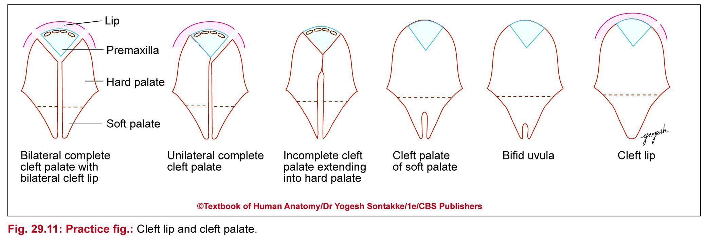

Slide 34
CLEFT PALATE

Slide 35
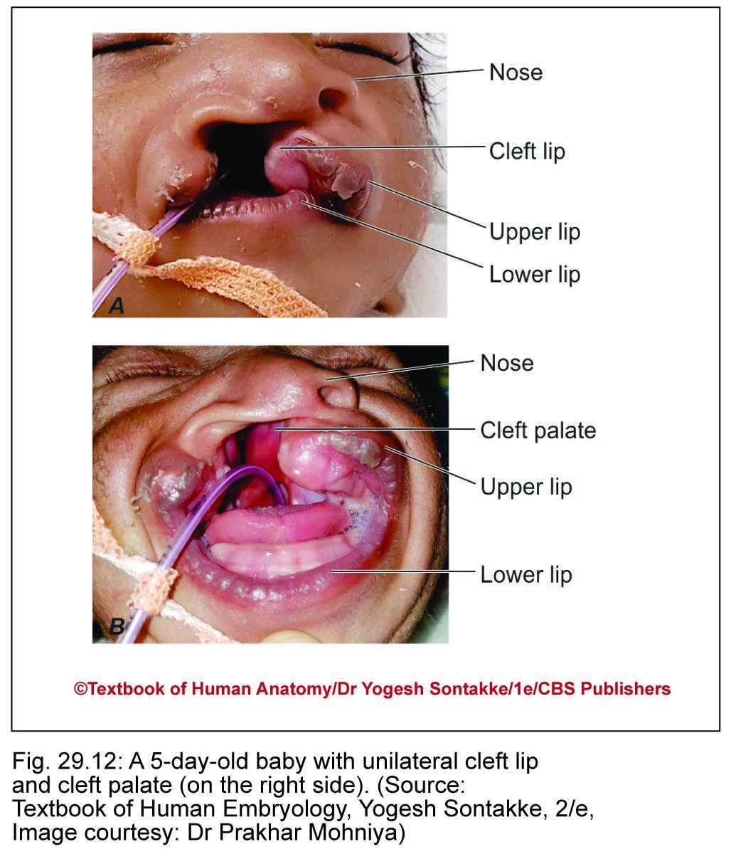

Slide 36
CLEFT PALATE

Slide 37
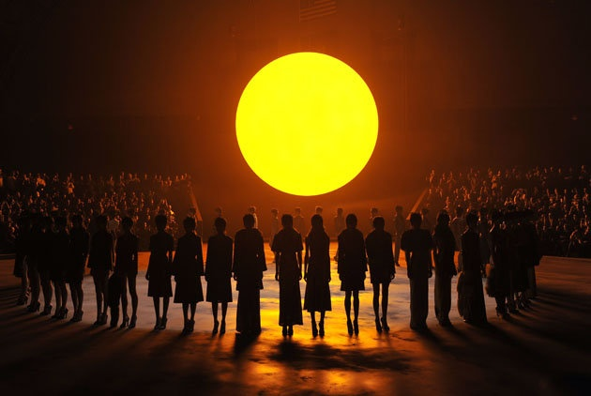
THANK YOU

Slide 38
THE TONSIL
(PALATINE TONSIL)

Slide 46
THANK YOU

Slide 47
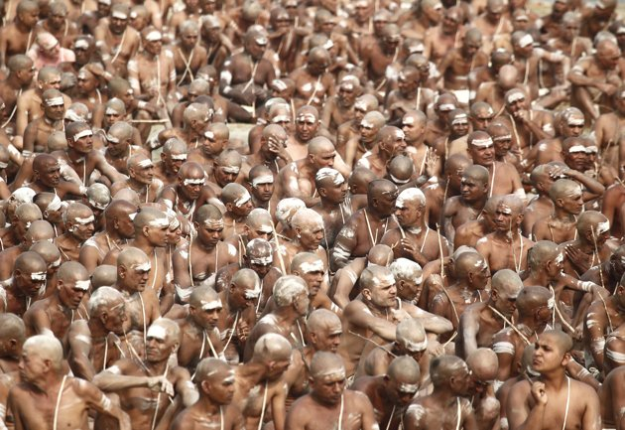
KUMBH SNAN

