Slide 1
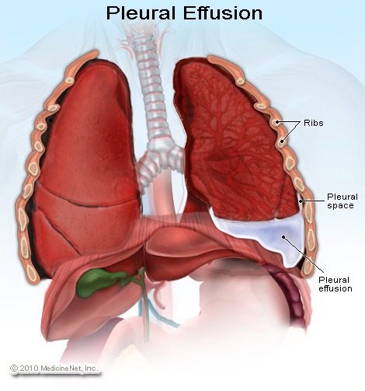
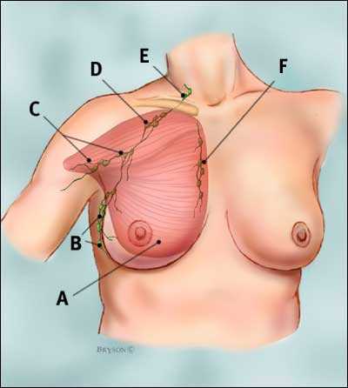
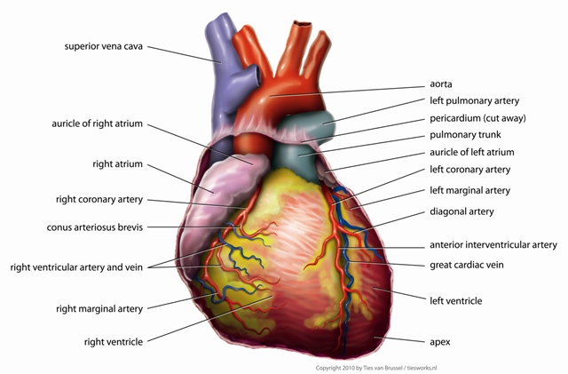
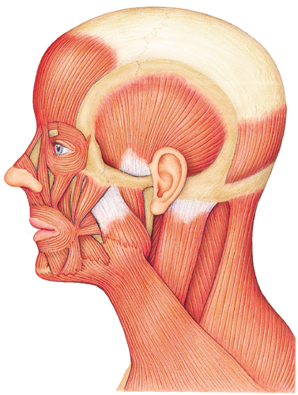
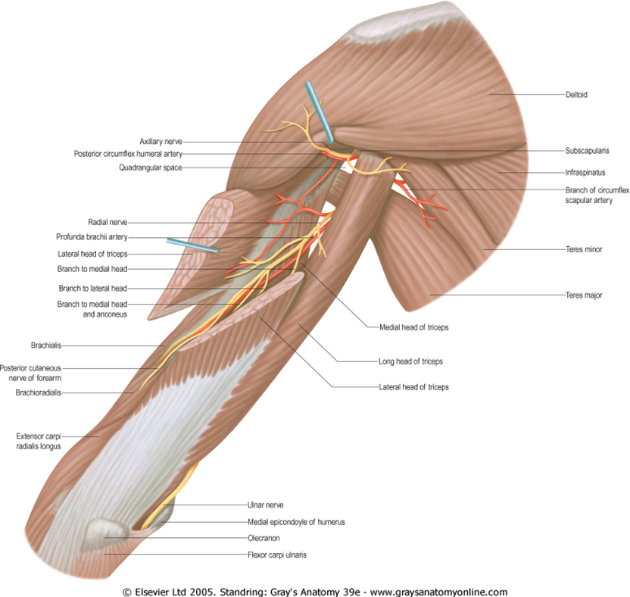
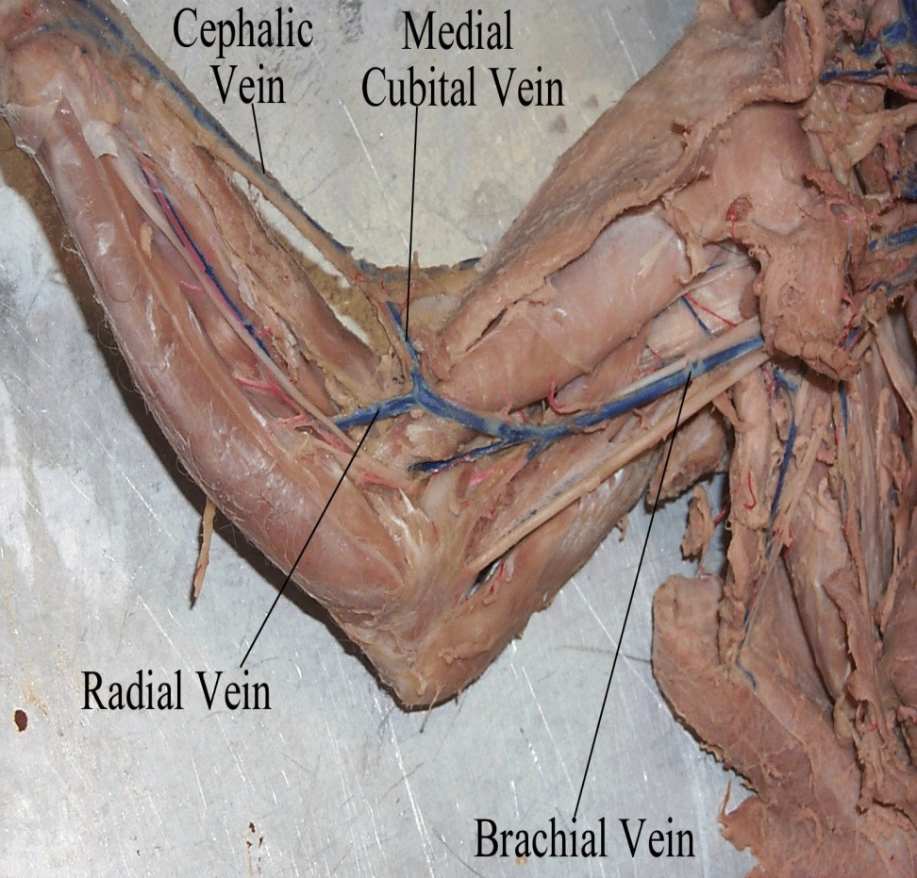
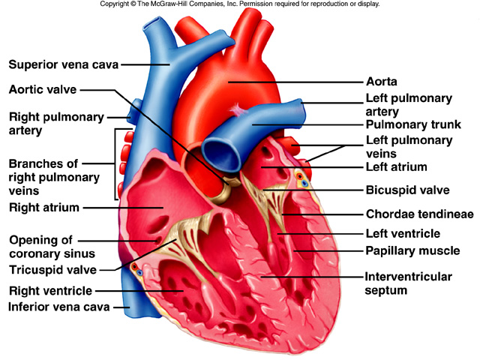
GROSS ANATOMY
FACE
DR. PRAVEEN KURREY ASSOCIATE PROFESSOR
DEPT. OF ANATOMY PT. J.N.M.M.C. RAIPUR

Slide 2
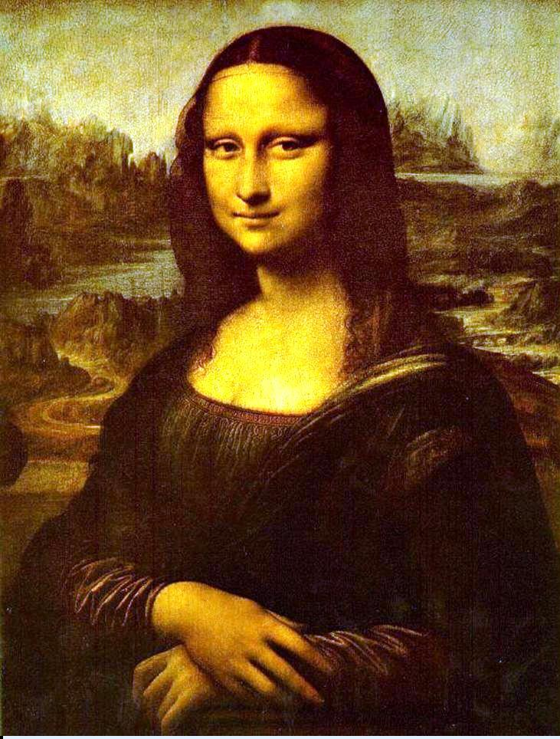
FACE – Symbol of Your Inner Heart

Slide 3
Face
Boundaries
Extends superiorly to the hair line, inferiorly to the chin and base of mandible, and on each side to auricle
Forehead is common to both scalp and face

Slide 4
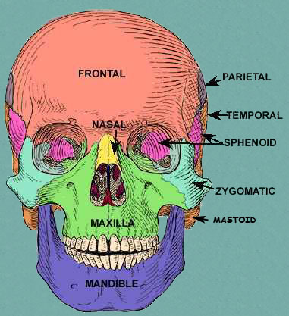

Slide 5
Skin
Very vascular
Due to rich vascularity face blush and blanch
Wounds of face bleed profusely but heal rapidly
Results of plastic surgery are excellent on face
Facial skin is rich in sebaceous gland and sweat gland
Sebaceous gland keep the skin oily but also cause acne in adult
Sweat gland regulate body temperature

Slide 6
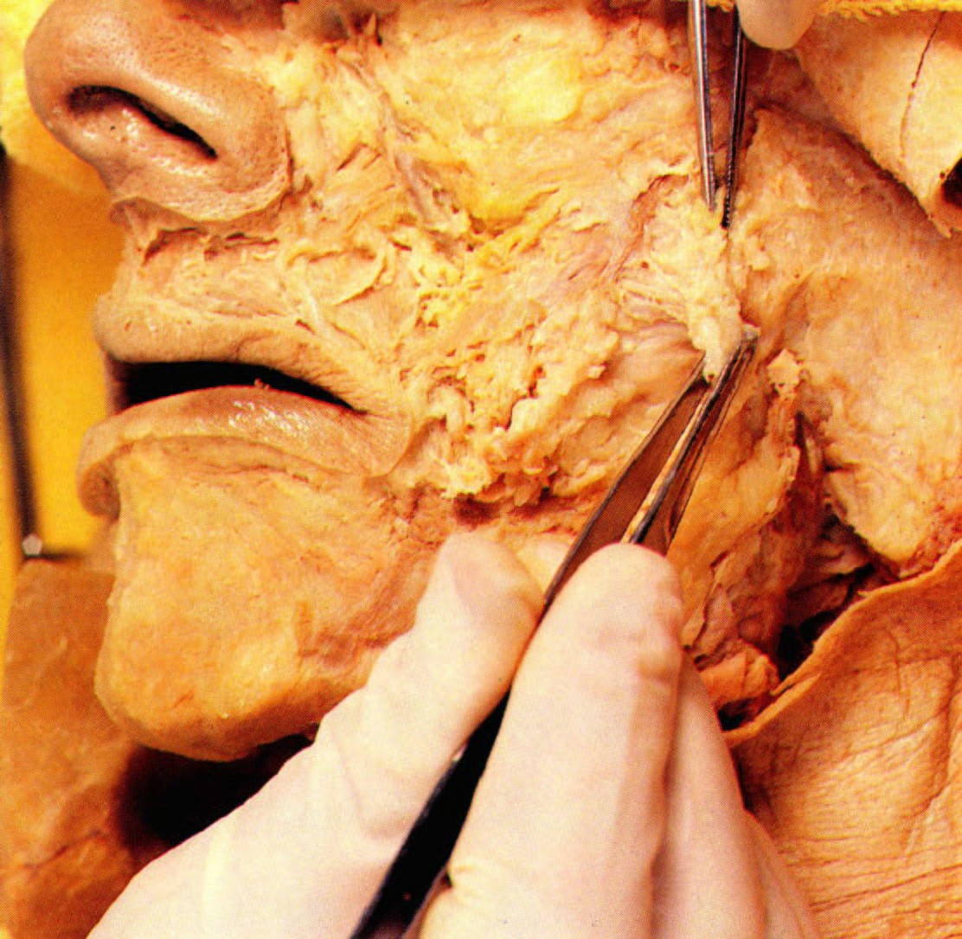
Superficial Fascia of the Face
Superficial fascia is copious and loose – however, there is no discrete layer of deep fascia of the face except …

Slide 7
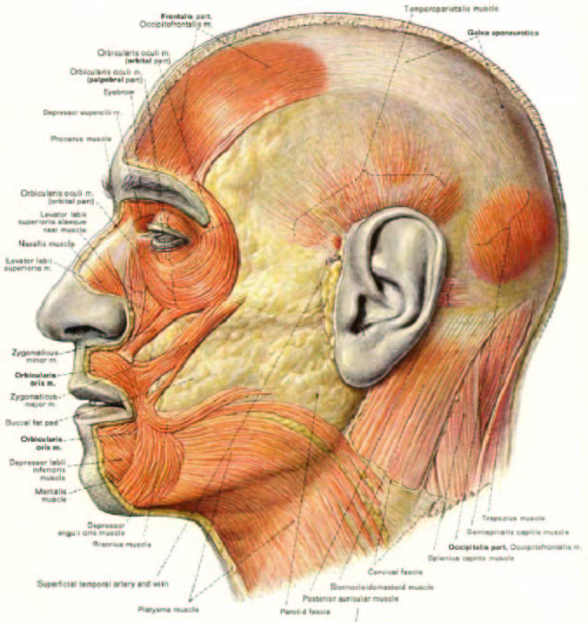
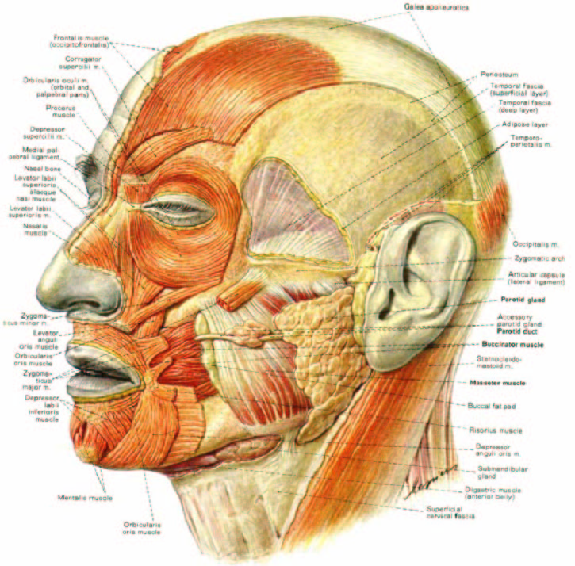
Buccal fat pad & Buccinator muscle

Slide 8
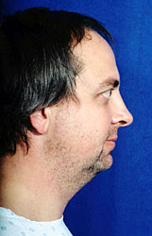
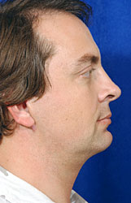
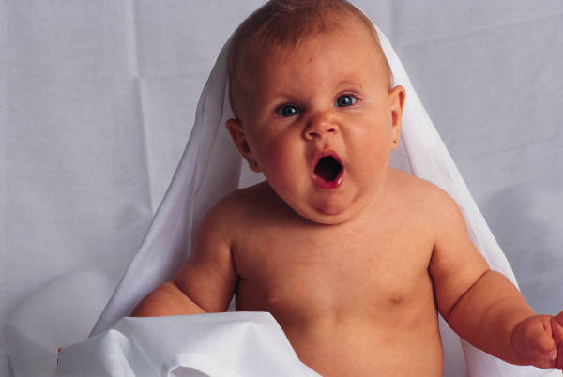
Buccal fat pad
Before
After
Buccal pad reduction

Slide 9
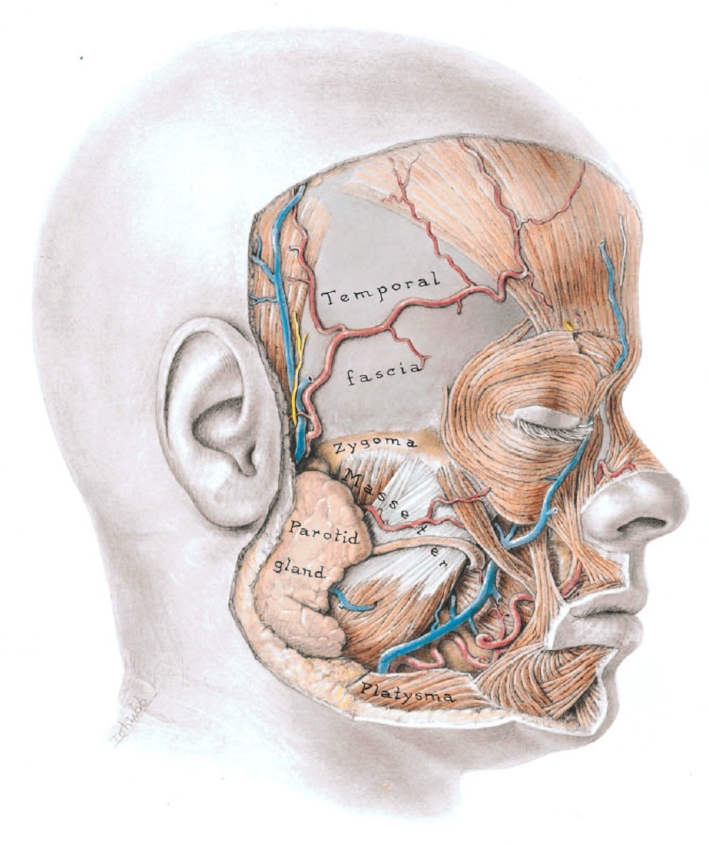
DEEP FASCIA
Deep fascia is absent in the face except -- parotid glands and the masseter muscles. It forms capsules around these structures. –Parotidomasseteric fascia
The other regions of the face have much subcutaneous tissue, but no deep fascia.

Slide 10
Facial muscle
Called muscle of facial expression and lie in superficial fascia
Embryologically they develop from mesoderm of 2nd branchial arch, therefore supplied by facial nerve

Slide 11
MUSCLES OF FACE
A. MUSCLES OF SCALP – Occipitofrontalis
MUSCLES AROUND EAR
Auricularis anterior
Auricularis Posterior
Auricularis superior
MUSCLES AROUND ORBIT
Orbicularis Occuli
Levator palpebrae superioris
Corrugator supercilli

Slide 12
MUSCLES AROUND MOUTH
  Orbicularis oris
  Levator labii superioris
  Zygomaticus
  Risorius
  Depressor anguli oris
  Levator anguli oris
  Depressor labii inferioris
  Buccinator
  Mentalis

Slide 13
Orbicularis oculi
3 parts-
Orbital part
  Originate from medial part of medial palpebral ligament and form concentric rings, return to point of origin
Action –closes the lids tightly
Palpebral part
  Originate from lateral part of medial palpebral ligament
  Insert into lateral palpebral raphe
Action-closes the lids gently
Lacrimal part
  Originate from lacrimal fascia& lacrimal bone
  Insert into upper &lower tarsi
Action-dilate lacrimal sac

Slide 14
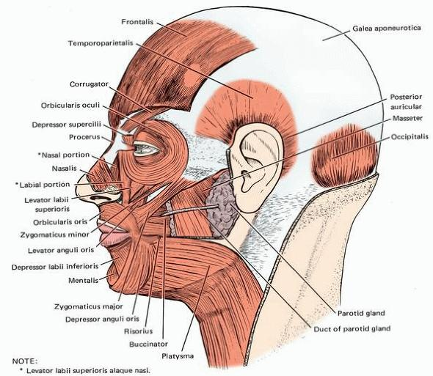

Slide 15
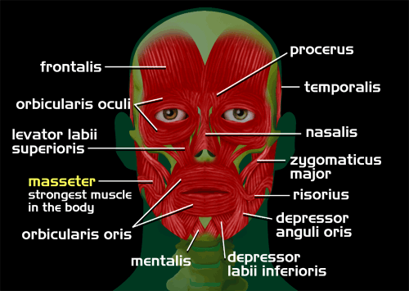

Slide 16
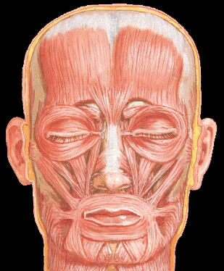
Orbicularis oris
Levator labii superioris
Zygomaticus
Risorius
Depressor anguli oris

Slide 17
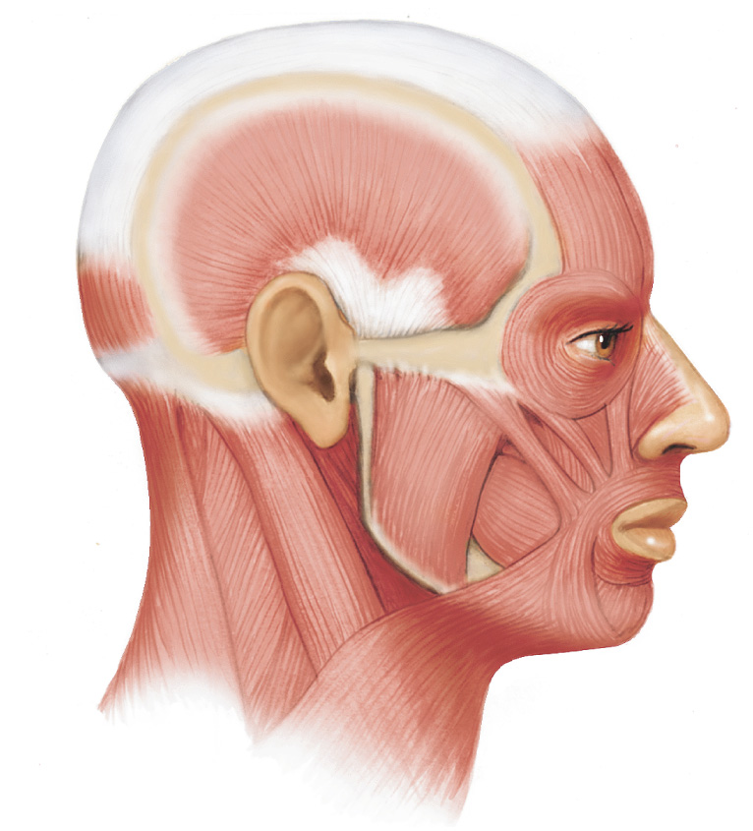
Fig. 9.25a
Muscles of Facial Expression
Frontalis
Epicranial
aponeurosis
Epicranius
Occipitalis
Orbicularis oculi
Zygomaticus
major
Zygomaticus
minor
Orbicularis oris
Buccinator
Platysma
Copyright © The McGraw-Hill Companies, Inc. Permission required for reproduction or display.

Slide 18
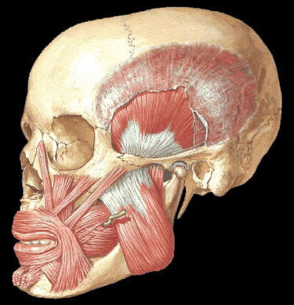
Levator anguli oris
Depressor labii inferioris

Slide 19
Buccinator
Mentalis

Slide 20
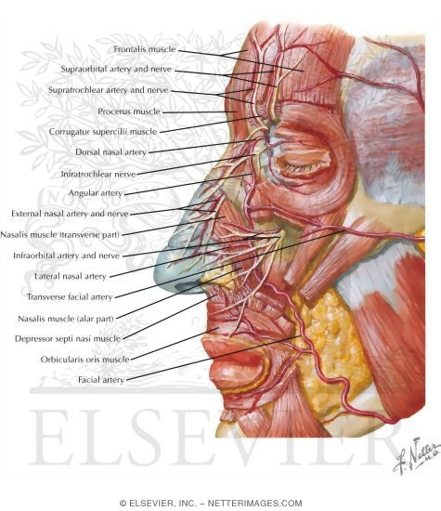

Slide 21
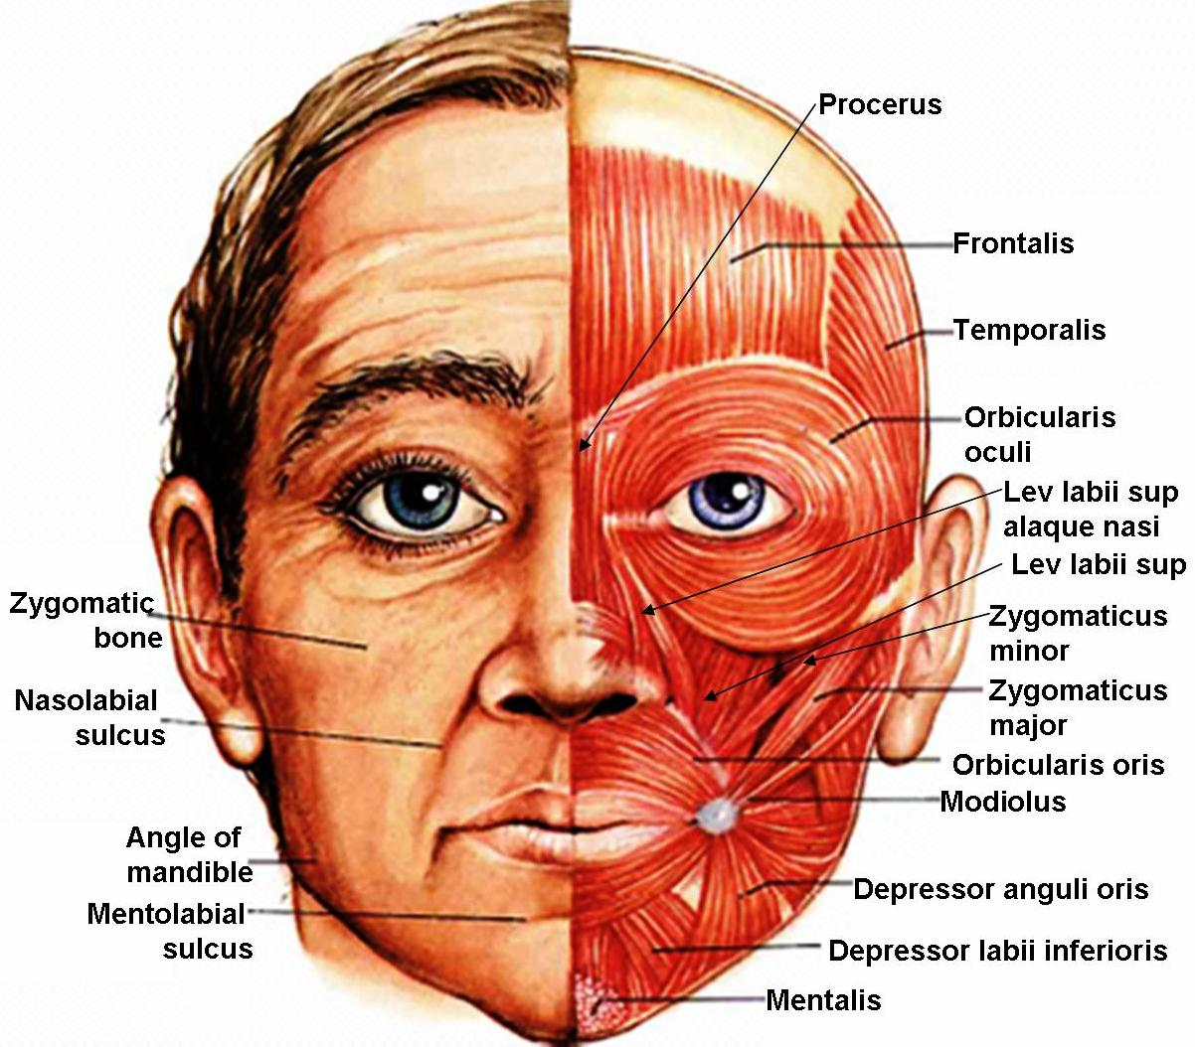

Slide 23
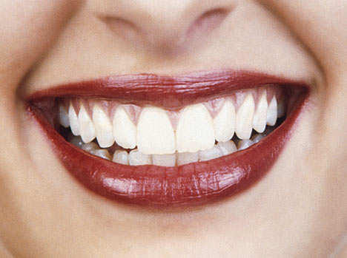
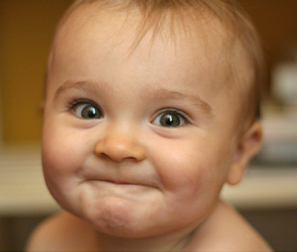
Laughing & Smiling Muscle

Slide 24

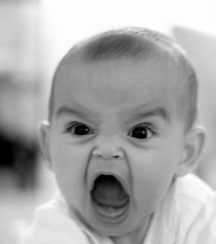
Anger

Slide 25
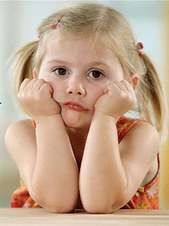
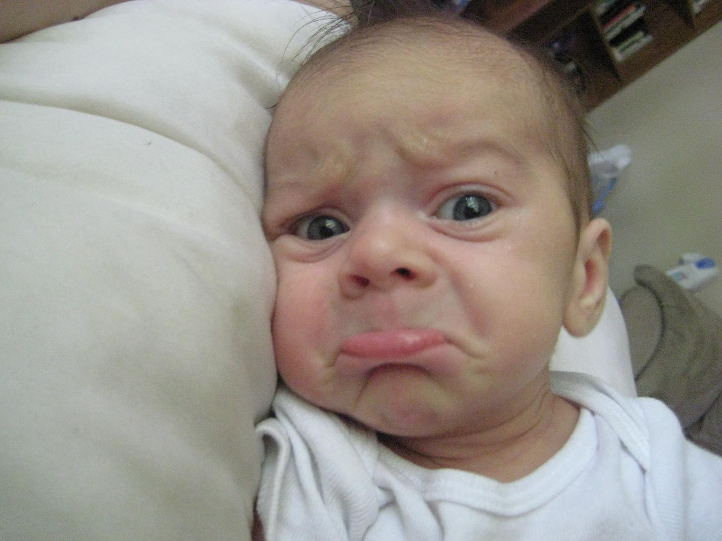
Sadness

Slide 26
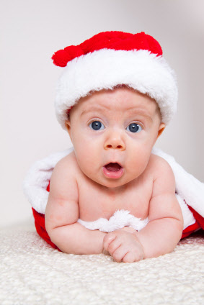
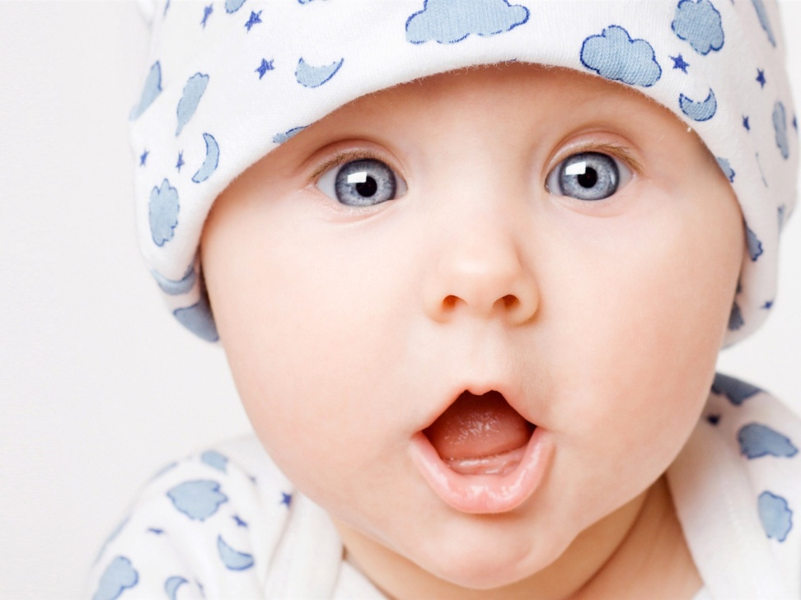
Surprise

Slide 27
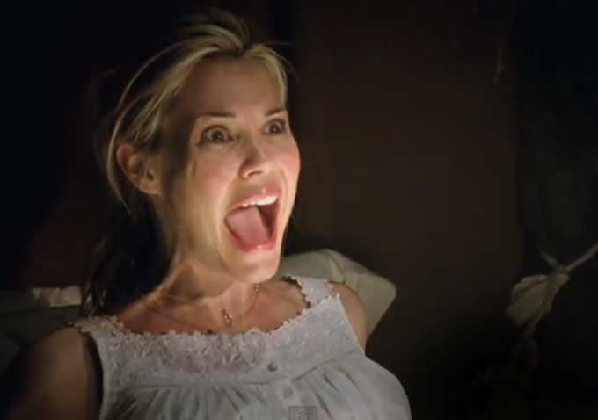
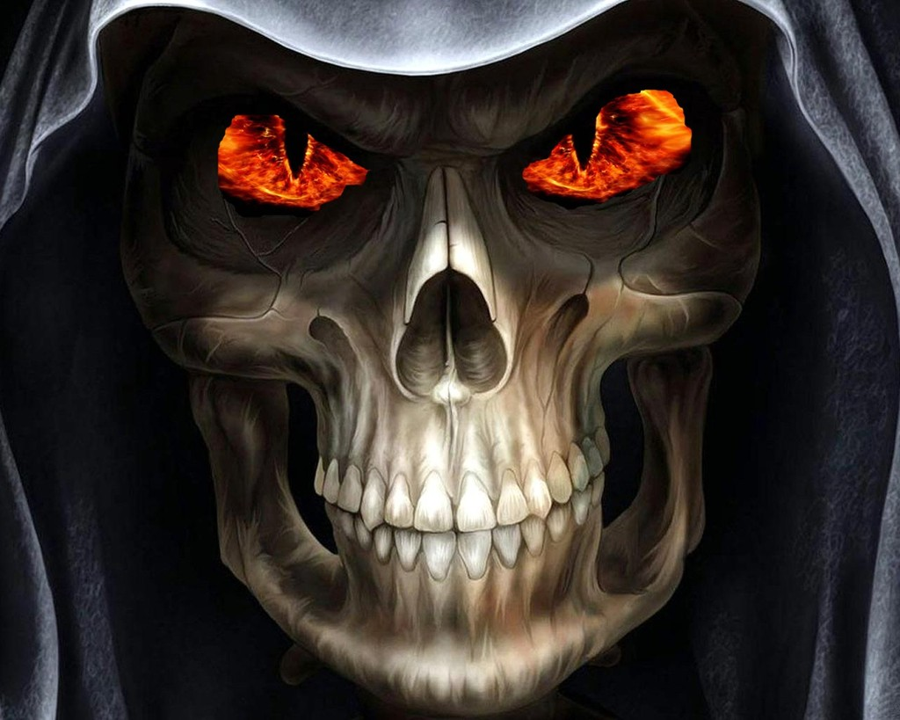
Horror, Terror

Slide 28
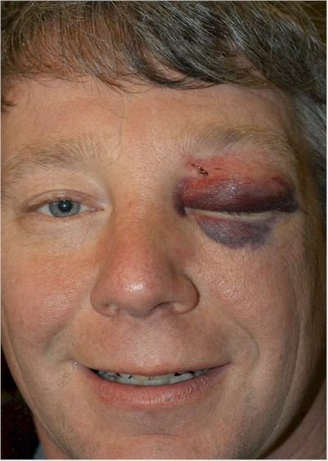
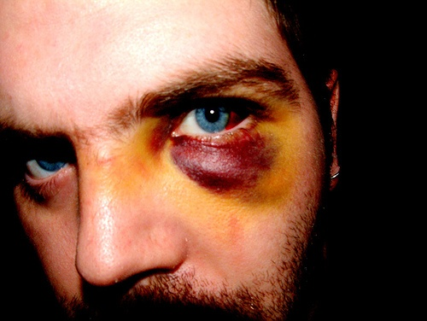
Black eye

Slide 29

Continued -- PART 2

Slide 30
NERVE SUPPLY OF FACE
MOTOR -- Facial nerve – 5 Branches
1. Temporal
2. Zygomatic
3. Buccal
4. Marginal Mandibular
5. Cervical
SENSORY -- Trigeminal nerve and its 3 branches
1. Ophthalmic
2. Maxillary
3. Mandiular

Slide 31
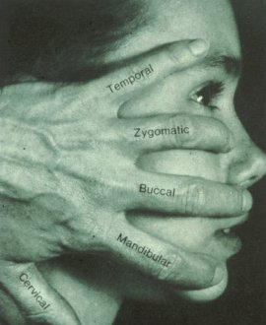
Facial Nerve
MOB TCD
Stroke
Upper motor neurone of facial
Forehead is spared
Can wrinkle forehead
Bilaterally innervated
All muscles of one side paralysed if it is a lower motor neurone e.g. Bell’s palsy

Slide 32
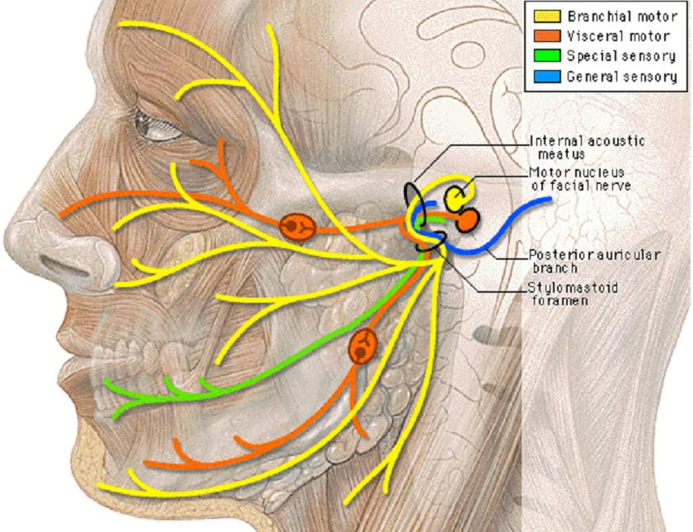
FACIAL NERVE – 5 BRANCHES

Slide 33
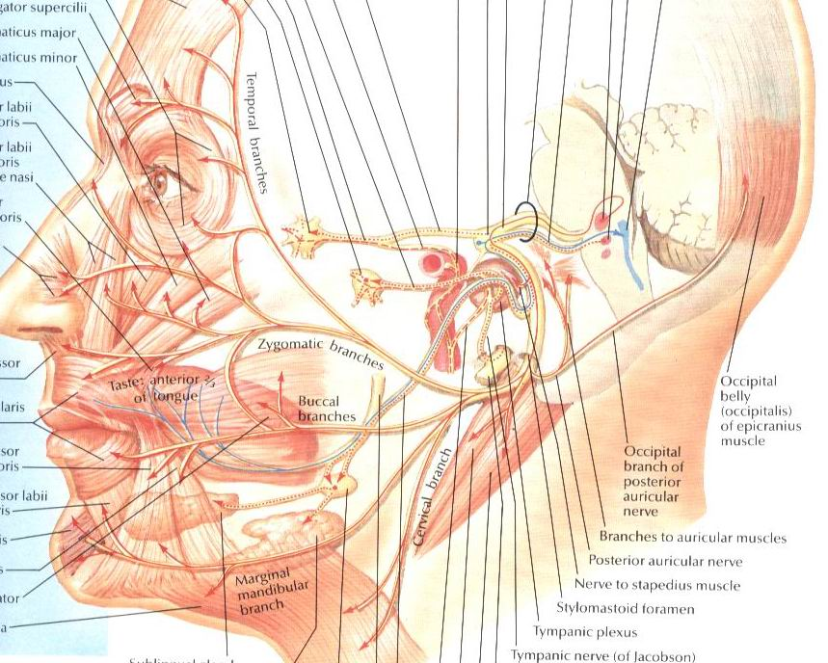

Slide 34
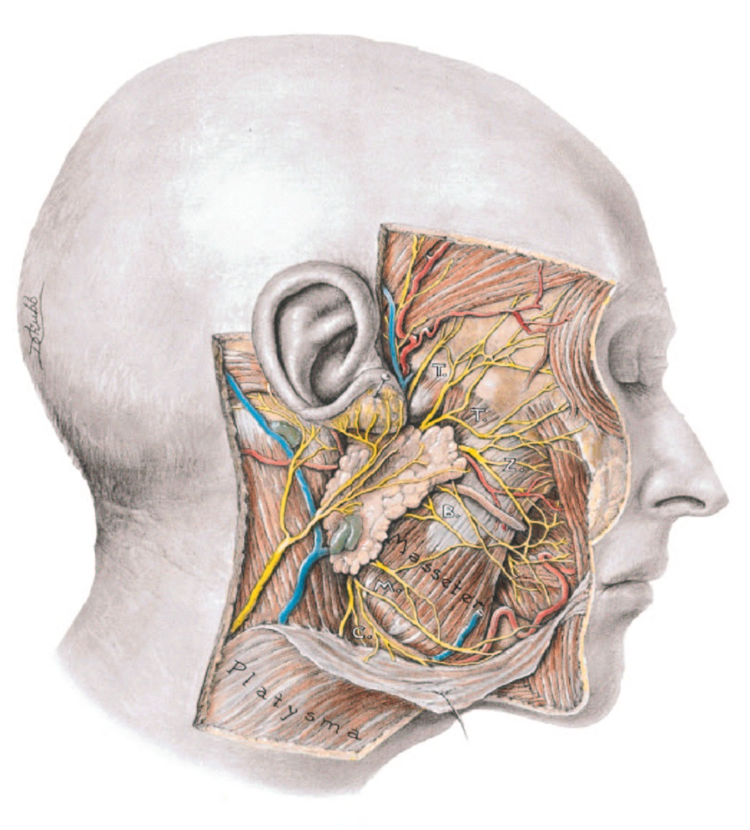
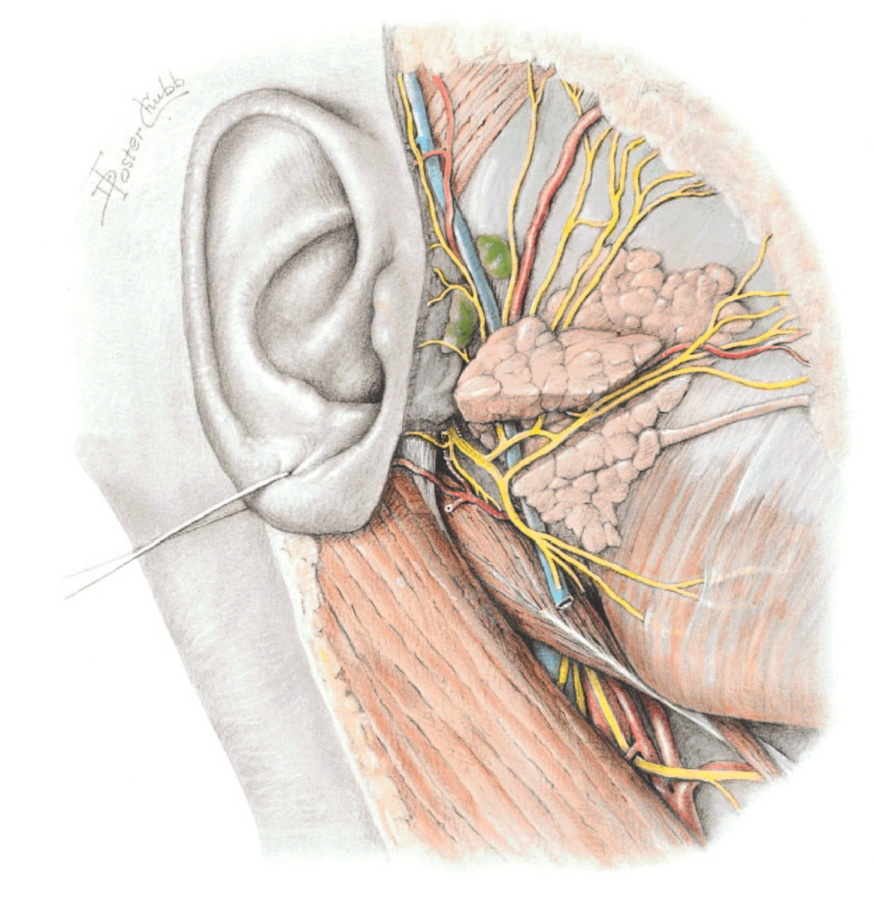
Parotid Gland: Relationship to the facial nerve

Slide 35
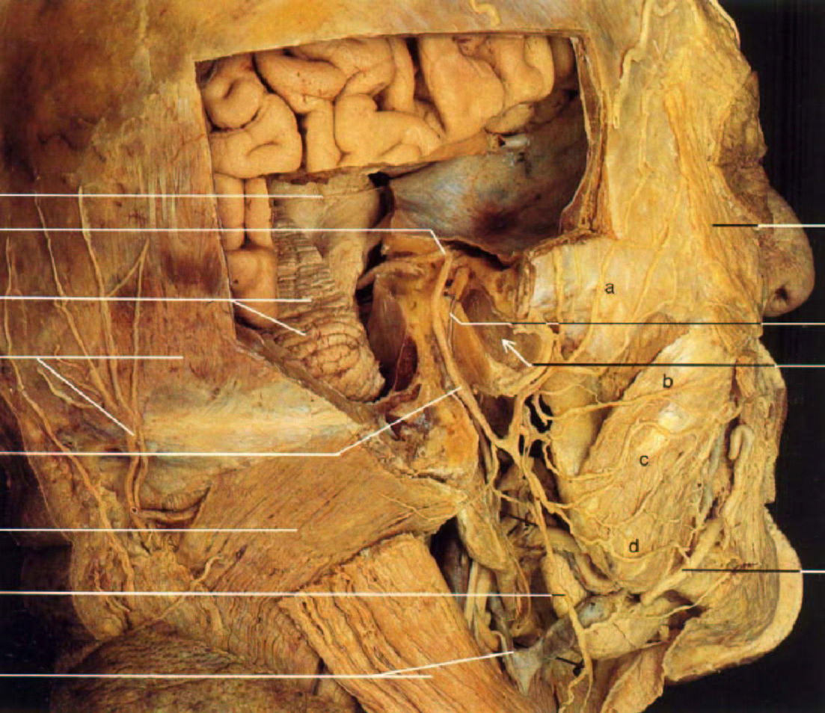
Facial nerve: Deep and superficial course

Slide 36
SENSORY SUPPLY OF FACE
Ophthalmic division
    Supratrochlear
    Supraorbital
    Lacrimal
    Infratrochlear
    External nasal
Maxillary nerve
    Infraorbital
    Zygomaticofacial
    zygomaticotemporal
Mandibular nerve
    Auriculotemporal
    Buccal nerve
    Mental

Slide 37

Ophthalmic nerve
Supraorbital & supratrochlear nerves…...forehead & upper eyelid.
Lacrimal nerve…lateral part of upper eyelid
Infratrochlear nerve…lower eyelid .
External nasal…nose till the tip .

Slide 38

Maxillary nerve
Infraorbital….palpebral & nasal &labial .
Zygomaticofacial….skin over zygomatic bone .
Zygomaticotemporal….skin of temple.

Slide 39

Mandibular nerve
Mental……lower lip&chin
Buccal….skin over buccinator .
Auriculotemporal…skin over auricle&temple .

Slide 40
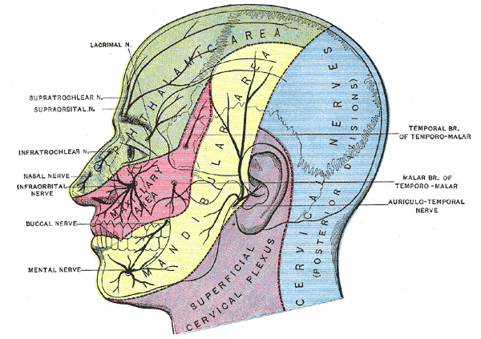

Slide 41
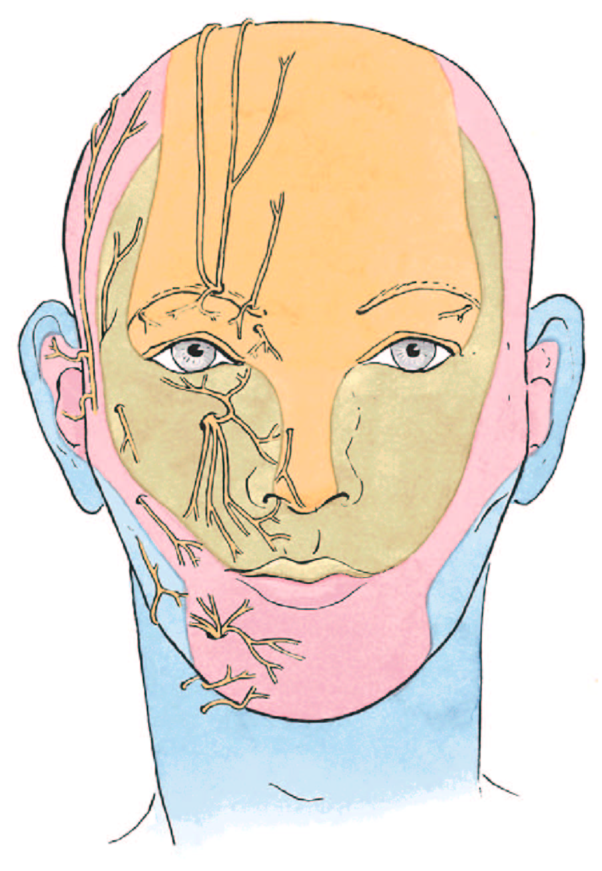
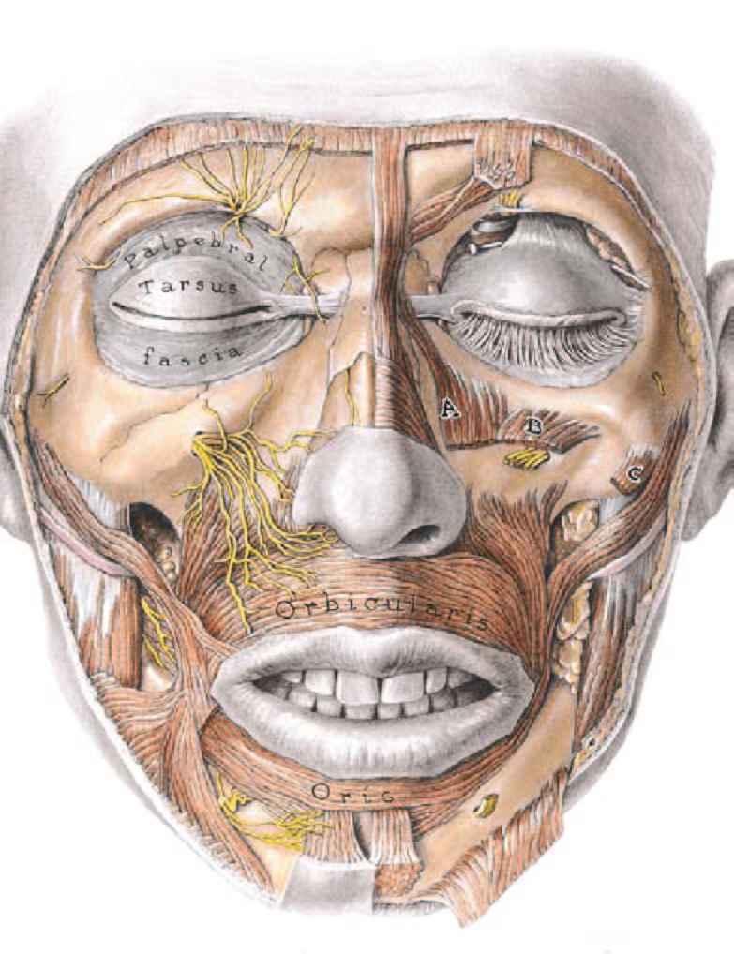
Cutaneous innervation of the face

Slide 42
PART -- III

Slide 43
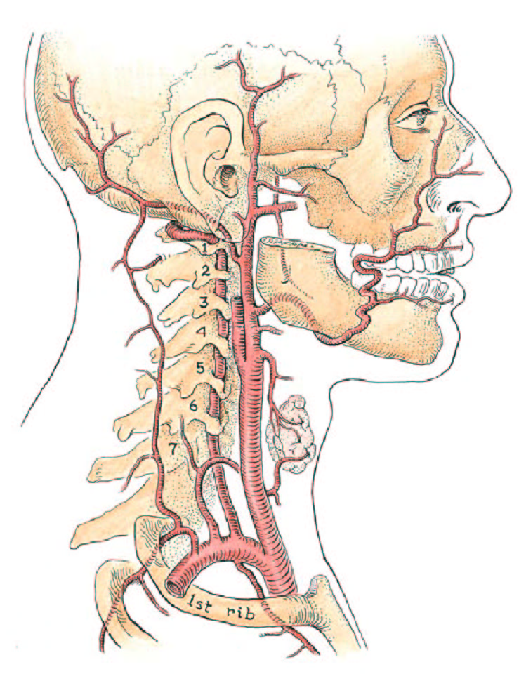

Blood supply to the face
Facial artery
Transverse facial a. (from the superficial temporal a.)

Slide 44
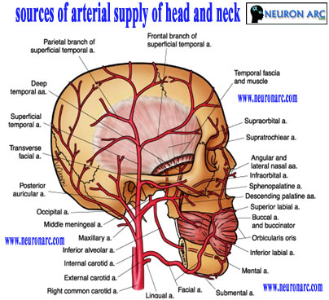

Slide 45
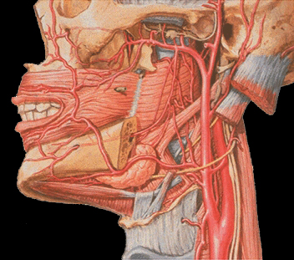
Facial Artery
Angular a.
Lateral nasal a.
Superior labial a.
Inferior labial a.
External carotid a.

Slide 46
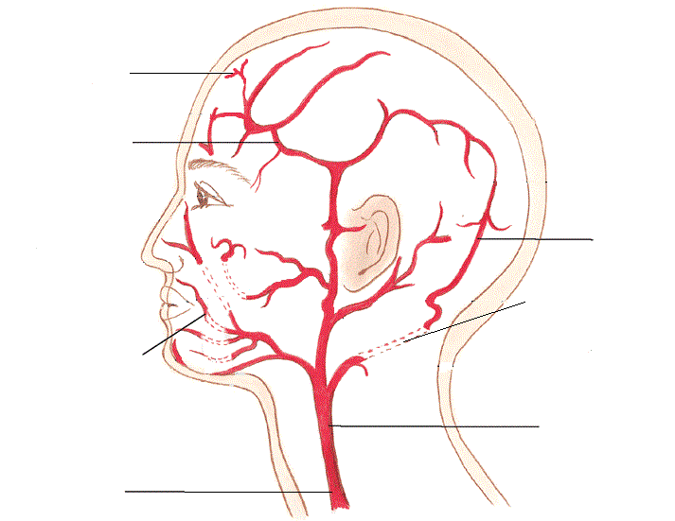
Blood flow to the face
Small arteries to the hair follicles
Temporal branch
Occipital branch
Internal carotid artery
Facial branch
External carotid artery
Common carotid artery

Slide 47

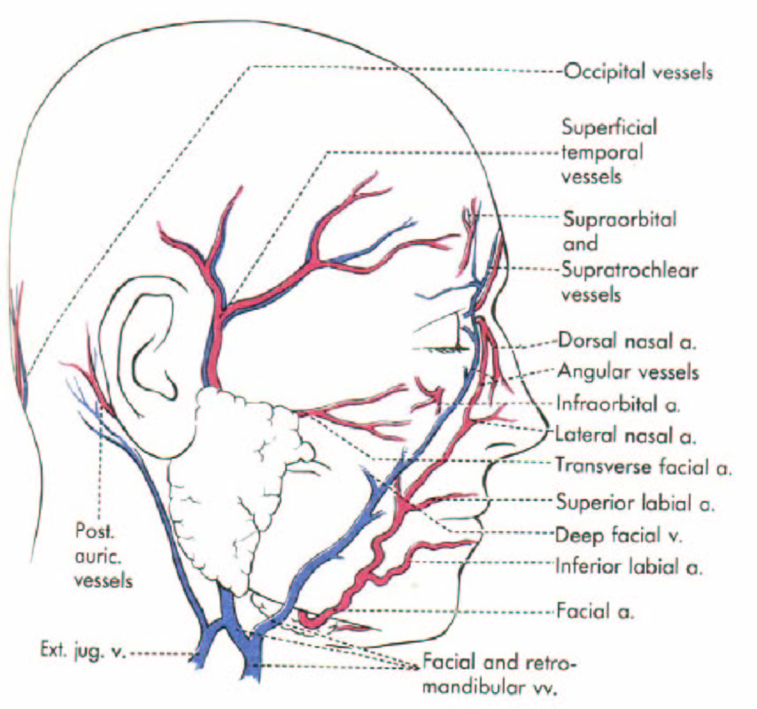
Venous drainage of the face
Facial vein = A tributary of the internal jugular vein

Slide 48
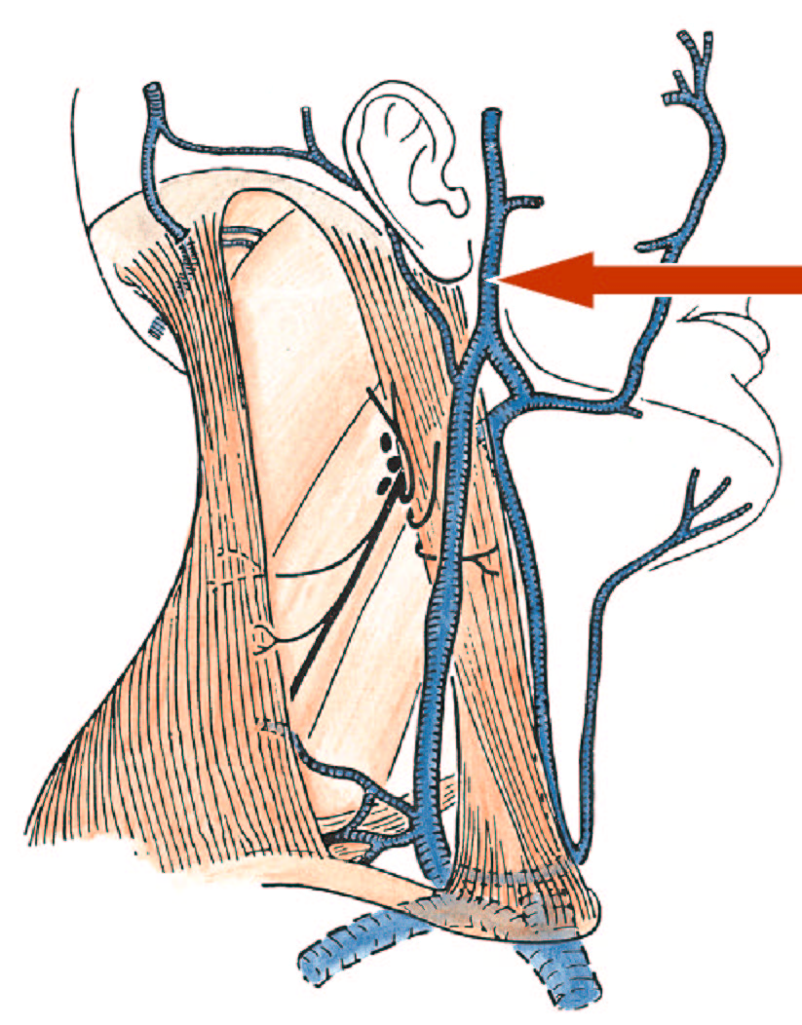
Superficial temporal vein
Maxillary vein
Retromandibular vein
Posterior division
Anterior division
Joins facial v. to form common facial v. → A tributary of the internal jugular v.
Joins posterior auricular v. to form external jugular v.

Slide 49
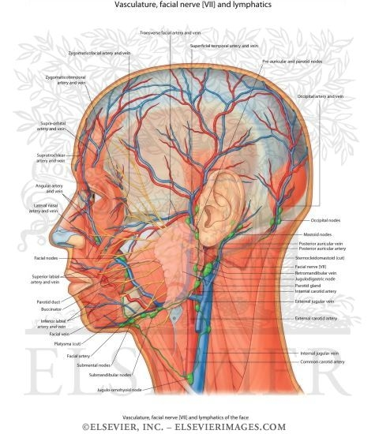

Slide 50

Lymphatic drainage of the face/scalp
Vessels carrying lymph from the face pass through nodes arranged like a “collar” around the base of the head.
Occipital
Retro-auricular (Mastoid)
Parotid
Submandibular
Submental

Slide 51

Lymphatic drainage
3 territories-
Upper territories- greater part of forehead, lateral ½ of eye lid, conjunctiva, lateral part of cheek and parotid area– preauricular lymph node (parotid)
Middle territories- median part of forehead, external nose, upper lip, lateral part of lower lip, medial ½ of eye lid, medial part of cheek, greater part of lower jaw– submandibular lymph node
Lower territories- central part of lower lip, chin– sub mental lymph node

Slide 52
APPLIED ANATOMY
Trigeminal neuralgia
  Maxillary and mandibular nerve are involved
  Excruciating pain in the region of distribution of these nerve
In infranuclear lesions of facial nerve (eg, bell’s palsy)- whole face is paralyzed
  c/f
    Affected side is motionless
    Loss of wrinkles
    Eye cannot be closed
    In smiling the mouth is drawn to normal side
    During mastication food accumulates in vestibule of mouth
In supranuclear lesions of facial nerve only the lower part of face is paralyzed. The upper part (frontalis &part of orbicularis oculi) escapes due to its bilateral innervation

Slide 53
Idiopathic facial palsy (Bell's Palsy)
Most common cause of facial paralysis (>50% of case)
Most age 25-30 yrs.
Male : Female = 1 : 1
Left side : Right side = 1 : 1
Unilateral > bilateral
Increase risk in
  pregnancy 3.3 times
  DM 4.5 times
Recurrent rate 10%
60% have previous URI

Slide 54
Etiology
Unknown
  Microcirculatory failure of vasa nervorum
  Viral infection (HSV)
  Ischemic neuropathy
  Autoimmune reaction
Entrapment theory

Slide 55
INFRANUCLEAR LESION OF FACIAL NERVE (BELL’S PALSY)
1.All tha muscles of same side of face get paralysed so:-
(a)Face become asymmetrical is drawn towards the normal side
(b)Affected side is immobile
2.On affected side patient is not able to
(a)Wrinkle (due to paralysis of Frontalis)
(b)Wink (due to paralysis of Orbicularis oculi)
(c)Whistle (due to paralysis of Buccinator)
3.(a)Palpebral fissure is wider
(b)Patient fails to close the eyelids
(c)Tears roll over the cheek
(d)Corneal reflex is disturbed and these may give rise to corneal ulceration

Slide 56
    Affected side is motionless
    Loss of wrinkles
    Eye cannot be closed
    In smiling the mouth is drawn to normal side
    During mastication food accumulates in vestibule of mouth

Slide 57
Medical treatment
Corticosteroids :
  prednisolone 1 mg/kg/day 7-10 days
Corticosteroids combine with antiviral drug is better
Acyclovir 400 mg 5 times/day
Famciclovir and valacyclovir 500 mg bid

Slide 58

Right sided Bell’s palsy

Slide 59

A) Demonstrates inability to raise the left eyebrow or generate wrinkles on the left side of forehead; B) Demonstrates difficulty closing the left eye and inability to raise the left corner of mouth; C) Demonstrates drooping at the left corner of mouth and inability to completely close the left eye. These findings are the result of idiopathic peripheral cranial nerve 7 palsy (Bell's palsy).

Slide 60
Herpes Zoster Oticus
(Ramsay Hunt Syndrome)
3rd most common of peripheral facial paralysis (10%)
Aged > 60 yrs. or low immune (low CMIR)
Virus travels to the dorsal root extramedullary cranial nerve ganglion
Infected of HZV at auricular, external canal or face
Prodromal symptoms very similar to those seen in Bell's palsy
but usually more severe

Slide 61

Black Eye

Slide 62

DANGEROUS AREA OF FACE

Slide 63

Dangerous area of face-
infections from face mainly from upper lip & nose can go to cavernous sinus through ophthalmic vein and deep facial vein

Slide 64


Chronic cauliflower ear

Slide 65

Nose Bleed (Epistaxis)

Slide 66

Horner's Syndrome
MOB TCD
Ptosis
Drooping eyelid
Meiosis
Constricted pupil
Anhydrosis
Lack of sweating
Enopthalmos

Slide 67

What matters most is how you see yourself …

Slide 68

THANK YOU

