Slide 1
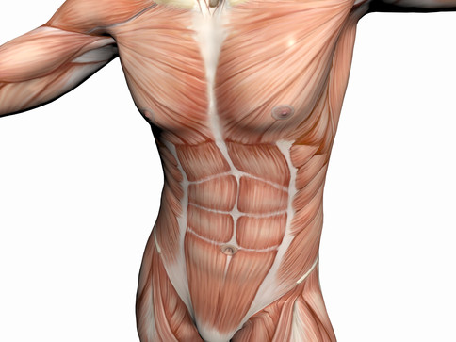
MUSCLES OF ANTERIOR ABDOMINAL WALL
Dr. Praveen Kumar Kurrey
MBBS, MS, BCME, BCBR
Professor Anatomy

Slide 2
Abdominal Regions
Divided into 9 regions by two pairs of planes:
Vertical Planes:
Left and right lateral planes
= midclavicular planes
Horizontal Planes:
Transpyloric plane:
Midway between jugular notch and pubic symphysis (between xiphoid and umbilicus).
Intertubercular plane:
Through tubercles of iliac crests.

Slide 3
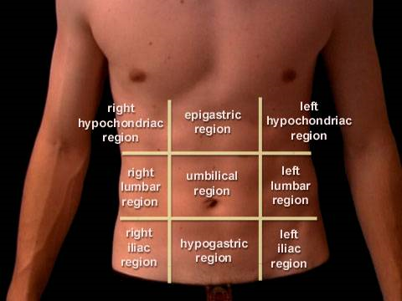

Slide 4
Layers of abdominal wall
1.Skin
2.Superficial Fascia
a)Fatty superficial layer - Camper’s fascia
b)Membranous deep layer - Scarpa’s fascia
3.External oblique muscle
4.Internal oblique muscle
5.Transversus abdominis muscle
6.Extraperitonial connective tissue
7.fascia Transversalis
8.Parietal Peritoneum

Slide 6
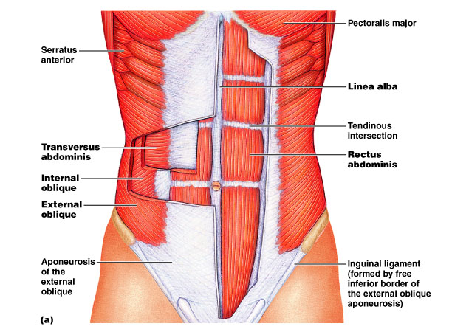

Slide 7
External Obliques
O: lower 8 ribs I: aponeurosis to linea alba
Function: Flex trunk, compress abd. wall (together) Rotate trunk (separate sides)
Internal Obliques
O: Lumbar fascia, iliac crest, inguinal ligament
I: Linea alba, pubic crest, last 3-4 ribs, costal margin
Function: Same as External obliques
Transversus Abdominis
O:same as Internals, plus last 6 ribs
I: Xiphoid process, costal cart. 5-7
Function: Compress abdomen
Rectus Abdominis
O: Pubic crest, pubic symphysis I: Xiphoid, cost cart 5-7
Function: Flex, rotate trunk, compress abdomen, fix ribs

Slide 8
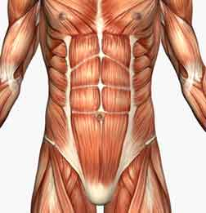

Slide 10
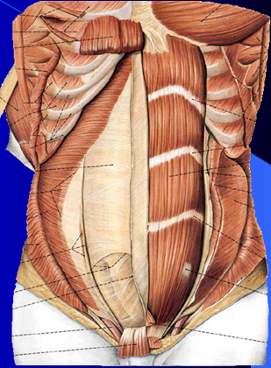

Slide 11
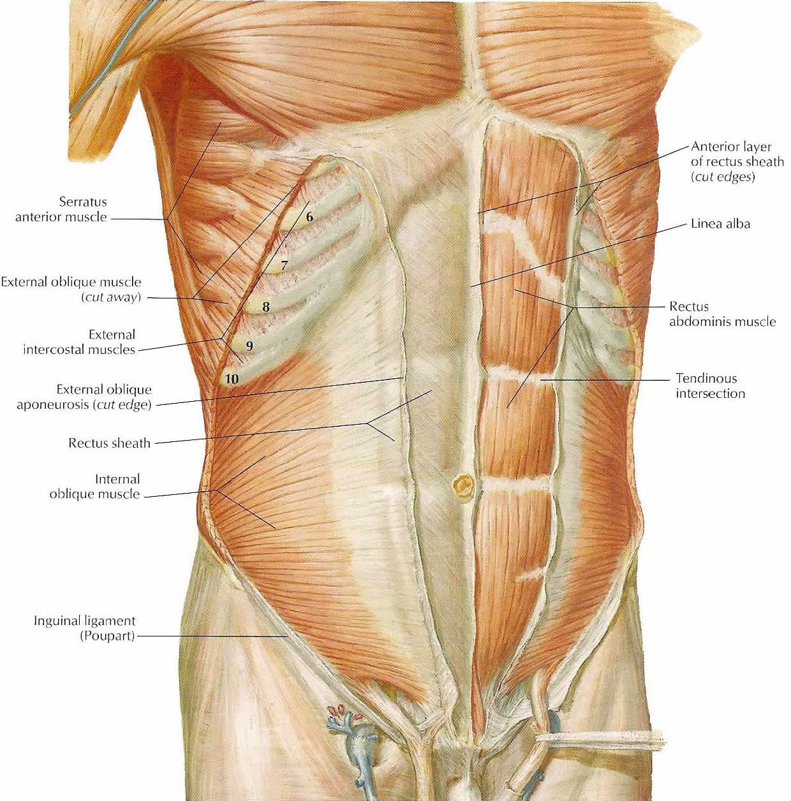

Slide 12
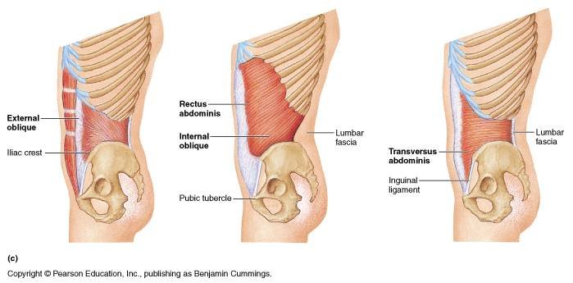
Muscles in Lateral view

Slide 13
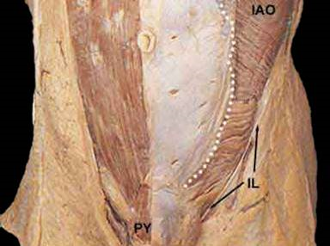
Pyramidalis Muscle

Slide 14
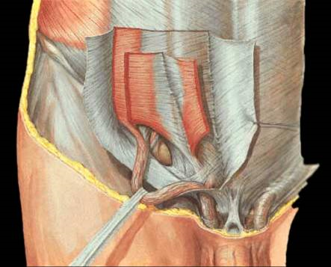
Cremaster Muscle

Slide 15
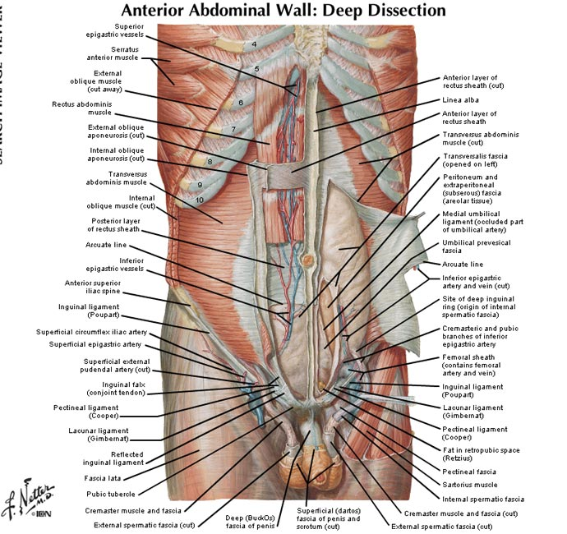

Slide 16
