Slide 1
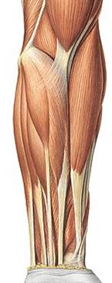
GROSS ANATOMY
FRONT OF forearm
DR. PRAVEEN KURREY
PROFESSOR ANATOMY
MBBS, MS, BCME, BCBR

Slide 2
CONTENTS OF FOEARM
Eight Muscles
Two arteries – Radial and Ulnar
Three nerves – Median , Ulnar and Radial

Slide 3
Muscles of forearm: Cross wrist + finger joints, moves hand
Cross Wrist = flex, extend, abduct, adduct hand
Cross Fingers = flex, extend fingers
Most muscles fleshy proximally, long tendons distally
Flexor + Extensor Retinacula
  wristbands keep tendons from bowing
  thick, deep fascia
Anterior Flexor Compartment (Superficial + Deep layers)
  Most flexors have common tendon on medial epicondyle
  Contains 2 pronators
  Innervated by *Median, Ulnar nerves
Posterior Extensor Compartment (Superficial + Deep layers)
  Innervated by Radial nerve (or branches of)

Slide 4
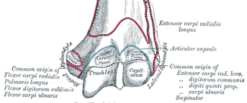
SUPERFICIAL MUSCLES : FRONT OF FOREARM
COMMON ORIGIN : From medial epicondyle of humerus
Distal humerus (anterior view)

Slide 5
5 SUPERFICIAL MUSCLES
Pronator Teres - PT
Flexor carpi Radialis -- FCR
Palmaris Longus -- PL
Flexor carpi ulnaris -- FCU
Flexor Digitorum Superficialis -- FDS

Slide 6
3 DEEP MUSCLES
Flexor Digitorum Profundus -- FDP
Flexor Pollicis Longus -- FPL
Pronator Quadratus -- PQ

Slide 7
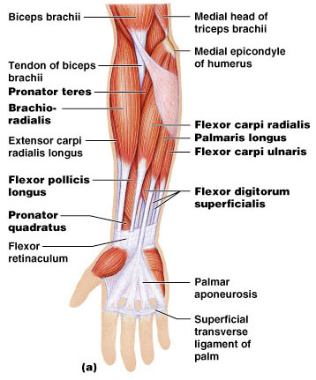
Muscles of the Forearm: Anterior Compartment
These muscles are primarily flexors of the wrist and fingers
Figure 10.15a

Slide 8
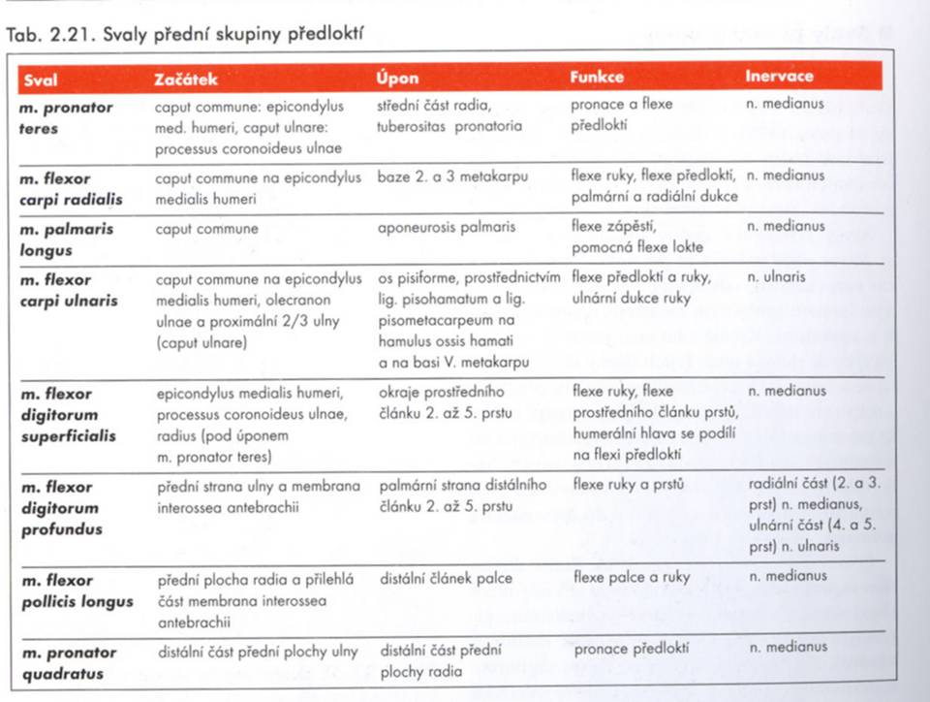

Slide 9
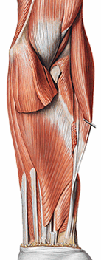
Muscles of the forearm
1st layer:
(common head)
PT,
FCR
PL,
FCU
2nd layer:
FDS

Slide 10
Anterior Compartment Forearm
pg 302
Medial Epicondyle
Brachioradialis
Pronator Teres
Flexor Carpi Radialis
Flexor Carpi Ulnaris
Flexor Retinaculum
Flexor Digitorum Superficialis is deep to other flexors
Anterior View

Slide 11
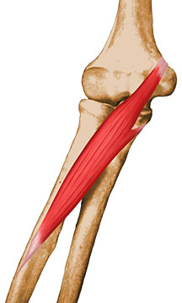
Pronator Teres
Origin: common flexor tendon at medial epicondyle and medial coronoid process
Insertion: lateral surface of radial shaft
Innervation: median nerve
Action: forearm pronation
Between 2 heads passes – Median nerve

Slide 12
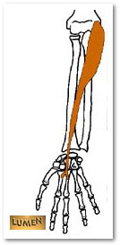
Flexor Carpi Radialis
Origin: common flexor tendon at medial epicondyle
Insertion: base of 2nd and 3rd metacarpals
Innervation: median nerve
Action: flexes and abducst/radial deviate the wrist

Slide 13
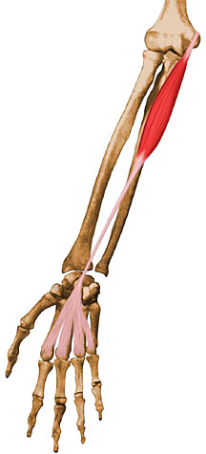
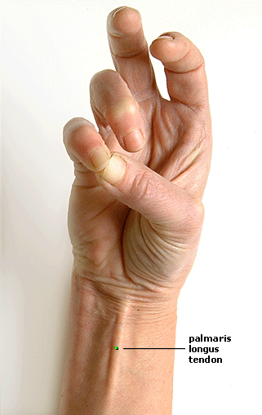
Palmaris Longus
Present in approximately 90% of population
Origin: common flexor tendon at medial epicondyle
Insertion: Flexor Retinaculum, palmar aponeurosis
Nerve supply : Median nerve
Action: flexes wrist and tenses palmar aponeurosis

Slide 14
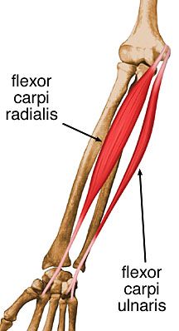
Flexor Carpi Ulnaris
Origin: common flexor tendon at medial epicondyle , Medial margin of olecranon process and proximal 2/3 of posterior ulnar border
Insertion: pisiform, hamate and 5th metacarpal
Innervation: ulnar
Action: flexes and adducts/ulnar deviate the wrist

Slide 15
1. Between 2 heads passes – Ulnar nerve
2. Pissohamate and
Pissometacarpal ligaments are true insersion of FCU
3. Pissiform, a sesamoid bone develops in the tendon of FCU

Slide 16
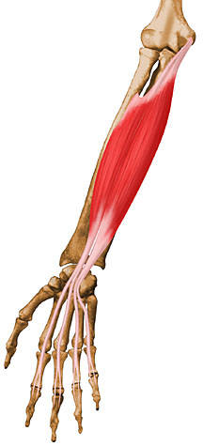
Flexor Digitorum Superficialis
Origin: common flexor tendon at medial epicondyle, medial aspect of coronoid process and oblique line of radius
Insertion: sides of middle phalanges of 2nd – 5th digits
Innervation: median nerve
Action: flexes PIP joints, assists flexion of MCP and wrist joints

Slide 17
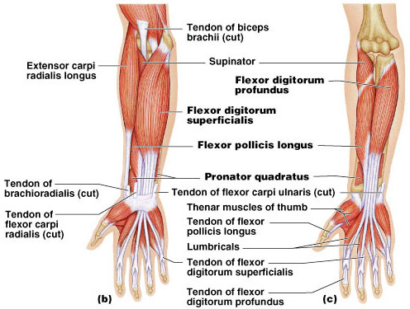
Muscles of the Forearm: Anterior Compartment
Figure 10.15b, c

Slide 18
Innervation of Anterior Compartment-Forearm Muscles
Muscle
Nerve
Superficial Muscles
  Flexor digitorum superficialis Median
  Flexor carpi radialis Median
  Pronator teres Median
  Palmaris longus Median
  Flexor carpi ulnaris Ulnar
Deep Muscles
  Pronator quadratus Median
  Flexor pollicis longus Median
  Flexor digitorum profundus Ulnar (med 1/2) Median (lat 1/2)

Slide 19
PART -- II

Slide 20
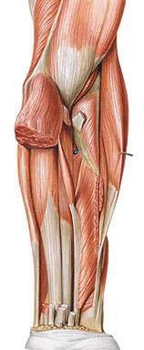
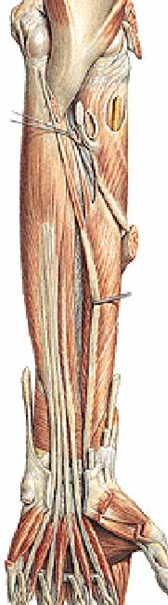
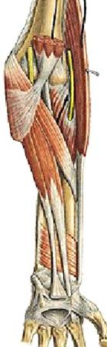
Muscles of the forearm
3rd layer:
FPL,
FDP
4th layer:
PQ

Slide 21
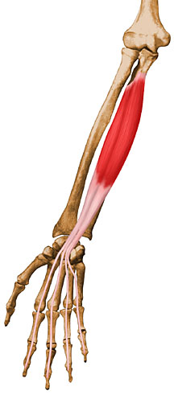
Flexor Digitorum Profundus
Origin: anteriomedial surface of ulna
Posterior border of ulna
Insertion: bases of distal phalanges (anteriorly) of 2nd-5th digits
Innervation: 1st and 2nd tendons by anterior interosseous nerve (median nerve), 3rd and 4th tendons by ulnar nerve
Action: flexes DIP joints, assists in flexion of PIP and MCP joints

Slide 22
FDP
Most Powerful muscle
Most Bulky muscle
Chief Gripping muscle
Goes up to terminal phalanx
Hybrid muscle – Median and Ulnar nerve
Act best when wrist is extended

Slide 23

Flexor Pollicus Longus
Origin: upper 3/4th of anterior surface of shaft of radius
Insertion: palmar surface of base of distal phalanx of thumb
Innervation: Anterior interosseous nerve (Median nerve)
Action: flexion of 1st interphalangeal and metacarpophalangeal joints

Slide 24

Pronator Quadratus
Origin: Oblique ridge on lower 1/4th of anterior surface of shaft of ulna
Insertion: Lower 1/4th of anterior surface of radius
Triangular area above the notch
Innervation: anterior interosseous nerve Median
Action: forearm pronation

Slide 25
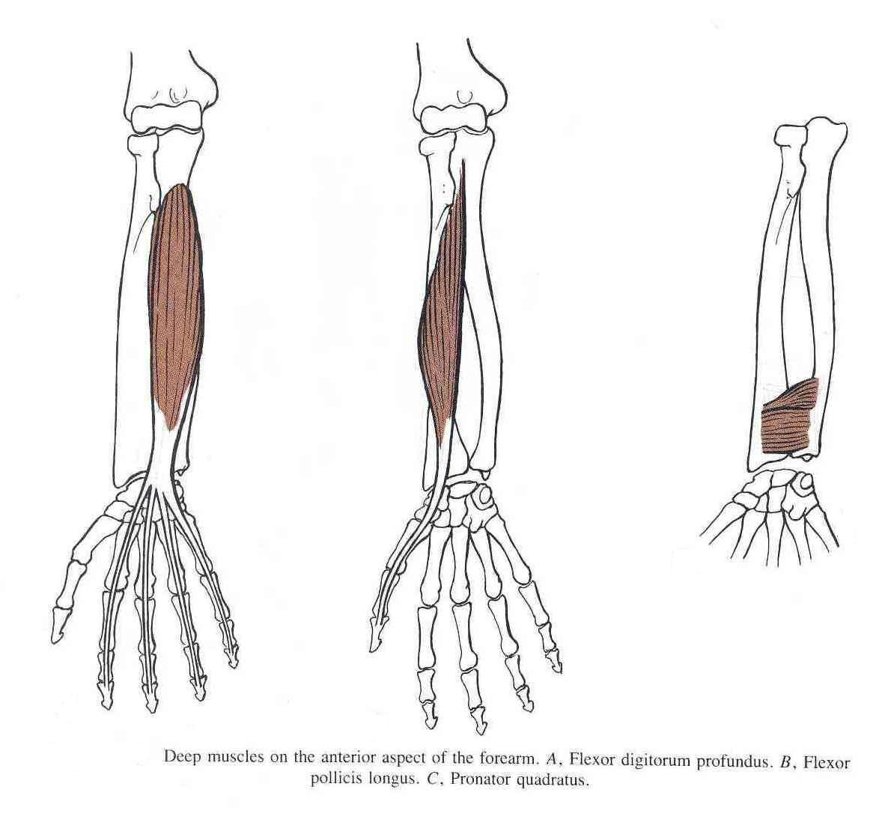
Flexor Digitorum Profundus
Insertion: bases of the distal phalanges of the medial four digits
Action: Flexes distal phalanges of medial four digits
Flexor Pollicis Longus
Insertion: Base of distal phalanx of thumb
Action: flexes interphalangeal, metacarpophalangeal & carpometacarpal joints of thumb
Pronator Quadratus
  Insertion: distal fourth of ant. surface of radius
  Action: pronates forearm (primover), helps to hold the bones together

Slide 26
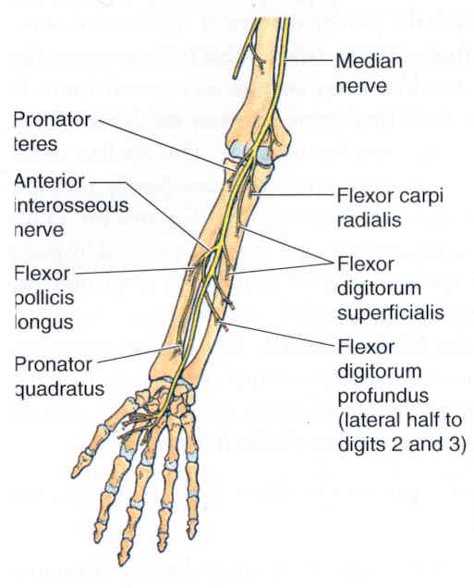
Anterior Interosseous Nerve
Anterior interosseous nerve (branch of median nerve)
Passes between 2 heads of pronator teres muscle, may be impinged upon
Anterior interosseous nerve syndrome characterized by abnormal pinch deformity (inability to extend DIP of thumb and index finger)

Slide 27
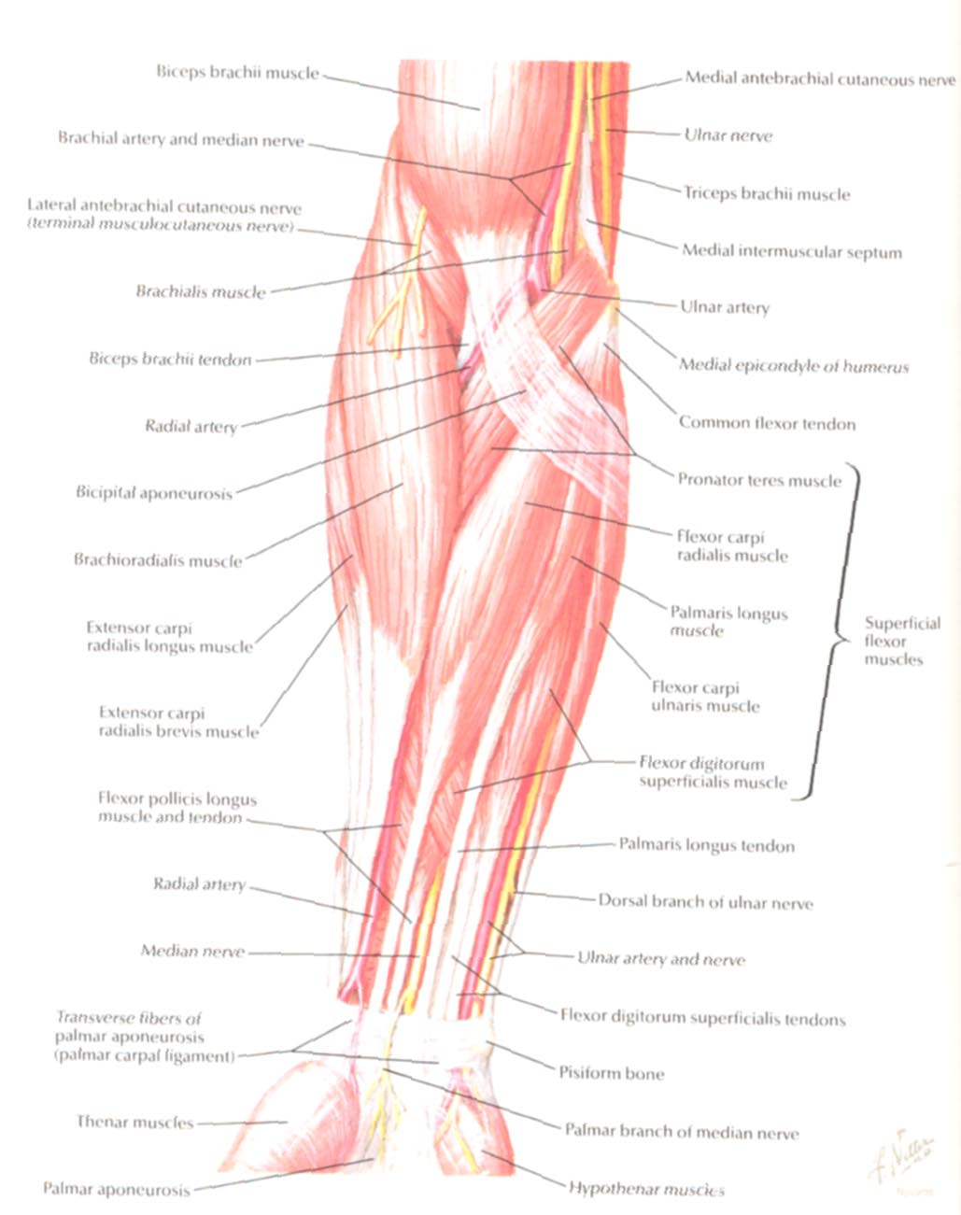
Ulnar Nerve
Median Nerve
Brachial Artery
Musculocutaneous Nerve
UlnarArtery
Where’s Radial Nerve?
Radial Artery
Median Nerve
Ulnar Nerve

Slide 28
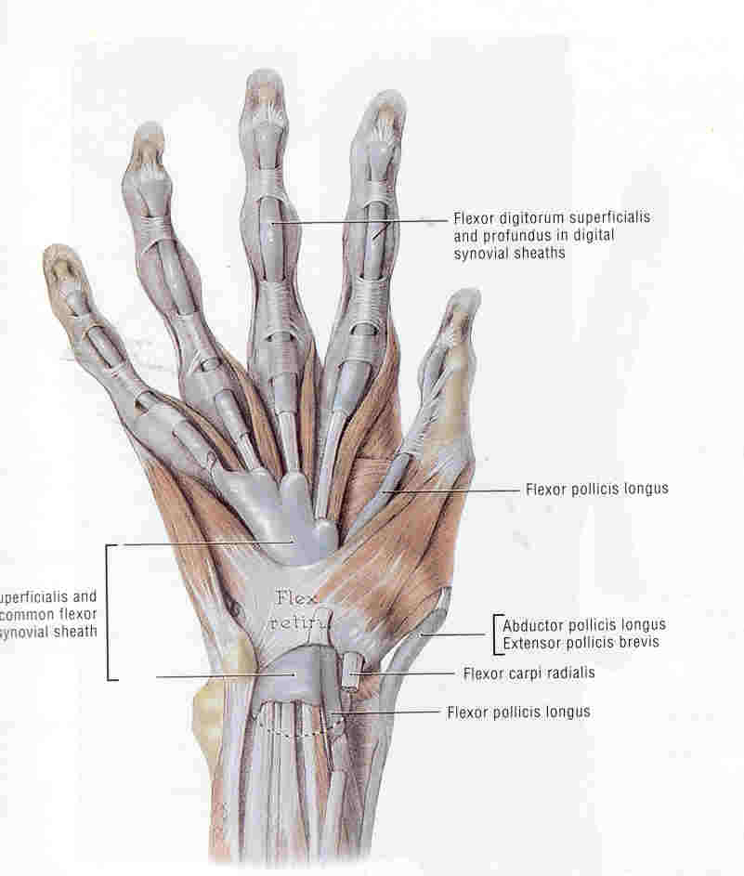
FLEXOR RETINACULUM : DEEP RELATIONS
(1) median nerve
(2) tendons of flexor digitorum superficialis
(3) tendons of FDP
(4) tendon of FPL
(5) ulnar bursa
(6) radial bursa

Slide 29
Innervation of Anterior Compartment-Forearm Muscles
Muscle
Nerve
Superficial Muscles
  Flexor digitorum superficialis Median
  Flexor carpi radialis Median
  Pronator teres Median
  Palmaris longus Median
  Flexor carpi ulnaris Ulnar
Deep Muscles
  Pronator quadratus Median
  Flexor pollicis longus Median
  Flexor digitorum profundus Ulnar (med 1/2) Median (lat 1/2)

Slide 30
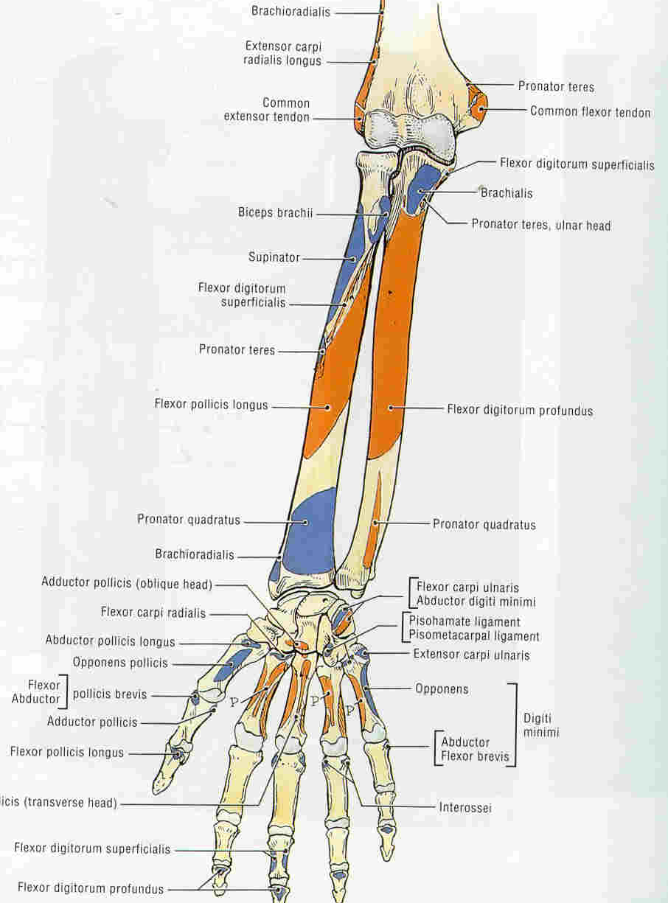
SUPERFICIAL MUSCLES : FRONT OF FOREARM
ADDITIONAL ORIGINS
Deep (ulnar) head of PT
Medial margin of coronoid process of ulna
Ulnar head of FCU
Medial margin of olecranon; upper 2/3 of aponeurosis attached to posterior border of ulna
FDS (ulnar & radial heads)
Ulnar head
Ulnar collateral ligament, sublime tubercle on medial border of cornoid process, fibrous ulnar arch between ulna & radius;
Radial head
Anterior border of radius

Slide 31
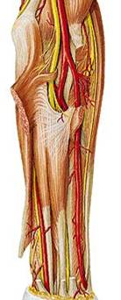
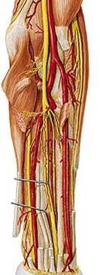
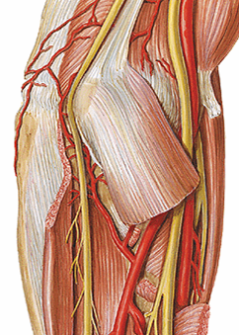
Nerves and vessels of the forearm

Slide 32
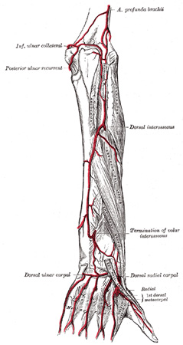
Vascular Structures
Ulnar artery
  Originates at radial head, continues medially down forearm

Slide 33
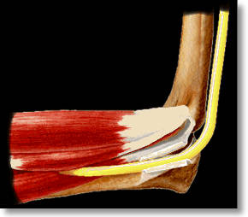
Ulnar Nerve
  Courses in cubital tunnel posterior to medial epicondyle
  Superficial and susceptible to compression or entrapment
  Courses down medial forearm to hand/wrist distribution
  Sensory distribution is pad of little finger

Slide 34
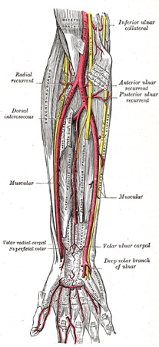
Radial artery
  Originates at radial head, emerges from antecubital fossa between brachioradialis and pronator teres muscles
  Continues laterally along forearm deep to brachioradialis muscle

Slide 35
RADIAL BED
Posterior relations of Radial artery in Forearm
Biceps tendon
Supinator
Insersion of Pronator teres
Flexor digitorum superficilais
Flexor pollicis longus
Pronator quadratus
Lower end of radius

Slide 36
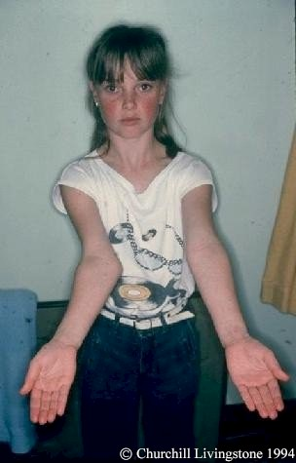
Clinical Anatomy
Carrying Angle/Cubitus Valgus
Formed by long axis of humerus and midline of forearm
Male norms – 11-14 degrees
Female norms – 13-16 degrees
Larger angles are considered abnormal

Slide 37
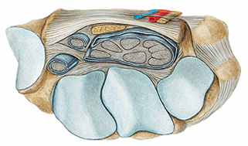
Carpal tunnel
Palmar carpal tendinous sheaths:
Common flexor sheath
Tendinous sheath of flexor carpi radialis
Tendinous sheath of flexor pollicis longus

Slide 38
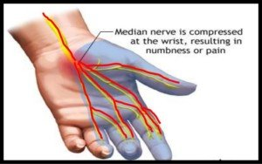
Carpal Tunnel Syndrome

Slide 39
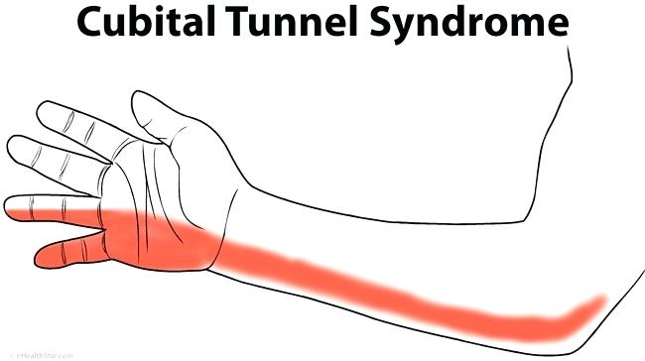

Slide 40
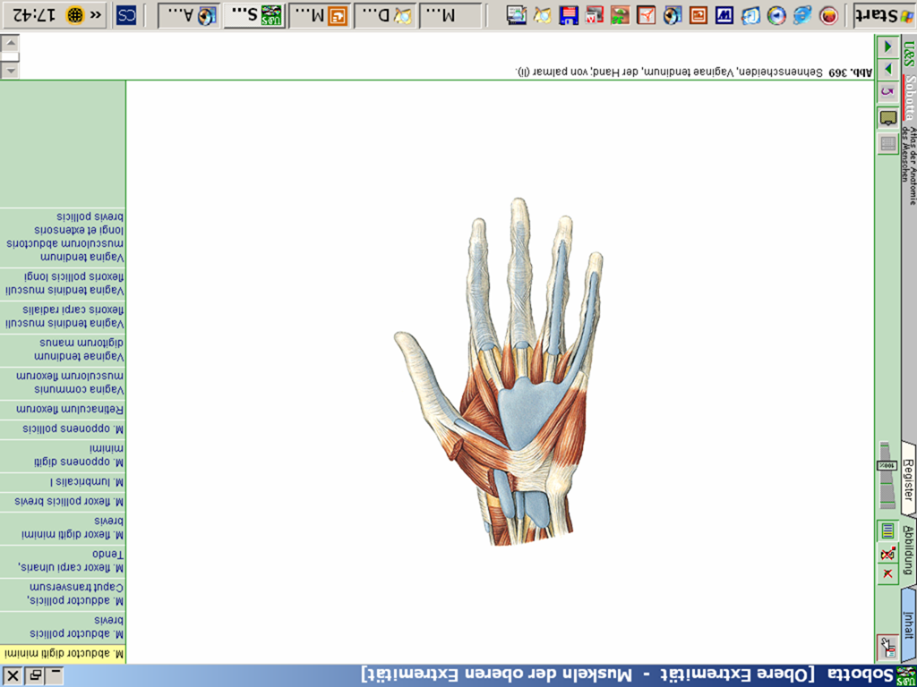
Flexor retinaculum
Palmar carpal tendinous sheaths:
Tendinous sheath of flexor pollicis longus
Tendinous sheath of flxor carpi radialis
Common flexor sheath
Fibrous and synovial sheaths of digits

Slide 41
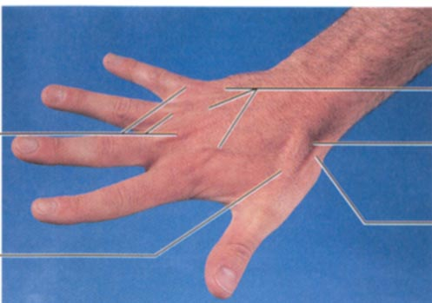
Surface Anatomy of Upper Limb
Carpal Tunnel
  Carpals concave anteriorly
  Carpal ligament covers it
  Contains: long tendons, Median nerve
  Inflammation of tendons = compression of Median nerve
Anatomical Snuffbox
  Lateral = E. pollicis brevis
  Medial = E. pollicis longus
  Floor = scaphoid, styloid of radius
  Contains Radial Artery (pulse)
pg 749

Slide 42
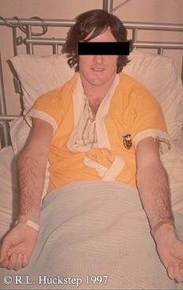
Gunstock Deformity/Cubitus Varus
Usually develops secondary to condylar humerus fracture

Slide 43

THANK YOU

